Slide 1
FilterDemod_ref
Documentation for the filterDemod_ref function

Slide 2
GNU Radio
Open source software tool for digital signal processing and radio control
Python based – runs best in linux environments
Run on
Pentoo (.iso booted from a flashdrive)
Raspian (OS for raspberry pis)
Lasso server
Windows (can do basic functions, but no hardware connection)
Block Diagrams
Synergizes nicely with HackRF hardware
11-part tutorial available: https://greatscottgadgets.com/sdr/1/

Slide 3
GNU Radio Setup
Key Linux commands for installation
sudo apt-get update (if necessary)
sudo apt-get install hackrf
sudo apt-get install gnuradio_companion
sudo apt-get install gr-osmosdr
Commands to see if software works
hackrf_info
Gnuradio_companion
GreatScott tutorial has sample programs to test

Slide 4
filterDemod_ref function
Python executable
Takes a binary data file (complex IQ samples) and puts it through a FIR low pass digital filter and then a wide-band FM receiver (demodulation) to output a .wav file of real data
Does not sacrifice any data samples or time accuracy/resolution
Can filter down to whatever bandwidth is necessary

Slide 5
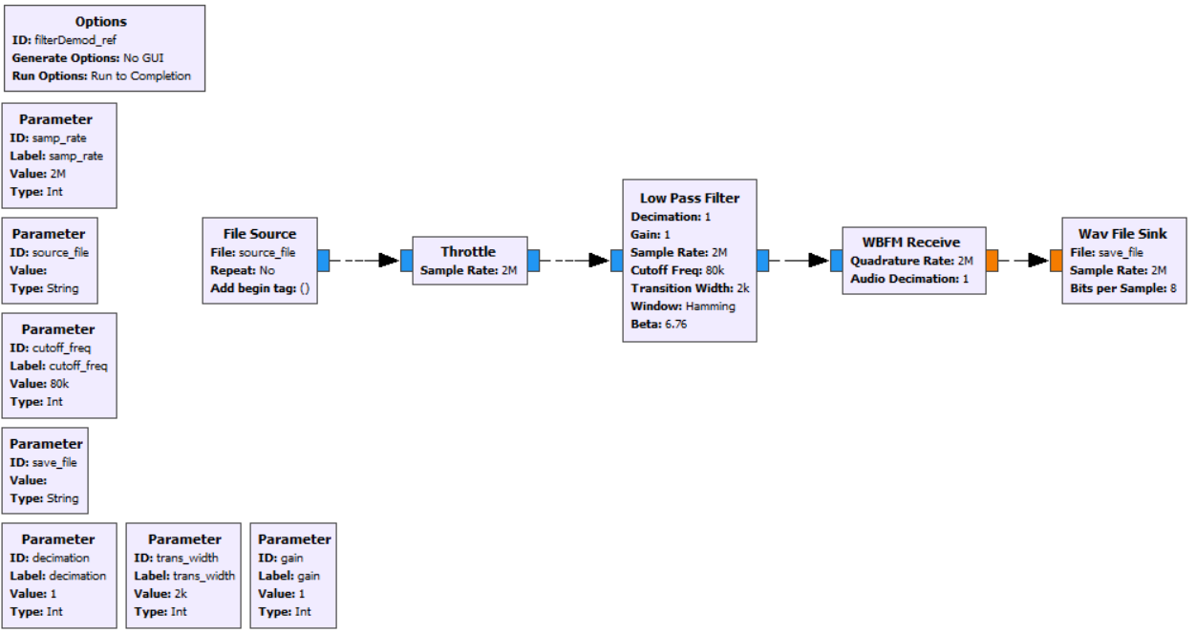
filterDemod_ref.grc in GNU Radio Companion

Slide 6
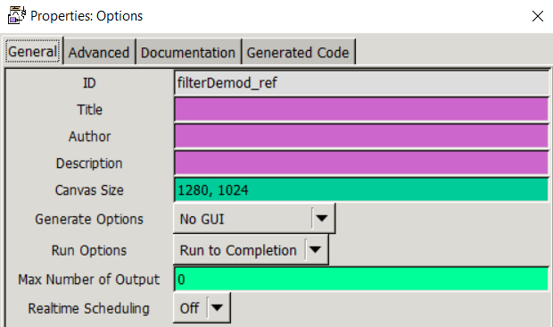
Options Block
Generate options is set to “NO GUI” because this program does not require a gui
Run options is set to “Run to Completion”
This will run the program until the file source block stops it

Slide 7
Parameter Blocks
samp_rate (int, default = 2000000)
Must match the rate that the data was sampled at
Minimum is 2 MSPS (default), maximum is 20 MSPS
source_file (String, default = “”)
Sets the local directory for the binary file containing the input data
Full path is required, including the file name
save_file (String, default = “”)
Sets the local directory for the .wav file containing output the data
Full path is required, including the new file name with “.wav” on the end
decimation (int, default = 1)
Enables decimation of samples (divides sample rate)
gain (int, default = 1)
Enables a gain for the samples (multiplies each sample by a constant)

Slide 8
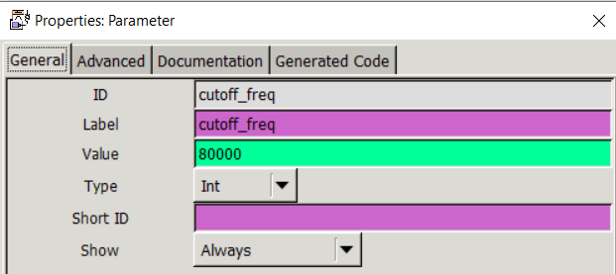
Parameter Blocks
cutoff_freq (int, default = 80000)
Defines that highest frequency on either side of the center (f=0) that is allowed to pass through the filter
Does not remove samples or shrink frequency window in fft
Ex. Signal is centered at 100 MHz with a signal bandwidth of 160 kHz. A cutoff frequency of 80 kHz will filter out all signals outside of 99.92 MHz – 100.08 MHz
trans_width (int, default = 2000)
Determines the steepness of the filter at the cutoff frequency in Hz

Slide 9
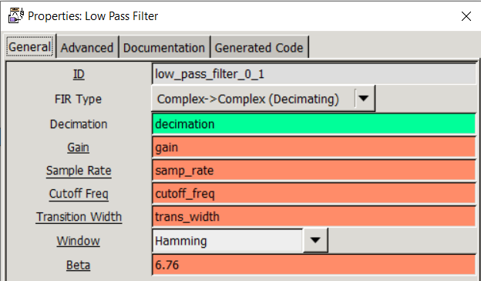
Low Pass Filter Block
Uses a series of weighted delays to achieve a finite impulse response filter
All delays and coefficients are calculated “behind the scenes” depending on the parameters

Slide 10
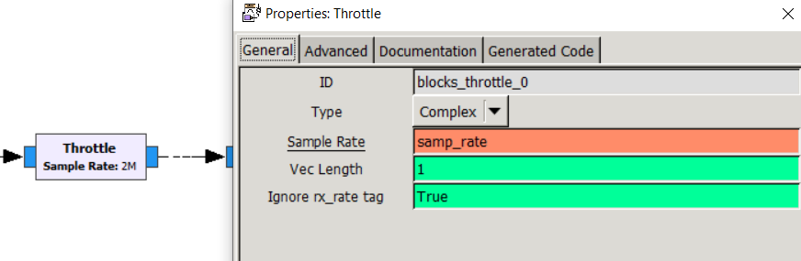
Throttle Block
Throttle blocks are necessary for any “purely software” operations in GNU Radio to prevent overloading of CPU

Slide 11
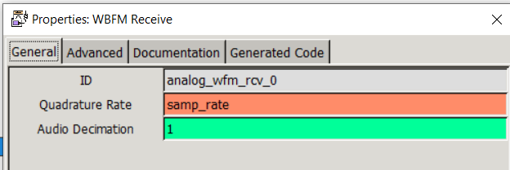
WBFM Receive Block
Performs FM demodulation operation on the complex IQ data (blue), resulting in a stream of real data (orange)

Slide 12
filterDemod_ref.grc in GNU Radio Companion

Slide 13
Application
This program can be run manually on a local PC or in an automated program that runs on the LASSO server
filterReader.py is a python executable that calls this program for a structured directory of data

Slide 14
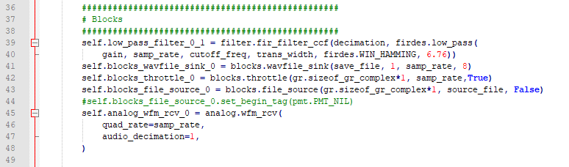
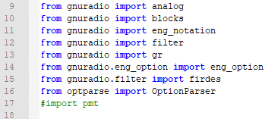
Notes
There is a detailed How To for running this program on the LASSO server “cross-correlation and automated filtering”
Lines 17 and 44 are commented out of filterDemod_ref.py because of an issue with polymorphic types
The .grc file generated these lines but they are not necessary and cause errors
Regeneration of the .py file will bring these lines back, so they must be again commented out each time

