Slide 1
Record_ref
And supporting software documentation

Slide 2
GNU Radio
Open source software tool for digital signal processing and radio control
Python based – runs best in linux environments
Run on
Pentoo (.iso booted from a flashdrive)
Raspian (OS for raspberry pis)
Lasso server
Windows (can do basic functions, but no hardware connection)
Block Diagrams
Synergizes nicely with HackRF hardware
11-part tutorial available: https://greatscottgadgets.com/sdr/1/

Slide 3
GNU Radio Setup
Key Linux commands for installation
sudo apt-get update (if necessary)
sudo apt-get install hackrf
sudo apt-get install gnuradio_companion
sudo apt-get install gr-osmosdr
Commands to see if software works
hackrf_info
Gnuradio_companion
GreatScott tutorial has sample programs to test

Slide 4
Record_ref function
Python executable
Tells the hackrf to record a certain number of IQ data samples at a specified frequency
Saves the samples to a specified local directory
The radio oscillates at a center frequency, but the stream is multiplied by a cosine to re-center to a channel frequency to remove the DC spike

Slide 5
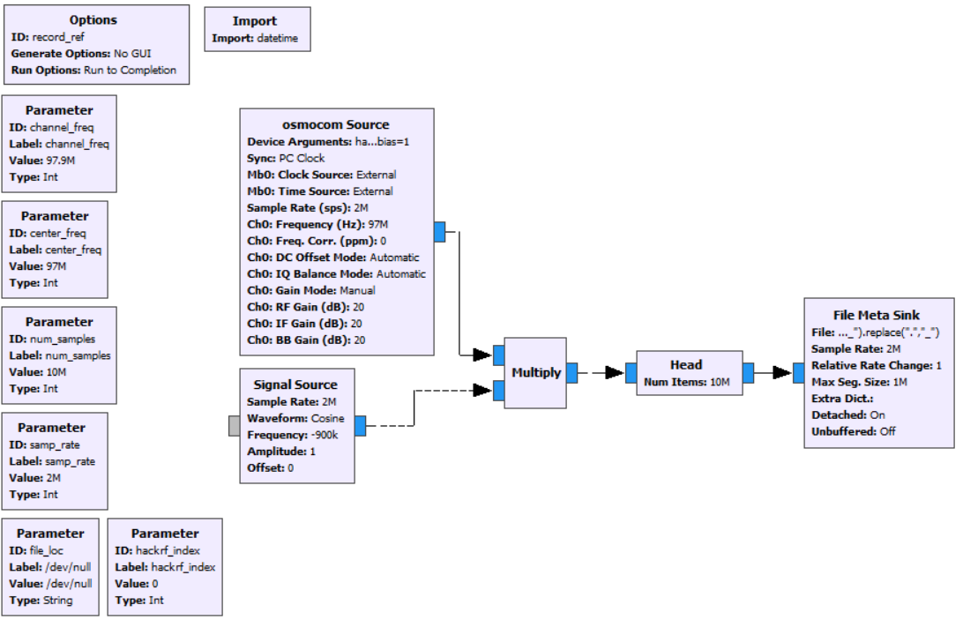
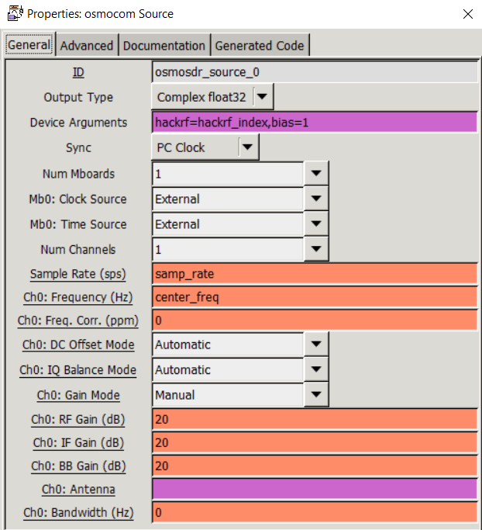
Record_ref.grc in GNURadio Companion

Slide 6
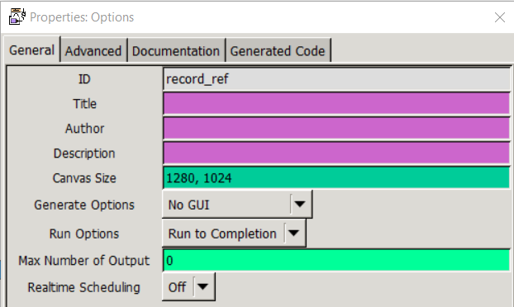
Options Block
Generate options is set to “NO GUI” because this program does not require a gui
Run options is set to “Run to Completion”
This will run the program until the header block stops it

Slide 7
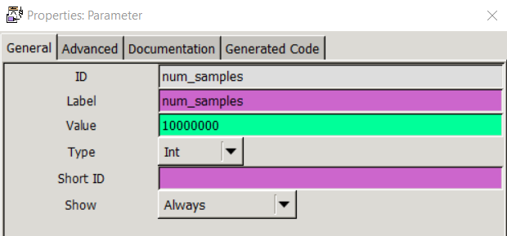
Parameter Blocks
Serve as variables to the python executable
They are:
channel_freq (int, default = 97900000)
This sets the target frequency for the multiplication shift
This should be the frequency of the signal of interest [Hz]
center_freq (int, default = 97000000)
This sets the recording center frequency for the hackrf
|channel_freq – center_freq| < samp_rate/2
num_samples (int, default = 10000000)
Sets the number of samples to be recorded before the header block stops the program
10000000 (10 million) samples is 80 MB of data

Slide 8
Parameter Blocks
samp_rate (int, default = 2000000)
Sets the hackrf sampling rate in samples per second
Minimum is 2 MSPS (default), maximum is 20 MSPS
file_loc (String, default = “/dev/null”)
Sets the local directory for the binary file containing the data
Full path is required, including the new file name
The program automatically amends this string to the end of the file name:
file_loc+"_END_"+str(datetime.datetime.now()).replace(" ","_").replace(":","_").replace(".","_")
There is an import block importing datetime in order to support this
hackrf_index (int, default = 0)
Sets the index for the hackrf in the osmocom Source block
Only non-zero for when two hackrf devices are being operated by the same computer or pi
Use hackrf_info to check the indexes of the hackrfs that are connected

Slide 9
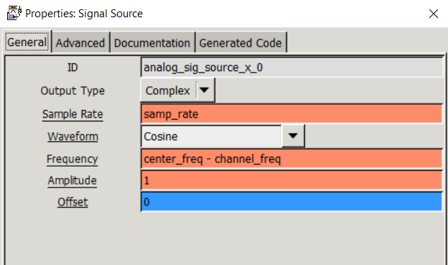
Parameter Blocks
Tips for using parameters in gnuradio
Any python code/functions can be implemented in the blocks in GNU Radio
Ex. Str(datetime.datetime.now()) for adding the recording time to the file name
Try to prevent the channel_freq from overlapping with the center_freq
There will be a DC spike visible in the FFT of the recording at the center_freq, which might prevent you from observing the target signal
The variable types are color coded in GNU Radio
Blue is complex (IQ)
Orange is real data (after demodulation)

Slide 10
Osmocom Source Block
Tells GNU Radio where the data is coming from
Tells the HackRF what to do
Device arguments:
hackrf = 0 (specifies which hackrf to use, 0 is the first/default index)
bias = 1 (tells the HackRF to use a DC bias in the Input port (SMA) to power the low noise amplifier
Sample rate is samp_rate
Ch0: Frequency is center_freq
Other gains/balances were left alone

Slide 11
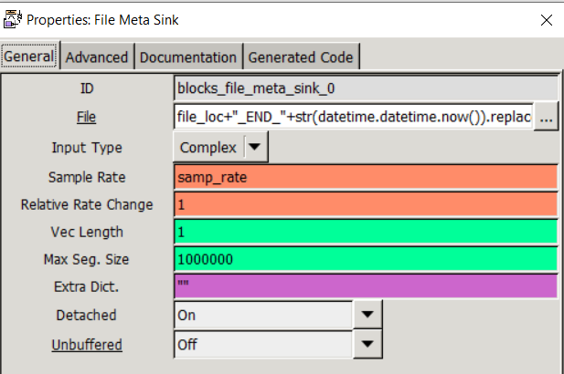
File Meta Sink Block
Sends the data to a local binary file
Data has no identifier (i.e. .txt, .dat, .csv)
A “meta” sink is used as opposed to a “regular” file sink in order to generate an accompanying .hdr file for each binary data file
.hdr files can contain extra information about the data such as time stamps
We were not able to utilize the .hdr files generated, so they were ignored after generation
File save function:
file_loc+"_END_"+str(datetime.datetime.now()).replace(" ","_").replace(":","_").replace(".","_")

Slide 12
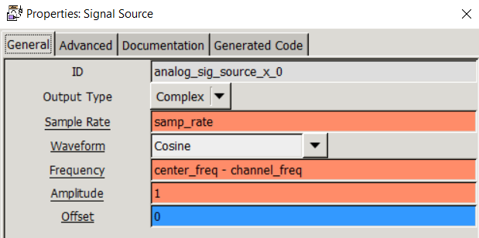
Signal Source Block (cosine)
Generates a cosine signal at a specified frequency
Multiplies with the data samples to shift in frequency

Slide 13
Record_ref.grc in GNURadio

Slide 14
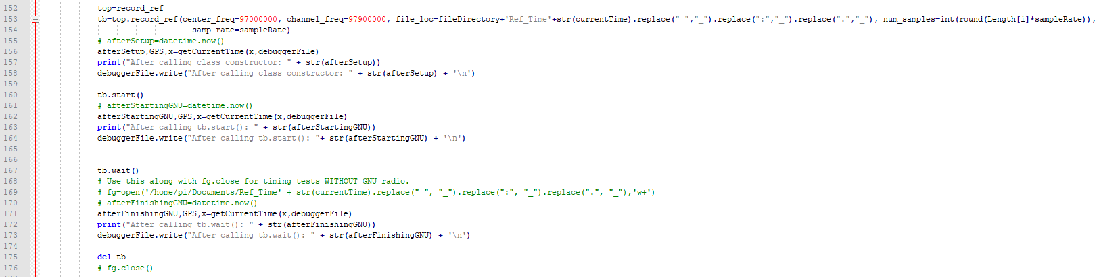
Application
Record_ref.py is called in scheduler.py and unified.py

Slide 15
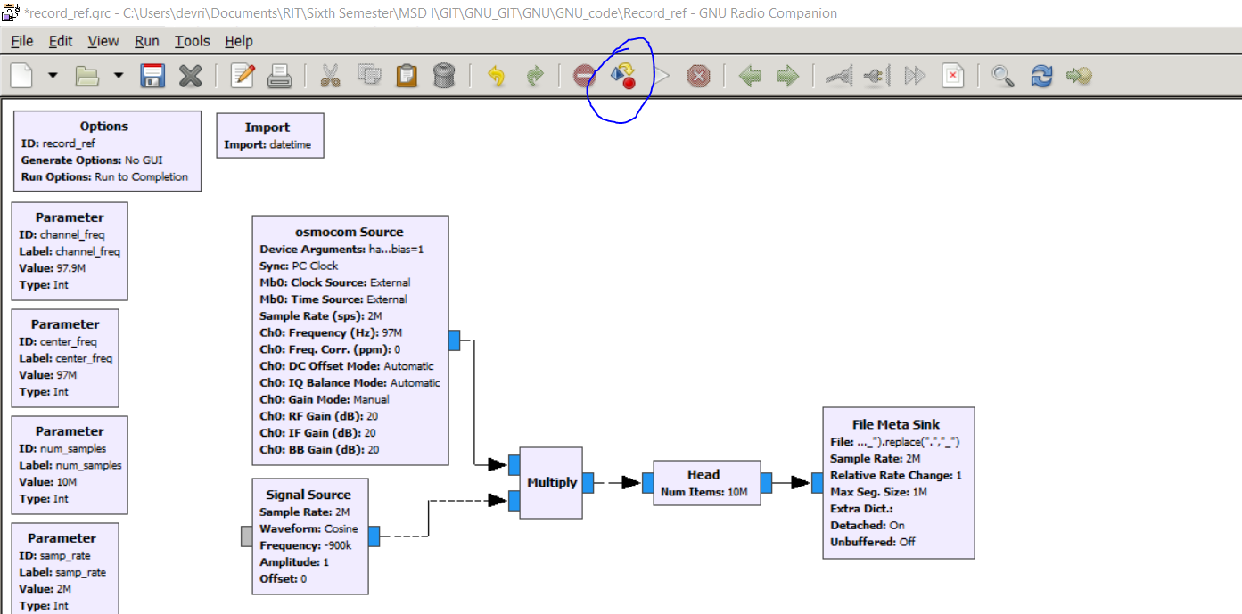
Notes
Record_ref_second_device.py is the same program but with the hackrf_index variable set to 1 for implementing a second hackrf
The GNU Radio program automatically generates all the python code with this button:

