Slide 1

Welcome to the
Montreal

Slide 2

Agenda
Time | Details
08h30-09h00 | Arrival/ Coffee
09h00-09h15 | Intro
09h15-10h00 | CI/CD
10h00-10h45 | ARM template
10h45-11h30 | Container Part 1
11h30-12h15 | Container Part Deux
12h15-13h00 | Lunch
13h00-13h45 | AI
13h45-14h30 | Serverless
14h30-15h15 | Security
15h15-16h30 | Ending
This Photo by Unknown Author is licensed under CC BY-SA

Slide 3

Are you ready?
Did you install all the pre-requisites?
Do you have an Azure Subscription?
Did you download the Repository?
Not sure?
github.com/FBoucher/GlobalAzureBootcamp-2019
This Photo by Unknown Author is licensed under CC BY-SA-NC

Slide 4

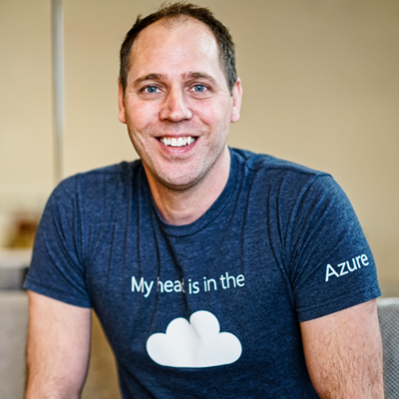

Speakers
Dominique St-Amand
Stephane Lapointe
Guy Barrette
Twitter: @DOMZE
Blog: domstamand.com
Twitter: @s_lapointe
Blog: codeisahighway.com
Twitter: @guybarrette
Blog: blog.guybarrette.com

Slide 5
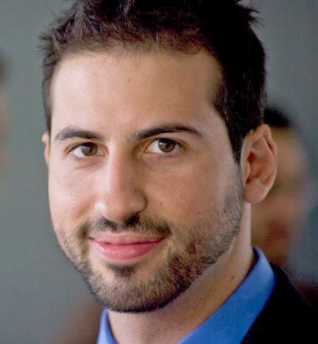
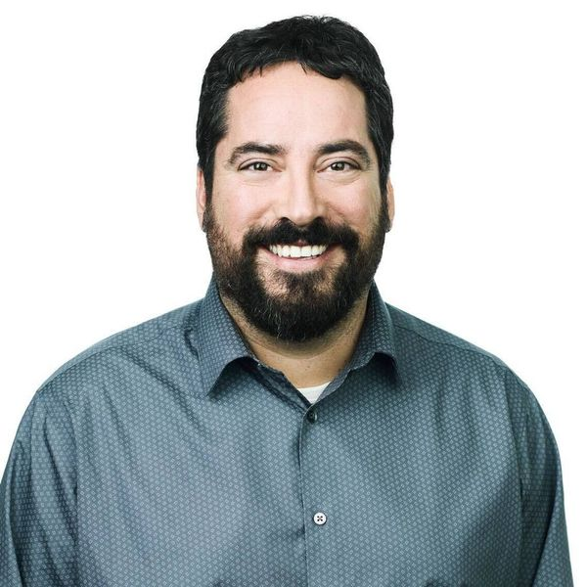
Speakers
Miguel Bernard
Alain Vézina
Twitter: @MiguelBernard88
Blog: https://blog.miguelbernard.com
Twitter: @avezina
Blog: http://alain.cloud

Slide 6
References:
Get started with Azure: https://docs.microsoft.com/en-us/azure/
GitHub – Repository: https://github.com/FBoucher/GlobalAzureBootcamp-2019

