Slide 1

Building Stuff with GenAI
The open-minded workshop beyond OpenAI
Same blocks, many vendors, your machine.
daenet — an ACP Digital company · 2026
Notes:
[F-01]
Welcome. One day, four segments, and one thesis: the building blocks are the same everywhere — tokens, chat API, structured output, tools, MCP and skills, the agent loop, workflows.
Once you see that, every vendor (OpenAI, Microsoft, Anthropic, Google, DeepSeek, Qwen, Moonshot, Mistral, your own GPU) is a base_url and a model name away. Today proves it by running the same code against Foundry, non-OpenAI vendors and a local runner.
Timing: one minute, then straight to the room check.
VERIFY: event, date, speaker — not decided yet (00_Workshop_Plan.md §8 Q1); put them into the meta line.
Sources: Workshop plan v001 — 00_Workshop_Plan.md · Narrative plan v001 — 06_Narrative_Plan_v001.md

Slide 2
Three quick questions decide today’s pace
BEFORE WE START
1
LANGUAGE
2
APIs
3
LOCAL
Which track are you on?
Called a model API from code?
Run a model on your own machine?
Python
never
not yet
C# / .NET
a few times
Ollama / LM Studio
TypeScript
every week
on my own GPU
→ which code panel we zoom into
→ how much of Segment 1 we keep
→ how much of Segment 4 is new
Mostly new to this: all of Segment 1. Mostly experts: less history, Lab 1 sooner.
Notes:
[F-02]
Three questions, hands up, two minutes. One: which track — Python, C#, TypeScript (hands for each). It tells you which code panel to zoom and where to stand during the labs.
Two: who has called a model API from code? Many "never" → keep all of Segment 1 and pace Lab 1 slowly; many "every week" → the plan says an expert room can start at S1-13 (skip the history block) and begin Lab 1 early.
Three: who runs models locally? It tells you how much of Segment 4 is new and whether people pre-pulled Ollama models (setup guide step 5).
If the quiz (F-06) is used, it gives the same signal with more precision.
Sources: Narrative plan v001 — 06_Narrative_Plan_v001.md · labs/00-setup/SETUP.md

Slide 3
By the end of today you can do six things you can’t do now
BEFORE WE START
Explain how a model is made, and what is model vs. PaaS on top
SEGMENT 1
Call any OpenAI-compatible endpoint with knobs, schemas and tools
LAB 1
Build a RAG and expose it as an MCP server or a skill
LAB 2
Build a two-agent workflow (MAF, LangGraph), know how to deploy it
LAB 3
Run text, image, speech and video models locally, and mix them
LAB 4
Judge vendor claims with sources
ALL DAY
We tick them off together before you leave.
Sources: Workshop plan v001
Notes:
[F-03]
These are the six outcomes of the workshop plan, in the order the day delivers them. Read them out, do not explain them yet.
Four of them have a lab behind them (Labs 1–4, pills on the right). The first is Segment 1 talk; the last — judging vendor claims with sources — runs all day: every fact slide has a source line and a date.
Promise: at the end of the day this list comes back with ticks (E-02).
Sources: Workshop plan v001 — 00_Workshop_Plan.md

Slide 4
Four segments, each ending with your hands on the keyboard
BEFORE WE START
Keys
+ setup
clinic
SEGMENT 1
Foundations
break
SEGMENT 2
Integrating AI
lunch
SEGMENT 3
The world of agents
break
SEGMENT 4
Local AI, media & beyond the West
Close
+ recap
talk
talk
talk
talk
live demos
live demos
live demos
live demos
Lab 1 · hands-on
Lab 2 · hands-on
Lab 3 · hands-on
Lab 4 · hands-on
CORE
Core lab — the part everyone finishes
stretch goals keep the fast ones busy
EVERY LAB, THREE LANGUAGES
STRETCH
Python, C# and TypeScript starters with a few TODO blocks to write — Lab 4 is Python-first.
Fast? Take the stretch goals. Stuck? A solution/ folder sits next to every starter.
Sources: Workshop plan v001 · labs/README.md
Notes:
[F-04]
Four segments, each talk → live demos → a hands-on lab. No minutes on the slides on purpose — we stay flexible; the plan (notes only): about 90 minutes per segment, lab 25–30 of them. Exact clock times are still open: the day is planned as 4 × 90 minutes, and every segment also has a 75-minute cut (trim rows in the plan).
The 15-minute rule: every lab has a core everyone finishes; stretch goals absorb fast attendees, and the demo slot can shrink to five minutes if the room is slow.
Example times from the plan (not fixed): 08:30 doors, keys and setup clinic · 09:00–10:30 S1 · break · 10:50–12:20 S2 · lunch 12:20–13:10 · 13:10–14:40 S3 · break · 15:00–16:30 S4 · 16:30–16:45 close.
Every lab folder has runnable starters with a few TODO blocks and a solution/ folder next to them (labs/README.md).
VERIFY: final times and lunch length (00_Workshop_Plan.md §8 Q2) — keep them in these notes, not on the slide.
Sources: Workshop plan v001 — 00_Workshop_Plan.md · labs/README.md

Slide 5
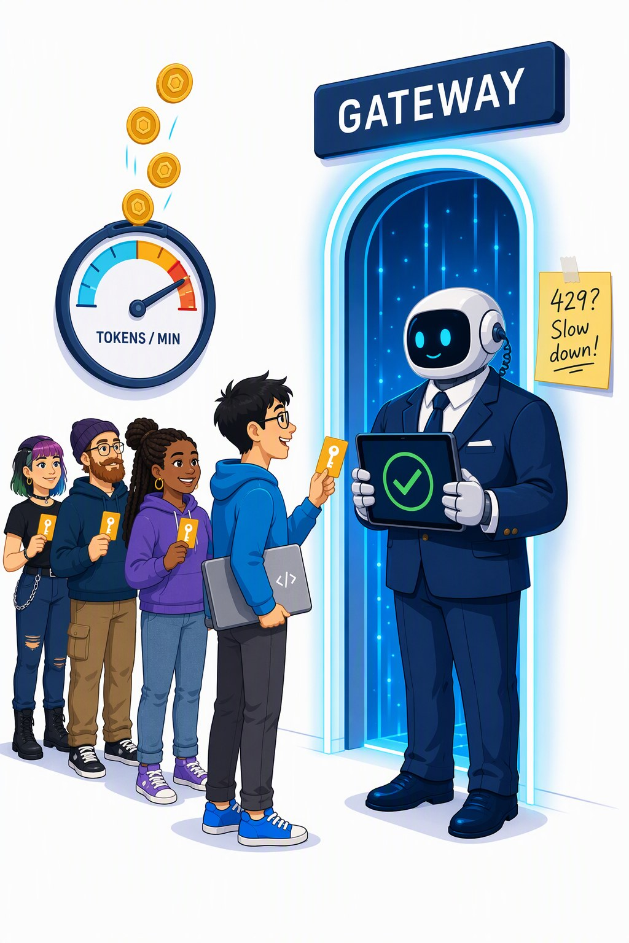
Your key, your endpoint, your fallback
BEFORE WE START
COPY YOUR HANDOUT CARD INTO labs/.env
labs/.env
GENAI_BASE_URL=https://<gateway-from-your-card>/openai/v1
GENAI_API_KEY=<your-personal-key>
GENAI_KEY_HEADER=api-key
GENAI_MODEL=gpt-5-mini
401 · KEY
403 · QUOTA
429 · TOO FAST
Key missing or wrong — check labs/.env
Today’s quota is used up — ask us
Tokens per minute used up — wait, it resets
NO NETWORK? SAME CODE, LOCAL MODEL
Ollama: GENAI_BASE_URL=http://localhost:11434/v1 and model qwen3.5:4b — or the instructor’s offline mock on the room network.
Sources: labs/.env.example · labs/00-setup/SETUP.md · Gateway policy attendee-policy.xml
Notes:
[F-05]
Copy labs/.env.example to labs/.env and paste the four lines from your handout card: the gateway URL (ends in /openai/v1), your personal key, the header name api-key, and the default model gpt-5-mini. GENAI_MODEL_2 (default DeepSeek-V3.2) is a second vendor on the same endpoint and key.
The key always travels in an "api-key" header — the gateway requires it (Ollama ignores it). 401 = key missing or mistyped; 403 = your daily token quota is used up; 429 = your per-minute token budget is spent — wait a minute. The gateway policy defines 429 for the rate and 403 for the quota; SETUP.md’s troubleshooting table still lumps both into 429.
No network: the same code runs on Ollama (localhost:11434/v1, qwen3.5:4b, GENAI_REASONING_EFFORT=none) or against the instructor’s offline mock (answers are echoes, every script runs).
VERIFY: gateway URL and key format (handout card still open — nothing provisioned), the QR code to labs/00-setup (repo URL not decided), and the 403-vs-429 wording in SETUP.md (align it with the policy).
Sources: labs/.env.example · labs/00-setup/SETUP.md · Gateway policy attendee-policy.xml — infra/policies/attendee-policy.xml · APIM llm-token-limit policy — https://learn.microsoft.com/en-us/azure/api-management/llm-token-limit-policy · labs/README.md

Slide 6

Your key never reaches the models
BEFORE WE START
YOUR CODE
api-key: your personal key
THE GATEWAY
Azure API Management
checks · counts · swaps the key
FOUNDRY MODELS
see only the gateway’s identity
1
Checks your personal key — no valid key, no entry (401).
2
Counts your tokens per minute and per day, and tells you what is left.
3
Swaps the key: drops your api-key header, signs in to Foundry as itself (managed identity).
PLANNED LIMITS PER KEY (TUNABLE)
20k
tokens per minute
500k
tokens per day
Your key is personal, rate-limited and switched off after the event.
Sources: Gateway policy attendee-policy.xml · Foundry provisioning plan · APIM llm-token-limit policy
Notes:
[F-05b]
Why a gateway: attendees have no Azure accounts, and Foundry keys are resource-wide, all-or-nothing. So Azure API Management sits in front and hands every attendee a personal key with its own limits.
The policy does three things: it checks the subscription key; llm-token-limit counts tokens per key (planned 20k per minute and 500k per day, tunable) and answers 429 on the rate and 403 on the quota; then it deletes the api-key header and authenticates to Foundry with the gateway’s managed identity — the Foundry key never leaves Azure.
Every answer carries x-tokens-consumed, x-remaining-tokens and x-remaining-quota-tokens headers; llm-emit-token-metric feeds a live leaderboard in Application Insights (S1-D3 shows the headers).
VERIFY: the design is a dry run — nothing is provisioned; confirm the limits and that token counting works on /responses, /embeddings, media paths and streaming in the pre-flight (00_Workshop_Plan.md §7).
Sources: Gateway policy attendee-policy.xml — infra/policies/attendee-policy.xml · Foundry provisioning plan — 01_Foundry_Provisioning_Plan.md · APIM llm-token-limit policy — https://learn.microsoft.com/en-us/azure/api-management/llm-token-limit-policy · Foundry auth and keys docs — https://learn.microsoft.com/en-us/azure/foundry/concepts/authentication-authorization-foundry · labs/00-setup/SETUP.md · Azure-Samples/AI-Gateway — https://github.com/Azure-Samples/AI-Gateway

Slide 7
Eight quick questions show where the room starts (1/2)
WARM-UP
1
TOKENS · SEGMENT 1
2
CONTEXT WINDOW · SEGMENT 2
What does a model actually read?
What is the context window?
A letters
B whole words
C word pieces called tokens
A everything the model sees in one call
B the model’s long-term memory
C its training data
3
TEMPERATURE · SEGMENT 1
4
QUANTIZATION · SEGMENT 4
Temperature 0 gives you …
A “Q4” model is …
A correct answers
B the likeliest token at each step
C a cheaper call
A a quarter as smart
B trained four times faster
C the same weights in ~4 bits
Hands up for A, B or C — or use the live poll. Answers after each card.
Sources: LLM 101 deck (Day of Data 2026) · Narrative plan v001
Notes:
[F-06]
Recap quiz from the LLM 101 pre-read (only if the pre-read + quiz option is used; trimmed in the 75-minute cut). About five minutes per slide: read the question, count hands for A/B/C, give the answer in one sentence.
Answers: Q1 C — Text is cut into tokens (word pieces, "playing" → "play" + "ing"); cost and limits are counted in tokens (S1-03). Q2 A — Instructions, history, tools, retrieved text and the answer share one window; the model keeps nothing between calls (S1-25, S2-12). Q3 B — Greedy-ish sampling: more repeatable, not more true — and reasoning models reject temperature (S1-26, S1-36). Q4 C — Compression of the weights: smaller and faster, a little less exact — "Q4 is fine until it isn’t" (S4-07, S4-08).
Calibrate: if most of the room gets 6 of 8, it is an expert room — shorten the Segment 1 history block; if most get fewer than 4, keep all of Segment 1 and pace Lab 1 slowly.
Sources: LLM 101 deck (Day of Data 2026) — LLM_101_100.pptx (DayOfData2026/LLM_101) — text in ref/llm101/slides.md · Narrative plan v001 — 06_Narrative_Plan_v001.md · Workshop plan v001 — 00_Workshop_Plan.md

Slide 8
Eight quick questions show where the room starts (2/2)
WARM-UP
5
RAG · SEGMENT 2
6
TOOL CALL · SEGMENT 1
RAG means …
Who runs the function in a tool call?
A retrieve text, put it in the prompt
B retrain the model on your files
C a kind of vector database
A the model
B your code
C the API provider
7
MCP · SEGMENT 2
8
AGENT · SEGMENT 3
MCP is …
An agent is …
A a new open-weights model
B a standard plug for tools and data
C an Azure service
A a bigger model
B a chatbot with a persona
C a loop: model → tool → model
Hands up for A, B or C — or use the live poll. Answers after each card.
Sources: LLM 101 deck (Day of Data 2026) · Narrative plan v001
Notes:
[F-06b]
Recap quiz from the LLM 101 pre-read (only if the pre-read + quiz option is used; trimmed in the 75-minute cut). About five minutes per slide: read the question, count hands for A/B/C, give the answer in one sentence.
Answers: Q5 A — Retrieval-augmented generation: search your documents, put the hits into the window, answer with citations (S2-03 … S2-11, Lab 2). Q6 B — The model only asks (tool_calls); your code runs the function and sends the result back (S1-28, Lab 1 step 4). Q7 B — Model Context Protocol: any host can plug in tools, resources and prompts from a server (S2-19, Lab 2). Q8 C — The tool loop plus a runtime that decides when to stop and owns budget, memory and permissions (S3-02).
Calibrate: if most of the room gets 6 of 8, it is an expert room — shorten the Segment 1 history block; if most get fewer than 4, keep all of Segment 1 and pace Lab 1 slowly.
Sources: LLM 101 deck (Day of Data 2026) — LLM_101_100.pptx (DayOfData2026/LLM_101) — text in ref/llm101/slides.md · Narrative plan v001 — 06_Narrative_Plan_v001.md · Workshop plan v001 — 00_Workshop_Plan.md

Slide 9
Everything here is dated — and the date is on the slide
BEFORE WE START
What | Checked | How
Model names, prices, licences | 2026‑09‑21 | vendor pages, model cards, Azure retail prices
Lab code and API shapes | 2026‑09‑22/23 | run on a real local model and the offline mock
Workshop endpoint, GPU runs | the week before the event | re-checked in the dry run: live gateway, ComfyUI on a real GPU
FACTS AS OF
2026-09-21
deck built 2026-09-23 — every fact slide says where it came from
WHAT WILL BE WRONG IN THREE MONTHS
FRONTIER
LICENCES
FRAMEWORKS
FOUNDRY
RUNNERS
new names, new prices
terms change with each release
renamed APIs, new major versions
which models your credits pay for
Ollama, ComfyUI, llama.cpp
Trust the method, re-check the numbers — the recipe is on the take-home slide.
Sources: Model catalog §0 (checked 2026-09-21) · labs/README.md · Snippet verification 2026-09-22 · genai-landscape-research skill
Notes:
[F-07]
This deck was built on 2026-09-23; its facts are as of 2026-09-21: the model catalog rows were checked against primary sources on 2026-09-19/21, and the lab code ran against a real local model (Ollama, 2026-09-22) and the offline mock (2026-09-23). The workshop endpoint (not provisioned yet) and ComfyUI on a real GPU are re-checked in the dry run the week before the event.
How fast it moves: in the two days before the last catalog pass Grok 4.7 (09-21), the Qwen-Image-2.1 open weights (09-20, non-commercial licence) and ComfyUI v0.37 (09-21) appeared.
Method (skill genai-landscape-research): package registries for versions, the Azure retail prices API for prices, the Foundry "sold by Azure" page for credit eligibility, model cards for licences — and a date next to every fact. UNVERIFIED items stay off slides.
VERIFY: re-run the landscape pass the week before the event and update core.VERIFIED_ON (facts as of); core.BUILT_ON moves with every build.
Sources: Model catalog §0 (checked 2026-09-21) — 05_Model_Catalog_2026-09.md · labs/README.md · Snippet verification 2026-09-22 — research/2026-09-22_framework-snippet-verification.md · genai-landscape-research skill — skills/genai-landscape-research/SKILL.md

Slide 10
Setup clinic: run the checker, fix what’s red
BEFORE WE START
RUN THE CHECKER FOR YOUR TRACK (FROM labs/)
NO WI-FI? THE INSTRUCTOR SERVES THE ROOM
TERMINAL
FALLBACK
python 00-setup/check_env.py # everyone
dotnet run --file 00-setup/check_env.cs # C# track
node 00-setup/check_env.mjs # TypeScript track
# instructor laptop
MOCK_HOST=0.0.0.0 python mock_openai_server.py
# your labs/.env
GENAI_BASE_URL=http://<instructor-ip>:8123/v1
GENAI_API_KEY=test
GENAI_MODEL=mock-model
ready — chat, tools, structured output and embeddings all answered
Answers become echoes, but every lab script runs.
Or use the instructor’s Ollama — the address is on the screen.
fine for now — e.g. no labs/.env because you use environment variables
fix it — the next line names the fix, e.g. “401: key missing or wrong”
Green before Segment 1 means no install drama in Lab 1.
Sources: labs/00-setup/SETUP.md · check_env.py / .cs / .mjs · mock_openai_server.py · labs/README.md
Notes:
[F-08]
Runs in the 30 minutes before Segment 1 (doors, keys, setup clinic) and again whenever someone is stuck. The checker tests, in order: Python version and pinned packages, labs/.env, the endpoint (chat, a tool call, structured output, embeddings) and Ollama; every failure prints the most likely fix.
Green = ready; amber is fine (e.g. no labs/.env because the settings come from environment variables); red = fix before the lab — typical: 401 (key or header), 404 (model name, or the URL does not end in /openai/v1), cannot connect (Wi-Fi, proxy, local server not running).
If the Wi-Fi or the endpoint dies: start the mock with MOCK_HOST=0.0.0.0 so the room can reach it (port 8123, key test, model mock-model) and put your IP on the screen; answers are echoes, but every lab script runs.
VERIFY: the instructor Ollama on the room network is in the plan (00_Workshop_Plan.md §7) but its LAN setup (listening address, models pulled) is not documented in labs/00-setup yet.
Sources: labs/00-setup/SETUP.md · check_env.py / .cs / .mjs — labs/00-setup/check_env.py · mock_openai_server.py — labs/00-setup/mock/mock_openai_server.py · labs/README.md · Workshop plan v001 — 00_Workshop_Plan.md

Slide 11

Foundations
SEGMENT 1
From a bag of words to a callable function
concepts & APIs
Talk · live demos · hands-on Lab 1
Notes:
[S1-00]
Segment 1 in one sentence: from a bag of words to a callable function. First how the thing works (tokens → transformer → training → today's models), then what you actually call (roles, knobs, structured output, the tool loop, the dialects), then why it lies and what to do about it. Demos: tokens live, what thinking costs, one script against five providers. Lab 1 closes the segment.
This segment is the LLM 101 deck, workshop cut; the full 143-slide deck is the pre-read.
Timing: ~0.5 min.

Slide 12
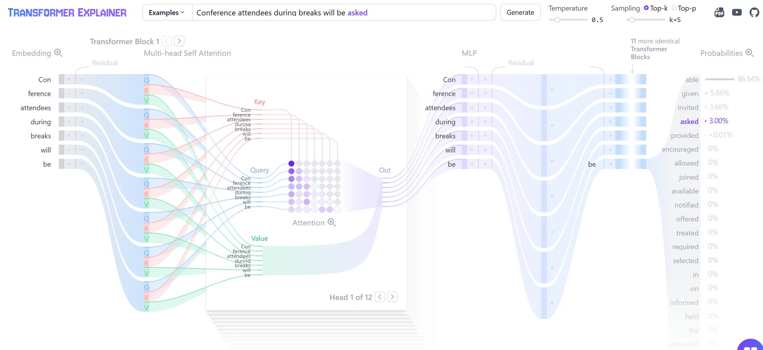
Watch attention run: GPT-2 small, live in your browser
SEGMENT 1 · FOUNDATIONS
Left to right: embedding → query · key · value → attention (head 1 of 12) → MLP → × 12 blocks → probabilities
TRY IT poloclub.github.io/transformer-explainer runs in the browser tab, nothing to install · source on GitHub
Sources: Transformer Explainer (Polo Club) · Transformer Explainer source (GitHub)
Notes:
[S1-05a]
Hook before any theory: this is what we are about to take apart. Transformer Explainer from Georgia Tech’s Polo Club: the real GPT-2 small running inside the browser tab. Read it left to right: every token becomes an embedding; in each block every token is projected to a query, a key and a value; the attention grid shows how strongly each token (row) looks at each earlier token (column) — the empty upper triangle is the causal mask; the MLP then works on each token alone; after 12 blocks the last position turns into next-token probabilities. Prompt on the screenshot: “Conference attendees during breaks will be …” — “able” gets 86.5 %, but with temperature 0.5 and top-k 5 the tool sampled “asked” at 3 %: sampling, not always the favourite (the knobs slide comes back to this). In the slide show a click on the screenshot opens the live tool. If the Wi-Fi is down, this slide is the demo.
Screenshot from Andreas’s AIExplainability deck; fallback copies in demos/S1-D1/fallback/.
Timing: ~1 min.
Sources: https://poloclub.github.io/transformer-explainer · https://github.com/poloclub/transformer-explainer

Slide 13
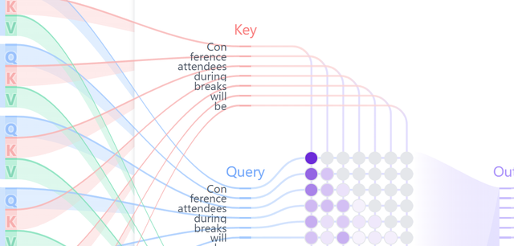
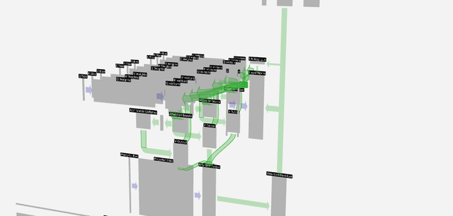
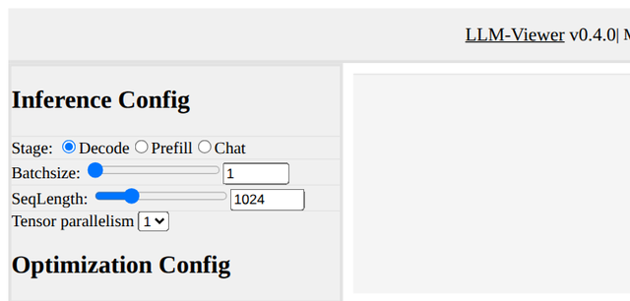
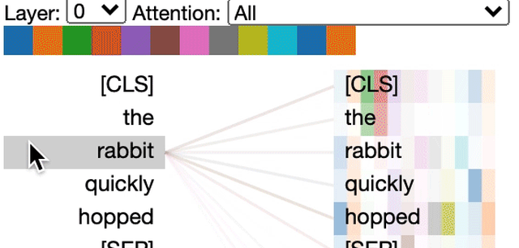
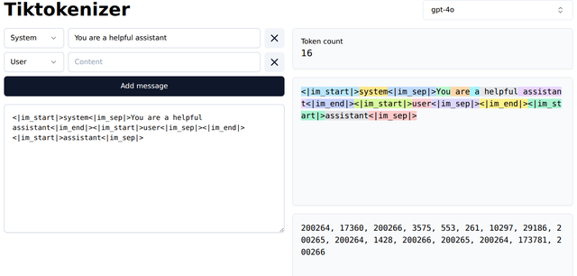
Five ways to look inside a transformer from your browser
SEGMENT 1 · FOUNDATIONS
Transformer Explainer Polo Club, Georgia Tech
LIVE GPT-2 · ATTENTION
GPT-2 small runs in the tab: type a prompt, open any of the 12 heads, drag the temperature
poloclub.github.io/transformer-explainer · github.com/poloclub/transformer-explainer
LLM Visualization Brendan Bycroft
3-D WALK-THROUGH
every matrix of a tiny GPT, animated step by step in 3-D — then GPT-2 and GPT-3 for scale
bbycroft.net/llm · github.com/bbycroft/llm-viz
LLM-Viewer hahnyuan
INFERENCE SIMULATOR
pick a model and a GPU, set batch and quantization — see memory, compute, time per layer
llm-viewer.com · github.com/hahnyuan/LLM-Viewer
BertViz Jesse Vig
ATTENTION · NOTEBOOK
attention lines head by head for most Hugging Face models — runs in Jupyter or Colab
github.com/jessevig/bertviz
Tiktokenizer dqbd
TOKENS
one step earlier: the tokens and token ids a prompt becomes, per model encoding
tiktokenizer.vercel.app
Open the first two before the session — and they are the best homework for this segment.
Sources: Transformer Explainer (Polo Club) · LLM visualisation (bbycroft.net) · LLM-Viewer · bertviz · tiktokenizer
Notes:
[S1-05b]
The take-home list — every name and URL on the slide is a link. Transformer Explainer is the one on the previous slide; we go live with it after the attention slide (S1-D1). LLM Visualization is Brendan Bycroft’s 3-D walk-through: every matrix of a tiny GPT (nano-gpt, about 85k parameters) animated step by step, with a guided tour; switch to GPT-2 or GPT-3 to feel the scale. LLM-Viewer is about running a model rather than its attention weights: choose a model and a GPU, batch size, sequence length and quantization, and it estimates memory, compute and latency per layer with a roofline model — Segment 4 (local AI) comes back to that. BertViz draws attention head by head for most Hugging Face models inside a Jupyter or Colab notebook; the thumbnail shows a BERT model attending from “rabbit”. Tiktokenizer is one step earlier: tokens and ids. Don’t click through all five live — one minute, then move on.
Links first collected in Andreas’s AIExplainability deck (slide 4) and LLM 101; checked 2026-09-23.
Timing: ~1 min.
Sources: https://poloclub.github.io/transformer-explainer · https://github.com/poloclub/transformer-explainer · https://bbycroft.net/llm · https://github.com/bbycroft/llm-viz · http://llm-viewer.com · https://github.com/hahnyuan/LLM-Viewer · https://github.com/jessevig/bertviz · https://tiktokenizer.vercel.app

Slide 14
Why now: three curves crossed in 2022 and haven’t uncrossed
SEGMENT 1 · FOUNDATIONS
Three trends got good enough at once — then ChatGPT added a chat box.
Nov 2022 · ChatGPT
compute
COMPUTE
data
GPT-3 (2020): 175 B parameters, 3.14e23 FLOPs
post-training
DATA
Llama 3 (2024): trained on 15 T tokens
good enough to ship
POST-TRAINING
InstructGPT (Jan 2022): SFT + RLHF
2017
2020
2022
2024
2026
schematic — shapes, not measurements
ChatGPT was a UX event, not a model event — and none of the three curves has flattened since.
Sources: LLM 101 deck (Day of Data 2026) · GPT-3 paper (arXiv 2005.14165) · OpenAI, InstructGPT (2022) · Epoch AI model database
Notes:
[S1-01]
Why now? Three curves crossed a “good enough” line in 2022: compute (GPT-3 was trained with 3.14e23 FLOPs in 2020), data (web-scale corpora — Llama 3 saw 15 trillion tokens) and post-training (InstructGPT, January 2022, taught a text predictor to answer). ChatGPT in November 2022 was GPT-3.5 plus a chat box — a UX event, not a model event. None of the curves has flattened: in 2026 every major software category ships GenAI (LLM 101 slide 13). The chart is schematic — say so if someone asks for the y-axis.
Ported from LLM 101 slides 12/13, 29, 30, 31, 33.
Timing: ~1.5 min.
Sources: LLM_101_100.pptx (DayOfData2026/LLM_101) — text in ref/llm101/slides.md · https://arxiv.org/pdf/2005.14165 · https://epoch.ai/data/ai-models · https://openai.com/index/instruction-following · https://openai.com/index/chatgpt

Slide 15
The whole day on one slide
SEGMENT 1 · FOUNDATIONS
Eight blocks: four this morning, the rest one segment at a time.
tokens
chat API
structured output
tools
MCP / skills
agent loop
workflow
media pipeline
S1 · Foundations
S3 · Agents
S2 · Integrating AI
S4 · Media
Same diagram, four returns: each segment opens by lighting up its blocks. By the end of the day every block has a knob you have turned yourself.
The thread through the day: same blocks, many vendors, your machine.
Notes:
[S1-02]
This is the map for the whole day, and it comes back at the start of every segment. Segment 1 builds tokens, the chat API, structured output and tools — everything Lab 1 needs. Segment 2 reuses structured output and tools and adds MCP and skills; Segment 3 turns the tool loop into agents and workflows; Segment 4 builds a media pipeline on your own machine. At the close we light everything and name the knob per block.
Timing: ~1 min.

Slide 16
A model sees tokens, not words
SEGMENT 1 · FOUNDATIONS
A tokenizer cuts your text into pieces from a fixed vocabulary first.
YOU TYPE
The cat is playing.
THE STRAWBERRY TEST
The model sees pieces such as “straw” + “berry”, not letters — so counting r’s is hard.
THE MODEL GETS — illustrative split, check it live
The
cat
is
play
ing
.
← one vector
per token
TOKENS ARE THE UNIT OF COST
GPT-2 small: 50,257 pieces in the vocabulary · 768 numbers per piece
Price per 1M tokens, the context window, rate limits: all counted in tokens.
Count tokens, not words — you pay, wait and hit limits per token.
Sources: LLM 101 deck (Day of Data 2026) · tiktokenizer · Foundry access research 2026-09-19
Notes:
[S1-03]
Text never reaches the model as words. A tokenizer splits it into pieces from a fixed vocabulary — GPT-2 had 50,257 — and every piece ID is looked up as a vector (768 numbers in GPT-2 small). The strawberry joke: models famously miscount letters because they never saw the letters. The split on the slide is illustrative — the demo right after the attention slide shows the real split in tiktokenizer. Everything you pay for and every limit you hit (price per 1M tokens, context window, TPM quotas) is counted in tokens.
Ported from LLM 101 slide 16. VERIFY in the demo: the actual split of “strawberry” for the demo model.
Timing: ~1.5 min.
Sources: LLM_101_100.pptx (DayOfData2026/LLM_101) — text in ref/llm101/slides.md · https://tiktokenizer.vercel.app · research/2026-09-19_foundry-access-for-workshop.md

Slide 17
Embeddings put meaning on a map
SEGMENT 1 · FOUNDATIONS
Every token becomes a vector; similar meanings land close together.
banana
A vector per token — GPT-2 small: 768 numbers; modern models use thousands
Distance = similarity of meaning — words cluster by topic
Directions carry meaning — king − man + woman ≈ queen
Segment 2 searches with it — embeddings + cosine similarity = retrieval
apple
king
queen
cherry
+ royal
car
bus
man
woman
bike
schematic 2-D projection of a space with hundreds to thousands of dims
The same object powers search, RAG and clustering — you will build one in Lab 2.
Sources: LLM 101 deck (Day of Data 2026) · TensorFlow Embedding Projector
Notes:
[S1-04]
After the lookup every token is a point in a high-dimensional space — 768 dimensions in GPT-2 small, 1,024 to 4,096 and more in modern models. Training arranges the space so that similar meanings cluster, and directions carry meaning: the famous king minus man plus woman lands near queen. To look at it we project it to 2-D with t-SNE, UMAP or PCA — distances survive only approximately. This is exactly the object Segment 2 searches with: embed the documents, embed the question, take the nearest ones. Try it: projector.tensorflow.org.
Ported from LLM 101 slides 16 and 20.
Timing: ~1 min.
Sources: LLM_101_100.pptx (DayOfData2026/LLM_101) — text in ref/llm101/slides.md · https://projector.tensorflow.org

Slide 18
Attention: every token looks back at every earlier token
SEGMENT 1 · FOUNDATIONS
Each token weighs the earlier ones — a river “bank” is not a loan “bank”.
ATTENTION
FROM “mat”
how much each earlier token counts
the
cat
sat
on
the
mat
0.05
0.40
0.35
0.04
0.06
current token
QUERY
KEY
VALUE
what this token is looking for
the label each token offers
what gets blended in, weighted by query · key
Multi-head attention runs many of these searches in parallel — grammar, meaning, references.
Sources: LLM 101 deck (Day of Data 2026) · Vaswani et al. 2017, Attention Is All You Need · Transformer Explainer (Polo Club)
Notes:
[S1-05]
Attention is how context changes a token’s meaning. Each token computes a query (“I’m ‘mat’ — what context do I need?”), every token offers a key (“I’m ‘cat’ — a noun, maybe the subject of ‘sat’”) and a value; the weights are softmax(Q·Kᵀ/√d) and the values are blended with them. In chat models a causal mask means each token only looks back. The weights are LLM 101’s example: from “mat”, “cat” and “sat” matter most. Multi-head runs many of these searches in parallel — next we watch it live.
Ported from LLM 101 slides 18 and 19.
Timing: ~1.5 min.
Sources: LLM_101_100.pptx (DayOfData2026/LLM_101) — text in ref/llm101/slides.md · https://arxiv.org/abs/1706.03762 · https://poloclub.github.io/transformer-explainer · https://github.com/jessevig/bertviz

Slide 19
Demo: tokens and attention, live
DEMO · SEGMENT 1
LIVE DEMO
1. tiktokenizer.vercel.app: paste a sentence, pick the demo model’s encoding, read the token count
2. type “strawberry”, a long German compound and a line of code — compare the splits
3. poloclub.github.io/transformer-explainer: type “the cat sat on the”, open one attention head
4. move the temperature slider and watch the next-token bars reshape (preview of the knobs slide)
Not metaphors: watch tokens and attention live in a browser.
WHAT TO LOOK FOR — illustrative splits
straw
berry
Donau
dampf
schiff
fahrt
IF IT BREAKS
live on the instructor laptop
you watch — the lab comes later
screenshots of both tools, the same four steps
Sources: tiktokenizer · Transformer Explainer (Polo Club)
Notes:
[S1-D1]
Two minutes, two browser tabs, opened before the session. In tiktokenizer show that the same sentence costs different token counts in different encodings, then the strawberry split and a German compound word (they explode into pieces). In Transformer Explainer (GPT-2 small in the browser) type “the cat sat on the”, click into one attention head and show the weights, then drag the temperature slider. If the Wi-Fi is down, show the dry-run screenshots — the point survives. The chips on the slide are illustrative splits; the live tool shows the real ones.
Fallback screenshots: demos/S1-D1/fallback/ (Transformer Explainer, tiktokenizer; captured 2026-09-23) — slide S1-05a is the same Transformer Explainer view.
Timing: ~2 min.
Sources: https://tiktokenizer.vercel.app · https://poloclub.github.io/transformer-explainer

Slide 20
The transformer block is attention + a small MLP, stacked
SEGMENT 1 · FOUNDATIONS
Attention lets tokens talk; the MLP lets each token think; stack it N times.
× N
tokens
+ positions
self-attention
feed-forward
(MLP)
project to
vocabulary
softmax →
p(next token)
+ residual · norm
+ residual · norm
GPT-2 SMALL
GPT-3 AND FRONTIER
Parameters = the weights
the numbers inside the attention and MLP matrices, learned in training
12 blocks
→
96+ blocks
TRY IT bbycroft.net/llm (3-D walk-through) · poloclub.github.io/transformer-explainer
Sources: LLM 101 deck (Day of Data 2026) · Vaswani et al. 2017, Attention Is All You Need · LLM visualisation (bbycroft.net)
Notes:
[S1-06]
Zoom out: a transformer is one block repeated. Attention lets tokens exchange information; the feed-forward MLP then processes each token on its own; residual connections and normalisation (RMSNorm in modern models) wrap both halves. GPT-2 small stacks 12 of these blocks, GPT-3 and today’s frontier models 96 and more. At the top, the last vector is projected onto the vocabulary and a softmax turns it into next-token probabilities. “Parameters” are simply the numbers inside these matrices.
Ported from LLM 101 slide 17. VERIFY before saying it: the plan’s aside “the paper is 15 pages”.
Timing: ~1 min.
Sources: LLM_101_100.pptx (DayOfData2026/LLM_101) — text in ref/llm101/slides.md · https://arxiv.org/abs/1706.03762 · https://bbycroft.net/llm · https://poloclub.github.io/transformer-explainer

Slide 21
Encoders understand, decoders generate — the 2018 fork
SEGMENT 1 · FOUNDATIONS
Same transformer block, different mask: who is allowed to look at whom.
GPT-1 · OpenAI · Jun 2018
→ chat & code models
GPT, Llama, Claude, DeepSeek, Qwen
decoder-only: reads left to right, predicts the next token
Transformer
2017
encoder + decoder
causal mask
BERT · Google · Oct 2018
→ search & embeddings
BERT, RoBERTa, ModernBERT
encoder-only: reads the whole sentence, fills in masked words
full attention
That’s why embedding models and chat models are cousins: same block, different mask.
Sources: LLM 101 deck (Day of Data 2026) · BERT paper (arXiv 1810.04805) · Vaswani et al. 2017, Attention Is All You Need
Notes:
[S1-07]
The 2017 transformer had an encoder and a decoder, built for translation. In 2018 the family split. GPT-1 (OpenAI, June) kept only the decoder: a causal mask, so each token sees only the past, trained to predict the next token. BERT (Google, October) kept only the encoder: every token sees every token, trained to fill in masked words. The grids show the difference — left, a triangle; right, the full square. That fork defined the next six years: chat models on one side, embedding and search models on the other.
Ported from LLM 101 slides 22 and 25.
Timing: ~1 min.
Sources: LLM_101_100.pptx (DayOfData2026/LLM_101) — text in ref/llm101/slides.md · https://arxiv.org/abs/1810.04805 · https://arxiv.org/abs/1706.03762

Slide 22
Three lineages you’ll meet today
SEGMENT 1 · FOUNDATIONS
Three wirings of the same block — and each one has a job in today’s labs.
ENCODER-ONLY
DECODER-ONLY
ENCODER–DECODER
both ways
one way
cross-attn
Reads all tokens at once
Outputs one vector per token
Good for search, classification
Today BGE-M3 embeddings (Lab 2)
Reads left to right
Outputs the next token
Good for chat, code, agents
Today gpt-5-mini, DeepSeek, Qwen (Labs 1–4)
Reads the input, then writes
Outputs a new sequence
Good for translation, ASR
Today Whisper-style ASR (Segment 4)
Decoder-only won for chat: one model handles any input and any output.
Sources: LLM 101 deck (Day of Data 2026) · Raschka, The Big LLM Architecture Comparison
Notes:
[S1-08]
Three wirings of the same block. Encoder-only models (BERT, RoBERTa, ModernBERT — and the BGE-M3 embedding model you run locally in Lab 2) read everything at once and output vectors. Decoder-only models (GPT, Llama, Claude, DeepSeek, Qwen, Gemini) read left to right and output the next token — every chat model today. Encoder–decoder models (T5, BART, the original transformer; Whisper-style speech recognition) read an input and write a new sequence. Decoder-only won for chat because one autoregressive model handles any input and output.
Ported from LLM 101 slides 24 and 25.
Timing: ~1 min.
Sources: LLM_101_100.pptx (DayOfData2026/LLM_101) — text in ref/llm101/slides.md · https://magazine.sebastianraschka.com/p/the-big-llm-architecture-comparison

Slide 23
An LLM is a next-token machine; the rest is scaffolding
SEGMENT 1 · FOUNDATIONS
Predict one token, append it, repeat. That loop is the whole engine.
the model
WHAT THE MODEL OUTPUTS AFTER “the cat sat on the”
append it to
the input
probabilities over
the vocabulary
mat
floor
sofa
roof
moon
pick one token
(sampling)
illustrative bars · temperature reshapes them before the pick
Chat formats, tools, agents: all scaffolding around this one loop.
Sources: LLM 101 deck (Day of Data 2026) · OpenAI, Better language models (GPT-2) · GPT-3 paper (arXiv 2005.14165)
Notes:
[S1-09]
Strip away the product and an LLM is a function from “text so far” to a probability for every token in the vocabulary. Pick one, append it, call the function again — until a stop token or a length limit. GPT-2 (2019) was the first to feel shockingly fluent; GPT-3 (2020) showed that a big enough next-token machine learns tasks from a few examples in the prompt. Everything we build today — chat, structured output, tools, agents — is scaffolding around this loop. The bars are illustrative; the knobs slide later shows how temperature reshapes them.
Ported from LLM 101 slide 26.
Timing: ~1 min.
Sources: LLM_101_100.pptx (DayOfData2026/LLM_101) — text in ref/llm101/slides.md · https://openai.com/index/better-language-models · https://arxiv.org/pdf/2005.14165

Slide 24
GPT-3: what 175 B parameters cost and ate
SEGMENT 1 · FOUNDATIONS
The 2020 model that made scaling a strategy — its diet and its bill are public.
WHAT IT ATE — the training mix
WHAT IT COST
Source | Tokens | Weight in training
Common Crawl (filtered) | 410 B | 60 %
WebText2 (Reddit-linked) | 19 B | 22 %
Books1 | 12 B | 8 %
Books2 | 55 B | 8 %
Wikipedia | 3 B | 3 %
Metric | Value
Parameters | 175 B (largest dense LM then)
Compute | 3.14e23 FLOPs
Hardware | 10,000 V100 (Azure)
Training time | ~15 days
Cost (compute only, est.) | ≈ $4.6 M
Carbon | 552 t CO₂
~499 B tokens raw, ~300 B used — good sources up-weighted
Rule of thumb (Chinchilla): training FLOPs ≈ 6 × parameters × tokens.
Sources: LLM 101 deck (Day of Data 2026) · GPT-3 paper (arXiv 2005.14165) · Chinchilla paper (arXiv 2203.15556)
Notes:
[S1-10]
GPT-3 is the model that made “just scale it” a strategy. It ate about 300 billion tokens sampled from ~499 billion, mostly filtered Common Crawl, with the good sources (WebText2, books, Wikipedia) up-weighted. It cost 3.14e23 FLOPs on about 10,000 V100s on Azure for roughly 15 days — about $4.6 M in compute, an estimate — and 552 t CO₂. Chinchilla’s rule of thumb ties it together: training FLOPs ≈ 6 × parameters × tokens. Trim slide: skip in the 75-minute cut.
Ported from LLM 101 slides 28, 29 and 33.
Timing: ~1 min.
Sources: LLM_101_100.pptx (DayOfData2026/LLM_101) — text in ref/llm101/slides.md · https://arxiv.org/pdf/2005.14165 · https://arxiv.org/abs/2203.15556

Slide 25
Instruct-tuning turned a text predictor into an assistant
SEGMENT 1 · FOUNDATIONS
Two training steps taught a text continuer to answer — InstructGPT, 2022.
base model
continues text
SFT
learns from human-written answers
reward model
humans rank answers
RL (PPO)
optimises for the rewards
assistant
follows instructions
RLHF = reward model + RL
illustrative outputs
BASE MODEL (continues)
INSTRUCT MODEL (answers)
“What is the capital of France?”
→ “What is the capital of Germany? What is the capital of …”
“What is the capital of France?”
→ “Paris.”
The recipe behind almost every chat model since 2022.
Sources: LLM 101 deck (Day of Data 2026) · OpenAI, InstructGPT (2022)
Notes:
[S1-11]
A base model is a document continuer: ask it a question and it may continue with more questions. InstructGPT (January 2022) added two steps. First supervised fine-tuning on human-written demonstrations. Then RLHF: humans rank several answers, a reward model learns those preferences, and reinforcement learning (PPO) optimises the model against it. The result follows instructions — and this recipe, in variations, is behind almost every chat model since. The two example outputs are illustrative.
Ported from LLM 101 slides 30 and 52.
Timing: ~1 min.
Sources: LLM_101_100.pptx (DayOfData2026/LLM_101) — text in ref/llm101/slides.md · https://openai.com/index/instruction-following

Slide 26
ChatGPT = InstructGPT + a chat box (+ a system prompt)
SEGMENT 1 · FOUNDATIONS
GPT-3.5
instruct-tuned + RLHF
a chat box
multi-turn, keeps the thread
a system prompt
hidden instructions
ChatGPT
November 2022
+
+
=
“The model barely changed — the interface did.”
What users got: multi-turn conversation · follow-up questions · it declines some harmful requests.
Sources: LLM 101 deck (Day of Data 2026) · OpenAI, Introducing ChatGPT (2022)
Notes:
[S1-12]
November 2022: ChatGPT. Under the hood it was GPT-3.5 with the InstructGPT recipe — instruction tuning plus RLHF — optimised for back-and-forth conversation. What was new was the interface: a chat box that keeps the thread, and a system prompt you never see. It asked clarifying questions and declined some harmful requests. The model barely changed; the interface did — and the chat format (roles, a system message) is still the API you call today, which is where the second half of this segment goes.
Ported from LLM 101 slide 31. Dark slide = thesis moment.
Timing: ~1 min.
Sources: LLM_101_100.pptx (DayOfData2026/LLM_101) — text in ref/llm101/slides.md · https://openai.com/index/chatgpt

Slide 27
The 2026 post-training stack: SFT → DPO → GRPO/RL → distil
SEGMENT 1 · FOUNDATIONS
Post-training is a modular pipeline now — and most teams never run RL.
SFT
format + instructions
1k–100k examples
DPO
preferences, no reward
model, no PPO loop
GRPO / RL
verifiable rewards
(math, code) → reasoning
distil
a big teacher trains
a small student
PEFT under any step: LoRA → QLoRA (4-bit: 70 B on one H100) → DoRA — next two slides
WHAT IS ACTUALLY IN PRODUCTION
DECISION RULE
QLoRA + DPO on a few thousand preference pairs; full fine-tunes are rare.
prompt → RAG → fine-tune: fine-tune for behaviour, RAG for knowledge.
“Reasoning” = RL on answers that can be checked automatically.
Sources: LLM 101 deck (Day of Data 2026) · Hugging Face TRL docs · DAPO paper (arXiv 2503.14476) · DeepSeek-R1 (arXiv 2501.12948)
Notes:
[S1-13]
Post-training in 2026 is a modular pipeline. SFT teaches format and instruction following (1k–100k examples, often synthetic); DPO is the default alignment step — preferences without a reward model or PPO loop (KTO, ORPO, SimPO are variants); GRPO and DAPO are DeepSeek-style RL with verifiable rewards, which is what makes reasoning models (R1, Qwen3, Nemotron Super); distillation lets a big teacher train a small student. Under any step sits PEFT — LoRA, QLoRA, DoRA — with tooling such as TRL 1.0, Unsloth and Axolotl. Most production fine-tuning is QLoRA + DPO; PPO is being displaced. The decision rule matters most: prompt, then RAG, fine-tune last.
Ported from LLM 101 slide 32; “distil” from 00_Workshop_Plan §3 S1 item 2.
Timing: ~1.5 min.
Sources: LLM_101_100.pptx (DayOfData2026/LLM_101) — text in ref/llm101/slides.md · https://huggingface.co/docs/trl · https://arxiv.org/abs/2503.14476 · https://arxiv.org/abs/2501.12948

Slide 28
Hyperparameters — which room are you in?
SEGMENT 1 · FOUNDATIONS
Hyperparameter = a setting you choose, not one the model learns.
INFERENCE ROOM
TRAINING ROOM
turn them per request — free and instant
set them per training run — hours and GPUs
temperature
top_p
seed
max_tokens
learning rate
batch size
epochs
reasoning_effort
LoRA rank r
alpha
dropout
Segment 4 adds: steps · CFG · sampler · LoRA strength
plus: which layers get adapters
Cost of a mistake: one bad answer. Try again.
Cost of a mistake: a burnt evening and a useless file.
When a tutorial says “tune the hyperparameters” — first ask: which room?
Sources: Beyond the Slop (daenet, Jul 2026) · Lab 1 code (tested 2026-09-22)
Notes:
[S1-14]
Borrowed from Beyond the Slop, because the word confuses everyone. Inference knobs — temperature, top_p, seed, max_tokens, reasoning_effort, and in Segment 4 steps, CFG, sampler and LoRA strength — you turn per request, free and instant; a mistake costs one bad answer. Training knobs — learning rate, batch size, epochs, LoRA rank, alpha, dropout, which layers get adapters — you set per training run; a mistake costs an evening of GPU time. Today’s labs only use the inference room; the next slide opens the door to the training room.
Ported from Beyond the Slop slide 16 (inference knobs re-labelled for LLMs from Lab 1 step 2).
Timing: ~1 min.
Sources: research/beyond_the_slop/Beyond_the_Slop_GenAI_2026_slide_text.txt · labs/01-hello-model

Slide 29
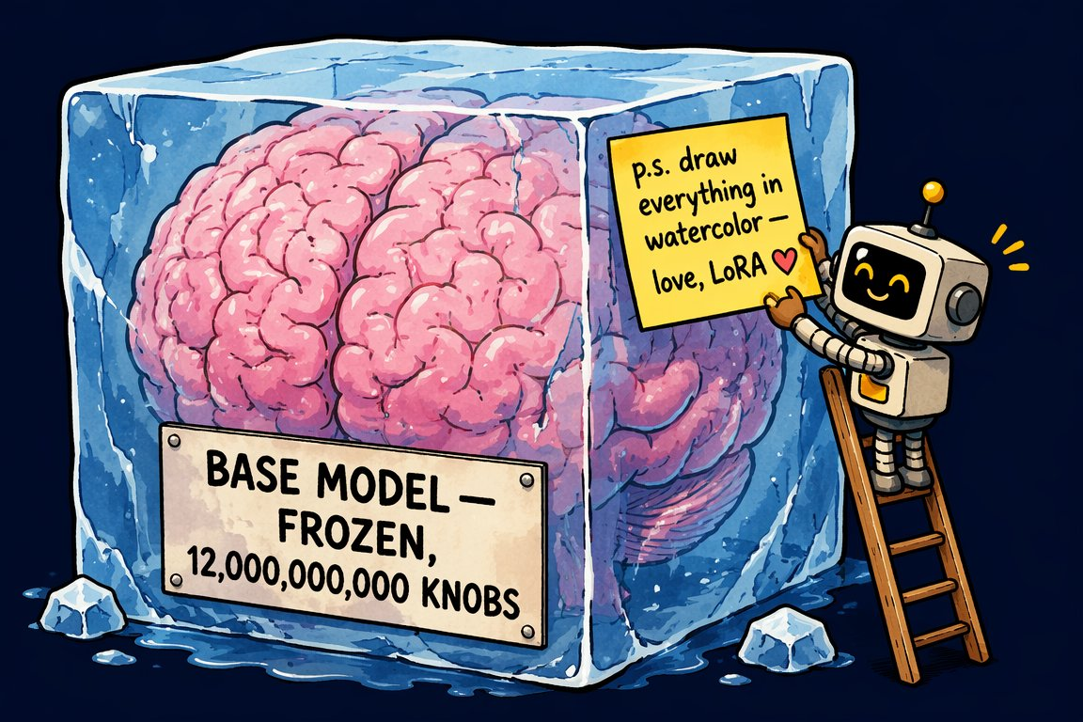
LoRA on a sticky note: ΔW = B·A
SEGMENT 1 · FOUNDATIONS
Freeze the big weight matrix W; train a tiny low-rank correction and add it on top.
W
d × d
frozen
B
+
·
A
r × d
ΔW = B·A
rank r ≈ 4–128
d × r
TO TRAIN · FULL 4096 × 4096 MATRIX
TO TRAIN · LoRA, r = 16
AI-generated · Beyond the Slop
16.8 M
→
131 k
a few-MB file · stackable (style + character) · a strength dial at inference
The same trick fine-tunes a diffusion model in Segment 4 — LoRA is the bridge.
Sources: Beyond the Slop (daenet, Jul 2026) · LLM 101 deck (Day of Data 2026)
Notes:
[S1-15]
LoRA is the reason fine-tuning got cheap. Nobody retrains billions of weights for a style or a behaviour: W stays frozen, and you train a low-rank correction ΔW = B·A with rank r somewhere between 4 and 128. The pair is arithmetic, not a benchmark: one 4096 × 4096 matrix holds 16.8 million numbers; B and A at rank 16 hold 131 thousand. The result is a file of a few megabytes that you can stack and dial in at inference. QLoRA does the same on a 4-bit base model, which is how a 70 B model fits one GPU. The identical trick fine-tunes image models — we meet it again in Segment 4.
Ported from Beyond the Slop slide 20 (image AI-generated, from BTS) and LLM 101 slide 32.
Timing: ~1.5 min.
Sources: research/beyond_the_slop/Beyond_the_Slop_GenAI_2026_slide_text.txt · LLM_101_100.pptx (DayOfData2026/LLM_101) — text in ref/llm101/slides.md

Slide 30
Scale kept paying, then MoE made it affordable
SEGMENT 1 · FOUNDATIONS
Many expert MLPs, a router picks a few per token: total ≠ active parameters.
expert 1
expert 2
Model | Total | Active per token
GPT-4 (2023, leaked) | ≈ 1.8 T | top-2 of 8–16 experts
DeepSeek V3 (Dec 2024) | 671 B | 37 B
Kimi K3 (Jul 2026) | 2.8 T | 104 B
DeepSeek V4.1 Flash (Sep 2026) | 552 B | 8–16 B
GLM-5.3 (Aug 2026) | 753 B | ≈ 40 B
expert 3
expert 4
token
router
expert 5
expert 6
expert 7
expert 8
only the lit experts run
Total parameters are the memory bill; active parameters are the compute bill.
Sources: LLM 101 slide 35 (GPT-4: leaked figures) · DeepSeek-V3 (arXiv 2412.19437) · Model catalog §2 (checked 2026-09-21)
Notes:
[S1-16]
Scale kept paying: GPT-4 (2023) cost an estimated $50–200 M to train and is reported — leaked, never confirmed by OpenAI — to be a mixture of experts with about 1.8 T parameters and top-2 routing; the GPT-4 technical report discloses no architecture or size. MoE replaces the one big MLP with many expert MLPs; a router picks a few per token. So “1 T parameters” is what you must hold in memory, while the active parameters decide the compute per token: DeepSeek V3 has 671 B total and 37 B active; the 2026 open models push the ratio further (rows from the model catalog). Trim slide: in the 75-minute cut the MoE row on the next slide carries the point.
Ported from LLM 101 slides 33–35 (the GPT-4 figures are LLM 101 slide 35’s leak numbers); 2026 rows from catalog §2 (dates are 2026 MM-DD).
Timing: ~1 min.
Sources: LLM_101_100.pptx (DayOfData2026/LLM_101) — text in ref/llm101/slides.md · https://arxiv.org/abs/2412.19437 · https://research.google/blog/mixture-of-experts-with-expert-choice-routing · 05_Model_Catalog_2026-09.md

Slide 31
Attention got cheap: GQA, MLA, sparse/hybrid layers
SEGMENT 1 · FOUNDATIONS
The inference bottleneck is the KV cache — every trick here shrinks it.
Trick | What it does | Popularised by
MHA (2017) | own K/V per head: best quality, biggest cache | the original transformer
MQA (2019) | one shared K/V for all heads: fastest, quality dips | —
GQA (2023) | groups of heads share K/V: the middle ground | Llama 2/3, Mistral, Qwen
MLA (2024) | compress K/V into a small latent vector | DeepSeek V2 → V3
Sliding window | attend to the last N tokens only | Gemma 3, Mistral
Hybrid layers | not every layer is attention (Mamba-2 MoE, 1M ctx) | Nemotron 3.5 Lightning
MoE | only a few expert MLPs run per token | DeepSeek V3: 671 B total, 37 B active
Chinese labs publish these tricks most openly — you run the results in Segment 4.
Sources: LLM 101 deck (Day of Data 2026) · Raschka, LLM architecture gallery (MLA) · Model catalog §2 (checked 2026-09-21)
Notes:
[S1-17]
Serving cost is dominated by the KV cache: for every token in the context the model keeps one key and one value vector per attention head. The tricks: MQA shares one K/V across all heads; GQA (Llama 2/3, Mistral, Qwen) shares per group; DeepSeek’s MLA compresses K/V into a small latent; sliding-window attention (Gemma 3, Mistral) only looks at the last N tokens; hybrid models such as NVIDIA’s Nemotron 3.5 Lightning mix Mamba-2 blocks in. MoE is the same idea for the MLP. LLM 101’s point stands: Chinese labs publish these most openly.
Ported from LLM 101 slides 36–37; hybrid row from catalog §2 (“Mamba-2 MoE, 1M ctx”). The MoE row is the 75-minute-cut replacement for S1-16.
Timing: ~1 min.
Sources: LLM_101_100.pptx (DayOfData2026/LLM_101) — text in ref/llm101/slides.md · https://sebastianraschka.com/llm-architecture-gallery/mla · 05_Model_Catalog_2026-09.md

Slide 32
The DeepSeek shock: frontier quality, a fraction of the bill
SEGMENT 1 · FOUNDATIONS
January 2025: R1 matched OpenAI’s o1 on reasoning, with open weights.
V3 · Dec 2024
671 B MoE, FP8
R1 · Jan 2025
RL reasoning (GRPO)
V4 Pro / Flash · 2026
sold by Azure (Foundry)
V4.1 Flash · 2026-09-10
MIT, 552 B / 8–16 B active
V3 FINAL PRETRAINING RUN (REPORTED)
WHOLE PROGRAMME (PLAUSIBLE)
final run only: 2.788 M H800-hours at ~$2/h — no research, failed runs, data or capex
$5.6 M
vs
$100s of M
NVIDIA, 27 JANUARY 2025
−17 % in one day (≈ $589 B)
What really changed: the engineering, the RL recipe — and MIT-licensed weights.
Sources: LLM 101 deck (Day of Data 2026) · DeepSeek-V3 (arXiv 2412.19437) · Model catalog §2 (checked 2026-09-21)
Notes:
[S1-18]
DeepSeek V3 (December 2024) and R1 (January 2025) landed back to back: R1 matched OpenAI’s o1 on reasoning with open weights, and on 27 January 2025 Nvidia lost about 17 % (~$589 B) in a day. Read the $5.6 M carefully: it is the final pretraining run only (2.788 M H800-hours at ~$2/h); research, ablations, failed runs, data and capex are not in it — the programme plausibly cost hundreds of millions. What really changed: the engineering (MLA, FP8, sparse MoE), the RL recipe, and the assumption that the frontier needs US-hyperscaler capex. Today V4 Pro/Flash are sold by Azure in Foundry, and V4.1 Flash is MIT-licensed — the bridge to Segment 4.
Ported from LLM 101 slide 38; 2026 boxes from catalog §2. The inference-price drop is a separate story (hardware, serving, competition) — say so if asked.
Timing: ~1.5 min.
Sources: LLM_101_100.pptx (DayOfData2026/LLM_101) — text in ref/llm101/slides.md · https://arxiv.org/abs/2412.19437 · https://arxiv.org/abs/2501.12948 · https://stratechery.com/2025/deepseek-faq/ · 05_Model_Catalog_2026-09.md

Slide 33
Beyond one token per step: three ways, three maturities
SEGMENT 1 · FOUNDATIONS
One token per forward pass is the default — three ways to get more.
SPECULATIVE DECODING
MULTI-TOKEN PREDICTION
DIFFUSION LMs
PRODUCTION
SHIPPING
RESEARCH / EARLY
small draft:
the
cat
sat
on
the
cat
sat
on
the
░░░░
▓▓▓▓
the cat sat
big model:
✓
✓
✓
✗
three new tokens in one forward pass
noise → denoise → clean tokens
A small model drafts, the big one verifies in parallel: same output, 2–4× faster.
2–4 tokens per forward pass — DeepSeek V3 ships it.
All tokens at once, refined over passes: Mercury 2, Gemini Diffusion.
Speculative decoding comes free with a good server; diffusion LMs are one to watch.
Sources: LLM 101 deck (Day of Data 2026) · Inception Labs (Mercury) · arXiv 2506.17298 · Google DeepMind, Gemini Diffusion
Notes:
[S1-19]
Standard models generate one token per forward pass — about 50–150 tokens per second for a single stream. Speculative decoding is production today: a small draft model guesses ahead, the big model verifies the guesses in parallel, output identical, 2–4× faster. Multi-token prediction trains the model to predict 2–4 tokens per pass; DeepSeek V3 ships it. Diffusion language models (Mercury 2 at over 1,000 tokens per second, Gemini Diffusion) generate the whole answer at once and refine it — a different pattern, still early. Trim slide.
Ported from LLM 101 slides 39–41.
Timing: ~1 min.
Sources: LLM_101_100.pptx (DayOfData2026/LLM_101) — text in ref/llm101/slides.md · https://www.inceptionlabs.ai · https://arxiv.org/abs/2506.17298 · https://deepmind.google/models/gemini-diffusion

Slide 34
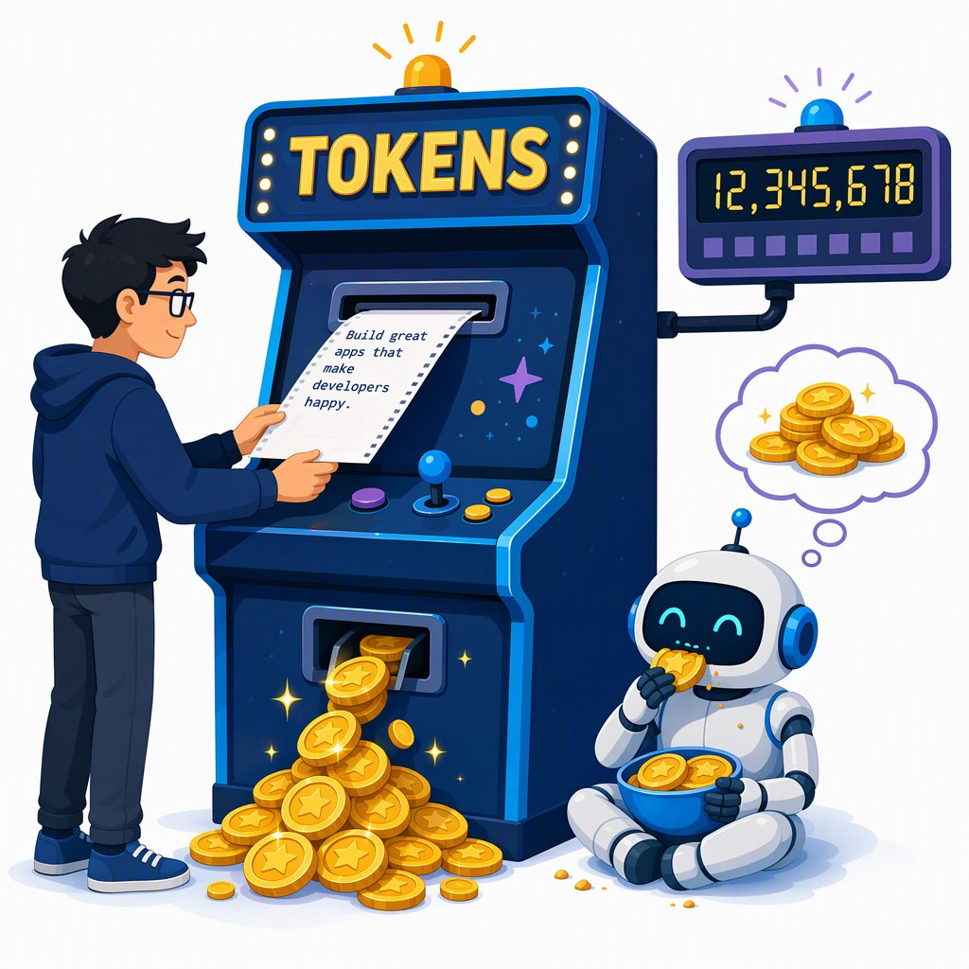
Reasoning models think in tokens you pay for
SEGMENT 1 · FOUNDATIONS
Reasoning models write a hidden chain of thought first — you wait for those tokens, and you pay for them.
STANDARD
prompt
answer
REASONING
prompt
thinking tokens · hidden · billed
answer
THINKING ON · qwen3:1.7b
reasoning_effort = "none"
41 s
→
5.6 s
same one-line answer: 336 → 46 output tokens
2 vCPU, no GPU · Ollama 0.34.3 · measured 2026-09-22
Helps: math, code, multi-step agents · wastes money: lookups, extraction, chit-chat
reasoning_effort is a cost knob — set it per task, not per project.
Sources: LLM 101 deck (Day of Data 2026) · OpenAI 2024, Learning to reason (o1) · Snippet verification 2026-09-22
Notes:
[S1-20]
Reasoning models are trained to think out loud before answering: input, a long chain of thought, then the answer. OpenAI’s o1 (September 2024) hid the chain and charged for it; DeepSeek R1 made it open; GPT-5-class models reason by default with an effort knob. Thinking tokens are billed as output — LLM 101 counted 5–50× more output tokens per answer. Our own measurement while verifying the lab code (a test machine with 2 vCPU and no GPU, Ollama 0.34.3, 2026-09-22): qwen3:1.7b took 41 s and 336 tokens for a one-liner with thinking on, 5.6 s and 46 tokens with reasoning_effort none. Use it where it helps (math, code, agents), switch it down for lookups. The next demo shows the bill on the workshop gateway.
Ported from LLM 101 slides 42 and 60; the measured pair is from research/2026-09-22_framework-snippet-verification.md §7 (same run as S4-05).
Timing: ~1.5 min.
Sources: LLM_101_100.pptx (DayOfData2026/LLM_101) — text in ref/llm101/slides.md · https://openai.com/index/learning-to-reason-with-llms · https://arxiv.org/abs/2501.12948 · research/2026-09-22_framework-snippet-verification.md · research/2026-09-19_foundry-access-for-workshop.md

Slide 35
Demo: what the router and reasoning_effort cost
DEMO · SEGMENT 1
LIVE DEMO
1. labs/01-hello-model/python/02_knobs.py with GENAI_MODEL=gpt-5-mini: temperature is rejected, the script switches to reasoning_effort
2. read the printout for minimal / low / high: seconds, completion tokens, hidden reasoning tokens
3. the same call through the workshop gateway with the raw response: token headers from the llm-token-limit policy (consumed / remaining)
4. optional: model-router — an easy and a hard prompt, print response.model
Thinking is billed: one prompt, three effort levels, three bills.
HIDDEN TOKENS PER EFFORT LEVEL — illustrative
minimal
low
high
live on the instructor laptop
you watch — the lab comes later
IF IT BREAKS
a screenshot of the 02_knobs run and the gateway headers
Sources: Lab 1 code (tested 2026-09-22) · APIM llm-token-limit policy
Notes:
[S1-D3]
Three minutes. Run 02_knobs.py against gpt-5-mini: the temperature call fails with a 400, the script catches it and loops over reasoning_effort minimal, low and high on “Is 1001 prime?”, printing seconds, completion tokens and the hidden reasoning tokens. Then show the same request through the APIM gateway with the response headers — the llm-token-limit policy can report tokens consumed and remaining per key. Punchline: the effort knob is a cost knob, and the gateway is where you see the bill. The bars on the slide are illustrative; the live run prints the real counts.
VERIFY: model-router is not in the provisioning model list (01_Foundry_Provisioning_Plan §3) — deploy it or skip step 4. VERIFY: the header names configured in the policy (remaining-tokens-header-name / tokens-consumed-header-name). VERIFY: capture the fallback screenshot in the dry run.
Timing: ~3 min.
Sources: labs/01-hello-model · https://learn.microsoft.com/en-us/azure/api-management/llm-token-limit-policy · 01_Foundry_Provisioning_Plan.md

Slide 36
September 2026: closed and open are one generation apart
SEGMENT 1 · FOUNDATIONS
as of 2026-09-21
Model (maker) | Released | Weights | AA index | Where you can call it
GPT-6 Astra (OpenAI) | 2026-09-03 | closed | 53 | API, Foundry DfA, Bedrock, OpenRouter
Claude Fable 5.1 (Anthropic) | 2026-09-01 | closed | 53 | API, Bedrock, Vertex, Foundry MP
Gemini 3.8 Flash (Google) | 2026-09-02 | closed | – | AI Studio, Vertex, OpenRouter
Grok 4.7 (xAI) | 2026-09-21 | closed | – | xAI API; Foundry DfA grok-4.6 preview, grok-4.1-fast
GLM-5.3 (Z.ai) | 2026-08-28 | open · GLM-5.3 licence | 45 | HF, OpenRouter, Ollama, LM Studio, FW
Qwen3.8 Max (Alibaba) | 2026-08-12 | open · custom licence | 45 | HF, OpenRouter
Kimi K3 (Moonshot) | 2026-07-27 | open · Kimi K3 licence | 44 | HF, OpenRouter, FW
DeepSeek V4.1 Flash (DeepSeek) | 2026-09-10 | open · MIT | 40 | HF, OpenRouter, Ollama, LM Studio, FW
permissive open weights
open with conditions
non-commercial · closed · API-only
BEST CLOSED · AA INDEX
BEST OPEN · AA INDEX
One generation apart — and the open ones run on hardware you control (Segment 4).
53
vs
45
Sources: Model catalog §1 (checked 2026-09-21) · Model catalog §2 (checked 2026-09-21) · Artificial Analysis
Notes:
[S1-21]
The September 2026 frontier, straight from the model catalog (checked 2026-09-21). Closed: GPT-6 Astra and Claude Fable 5.1 tie at 53 on the Artificial Analysis index; Gemini 3.8 Flash and Grok 4.7 have no index value in the catalog. Open weights: GLM-5.3 and Qwen3.8 Max share first place at 45, then Kimi K3 (44) and DeepSeek V4.1 Flash (40). The gap is about one model generation. The dots are the catalog’s licence traffic light: green = permissive (MIT), amber = open with conditions (revenue or MaaS clauses), red = closed — the Segment 4 licence slide explains them. Tencent Hy4-preview (Apache-2.0, 770B/49B) is the ninth name in the plan; it is left out for space.
Refreshed LLM 101 slide 43. Re-run skills/genai-landscape-research the week before — this table has a half-life of weeks.
Timing: ~1.5 min.
Sources: 05_Model_Catalog_2026-09.md · 05_Model_Catalog_2026-09.md · https://artificialanalysis.ai · LLM_101_100.pptx (DayOfData2026/LLM_101) — text in ref/llm101/slides.md

Slide 37
What’s in the weights vs. what’s PaaS on top
SEGMENT 1 · FOUNDATIONS
You never call a bare model — every endpoint wraps it in a platform.
THE ENDPOINT YOU CALL — platform (PaaS)
system prompt
safety classifiers
content filters (Foundry RAI)
model router
your
request
the weights
next-token machine
+ what training baked in
“thinking” budget
rate limits & quotas
tool routing
retrieval / file search
memory & state
prompt caching
Model differences you notice are often platform differences — test the endpoint, not just the model.
Sources: LLM 101 deck (Day of Data 2026) · OpenAI, Introducing GPT-5 · Foundry access research 2026-09-19
Notes:
[S1-22]
This is the honest map of what you actually call. The weights are a next-token machine plus whatever training baked in. Around them the platform adds a system prompt, safety classifiers and content filters (the Foundry RAI policy), a model router — GPT-5 launched as a family behind one router that picks a fast or a thinking model per prompt — a thinking budget, tool routing and built-in tools, retrieval, memory, prompt caching, and quotas at the gateway. Two endpoints serving “the same model” can behave differently because of these layers. That is why the labs test the endpoint you will really use.
Refreshed LLM 101 slide 44 (GPT-5 router) → new “model vs PaaS” map (00_Workshop_Plan §3 S1 item 2).
Timing: ~1.5 min.
Sources: LLM_101_100.pptx (DayOfData2026/LLM_101) — text in ref/llm101/slides.md · https://openai.com/index/introducing-gpt-5 · research/2026-09-19_foundry-access-for-workshop.md

Slide 38
Benchmarks: a vocabulary, not a verdict
SEGMENT 1 · FOUNDATIONS
Know the names to read a model card — then trust the trajectory and your own tests.
Area | Benchmarks you will see
General reasoning | MMLU-Pro · GPQA-Diamond · BIG-bench Hard · ARC-AGI-2
Coding | SWE-bench Verified · LiveCodeBench · HumanEval+ · Aider polyglot
Agents / web | BrowseComp · WebArena · OSWorld · GAIA · SWE-Lancer
Math | AIME · MATH · FrontierMath · OmniMATH
Multimodal | MMMU · MMMU-Pro · VideoMME · RealWorldQA
Long context | RULER · needle-in-a-haystack · LongBench · BABILong
WHY NOT A VERDICT
Test questions leak into training data; scores swing with prompt tweaks.
TRUST WHAT YOU CAN RE-RUN
A small eval on your own data beats a public rank — Lab 2’s stretch goal is one.
Trust the trajectory across releases — and the leaderboard you can re-run yourself.
Sources: LLM 101 deck (Day of Data 2026) · LiveBench · Artificial Analysis
Notes:
[S1-23]
Benchmarks are a vocabulary: you need the names to read a model card or the Artificial Analysis index on the previous slide. They are not a verdict: contamination is a constant battle, absolute scores swing with prompt tweaks, and every vendor chooses the benchmarks it publishes. LLM 101’s advice holds — trust the trajectory across releases, not the rank. The practical version for developers: build a small eval on your own data; Lab 2’s stretch goal is a six-question golden set you can re-run after every model swap. Trim slide.
Ported from LLM 101 slide 47.
Timing: ~1 min.
Sources: LLM_101_100.pptx (DayOfData2026/LLM_101) — text in ref/llm101/slides.md · https://livebench.ai · https://artificialanalysis.ai

Slide 39
Era 1 — old-school completion: one string in, one string out
SEGMENT 1 · FOUNDATIONS
A base model doesn’t follow instructions — it continues the document you started.
ONE STRING IN
ONE STRING OUT (illustrative)
Q: Capital of France?
A:
base
model
Paris
Q: Capital of Spain?
A: Madrid …
You write the start of the answer · few-shot examples set the pattern · a stop sequence ends it.
BASE MODELS STILL SHIP
CODE COMPLETION
FEW-SHOT
e.g. Xiaomi MiMo-V2.5 (incl. base), AliceAI-80B-A3B base
fill-in-the-middle: prefix + suffix in, the middle out
show three examples — the model continues the pattern
Sources: LLM 101 deck (Day of Data 2026) · GPT-3 paper (arXiv 2005.14165) · Model catalog §2 (checked 2026-09-21)
Notes:
[S1-24]
Era 1 is the base-model era: GPT-2, GPT-3 davinci, BLOOM, Llama base. One string in, one string out — no roles, no system prompt. You wrote the start of the answer (“Q: … A:”), showed a few examples so the model continued the pattern, and a stop sequence ended it; a trailing space could break everything. Why it still matters: open labs still publish base models (MiMo, AliceAI base in the catalog), code completion in the IDE is fill-in-the-middle, and few-shot is still the cheapest way to pin a format. Trim slide (the 75-minute cut moves it to the appendix).
Ported from LLM 101 slides 52–53. VERIFY: there is no tested completions-API snippet in labs/ — the slide shows prompts, not an API call (the LLM 101 code used a retired davinci model and was never run here).
Timing: ~1 min.
Sources: LLM_101_100.pptx (DayOfData2026/LLM_101) — text in ref/llm101/slides.md · https://arxiv.org/pdf/2005.14165 · 05_Model_Catalog_2026-09.md

Slide 40
Era 2 — chat: roles are the API
SEGMENT 1 · FOUNDATIONS
Chat models are trained on who speaks — and you resend the whole list every call.
messages = [ … ] — the context window is this list (Lab 1 step 4)
SYSTEM
USER
ASSISTANT
TOOL
ASSISTANT
Use the tools for facts. Be brief.
What’s the weather in Paris …?
tool_calls: get_weather(Paris)
{"temp_c": 19, "sky": "light rain"}
19 °C, light rain (66.2 °F)
PYTHON
C#
r = client.chat.completions.create(
model=MODEL, **EXTRA, messages=[
{"role": "system", "content": system},
{"role": "user", "content": question}])
ChatCompletion r = await client.CompleteChatAsync(
[new SystemChatMessage(system),
new UserChatMessage(question)], options);
The model remembers nothing between calls — the list is the memory.
Sources: LLM 101 deck (Day of Data 2026) · Lab 1 code (tested 2026-09-22) · Lab 2 code (tested 2026-09-22)
Notes:
[S1-25]
Era 2: instruction-tuned chat models are trained on who is speaking — system, user, assistant, tool — and the API is exactly that list. The model is stateless: you send the whole conversation every call, so the context window is a list you own. The strip is Lab 1 step 4 as it grows: system, user, the assistant’s tool call, the tool result, the answer. The code is Lab 2’s call — the same two roles; in Segment 2 the system message carries the retrieved sources. TypeScript twin: labs/02-rag-mcp/typescript/solution/03_ask.mjs.
Ported from LLM 101 slide 54. Code: labs/02-rag-mcp/{python,csharp}/solution/03_ask (tested 2026-09-22), reflowed for the panel (whitespace only).
Timing: ~1 min.
Sources: LLM_101_100.pptx (DayOfData2026/LLM_101) — text in ref/llm101/slides.md · labs/01-hello-model · labs/02-rag-mcp

Slide 41
Sampling knobs — and what they don’t fix
SEGMENT 1 · FOUNDATIONS
The knobs choose from the probabilities — none of them makes an answer true.
Knob | What it does
temperature | 0 ≈ repeatable · 1 = as trained · > 1 = chaos
top_p | keep only the most likely tokens
seed | best-effort reproducibility, not a guarantee
reasoning_effort | what reasoning models offer instead
temperature 0
temperature 1
temperature 1.6
illustrative next-token bars — the same five candidates each time
gpt-5-mini rejects temperature (HTTP 400) — Lab 1 step 2 falls back to reasoning_effort.
WATCH FOR
Temperature 0 means “mostly the same” — not “correct”, and not guaranteed identical.
Sources: LLM 101 deck (Day of Data 2026) · Lab 1 code (tested 2026-09-22)
Notes:
[S1-26]
The model gives you a probability for every token; the knobs decide how you pick. Temperature 0 is greedy and mostly repeatable, 1 samples the trained distribution, above 1 flattens it into chaos; top_p keeps only the most likely tokens; seed is best-effort reproducibility, not a guarantee. The modern twist: reasoning models such as the gpt-5 family fix temperature and reject the parameter — their knob is reasoning_effort, and Lab 1 step 2 runs both paths. None of these knobs makes an answer true — hold that thought for the last two slides.
Ported from LLM 101 slides 54–55; the 400/reasoning_effort behaviour from labs/01-hello-model/README.md step 2.
Timing: ~1.5 min.
Sources: LLM_101_100.pptx (DayOfData2026/LLM_101) — text in ref/llm101/slides.md · labs/01-hello-model

Slide 42
Era 3 — structured output: a contract, not a hope
SEGMENT 1 · FOUNDATIONS
Describe the shape as a type; the SDK sends a JSON Schema, and decoding obeys it.
PYTHON
C#
class Weather(BaseModel):
city: str
temp_c: float
sky: str
client = OpenAI(base_url=BASE, api_key=KEY,
default_headers=headers)
r = client.chat.completions.parse(
model=MODEL,
messages=[{"role": "user",
"content": "Weather in Paris as JSON"}],
response_format=Weather)
print("CC parse ->", r.choices[0].message.parsed)
IChatClient chatClient =
openai.GetChatClient(model).AsIChatClient();
ChatResponse<CityInfo> typed =
await chatClient.GetResponseAsync<CityInfo>(
"Give me basic facts about Paris.");
[Description("Basic facts about a city")]
record CityInfo([property: Description("City name")]
string Name, string Country,
int Population);
Constrained decoding masks every token that would break the schema — no regex, no retries.
Sources: LLM 101 deck (Day of Data 2026) · Verified snippets 2026-09-22 · Snippet verification 2026-09-22
Notes:
[S1-27]
Era 3 turns the model into a callable function. JSON mode only promises valid JSON; structured output promises your schema: you describe the shape as a type (Pydantic model, C# record), the SDK turns it into a JSON Schema, and the service masks every token that would violate it before sampling. Python uses chat.completions.parse with response_format; C# uses IChatClient.GetResponseAsync<T> from Microsoft.Extensions.AI — both return a typed object. Lab 1 step 3 does this with a Session type and shows that a field description is a hint, not a constraint.
Ported from LLM 101 slides 56–57. Code: labs/_verified_snippets/python/v7_structured_output.py and round2/csharp/06_meai_extras.cs (verified 2026-09-22), reflowed for the panel (whitespace only). TypeScript: round2/typescript/04_structured_output.mjs (needs supportsStructuredOutputs: true).
Timing: ~1.5 min.
Sources: LLM_101_100.pptx (DayOfData2026/LLM_101) — text in ref/llm101/slides.md · labs/_verified_snippets · research/2026-09-22_framework-snippet-verification.md · labs/01-hello-model

Slide 43
Era 4 — the tool-call loop is the foundation of every agent
SEGMENT 1 · FOUNDATIONS
The model never runs your tool — it asks, and your code runs it.
model
Declare tools: name, description, JSON Schema
The model asks: get_weather(city="Paris")
Your code runs it and appends a tool message
Stop when it answers without a tool — or the budget ends
tool message
tool_calls
your code runs it
Memory, budgets, permissions, teams: Segment 3 is the runtime around this loop.
Sources: LLM 101 deck (Day of Data 2026) · Lab 1 code (tested 2026-09-22)
Notes:
[S1-28]
The most important slide of the segment. The model never calls anything: you declare tools (name, description, JSON Schema of the arguments), the model answers with a structured tool call instead of text, your code runs the function and appends the result as a tool message, and you call the model again. The model decides when it has enough and answers in plain text. Every agent framework in Segment 3 — Agent Framework, LangGraph, the AI SDK’s ToolLoopAgent — runs exactly this loop for you, plus memory, budgets and permissions. Next slide: the loop in code.
Ported from LLM 101 slide 58.
Timing: ~1 min.
Sources: LLM_101_100.pptx (DayOfData2026/LLM_101) — text in ref/llm101/slides.md · labs/01-hello-model

Slide 44
The loop in 20 lines
SEGMENT 1 · FOUNDATIONS
PYTHON
C#
for step in range(6):
response = client.chat.completions.create(
model=MODEL, messages=messages, tools=TOOLS,
**EXTRA)
msg = response.choices[0].message
messages.append(msg.model_dump(exclude_none=True))
if not msg.tool_calls:
break
for call in msg.tool_calls:
args = json.loads(call.function.arguments or "{}")
result = IMPLEMENTATIONS[call.function.name](**args)
messages.append(
{"role": "tool", "tool_call_id": call.id,
"content": result})
for (; step < Budget; step++)
{
ChatCompletion response =
await client.CompleteChatAsync(messages, options);
messages.Add(new AssistantChatMessage(response));
if (response.ToolCalls.Count == 0)
{
break;
}
foreach (ChatToolCall call in response.ToolCalls)
{
string result = Run(call);
messages.Add(new ToolChatMessage(call.Id, result));
}
}
1
call with the whole history
2
append the assistant turn
3
no tool call? done
4
run each tool, append a tool message
Lab 1 step 4 (TODO 2) is exactly this loop.
Sources: Lab 1 code (tested 2026-09-22) · Verified snippets 2026-09-22
Notes:
[S1-29]
The loop from Lab 1 step 4 in both languages — the solution files with the print lines removed and the lines wrapped to fit. A budget of six rounds: call the model with the whole message list and the tools, append the assistant turn including its tool calls, stop if there are none, otherwise run each function and append one tool message per call with the matching id. That is all an agent is at its core. With Agent Framework (labs/_verified_snippets/csharp/MafCheck) the loop disappears into agent.RunAsync; the TypeScript twin is 04_tool_loop.mjs, and 07_ai_sdk_agent.mjs hands it to the AI SDK’s ToolLoopAgent.
Code: labs/01-hello-model/{python,csharp}/solution/04_tool_loop (tested 2026-09-22 against the mock and Ollama), reflowed for the panel (whitespace only, AST-checked).
Timing: ~1.5 min.
Sources: labs/01-hello-model · labs/_verified_snippets

Slide 45
The toolbox: streaming, vision, embeddings, batch, cache
SEGMENT 1 · FOUNDATIONS
Five more blocks — each changes the experience or the bill.
Block | What it is | When it pays
Streaming | server-sent events: tokens arrive as generated | chat UIs: users read while it writes
Vision input | images are cut into patches that become tokens | screenshots, scanned documents, UI tests
Embeddings | text → a vector; similar texts land close together | search, RAG, clustering — Segment 2
Batch | send jobs now, results within 24 h | Foundry Global/DataZone Batch: 50 % off
Prompt caching | a repeated prompt prefix is reused | OpenAI: automatic; cached input up to 90 % off (model-dependent)
Streaming changes the experience; batch and caching change the bill.
Sources: LLM 101 deck (Day of Data 2026) · Foundry deployment types · OpenAI prompt caching guide · Verified snippets 2026-09-22
Notes:
[S1-30]
Quick tour of the rest of the API toolbox. Streaming sends tokens as they are generated — every lab SDK supports it (verified in the snippets). Vision input cuts images into patches that become tokens, so a screenshot is just more input. Embeddings you met on the map slide; Segment 2 builds on them. Batch jobs in Foundry (Global or DataZone Batch) are 50 % cheaper if you can wait up to 24 hours. Prompt caching reuses a repeated prefix, and OpenAI does it automatically: from GPT-5.6 on it starts at 1,024 tokens and cached input costs 0.1× the normal input rate (up to 90 % off); for older models the minimum and the discount are model-dependent (LLM 101 in June still said 50 %). Long system prompts, RAG context and agent transcripts benefit most.
From LLM 101 slides 98 (caching) and 119 (vision); caching refreshed from the OpenAI guide (web-checked 2026-09-23); batch from research/2026-09-19_foundry-access-for-workshop.md §2.
Timing: ~1 min.
Sources: LLM_101_100.pptx (DayOfData2026/LLM_101) — text in ref/llm101/slides.md · https://learn.microsoft.com/en-us/azure/foundry/foundry-models/concepts/deployment-types · https://developers.openai.com/api/docs/guides/prompt-caching · labs/_verified_snippets

Slide 46
Chat Completions vs Responses: two dialects, one model
SEGMENT 1 · FOUNDATIONS
Same models, two wire formats: the lingua franca and its stateful successor.
 | Chat Completions | Responses API
Request | messages: role + content | input items + instructions
Conversation state | you resend the history | previous_response_id (server keeps it)
Tools | your functions (function calling) | + hosted: web search, file search, code interpreter, MCP
Streaming | token deltas | semantic events (response.output_text.delta)
Who speaks it | every OpenAI-compatible server, gateway, the mock | OpenAI, Foundry /openai/v1, Ollama 0.34
Agent Framework (Py) | OpenAIChatCompletionClient | OpenAIChatClient (the default)
.NET (OpenAI 2.13) | GetChatClient(model) | GetResponsesClient() — still experimental
Assistants API: shut down 2026-08-26 — don’t start there
Labs default to Chat Completions: every endpoint speaks it.
Sources: Snippet verification 2026-09-22 · Framework landscape 2026-09-19 · OpenAI API deprecations
Notes:
[S1-31]
Two dialects for the same models. Chat Completions: a list of messages you resend every time — everything OpenAI-compatible speaks it (Ollama, LM Studio, vLLM, gateways, our mock). Responses: input items plus instructions, server-side state via previous_response_id, hosted tools (web search, file search, code interpreter, MCP) and streaming as typed semantic events. The client name tells you the dialect: Agent Framework Python’s OpenAIChatClient speaks Responses, OpenAIChatCompletionClient speaks Chat Completions; .NET has GetChatClient vs GetResponsesClient (still OPENAI001-experimental). The Assistants API was shut down on 2026-08-26 — don’t start there; Lab 1’s stretch step 6 tries Responses.
From research/2026-09-22_framework-snippet-verification.md §3.1 and §6.4; LLM 101 slide 97.
Timing: ~1.5 min.
Sources: research/2026-09-22_framework-snippet-verification.md · research/2026-09-19_framework-landscape.md · https://developers.openai.com/api/docs/deprecations · https://platform.openai.com/docs/guides/responses · labs/01-hello-model

Slide 47
One lingua franca (OpenAI’s), three dialects that aren’t
SEGMENT 1 · FOUNDATIONS
Most endpoints speak OpenAI’s format — switching is base_url, key and model name.
SPEAKS OPENAI — CHANGE base_url + key
OWN DIALECTS
Endpoint | base_url | Key
Foundry (Direct from Azure) | https://<resource>.openai.azure.com/openai/v1 | api-key header
Workshop gateway (APIM) | https://<gateway>/openai/v1 | api-key (yours)
Fireworks on Foundry | your Foundry project endpoint | Azure key
OpenRouter · HF router | openrouter.ai/api/v1 · router.huggingface.co/v1 | Bearer token
Ollama · LM Studio | localhost:11434/v1 · localhost:1234/v1 | any string (e.g. ollama)
Foundry Local · vLLM | localhost:<port>/v1 · your server | any string, or yours
ANTHROPIC MESSAGES
Claude’s own shape; Foundry serves it under /anthropic
GEMINI API
Google’s own shape (AI Studio, Vertex)
FOUNDRY MODEL INFERENCE
/models/chat/completions — APIM’s “Azure AI” option
The api-key header is the one line that differs — every lab file carries it.
Sources: Foundry access research 2026-09-19 · Snippet verification 2026-09-22 · Foundry SDK overview (endpoints) · OpenRouter docs
Notes:
[S1-32]
The lingua franca of 2026 is the OpenAI Chat Completions format: Foundry’s /openai/v1 route, our APIM gateway, Fireworks on Foundry, OpenRouter (openrouter.ai/api/v1) and the Hugging Face router, Ollama, LM Studio, Foundry Local and vLLM all accept it — switching is base_url, key and model name. Keys differ: Foundry and the workshop gateway want an api-key header (the SDKs send only a Bearer token unless you add it — two of our own first drafts failed on that); OpenRouter and the HF router take a Bearer token; Ollama ignores the key (the labs send “ollama”, because the SDKs insist on a non-empty string), and a server you run yourself wants whatever key you gave it, if any. Three dialects differ: Anthropic Messages (Foundry serves it under /anthropic), the Gemini API, and Foundry’s Model Inference route. Foundry Local picks its port at start — read it from the SDK or foundry service status.
From research/2026-09-19_foundry-access-for-workshop.md §2/§3/§5, the verification note §3.2 and labs/.env.example; the OpenRouter base URL from its docs (web-checked 2026-09-23). Illustration s1_universal_adapter sits on the demo card that follows the next slide.
Timing: ~1.5 min.
Sources: research/2026-09-19_foundry-access-for-workshop.md · research/2026-09-22_framework-snippet-verification.md · labs/.env.example · https://learn.microsoft.com/en-us/azure/foundry/how-to/develop/sdk-overview · https://openrouter.ai/docs/quickstart · https://learn.microsoft.com/en-us/azure/api-management/azure-ai-foundry-api · https://learn.microsoft.com/en-us/azure/foundry/how-to/fireworks/enable-fireworks-models · https://learn.microsoft.com/en-us/azure/foundry-local/what-is-foundry-local

Slide 48
One abstraction per language: M.E.AI, LangChain, Vercel AI SDK
SEGMENT 1 · FOUNDATIONS
Each ecosystem has one interface that hides the vendor — construct it once.
C#
Microsoft.Extensions.AI 10.10 · IChatClient
C#
IChatClient chatClient = openai.GetChatClient(model).AsIChatClient();
Python
LangChain 1.4 · init_chat_model
PYTHON
llm = init_chat_model(f"openai:{MODEL}", base_url=BASE, api_key=KEY,
default_headers=headers, temperature=0.2)
TypeScript
Vercel AI SDK 7 · openai-compatible provider
TYPESCRIPT
const provider = createOpenAICompatible(
{ name: "foundry", baseURL: BASE, apiKey: KEY, headers });
WHAT THEY BUY
WHAT THEY HIDE
provider swap · middleware · OpenTelemetry tracing
vendor knobs: reasoning effort “minimal” needs M.E.AI’s raw-options escape hatch
Sources: Framework landscape 2026-09-19 · Verified snippets 2026-09-22 · LangChain v1 release notes · Vercel, AI SDK 7
Notes:
[S1-33]
Every language has one abstraction worth knowing. .NET: Microsoft.Extensions.AI — IChatClient and IEmbeddingGenerator with DI and middleware; Agent Framework sits on top, so teach M.E.AI first. Python: LangChain’s init_chat_model works for every OpenAI-compatible endpoint (pass default_headers for the api-key); TypeScript: the Vercel AI SDK 7 with the openai-compatible provider. They buy a provider swap, middleware and tracing; they hide vendor-specific knobs — Lab 1’s C# structured-output file needs RawRepresentationFactory to send “minimal”, which the neutral options don’t know. All three lines are from the verified snippets.
Code: labs/_verified_snippets/round2/csharp/06_meai_extras.cs, round2/python/06_init_chat_model.py, typescript/v2_vercel_ai_sdk.mjs (verified 2026-09-22). “What they hide” example from labs/01-hello-model/csharp/solution/03_structured.cs.
Timing: ~1 min.
Sources: research/2026-09-19_framework-landscape.md · research/2026-09-22_framework-snippet-verification.md · labs/_verified_snippets · https://docs.langchain.com/oss/python/releases/langchain-v1 · https://vercel.com/blog/ai-sdk-7

Slide 49
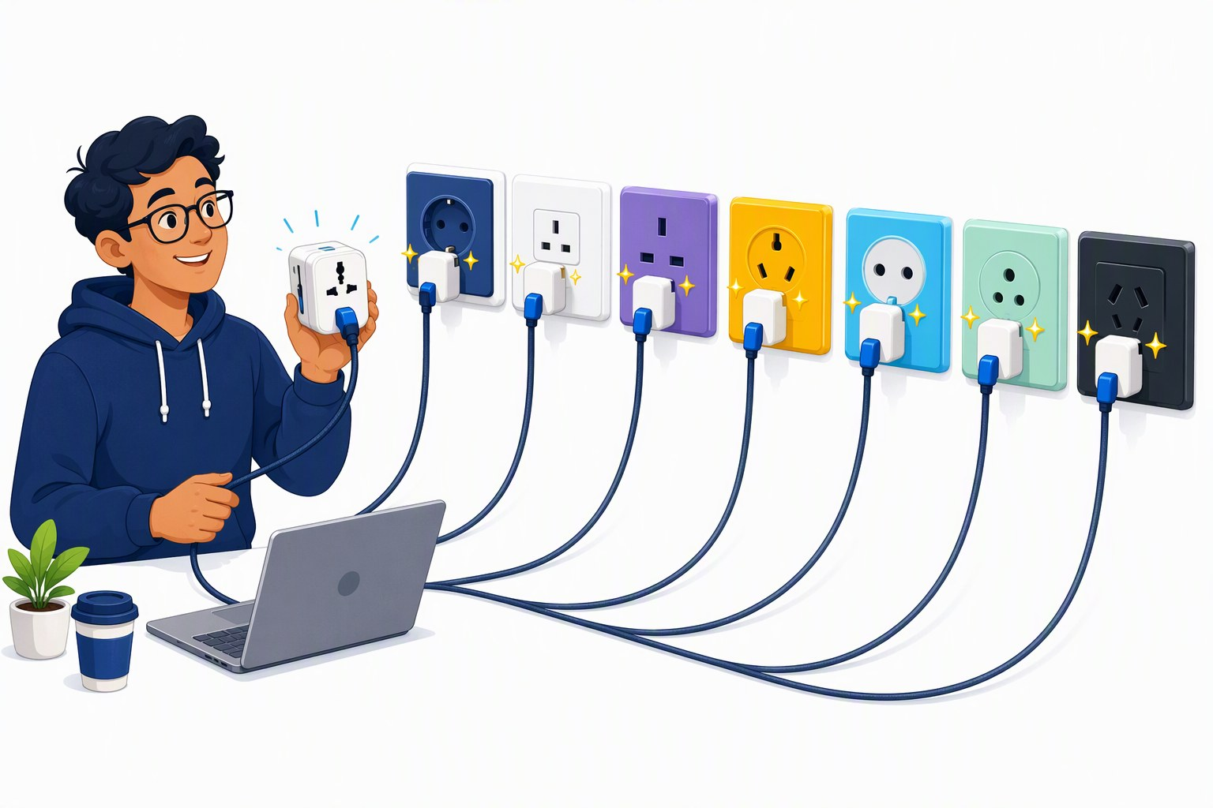
Demo: one script, five providers
DEMO · SEGMENT 1
LIVE DEMO
1. labs/01-hello-model/python/05_same_code_other_model.py against gpt-5-mini (workshop gateway)
2. GENAI_MODEL_2 = DeepSeek-V3.2, then grok-4.1-fast, then Kimi-K2.6 — same key, same URL
3. local: gemma4:e4b on Ollama — no key, no network
4. compare style, latency, token counts and tool-calling habits
Same prompt, same code — only the model and the URL change.
IF IT BREAKS
a recorded terminal run of the same script
live on the instructor laptop
you watch — the lab comes later
Sources: Lab 1 code (tested 2026-09-22) · Foundry provisioning plan 2026-09-19 · Model catalog §10 (checked 2026-09-21)
Notes:
[S1-D2]
Five minutes, the thesis of the day in one script. Run 05_same_code_other_model.py: it sends one prompt and one tool round-trip to every target it finds in labs/.env. Start with gpt-5-mini on the gateway, then set GENAI_MODEL_2 to DeepSeek-V3.2, grok-4.1-fast and Kimi-K2.6 — the same key and URL, different vendors, all sold by Azure — and finally Ollama with gemma4:e4b on this laptop. Read the output together: answer style, latency, token counts, whether the model called the tool. Independence means making this switch in one line — and knowing what you gain or lose.
VERIFY: exact deployment names on the day — the slides say grok-4.1-fast (model catalog §10, deck-wide decision), while the provisioning plan §3 and labs/.env.example still say grok-4-fast; also the Kimi-K2.6 format string (provisioning plan go/no-go list). gemma4:e4b is a 9.6 GB pull — pre-pull it. VERIFY: record the fallback terminal run in the dry run.
Timing: ~5 min.
Sources: labs/01-hello-model · 01_Foundry_Provisioning_Plan.md · 05_Model_Catalog_2026-09.md

Slide 50
Generate, compare or decide? Not every question needs an LLM
SEGMENT 1 · FOUNDATIONS
Three model classes, three kinds of question — use the cheapest that does the job.
GENERATE
COMPARE
DECIDE
LLM
embedding model
decision model
text in → new text out
two texts → one similarity
state + questions → typed, calibrated choices
For: writing, summaries, tool calls, agents
E.g.: gpt-5-mini, DeepSeek, Gemma
For: search, dedup, relevance filters
E.g.: BGE-M3, text-embedding-3-large
For: routers, guardrails, triage
E.g.: Jev (API only, waitlist) · open clones · logprobs of a local LLM
Teaser for Segment 2: a router or a relevance filter needs a decision, not a paragraph.
Sources: Model catalog §4 (checked 2026-09-21) · Jev / System One note 2026-09-21 · TypeSafe AI, Introducing Jev
Notes:
[S1-34]
Not every question needs a generator. Generate: an LLM writes new text — you pay per output token. Compare: an embedding model turns two texts into vectors and a similarity; a threshold makes it a yes/no. Decide: a new class since this month — TypeSafe AI’s Jev (launched 2026-09-15/18, API only with a waitlist) takes a state plus questions and returns typed choices with calibrated probabilities; open replications appeared within days, and the do-it-yourself version is reading the logprobs of any local model. The vendor’s speed and cost claims are vendor-run evals — say “TypeSafe reports”. Segment 2 uses this for routers and relevance filters.
New slide: catalog §4 and research/2026-09-21_jev-system-one-models.md.
Timing: ~1 min.
Sources: 05_Model_Catalog_2026-09.md · research/2026-09-21_jev-system-one-models.md · https://typesafe.ai/blog/introducing-system-one-models-and-jev

Slide 51

Hallucination is miscalibration, not lying
SEGMENT 1 · FOUNDATIONS
Every token is sampled from a distribution. The honest question: how well does the model’s confidence match reality?
Benchmarks reward guessing over “I don’t know” (OpenAI, 2025)
Errors compound — each token can drift off the right path
Models often do know — a “known entity” feature can wrongly switch off the default “can’t answer” (Anthropic)
pre-trained
accuracy →
after RLHF
confidence →
schematic after the GPT-4 technical report
Fix the incentives, not the vocabulary: reward “I don’t know”, ground the answer, check it.
Sources: LLM 101 deck (Day of Data 2026) · OpenAI 2025, Why LMs hallucinate · Anthropic, circuit tracing · GPT-4 report (2303.08774)
Notes:
[S1-35]
Hallucination is not lying: every token is sampled, and the real question is whether the model’s confidence is calibrated. OpenAI’s September 2025 paper argues hallucinations persist because benchmarks score a confident guess above an honest “I don’t know”; errors also compound over long outputs. Anthropic’s circuit tracing found models often do know — a “known entity” feature suppressing the default “can’t answer” circuit is the hallucination. The plot is a schematic: post-training for helpfulness tends to flatten calibration compared with the pre-trained model. Reasoning models add a new surface — they can fabricate their reasoning (Transluce on o3).
Ported from LLM 101 slide 62. VERIFY: the calibration figure (pre-trained vs post-trained) in the GPT-4 technical report, arXiv 2303.08774 — confirm the figure before showing the schematic as “after the report”.
Timing: ~1 min.
Sources: LLM_101_100.pptx (DayOfData2026/LLM_101) — text in ref/llm101/slides.md · https://openai.com/index/why-language-models-hallucinate · https://anthropic.com/research/tracing-thoughts-language-model · https://transluce.org/investigating-o3-truthfulness · https://arxiv.org/abs/2303.08774

Slide 52
Mitigations that actually move the number
SEGMENT 1 · FOUNDATIONS
No single fix works — stack two or three and a confident lie turns into “I don’t know”.
Grounding (Segment 2)
necessary, not sufficient
MYTHS TO RETIRE
Structured output
no room for invented prose
temperature 0 fixes it · RAG eliminates it · bigger is immune · reasoning models don’t hallucinate — all false
Tools as ground truth
calculators, code, search instead of guesses
Verify, then revise
quote-back, Chain-of-Verification
CLAUDE OPUS 4.8
GPT-5.5
~36 %
vs
~86 %
Allow abstention
“Not in the documents.” (Lab 2’s prompt)
hallucination rate, AA-Omniscience
May 2026 · previous generation
Model choice is a mitigation too — pick it with your own eval, not the brochure.
Sources: LLM 101 deck (Day of Data 2026) · Chain-of-Verification (arXiv 2309.11495) · Artificial Analysis, AA-Omniscience
Notes:
[S1-36]
What moves the number: grounding with retrieval (necessary, not sufficient — bad retrieval hallucinates with citations), structured output, tools as ground truth, and verification loops such as quote-back or Chain-of-Verification. Explicitly allow abstention: Lab 2’s prompt tells the model to answer “Not in the documents.” Retire the myths — temperature 0 does not fix it, RAG does not eliminate it, bigger is not immune, reasoning models hallucinate too. Model choice is itself a mitigation: on AA-Omniscience (numbers from May 2026, quoted in LLM 101 in June) Claude Opus 4.8 hallucinated about 36 % against GPT-5.5’s 86 %. Both are a generation behind the frontier table — the spread is the point, so pick with your own eval.
Ported from LLM 101 slide 64; “temperature 0 is not one of them” from the plan row. The 35.9 % / 86 % pair is confirmed by CodingFleet (2026-05-29); the AA-Omniscience page shows no rates for the newer models yet (fact-check 2026-09-23). VERIFY: re-check AA-Omniscience for current models before the event.
Timing: ~1 min.
Sources: LLM_101_100.pptx (DayOfData2026/LLM_101) — text in ref/llm101/slides.md · https://arxiv.org/abs/2309.11495 · https://platform.claude.com/docs/en/test-and-evaluate/strengthen-guardrails/reduce-hallucinations · https://artificialanalysis.ai/evaluations/omniscience · https://codingfleet.com/blog/ai-model-hallucination-rates-2026/ · labs/02-rag-mcp

Slide 53
Lab 1 — Hello, model
HANDS-ON LAB · SEGMENT 1
YOUR TURN
1. 01_hello — first call → an answer plus a usage line
2. 02_knobs — temperature vs reasoning_effort → gpt-5-mini rejects temperature
3. 03_structured — TODO 1: the Session type → a typed object
4. 04_tool_loop — TODO 2: the loop by hand → 19 °C and °F
5. 05_same_code_other_model → at least two targets answer
Call a model from code, feel the knobs, get typed output, write the tool loop by hand — then run the same code on another vendor and on your laptop.
CHECKPOINT
step 4 answers with 19 °C and °F — and in step 5 the same code answers from a second target
Code: labs/01-hello-model
Fallback: Ollama or the instructor mock
STRETCH
WATCH FOR
a small local model explains “crypto tokens” → name the domain in the system prompt
some models call get_weather and to_fahrenheit in one turn → try parallel_tool_calls=False
06_responses_api · TS: 07_ai_sdk_agent (ToolLoopAgent) · steps 1–4 offline on Ollama
Sources: Lab 1 code (tested 2026-09-22)
Notes:
[S1-L1]
Thirty minutes, fifteen of them core. Python, C# and TypeScript folders have the same steps; starters stop at TODO 1 (the Session type for structured output) and TODO 2 (the tool loop). Everyone should reach step 5 by minute 20 — if TODO 2 is not done, run the solution file: the point of step 5 is identical code against a second vendor (GENAI_MODEL_2) and Ollama. Watch-fors from the README: small local models explain “crypto tokens” unless the system prompt names the domain; gpt-5-mini rejects temperature; some models call get_weather and to_fahrenheit in the same turn (try parallel_tool_calls=False). No key yet or endpoint down: GENAI_BASE_URL=http://localhost:11434/v1 with qwen3.5:4b, or the instructor mock.
Step numbers match labs/01-hello-model/README.md (file prefix = step). Suggested pacing (not in the README): steps 1–4 = core 15; step 5 by minute 20; stretch after that.
Timing: ~30 min.
Sources: labs/01-hello-model

Slide 54
Three things to keep from Segment 1
SEGMENT 1 · FOUNDATIONS
1
2
3
A NEXT-TOKEN MACHINE
FOUR BUILDING BLOCKS
A base_url AWAY
An LLM predicts one token at a time; system prompt, tools, retrieval and memory are scaffolding around it.
Messages, sampling knobs, structured output and the tool-call loop are the API you need.
The same code ran on Foundry, another vendor and a local model — only the settings changed.
NEXT · SEGMENT 2
Integrating AI — the context window is the product
Sources: Narrative plan v001
Notes:
[E-01-S1]
Recap of Segment 1 (Foundations — concepts & APIs) in three sentences — read the cards, no new content.
Arc of the segment: From a bag of words to a callable function. The lab (Lab 1 — Hello, model) is where each card became code.
Bridge: next is Segment 2 — Integrating AI — context, tools, standards; its motto: The context window is the product.
Sources: Narrative plan v001 — 06_Narrative_Plan_v001.md

Slide 55
Thank you
daenet — an ACP Digital company
CONTACT · E-MAIL · QR — to be added
Every source of today: appendix A-01 (References).
Building Stuff with GenAI · the open-minded workshop beyond OpenAI
Notes:
[E-04]
Thank you. Point to the references appendix (A-01): every fact slide of the day is listed there with its URL and the date it was checked.
Remind people that the workshop keys are switched off after the event; the labs keep running on Ollama or the offline mock.
VERIFY: contact / QR — speaker name, e-mail and QR code are not in the sources yet (LLM 101 slide 141 has the contact pattern to reuse).
Sources: Narrative plan v001 — 06_Narrative_Plan_v001.md · labs/00-setup/SETUP.md

Slide 56
Appendix
IN THIS APPENDIX
A-01 References
A-02 LLM 101 history (cut)
BUILDING STUFF WITH GENAI
Reference slides — not presented
Facts as of 2026-09-21 · built 2026-09-23
Notes:
[A-00]
Appendix: reference slides for after the day, not presented.
A-01 lists every source cited in this deck (generated from refs.py; only the keys this deck actually cites). The catalog tables are generated from 05_Model_Catalog_2026-09.md at build time — numbers are never typed into the deck.
Sources: Narrative plan v001 — 06_Narrative_Plan_v001.md

Slide 57
Every source cited in this deck (1/5)
APPENDIX · SOURCES
Source | Link | Checked | Used on
Workshop plan v001 | 00_Workshop_Plan.md | 2026‑09‑22 | F-03, F-04
labs/README.md | labs/README.md | 2026‑09‑23 | F-04, F-07, F-08
labs/.env.example | labs/.env.example | 2026‑09‑23 | F-05
labs/00-setup/SETUP.md | labs/00-setup/SETUP.md | 2026‑09‑23 | F-05, F-08
Gateway policy attendee-policy.xml | infra/policies/attendee-policy.xml | 2026‑09‑19 | F-05, F-05b
Foundry provisioning plan | 01_Foundry_Provisioning_Plan.md | 2026‑09‑19 | F-05b, S1-D2
APIM llm-token-limit policy | learn.microsoft.com/en-us/azure/api-manag…ken-limit-policy | 2026‑09‑19 | F-05b, S1-D3
LLM 101 deck (Day of Data 2026) | LLM_101_100.pptx (DayOfData2026/LLM_101) …llm101/slides.md | 2026‑06 | F-06, F-06b, S1‑01 +31
Narrative plan v001 | 06_Narrative_Plan_v001.md | 2026‑09‑22 | F-06, F-06b, E-01-S1
Model catalog §0 (checked 2026‑09‑21) | 05_Model_Catalog_2026‑09.md | 2026‑09‑21 | F-07
Snippet verification 2026‑09‑22 | research/2026‑09‑22_framework-snippet-verification.md | 2026‑09‑22 | F-07, S1‑20, S1‑27 +2
genai-landscape-research skill | skills/genai-landscape-research/SKILL.md | 2026‑09‑19 | F-07
check_env.py / .cs / .mjs | labs/00-setup/check_env.py | 2026‑09‑23 | F-08
mock_openai_server.py | labs/00-setup/mock/mock_openai_server.py | 2026‑09‑23 | F-08
Transformer Explainer (Polo Club) | poloclub.github.io/transformer-explainer | 2026‑06 | S1‑05a, S1‑05b, S1‑05, S1-D1
Notes:
[A-01a]
Generated from refs.py (merged REFS of all deck modules) — only the sources this deck cites, in the order of their first use; "Used on" lists slide ids. Links are clickable in the file and the PDF; the full list with every URL is 07_References_v001.md (refs.write_markdown).
Full URLs on this page: Workshop plan v001 — 00_Workshop_Plan.md · labs/README.md · labs/.env.example · labs/00-setup/SETUP.md · Gateway policy attendee-policy.xml — infra/policies/attendee-policy.xml · Foundry provisioning plan — 01_Foundry_Provisioning_Plan.md · APIM llm-token-limit policy — https://learn.microsoft.com/en-us/azure/api-management/llm-token-limit-policy · LLM 101 deck (Day of Data 2026) — LLM_101_100.pptx (DayOfData2026/LLM_101) — text in ref/llm101/slides.md · Narrative plan v001 — 06_Narrative_Plan_v001.md · Model catalog §0 (checked 2026-09-21) — 05_Model_Catalog_2026-09.md · Snippet verification 2026-09-22 — research/2026-09-22_framework-snippet-verification.md · genai-landscape-research skill — skills/genai-landscape-research/SKILL.md · check_env.py / .cs / .mjs — labs/00-setup/check_env.py · mock_openai_server.py — labs/00-setup/mock/mock_openai_server.py · Transformer Explainer (Polo Club) — https://poloclub.github.io/transformer-explainer

Slide 58
Every source cited in this deck (2/5)
APPENDIX · SOURCES
Source | Link | Checked | Used on
Transformer Explainer source (GitHub) | github.com/poloclub/transformer-explainer | 2026‑09‑23 | S1‑05a
LLM visualisation (bbycroft.net) | bbycroft.net/llm | 2026‑06 | S1‑05b, S1‑06
LLM-Viewer | llm-viewer.com | 2026‑09‑23 | S1‑05b
bertviz | github.com/jessevig/bertviz | 2026‑06 | S1‑05b
tiktokenizer | tiktokenizer.vercel.app | 2026‑06 | S1‑05b, S1‑03, S1-D1
GPT-3 paper (arXiv 2005.14165) | arxiv.org/pdf/2005.14165 | 2026‑06 | S1‑01, S1‑09, S1‑10, S1‑24
OpenAI, InstructGPT (2022) | openai.com/index/instruction-following | 2026‑06 | S1‑01, S1‑11
Epoch AI model database | epoch.ai/data/ai-models | 2026‑06 | S1‑01
Foundry access research 2026‑09‑19 | research/2026‑09‑19_foundry-access-for-workshop.md | 2026‑09‑19 | S1‑03, S1‑22, S1‑32
TensorFlow Embedding Projector | projector.tensorflow.org | 2026‑06 | S1‑04, A-02a
Vaswani et al. 2017, Attention Is All You Need | arxiv.org/abs/1706.03762 | 2026‑09‑23 | S1‑05, S1‑06, S1‑07, A-02a
BERT paper (arXiv 1810.04805) | arxiv.org/abs/1810.04805 | 2026‑06 | S1‑07
Raschka, The Big LLM Architecture Comparison | magazine.sebastianraschka.com/p/the-big-l…cture-comparison | 2026‑06 | S1‑08
OpenAI, Better language models (GPT-2) | openai.com/index/better-language-models | 2026‑06 | S1‑09
Notes:
[A-01b]
Generated from refs.py (merged REFS of all deck modules) — only the sources this deck cites, in the order of their first use; "Used on" lists slide ids. Links are clickable in the file and the PDF; the full list with every URL is 07_References_v001.md (refs.write_markdown).
Full URLs on this page: Transformer Explainer source (GitHub) — https://github.com/poloclub/transformer-explainer · LLM visualisation (bbycroft.net) — https://bbycroft.net/llm · LLM-Viewer — http://llm-viewer.com · bertviz — https://github.com/jessevig/bertviz · tiktokenizer — https://tiktokenizer.vercel.app · GPT-3 paper (arXiv 2005.14165) — https://arxiv.org/pdf/2005.14165 · OpenAI, InstructGPT (2022) — https://openai.com/index/instruction-following · Epoch AI model database — https://epoch.ai/data/ai-models · Foundry access research 2026-09-19 — research/2026-09-19_foundry-access-for-workshop.md · TensorFlow Embedding Projector — https://projector.tensorflow.org · Vaswani et al. 2017, Attention Is All You Need — https://arxiv.org/abs/1706.03762 · BERT paper (arXiv 1810.04805) — https://arxiv.org/abs/1810.04805 · Raschka, The Big LLM Architecture Comparison — https://magazine.sebastianraschka.com/p/the-big-llm-architecture-comparison · OpenAI, Better language models (GPT-2) — https://openai.com/index/better-language-models

Slide 59
Every source cited in this deck (3/5)
APPENDIX · SOURCES
Source | Link | Checked | Used on
Chinchilla paper (arXiv 2203.15556) | arxiv.org/abs/2203.15556 | 2026‑06 | S1‑10
OpenAI, Introducing ChatGPT (2022) | openai.com/index/chatgpt | 2026‑06 | S1‑12
Hugging Face TRL docs | huggingface.co/docs/trl | 2026‑06 | S1‑13
DAPO paper (arXiv 2503.14476) | arxiv.org/abs/2503.14476 | 2026‑06 | S1‑13
DeepSeek-R1 (arXiv 2501.12948) | arxiv.org/abs/2501.12948 | 2026‑06 | S1‑13
Beyond the Slop (daenet, Jul 2026) | research/beyond_the_slop/Beyond_the_Slop_…6_slide_text.txt | 2026‑07‑14 | S1‑14, S1‑15
Lab 1 code (tested 2026‑09‑22) | labs/01-hello-model | 2026‑09‑22 | S1‑14, S1-D3, S1‑25 +5
DeepSeek-V3 (arXiv 2412.19437) | arxiv.org/abs/2412.19437 | 2026‑06 | S1‑16, S1‑18
Model catalog §2 (checked 2026‑09‑21) | 05_Model_Catalog_2026‑09.md | 2026‑09‑21 | S1‑16, S1‑17, S1‑18 +2
Raschka, LLM architecture gallery (MLA) | sebastianraschka.com/llm-architecture-gallery/mla | 2026‑06 | S1‑17
Inception Labs (Mercury) | inceptionlabs.ai | 2026‑06 | S1‑19
arXiv 2506.17298 | arxiv.org/abs/2506.17298 | 2026‑06 | S1‑19
Google DeepMind, Gemini Diffusion | deepmind.google/models/gemini-diffusion | 2026‑06 | S1‑19, A-02c
OpenAI 2024, Learning to reason (o1) | openai.com/index/learning-to-reason-with-llms | 2026‑06 | S1‑20
Notes:
[A-01c]
Generated from refs.py (merged REFS of all deck modules) — only the sources this deck cites, in the order of their first use; "Used on" lists slide ids. Links are clickable in the file and the PDF; the full list with every URL is 07_References_v001.md (refs.write_markdown).
Full URLs on this page: Chinchilla paper (arXiv 2203.15556) — https://arxiv.org/abs/2203.15556 · OpenAI, Introducing ChatGPT (2022) — https://openai.com/index/chatgpt · Hugging Face TRL docs — https://huggingface.co/docs/trl · DAPO paper (arXiv 2503.14476) — https://arxiv.org/abs/2503.14476 · DeepSeek-R1 (arXiv 2501.12948) — https://arxiv.org/abs/2501.12948 · Beyond the Slop (daenet, Jul 2026) — research/beyond_the_slop/Beyond_the_Slop_GenAI_2026_slide_text.txt · Lab 1 code (tested 2026-09-22) — labs/01-hello-model · DeepSeek-V3 (arXiv 2412.19437) — https://arxiv.org/abs/2412.19437 · Model catalog §2 (checked 2026-09-21) — 05_Model_Catalog_2026-09.md · Raschka, LLM architecture gallery (MLA) — https://sebastianraschka.com/llm-architecture-gallery/mla · Inception Labs (Mercury) — https://www.inceptionlabs.ai · arXiv 2506.17298 — https://arxiv.org/abs/2506.17298 · Google DeepMind, Gemini Diffusion — https://deepmind.google/models/gemini-diffusion · OpenAI 2024, Learning to reason (o1) — https://openai.com/index/learning-to-reason-with-llms

Slide 60
Every source cited in this deck (4/5)
APPENDIX · SOURCES
Source | Link | Checked | Used on
Model catalog §1 (checked 2026‑09‑21) | 05_Model_Catalog_2026‑09.md | 2026‑09‑21 | S1‑21
Artificial Analysis | artificialanalysis.ai | 2026‑09‑21 | S1‑21, S1‑23
OpenAI, Introducing GPT-5 | openai.com/index/introducing-gpt-5 | 2026‑06 | S1‑22
LiveBench | livebench.ai | 2026‑06 | S1‑23
Lab 2 code (tested 2026‑09‑22) | labs/02-rag-mcp | 2026‑09‑22 | S1‑25
Verified snippets 2026‑09‑22 | labs/_verified_snippets | 2026‑09‑22 | S1‑27, S1‑29, S1‑30, S1‑33
Foundry deployment types | learn.microsoft.com/en-us/azure/foundry/f…deployment-types | 2026‑09‑19 | S1‑30
OpenAI prompt caching guide | developers.openai.com/api/docs/guides/prompt-caching | 2026‑09‑23 | S1‑30
Framework landscape 2026‑09‑19 | research/2026‑09‑19_framework-landscape.md | 2026‑09‑19 | S1‑31, S1‑33
OpenAI API deprecations | developers.openai.com/api/docs/deprecations | 2026‑09‑19 | S1‑31
Foundry SDK overview (endpoints) | learn.microsoft.com/en-us/azure/foundry/h…lop/sdk-overview | 2026‑09‑19 | S1‑32
OpenRouter docs | openrouter.ai/docs/quickstart | 2026‑09‑23 | S1‑32
LangChain v1 release notes | docs.langchain.com/oss/python/releases/langchain-v1 | 2026‑09‑19 | S1‑33
Vercel, AI SDK 7 | vercel.com/blog/ai-sdk-7 | 2026‑09‑19 | S1‑33
Notes:
[A-01d]
Generated from refs.py (merged REFS of all deck modules) — only the sources this deck cites, in the order of their first use; "Used on" lists slide ids. Links are clickable in the file and the PDF; the full list with every URL is 07_References_v001.md (refs.write_markdown).
Full URLs on this page: Model catalog §1 (checked 2026-09-21) — 05_Model_Catalog_2026-09.md · Artificial Analysis — https://artificialanalysis.ai · OpenAI, Introducing GPT-5 — https://openai.com/index/introducing-gpt-5 · LiveBench — https://livebench.ai · Lab 2 code (tested 2026-09-22) — labs/02-rag-mcp · Verified snippets 2026-09-22 — labs/_verified_snippets · Foundry deployment types — https://learn.microsoft.com/en-us/azure/foundry/foundry-models/concepts/deployment-types · OpenAI prompt caching guide — https://developers.openai.com/api/docs/guides/prompt-caching · Framework landscape 2026-09-19 — research/2026-09-19_framework-landscape.md · OpenAI API deprecations — https://developers.openai.com/api/docs/deprecations · Foundry SDK overview (endpoints) — https://learn.microsoft.com/en-us/azure/foundry/how-to/develop/sdk-overview · OpenRouter docs — https://openrouter.ai/docs/quickstart · LangChain v1 release notes — https://docs.langchain.com/oss/python/releases/langchain-v1 · Vercel, AI SDK 7 — https://vercel.com/blog/ai-sdk-7

Slide 61
Every source cited in this deck (5/5)
APPENDIX · SOURCES
Source | Link | Checked | Used on
Model catalog §10 (checked 2026‑09‑21) | 05_Model_Catalog_2026‑09.md | 2026‑09‑21 | S1-D2
Model catalog §4 (checked 2026‑09‑21) | 05_Model_Catalog_2026‑09.md | 2026‑09‑21 | S1‑34
Jev / System One note 2026‑09‑21 | research/2026‑09‑21_jev-system-one-models.md | 2026‑09‑21 | S1‑34
TypeSafe AI, Introducing Jev | typesafe.ai/blog/introducing-system-one-models-and-jev | 2026‑09‑21 | S1‑34
OpenAI 2025, Why LMs hallucinate | openai.com/index/why-language-models-hallucinate | 2026‑06 | S1‑35
Anthropic, circuit tracing | anthropic.com/research/tracing-thoughts-language-model | 2026‑06 | S1‑35
GPT-4 report (2303.08774) | arxiv.org/abs/2303.08774 | 2026‑06 | S1‑35
Chain-of-Verification (arXiv 2309.11495) | arxiv.org/abs/2309.11495 | 2026‑06 | S1‑36
Artificial Analysis, AA-Omniscience | artificialanalysis.ai/evaluations/omniscience | 2026‑09‑23 | S1‑36
BigScience BLOOM model card | huggingface.co/bigscience/bloom | 2026‑06 | A-02b
Altman at MIT, Apr 2023 (via Wired) | x.com/peterhartree/status/1648423541837299713 | 2026‑09‑23 | A-02b
Anthropic, Golden Gate Claude | anthropic.com/news/golden-gate-claude | 2026‑06 | A-02c
Crooked Timber, Shoggoths amongst us | crookedtimber.org/2023/07/03/shoggoths-amongst-us | 2026‑06 | A-02d
LessWrong, The Waluigi Effect | lesswrong.com/posts/D7PumeYTDPfBTp3i7/the…effect-mega-post | 2026‑06 | A-02d
Notes:
[A-01e]
Generated from refs.py (merged REFS of all deck modules) — only the sources this deck cites, in the order of their first use; "Used on" lists slide ids. Links are clickable in the file and the PDF; the full list with every URL is 07_References_v001.md (refs.write_markdown).
Full URLs on this page: Model catalog §10 (checked 2026-09-21) — 05_Model_Catalog_2026-09.md · Model catalog §4 (checked 2026-09-21) — 05_Model_Catalog_2026-09.md · Jev / System One note 2026-09-21 — research/2026-09-21_jev-system-one-models.md · TypeSafe AI, Introducing Jev — https://typesafe.ai/blog/introducing-system-one-models-and-jev · OpenAI 2025, Why LMs hallucinate — https://openai.com/index/why-language-models-hallucinate · Anthropic, circuit tracing — https://anthropic.com/research/tracing-thoughts-language-model · GPT-4 report (2303.08774) — https://arxiv.org/abs/2303.08774 · Chain-of-Verification (arXiv 2309.11495) — https://arxiv.org/abs/2309.11495 · Artificial Analysis, AA-Omniscience — https://artificialanalysis.ai/evaluations/omniscience · BigScience BLOOM model card — https://huggingface.co/bigscience/bloom · Altman at MIT, Apr 2023 (via Wired) — https://x.com/peterhartree/status/1648423541837299713 · Anthropic, Golden Gate Claude — https://www.anthropic.com/news/golden-gate-claude · Crooked Timber, Shoggoths amongst us — https://crookedtimber.org/2023/07/03/shoggoths-amongst-us · LessWrong, The Waluigi Effect — https://lesswrong.com/posts/D7PumeYTDPfBTp3i7/the-waluigi-effect-mega-post

Slide 62
LLM 101 extra: the 2017–2018 foundations
APPENDIX · LLM 101 REFERENCE
Idea | In one line | Explore
Embeddings have geometry | tokens are points in 768-D to 4096-D space; similar meanings cluster; king − man + woman ≈ queen | projector.tensorflow.org · atlas.nomic.ai · poloclub.github.io/wizmap
Attention Is All You Need | 2017, Vaswani et al. at Google Brain: attention + feed-forward replaced RNN/LSTM; encoder + decoder for translation; multi-head | arxiv.org/abs/1706.03762 · the Annotated Transformer
Tokens, attention, transformers | tokenization turns text into vectors, attention learns the relationships; every token sees every token | platform.openai.com/tokenizer · karpathy.ai/zero-to-hero
Covered in the talk: tokens, embeddings, attention and the transformer block.
Sources: LLM 101 deck, slides 20, 21, 23 · Vaswani et al. 2017, Attention Is All You Need · TensorFlow Embedding Projector
Notes:
[A-02a]
Reference slide, not presented in the talk. It collects LLM 101 slides 20, 21 and 23, cut because S1-03 to S1-06 cover the same ground. Point attendees here for the 2017 paper, the Annotated Transformer and Karpathy’s course.
Sources: LLM_101_100.pptx (DayOfData2026/LLM_101) — text in ref/llm101/slides.md · https://arxiv.org/abs/1706.03762 · https://projector.tensorflow.org · https://atlas.nomic.ai/discover · https://poloclub.github.io/wizmap · https://nlp.seas.harvard.edu/annotated-transformer · https://karpathy.ai/zero-to-hero.html

Slide 63
LLM 101 extra: scale in numbers, 2020–2023
APPENDIX · LLM 101 REFERENCE
Model | Why it mattered | Numbers (as reported)
BLOOM (BigScience) | an open foundation model trained in public: data, method, checkpoints, evaluation — not instruction-tuned | 176 B parameters · 46 languages + 13 programming languages
GPT-3 training | the largest dense language model of its time (2020) | 175 B params · 3.14e23 FLOPs · 10,000 V100 · ~15 days · ≈ $4.6 M · 552 t CO₂
GPT-4 | announced 2023-03-14, multimodal from launch; “Sparks of AGI” paper 8 days later | MoE (leaked, unconfirmed): ~1.8 T total, top-2 routing · 8k / 32k context · est. $50–200 M
“It’s more than that.”
— Sam Altman at MIT (April 2023), asked whether GPT-4 cost $100 M to train
Sources: LLM 101 deck, slides 27, 29, 34–35 · BigScience BLOOM model card · Altman at MIT, Apr 2023 (via Wired)
Notes:
[A-02b]
Reference slide, not presented: LLM 101 slides 27, 29, 34 and 35. GPT-4 architecture numbers are leaks, never confirmed by OpenAI — say “reported” if you use them. The Altman line: LLM 101 quoted it as “much more than $50M–$100M — but we don’t share”; the widely reported exchange (MIT event, April 2023, via Wired) is the shorter “It’s more than that.”, his answer to whether GPT-4 cost $100 M to train. S1-10 and S1-16 carry the story in the talk.
Altman quote corrected after the fact-check of 2026-09-23 (web-checked).
Sources: LLM_101_100.pptx (DayOfData2026/LLM_101) — text in ref/llm101/slides.md · https://huggingface.co/bigscience/bloom · https://arxiv.org/pdf/2005.14165 · https://arxiv.org/abs/2303.12712 · https://research.google/blog/mixture-of-experts-with-expert-choice-routing · https://x.com/peterhartree/status/1648423541837299713

Slide 64
LLM 101 extra: interpretability and diffusion text
APPENDIX · LLM 101 REFERENCE
INTERPRETABILITY
GEMINI DIFFUSION
Sparse autoencoders split activations into human-readable features. Anthropic found features for the Golden Gate Bridge, code bugs and sycophancy in Claude 3 Sonnet; turning one up steers the model — “Golden Gate Claude”.
Google DeepMind’s diffusion text model: all tokens are generated together and refined over passes, instead of one token at a time — like speculative decoding and multi-token prediction, a way past one token per step.
Explore
neuronpedia.org · goodfire.ai/ember · transformer-circuits.pub · anthropic.com/news/golden-gate-claude · deepmind.google/models/gemini-diffusion
Sources: LLM 101 deck, slides 41, 45 · Anthropic, Golden Gate Claude · Google DeepMind, Gemini Diffusion
Notes:
[A-02c]
Reference slide, not presented in the talk. LLM 101 slide 45 covered interpretability (sparse autoencoders, Golden Gate Claude); slide 41 showed Gemini Diffusion with a video example that stays in the LLM 101 folder. S1-19 carries the diffusion-LM idea in the talk (it is a trim slide in the 75-minute cut).
Sources: LLM_101_100.pptx (DayOfData2026/LLM_101) — text in ref/llm101/slides.md · https://www.anthropic.com/news/golden-gate-claude · https://neuronpedia.org · https://transformer-circuits.pub · https://deepmind.google/models/gemini-diffusion

Slide 65
LLM 101 extra: live tools and conceptual reading
APPENDIX · LLM 101 REFERENCE
ARCHITECTURE
EMBEDDINGS
INTERPRETABILITY
CONCEPTS
poloclub.github.io/transformer-explainer
bbycroft.net/llm
github.com/hahnyuan/LLM-Viewer
Raschka: the big LLM architecture comparison
projector.tensorflow.org
atlas.nomic.ai/discover
poloclub.github.io/wizmap
github.com/jessevig/bertviz
neuronpedia.org
goodfire.ai/ember
transformer-circuits.pub
The Shoggoth: RLHF as a friendly mask on a strange base model
Goodbye Shoggoth: the Stage
The Waluigi Effect
The concept pieces are attempts to make sense of LLMs, not accepted truth.
Sources: LLM 101 deck, slides 46, 48–50 · Crooked Timber, Shoggoths amongst us · LessWrong, The Waluigi Effect
Notes:
[A-02d]
Reference slide, not presented in the talk. It merges LLM 101 slide 46 (every live tool) with slides 48–50: the Shoggoth metaphor and its reading list (Alignment Forum “Goodbye Shoggoth, the Stage”, LessWrong “Why assume there’s a Shoggoth?” and “The Waluigi Effect”). The concept pieces are attempts to make sense of LLMs, not accepted truth — say so if you ever show it (LLM 101 slide 50 says the same).
Sources: LLM_101_100.pptx (DayOfData2026/LLM_101) — text in ref/llm101/slides.md · https://poloclub.github.io/transformer-explainer · https://bbycroft.net/llm · https://github.com/jessevig/bertviz · https://crookedtimber.org/2023/07/03/shoggoths-amongst-us · https://lesswrong.com/posts/D7PumeYTDPfBTp3i7/the-waluigi-effect-mega-post

