Slide 1

Building Stuff with GenAI
Segment 4 — Local AI, media & beyond the West
Slot machine → instrument
daenet — an ACP Digital company · 2026
Notes:
[F-01-S4]
Segment deck 4 of 4 of Building Stuff with GenAI — Local AI, media & beyond the West — local AI, media generation, and AI beyond the Western corporate world.
Motto of the segment: Slot machine → instrument. Planned: 90 min · talk 35′ · demos 25′ · Lab 4 25′.
The day deck (BuildingStuffGenAI_001) carries the full opening; this deck repeats only where we are in the day and the key card.
VERIFY: event, date, speaker — not decided yet (00_Workshop_Plan.md §8 Q1).
Sources: Workshop plan v001 — 00_Workshop_Plan.md · Narrative plan v001 — 06_Narrative_Plan_v001.md

Slide 2
Where we are in the day: Segment 4 of 4
SEGMENT 4 · LOCAL AI, MEDIA & BEYOND THE WEST
YOU ARE HERE
Keys
+ setup
clinic
SEGMENT 1
Foundations
break
SEGMENT 2
Integrating AI
lunch
SEGMENT 3
The world of agents
break
SEGMENT 4
Local AI, media & beyond the West
Close
+ recap
talk
talk
talk
talk
live demos
live demos
live demos
live demos
Lab 1 · hands-on
Lab 2 · hands-on
Lab 3 · hands-on
Lab 4 · hands-on
TODAY’S LAB · CORE + STRETCH
CORE
Core lab — the part everyone finishes
stretch goals keep the fast ones busy
Lab 4 — Local & multimodal, the craft lab
labs/04-local-media
STRETCH
Sources: Workshop plan v001
Notes:
[F-04-S4]
Segment 4: Local AI, media & beyond the West — local AI, media generation, and AI beyond the Western corporate world — 90 min · talk 35′ · demos 25′ · Lab 4 25′.
The lab of this segment is Lab 4 — Local & multimodal, the craft lab (labs/04-local-media); its core takes 15 minutes and everyone finishes it, the stretch goals are for the fast ones.
Times are placeholders until the event date is fixed. VERIFY: final times (00_Workshop_Plan.md §8 Q2).
Sources: Workshop plan v001 — 00_Workshop_Plan.md · Narrative plan v001 — 06_Narrative_Plan_v001.md

Slide 3
Reminder: your key, your endpoint, your fallback
SEGMENT 4 · LOCAL AI, MEDIA & BEYOND THE WEST
labs/.env — FROM YOUR HANDOUT CARD
labs/.env
NO NETWORK? SAME CODE
GENAI_BASE_URL=https://<gateway-from-your-card>/openai/v1
GENAI_API_KEY=<your-personal-key>
GENAI_KEY_HEADER=api-key
GENAI_MODEL=gpt-5-mini
Ollama, model qwen3.5:4b:
GENAI_BASE_URL=http://localhost:11434/v1
— or the instructor’s offline mock.
401 · KEY
403 · QUOTA
429 · TOO FAST
Key missing or wrong — check labs/.env
Today’s quota is used up — ask us
Tokens per minute used up — wait, it resets
Everything in labs/04-local-media reads these settings — nothing else to configure.
Sources: labs/.env.example · labs/00-setup/SETUP.md · Gateway policy attendee-policy.xml
Notes:
[F-05-S4]
Copy labs/.env.example to labs/.env and paste the four lines from your handout card: the gateway URL (ends in /openai/v1), your personal key, the header name api-key, and the default model gpt-5-mini. GENAI_MODEL_2 (default DeepSeek-V3.2) is a second vendor on the same endpoint and key.
The key always travels in an "api-key" header — the gateway requires it (Ollama ignores it). 401 = key missing or mistyped; 403 = your daily token quota is used up; 429 = your per-minute token budget is spent — wait a minute. The gateway policy defines 429 for the rate and 403 for the quota; SETUP.md’s troubleshooting table still lumps both into 429.
No network: the same code runs on Ollama (localhost:11434/v1, qwen3.5:4b, GENAI_REASONING_EFFORT=none) or against the instructor’s offline mock (answers are echoes, every script runs).
VERIFY: gateway URL and key format (handout card still open — nothing provisioned), the QR code to labs/00-setup (repo URL not decided), and the 403-vs-429 wording in SETUP.md (align it with the policy).
Sources: labs/.env.example · labs/00-setup/SETUP.md · Gateway policy attendee-policy.xml — infra/policies/attendee-policy.xml · APIM llm-token-limit policy — https://learn.microsoft.com/en-us/azure/api-management/llm-token-limit-policy · labs/README.md

Slide 4

Local AI, media & beyond the West
SEGMENT 4
Slot machine → instrument
local AI, media generation, and AI beyond the Western corporate world
Talk · live demos · hands-on Lab 4
Notes:
[S4-00]
Segment 4 — 90 minutes: talk 35′, demos 25′, Lab 4 25′. Thesis: slot machine → instrument. The blocks from the morning stay the same; now they run on your own machine and they make pictures, voices and video too.
Order of demos = order of safety: the reliable local LLM demos first, the GPU media demos later.
Sources: 06_Narrative_Plan_v001.md §5; 00_Workshop_Plan.md §3 (S4).

Slide 5
The spine, last pass: the media pipeline — on your machine
SEGMENT 4 · LOCAL AI, MEDIA & BEYOND THE WEST
One block left — the media pipeline — and it all runs on your machine.
tokens
chat API
structured output
tools
MCP / skills
agent loop
workflow
media pipeline
YOUR MACHINE — Ollama · LM Studio · Foundry Local serve the text blocks, ComfyUI runs the media pipeline
THIS SEGMENT
why local
& how
how media
is made
taking
control
the zoo beyond
the big clouds
the pipeline
is the sauce
Notes:
[S4-01]
Callback to the spine from Segment 1: the same eight blocks, lit segment by segment. Segment 4 lights the last one — the media pipeline — and moves the whole spine onto the laptop: the chat blocks through Ollama, LM Studio or Foundry Local, the media blocks through ComfyUI.
Walk the five movements in one breath: why local and how (runners, hardware, quantization) · how an image is made (five stages, four knobs) · taking control (LoRA, ControlNet, IP-Adapter, inpainting) · the zoo beyond the big clouds · the pipeline as the magic sauce. ~30 seconds.
Sources: 06_Narrative_Plan_v001.md §0 (the spine) and §5.

Slide 6
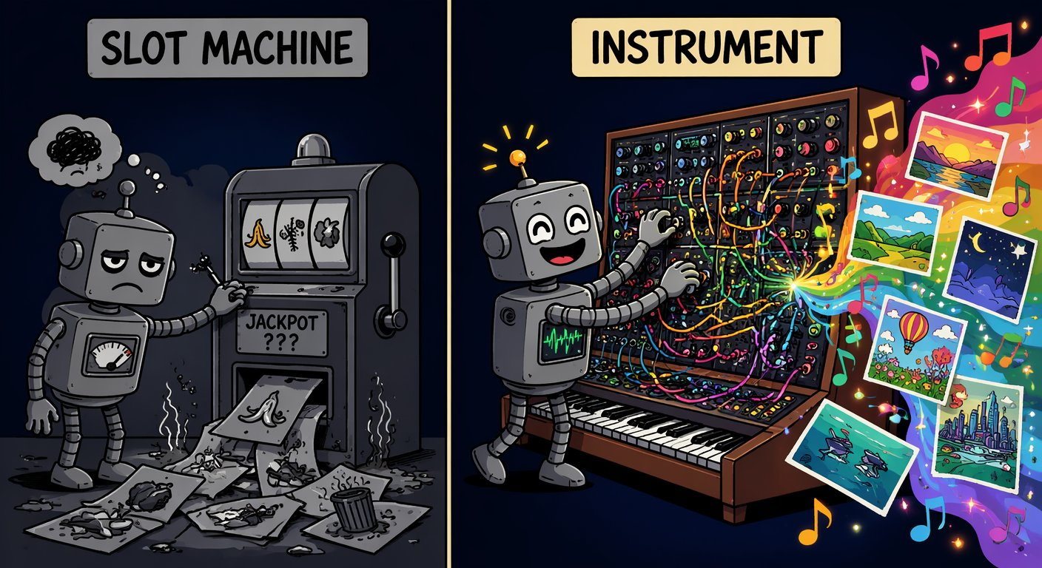
Slot machine or instrument?
SEGMENT 4 · LOCAL AI, MEDIA & BEYOND THE WEST
“Treat a generator like a slot machine and you get slop. Treat it like an instrument — pipeline, knobs, adapters — and you get craft.”
— Andreas Erben, “Beyond the Slop” (2026)
NO SEED
NO CONTROL INPUTS
NO PIPELINE
nothing is reproducible
pose, layout and face are random
every fix is a new gamble
Sources: Beyond the Slop (Jul 2026)
Notes:
[S4-02]
The thesis of the segment, borrowed from “Beyond the Slop”. Most people stop at “nice”: pull the lever, burn credits, hope. The three cards are the symptoms of prompt & pray — no seed, no control inputs, no pipeline.
Today we turn the slot machine into a synthesizer: the knobs (seed, steps, CFG, denoise), the adapters (LoRA, ControlNet, IP-Adapter, inpainting) and a machine you own. Same idea as the whole workshop: the blocks are stable, the models rotate. ~1 minute.
Image: meme_instrument.png (AI-generated, Beyond the Slop). Sources: Beyond the Slop slides 2 and 5 (research/beyond_the_slop/).

Slide 7
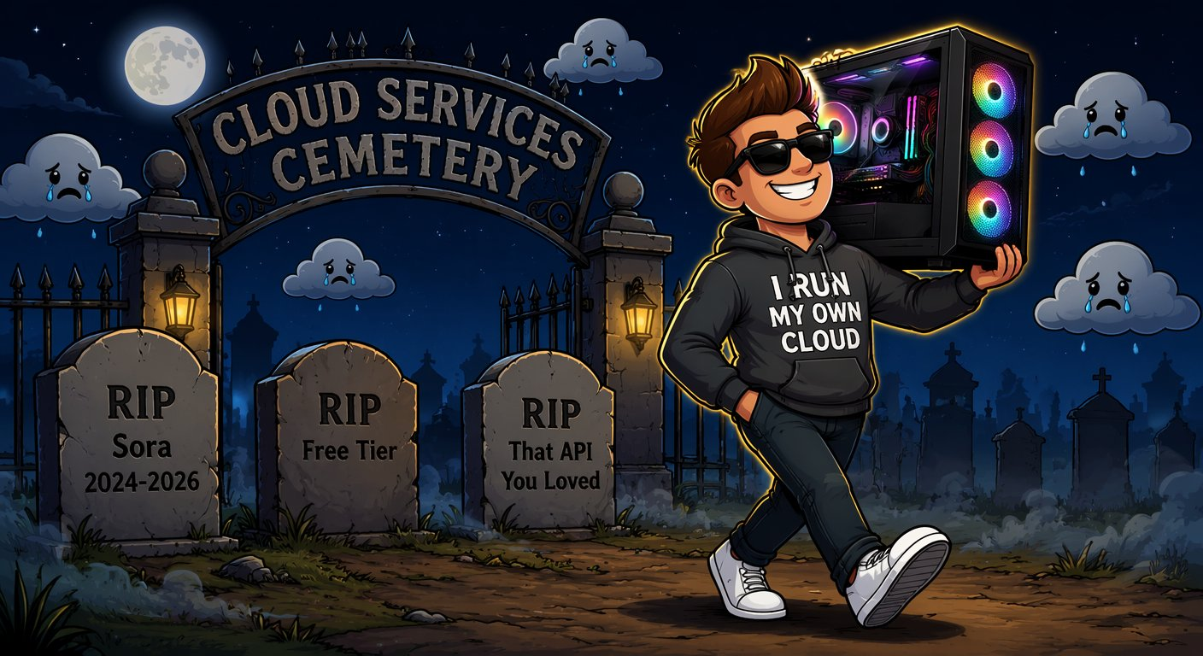
Why local: rug pulls, privacy, cost, control
SEGMENT 4 · LOCAL AI, MEDIA & BEYOND THE WEST
NO RUG PULLS
PRIVACY
Sora: app off since 2026-04-26, API off 2026-09-24. Weights on your disk stay.
Client faces, unreleased products, your voice — some data must not leave the building.
COST
CONTROL
A one-time GPU beats per-call pricing when you iterate hundreds of times.
Every knob is yours — and the licence: MIT/Apache weights vs custom clauses (Kimi K3, GLM‑5.3).
AI-generated · Beyond the Slop
Local is the hedge: nobody can switch it off, reprice it or read along.
Sources: Model catalog §7, §11 (2026-09-21) · Beyond the Slop (Jul 2026) · LLM 101 slide 131
Notes:
[S4-03]
Four reasons, one example each. Rug pull: OpenAI switched off the Sora app on 2026-04-26 and the Sora API on 2026-09-24 — every workflow built on it died with it (Foundry still lists sora-2; that listing is stale). Privacy: client faces, unreleased products, a voice. Cost: iteration — a creative loop is hundreds of calls. Control: every knob of the next 20 minutes, and the licence — GLM-5.3 moved off MIT to a custom licence, Kimi K3 has a branding clause; MIT/Apache weights (DeepSeek, gpt-oss, Gemma 4, Qwen3.8-27B) are yours to run.
Honest counterpoint from LLM 101 (slide 134): APIs still win most production workloads — local is the hedge and the lab bench, not a religion. ~1 minute.
Image: meme_rugpull_safe.png (the logo-free variant of meme_rugpull — no vendor logos in a cemetery).
Sources: 05_Model_Catalog §7/§11 (Sora dates, confirmed via the OpenAI Help Center per research/2026-09-19_beyond-the-slop-integration.md §2); Beyond the Slop slide 33; LLM 101 slide 131.

Slide 8
Six local runners, one contract: an OpenAI-compatible base_url
SEGMENT 4 · LOCAL AI, MEDIA & BEYOND THE WEST
as of 2026-09-21
Runner | Version (Sep 2026) | Runs on | Best for
Ollama | 0.34.3 | CPU · GPU · Apple MLX | easiest start; cloud models as a fallback
LM Studio | 0.4.25 · Bionic 1.1.5 | CPU · GPU · Apple MLX | GUI, model browser, MCP host
Foundry Local | 2.0.1 | best of GPU / NPU, else CPU | managed Windows; no Azure subscription
llama.cpp | 0.4.1 | CPU · GPU (incl. Intel Arc) | the engine under Ollama and LM Studio
vLLM · SGLang | 0.29 · 0.5.20 | GPU servers (CUDA, ROCm) | many users on one GPU server
Docker Model Runner | — | GPU | GA; models as OCI artifacts in Compose
Ollama → localhost:11434/v1 · LM Studio → localhost:1234/v1 · Foundry Local → foundry service status
All of them are a base_url — pick the runner by hardware, your code only sees a URL.
Sources: Model catalog §0, §10 (2026-09-21) · Research: local AI & media (2026-09-19) · LLM 101 slide 133 · Foundry Local docs
Notes:
[S4-04]
Six runners, one contract. Ollama is the lowest-friction start (and can run a cloud model with the same CLI when the laptop is too small). LM Studio is the GUI with a model browser and doubles as an MCP host; its Bionic app adds local agents. Foundry Local is Microsoft’s answer for managed Windows fleets — no Azure subscription; it picks the best execution provider by itself (GPU or NPU when available, CPU as the fallback). llama.cpp is the engine under Ollama and LM Studio; vLLM and SGLang serve many users from a GPU server; Docker Model Runner (GA, no version in our catalog) ships models as OCI artifacts next to your containers.
The point for developers: every one of them exposes an OpenAI-compatible endpoint. Use the Chat Completions client for local runtimes (Ollama 0.34 also serves /v1/responses). Foundry Local picks its port at start-up — `foundry service status`. ~1 minute.
VERIFY: MCP-host support of the other runners is not in our sources — only LM Studio is claimed as an MCP host.
Sources: 05_Model_Catalog §0/§10 (versions); research/2026-09-19_local-ai-media-beyond-west.md §1; https://learn.microsoft.com/en-us/azure/foundry-local/what-is-foundry-local (“selects the best execution provider … accelerates inference on GPUs and NPUs when available and falls back to CPU”, web-checked 2026-09-23 per the fact-check); https://github.com/ollama/ollama/releases · https://lmstudio.ai/docs/app · https://github.com/ggml-org/llama.cpp/releases · https://github.com/vllm-project/vllm/releases · https://github.com/sgl-project/sglang/releases · https://www.docker.com/products/model-runner/ ; research/2026-09-22_framework-snippet-verification.md §3.1 and §6.4; labs/.env.example; labs/04-local-media/README.md.

Slide 9
The same Lab-1 code on Ollama — nothing changes but the env
SEGMENT 4 · LOCAL AI, MEDIA & BEYOND THE WEST
labs/.env · workshop endpoint (handout card)
.ENV
labs/.env · your laptop (Ollama)
.ENV
GENAI_BASE_URL=https://<gateway-from-your-card>/openai/v1
GENAI_API_KEY=<your-personal-key>
GENAI_MODEL=gpt-5-mini
GENAI_REASONING_EFFORT=low
GENAI_BASE_URL=http://localhost:11434/v1
GENAI_API_KEY=ollama
GENAI_MODEL=qwen3.5:4b
GENAI_REASONING_EFFORT=none
01_hello.py (excerpt) · the same file for both
PYTHON
BASE, KEY, MODEL = os.environ["GENAI_BASE_URL"], os.environ["GENAI_API_KEY"], os.environ["GENAI_MODEL"]
HEADERS = {"api-key": KEY} if os.getenv("GENAI_KEY_HEADER", "api-key") == "api-key" else None
client = OpenAI(base_url=BASE, api_key=KEY, default_headers=HEADERS)
EXTRA = {"reasoning_effort": os.environ["GENAI_REASONING_EFFORT"]} if os.getenv("GENAI_REASONING_EFFORT") else {}
THINKING ON · qwen3:1.7b · CPU
GENAI_REASONING_EFFORT=none
41 s
5.6 s
ATTENDEE DEFAULT
→
qwen3.5:4b (3.4 GB) + bge-m3 (1.2 GB); thinking off: GENAI_REASONING_EFFORT=none
one-liner prompt · 336 → 46 tokens · 2 vCPU, no GPU · Ollama 0.34.3 · measured 2026-09-22
Only the env changes — and on a laptop, switch thinking off.
Sources: Framework verification §7 (2026-09-22) · labs/00-setup/SETUP.md · Lab 1 01_hello.py (tested)
Notes:
[S4-05]
The recurring proof of the day: the same file, one env block changed. Left: the handout card values for the workshop gateway. Right: the same four variables pointing at Ollama on the laptop (the setup guide’s test-at-home block). The code reads GENAI_BASE_URL, GENAI_API_KEY and GENAI_MODEL and passes reasoning_effort through when GENAI_REASONING_EFFORT is set.
The measurement that matters on a laptop: a local thinking model spends most of its time thinking. qwen3:1.7b on 2 vCPUs without a GPU needed 41 s and 336 tokens for a one-liner with thinking on, 5.6 s and 46 tokens with reasoning_effort "none" (Ollama honours it on /v1; a think:false body field is ignored). When Ollama is the second model next to the workshop endpoint (Lab 1 step 5, Lab 4), the same switch is OLLAMA_REASONING_EFFORT=none in labs/.env.
Attendee default from the setup guide: qwen3.5:4b (3.4 GB) plus bge-m3 (1.2 GB); gemma4:e4b is a 9.6 GB download. Click path: show labs/.env, run `python 01_hello.py` once against each block if time allows. ~1.5 minutes.
Sources: research/2026-09-22_framework-snippet-verification.md §7; labs/00-setup/SETUP.md §5–6; labs/.env.example; labs/01-hello-model/python/solution/01_hello.py.

Slide 10
Demo: a Qwen3.8-27B tool call on Ollama
DEMO · SEGMENT 4
LIVE DEMO
1. Show ollama ps: Qwen3.8-27B (Q4) pulled and warm
2. Point labs/.env at Ollama: base_url, the Qwen3.8-27B tag, reasoning effort none
3. Run python 04_tool_loop.py: get_weather, then to_fahrenheit
4. Same loop as Segment 1: tool call → your code → answer
5. Show ollama ps again: memory used, GPU/CPU split
The Lab-1 tool loop, unchanged — the model now runs on this laptop.
IF IT BREAKS
live on the instructor laptop
you watch — the lab comes later
A recorded terminal run — or the same loop on qwen3.5:4b
Sources: Model catalog §3 (2026-09-21) · Qwen3.8-27B model card · Research: hardware sizing (2026-09-21)
Notes:
[S4-D1]
Two minutes. Qwen3.8-27B is the strongest 27B dense open model in the catalog (Apache-2.0, ~17 GB at Q4). Pre-pull and pre-warm it before the session — the first call includes loading the model.
What to say while it runs: this is Lab 1 step 4, file unchanged; the checkpoint is an answer that mentions 19 °C and the Fahrenheit value. Local models sometimes guess parallel tool calls (the second argument invented before the first result exists) — if it happens, point it out: that is what the tool-call guards in Segments 2 and 3 are for.
Fallback files: demos/S4-D1/fallback/ (recorded terminal run).
VERIFY: the exact Ollama tag for Qwen3.8-27B; ~17 GB at Q4 does not fit a 16 GB laptop GPU completely — the hardware note sizes the UD-IQ4_XS GGUF at 14 GB (fully in VRAM, est. 25–35 tok/s), otherwise Ollama offloads layers to the CPU and it gets slower.
Sources: 05_Model_Catalog §3; https://huggingface.co/Qwen/Qwen3.8-27B; research/2026-09-21_local-hardware-sizing-chinese-models.md; labs/01-hello-model/python/solution/04_tool_loop.py.

Slide 11
Demo: Foundry Local on the Windows NPU
DEMO · SEGMENT 4
LIVE DEMO
1. Run foundry model run with a small model, e.g. Phi‑4‑mini
2. Show the device it picked: NPU, GPU or CPU
3. Run foundry service status → copy the URL, add /v1
4. Set FOUNDRY_LOCAL_BASE_URL in labs/.env, run 01_local_models.py
5. Open Task Manager: which accelerator is busy?
Microsoft’s local runner picks the best accelerator — GPU or NPU — by itself, and still speaks the OpenAI API.
IF IT BREAKS
live on the instructor laptop
you watch — the lab comes later
Screenshots of the Foundry Local terminal and Task Manager
Sources: Foundry Local docs · Model catalog §10 (2026-09-21) · Lab 4 README
Notes:
[S4-D2]
Two minutes. Foundry Local (2.0.1 in the catalog) runs on Windows, macOS on Apple silicon and Linux, needs no Azure subscription and serves an OpenAI-compatible endpoint (incl. the Responses API format). Microsoft’s docs: it “selects the best execution provider” — it accelerates on GPUs and NPUs when available and falls back to CPU. It picks its port at start-up — `foundry service status` shows it.
Lab 4 step 1 (01_local_models.py) measures time to first token, tokens per second and whether a tool call works — run it against Ollama and Foundry Local side by side. Message: the NPU is for always-on, low-power work; it is not where image generation happens (next slides).
Fallback files: demos/S4-D2/fallback/ (screenshots of the terminal and Task Manager).
VERIFY: the NPU run needs a Copilot+ laptop with an NPU — the instructor laptop (i9-13900HX) has none, so on that machine the demo shows the GPU path (say so); which catalog model has an NPU build (`foundry model list`); the exact CLI syntax on 2.0.1.
Sources: https://learn.microsoft.com/en-us/azure/foundry-local/what-is-foundry-local (updated 2026-08-04); 05_Model_Catalog §3/§10; labs/04-local-media/README.md (step 1).

Slide 12

Hardware in 2026: bandwidth rules, and memory got expensive
SEGMENT 4 · LOCAL AI, MEDIA & BEYOND THE WEST
as of 2026-09-21
Box | Memory · bandwidth | Price band | Sweet spot
RTX 5090 | 32 GB GDDR7 | ~$3–5k | ≈ 30B at Q4
RTX PRO 6000 | 96 GB GDDR7 | $12–17k | ≈ 70B, fast
DGX Spark | 128 GB unified · bandwidth-bound | $4.7k | big MoE, slowly
Strix / Gorgon Halo | 128–192 GB unified · bandwidth-bound | — | big MoE, slowly
Mac Studio M5 Max | up to 128 GB unified · 614 GB/s | from $2.5k | most GB per $
Mac Studio M5 Ultra | up to 512 GB unified · 1.2 TB/s | from $5.5k | the biggest MoE
DRAM CONTRACT PRICES · Q1 2026
Q3 2026 · ON TOP
THE RULE
decode speed ≈ memory bandwidth ÷ model bytes
+90–95 %
→
+58–63 %
Shortage forecast through 2030 — capacity decides if it loads, bandwidth if it’s usable.
Sources: Model catalog §3 (2026-09-21) · Apple Newsroom 2026-08-25 (Mac Studio M5) · Tom's Hardware: DRAM at a 15-year high · LLM 101 slide 132
Notes:
[S4-06]
The one rule: decode speed ≈ memory bandwidth ÷ bytes read per token. Capacity decides whether a model loads; bandwidth decides whether it is usable. That is why a 128 GB unified-memory box (DGX Spark, Strix/Gorgon Halo) loads big MoE models but is bandwidth-bound, while a 32 GB RTX 5090 is fast up to ~30B at Q4. Mac Studio M5 (announced 2026-08-25, shipping since 2026-09-22) is the best capacity per dollar: M5 Max up to 128 GB at 614 GB/s from $2,499, M5 Ultra up to 512 GB at 1.2 TB/s from $5,499 — the 512 GB option ships late October.
The DRAM crunch: contract DRAM +90–95 % in Q1 2026 and another +58–63 % in Q3 (a 15-year high); memory is ~35 % of a PC build (HP); SK hynix expects the shortage through 2030 as capacity moves to HBM. If you plan to buy, buy memory early. For scale: the instructor laptop is an RTX 4090 Laptop (16 GB, ~576 GB/s); a desktop RTX 4090 has 24 GB at ~1,008 GB/s. ~1 minute.
VERIFY: bandwidth figures for RTX 5090, RTX PRO 6000, DGX Spark and Strix/Gorgon Halo (not in our sources, so the table says “GDDR7” / “bandwidth-bound”); a Strix/Gorgon Halo street price (research note: “roughly half the Spark price”, unverified — prices move weekly).
Sources: 05_Model_Catalog §3 (hardware rule); research/2026-09-19_local-ai-media-beyond-west.md §3; https://www.apple.com/newsroom/2026/08/apple-introduces-new-mac-studio-with-m5-max-and-m5-ultra/ ; https://www.tomshardware.com/pc-components/dram/amds-gorgon-halo-pushes-on-device-ai-memory-to-192gb-as-dram-prices-hit-15-year-high ; research/2026-09-21_local-hardware-sizing-chinese-models.md; LLM 101 slide 132 (GDDR7).

Slide 13
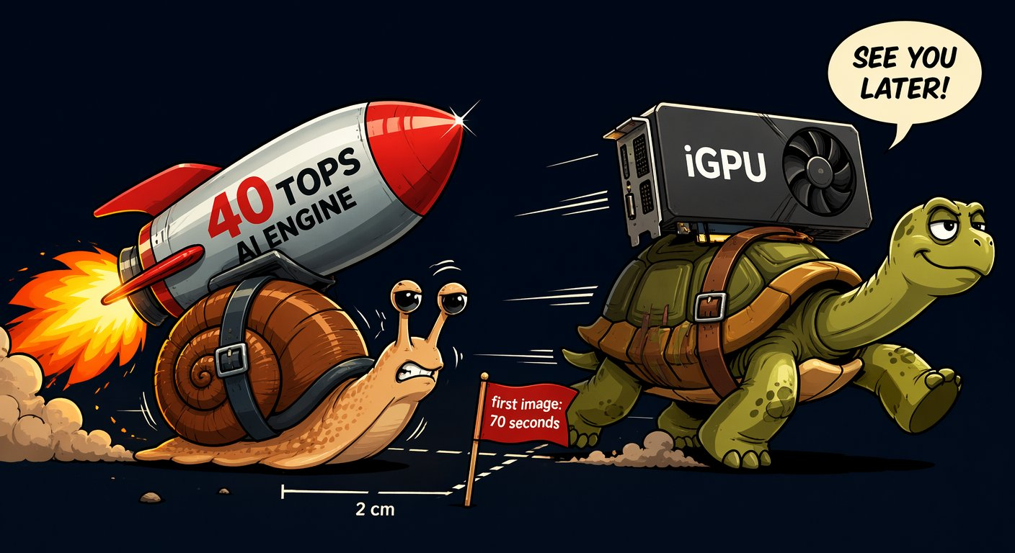
VRAM reality: what a model weighs at FP16, FP8 and 4-bit
SEGMENT 4 · LOCAL AI, MEDIA & BEYOND THE WEST
Size | FP16 | FP8 | Q4 · NF4 | A real download
4 B | ≈ 8 GB | ≈ 4 GB | ≈ 2 GB | qwen3.5:4b — 3.4 GB (Ollama)
27 B | ≈ 54 GB | ≈ 27 GB | ≈ 14 GB | Qwen3.8-27B — ~17 GB at Q4
120 B | ≈ 240 GB | ≈ 120 GB | ≈ 60 GB | Mistral Small 4 (119B) — ~64 GB
weights only: parameters × bits ÷ 8 — real files are a bit bigger
NPU HONESTY
WEIGHTS · 9B AT Q4
KV CACHE · 128K CONTEXT
TOTAL
≈ 5 GB
+
4–5 GB
=
≈ 9–10 GB
LLMs: yes — Foundry Local can run them on an NPU. Images and video: a discrete GPU still wins. Buy TOPS for battery, VRAM for creation.
Budget = weights + KV cache — and the context you need decides the second part.
Sources: Model catalog §3 (2026-09-21) · labs/00-setup/SETUP.md · LLM 101 slide 133 · Beyond the Slop (Jul 2026) · Foundry Local docs
Notes:
[S4-07]
Rule of thumb: weights ≈ parameters × bits ÷ 8. A 27B model is ~54 GB at FP16, ~27 GB at FP8 and ~14 GB at 4 bit; real files are a bit bigger (Qwen3.8-27B is ~17 GB at Q4 in the catalog, 14 GB as an IQ4_XS GGUF). A 120B class model needs ~64 GB even at 4 bit (Mistral Small 4) — that is the 128 GB-box territory from the last slide.
Then the part people forget: the KV cache grows with the context. LLM 101 measured a 9B model at Q4 as ~5 GB of weights plus 4–5 GB of KV cache at 128K tokens — about 9–10 GB together. On a 16 GB GPU a 14 GB model leaves ~2 GB for context.
NPU honesty: NPUs are for always-on, low-power work (transcription, background blur, small assistants). Foundry Local accelerates LLMs on an NPU (or a GPU) when one is available — it picks the best execution provider itself; for image and video generation a discrete GPU still wins. Beyond the Slop measured mid-2026: Ryzen AI NPU ~70 s per SD image vs ~30 s on the iGPU of the same chip — VERIFY before quoting these numbers (not re-measured; the meme shows the 70 s joke). ~1 minute.
Sources: 05_Model_Catalog §3; research/2026-09-21_local-hardware-sizing-chinese-models.md; labs/00-setup/SETUP.md; LLM 101 slide 133 (KV cache); Beyond the Slop slides 37–39; https://learn.microsoft.com/en-us/azure/foundry-local/what-is-foundry-local ; research/2026-09-19_beyond-the-slop-integration.md §2 (NPU).

Slide 14
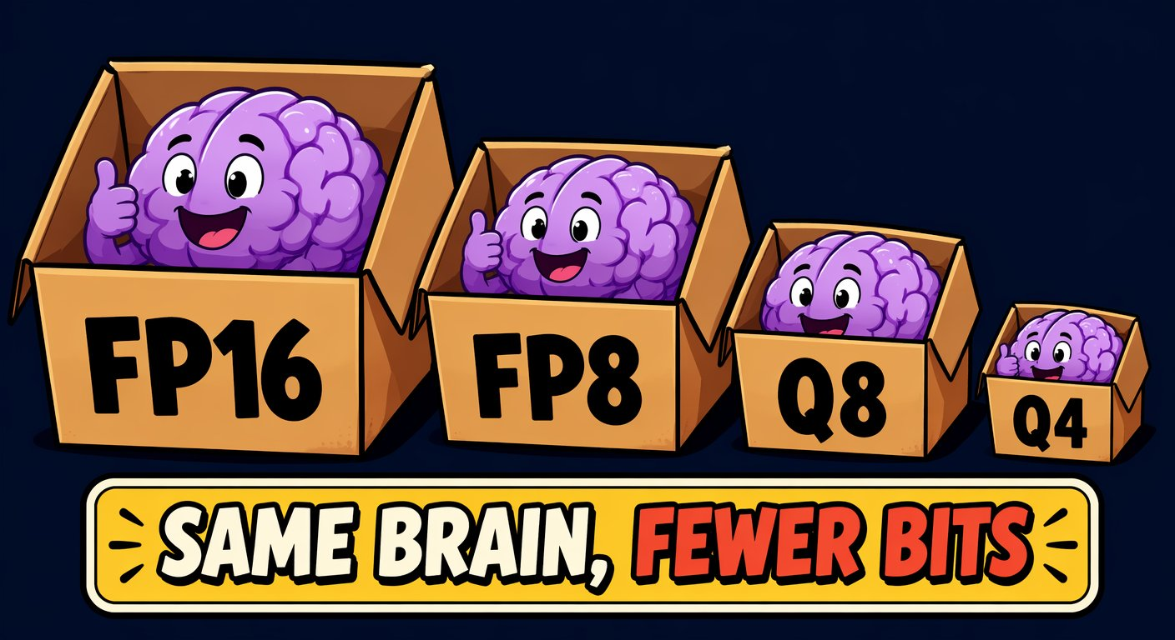
Quantization is compression with a taste
SEGMENT 4 · LOCAL AI, MEDIA & BEYOND THE WEST
GGUF
llama.cpp’s format (Q8 … Q4 … IQ2) — what Ollama and LM Studio load
MXFP4
4-bit float — gpt-oss-20b ships in it, Kimi K3 was trained for it
NVFP4
NVIDIA’s 4-bit float for Blackwell GPUs (FLUX.2 [klein] builds)
NF4
4-bit “normal float” — what QLoRA fine-tunes on
MEMORY VS QUALITY
16-bit
the reference
8-bit
half the memory, near-zero loss — the default move
4-bit
a quarter — minor detail loss, huge reach
2-bit
fits the monster MoE — measure it on your task
Quantize until it fits, not further — Q4 is fine until it isn’t (tool calls, long context).
Sources: Beyond the Slop (Jul 2026) · Model catalog §3 (2026-09-21) · Research: hardware sizing (2026-09-21) · Research: local AI & media (2026-09-19)
Notes:
[S4-08]
Same brain, fewer bits. Four formats you will meet: GGUF is llama.cpp’s container with Q8/Q4/IQ2 variants — what Ollama and LM Studio run. MXFP4 is a 4-bit float with shared scales; gpt-oss ships in it (the 20b is ~12 GB) and Kimi K3 was trained for 4 bit (quantization-aware), so its 4-bit form is near-native. NVFP4 is NVIDIA’s 4-bit float for Blackwell cards — FLUX.2 [klein] offers FP8 and NVFP4 builds. NF4 is the 4-bit “normal float” QLoRA fine-tunes on.
Quality: FP16 → FP8 is the default move with near-zero loss; Q4 costs a little crispness; 2-bit lets a 229B MoE (MiniMax-M2.7, 61 GB) load on a laptop with 64 GB RAM + 16 GB VRAM, but its quality must be measured on your tasks. Rule of thumb for the lab: Q4 is fine until it isn’t — test tool-call JSON and long-context recall first, not the vibes. ~1 minute.
Sources: Beyond the Slop slide 38; 05_Model_Catalog §3 (gpt-oss-20b MXFP4); research/2026-09-21_local-hardware-sizing-chinese-models.md (Kimi K3 MXFP4 QAT, 2-bit sizing); research/2026-09-19_local-ai-media-beyond-west.md §4 (FLUX.2 klein FP8/NVFP4).

Slide 15
Text models worth running locally this month
SEGMENT 4 · LOCAL AI, MEDIA & BEYOND THE WEST
as of 2026-09-21
Model | Size | Licence | Q4 footprint | Why
Gemma 4 E2B / E4B / 12B / 26B-A4B / 31B | 2–31B | Apache-2.0 | 2–19 GB | text+image everywhere, audio in on E2B/E4B/12B, thinking modes, tools
Qwen3.8-27B (VL) | 27B dense | Apache-2.0 | ~17 GB | strongest 27B; 262K–1M ctx; reasoning_effort
Muse Glimmer 30B | 29.6B dense VL | Apache-2.0 | ~20 GB | Meta's agentic/multimodal local model (24–32 GB GPUs, M4/M5 Max)
Mistral Small 4 · Ministral 3 (14B/8B/3B) | 119B/6B · ≤14B | Apache-2.0 | Small 4 needs ~64 GB; Ministral 3B ≈ 2 GB | unified instruct/reasoning/coding; smallest credible
gpt-oss-20b | 21B/3.6B | Apache-2.0 | ~12 GB (MXFP4) | OpenAI weights, reasoning, tools
GLM-5.3-Flash · Nemotron 3.5 Lightning · DeepSeek V4.1 Flash | 320B/18B · 30B/3B · 552B/8B–16B | MIT · OpenMDW · MIT | 128 GB-class boxes (Spark, Halo, Mac Studio) for Flash/V4.1; Lightning ~18 GB | MoE with tiny active sets — the 2026 "big weights, small compute" pattern
permissive open weights
open with conditions
non-commercial · closed · API-only
Most rows run in Ollama — same base_url, same Lab-1 code.
Sources: Model catalog §3 (2026-09-21) · Gemma 4 model card · Qwen3.8-27B model card
Notes:
[S4-09]
The local shelf, straight from catalog §3 (checked 2026-09-21; re-verify the week before). Gemma 4 is the all-rounder with audio input on E2B/E4B/12B; Qwen3.8-27B the strongest 27B (Apache-2.0, 262K–1M context, honours reasoning_effort); Muse Glimmer 30B is Meta’s open agentic/multimodal model; Mistral Small 4 is a 119B MoE with only 6B active — laptop-class compute, workstation-class memory; gpt-oss-20b is OpenAI’s open model in MXFP4.
Last row = the 2026 pattern “big weights, small compute”: MoE models with tiny active sets — Nemotron 3.5 Lightning (30B/3B, ~18 GB) fits a 24 GB card, GLM-5.3-Flash (320B/18B) and DeepSeek V4.1 Flash (552B, 8B–16B active) want 128 GB-class boxes. “Most rows”, not all: llama.cpp master does not run DeepSeek V4.1 Flash yet (new architecture) and GLM-5.3-Flash needs a PR build (hardware note), so their Ollama tags may lag. Green dot = permissive licence (Apache-2.0 / MIT / OpenMDW). ~1 minute.
VERIFY: the Ollama tags for GLM-5.3-Flash and DeepSeek V4.1 Flash the week before the event.
Sources: 05_Model_Catalog §3; research/2026-09-21_local-hardware-sizing-chinese-models.md (llama.cpp support); https://ai.google.dev/gemma/docs/core/model_card_4 ; https://huggingface.co/Qwen/Qwen3.8-27B

Slide 16
Demo: Gemma 4 E4B hears you
DEMO · SEGMENT 4
LIVE DEMO
1. Show gemma4:e4b pulled (9.6 GB) and warm
2. Record a 5-second question from the room
3. Send the audio with “answer in one sentence”
4. Read the answer on screen — Wi-Fi off to prove it
5. Type the same question: compare
A small open model with ears: ask out loud — this laptop transcribes and answers, no cloud.
IF IT BREAKS
A recorded clip and its answer
live on the instructor laptop
you watch — the lab comes later
Sources: Model catalog §3 (2026-09-21) · Gemma 4 model card · Framework verification §7 (2026-09-22)
Notes:
[S4-D3]
Two minutes — the first cut when the segment runs 75 minutes. Gemma 4 E2B, E4B and 12B take audio in (speech recognition and speech translation) besides text and images, under Apache-2.0. The point: multimodal input no longer needs a separate speech-to-text service.
Fallback files: demos/S4-D3/fallback/ (recorded clip + answer).
VERIFY: which runtime passes audio to gemma4:e4b on the demo machine (Ollama’s API, LM Studio or a transformers script) — none of our verified snippets covers audio input; test it in the dry run and record the fallback.
Sources: 05_Model_Catalog §3; https://ai.google.dev/gemma/docs/core/model_card_4 ; research/2026-09-22_framework-snippet-verification.md §7 (download size).

Slide 17

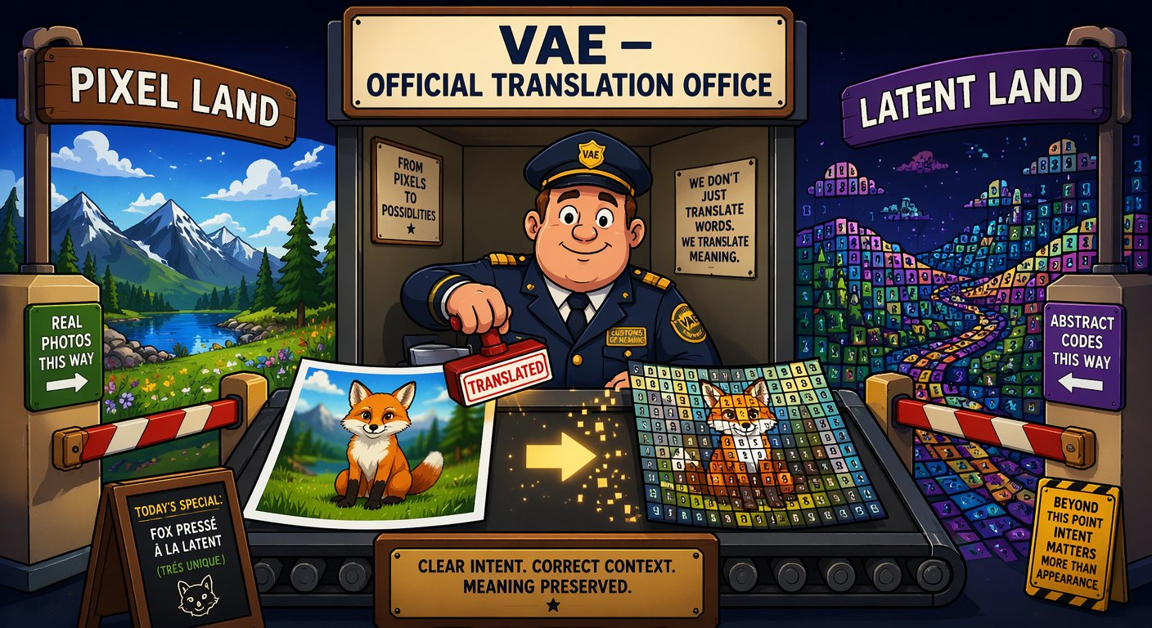
How an image is made: five stages, one denoising loop
SEGMENT 4 · LOCAL AI, MEDIA & BEYOND THE WEST
LATENT SPACE · 16 channels, not pixels
PROMPT
“a fox, cinematic”
TEXT ENCODER
CLIP · T5 · LLM
DENOISER
UNet or DiT
SAMPLER
steps · CFG
VAE
decoder
IMAGE
one pass per step
“a fox, cinematic”
[ 0.12, −0.83, 0.47, … ]
TEXT ENCODER · the interpreter: your prompt becomes numbers
LATENT · the suitcase: ~48× smaller, still a fox
VAE · the customs office between pixel land and latent land
Every control trick in this segment docks onto exactly this loop.
Sources: Beyond the Slop (Jul 2026)
Notes:
[S4-10]
“Prompt in, image out” is a useful lie — inside is a chain of swappable blocks. The text encoder turns the prompt into embeddings (CLIP, T5, and since 2025/26 a full LLM/VLM: FLUX.2 uses a Mistral model, Qwen-Image a Qwen-VL). The image is packed into a latent ~48× smaller than its pixels (16 channels in modern models) — the suitcase. The denoiser (UNet or a transformer) removes noise step by step, the sampler plans the steps (and applies CFG), and the VAE — the customs office — unpacks the latent into pixels at the end; the denoiser never sees a pixel.
Every block is swappable and every block is a docking point for control — that is the rest of the segment. ~1.5 minutes.
Diagram: Beyond the Slop diagram 01 (signal loop), redrawn natively. Images: meme_suitcase.png, meme_customs.png (AI-generated memes from Beyond the Slop).
Sources: Beyond the Slop slides 7–11 (research/beyond_the_slop/); fact sheet KND_RESEARCH_FACTSHEET_de.md §0.

Slide 18
UNet → MMDiT, diffusion → flow: why steps fell to 1–8
SEGMENT 4 · LOCAL AI, MEDIA & BEYOND THE WEST
UNET ERA · cross-attention
MMDiT · one attention table
WHO TALKS TO WHOM
UNet (SDXL): the text slips notes into the painting room — one-way.
MMDiT (FLUX, SD3.5, Qwen-Image): text and image tokens at one table — prompt fidelity, typography.
Turbo models need 1–8 steps;
Z-Image-Turbo uses 8.
P1
P2
P3
T1
P1
T2
P2
text
tokens
P4
P5
P6
P7
P8
P9
P3
T3
P4
P5
patches listen, never answer
everyone talks to everyone
DIFFUSION
20–50 noisy steps
noise
image
RECTIFIED FLOW
few steps, nearly straight
noise
image
Same mental model, better motor — “steps” now means something different per model.
Sources: Beyond the Slop (Jul 2026) · Model catalog §6 (2026-09-21)
Notes:
[S4-11]
Two upgrades explain the 2026 generation. Architecture: the UNet era (SDXL) injects the text by cross-attention — the image patches listen but never answer. MMDiT (FLUX, SD3.5, Qwen-Image) puts text and image tokens into one attention space — everyone talks to everyone, which is why prompt fidelity and text rendering got so much better. Video DiTs do the same across space and time.
Engine: classic diffusion wanders noisily to the image in 20–50 steps; rectified flow / flow matching walks a nearly straight line — same mental model, better motor, fewer steps. Distilled turbo models go further: 1–8 steps (Z-Image-Turbo uses 8). Consequence for you: the steps knob means something different per model. ~1 minute.
Diagrams: Beyond the Slop diagrams 12 (cross-attention vs MMDiT) and 10 (flow trajectories), redrawn natively.
Sources: Beyond the Slop slides 12–13; 05_Model_Catalog §6 (Z-Image-Turbo 8 steps).

Slide 19
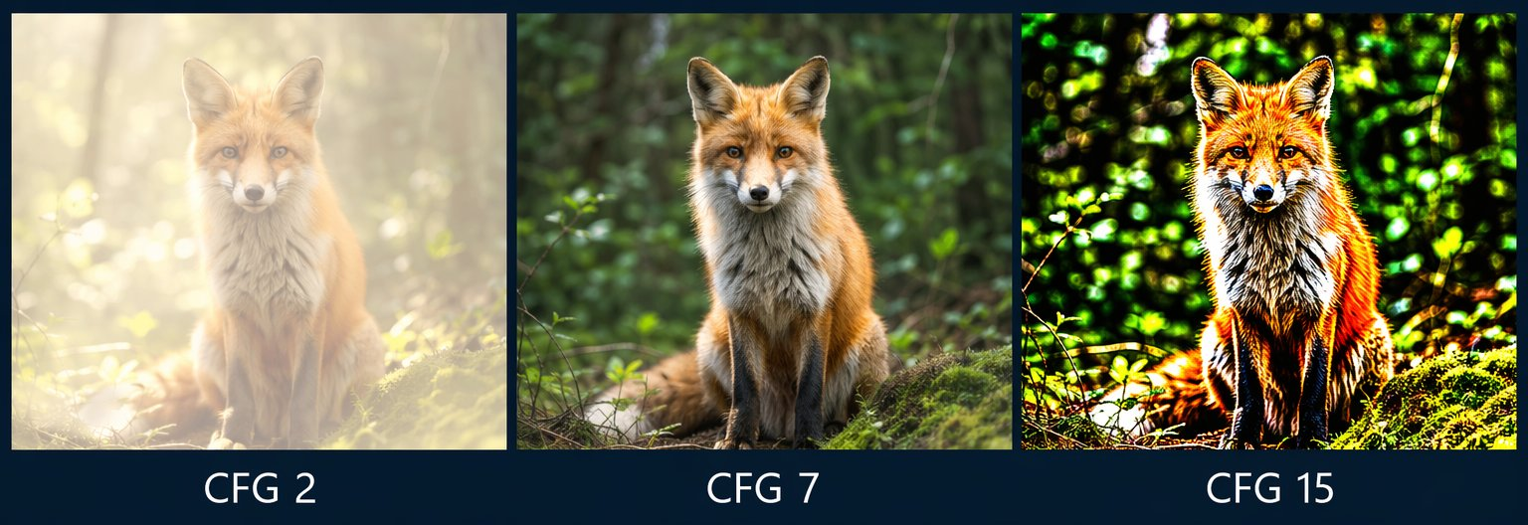
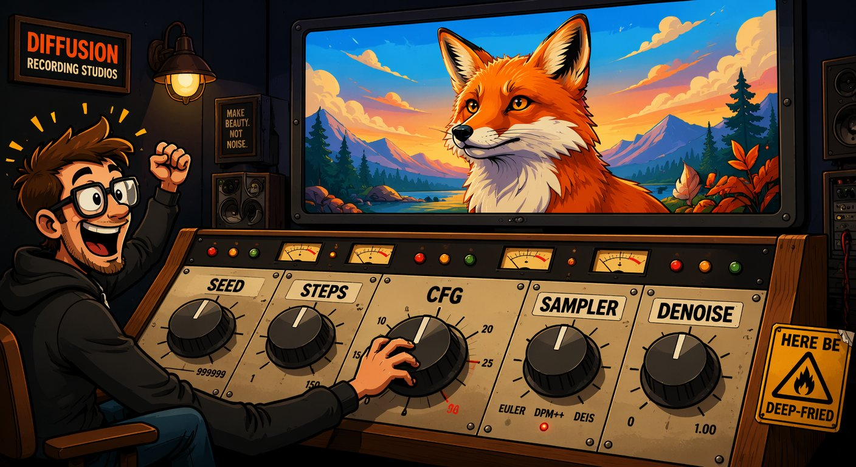
The four knobs that matter: seed, steps, CFG, denoise
SEGMENT 4 · LOCAL AI, MEDIA & BEYOND THE WEST
SEED
STEPS
CFG
DENOISE
the lottery ticket — same seed + same settings = the same image. Log it.
the patience knob — too few = mush; past ~30 you mostly pay for nothing.
the obedience knob — low drifts off the prompt, high deep-fries the colours.
the edit dial — 0.3 = gentle restyle, 0.9 = almost from scratch.
AI-generated · same seed, same prompt — only CFG changes
Craft principle #1: log the seed. #2: change one knob at a time.
Sources: Beyond the Slop (Jul 2026) · Lab 4 ComfyUI handouts
Notes:
[S4-12]
Four knobs, four nicknames. Seed = the starting noise: same seed + same settings = the same image — your reproducibility anchor, so log it. Steps: too few gives mush, beyond ~30 you mostly pay for nothing; turbo models need 1–8. CFG = how hard the model follows the prompt: 2 barely listens and looks washed out, 7 is the sweet spot, 15 is deep-fried (the strip). Denoise = img2img strength: 0.3 restyles gently, 0.9 is almost from scratch — the inpainting dial.
Sampler, scheduler and resolution are the rest of the console — they go to the Lab 4 README. This is the “which room?” slide from Segment 1: these are inference knobs, free and instant; training knobs cost an evening. Next: the live demo. ~1 minute.
Sources: Beyond the Slop slides 14–16; handout 01_txt2img_sdxl.json (seed 42, 25 steps, cfg 6.5, denoise 1.0).

Slide 20
Demo: Z-Image-Turbo in ComfyUI — seed and CFG live
DEMO · SEGMENT 4
LIVE DEMO
1. Z-Image-Turbo, 8 steps: a prompt from the room, seed 42
2. Queue again with seed 42 → the identical image
3. Change only the seed → new composition, same look
4. Handout 01 (SDXL): CFG 2 → 7 → 15 at a fixed seed
5. Lab script 02_comfy_run.py logs the seed next to every image
Same seed, same settings, same image. Change one knob and you see exactly what it does.
AI-generated · what you will see: CFG 2 · 7 · 15 at one seed
IF IT BREAKS
live on the instructor laptop
you watch — the lab comes later
Pre-rendered contact sheets (seed, CFG) — or the ComfyUI stand-in in labs/_tools
Sources: Model catalog §6 (2026-09-21) · Z-Image-Turbo model card · Lab 4 ComfyUI handouts · Lab 4 README
Notes:
[S4-D4]
Three minutes. Z-Image-Turbo (Alibaba Tongyi-MAI, 6B, Apache-2.0, ~16 GB, 8 steps) is the best quality per GB in the catalog. It is distilled and runs without CFG — so the CFG sweep runs on the SDXL handout 01, where CFG visibly matters (2 washed out, 7 fine, 15 deep-fried). ComfyUI 0.37.0 per the catalog.
Click path: ComfyUI → load the Z-Image-Turbo graph → set the seed to fixed → Queue twice (identical) → change the seed → Queue. Then load 01_txt2img_sdxl.json → set CFG 2, 7, 15 → Queue each. Finish with Lab 4 step 2: `python 02_comfy_run.py ../comfyui_workflows/01_txt2img_sdxl.json --seed 42` writes a .json with the settings next to every image — craft principle #1.
Fallback files: demos/S4-D4/fallback/ (contact sheets); the stand-in is labs/_tools/comfy_mock.py (flat images that print the knobs they received).
VERIFY: a Z-Image-Turbo graph in API format is not among the handouts yet (export it, pin the model file names); re-test the handouts on ComfyUI v0.37.
Sources: 05_Model_Catalog §6; https://huggingface.co/Tongyi-MAI/Z-Image-Turbo ; research/2026-09-19_local-ai-media-beyond-west.md §4 (no CFG); labs/04-local-media/README.md; labs/04-local-media/comfyui_workflows/README_EN.md.

Slide 21
Prompt = what, ControlNet = where, LoRA = who, inpaint = fix
SEGMENT 4 · LOCAL AI, MEDIA & BEYOND THE WEST
ControlNet
where: pose, depth, edges
LoRA
who: a character, a style
IP-Adapter
like this: a reference image
Text encoder
prompt = what
Denoiser
UNet or DiT
Sampler + latent
noise → denoised
VAE
image
LATENT SPACE
Inpaint / outpaint
fix: masked latents
1 · LoRA
locks the character
2 · ControlNet
locks the pose
3 · IP-Adapter
locks the style
4 · Inpaint
fixes the hand
5 · Outpaint
widens the shot
They compose on one loop, with zero retraining — that is what “taking control” means.
Sources: Beyond the Slop (Jul 2026)
Notes:
[S4-13]
The map for the next five slides. Dock, don’t rebuild: every adapter grabs the same loop at a different place. ControlNet injects structure into the denoiser (where), a LoRA is a small weight update inside its attention blocks (who or which style), IP-Adapter feeds a reference image through its own attention channel (like this), inpainting works on masked latents (fix). The prompt still says what.
Bottom row: one image, five interventions — LoRA locks the character, ControlNet the pose, IP-Adapter the style, inpaint fixes the hand, outpaint widens the shot. They compose, and because each step is a node, the whole stack fits into one reproducible ComfyUI graph. ~1 minute.
Diagram: Beyond the Slop diagram 02 (adapter dock), redrawn natively.
Sources: Beyond the Slop slides 19 and 31.

Slide 22
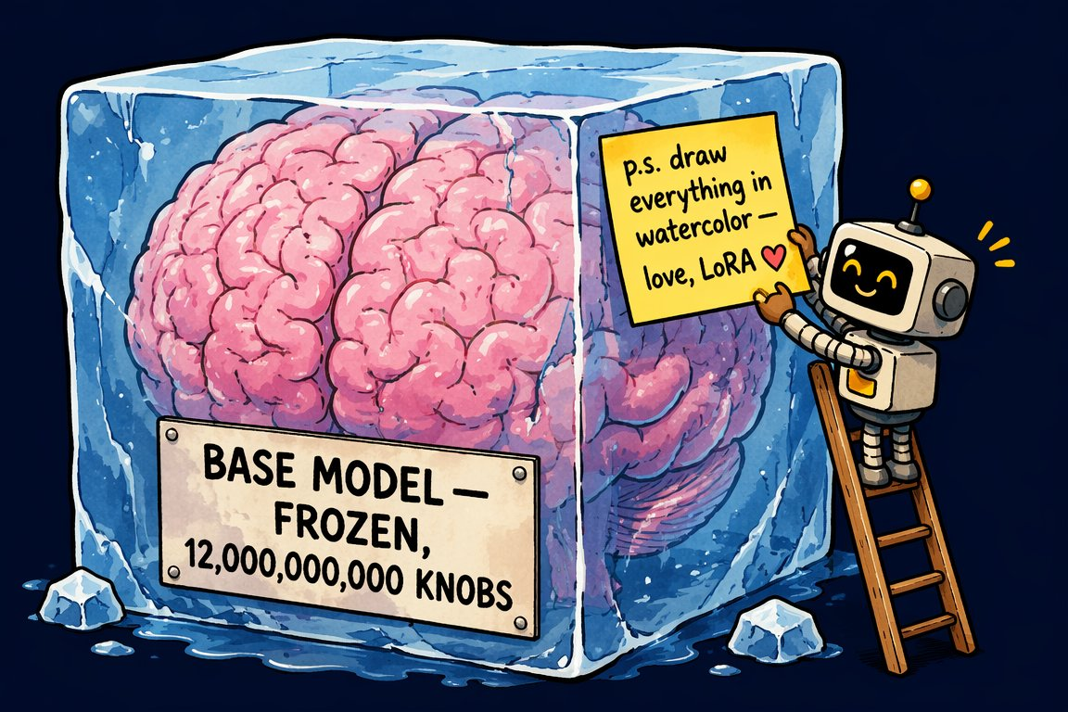
LoRA for images is the sticky note from Segment 1 again
SEGMENT 4 · LOCAL AI, MEDIA & BEYOND THE WEST
W
frozen
billions of weights
B
A
+
ΔW = B·A
rank r ≈ 4–128 · trained, tiny
Same maths as Segment 1 — now in the attention blocks of a diffusion transformer
A few-MB .safetensors — strength 0.0–1.2, stackable (style + character)
Civitai: hundreds of thousands — the mod scene of image models
Licence check: a LoRA runs on its base model — read that licence (FLUX.2 [dev]: non-commercial)
Freeze the brain, add a sticky note — for language and image models alike.
Sources: Beyond the Slop (Jul 2026) · Model catalog §6, §11 (2026-09-21)
Notes:
[S4-14]
Callback to the LoRA slide in Segment 1: LoRA freezes the base weights W and trains a low-rank correction ΔW = B·A next to them (rank ≈ 4–128). For image models the adapters sit in the attention layers of the UNet or the DiT blocks. The result is a few-MB .safetensors file that whispers “draw it THIS way”; trainable on a consumer GPU, stackable (style + character), with a strength dial from 0.0 to 1.2.
Civitai is the LoRA bazaar — hundreds of thousands of them (July 2026). The licence question it raises: a LoRA is useless without its base model, so the base model’s licence applies to what you ship — FLUX.2 [dev] and klein-9B are non-commercial, FLUX.2 [klein] 4B and Z-Image are Apache-2.0. Also ask where the training images came from. The LoRA family tree (QLoRA, DoRA, PiSSA, LyCORIS …) is in the appendix (A-03). ~1 minute.
Image: meme_stickynote.png (AI-generated, Beyond the Slop).
Sources: Beyond the Slop slides 20–22 and 42; 05_Model_Catalog §6/§11.

Slide 23
A character LoRA in one slide: one evening, one GPU
SEGMENT 4 · LOCAL AI, MEDIA & BEYOND THE WEST
15–50 photos
vary pose, light, background
captions
a VLM writes them + a trigger word
train
rank 16–32 · ~1–3k steps
character.safetensors
a few MB
12–16 GB VRAM · kohya_ss · ai-toolkit · OneTrainer
HOW LoRAs GET BURNT
LEARNS THE COUCH
CRISPY
STYLE DRIFT
SCREAMS
20 near-identical selfies: it learns the couch, not the face.
Learning rate too high: artefacts on everything.
No regularisation images: everything drifts toward your subject.
Over-trained: it shouts over every prompt.
The fix is boring: fewer steps, lower strength, better captions.
Sources: Beyond the Slop (Jul 2026) · Lab 4 README
Notes:
[S4-15]
The recipe: 15–50 curated images of the subject — vary pose, light and background; caption each one (a vision-language model does that for you) and put a unique trigger word into every caption; train rank 16–32 for roughly 1–3k steps on a 12–16 GB GPU with kohya_ss, ai-toolkit or OneTrainer; the output is a few-MB character.safetensors.
The four classic failures are all data or schedule problems, not model problems. And the honest guide from the LoRA family research: the variant matters less than your dataset and learning rate. In Lab 4 this is a stretch goal — attendees use a ready-made Civitai LoRA in handout 02 instead. ~1 minute.
Sources: Beyond the Slop slides 22–23; labs/04-local-media/README.md (handout 02 uses character.safetensors).

Slide 24
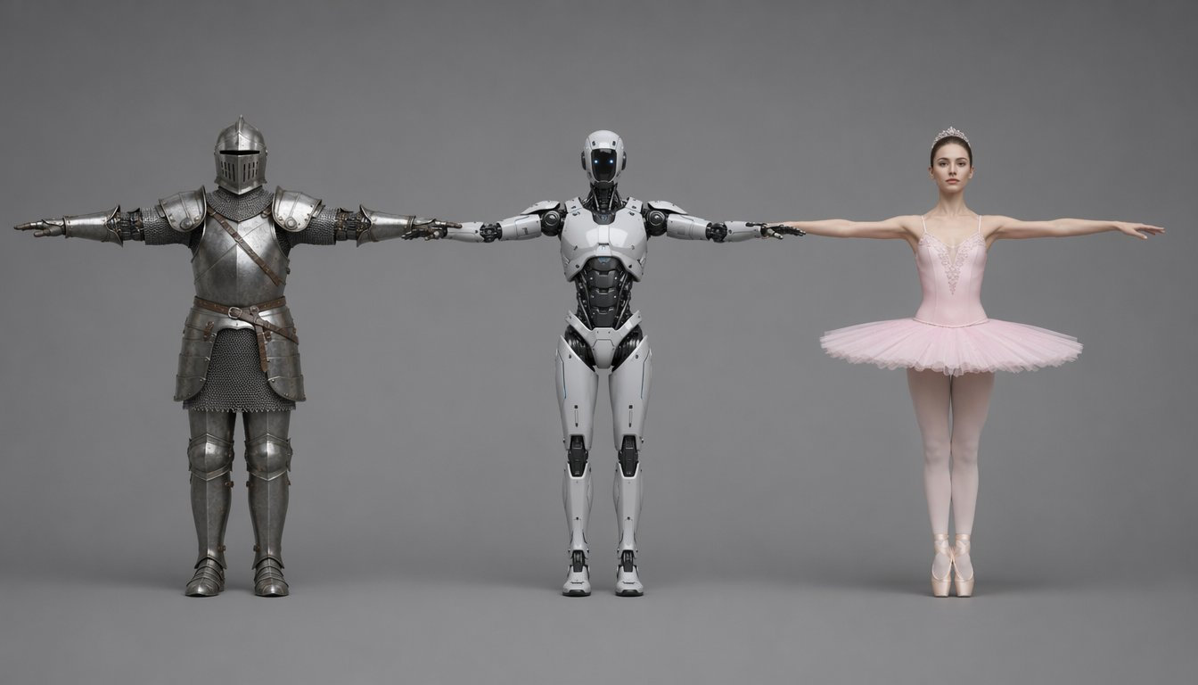
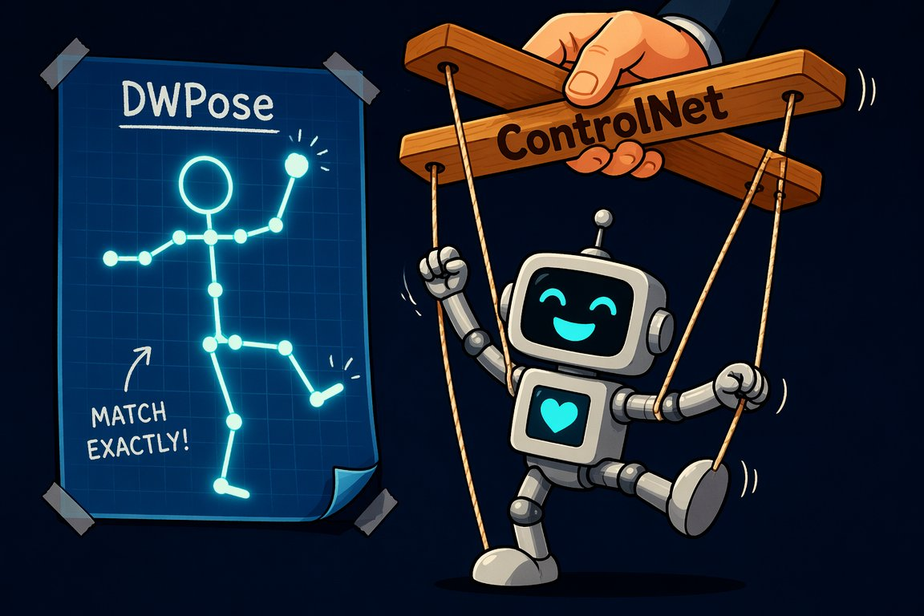
ControlNet and DWPose: the puppeteer for composition
SEGMENT 4 · LOCAL AI, MEDIA & BEYOND THE WEST
CANNY
edges — outlines, architecture, products
AI-generated · one DWPose skeleton + three prompts = three characters, identical pose
DEPTH
3D layout — keeps space, frees surfaces
POSE
DWPose skeleton — THE tool for characters
Prompt = what, ControlNet = where. Start at weight 0.6–0.8.
Sources: Beyond the Slop (Jul 2026) · Zhang & Agrawala 2023, ControlNet · Lab 4 ComfyUI handouts
Notes:
[S4-16]
ControlNet is the puppeteer: you hand the model a structure image — edges (Canny), a depth map or a pose skeleton — and it must follow that structure while the prompt decides style and content. Under the hood a trainable half-copy of the denoiser injects the hint at every step through zero-convolutions (they start at 0, so the copy disturbs nothing at first).
DWPose reads body, hand and face keypoints from any photo; the coloured skeleton feeds a pose ControlNet: same skeleton + three prompts = the knight, the robot and the ballerina. The leash rule: the higher the weight, the more structure survives and the less the prompt can breathe — 0.6–0.8 is a good start. Union models do 10+ modes in one file; T2I-Adapter is the light option. Demo next. ~1 minute.
Images: ex_pose_trio.png, meme_puppeteer.png (AI-generated, Beyond the Slop).
Sources: Beyond the Slop slides 24–27; https://arxiv.org/abs/2302.05543 ; handout 02_pose_lora_sdxl.json.

Slide 25
Demo: pose swap with ControlNet
DEMO · SEGMENT 4
LIVE DEMO
1. Handout 02: pose_ref.png → the DWPose skeleton preview
2. Prompt “knight in armour” → Queue (seed fixed)
3. Same skeleton: “robot”, then “ballerina”
4. ControlNet strength 1.0 → 0.6: looser leash, more prompt
5. Optional: switch on the character LoRA node
One stick figure, three characters: the skeleton says where, the prompt says who.
IF IT BREAKS
AI-generated · what you will see: one skeleton, three prompts
live on the instructor laptop
you watch — the lab comes later
The pre-rendered pose trio and a screenshot of the graph
Sources: Lab 4 ComfyUI handouts · Beyond the Slop (Jul 2026)
Notes:
[S4-D5]
Three minutes. Handout 02_pose_lora_sdxl.json: SDXL checkpoint → LoRA loader (character.safetensors, strength 0.8) → DWPreprocessor on pose_ref.png → OpenPose ControlNet (strength 1.0) → KSampler (seed 123, 30 steps, cfg 6.0) at 832×1216. Needs the comfyui_controlnet_aux custom nodes.
Click path: open the graph, show the skeleton preview, queue the knight, swap the prompt twice, then drop the ControlNet strength to 0.6 and show the pose loosening. If the LoRA file is not present, bypass the LoRA node.
Fallback files: demos/S4-D5/fallback/ (the Beyond the Slop pose trio, ex_pose_trio.png, + a graph screenshot).
VERIFY: re-test handout 02 on ComfyUI v0.37 with comfyui_controlnet_aux; pin the model file names (controlnet-openpose-sdxl-1.0, sd_xl_base_1.0) and put pose_ref.png into ComfyUI’s input/ folder.
Sources: labs/04-local-media/comfyui_workflows/README_EN.md and 02_pose_lora_sdxl.json; Beyond the Slop slide 26.

Slide 26
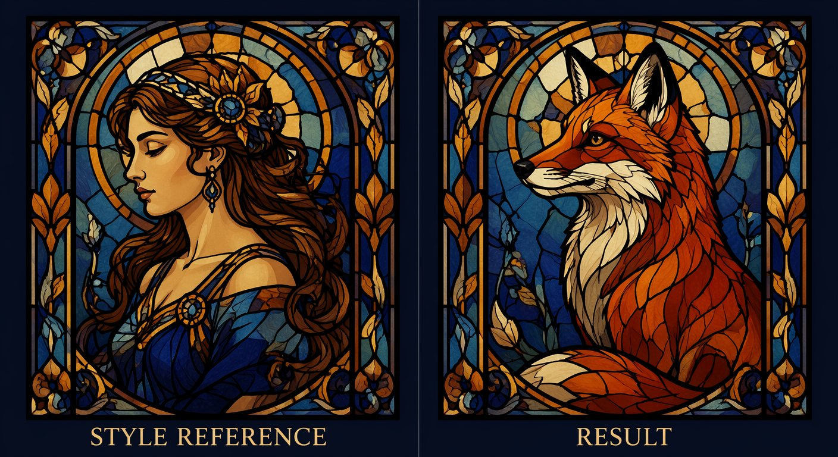
IP-Adapter and identity lock: show it instead of describing it
SEGMENT 4 · LOCAL AI, MEDIA & BEYOND THE WEST
The reference image is encoded into its own attention channel, parallel to the text.
BEATS A LoRA ON SPEED
No training: a ~100 MB adapter works instantly — right for a handful of shots.
LOSES ON FIDELITY
Zero-shot identity drifts over many shots — for a whole film, train a character LoRA.
AI-generated · a style reference, no training
faces: FaceID (ArcFace) · InstantID · PuLID
Text says it. The image shows it.
Sources: Beyond the Slop (Jul 2026) · Ye et al. 2023, IP-Adapter
Notes:
[S4-17]
IP-Adapter: an image is worth a thousand prompt words. The reference image is encoded (CLIP image encoder) and fed through its own, decoupled cross-attention channel next to the text. Style transfer without training anything: a ~100 MB adapter that works instantly.
For faces there is a specialist family — FaceID (an ArcFace identity embedding), InstantID, PuLID: zero-shot identity. Where it beats a LoRA: speed, no dataset, a handful of images. Where it loses: over many shots the identity drifts — for a whole film or a campaign, train a character LoRA (previous slides). ~1 minute.
Image: ip_adapter_pair_en.png (AI-generated, Beyond the Slop).
Sources: Beyond the Slop slide 28; https://arxiv.org/abs/2308.06721 ; BTS fact sheet (FaceID = IP-Adapter + LoRA on an ArcFace embedding).

Slide 27
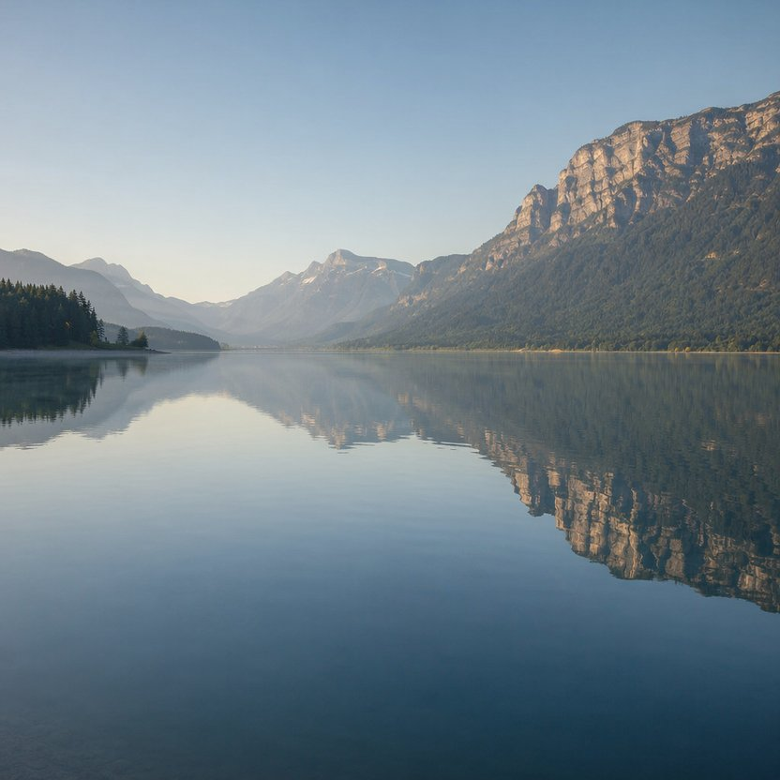
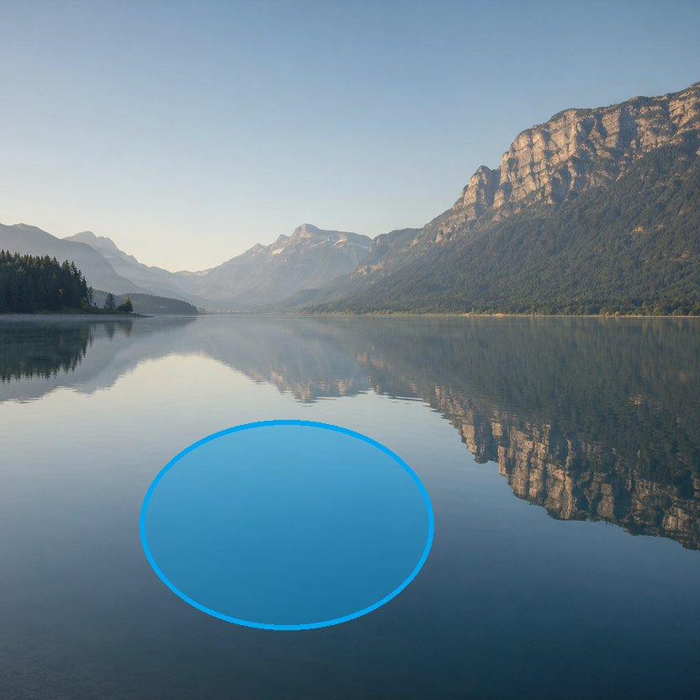

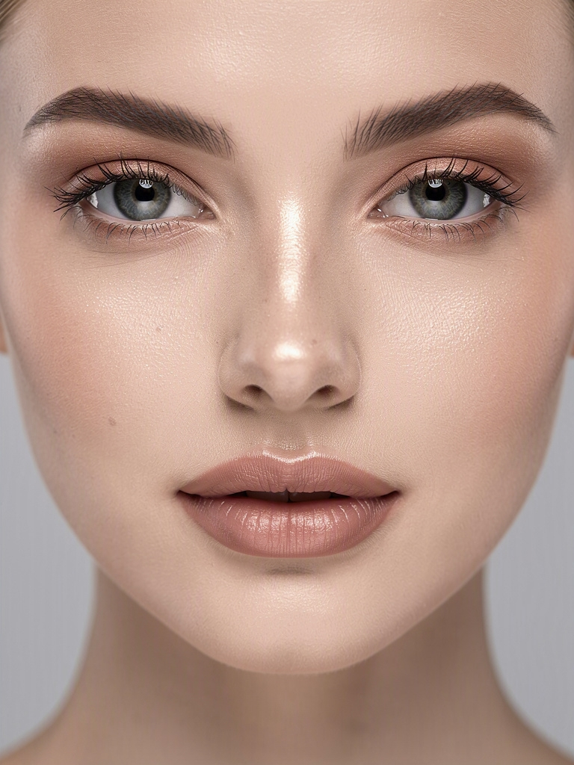
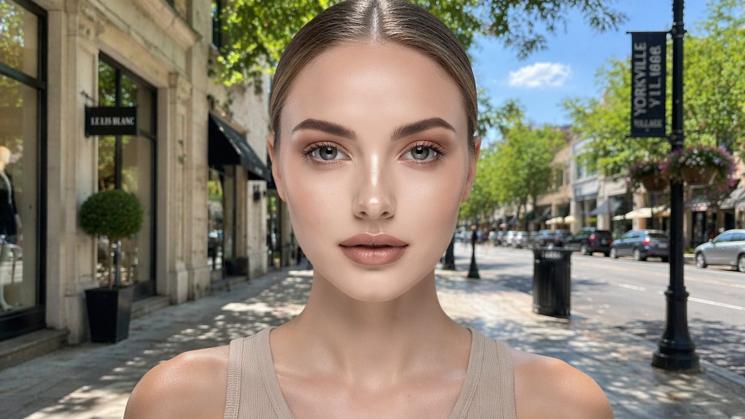
Real inpainting and outpainting: fix one detail, keep the seed
SEGMENT 4 · LOCAL AI, MEDIA & BEYOND THE WEST
THREE MOVES
MASK
what may change — the rest stays pixel-identical
DENOISE
how much: 0.3 restyles, 0.9 regenerates
1 · the image you have
2 · mask the water
3 · “a red rowboat” — done
SEAM
grow or feather the mask so edges blend
Outpainting: the same trick with the mask pointing outward — keep the original pixels, portrait → 16:9.
outpaint: the crop you have → the shot you needed · AI-generated (Beyond the Slop)
Surgery instead of re-rolling: fix one detail, keep the seed.
Sources: Beyond the Slop (Jul 2026) · Lab 4 ComfyUI handouts
Notes:
[S4-18]
Inpainting is surgery instead of re-rolling: only the masked region is re-noised and regenerated — every other pixel stays untouched (check the mountains). Denoise is the dial: handout 03_inpaint.json uses 0.9 with VAEEncodeForInpaint and grow_mask_by = 6, so the seam blends; differential diffusion (a soft grey mask) or FLUX Fill give softer edges.
Outpainting is the same trick with the mask pointing outward: extend the canvas, keep the original pixels, let the model fill the new area — portrait → 16:9. The craft rule: fix one detail and keep the seed, don’t roll the whole image again. That closes “taking control”; next part: the model zoo. ~1 minute.
Images: ex_inpaint_before832 / mask_vis / after_real, ex_outpaint_before / after_real (AI-generated, Beyond the Slop).
Sources: Beyond the Slop slides 29–30; handout 03_inpaint.json (denoise 0.9, grow_mask_by 6).

Slide 28
The model zoo has moved: image
SEGMENT 4 · LOCAL AI, MEDIA & BEYOND THE WEST
as of 2026-09-21
Model | Maker | Date | Licence | Why it matters
Z-Image-Turbo · Z-Image · Edit | Alibaba Tongyi-MAI | 11-2025 01-23 | Apache-2.0 | 6B, ~16 GB, 8 steps — best quality per GB
FLUX.2 [klein] 4B | Black Forest Labs | 01-15 | Apache-2.0 | ≈ 13 GB, sub-0.5 s — the laptop pick
FLUX.2 [klein] 9B · [dev] | Black Forest Labs | 01-15 11-2025 | non-commercial | [dev] = top open ELO
Qwen-Image-2512 · Edit · Layered | Alibaba | 12-2025 | Apache-2.0 | 20B MMDiT, 4 GB with offload — the commercial Qwen line
Qwen-Image-2.1 | Alibaba | 09-20 | Qwen Research Licence: non-commercial | 7B DiT, ≤ 10 references, RGBA — demo yes, client work no
HunyuanImage-3.0 | Tencent | 09-2025 01-2026 | Hunyuan community | native multimodal image model
Ideogram 4.0 | Ideogram | 06-03 | open weights, non-commercial | layout + typography control; 24 GB-class
permissive open weights
open with conditions
non-commercial · closed · API-only
MM-DD dates are 2026
Read the licence per checkpoint: Qwen-Image 2512 is Apache, 2.1 is non-commercial.
Sources: Model catalog §6 (checked 2026-09-21) · Model catalog §11 (checked 2026-09-21) · Research: Beyond the Slop integration
Notes:
[S4-19]
≈ 1 min. Read the dots, not the rows: green you can ship, amber you read first, red you can demo but not sell. Z-Image-Turbo is the best quality per GB (6B, ~16 GB, 8 steps); FLUX.2 [klein] 4B is the laptop pick (Apache, ~13 GB, sub-second). The Qwen-Image line is the licence-gradient example: 2512 is Apache, 2.1 (weights released 2026-09-20) is research-only — commercial licence on request, “Built with Qwen” attribution — and 2.0/3.0 are API-only (next slide). Beyond the Slop (July) said “Qwen-Image 2.0 · Apache 2.0” — corrected here. Ideogram 4.0 did go open, but non-commercial.
Sources: 05_Model_Catalog_2026-09.md §6 + §11 (checked 2026-09-21); research/2026-09-19_beyond-the-slop-integration.md §2; https://huggingface.co/Tongyi-MAI/Z-Image-Turbo · https://bfl.ai/blog/flux2-klein-towards-interactive-visual-intelligence · https://github.com/QwenLM/Qwen-Image · https://github.com/Tencent-Hunyuan/HunyuanImage-3.0

Slide 29
Image, part 2: revenue caps and the closed leaders
SEGMENT 4 · LOCAL AI, MEDIA & BEYOND THE WEST
as of 2026-09-21
Model | Maker | Date | Licence | Why it matters
Krea 2 Raw / Turbo | Krea | 06-22 | commercial only < $1M revenue; revocable | 12B; Turbo 2K in ~2 s
SDXL · SD3.5 · HiDream-I1 · Chroma | – | 2023–2025 | mixed: HiDream-I1 MIT, Chroma Apache | runs on 8 GB; SDXL is still the LoRA / ControlNet king
Qwen-Image 2.0 / 3.0 | Alibaba | – | API / chat only | the flagship stays closed
FLUX.2 [pro] · [flex] · FLUX.1 Kontext [pro] | Black Forest Labs | – | API: Foundry DfA | per-megapixel meters
GPT-Image-2.5 Flare / Sunburst | OpenAI | 09-08 | API: Foundry DfA, also gpt-image-2, -1-mini | arena #1 / #2
MAI-Image-2.6 / 2.6-Flash | Microsoft | – | API: Foundry DfA | arena #4
Nano Banana 2 · Pro · 2 Lite | Google | 02-26 06-30 | API | Nano Banana 2 = gemini-3.1-flash-image
Midjourney V8.1 · Seedream 5.0 Pro Grok Imagine 2.0 · Reve 2.1 | – | – | closed | also Recraft V4.1
permissive open weights
open with conditions
non-commercial · closed · API-only
MM-DD dates are 2026
No GPU? The Foundry rows (gpt-image, FLUX.2, MAI-Image) are Lab 4’s cloud path.
Sources: Model catalog §6 (checked 2026-09-21) · Model catalog §10 (checked 2026-09-21) · Model catalog §11 (checked 2026-09-21)
Notes:
[S4-19b]
[trim] ≈ 45 s — skip it in the 75-minute cut. Krea 2 is commercial only below $1M revenue, and the licence is revocable. SDXL is old but still the LoRA/ControlNet ecosystem king; Stability shipped no new image model in 2026. The closed tier leads the arena (GPT-Image-2.5 Flare/Sunburst #1/#2, MAI-Image-2.6 #4), and the Foundry Direct-from-Azure rows are credit-eligible — that is Lab 4’s no-GPU path (04_cloud_image.py with GENAI_IMAGE_MODEL). FLUX 3 is in early access; BFL says weights “later in 2026”.
Sources: catalog §6, §10, §11 (checked 2026-09-21); https://artificialanalysis.ai/image/leaderboard/text-to-image

Slide 30
The model zoo has moved: video
SEGMENT 4 · LOCAL AI, MEDIA & BEYOND THE WEST
as of 2026-09-21
Model | Maker | Date | Licence | Why it matters
Wan 2.2: T2V/I2V-A14B, TI2V-5B, S2V-14B, Animate-2, Dancer | Alibaba | 07-2025 → 07-2026 | Apache-2.0 | last open Wan base; 5B: 5 s 720p in <9 min on a 4090
Wan 2.5 / 2.6 / 2.7 / 3.0 | Alibaba | → 08-24 | API only | “Wan 2.7 open source” claims are fabrications
HunyuanVideo 1.5 | Tencent | 11-2025 | Hunyuan community | 8.3B, 14 GB with offload — the laptop video model
LTX-2.5 | Lightricks | 08-11 | LTX-2.x Community (< $10M revenue) | 22B distilled DiT + Gemma 4 12B encoder; synced audio
MiniMax-H3 (+ H3-World LoRA) | MiniMax | 08-02 | Community: excludes EU, UK, South Korea, USA | 33B; best open T2V + audio — mention, don’t demo
Gemini Omni 1.1 Flash · Veo 3.1 Seedance 2.5 · Kling 3.0 Runway Gen-4.5 · Luma Ray 3 | – | 08-27 (Omni GA) | closed / API | Gemini Omni 1.1 Flash = arena #1
Sora | OpenAI | app off 04-26 API off 09-24 | gone | Foundry’s sora-2 listing is stale
permissive open weights
open with conditions
non-commercial · closed · API-only
MM-DD dates are 2026
The open base is still Wan 2.2 — the flagships moved behind APIs.
Sources: Model catalog §7 (checked 2026-09-21) · Model catalog §11 (checked 2026-09-21) · Research: local AI, media & beyond the West, 2026-09-19
Notes:
[S4-20]
≈ 1 min. Video is where the open/closed line is sharpest: Alibaba’s last open Wan base is 2.2 — 2.5 to 3.0 are API-only, and the “Wan 2.7 open source” pages are SEO fabrications. HunyuanVideo 1.5 is the laptop model (8.3B, 14 GB with offload); LTX-2.5 adds synced audio but is free only below $10M revenue. MiniMax-H3 is the best open text-to-video with audio, but its licence excludes the EU, the UK, South Korea and the USA — so we mention it and do not demo it. Sora’s API ends 2026-09-24; Foundry’s sora-2 listing is stale.
Sources: catalog §7 + §11 (checked 2026-09-21); research/2026-09-19_local-ai-media-beyond-west.md §4; https://github.com/Wan-Video/Wan2.2 · https://github.com/Tencent-Hunyuan/HunyuanVideo-1.5 · https://huggingface.co/Lightricks/LTX-2.5 · https://huggingface.co/MiniMaxAI/MiniMax-H3

Slide 31
The model zoo has moved: speech and voice
SEGMENT 4 · LOCAL AI, MEDIA & BEYOND THE WEST
as of 2026-09-21
Model | Maker | Date | Licence | Why it matters
Qwen3-TTS 0.6B / 1.7B (Base · CustomVoice · VoiceDesign) | Alibaba | 01-21 | Apache-2.0 | 3-s voice cloning, voice design by text, 10 languages
AuK / AuK-Flash | Tencent | 09-09 | MIT | 1.5B: TTS + speech editing + enhancement + separation
Chatterbox Flash · VibeVoice · VoxCPM2 · Kokoro-82M | – | 2026 | MIT · MIT · Apache · Apache | 23 languages · long-form multi-speaker · edge
RVC / Applio · So-VITS-SVC | community | – | permissive | voice conversion, not TTS
Parakeet-TDT-0.6B-v3 · Nemotron-3.5-ASR-streaming | NVIDIA | 08-2025 2026 | CC-BY-4.0 · OpenMDW | 25 languages, RTFx ~3,300 — live captions
Whisper large-v3-turbo · Qwen3-ASR · Canary-Qwen-2.5B · Granite-Speech-3.3 | – | – | permissive | multilingual ASR baselines
Kyutai Moshi / Unmute | Kyutai | 2025 | permissive | open full-duplex voice
GPT-Live-1 · gpt-realtime-2 · gpt-4o-mini-tts · MAI-Voice-2 | – | 09-10 (GPT-Live-1) | closed / API | gpt-realtime, gpt-4o-mini-tts on Foundry DfA
permissive open weights
open with conditions
non-commercial · closed · API-only
MM-DD dates are 2026
Nearly all green: clone, edit and caption speech locally, under permissive licences.
Sources: Model catalog §8 (checked 2026-09-21) · Model catalog §11 (checked 2026-09-21)
Notes:
[S4-21]
≈ 1 min, then straight into the demo (S4-D6). Speech is the greenest shelf: Qwen3-TTS clones a voice from 3 seconds and designs voices from a text description (Apache, 10 languages); Tencent AuK (MIT, 09-09) also edits and cleans speech; Parakeet v3 transcribes 25 languages at RTFx ~3,300 — that is the live-caption demo. RVC/Applio convert timbre; they are not TTS. The closed row adds Gemini 3.8 Live and ElevenLabs v3. Say it once: clone only voices you have consent for.
VERIFY: IndexTTS-2.5 sits in the catalog row with licence “mixed” — left off the slide until its licence is checked; Fish Audio S2 Pro is research-only (red in §11).
Sources: catalog §8 + §11 (checked 2026-09-21); https://github.com/QwenLM/Qwen3-TTS · https://huggingface.co/tencent/AuK · https://huggingface.co/nvidia/parakeet-tdt-0.6b-v3 · https://huggingface.co/blog/open-asr-leaderboard

Slide 32
Demo: Qwen3-TTS voice clone + Parakeet live captions
DEMO · SEGMENT 4
LIVE DEMO
1. Record 3 s of my own voice (consent: mine, not yours)
2. Qwen3-TTS clones it and reads a paragraph
3. VoiceDesign: describe a voice in words, then hear it
4. Parakeet v3 captions the room live
5. Same captions for another European language
Three seconds of a voice are enough to clone it — and live captions run on the same laptop.
IF IT BREAKS
Play the pre-recorded WAVs (clone + designed voice) and a screen recording of the live captions.
live on the instructor laptop
you watch — the lab comes later
Sources: Model catalog §8 (checked 2026-09-21) · Qwen3-TTS (GitHub) · Parakeet TDT 0.6B v3 (HF)
Notes:
[S4-D6]
5 minutes, instructor laptop, all local. Qwen3-TTS (0.6B or 1.7B) clones a voice from a 3-second sample; the VoiceDesign variant makes a voice from a text description (“a calm radio host, slightly amused”). Use your own voice — never clone an attendee’s voice on stage, and delete the sample afterwards. Then start Parakeet-TDT-0.6B-v3 on the room microphone: 25 languages, RTFx ~3,300, so captions keep up with speech. Pre-load both models before the segment (the first call includes loading). VERIFY in the dry run: how Parakeet handles a language switch mid-stream. Fallback files: demos/S4-D6/fallback/. Sources: catalog §8; https://github.com/QwenLM/Qwen3-TTS · https://simonwillison.net/2026/Jan/22/qwen3-tts/ · https://huggingface.co/nvidia/parakeet-tdt-0.6b-v3

Slide 33
Music and lipsync: whole songs on a small GPU, under MIT
SEGMENT 4 · LOCAL AI, MEDIA & BEYOND THE WEST
as of 2026-09-21
Model | Maker | Date | Licence | Why it matters
ACE-Step 1.5 / 1.5 XL (4B DiT + LM planner) | ACE Studio | 01-23 04-02 | MIT | lyrics → full song with vocals, <4 GB VRAM, <10 s on a 3090
YuE2-3B | m-a-p | 09-09 | CC-BY-NC-4.0 | claims > Suno v5/v6 on WildSongBench; 24 GB
MiniMax-Music3 (2B) · Stable Audio 3 | MiniMax · Stability | 08-2026 05-21 | community (Stable Audio 3: < $1M) | –
Wan 2.2 S2V-14B | Alibaba | 07-2025 → 07-2026 | Apache-2.0 | image + audio → singing avatar (lipsync)
Suno v6 / v6-wild / v6-mini | Suno | 09-09 | closed: licensed catalogue only | v4–5.5 retired; download caps
Udio · Lyria 3.5 · ElevenLabs Music 2.5 | – | – | closed | Udio: walled garden
permissive open weights
open with conditions
non-commercial · closed · API-only
MM-DD dates are 2026
The segment’s closer is row 1: Lab 1 code writes the lyrics, ACE-Step 1.5 sings them.
Sources: Model catalog §7 (checked 2026-09-21) · Model catalog §8 (checked 2026-09-21) · Model catalog §11 (checked 2026-09-21)
Notes:
[S4-21b]
≈ 45 s. ACE-Step 1.5 (MIT) turns lyrics into a full song with vocals in under 4 GB of VRAM — under 10 s per song on a 3090 — on CUDA, MLX or ROCm; it is this segment’s closer. Beyond the Slop said “Apache 2.0”; the catalog says MIT (corrected). YuE2-3B claims to beat Suno on WildSongBench, but it is CC-BY-NC and needs 24 GB. Suno v6 now trains on a licensed catalogue (WMG/BMG/Believe) and retired v4–5.5; Udio is a walled garden. Wan 2.2 S2V is the open lipsync block of the music-video chain (S4-29).
VERIFY: InfiniteTalk and LatentSync (lipsync, BTS slide 36) are not in the September catalog — left off.
Sources: catalog §7, §8, §11 (checked 2026-09-21); research/2026-09-19_beyond-the-slop-integration.md §2; https://github.com/ace-step/ACE-Step-1.5 · https://huggingface.co/m-a-p/YuE2-3B

Slide 34
3D and world models — one slide, two warnings
SEGMENT 4 · LOCAL AI, MEDIA & BEYOND THE WEST
as of 2026-09-21
3D / world | Licence | Note
Hunyuan3D 2.1 (+ Omni, Part) | community: excludes EU, UK, South Korea | 3.0 / 3.1 hosted-only
TRELLIS.2-4B | MIT | safe pick
TripoSG · TripoSplat | MIT | –
Matrix-Game 3.0 | Apache | world model
HY-World 2.0 · H3-World | community · H3 licence applies | world models
Project Genie · Oasis 3 Atlas · GWM Worlds 2 | subscription · API · closed · preview | world models
VIDEO MODEL — one fixed clip
prompt
model
clip (fixed)
WORLD MODEL — interactive, stateful
state
+ action
model
next frame
every frame becomes the new state — a playable simulator
permissive open weights
open with conditions
non-commercial · closed · API-only
WARNING 1 — 3D
WARNING 2 — world models
Hunyuan3D’s licence excludes the EU, the UK and South Korea: use TRELLIS.2 (MIT).
Mostly subscription, API or preview — and H3-World inherits H3’s region exclusions.
Sources: Model catalog §9 (checked 2026-09-21) · Model catalog §11 (checked 2026-09-21) · Beyond the Slop (daenet, Jul 2026)
Notes:
[S4-22]
[trim] ≈ 45 s. Two warnings, that is the slide. One: Hunyuan3D 2.1 is open, but its licence excludes the EU, the UK and South Korea (and needs approval above 1M MAU) — for a European customer use TRELLIS.2-4B (MIT). Two: a world model is “video with a controller” — state plus an action gives the next frame, and that frame becomes the new state. Today that means Project Genie (Genie 3, subscription), Decart Oasis 3 (API), World Labs Atlas (closed) or Runway GWM Worlds 2 (preview); Matrix-Game 3.0 (Apache) is the open one to try, and H3-World inherits the H3 licence.
The diagram is a native redraw of Beyond the Slop diagram 08 — its footer (“Open: Oasis”) is outdated: Oasis 3 is API-only.
Sources: catalog §9 + §11 (checked 2026-09-21); Beyond the Slop slide 50 / diagram 08.

Slide 35
Where to run them — and which routes the Azure credits pay for
SEGMENT 4 · LOCAL AI, MEDIA & BEYOND THE WEST
as of 2026-09-21
Route | What it is | Credits | Examples
Foundry — Direct from Azure (DfA) | first-party meters | yes | gpt-5-mini · DeepSeek V4-Pro · Kimi-K2.7-Code · grok-4.6 · FLUX.2 · MAI-Image-2.6
Foundry — Fireworks (FW) | pay-per-token, billed by Azure, US data zone | verify | GLM-5.3 · DeepSeek V4.1 Flash · Kimi K3 · Nemotron · gpt-oss-120b
Foundry — Marketplace partner (MP) | Azure Marketplace | no | Claude (Fable 5.1, Opus 5, Sonnet 5)
Hugging Face Inference Providers | one OpenAI-compatible router, 16+ providers | – | router.huggingface.co/v1 — media via fal / Replicate
OpenRouter · SiliconFlow Together · Groq · Cerebras | open-model APIs | – | OpenRouter: 7 of the top 10 by tokens are Chinese labs
Hugging Face · ModelScope | the weights themselves | – | download, then run them with a local runner
Local runners | your hardware | – | Foundry Local (NPU) · Ollama · LM Studio · llama.cpp · vLLM · SGLang
Credits: yes = sponsorship-eligible first-party meters · verify = test on the real subscription · no = Marketplace, charged to the card on file
Most routes speak the OpenAI API: a new base_url and key, the same Lab 1 code.
Sources: Model catalog §10 (checked 2026-09-21) · Foundry access research 2026-09-19 · Foundry Models sold by Azure · HF Inference Providers docs
Notes:
[S4-23]
≈ 1 min. Four ways to get a model: Foundry, the open-model APIs, the Hugging Face router — or the weights themselves. On the sponsored Azure subscription only the Direct-from-Azure rows are paid by credits (first-party meters). Fireworks on Foundry is Azure-billed pay-per-token in the US data zone — probably credit-eligible, verify on the real subscription — and it sits outside the EU Data Boundary, worth saying to EU customers. Marketplace models such as Claude are never paid by credits: with a card on file Azure charges the card, silently. Everything else here is a base_url plus a key for the same client.
VERIFY: Fireworks pay-per-token credit eligibility on the real sponsored subscription (deploy one model, watch the meter).
Sources: catalog preamble, §1, §10 (checked 2026-09-21); research/2026-09-19_foundry-access-for-workshop.md; https://learn.microsoft.com/en-us/azure/ai-foundry/foundry-models/concepts/models-sold-directly-by-azure · https://learn.microsoft.com/en-us/azure/foundry/how-to/fireworks/enable-fireworks-models · https://huggingface.co/docs/inference-providers/en/index · https://openrouter.ai/rankings

Slide 36
The Chinese labs, mapped: what is open, what stays closed
SEGMENT 4 · LOCAL AI, MEDIA & BEYOND THE WEST
as of 2026-09-21
OPENROUTER · 2026-09-18
7 of the top 10 models by tokens come from Chinese labs
DeepSeek
Alibaba · Qwen, Wan, Tongyi
Moonshot · Kimi
V4.1 Flash · V4 Pro · V3.2 — MIT
Qwen3.8-27B · Wan 2.2 · Z-Image ·
Qwen-Image-2512 — Apache
Kimi K3 — own licence (revenue, attribution)
Foundry DfA: V4-Pro, V4-Flash, V3.2
Wan 3.0 · Qwen-Image 2.0/3.0 — API only
Kimi K2.8 Preview — closed
K2.6, K2.7-Code on Foundry DfA
Z.ai (Zhipu) · GLM
Tencent · Hunyuan, Hy
MiniMax
GLM-5.3 — own licence;
joint top on the AA index (45)
Hy4-preview · Hy3 — Apache
AuK speech model — MIT
MiniMax-M3 · H3 — community
H3 excludes the EU, UK, South Korea and USA
GLM-5.3-Flash — MIT
HunyuanVideo · HunyuanImage ·
Hunyuan3D — community
Xiaomi · MiMo
ByteDance · Seed
StepFun
MiMo-V2.5 / Pro — MIT, incl. base
Seedance 2.5 video (30 s with audio) — closed, API only
Step-3.7-Flash — Apache
among the most-used models on OpenRouter
≈200B total / ~11B active
Sources: Model catalog §2 (checked 2026-09-21) · OpenRouter rankings 2026-09-18 · Research: local AI, media & beyond the West, 2026-09-19
Notes:
[S4-24]
≈ 1 min. Start with the number: on OpenRouter (2026-09-18) seven of the ten most-used models by tokens come from Chinese labs — DeepSeek V4.1 Flash #2, Tencent Hy4 preview #3, GLM-5.3-Flash #4, Xiaomi MiMo-V2.5 #6. Then the pattern per lab: DeepSeek and Xiaomi are MIT all the way; Alibaba and Tencent ship Apache open lines and keep flagships closed; Moonshot, Z.ai and MiniMax moved to their own licences at the frontier. Credit-eligible on Foundry: DeepSeek (V4-Pro, V4-Flash, V3.2) and Kimi (K2.6, K2.7-Code), Direct from Azure.
GLM-5.3 shares the top open score on the AA index (45) with Qwen3.8 Max. StepFun’s Step-3.7-Flash is in catalog §2 since the 2026-09-23 fact-check: Apache-2.0, ≈200B total (198B per the model card) with ~11B active. ByteDance Seed is closed on our shelves (Seedance 2.5; the research note still says 2.0). Dots follow catalog §11 (StepFun: the §2 row).
Sources: catalog §1, §2, §6–§11 (checked 2026-09-21; Step-3.7-Flash row 2026-09-23); research/2026-09-19_local-ai-media-beyond-west.md §5; https://openrouter.ai/rankings · https://huggingface.co/stepfun-ai/Step-3.7-Flash

Slide 37
Two licence trends: fences for hyperscalers, closed flagships
SEGMENT 4 · LOCAL AI, MEDIA & BEYOND THE WEST
as of 2026-09-21
1 · OPEN — EXCEPT FOR HYPERSCALERS
2 · OPEN-TRAILING, CLOSED FLAGSHIP
clauses aimed at clouds that resell the model (MaaS)
the open model wins developers; the flagship stays a paid API
Model | Clause
GLM-5.3 | MaaS > $10B revenue → Z.ai security review
Kimi K3 | MaaS > $20M → agreement; attribution > 100M MAU
Qwen3.8 Max | MaaS > $50M → a licence
Mistral Medium 3.5 | > $20M / month → no rights
Wan 2.2 — Apache
Wan 2.5 … 3.0 — API only
Qwen-Image-2512
Apache
Qwen-Image-2.1
non-commercial
2.0 / 3.0
API only
Muse Glimmer — Apache
Muse Spark — closed, weights “promised”
Aimed at the clouds — not at a team running its own copy. Still: read it.
Aimed at developers — the open model wins you, the flagship bills you.
Open weights are a market-entry tool, not a promise — pin the version you ship.
Sources: Model catalog §2 (checked 2026-09-21) · Model catalog §11 (checked 2026-09-21) · Research: local AI, media & beyond the West, 2026-09-19
Notes:
[S4-25]
≈ 1 min. Direction one: the frontier labs added fences — GLM-5.3 left MIT for its own licence (MaaS providers above $10B revenue need a Z.ai security review), Kimi K3 wants an agreement above $20M MaaS revenue and attribution above 100M MAU, Qwen3.8 Max needs a licence above $50M, and Mistral Medium 3.5 grants no rights above $20M a month. These clauses target the clouds that resell the model — but read them. Direction two: open-trailing, closed-flagship — Wan stops at 2.2, Qwen-Image goes Apache → non-commercial → API, Meta’s Muse Glimmer is open while Muse Spark is closed with weights “promised”. Open weights are a market-entry tool, not a standing commitment.
Sources: catalog §1, §2, §3, §6, §7, §11 (checked 2026-09-21); research/2026-09-19_local-ai-media-beyond-west.md §5; https://thenewstack.io/zai-glm-weights-license/ · https://huggingface.co/moonshotai/Kimi-K3

Slide 38
Beyond the US and China: sovereign labs ship open weights too
SEGMENT 4 · LOCAL AI, MEDIA & BEYOND THE WEST
as of 2026-09-21
Lab | Open weights | Date | Licence | Note
Mistral (FR) | Large 3 | 12-2025 | Apache-2.0 | 675B / 41B active; on Foundry DfA
Mistral (FR) | Small 4 | 03-16 | Apache-2.0 | 119B MoE, 6B active — needs a ~64 GB box
Mistral (FR) | Medium 3.5 | 04-28 | modified MIT: > $20M / month → no rights | on Foundry DfA
Sarvam (IN) | Sarvam-30B / 105B | 03-03 | Apache-2.0 | Indian-language data
Swiss AI (CH) | Apertus v1.5 8B / 70B | 07-24 | Apache-2.0 | fully open, incl. data and recipe
Cohere (CA) | Command A+ | 05-20 | Apache-2.0 | 218B sparse MoE; on Foundry DfA
permissive open weights
open with conditions
non-commercial · closed · API-only
MM-DD dates are 2026
Sovereign in practice: an Apache model, run in your own region.
Sources: Model catalog §2 (checked 2026-09-21) · Model catalog §11 (checked 2026-09-21) · Research: local AI, media & beyond the West, 2026-09-19
Notes:
[S4-26]
[trim] ≈ 30 s. The non-US, non-Chinese shelf that shipped weights: Mistral (FR) Large 3 and Small 4 under Apache — Small 4 is a 119B MoE with only 6B active, so it computes like a small model but needs a ~64 GB box (as on the local shelf) — and Medium 3.5 carries a revenue clause; Sarvam (IN) 30B / 105B, built on Indian-language data; Swiss AI’s Apertus, fully open including data and recipe; Cohere Command A+ (CA), Apache and credit-eligible on Foundry. The EU angle without the politics: sovereignty in practice is an Apache model you run in your own region.
VERIFY before adding: TII (Falcon, UAE), AI21 (IL) and EuroLLM — named in the 2026-09-19 research note, but not in the September catalog (no current model or licence). IBM Granite 4.2 and Yandex AliceAI are on the same catalog row; left off (US / not needed).
Sources: catalog §2 + §11 (checked 2026-09-21); research/2026-09-19_local-ai-media-beyond-west.md §5; https://docs.mistral.ai/getting-started/models/models_overview

Slide 39
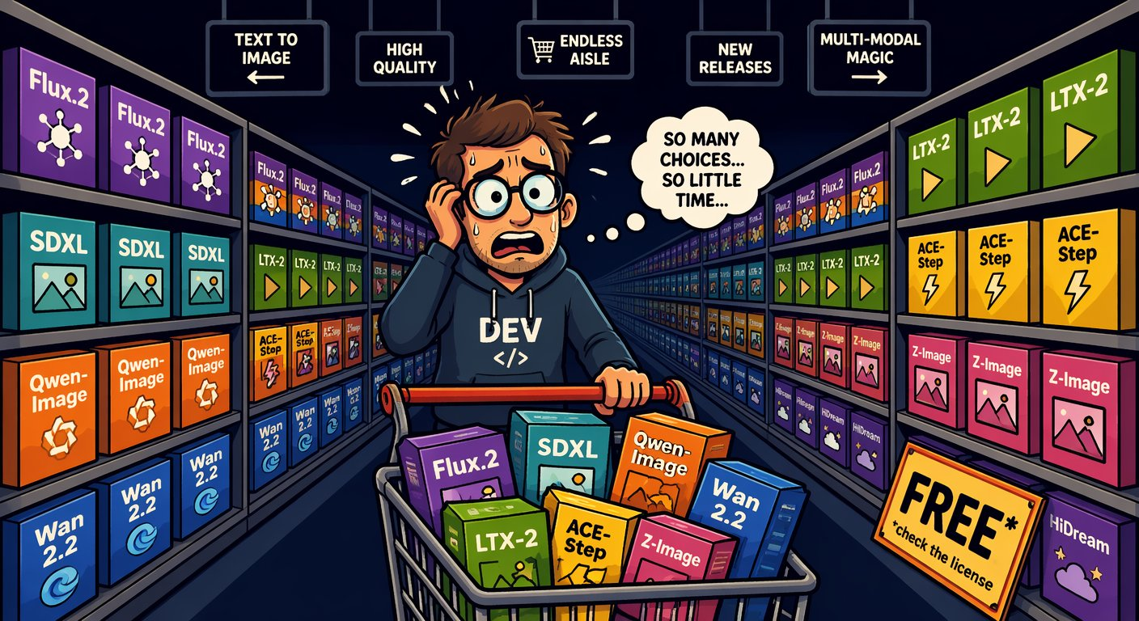
The licence traffic light: read it before you ship
SEGMENT 4 · LOCAL AI, MEDIA & BEYOND THE WEST
as of 2026-09-21
GO — Apache · MIT · OpenMDW · CC-BY
gpt-oss · Gemma 4 · Qwen3.8-27B · DeepSeek V4.x · GLM-5.3-Flash ·
Hy4 · MiMo · Z-Image · FLUX.2 klein 4B · Qwen-Image-2512 · Wan 2.2 ·
ACE-Step 1.5 · Qwen3-TTS · AuK · Parakeet · TRELLIS.2
READ IT FIRST — clauses, revenue caps, regions
GLM-5.3, Kimi K3 (clauses) · Qwen3.8 Max · Llama 4 ·
LTX-2.5, Krea 2 (revenue caps) · HunyuanVideo 1.5 (community) ·
MiniMax-H3, Hunyuan3D (region exclusions)
AI-generated · Beyond the Slop
“The model card is 90 seconds of reading that can save you a lawyer.”
STOP — non-commercial, closed or gone
non-commercial: FLUX.2 [dev] · Ideogram 4.0 · Qwen-Image-2.1 · YuE2
closed: Qwen-Image 2.0/3.0 · Wan 3.0 · Muse Spark ·
Suno v6 (licensed-only) · Sora (ends 09-24)
— Beyond the Slop, 2026
Licences changed a lot in 2025/26 — re-check before every release.
Sources: Model catalog §11 (checked 2026-09-21) · Beyond the Slop (daenet, Jul 2026)
Notes:
[S4-27]
≈ 45 s. The traffic light every zoo row used today, straight from catalog §11. Green = Apache, MIT, OpenMDW or CC-BY: ship it and keep the licence file. Amber = read it first: hyperscaler clauses, revenue caps (LTX-2.5 below $10M, Krea 2 below $1M), region exclusions (MiniMax-H3 and Hunyuan3D both exclude the EU). Red = non-commercial, closed or gone — fine for a demo, not for client work. And check every LoRA’s base model before it reaches a client.
Sources: catalog §11 (checked 2026-09-21); Beyond the Slop slide 42 (July 2026, refreshed per research/2026-09-19_beyond-the-slop-integration.md). The meme is AI-generated (Beyond the Slop assets).

Slide 40
Regulation: open weights skip most GPAI duties, not all
SEGMENT 4 · LOCAL AI, MEDIA & BEYOND THE WEST
as of June 2026 (LLM 101)
Under the EU AI Act, open-source general-purpose models are exempt from most obligations — not from a copyright policy and a training-data summary, and not if they carry systemic risk.
When | What
2025-08-02 | GPAI obligations apply
2026-08-02 | Commission enforcement powers — fines up to 3 % of turnover or €15M
2027-08-02 | deadline for GPAI models placed on the market before August 2025
Dec 2027 / Aug 2028 | high-risk obligations, delayed by the Digital Omnibus (May 2026)
MEANWHILE IN THE US
The “No DeepSeek on Government Devices” bills are proposed or state-level — and target the hosted app, not MIT weights on your own hardware.
1 · the model card
2 · the licence
3 · the law
One link: artificialintelligenceact.eu — enforcement of Chapter V.
Sources: EU AI Act: enforcement of Chapter V · Research: local AI, media & beyond the West, 2026-09-19 · LLM 101 (Day of Data 2026) slides 136–139
Notes:
[S4-28]
[trim] ≈ 30 s. One line: under the EU AI Act, open-source general-purpose models are exempt from most GPAI obligations — not from the copyright policy and the training-data summary, and not if they carry systemic risk (above 10^25 FLOP of training compute). The dates in the table come from the enforcement page and LLM 101 (Digital Omnibus delay). In the US, the “No DeepSeek on Government Devices” bills (H.R.1121 / S.765) are proposed or state-level — about the hosted app, not MIT weights on your own hardware. Read in this order: model card, licence, law.
Digital Omnibus (last table row, from LLM 101, June 2026): provisional political agreement on 2026-05-06, confirmed 2026-05-13 — Annex III high-risk obligations move to 2 Dec 2027, Annex I to 2 Aug 2028 (https://www.gibsondunn.com/eu-ai-act-omnibus-agreement-postponed-high-risk-deadlines-and-other-key-changes/, web-checked 2026-09-23 in the deck fact-check). Publication in the Official Journal was “expected in the coming weeks”.
VERIFY: that the Omnibus text is published in the Official Journal before presenting these dates as law. VERIFY: the enactment status of H.R.1121 / S.765 (research note: not verified — keep saying “proposed / state-level”); add a link to the GPAI Code of Practice if you want it on the slide (not in our sources).
Sources: https://artificialintelligenceact.eu/enforcement-of-chapter-v-under-the-eu-ai-act/ · research/2026-09-19_local-ai-media-beyond-west.md §5 · LLM 101 (Day of Data 2026) slide 139 · https://www.gibsondunn.com/eu-ai-act-omnibus-agreement-postponed-high-risk-deadlines-and-other-key-changes/

Slide 41
The magic sauce is the pipeline, not the model
SEGMENT 4 · LOCAL AI, MEDIA & BEYOND THE WEST
One block’s output is the next block’s input — and every block can be swapped.
1
2
3
4
5
6
LLM
ACE-Step 1.5
FLUX / SDXL
character LoRA
Wan 2.2 I2V
Wan 2.2 S2V
lyrics + story
song with vocals
avatar image
lock the identity
image → video
singing avatar
text
audio
image
keyframes
clip
music video
… OR SWAP IN
any base_url
YuE2-3B
(non-commercial)
Z-Image-Turbo
IP-Adapter
LTX-2.5 ·
HunyuanVideo 1.5
ARTIFACTS
lyrics.txt → song.wav → avatar.png → character.safetensors → clip.mp4 → music_video.mp4
Magic sauce = the composition of the blocks — not one miracle model.
Sources: Beyond the Slop (daenet, Jul 2026) · Model catalog §7 (checked 2026-09-21) · Model catalog §8 (checked 2026-09-21)
Notes:
[S4-29]
≈ 1.5 min — Act IV of Beyond the Slop, now the workshop’s idea for media. Walk the chain left to right: an LLM writes tagged lyrics, ACE-Step 1.5 sings them, FLUX or SDXL makes the avatar, a character LoRA locks the identity, Wan 2.2 turns the image into a clip and S2V makes it sing. Every block reads the previous block’s file — that is why any block can be swapped (grey line). Corrections to the July talk: ACE-Step is MIT, not Apache; LTX-2.5 replaced LTX 2.3; YuE2 is non-commercial.
Drawn natively instead of BTS diagram 07, which still says “Apache 2.0” for ACE-Step and “LTX 2.3”.
Sources: Beyond the Slop slides 43–46 (July 2026); catalog §6–§8 (checked 2026-09-21); research/2026-09-19_beyond-the-slop-integration.md §2.

Slide 42

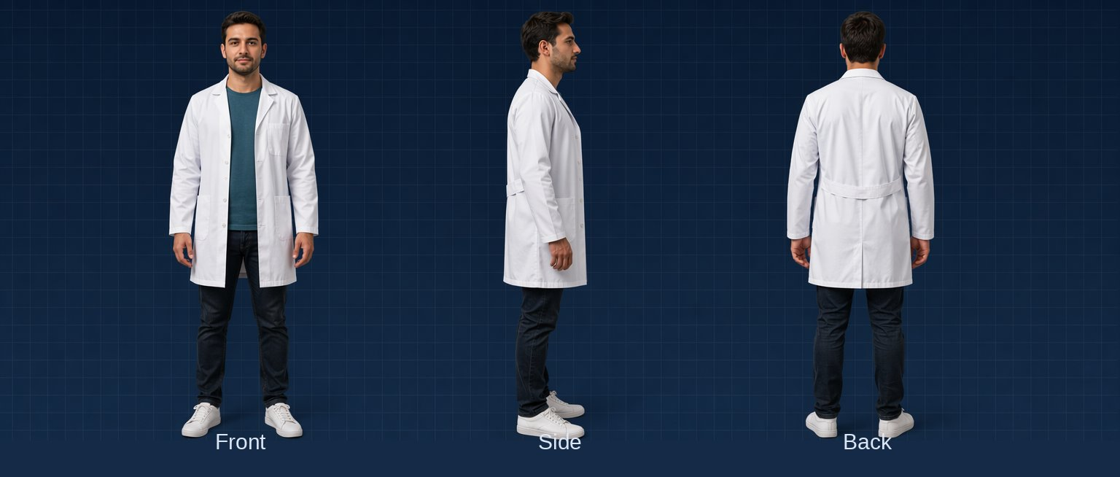

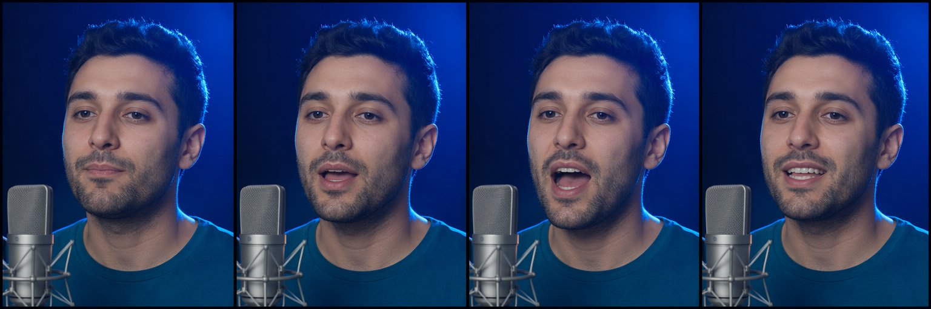
Case: “Vier Tage Sommer” — the DWX chain, block by block
SEGMENT 4 · LOCAL AI, MEDIA & BEYOND THE WEST
1 · avatar (FLUX + FaceID)
2 · character sheet → train a character LoRA
3 · new scenes — same face
AI-generated
AI-generated
AI-generated
THE SOUNDTRACK
An LLM writes tagged lyrics → ACE-Step 1.5 turns them into a full song with vocals, on your own GPU (MIT). Every stage consumed the previous stage’s file.
4 · Wan 2.2 S2V: image + audio → a singing, lip-synced clip
AI-generated
Sources: Beyond the Slop (daenet, Jul 2026) · Research: Beyond the Slop integration · Model catalog §8 (checked 2026-09-21)
Notes:
[S4-30]
HIDDEN until cleared (00_Workshop_Plan §8 Q10: may the DWX “Vier Tage Sommer” music-video pipeline be shown?). If cleared: ≈ 1.5 min, block by block — avatar (FLUX + FaceID), character sheet → character LoRA, new scenes with the same face, Wan 2.2 S2V lipsync; the soundtrack from LLM lyrics through ACE-Step 1.5.
VERIFY: stage times and GPU costs of the DWX production — none are in our sources; add them as labelled pairs (d.pair) only once the DWX team confirms them. The stills are the Beyond the Slop proof-of-concept images (AI-generated, labelled); confirm they are the DWX character before calling them “the DWX chain”.
Sources: Beyond the Slop slides 44–46 (July 2026); assets/from_beyond_the_slop/images/char_*.png; research/2026-09-19_beyond-the-slop-integration.md §1 and §4.

Slide 43
Demo: the music-video chain, stage by stage + Wan2GP
DEMO · SEGMENT 4
LIVE DEMO
1. lyrics.txt → song.wav (ACE-Step 1.5)
2. avatar.png → character sheet → character LoRA
3. clip.mp4 (Wan 2.2 I2V) → music_video.mp4 (S2V)
4. Wan2GP: the same video models in a low-VRAM UI
5. Open the output folder: files, not magic
Every stage consumed the previous stage’s file — swap one block and the chain survives.
IF IT BREAKS
Show the stills of every stage and a Wan2GP screenshot.
live on the instructor laptop
you watch — the lab comes later
Sources: Beyond the Slop (daenet, Jul 2026) · Model catalog §7 (checked 2026-09-21) · Wan2GP (GitHub)
Notes:
[S4-D7]
[trim] 4 minutes, pre-rendered — no live video generation on stage (Wan 2.2 TI2V-5B needs minutes per 5-second clip even on a 4090). Play the stages in order from the artifact folder, then switch to Wan2GP (12.61): show the model list (Wan 2.2, HunyuanVideo 1.5, LTX) and queue one image-to-video job to show the knobs, cancel it. If S4-30 is not cleared, present the stills as the Beyond the Slop proof of concept, not as the DWX production. Fallback stills: assets/from_beyond_the_slop/images/char_*.png. Sources: Beyond the Slop slides 44–46; catalog §7 + §10; https://github.com/deepbeepmeep/Wan2GP

Slide 44
The cloud twin: same chain, same client, no GPU
SEGMENT 4 · LOCAL AI, MEDIA & BEYOND THE WEST
TEXT
IMAGE
VOICE
VIDEO
Ollama · LM Studio
Qwen3.8-27B · Gemma 4
ComfyUI
Z-Image · FLUX.2 klein
Qwen3-TTS
mlx-audio · GGUF
Wan2GP
Wan 2.2 · HunyuanVideo 1.5
LOCAL
Foundry DfA
gpt-5-mini · DeepSeek
Foundry DfA
gpt-image-1-mini · FLUX.2
Foundry DfA
gpt-4o-mini-tts
HF router
fal · Replicate: Wan 2.2
CLOUD
Lab 4 · 05_tts.py — a local TTS server or the workshop endpoint: the same OpenAI client class
PYTHON
if os.getenv("TTS_BASE_URL"):
client, model = OpenAI(base_url=os.environ["TTS_BASE_URL"], api_key="local"), os.environ["TTS_MODEL"]
else:
key = os.environ["GENAI_API_KEY"]
headers = {"api-key": key} if os.getenv("GENAI_KEY_HEADER", "api-key") == "api-key" else None
client = OpenAI(base_url=os.environ["GENAI_BASE_URL"], api_key=key, default_headers=headers)
model = os.getenv("GENAI_TTS_MODEL", "gpt-4o-mini-tts")
Same client, new base_url and model name — the pipeline doesn’t change.
Sources: Model catalog §10 (checked 2026-09-21) · Model catalog §8 (checked 2026-09-21) · Lab 4 05_tts.py (tested vs mock)
Notes:
[S4-31]
≈ 1 min. Same chain, no GPU: the cloud row replaces every local block with a Foundry or Hugging Face endpoint, and the client stays the OpenAI one. The code is Lab 4 step 5 (05_tts.py): with TTS_BASE_URL set it talks to a local OpenAI-compatible TTS server (e.g. Qwen3-TTS or Kokoro), otherwise to GENAI_TTS_MODEL on the workshop endpoint — only base_url, key and model name change. The stretch goal 06_chain.py does the same for the image block: with --workflow the image comes from ComfyUI, without it from GENAI_IMAGE_MODEL in the cloud. No sora-2: its API ends 2026-09-24, so cloud video goes through fal or Replicate on the Hugging Face router.
Sources: catalog §3, §8, §10 (checked 2026-09-21); labs/04-local-media/python/solution/05_tts.py and 06_chain.py (solutions tested against the offline mock and comfy_mock, 2026-09-23).

Slide 45
Cockpits: ComfyUI for graphs, Wan2GP for low-VRAM video
SEGMENT 4 · LOCAL AI, MEDIA & BEYOND THE WEST
CLIP Text Encode (+)
Load Checkpoint
“a red fox, forest”
KSampler
VAE Decode
Save
MODEL · CLIP · VAE
steps 25 · cfg 5
euler · seed 42
latent → pixels
PNG
CLIP Text Encode (−)
“blurry, lowres”
Empty Latent
1024 × 1024
ComfyUI v0.37
Wan2GP 12.61
Lab 4 handouts
Workflows are JSON: export the API format, run it from code (POST /prompt).
One low-VRAM UI for Wan 2.2,
HunyuanVideo 1.5, LTX, ACE-Step
txt2img · pose + LoRA · inpaint · upscale · image → 3D, as ComfyUI workflows
The graph IS the documentation — share the JSON, not a screenshot.
Sources: Model catalog §0 (checked 2026-09-21) · Research: local AI, media & beyond the West, 2026-09-19 · Beyond the Slop (daenet, Jul 2026)
Notes:
[S4-32]
≈ 1 min. Walk the graph left to right: the checkpoint feeds MODEL to the sampler and CLIP to the two prompt encoders, the empty latent is the canvas, the KSampler holds the knobs (steps, CFG, sampler, seed), the VAE decodes to pixels. ComfyUI is the graph editor for exactly this: every block of the loop is a node you can see and rewire, and a workflow is a JSON file — export it in API format and code can run it (Lab 4 posts it to /prompt). v0.37 (2026-09-21) brought day-0 Qwen-Image-2.1; blueprints, subgraphs and partner API nodes came with the 0.36 line. Wan2GP is the cockpit “for the GPU poor”: one UI for Wan 2.2, HunyuanVideo 1.5, LTX, Z-Image, Qwen3-TTS and ACE-Step, tuned for small VRAM. The five handout workflows (labs/04-local-media/comfyui_workflows: 01 txt2img, 02 pose + LoRA, 03 inpaint, 04 upscale, 05 image → 3D) come from Beyond the Slop and ship with Lab 4.
The graph is a native redraw of Beyond the Slop diagram 04 (the picture’s MODEL wire crossed the header of the negative-prompt node).
Sources: catalog §0 + §10 (checked 2026-09-21); research/2026-09-19_local-ai-media-beyond-west.md §4; https://docs.comfy.org/changelog · https://github.com/deepbeepmeep/Wan2GP · labs/04-local-media/comfyui_workflows/README_EN.md · Beyond the Slop slides 40–41 (diagram 04).

Slide 46
Lab 4 — Local & multimodal: the craft lab
HANDS-ON LAB · SEGMENT 4
YOUR TURN
1. Your machine · 01_local_models.py: TTFT, tok/s, tools
2. ComfyUI from code · 02_comfy_run.py: log the seed
3. One knob · 03_one_knob.py (TODO 1): contact sheet
4. No GPU · 04_cloud_image.py on the workshop endpoint
5. Speech · 05_tts.py (TODO 1): cloud or local TTS
Run your Lab 1 code on your own machine, then drive image generation from code like a craftsperson.
CHECKPOINT
Core = steps 1–3 (no GPU: 1, 4, 5). Done when a PNG + .json with its seed re-renders the same image.
Code: labs/04-local-media
Fallback: no GPU → steps 4–5; _tools/comfy_mock.py stands in for ComfyUI
STRETCH
06_chain.py — LLM → image → voice; swap any block, the chain stays.
Sources: Lab 4 README
Notes:
[S4-L4]
25 minutes, core 15. Everyone does step 1 — the Lab 1 code on Ollama, LM Studio or Foundry Local, measuring time to first token and tokens per second (first call includes loading; OLLAMA_REASONING_EFFORT=none switches thinking off). With a GPU: steps 2–3 in ComfyUI; without: steps 4–5 on the workshop endpoint. The two craft checkpoints: a seed in every .json, one knob per contact sheet. Fallbacks: comfy_mock.py renders flat images that print the knobs they received; pre-rendered contact sheets and audio on screen. Source: labs/04-local-media/README.md (verified 2026-09-23 against the mocks and Ollama; not yet on a real GPU — do that in the dry run).

Slide 47
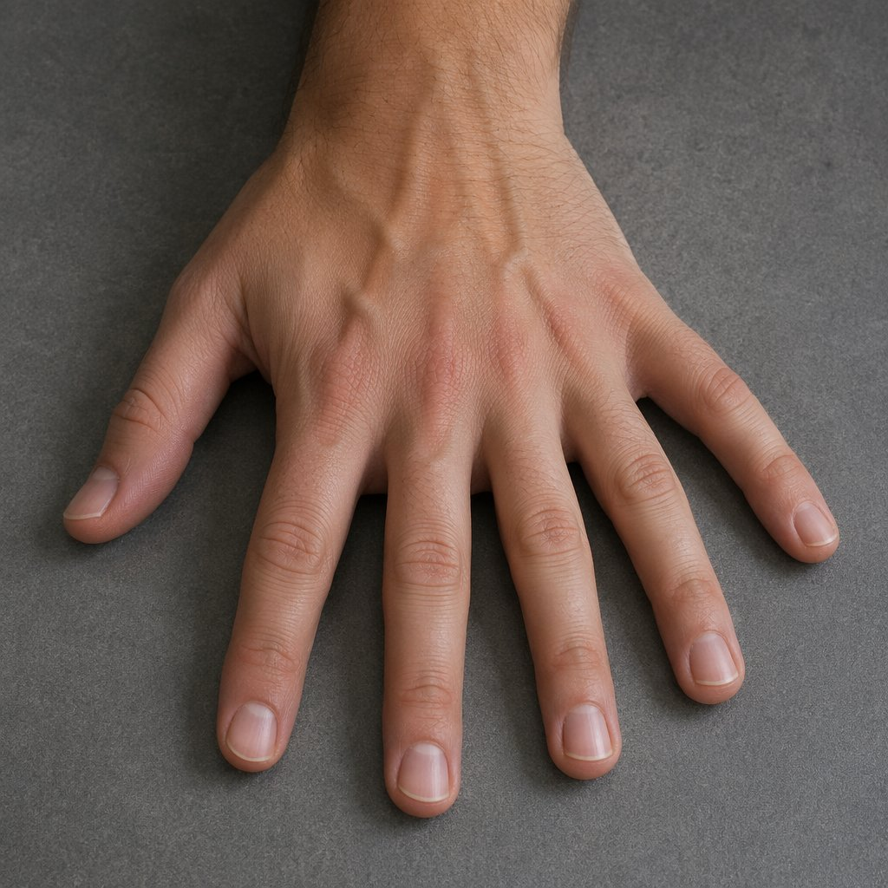
Where it still breaks — and what to tell the customer
SEGMENT 4 · LOCAL AI, MEDIA & BEYOND THE WEST
ANATOMY — hands, teeth, text
DRIFT — identity & style
Better in 2026, not solved. Fix: inpaint + FaceDetailer, DWPose with hand keypoints.
Zero-shot identity drifts over many shots. Fix: character LoRA, fixed seeds, reference frames.
COHERENCE — long videos
COMPUTE — time & VRAM
Motion falls apart in long clips. Fix: keyframe chains, VACE control, cuts.
Video eats GPUs for breakfast. Fix: quantization, low-res drafts, upscale the winner.
AI-generated · the classic: bonus fingers
LICENCES — the one you can’t inpaint
Check every LoRA’s base model and every model card before it reaches a client.
Tell the customer: the first roll is slop — the craft is the iteration.
Sources: Beyond the Slop (daenet, Jul 2026)
Notes:
[S4-33]
≈ 1 min. Four ways it still breaks, each with its fix: anatomy (hands, teeth, text) → inpaint + FaceDetailer, DWPose with hand keypoints; drift of identity and style → character LoRA, fixed seeds, reference frames; coherence of long videos (in July motion fell apart beyond ~10–20 s) → keyframe chains, VACE control, cuts; compute → quantization, low-res drafts, upscale the winner. The fifth is the licence — you cannot inpaint your way out of a non-commercial base model. What to tell the customer: slop is not a model property, it is what shipping the first roll looks like.
Sources: Beyond the Slop slides 42 and 47 (July 2026). The hand is AI-generated (Beyond the Slop assets).

Slide 48
Five craft principles — tape them to your monitor
SEGMENT 4 · LOCAL AI, MEDIA & BEYOND THE WEST
1
2
3
4
5
Log the seed
Change one knob
Control before prompt
Fix, don’t regenerate
Keep the pipeline, swap the model
Reproducibility is the difference between craft and gambling.
Seed fixed, one change, compare: debugging, not magic.
A pose skeleton or a reference image beats fifty adjectives.
Inpaint the hand; keep the seed and the rest of the image.
The graph is the asset; the models rotate.
Lab 4 checks the first two: a seed in every .json, one knob per contact sheet.
Sources: Beyond the Slop (daenet, Jul 2026) · Lab 4 README
Notes:
[S4-34]
≈ 45 s. Five principles — tape them to the monitor. Log the seed: reproducibility is the difference between craft and gambling. Change one knob: seed fixed, one change, compare. Control before prompt: a pose skeleton or a reference image says more than fifty adjectives. Fix, don’t regenerate: inpaint the detail, keep the seed. Keep the pipeline, swap the model. Lab 4 checks the first two — every image gets a .json with its seed, and 03_one_knob.py builds a one-knob contact sheet.
Sources: Beyond the Slop slide 48 (July 2026), adapted to the plan’s five (06_Narrative_Plan S4-34); labs/04-local-media/README.md.

Slide 49
Bet on the loop, not the model
SEGMENT 4 · LOCAL AI, MEDIA & BEYOND THE WEST
Models rotate every quarter. The loop — encoder → latent → denoiser → VAE — has been stable for years.
THE LOOP
ADAPTERS
OPEN WEIGHTS
PIPELINES
The blocks and knobs you learned today outlive every model release.
LoRA, ControlNet, IP-Adapter survive model generations — your skills transfer.
They can’t be discontinued — and in 2026 they are genuinely good.
Composition is the moat: anyone can prompt, few can build the chain.
The same bet as the whole day: the blocks stay, the models rotate.
Sources: Beyond the Slop (daenet, Jul 2026)
Notes:
[S4-35]
≈ 45 s — the segment’s thesis (dark, like its opening thesis S4-02). Models rotate every quarter; encoder → latent → denoiser → VAE has been stable for years. Adapters — LoRA, ControlNet, IP-Adapter — survive model generations, so your skills transfer. Open weights can’t be discontinued, and in 2026 they are genuinely good. Pipelines are the moat: anyone can prompt, few can build the chain. It is the same bet as the whole day: the blocks stay, the models rotate.
Source: Beyond the Slop slide 54 (July 2026).

Slide 50
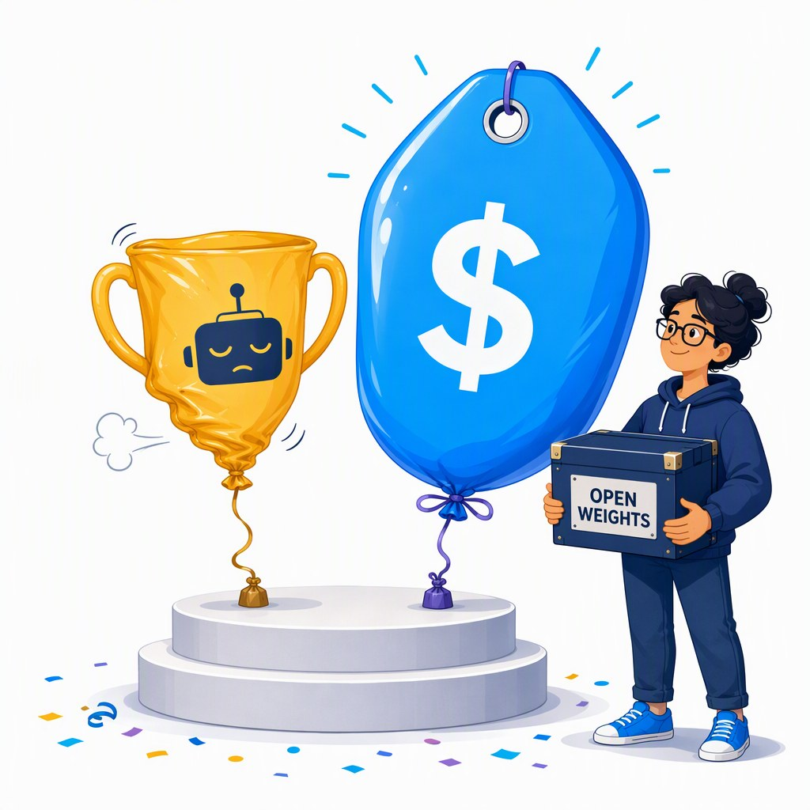
Economics: the nerf cycle, and why open weights are the hedge
SEGMENT 4 · LOCAL AI, MEDIA & BEYOND THE WEST
as of June 2026 (LLM 101)
The pattern: launch flat-rate → reach saturation → meter the agent users.
When | Who | What changed
2025-08 | Anthropic | weekly limits on Claude Pro / Max
2026-06-01 | GitHub Copilot | premium requests → token-based AI Credits
2025–26 | OpenAI | ChatGPT Plus message caps tightened, several times
– | Cursor · Windsurf · Replit Agent | “unlimited” → “fair use” → caps
Route — cheap model first, escalate when needed
Own the catalog — a base_url and a model list you control
Keep an open fallback — open weights on your hardware = predictable cost
Architect for choice: a base_url plus a catalog you own is the hedge.
Sources: LLM 101 (Day of Data 2026) slides 136–139
Notes:
[S4-36]
≈ 1 min. The pattern from LLM 101: introduce flat-rate or “unlimited”, reach saturation, then meter the agent users — Anthropic’s weekly limits on Claude Pro/Max (Aug 2025), GitHub Copilot’s switch to token-based AI Credits (2026-06-01; agentic users report 10–50× cost jumps), ChatGPT Plus caps tightened several times, and “unlimited” tiers at Cursor, Windsurf and Replit that became “fair use”, then explicit caps. Why: reasoning and agents cost 5–50× more than 2024 chat, and the subsidy era is ending. The hedge is architecture: route cheap first and escalate, keep a base_url and a model catalog you own, and keep an open-weight fallback on your own hardware for predictable cost.
The table is LLM 101 slide 137 (June 2026), hence the pill. Newer evidence for the same point, if asked: GitHub Models was retired on 2026-07-30 (https://github.blog/changelog/2026-07-30-github-models-is-now-retired/) and the Sora API ends on 2026-09-24 (catalog §7).
Sources: LLM 101 (Day of Data 2026) slides 136–139; research/2026-09-19_foundry-access-for-workshop.md §6; catalog §7.

Slide 51
Closer: an ACE-Step song about today
DEMO · SEGMENT 4
LIVE DEMO
1. Chat model → tagged lyrics from the agenda (Lab 1 style)
2. ACE-Step 1.5: lyrics + style → a full song with vocals
3. Log the seed next to the WAV (craft principle #1)
4. Play it — the outro of Segment 4
Lab 1 code turns today’s agenda into lyrics; ACE-Step 1.5 sings them — on one GPU, under MIT.
IF IT BREAKS
live on the instructor laptop
you watch — the lab comes later
Play the pre-rendered song.
Sources: Model catalog §8 (checked 2026-09-21) · ACE-Step 1.5 (GitHub)
Notes:
[S4-D8]
3 minutes, the last thing before the close. Try it live, with the dry-run song as backup: the chat model turns the agenda into tagged lyrics ([verse] / [chorus]) with structured output, exactly like Lab 1; ACE-Step 1.5 renders the song (<4 GB VRAM, under 10 s on a 3090; MLX on a Mac). Log the seed next to the WAV — craft principle #1. In the 75-minute cut this becomes the break music. Fallback file: demos/S4-D8/fallback/. Sources: catalog §8; https://github.com/ace-step/ACE-Step-1.5

Slide 52
The settings you now control
WRAP-UP
One knob per block — you turned every one of them today.
tokens
chat API
structured output
tools
MCP / skills
agent loop
workflow
media pipeline
vocabulary
temperature
JSON schema
tool list
server / SKILL.md
session · budget
orchestration
seed · CFG
S1 · LAB 1
S3 · LAB 3
S2 · LAB 2
S4 · LAB 4
Same blocks, many vendors, your machine: the knobs travel with your code.
Sources: Narrative plan v001
Notes:
[E-01]
The spine from S1-02 once more, complete: tokens → chat API → structured output → tools → MCP/skills → agent loop → workflow → media pipeline. Under each block, the knob you touched today: vocabulary, temperature, JSON schema, tool list, server/SKILL.md, session and budget, orchestration, seed and CFG.
The bars show where each segment and lab worked on the spine (Segments 1 and 2 overlap on structured output and tools).
Message: none of these knobs belongs to one vendor — the same settings work on Foundry, DeepSeek, Kimi or Ollama. Timing: one minute.
Sources: Narrative plan v001 — 06_Narrative_Plan_v001.md · Workshop plan v001 — 00_Workshop_Plan.md

Slide 53
What you can do now: this morning’s checklist, ticked
WRAP-UP
✓
Explain how a model is made, and what is model vs. PaaS on top
SEGMENT 1
✓
Call any OpenAI-compatible endpoint with knobs, schemas and tools
LAB 1
✓
Build a RAG and expose it as an MCP server or a skill
LAB 2
✓
Build a two-agent workflow (MAF, LangGraph), know how to deploy it
LAB 3
✓
Run text, image, speech and video models locally, and mix them
LAB 4
✓
Judge vendor claims with sources
ALL DAY
Something unticked? Every lab has a solution folder and runs on Ollama or the offline mock.
Sources: Workshop plan v001 · labs/README.md
Notes:
[E-02]
The six outcomes from the opening (F-03), ticked. Go through them quickly and name the lab or demo where each one happened: Segment 1 talk; Lab 1; Lab 2; Lab 3 plus the hosted-agent demo; Lab 4 plus the Segment 4 demos; and the source lines all day.
Ask for one hand per outcome that feels shaky — that is the list for the take-home slide.
Every lab folder has python/, csharp/ and typescript/ starters plus solution/, and every script runs against Ollama or the offline mock.
Sources: Workshop plan v001 — 00_Workshop_Plan.md · labs/README.md

Slide 54
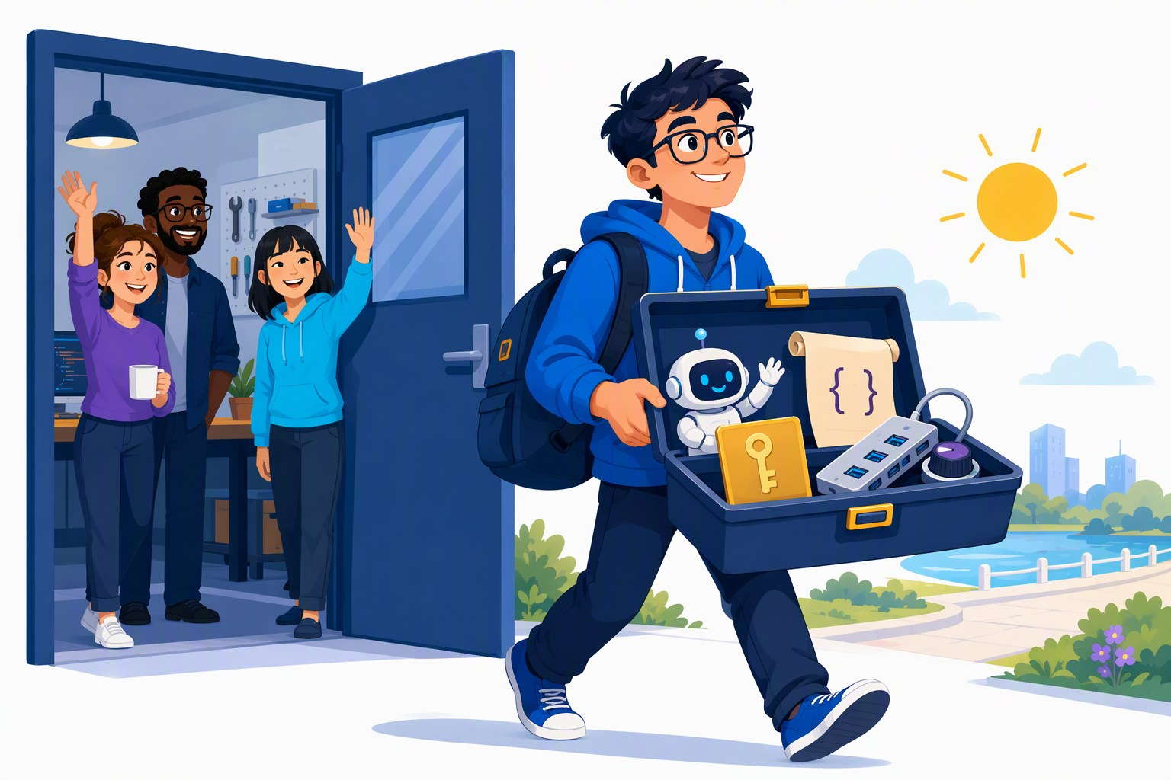
Take-home: the labs, the catalog, and how to re-check both
WRAP-UP
THE LABS
labs/ — four labs in Python, C# and TypeScript (Lab 4 Python-first), each with its solution; they also run on Ollama or the offline mock.
THE CATALOG
05_Model_Catalog_2026-09: names, prices, licences and where to run — checked 2026-09-21, with a half-life of weeks.
REPO LINK + FEEDBACK QR
to be added
THE RECIPE
Before you quote a fact: registries for versions, Azure retail prices for prices, the model card for the licence — and write the date next to it.
Sources: labs/README.md · Model catalog §0 (checked 2026-09-21) · genai-landscape-research skill
Notes:
[E-03]
Three things to take home. The labs: four labs, three languages, starters plus solutions, one settings file; they keep working after today on Ollama or the offline mock (the workshop keys are switched off after the event).
The model catalog: every model, price and licence on today’s slides came from it; it was checked on 2026-09-21 and ages in weeks — treat it as a dated snapshot.
The recipe (skill genai-landscape-research): pkg_versions.py for framework versions, the Azure retail prices API for prices, the Foundry "sold by Azure" page for credit eligibility, model cards for licences — and a date next to every fact.
VERIFY: repository URL (SETUP.md still says <repository-url-from-the-invitation>), the feedback QR code, and whether the catalog is handed out as a PDF.
Sources: labs/README.md · Model catalog §0 (checked 2026-09-21) — 05_Model_Catalog_2026-09.md · genai-landscape-research skill — skills/genai-landscape-research/SKILL.md · labs/00-setup/SETUP.md

Slide 55
Thank you
daenet — an ACP Digital company
CONTACT · E-MAIL · QR — to be added
Every source of today: appendix A-01 (References).
Building Stuff with GenAI · the open-minded workshop beyond OpenAI
Notes:
[E-04]
Thank you. Point to the references appendix (A-01): every fact slide of the day is listed there with its URL and the date it was checked.
Remind people that the workshop keys are switched off after the event; the labs keep running on Ollama or the offline mock.
VERIFY: contact / QR — speaker name, e-mail and QR code are not in the sources yet (LLM 101 slide 141 has the contact pattern to reuse).
Sources: Narrative plan v001 — 06_Narrative_Plan_v001.md · labs/00-setup/SETUP.md

Slide 56
Appendix
IN THIS APPENDIX
A-01 References
BUILDING STUFF WITH GENAI
Reference slides — not presented
Facts as of 2026-09-21 · built 2026-09-23
Notes:
[A-00]
Appendix: reference slides for after the day, not presented.
A-01 lists every source cited in this deck (generated from refs.py; only the keys this deck actually cites). The catalog tables are generated from 05_Model_Catalog_2026-09.md at build time — numbers are never typed into the deck.
Sources: Narrative plan v001 — 06_Narrative_Plan_v001.md

Slide 57
Every source cited in this deck (1/3)
APPENDIX · SOURCES
Source | Link | Checked | Used on
Workshop plan v001 | 00_Workshop_Plan.md | 2026‑09‑22 | F-04-S4, E-02
labs/.env.example | labs/.env.example | 2026‑09‑23 | F-05-S4
labs/00-setup/SETUP.md | labs/00-setup/SETUP.md | 2026‑09‑23 | F-05-S4, S4‑05, S4‑07
Gateway policy attendee-policy.xml | infra/policies/attendee-policy.xml | 2026‑09‑19 | F-05-S4
Beyond the Slop (daenet, Jul 2026) | research/beyond_the_slop/Beyond_the_Slop_…6_slide_text.txt | 2026‑07‑14 | S4‑02, S4‑03, S4‑07 +20
Model catalog §7 (checked 2026‑09‑21) | 05_Model_Catalog_2026‑09.md | 2026‑09‑21 | S4‑03, S4‑20, S4‑21b +2
Model catalog §11 (checked 2026‑09‑21) | 05_Model_Catalog_2026‑09.md | 2026‑09‑21 | S4‑03, S4‑14, S4‑19 +8
LLM 101 (Day of Data 2026) slide 131 | DayOfData2026/LLM_101/LLM_101_100.pptx | 2026‑09‑23 | S4‑03, S4‑04, S4‑06, S4‑07
Model catalog §0 (checked 2026‑09‑21) | 05_Model_Catalog_2026‑09.md | 2026‑09‑21 | S4‑04, S4‑32, E-03
Model catalog §10 (checked 2026‑09‑21) | 05_Model_Catalog_2026‑09.md | 2026‑09‑21 | S4‑04, S4-D2, S4‑19b +2
Research: local AI, media & beyond the West, 2026‑09‑19 | research/2026‑09‑19_local-ai-media-beyond-west.md | 2026‑09‑19 | S4‑04, S4‑08, S4‑20 +5
Foundry Local docs | learn.microsoft.com/en-us/azure/foundry-l…is-foundry-local | 2026‑09‑19 | S4‑04, S4-D2, S4‑07
Framework verification 2026‑09‑22 §7 | research/2026‑09‑22_framework-snippet-verification.md | 2026‑09‑22 | S4‑05, S4-D3
Lab 1 01_hello.py (tested) | labs/01-hello-model/python/solution/01_hello.py | 2026‑09‑22 | S4‑05
Model catalog §3 (checked 2026‑09‑21) | 05_Model_Catalog_2026‑09.md | 2026‑09‑21 | S4-D1, S4‑06, S4‑07 +3
Notes:
[A-01a]
Generated from refs.py (merged REFS of all deck modules) — only the sources this deck cites, in the order of their first use; "Used on" lists slide ids. Links are clickable in the file and the PDF; the full list with every URL is 07_References_v001.md (refs.write_markdown).
Full URLs on this page: Workshop plan v001 — 00_Workshop_Plan.md · labs/.env.example · labs/00-setup/SETUP.md · Gateway policy attendee-policy.xml — infra/policies/attendee-policy.xml · Beyond the Slop (daenet, Jul 2026) — research/beyond_the_slop/Beyond_the_Slop_GenAI_2026_slide_text.txt · Model catalog §7 (checked 2026-09-21) — 05_Model_Catalog_2026-09.md · Model catalog §11 (checked 2026-09-21) — 05_Model_Catalog_2026-09.md · LLM 101 (Day of Data 2026) slide 131 — DayOfData2026/LLM_101/LLM_101_100.pptx · Model catalog §0 (checked 2026-09-21) — 05_Model_Catalog_2026-09.md · Model catalog §10 (checked 2026-09-21) — 05_Model_Catalog_2026-09.md · Research: local AI, media & beyond the West, 2026-09-19 — research/2026-09-19_local-ai-media-beyond-west.md · Foundry Local docs — https://learn.microsoft.com/en-us/azure/foundry-local/what-is-foundry-local · Framework verification 2026-09-22 §7 — research/2026-09-22_framework-snippet-verification.md · Lab 1 01_hello.py (tested) — labs/01-hello-model/python/solution/01_hello.py · Model catalog §3 (checked 2026-09-21) — 05_Model_Catalog_2026-09.md

Slide 58
Every source cited in this deck (2/3)
APPENDIX · SOURCES
Source | Link | Checked | Used on
Qwen3.8‑27B model card | huggingface.co/Qwen/Qwen3.8‑27B | 2026‑09‑19 | S4-D1, S4‑09
Research: hardware sizing & Chinese models, 2026‑09‑21 | research/2026‑09‑21_local-hardware-sizing…hinese-models.md | 2026‑09‑21 | S4-D1, S4‑08
Lab 4 README | labs/04-local-media/README.md | 2026‑09‑23 | S4-D2, S4-D4, S4‑15 +2
Apple Newsroom 2026‑08‑25 (Mac Studio M5) | apple.com/newsroom/2026/08/apple-introduc…ax-and-m5-ultra/ | 2026‑09‑19 | S4‑06
Tom’s Hardware: DRAM at a 15-year high | tomshardware.com/pc-components/dram/amds-…hit-15-year-high | 2026‑09‑19 | S4‑06
Gemma 4 model card | ai.google.dev/gemma/docs/core/model_card_4 | 2026‑09‑19 | S4‑09, S4-D3
Model catalog §6 (checked 2026‑09‑21) | 05_Model_Catalog_2026‑09.md | 2026‑09‑21 | S4‑11, S4-D4, S4‑14 +2
Lab 4 ComfyUI handouts | labs/04-local-media/comfyui_workflows/README_EN.md | 2026‑09‑23 | S4‑12, S4-D4, S4‑16 +2
Z-Image-Turbo model card | huggingface.co/Tongyi-MAI/Z-Image-Turbo | 2026‑09‑19 | S4-D4
Zhang & Agrawala 2023, ControlNet | arxiv.org/abs/2302.05543 | 2026‑07‑02 | S4‑16
Ye et al. 2023, IP-Adapter | arxiv.org/abs/2308.06721 | 2026‑07‑02 | S4‑17
Research: Beyond the Slop integration | research/2026‑09‑19_beyond-the-slop-integration.md | 2026‑09‑19 | S4‑19, S4‑30
Model catalog §8 (checked 2026‑09‑21) | 05_Model_Catalog_2026‑09.md | 2026‑09‑21 | S4‑21, S4-D6, S4‑21b +4
Qwen3-TTS (GitHub) | github.com/QwenLM/Qwen3-TTS | 2026‑09‑19 | S4-D6
Parakeet TDT 0.6B v3 (HF) | huggingface.co/nvidia/parakeet-tdt-0.6b-v3 | 2026‑09‑19 | S4-D6
Notes:
[A-01b]
Generated from refs.py (merged REFS of all deck modules) — only the sources this deck cites, in the order of their first use; "Used on" lists slide ids. Links are clickable in the file and the PDF; the full list with every URL is 07_References_v001.md (refs.write_markdown).
Full URLs on this page: Qwen3.8-27B model card — https://huggingface.co/Qwen/Qwen3.8-27B · Research: hardware sizing & Chinese models, 2026-09-21 — research/2026-09-21_local-hardware-sizing-chinese-models.md · Lab 4 README — labs/04-local-media/README.md · Apple Newsroom 2026-08-25 (Mac Studio M5) — https://www.apple.com/newsroom/2026/08/apple-introduces-new-mac-studio-with-m5-max-and-m5-ultra/ · Tom's Hardware: DRAM at a 15-year high — https://www.tomshardware.com/pc-components/dram/amds-gorgon-halo-pushes-on-device-ai-memory-to-192gb-as-dram-prices-hit-15-year-high · Gemma 4 model card — https://ai.google.dev/gemma/docs/core/model_card_4 · Model catalog §6 (checked 2026-09-21) — 05_Model_Catalog_2026-09.md · Lab 4 ComfyUI handouts — labs/04-local-media/comfyui_workflows/README_EN.md · Z-Image-Turbo model card — https://huggingface.co/Tongyi-MAI/Z-Image-Turbo · Zhang & Agrawala 2023, ControlNet — https://arxiv.org/abs/2302.05543 · Ye et al. 2023, IP-Adapter — https://arxiv.org/abs/2308.06721 · Research: Beyond the Slop integration — research/2026-09-19_beyond-the-slop-integration.md · Model catalog §8 (checked 2026-09-21) — 05_Model_Catalog_2026-09.md · Qwen3-TTS (GitHub) — https://github.com/QwenLM/Qwen3-TTS · Parakeet TDT 0.6B v3 (HF) — https://huggingface.co/nvidia/parakeet-tdt-0.6b-v3

Slide 59
Every source cited in this deck (3/3)
APPENDIX · SOURCES
Source | Link | Checked | Used on
Model catalog §9 (checked 2026‑09‑21) | 05_Model_Catalog_2026‑09.md | 2026‑09‑21 | S4‑22
Foundry access research 2026‑09‑19 | research/2026‑09‑19_foundry-access-for-workshop.md | 2026‑09‑19 | S4‑23
Foundry Models sold by Azure | learn.microsoft.com/en-us/azure/ai-foundr…irectly-by-azure | 2026‑09‑19 | S4‑23
HF Inference Providers docs | huggingface.co/docs/inference-providers/en/index | 2026‑09‑19 | S4‑23
Model catalog §2 (checked 2026‑09‑21) | 05_Model_Catalog_2026‑09.md | 2026‑09‑21 | S4‑24, S4‑25, S4‑26
OpenRouter rankings 2026‑09‑18 | openrouter.ai/rankings | 2026‑09‑19 | S4‑24
EU AI Act: enforcement of Chapter V | artificialintelligenceact.eu/enforcement-…r-the-eu-ai-act/ | 2026‑09‑19 | S4‑28
LLM 101 (Day of Data 2026) slides 136–139 | DayOfData2026/LLM_101 deck, slides 136–139 | 2026‑09‑23 | S4‑28, S4‑36
Wan2GP (GitHub) | github.com/deepbeepmeep/Wan2GP | 2026‑09‑19 | S4-D7
Lab 4 05_tts.py (tested vs mock) | labs/04-local-media/python/solution/05_tts.py | 2026‑09‑23 | S4‑31
ACE-Step 1.5 (GitHub) | github.com/ace-step/ACE-Step-1.5 | 2026‑09‑19 | S4-D8
Narrative plan v001 | 06_Narrative_Plan_v001.md | 2026‑09‑22 | E-01
labs/README.md | labs/README.md | 2026‑09‑23 | E-02, E-03
genai-landscape-research skill | skills/genai-landscape-research/SKILL.md | 2026‑09‑19 | E-03
Notes:
[A-01c]
Generated from refs.py (merged REFS of all deck modules) — only the sources this deck cites, in the order of their first use; "Used on" lists slide ids. Links are clickable in the file and the PDF; the full list with every URL is 07_References_v001.md (refs.write_markdown).
Full URLs on this page: Model catalog §9 (checked 2026-09-21) — 05_Model_Catalog_2026-09.md · Foundry access research 2026-09-19 — research/2026-09-19_foundry-access-for-workshop.md · Foundry Models sold by Azure — https://learn.microsoft.com/en-us/azure/ai-foundry/foundry-models/concepts/models-sold-directly-by-azure · HF Inference Providers docs — https://huggingface.co/docs/inference-providers/en/index · Model catalog §2 (checked 2026-09-21) — 05_Model_Catalog_2026-09.md · OpenRouter rankings 2026-09-18 — https://openrouter.ai/rankings · EU AI Act: enforcement of Chapter V — https://artificialintelligenceact.eu/enforcement-of-chapter-v-under-the-eu-ai-act/ · LLM 101 (Day of Data 2026) slides 136–139 — DayOfData2026/LLM_101 deck, slides 136–139 · Wan2GP (GitHub) — https://github.com/deepbeepmeep/Wan2GP · Lab 4 05_tts.py (tested vs mock) — labs/04-local-media/python/solution/05_tts.py · ACE-Step 1.5 (GitHub) — https://github.com/ace-step/ACE-Step-1.5 · Narrative plan v001 — 06_Narrative_Plan_v001.md · labs/README.md · genai-landscape-research skill — skills/genai-landscape-research/SKILL.md

