Slide 1

US CRIME RATE DATA
ANALYSIS
Data science Final Project
Team Data geeks

Slide 2

Team Members
Pavani
Billapati
Vishnupriya
Doddapaneni
Gowthami
Middela
Trilok Kumar

Slide 3

OBJECTIVE
Aim of this study is to scrutinize &
predict the occurrence of crime
rates in an area in the US using
Logistic regression algorithm

Slide 4

Our Dataset
contains
almost US
state crime
data
information

Slide 5
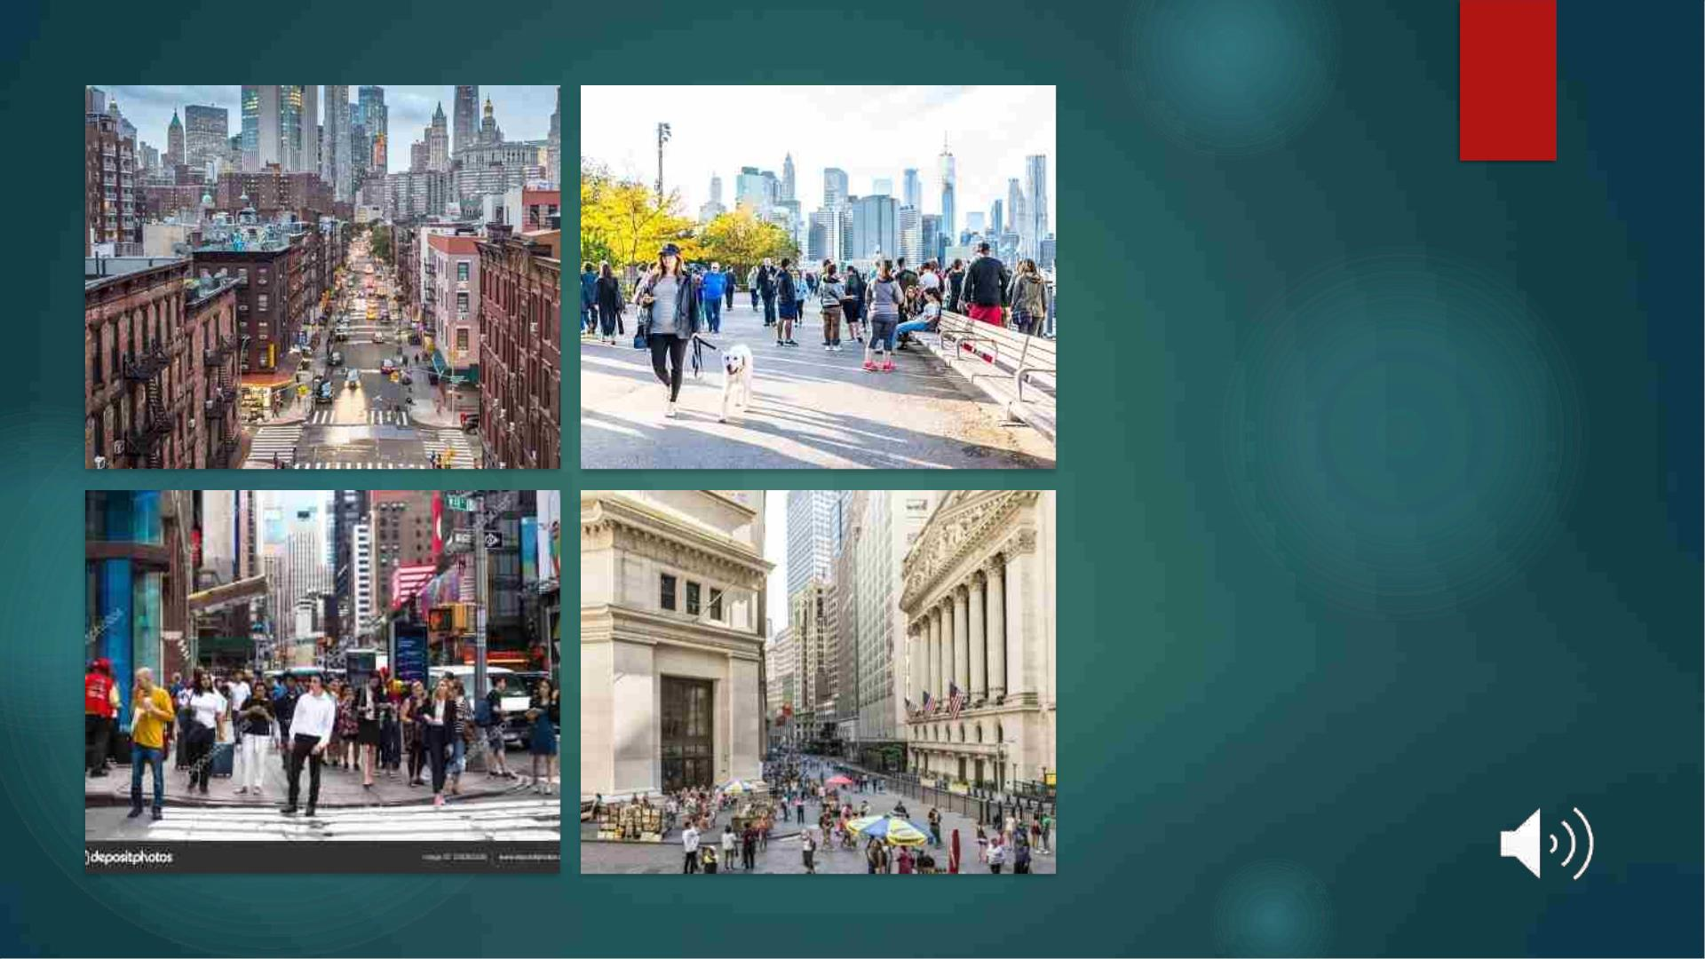
Each state differs in
its lifestyle,
demographics,
wealth, and age
group distribution
which eventually
has an effect on the
occurrence &
severity of the crime

Slide 6

Focus
◆ To predict the occurrence of crime in a given region using
different aspects.

Slide 7
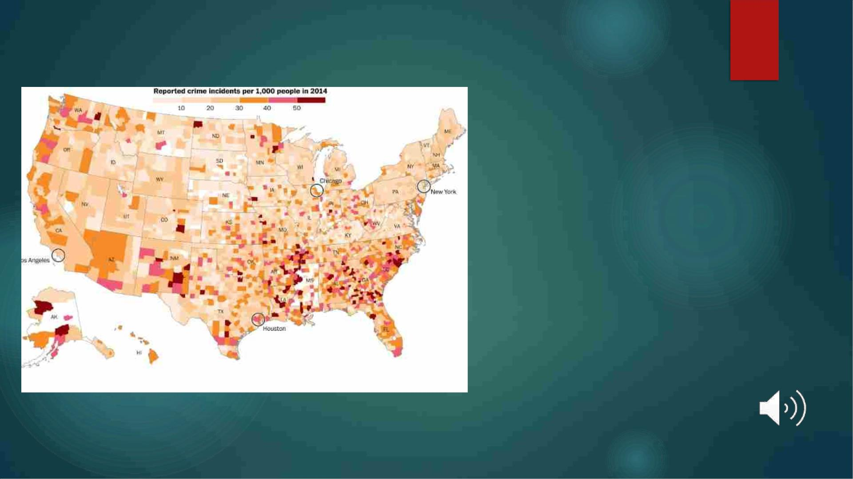
STATISTICS

Slide 8
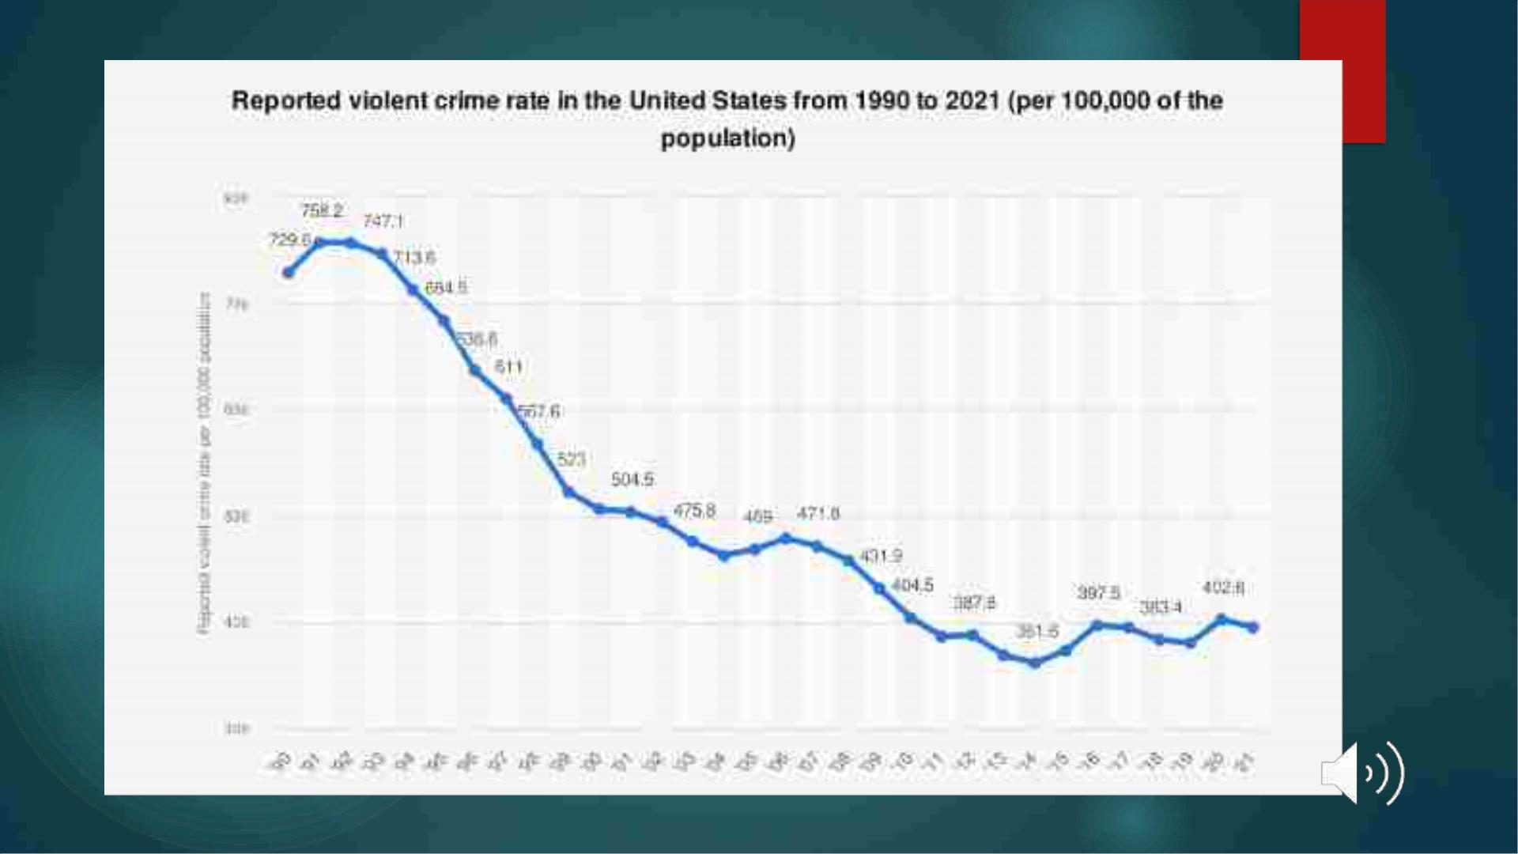

Slide 9

Crimedata
Ø Source - Kaggle
Ø Information about Contains 148 features.
Ø Contains information about the regional
distribution of population(rural, urban),
employment rates, race, age, financial status
etc.
Data

Slide 10
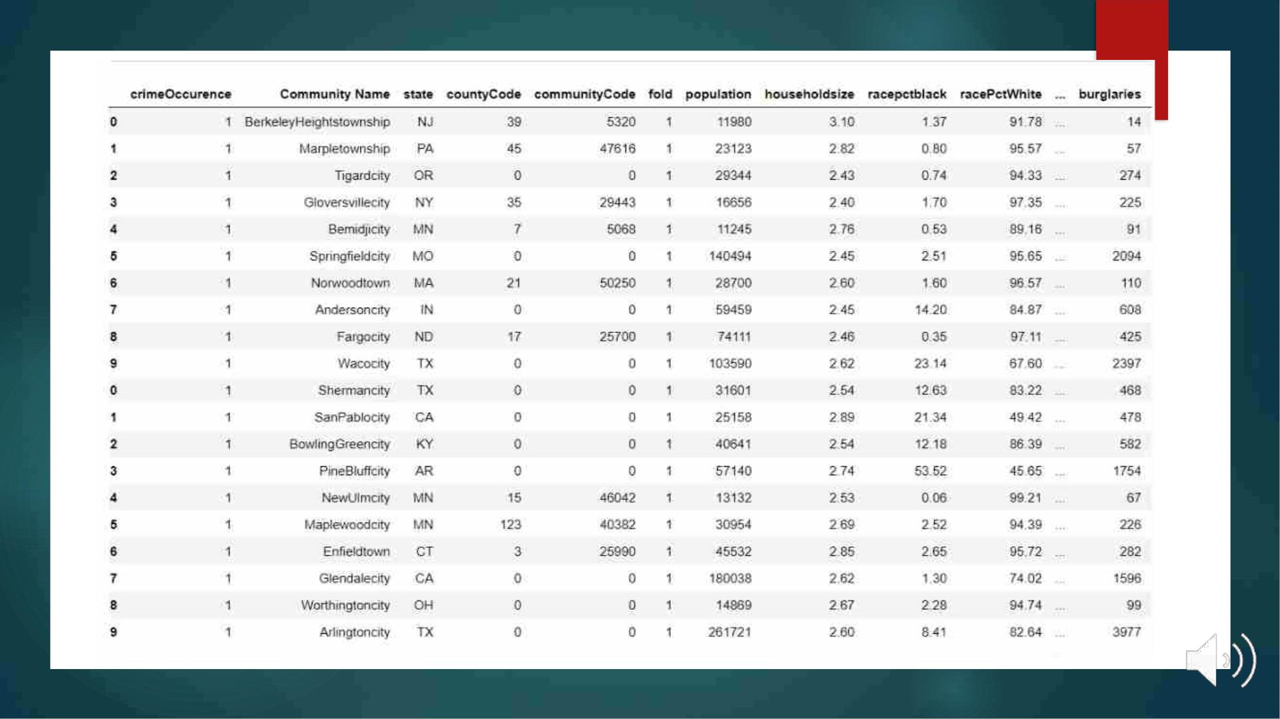

Slide 11
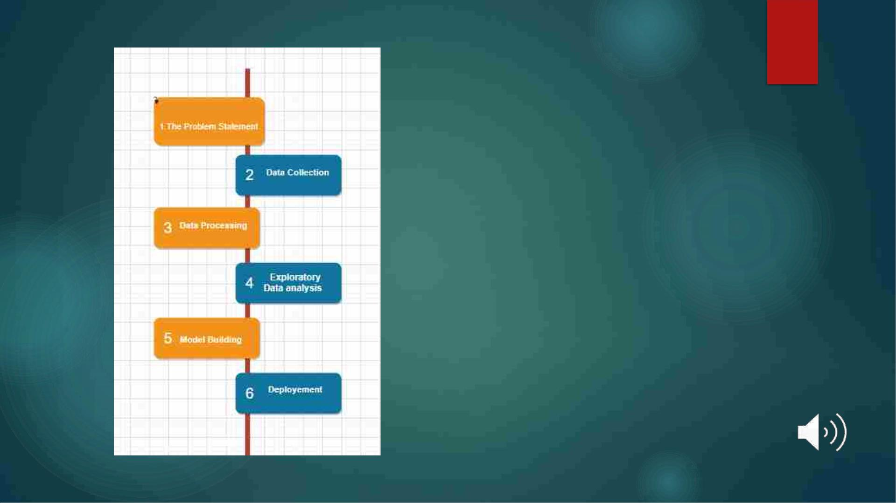
Workflow
Diagram

Slide 12

Problem Statement
◆ Defines the point you hope to
solve or the impact you hope to
make with your work.
◆ What is the problem that you are
trying to solve?”
◆ should be clear, concise, and
define a measurable outcome.
◆ Here it is predicting the
occurrence of crime

Slide 13

Data Collection
Depends upon the problem selected
◆ IOT system - various sources such as a
file, database, sensor
◆ Kaggle
◆ UCI Machine Learning Repository

Slide 14

◆ Involves cleaning raw data
Data
Processing
◆ Every data scientist should spend more time on data pre-
processing compared to actually performing the analysis
◆ We have split the data set into training & testing sets in a
4:1 ratio

Slide 15

◆ Identify obvious errors, as well as better
understand patterns within the data, detect
outliers or anomalous events, find interesting
relations among the variables.
Exploratory
Data Analysis

Slide 16

◆ Develop data sets for training, testing, and
production purposes.
Model Building
◆ We are using the Logistic Regression Model

Slide 17

Evaluation
◆ Confusion matrix – a popular measure used for
classification problems.
◆ Can be applied for binary as well as multiclass
classification problems
◆ Accuracy obtained for our model is 72.5

Slide 18

Deployment
◆ We have deployed a user interface that can take region details, age
& unemployment percentages to predict the occurrence of crime

Slide 19


Slide 20
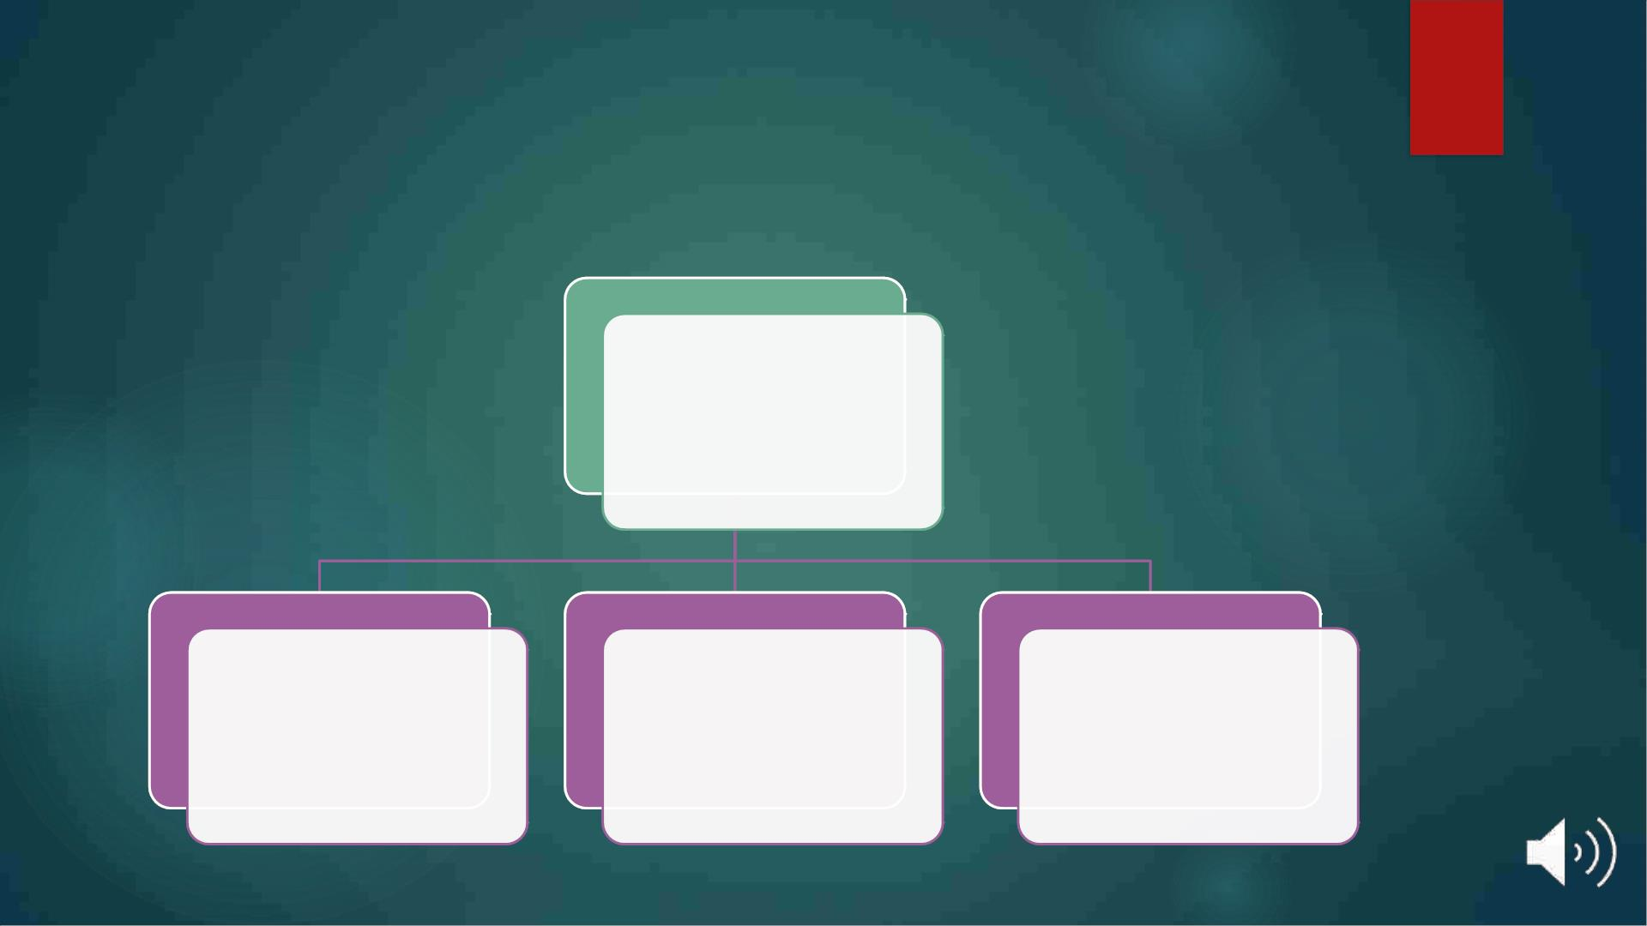
Added value
Realtime usage
Taking
precautionary
measures
To bring
awareness among
the general public
For predicting the
crime hotspots

Slide 21

Thank
you...

