Slide 1
Recitation 2: Testing with Stubs Venkata Nikitha Machineni Paulo Canelas

Slide 2
What is Unit Testing?
Test individual units/components of system
Not test functionality of dependencies
Trust implementation
Will test it ourselves
No implementation yet

Slide 3
Example 1
Suppose we want to test a AutonomousCar object driving from two locations;
Consider a Route class that uses a complex search algorithm to find the shortest path between two GPS locations;
The algorithm is slow;
Just need to give some directions to the AutonomousCar object.

Slide 4
Example 2
IoTController unlocks doors when someone has arrived to the house;
Cannot actually go to different locations;
Just need geolocation information to test algorithm.

Slide 5
Terminology
Dummy
Fake
Stub
Mock

Slide 6
Fake Objects
Optimized and stripped-down working implementations of some functionality;
+ Less overhead
- Not production ready

Slide 7
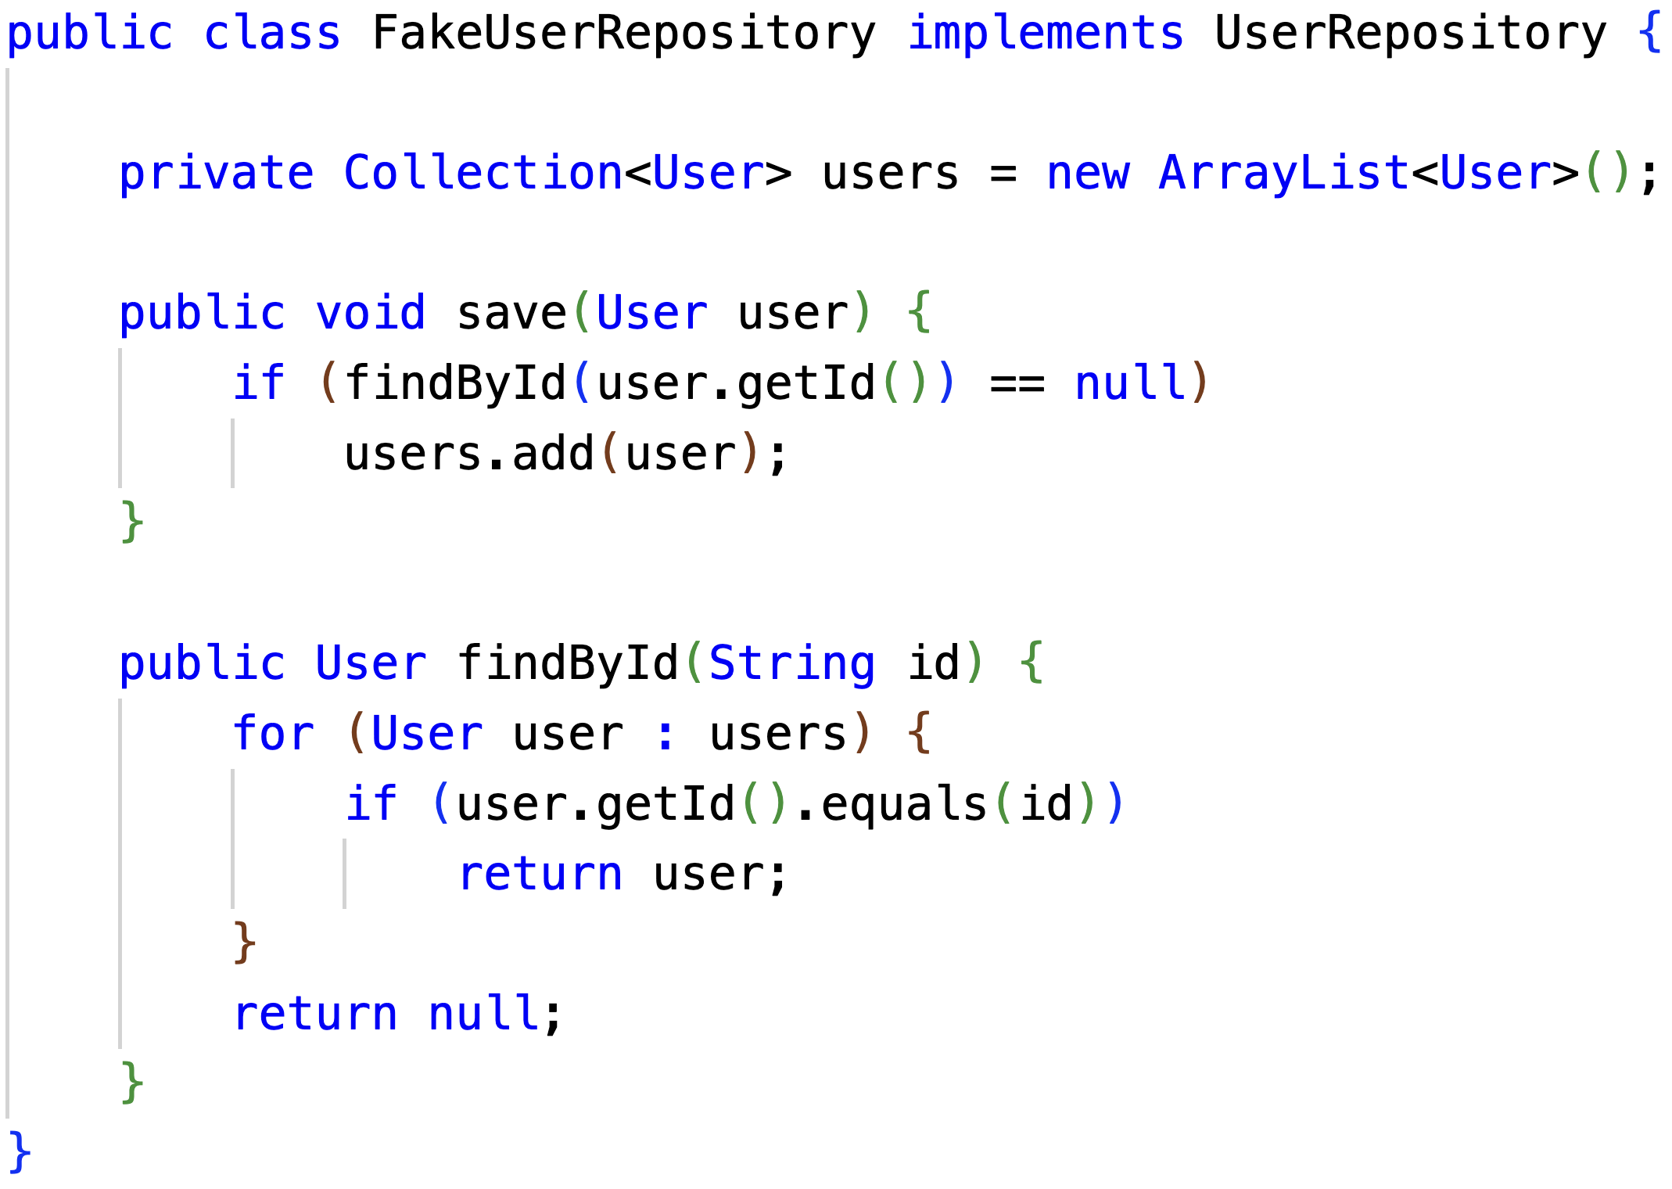
Fake Example

Slide 8
Stub Objects
Holds predefined data
Answers calls during tests

Slide 9
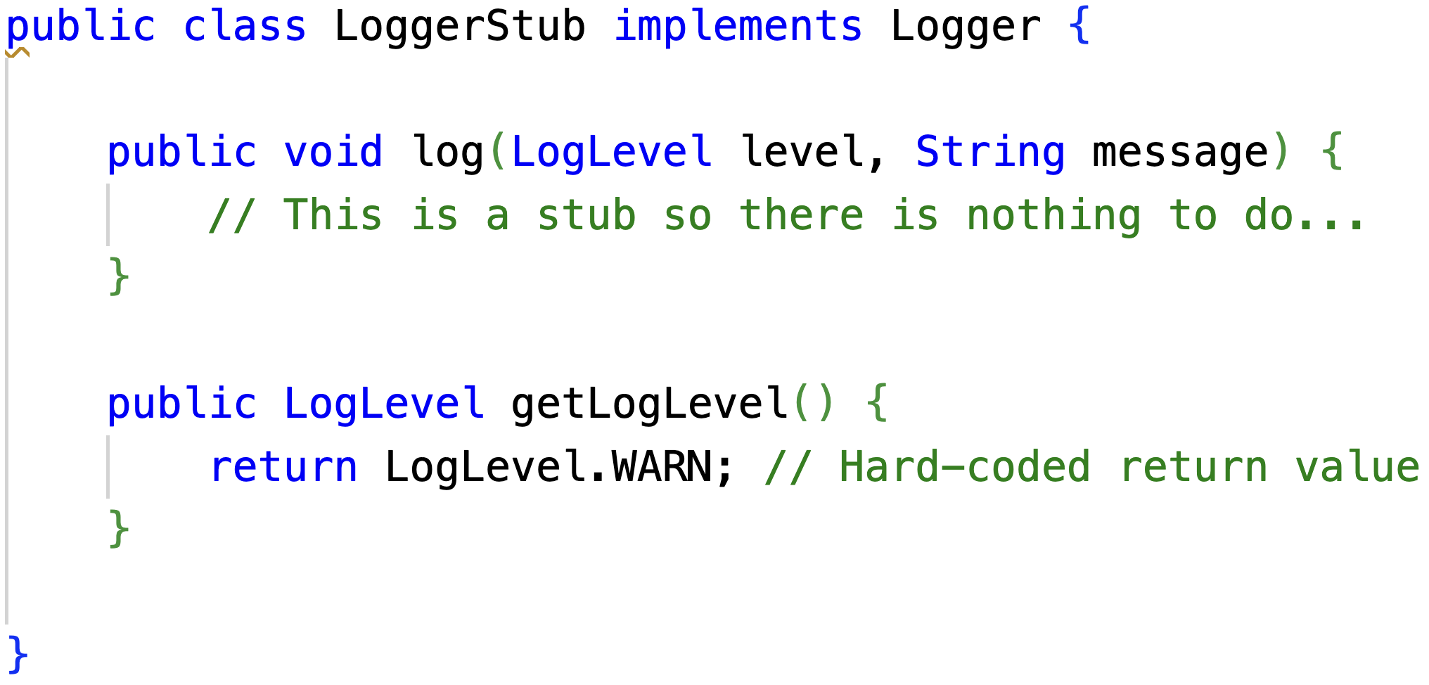
Stub Objects

Slide 10
Mock Objects
Register calls they receive
Assert/Verify behavior
Do not return values

Slide 11
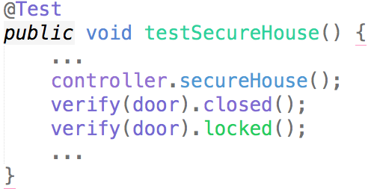
Mock Example

Slide 12
Advantages and Disadvantages
+ Test object interactions
+ Encourage modular design
+ Testing unimplemented dependencies
- Code complexity
- More code to maintain
- Not integration testing
- Testing behavior, not other attributes (e.g., performance)

Slide 13
Mocking Java Frameworks
EasyMock
Mockito

Slide 14
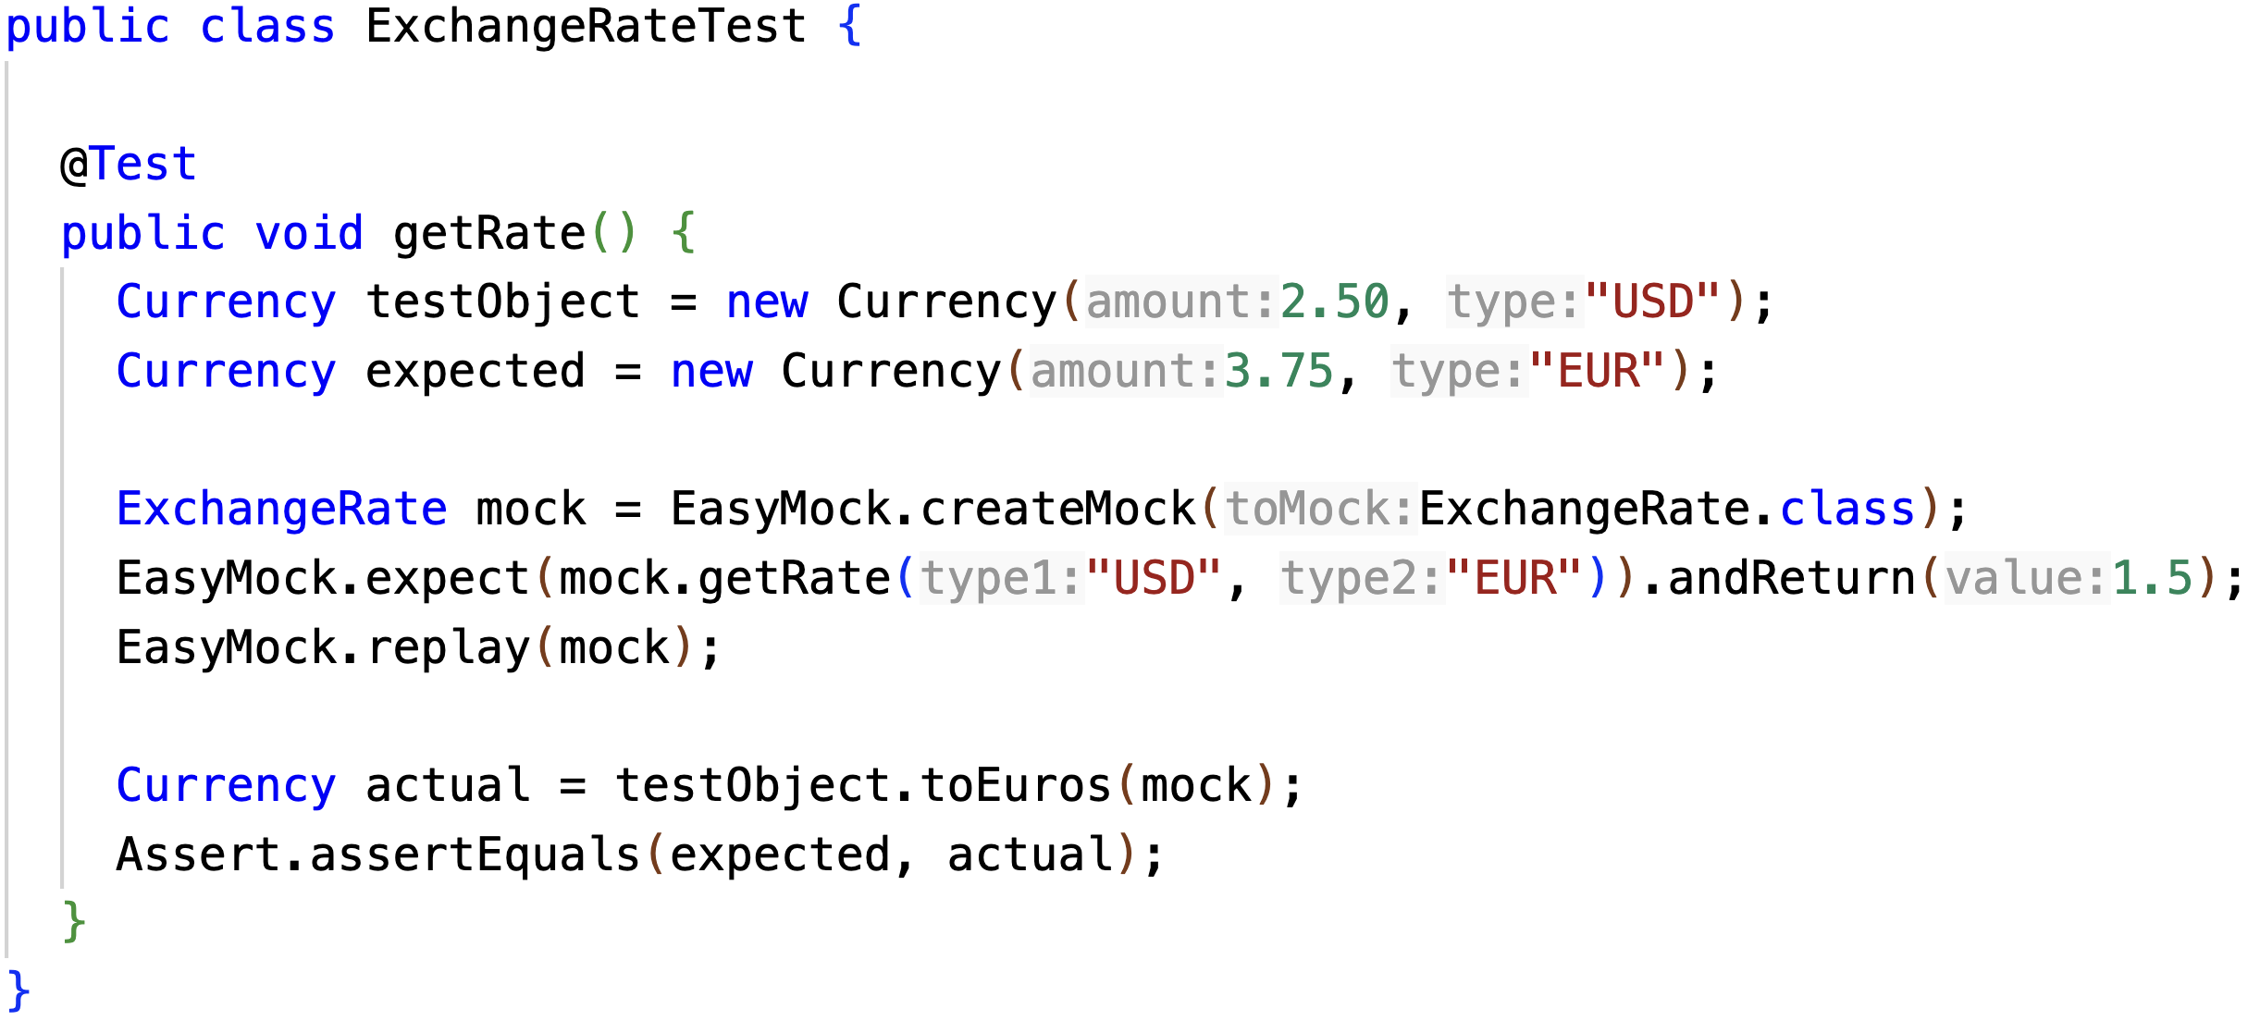
EasyMock Example

Slide 15
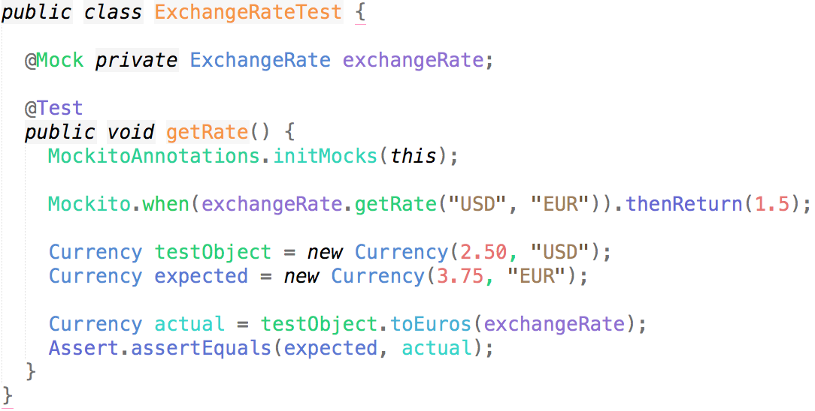
Mockito Example

Slide 16
Exercise
1. Implement toDollars method in Currency
2. Use your favorite mocking framework

Slide 17
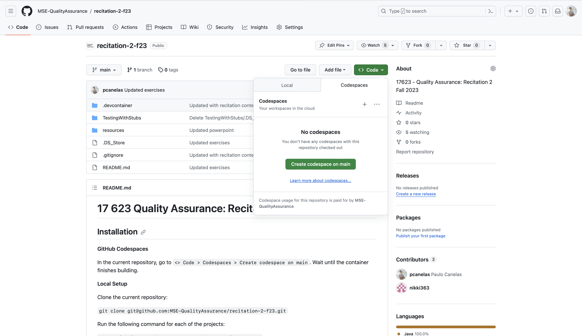
https://github.com/MSE-QualityAssurance/recitation-2-f23

