Slide 1
Recitation 2: Testing with Stubs Venkata Nikitha Machineni Paulo Canelas

Slide 2
What is Unit Testing?
Test individual units/components of system
Not test functionality of dependencies
Trust implementation
Will test it ourselves
No implementation yet

Slide 3
Example 1
Suppose we want to test a AutonomousCar object driving from two locations
Consider a Route class that uses a complex search algorithm to find the shortest path between two GPS locations
The algorithm is slow
Just need to give some directions to the AutonomousCar object

Slide 4
Example 2
IoTController unlocks doors when someone has arrived to the house
Cannot actually go to different locations
Just need geolocation information to test algorithm

Slide 5
Terminology
Dummy
Fake
Stub
Mock

Slide 6
Fake Objects
Optimized and stripped-down working implementations of some functionality
Less overhead
Not production ready

Slide 7
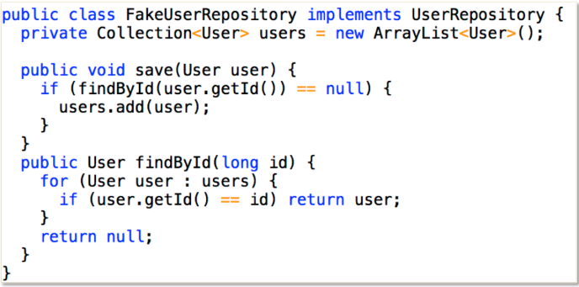
Fake Example

Slide 8
Stub Objects
Holds predefined data
Answers calls during tests

Slide 9
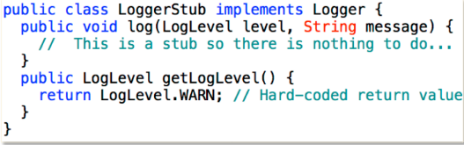
Stub Objects

Slide 10
Mock Objects
Register calls they receive
Assert/Verify behavior
Do not return values

Slide 11
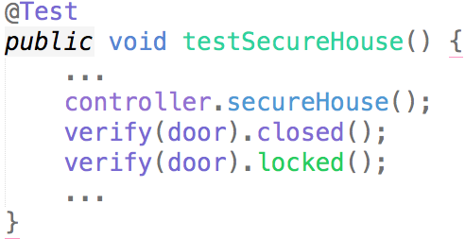
Mock Example

Slide 12
Advantages
Test object interactions
Encourage modular design
Testing unimplemented dependencies

Slide 13
Disadvantages
Code complexity
More code to maintain
Not integration testing
Testing behavior, not other attributes (e.g., performance)

Slide 14
Mocking Frameworks

Slide 15
Mocking Java Frameworks
EasyMock
Mockito
JMockit

Slide 16
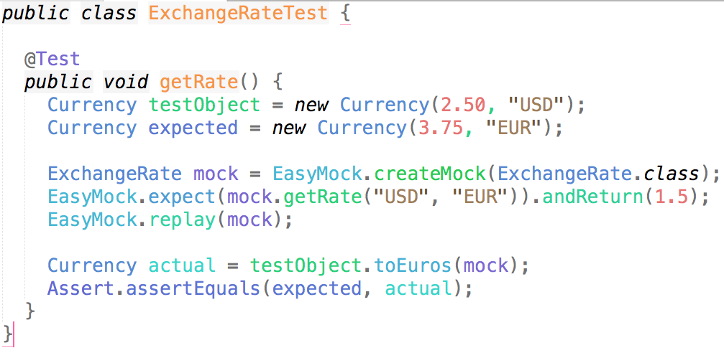
EasyMock Example

Slide 17
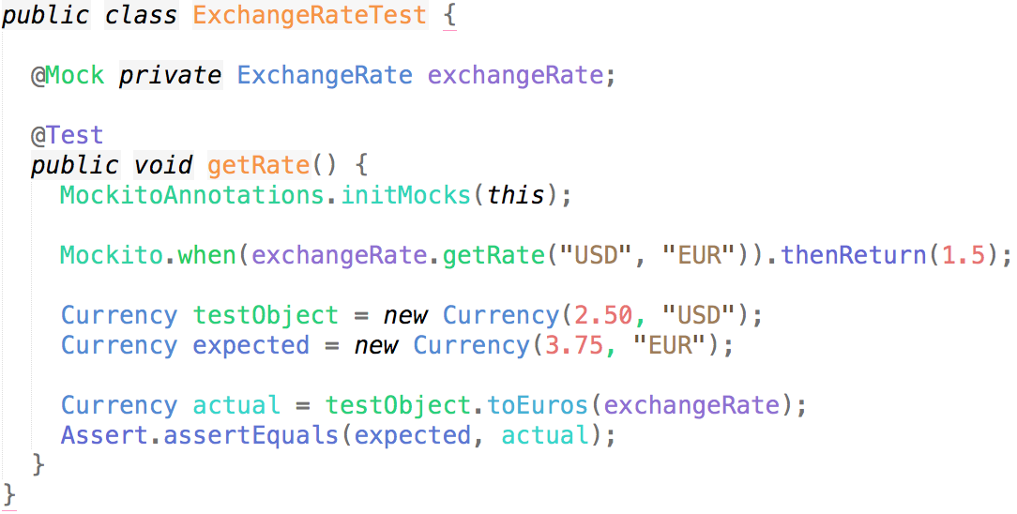
Mockito Example

Slide 18
Exercise
Implement toDollars method in Currency
Use your favorite mocking framework
Use maven or gradle

