Slide 1
Recitation 4: Static Analysis Paulo Canelas Venkata Nikitha Machineni

Slide 2
What is Static Analysis?
Static: without executing
Analysis: studying an artifact or phenomenon by decomposing it into its constituent parts
Defects can be on uncommon or difficult-to-force execution paths:
Which is why it’s hard to find them via testing;
Executing (or interpreting/otherwise analyzing) all paths concretely to find such defects is infeasible.
What we really want to do is check the entire possible state space of the program for particular properties.
Brief Overview from Lecture

Slide 3
What is Static Analysis?
Static: without executing
Analysis: studying an artifact or phenomenon by decomposing it into its constituent parts
Defects can be on uncommon or difficult-to-force execution paths:
Which is why it’s hard to find them via testing;
Executing (or interpreting/otherwise analyzing) all paths concretely to find such defects is infeasible.
What we really want to do is check the entire possible state space of the program for particular properties.

Slide 4




What is Static Analysis?
Program
Static Analysis Tool
+
Set of
properties

Slide 5
Results from Static Analysis
True Positive: The error condition warned about can occur at run time, for some program input.
True Negative: Analysis correctly tells us that the program does not contain a given defect.
False Positive: The error condition cannot occur reality, no matter what the program input is.
False Negative: The program can get into an error condition for an attribute covered by the tool for some input, but the tool does not warn of it.

Slide 6



Examples of Static Analysis Tools
Infer
PMD
SpotBugs

Slide 7
Recitation Outline
Recitation Exercises:
Checking Array Index Out of Bounds with Infer;
Checking Best Practices, Code Style and Error Prone practices with PMD;
Checking any potential bugs with SpotBugs.
https://github.com/MSE-QualityAssurance/recitation-4-f23
Beginning of Homework 4:
Build and Setup of the Homework;
Execution of the static analysis tools in the Simple-Java-Text-Editor.
https://canvas.cmu.edu/courses/36250/assignments/614274

Slide 8
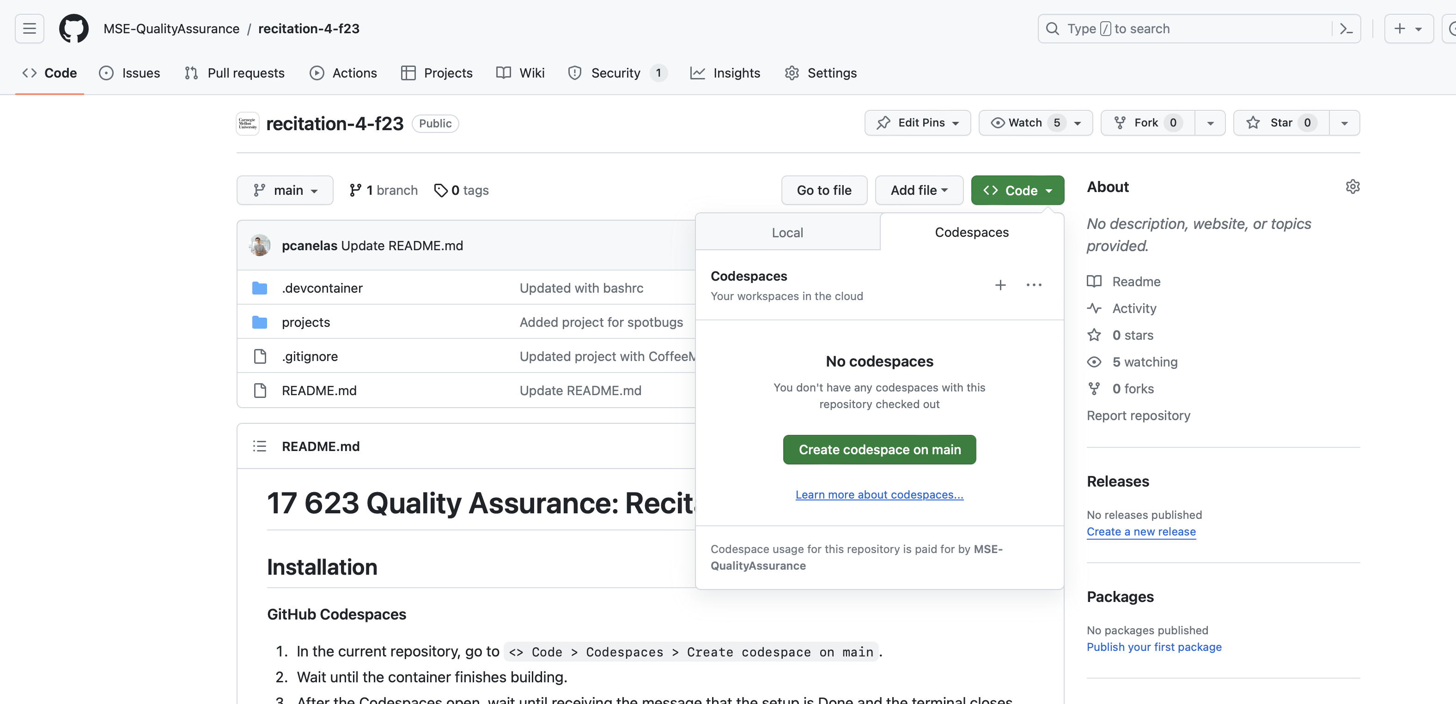
Create a Codespace from Github
https://github.com/MSE-QualityAssurance/recitation-4-f23

Slide 9
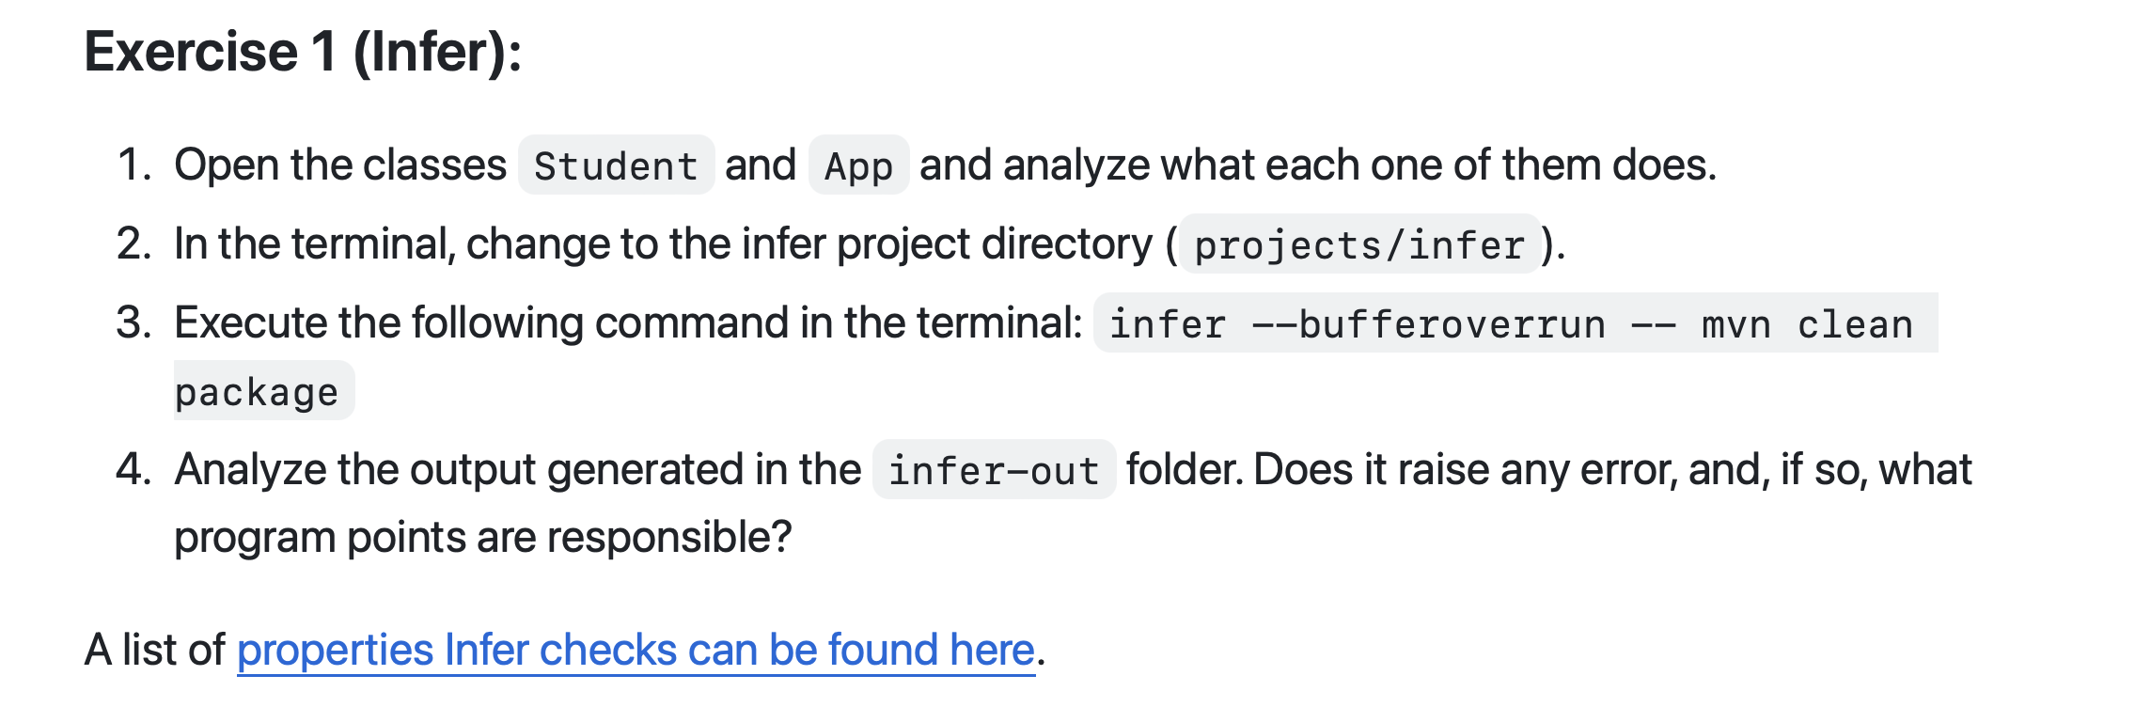

Exercise 1: Detecting Array Index Out of Bounds with Infer

Slide 10
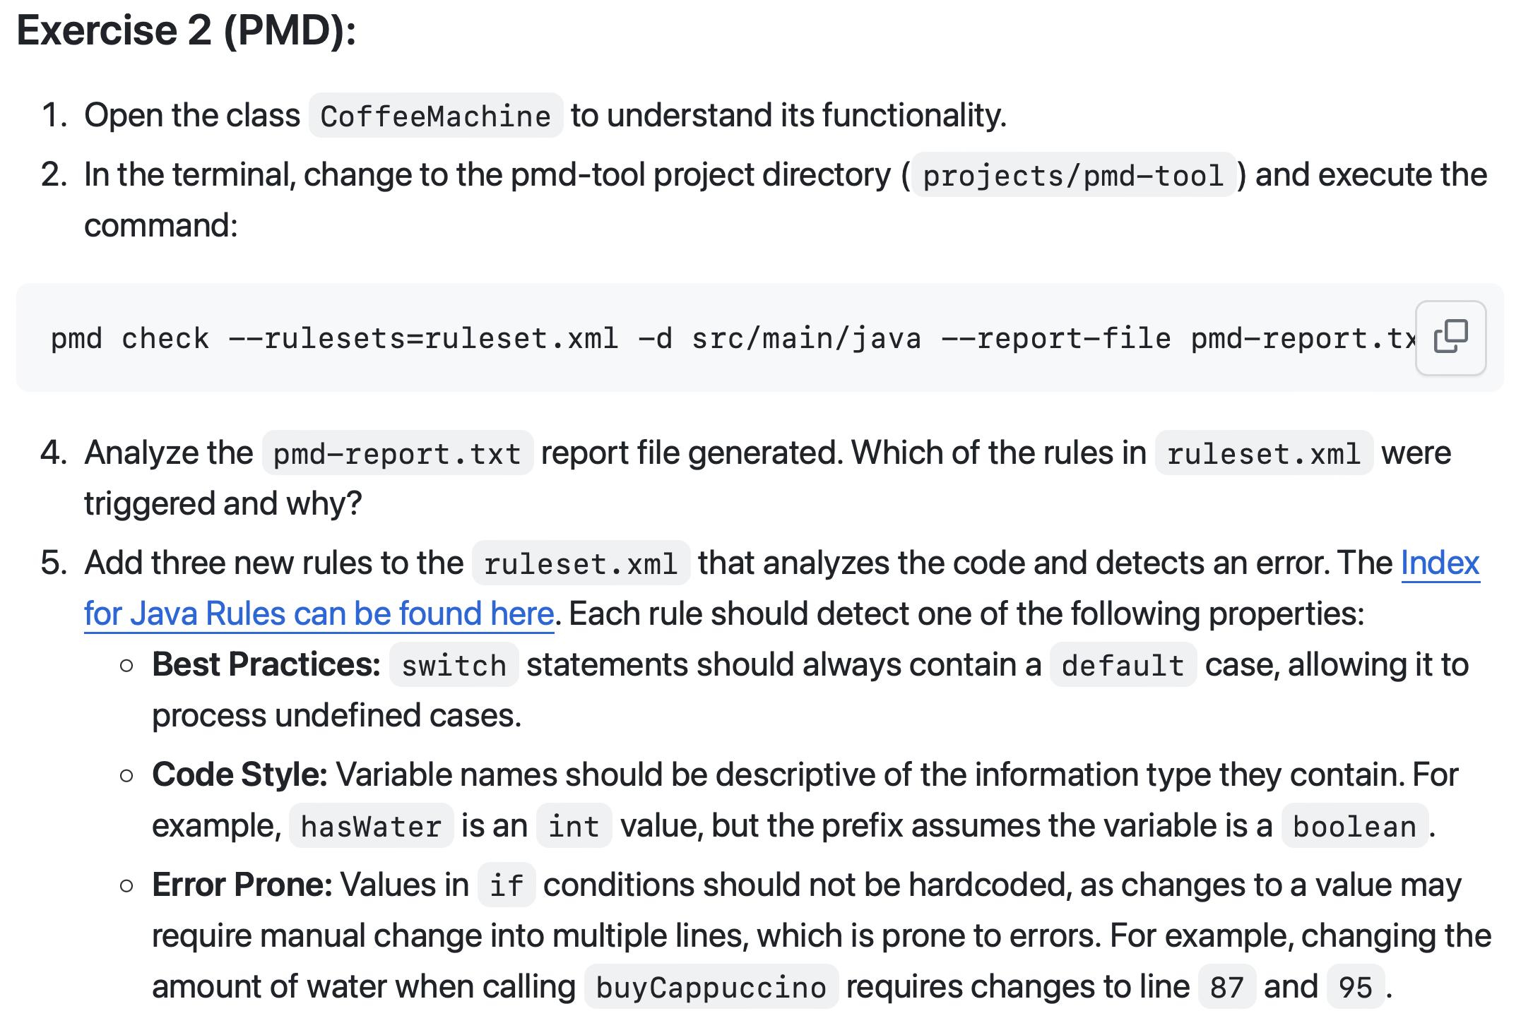

Exercise 2: Detecting Bad Practices, Incorrect Code Styles and Error Prone statements with PMD

Slide 11
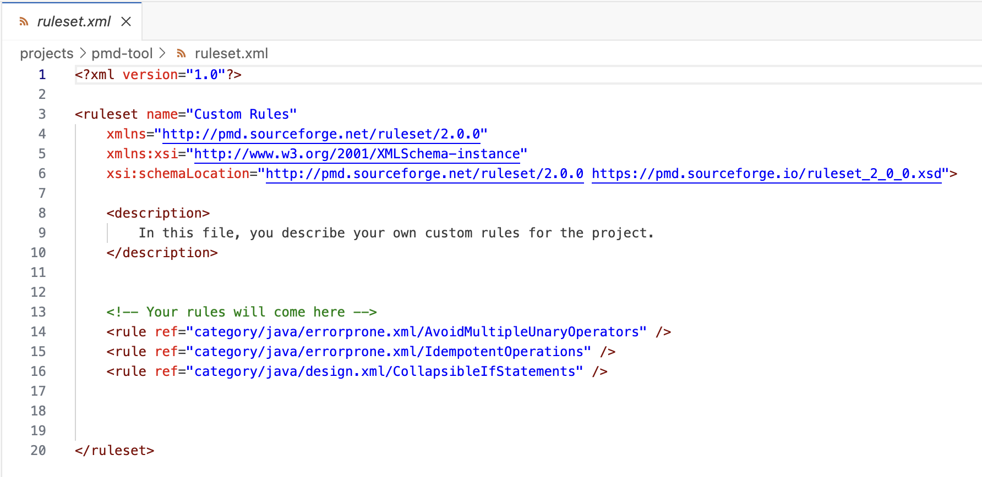
Exercise 2: Detecting Bad Practices, Incorrect Code Styles and Error Prone statements with PMD
Add rules to ruleset.xml

Slide 12
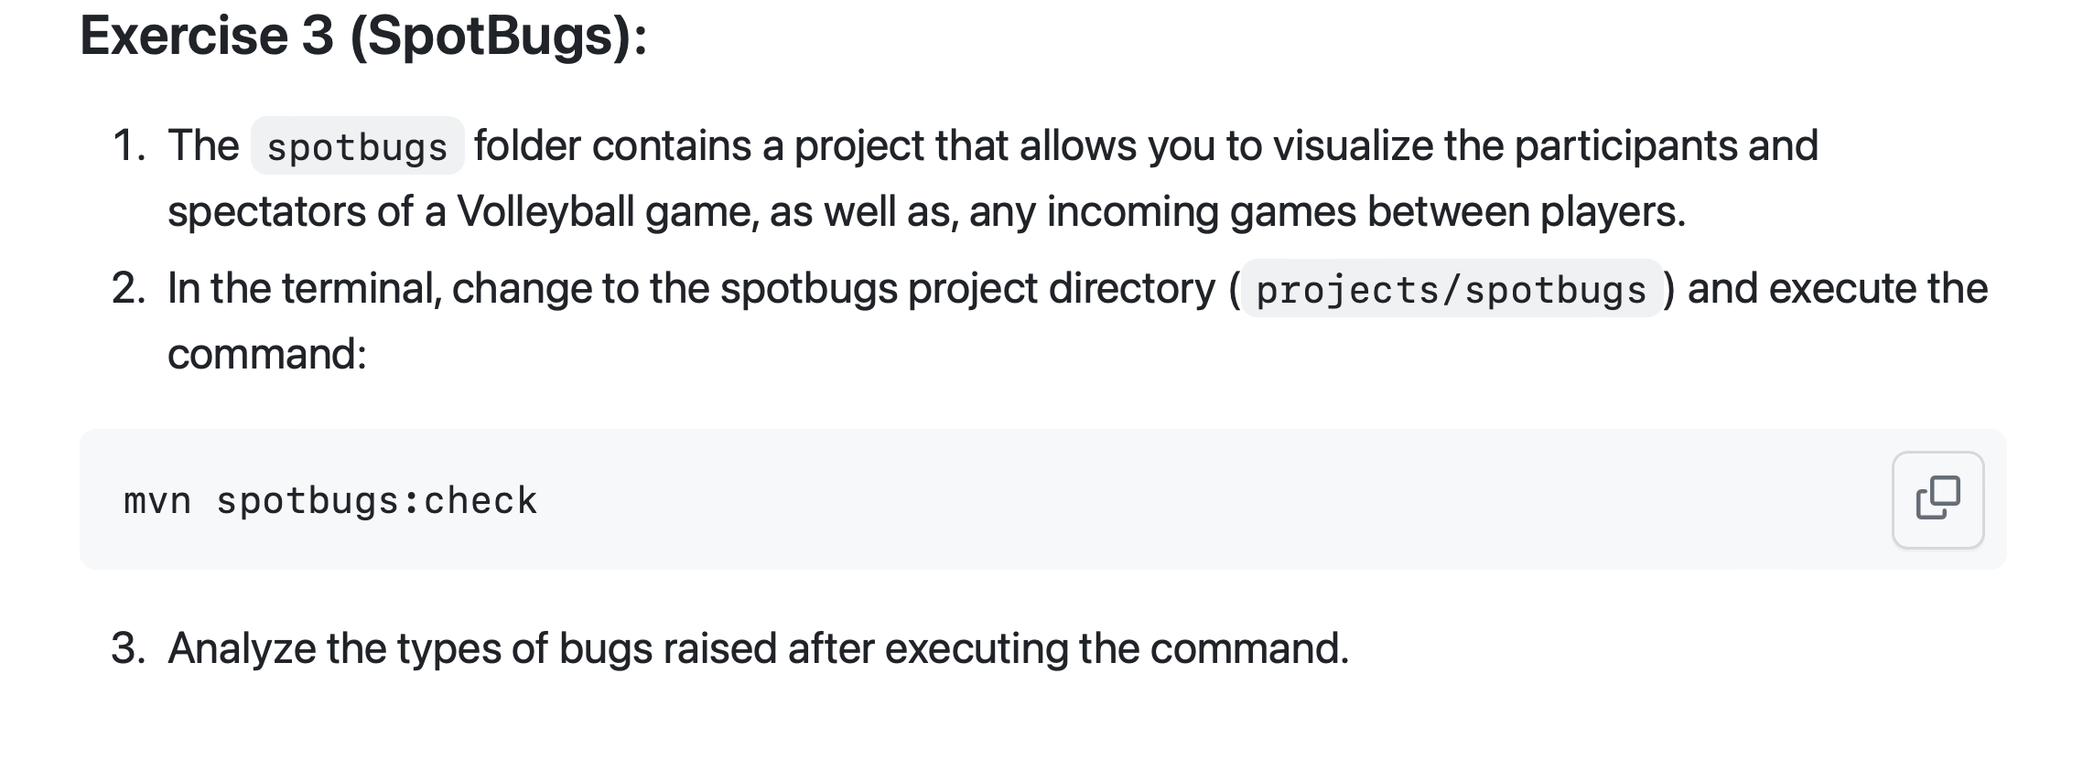

Exercise 3: Checking any potential bugs with SpotBugs

Slide 13
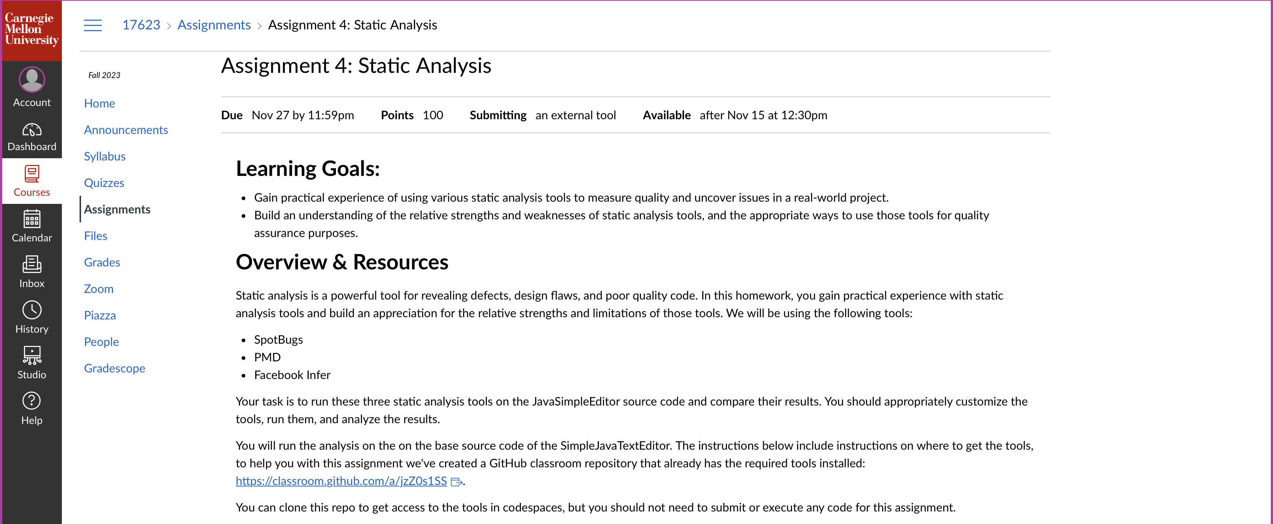
Homework 4: Static Analysis

