Slide 1




CONFIDENTIAL · PREPARED FOR ZACHARY BROOKS
A Resale Strategy for Historical Homes
Three data-backed hypotheses on renovation, neighborhood, and build quality.
Historical Homes
Best Neighborhoods
High Profit
Right Timing
Data source: King County residential sales — 21,597 transactions, 21,420 unique houses.

Slide 2
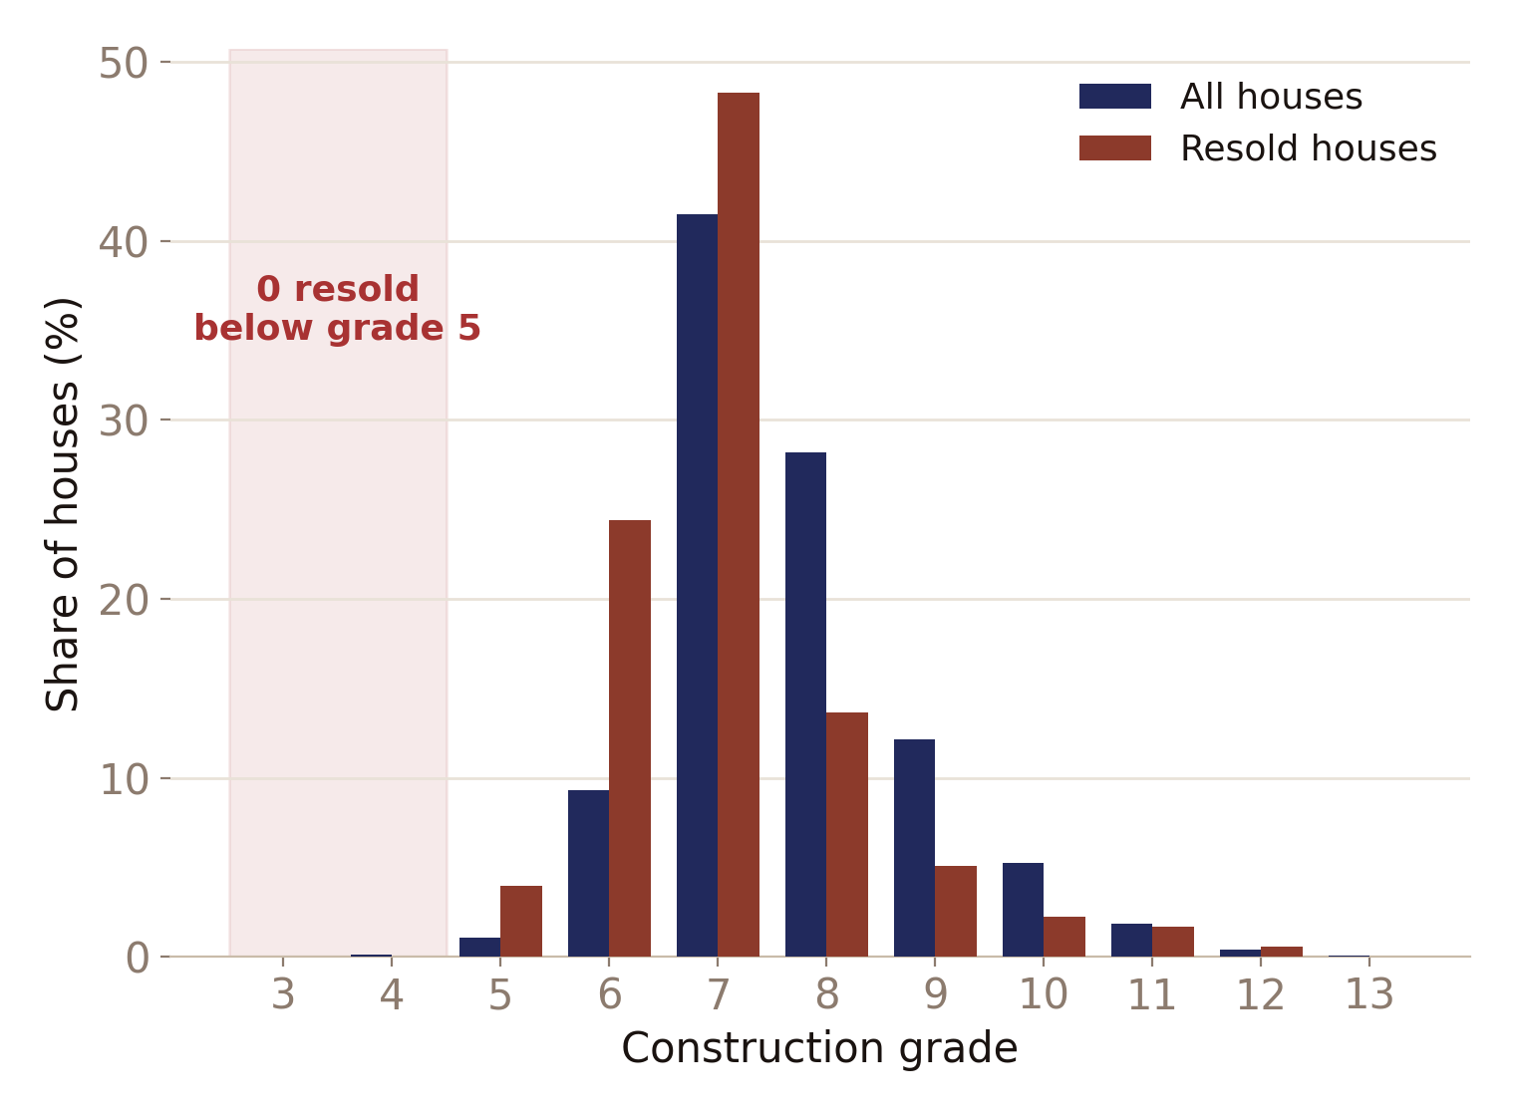
HYPOTHESIS 1
176 REPEAT SALES ANALYZED
Resold Homes Never Fall Below Grade 5
Zero of 176 resold houses fall below construction grade 5 — even though 28 lower-grade houses exist county-wide.
Zachary Brooks — Resale Strategy | 2 / 8

Slide 3

RECOMMENDATION
Set Grade 5 as Your Acquisition Floor
Below grade 5, a property has no track record of ever finding a second buyer.
Zachary Brooks — Resale Strategy | 3 / 8

Slide 4
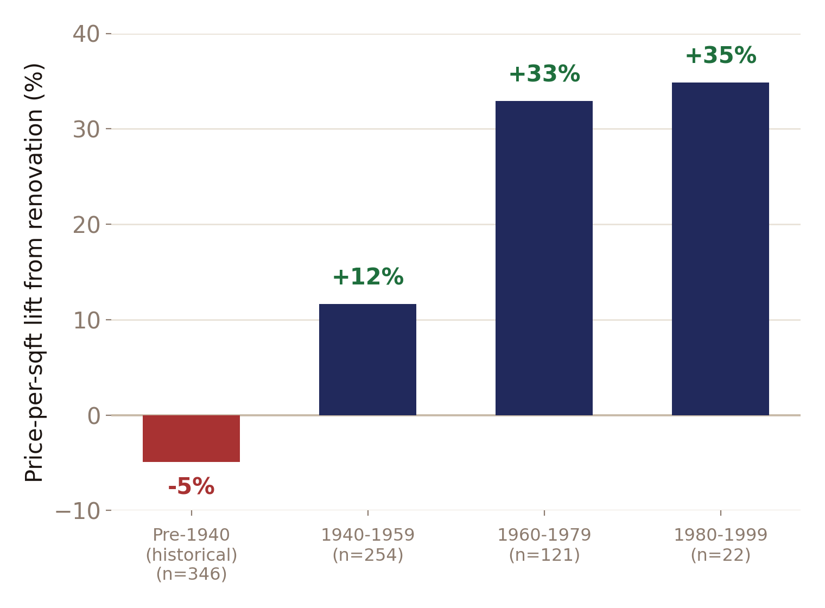
HYPOTHESIS 2
743 RENOVATIONS ANALYZED
Renovation Pays Off — But Not Everywhere
Renovation lifts value 12–35% for 1940–1999 homes — but costs 5% on true pre-1940 stock.
Zachary Brooks — Resale Strategy | 4 / 8

Slide 5

RECOMMENDATION
Renovate Mid-Century, Preserve the Historical
Modernize 1940–1999 acquisitions before listing. On true pre-1940 homes, protect the original character instead.
Zachary Brooks — Resale Strategy | 5 / 8

Slide 6
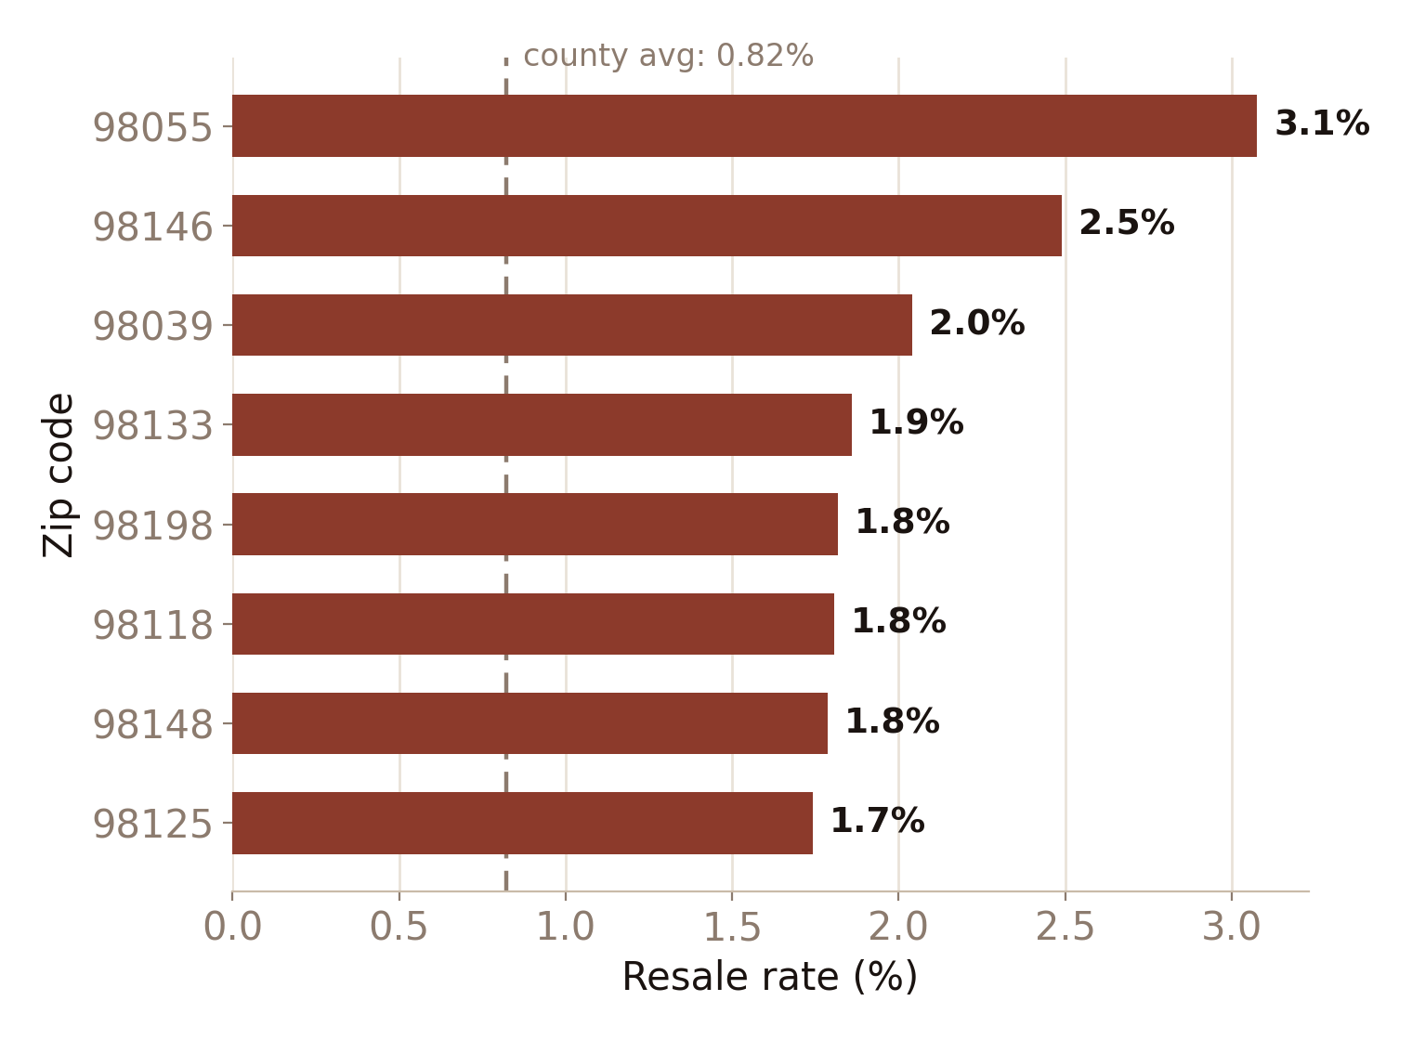
HYPOTHESIS 3
70 ZIP CODES COMPARED
A Few Zip Codes Drive Most of the Resales
Just 10 of 70 zip codes account for 41% of every repeat sale in the county.
Zachary Brooks — Resale Strategy | 6 / 8

Slide 7
RECOMMENDATION
Source in the Most Liquid Zip Codes
98055, 98146, 98133, 98118, and 98006 resell 2–4x more often than the county average.
Zachary Brooks — Resale Strategy | 7 / 8

Slide 8
PUTTING IT TOGETHER
The Ideal Class of Units to Target
Grade 6+
Built 1940–1999
Liquid zip codes
Renovated pre-listing
never below the resale floor
where renovation pays off
98055, 98146, 98133, 98118, 98006
for this vintage only
One buy box: mid-century, well-built homes in proven-liquid neighborhoods, renovated before resale — true pre-1940 landmarks are a different play, held longer and left original.
Zachary Brooks — Resale Strategy | 8 / 8

