Slide 1
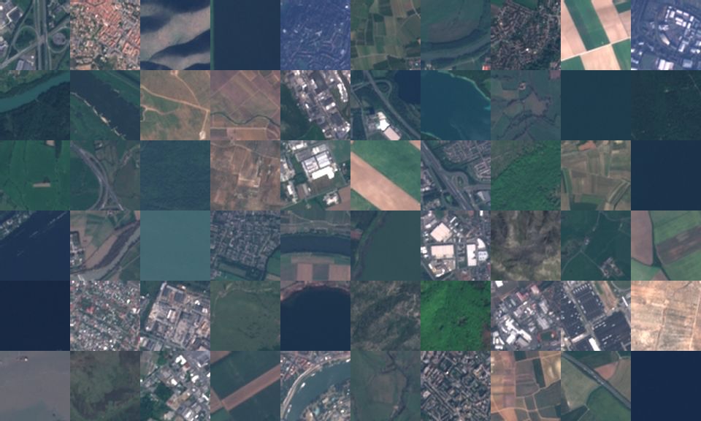
Teaching a computer to read satellite images
Land-use classification with convolutional neural networks
Mohamed Sabry Eldeeb, PhD
Notes:
This project teaches a computer to look at a small satellite photo and say what kind of land it shows: a forest, a river, a city, a field. The mosaic on the right is made of real images from the dataset.

Slide 2
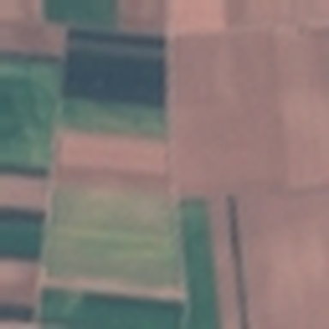
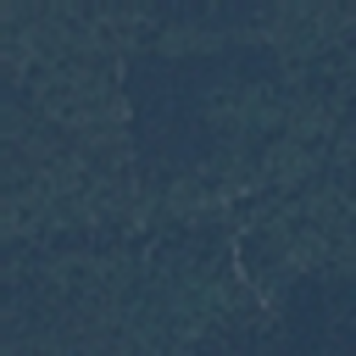
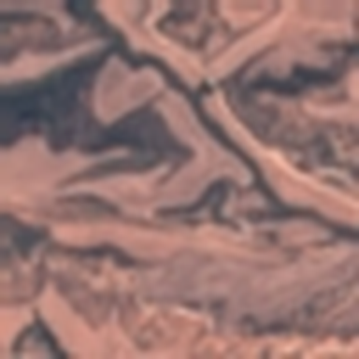
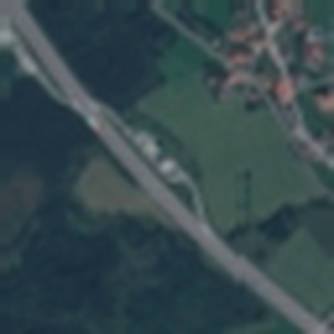
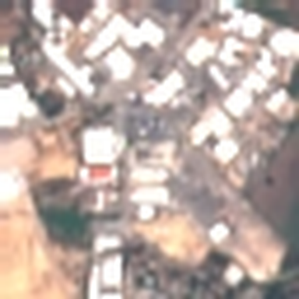
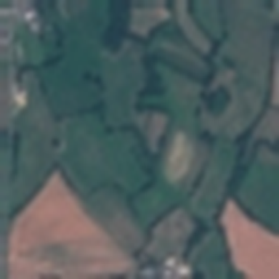
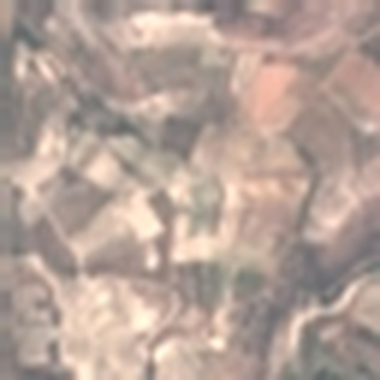
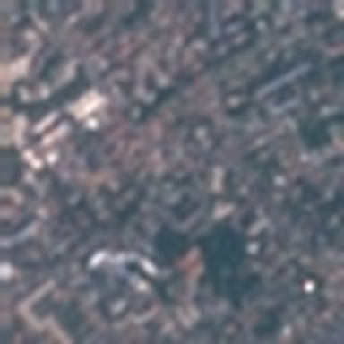
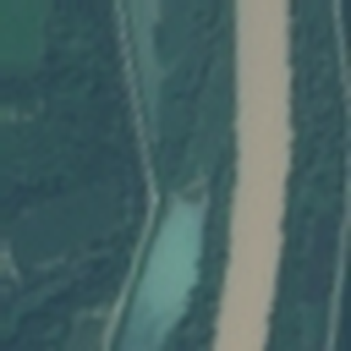

What is on this piece of land?
Each image shows a 640 m × 640 m square of Europe, photographed from space. The computer must give it one of ten labels.
Annual crop
Forest
Herbaceous veg.
Highway
Industrial
Pasture
Permanent crop
Residential
River
Sea / lake
Notes:
Here is one example of each of the ten categories. Some are easy for us, like the blue sea. Others, like pasture versus herbaceous vegetation, are hard even for people.

Slide 3




Why this matters
City planning
Agriculture
Environment
Energy
Track how towns and industrial areas grow over time.
Map crops and pastures across whole countries, every few days.
Spot deforestation, changing rivers and lake levels.
Find suitable land and roofs for solar panels.
Notes:
Satellites photograph the whole of Europe every few days. Nobody can look at all those images by hand, so automatic classification is what makes this data useful.

Slide 4
The data: EuroSAT
27,000
labelled images
10
land-use classes
64 × 64
pixels per image
10 m
per pixel
Source: Sentinel-2 satellite (EU Copernicus programme), EuroSAT dataset by Helber et al., 2019.
Notes:
EuroSAT was built by researchers from free images taken by the European Sentinel-2 satellite. Every image was labelled with what it shows. The classes are fairly balanced: the biggest class has only one and a half times as many images as the smallest.

Slide 5




Why I chose this dataset
Real-world images
Well balanced
Real satellite photos, not toy pictures: the same kind of data used in industry, for example to analyse roofs for solar panels.
Every class has 2,000–3,000 examples, so a high score cannot come from always guessing the most common class.
Laptop-sized
Open benchmark
Small 64 × 64 images: a full model trains on an ordinary computer in about an hour, without special hardware.
Freely available and widely studied, so my results can be compared with published research.
Notes:
I picked EuroSAT for four reasons. It is real data. It is balanced, so accuracy is an honest measure. It is small enough to train without a GPU. And because it is a public benchmark, I can check my results against other people's.

Slide 6
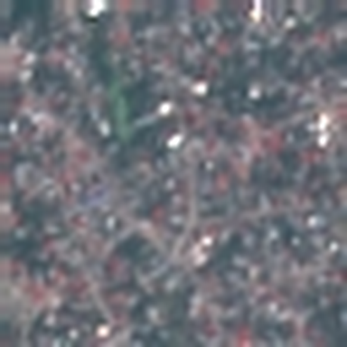
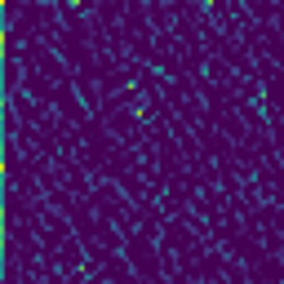
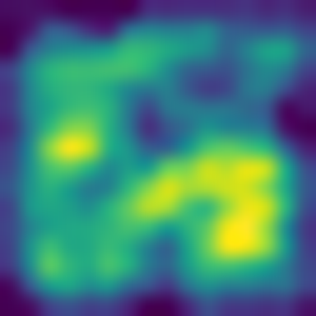

How a neural network learns to see
Residential
100%
1. The image
2. Simple patterns
3. Textures and shapes
4. The decision
The computer only sees numbers: 64 × 64 pixels × 3 colours.
The first layers react to edges, lines and colour changes.
Deeper layers combine them into roads, rooftops, field stripes.
The last layer gives a probability for each class. Here: 100% residential.
Images 2 and 3 are real activation maps from my trained model: bright areas show where a filter 'fires'.
Notes:
A convolutional neural network works in stages. Early layers detect simple things like edges. Later layers combine them into more meaningful patterns. The last layer turns all of that into a probability for each class. Nobody programs these filters; the network learns them from the examples.

Slide 7
A fair exam: data the model has never seen
70%
18,899 images
15%
4,051 images
15%
4,050 images
Practice
Check-in
Final exam
The model learns from these images.
Used during training to pick the best version.
Locked away until the very end.
Every class keeps the same share in all three parts, and the split is fixed with a random seed so anyone can reproduce it.
Notes:
Like a student, a model can memorise its practice questions. So I keep 15 percent of the images completely hidden and only use them once, at the end. That final score is the honest one.

Slide 8
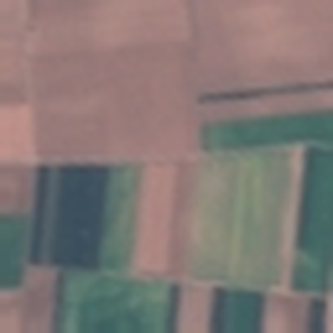
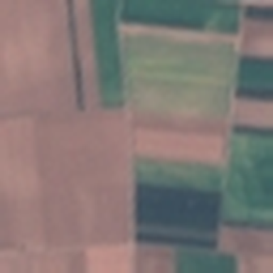
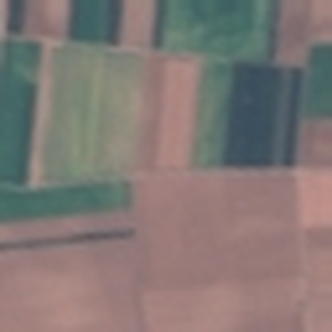
Two models: simple first, then improved
Augmentation: a field seen from space has no ‘up’
Baseline CNN
Improved CNN
1.14 M parameters
0.58 M parameters
3 convolution layers, then a classic dense classifier
Quick to train and easy to understand
Tends to memorise the practice images
7 convolution layers with batch normalisation and dropout
Data augmentation: random flips and 90° turns
Fewer parameters, but learns more general patterns
Showing turned and flipped copies teaches the model that orientation does not matter.
Notes:
I always start with a simple model to get a baseline. The improved model is deeper, but it actually has fewer parameters. The key trick is data augmentation: I show the model rotated and mirrored copies of each image, because a forest is still a forest when you turn the photo.

Slide 9
Results on the final exam
87.5%
Baseline CNN accuracy
96.5%
Improved CNN accuracy
Out of 4,050 unseen images, the improved model labels 3,909 correctly: 72% fewer mistakes than the baseline.
Notes:
On images it had never seen, the simple model scored 87.5% and the improved model 96.5%. The chart shows the score for each class. F1 combines how often the model is right when it names a class with how many of that class it finds.

Slide 10
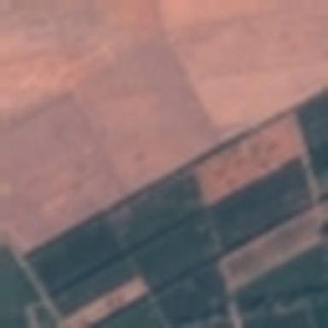
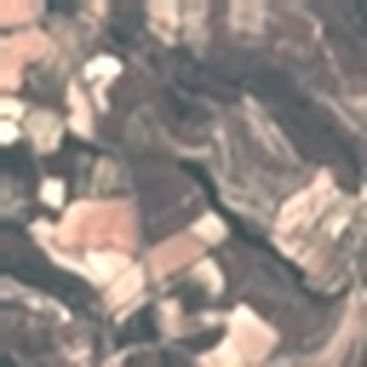
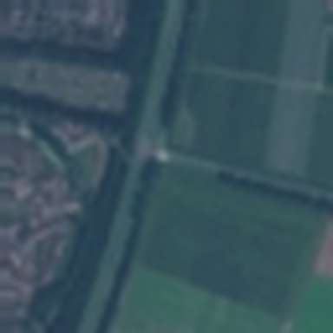
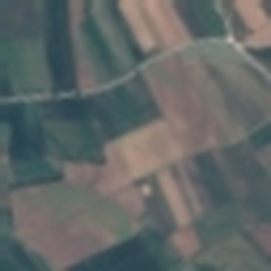
Where the model still gets confused
Really: Permanent crop
Model said: Annual crop (100%)
Really: Herbaceous veg.
Model said: Permanent crop (99%)
Really: Highway
Model said: River (93%)
Really: Annual crop
Model said: Permanent crop (98%)
The most common mix-ups are permanent crop taken for annual crop (13 images) and herbaceous veg. taken for permanent crop (13). These classes look alike from space, and some tiles contain both.
Notes:
Looking at mistakes is the most useful part of the analysis. Most errors are between classes that genuinely look alike from 640 metres up, and some images are ambiguous even for a human.

Slide 11


What I learned and what comes next
Lessons
Next steps
Start simple: a baseline makes every improvement measurable
Use knowledge about the data: satellite images have no ‘up’
Keep a test set locked away to get an honest score
Errors teach more than the headline accuracy
Transfer learning from a large pretrained network
Use all 13 Sentinel-2 colour bands, not just RGB
Explain predictions with saliency maps
Package the model as a small web demo
Notes:
The biggest lessons were about process: start with a baseline, use what you know about the data, and test honestly. There are clear next steps that would push the accuracy higher.

Slide 12
Thank you
Code, data instructions and all results:
github.com/MSEldeeb
Mohamed Sabry Eldeeb, PhD · mohamed.sabry.eldeeb@gmail.com
Notes:
Everything is on GitHub, so anyone can rerun the experiment and get the same numbers.

