Slide 1
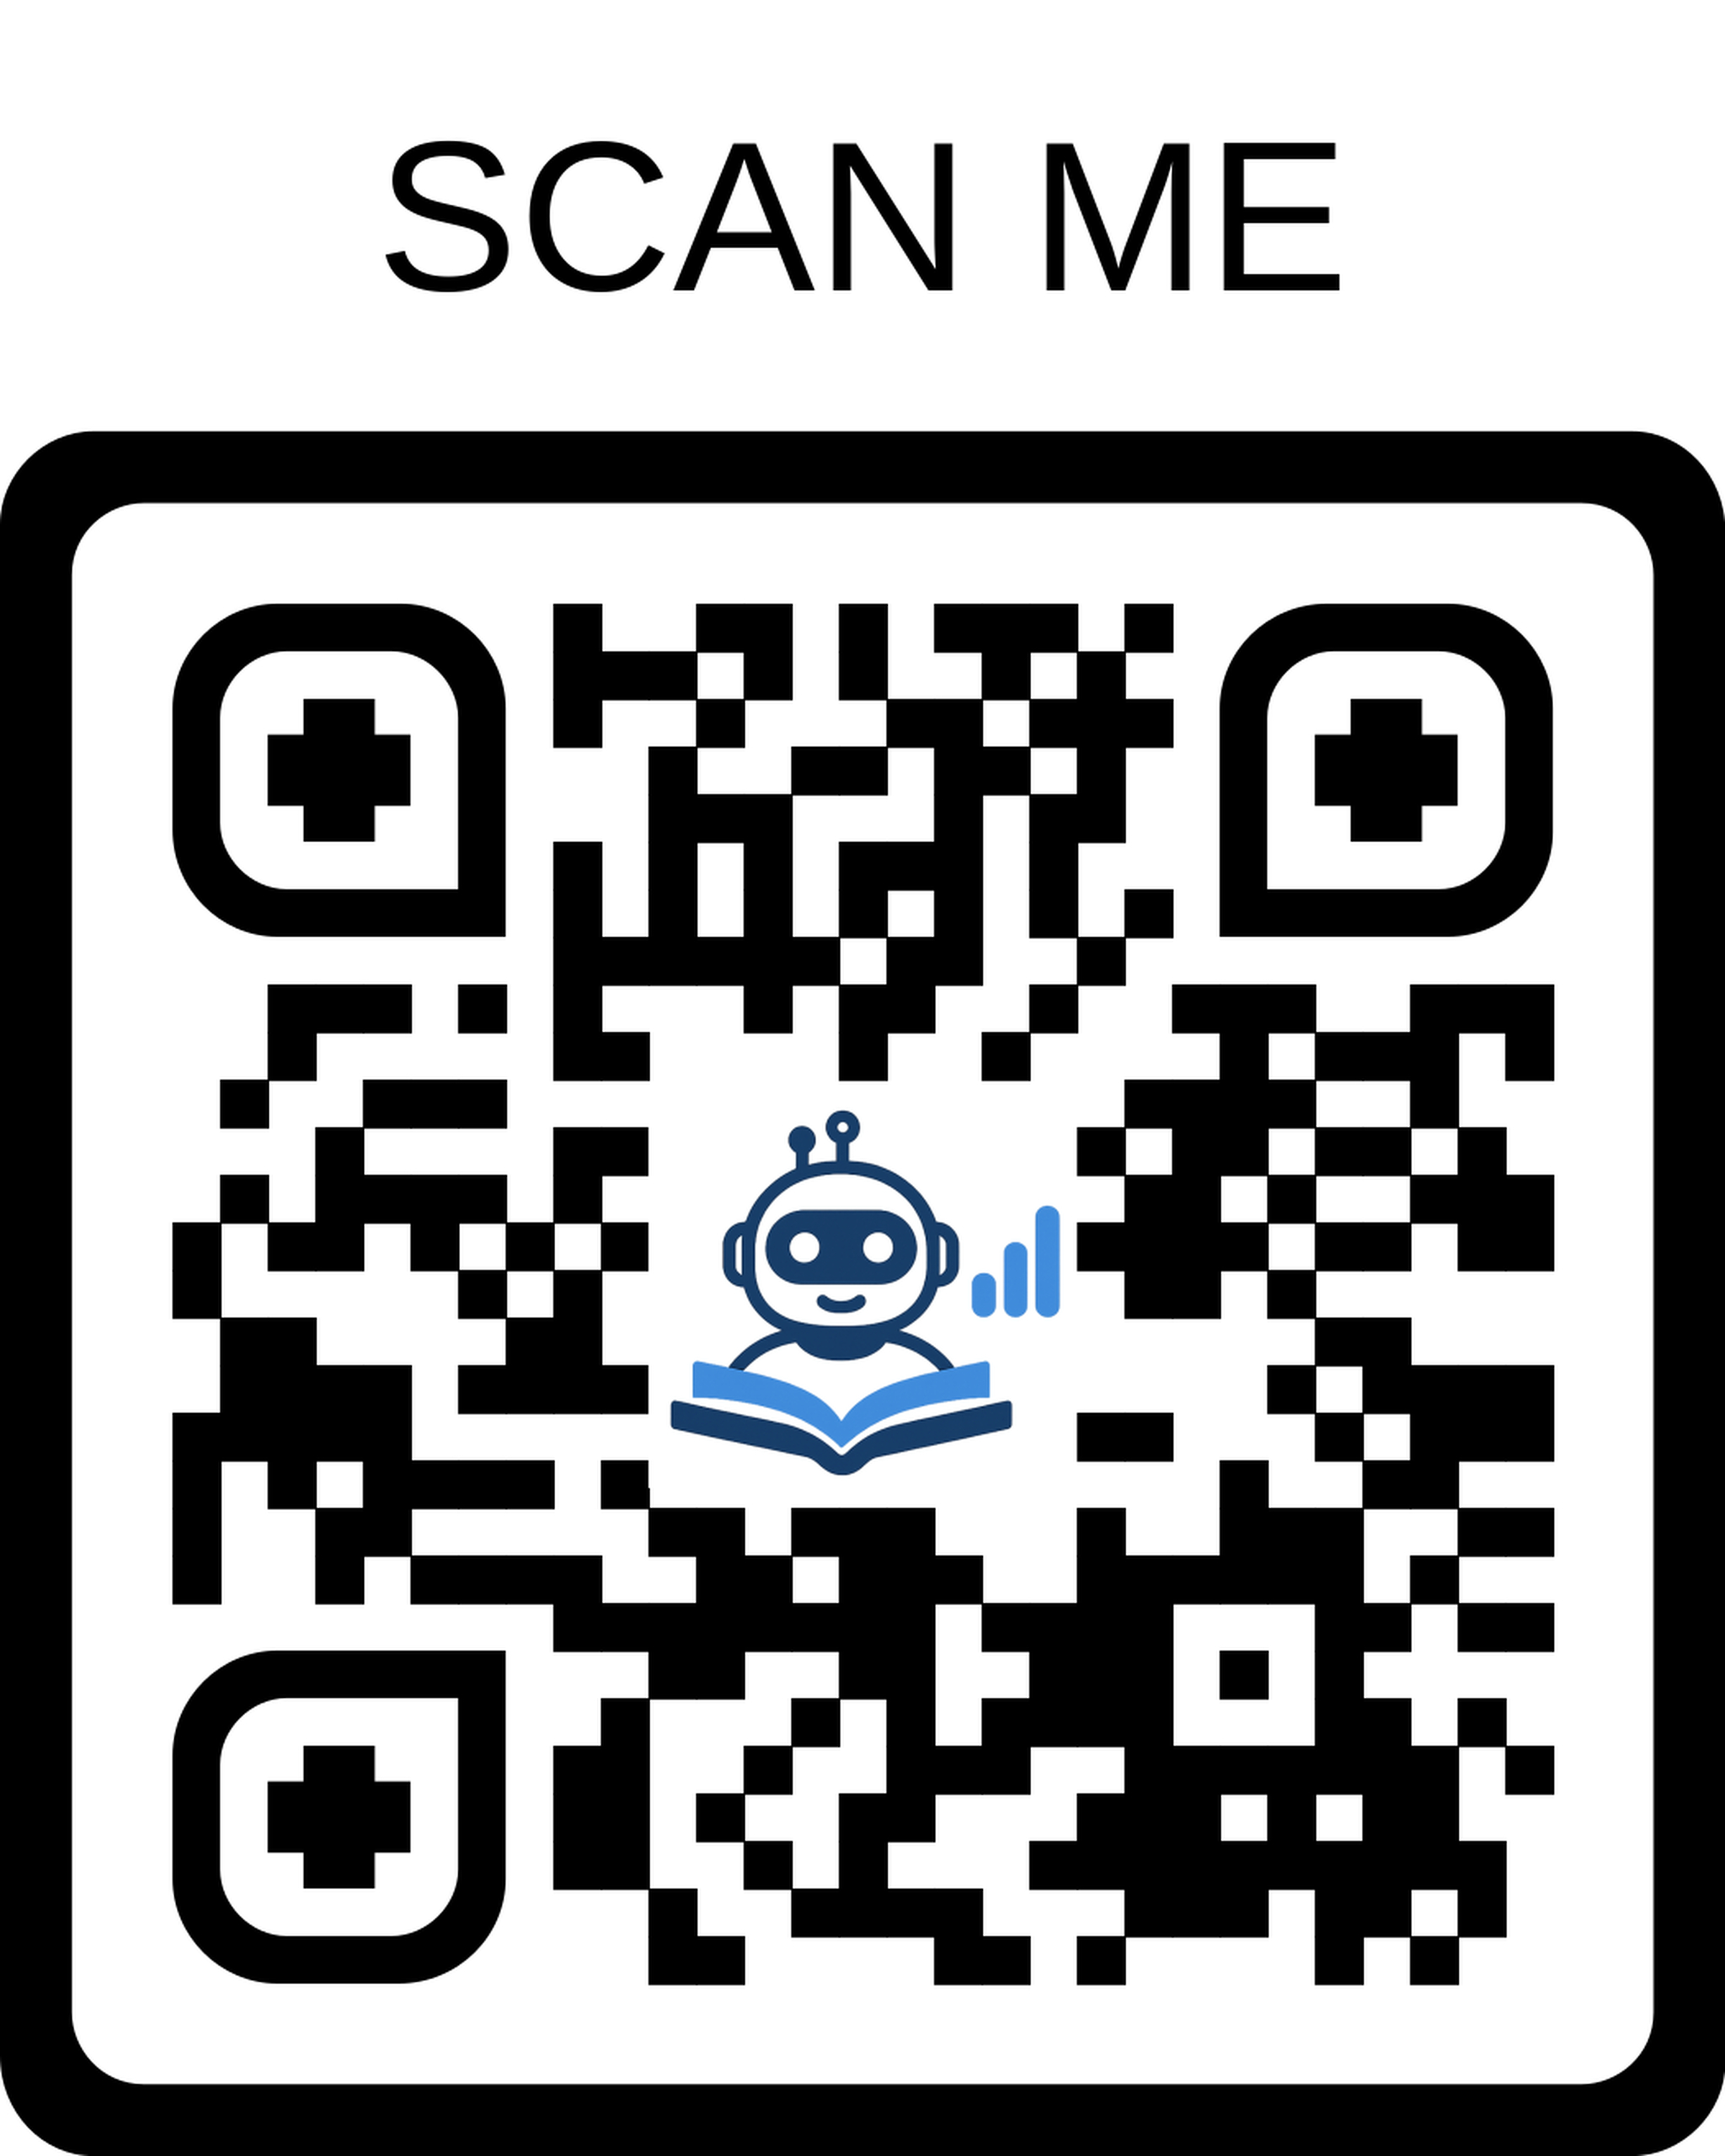
SafeStep
AI-Powered Safety Planning for Domestic Violence Survivors
MSIS 522 | March 2026
Anushka Chougule
Li Huai
Miranda Grato
Rithvik Ravi

Slide 2



THE PROBLEM
Leaving is the most
dangerous moment.
1 in 4
1 in 9
#1 Risk
women in the US
experience domestic
violence
men in the US
experience domestic
violence
moment is planning
to leave — when
abusers retaliate
Existing tools — hotlines, shelter directories, generic checklists — are not discreet, not personalized, and not safe on a monitored device.

Slide 3




THE SOLUTION
SafeStep — A lifeline in your pocket,
hidden in plain sight.
Decoy Interface
AI Safety Plan
Users choose a disguise — recipe app, notes app, budget tracker. One triple-tap reveals SafeStep.
Claude API generates a personalized, prioritized exit checklist based on a 5-question intake.
Resource Lookup
Quick Exit
Google Places API surfaces nearby shelters, legal aid, and therapists by ZIP code.
One tap returns to the decoy screen and clears visible session state instantly.

Slide 4
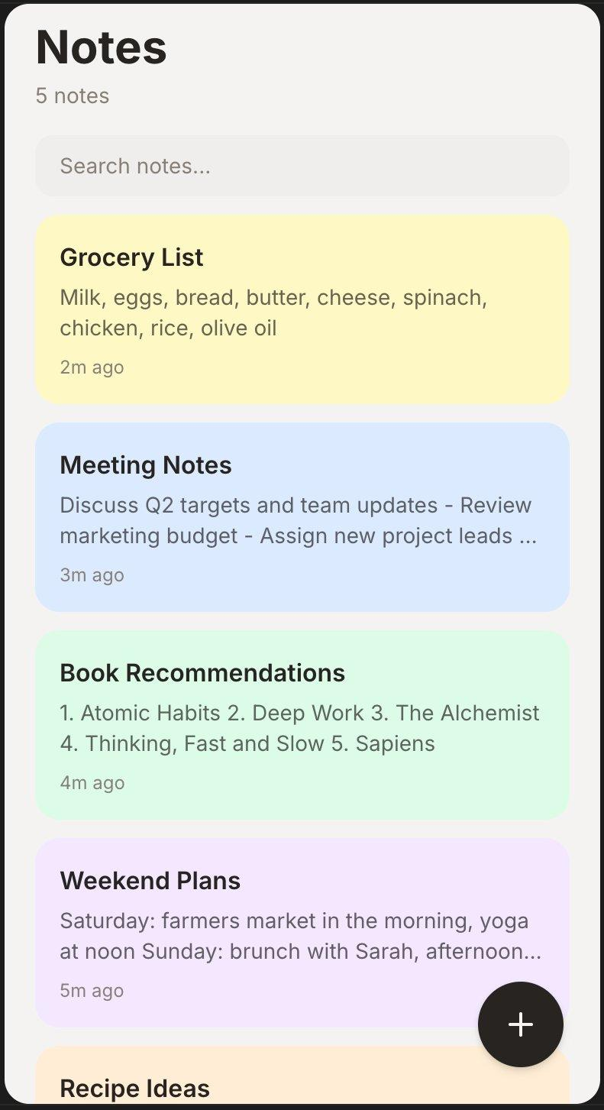
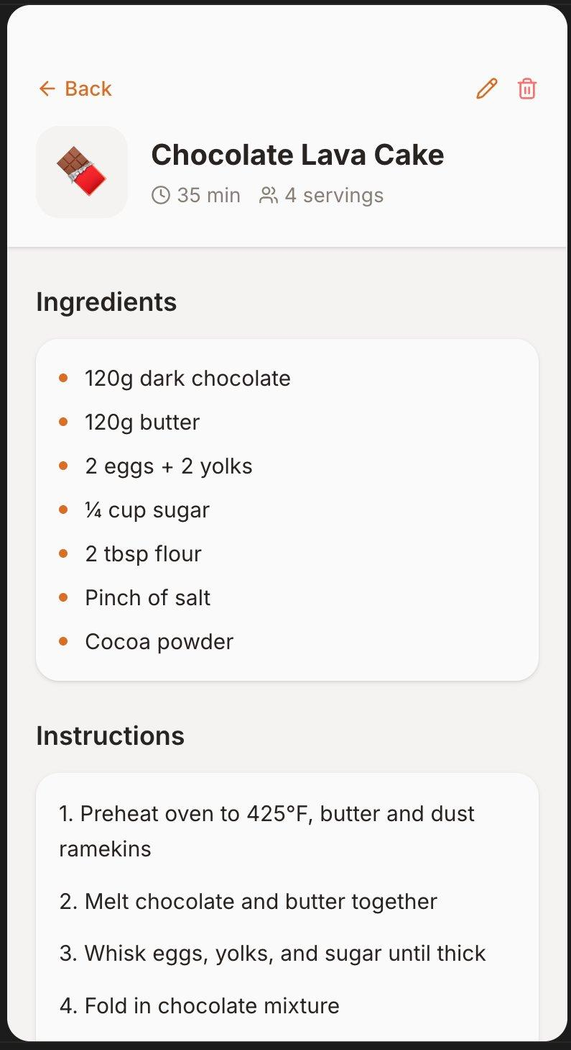
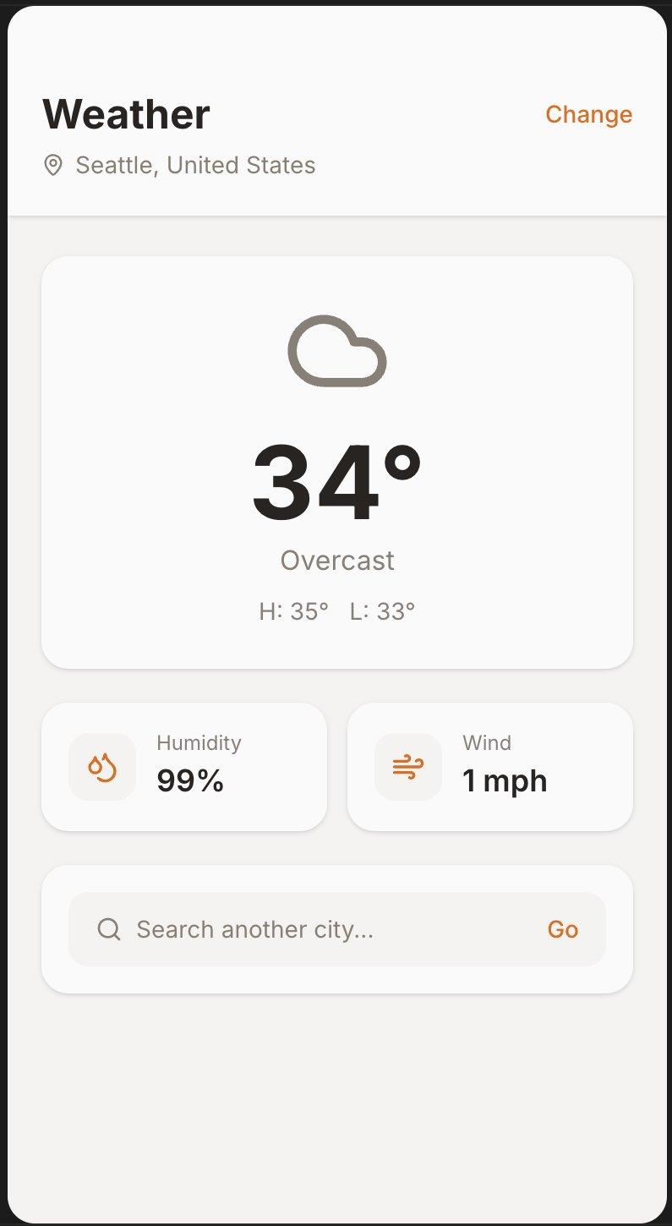
THE DECOY
Hidden in Plain Sight
Users choose their own disguise — SafeStep hides behind a normal-looking app on their home screen.
Triple-tap anywhere to reveal SafeStep
Notes App
Recipe App
Weather App

Slide 5








FUTURE WORK & ETHICS
Where SafeStep Goes Next
Future Work
Ethics & Limitations
Multilingual support — Spanish, Mandarin, and more
Stalkerware — app-level protection has limits; users advised to use trusted devices
Advocate review mode — trained counselors verify AI-generated plans
Not a legal or crisis counseling service — always routes to professionals
Native iOS / Android app with biometric unlock
AI responses must be trauma-informed; system prompt reviewed by DV advocates
Anonymized outcome tracking to improve AI recommendations
Anthropic high-risk compliance: AI disclosure, human review, flagging mechanism

Slide 6
Q & A
SafeStep

Slide 7
