Slide 1
Guardian Ecosystem
Team Guardian

Slide 2
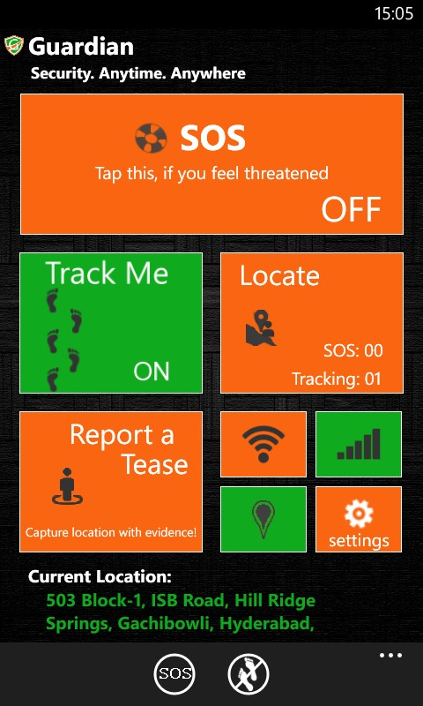

Guardian Ecosystem
Window Phone 8 App
  SOS/ Real-time tracking by buddies and security agencies.
  One-Click event reporting.
  Tracking by heterogeneous platforms.
Accompanying Web Portal
  Runs on Azure
  Incident recording for evidences
  GPS coordinates based complete trail locator
  Call back and announcements as crime deterrents

Slide 3
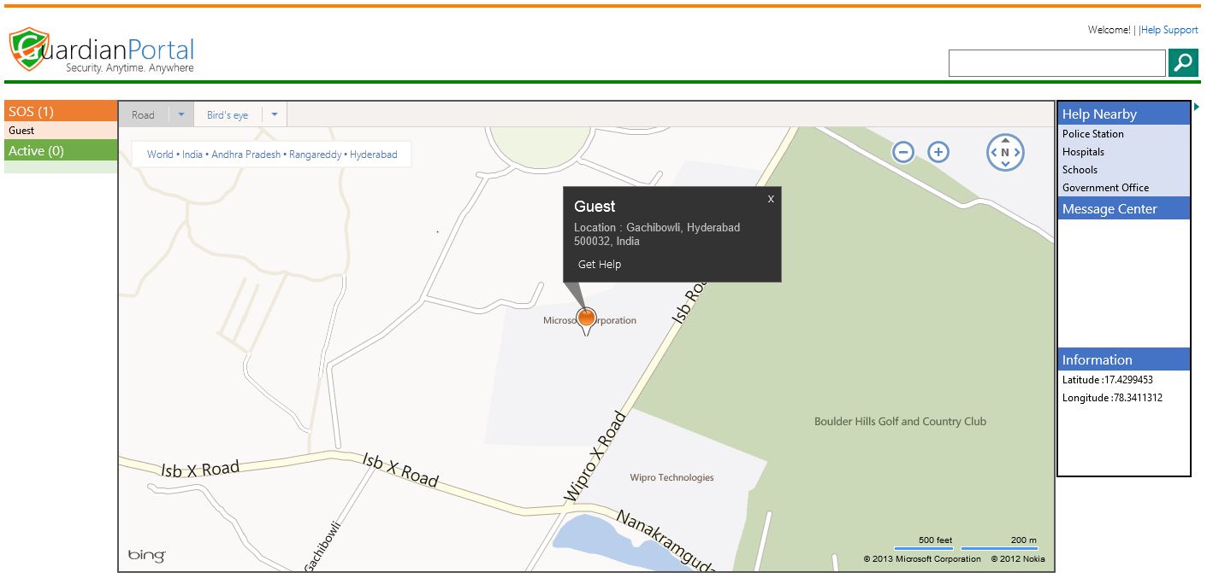
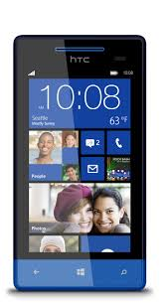

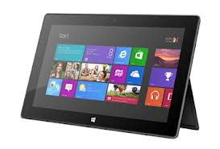
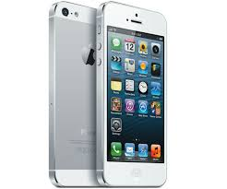

Guardian – Windows Phone 8 and Azure
Groups and Registered Users
Buddy devices
SOC HYD (Private)
DELHI POLICE (Public)
EMRI-108 (Social)
Messages to buddies
Guardian Cloud Services
Azure Mobile Services
Broadcast Service
Guardian Azure Storage
In-House Locating Module
Notes:
Window Phone 8 App
SOS/ Real-time tracking by buddies and security agencies.
One-Click event reporting.
Tracking by heterogeneous platforms.
Accompanying Web Portal
Runs on Azure
Incident recording for evidences
GPS MAP based complete trail locator
Call back and announcements as crime deterrents

Slide 4
Next Steps
Make it go live with SOC
Need resources to support development.
  2 devs + 1 test : 1.5 months

Slide 5
Q & A

Slide 6
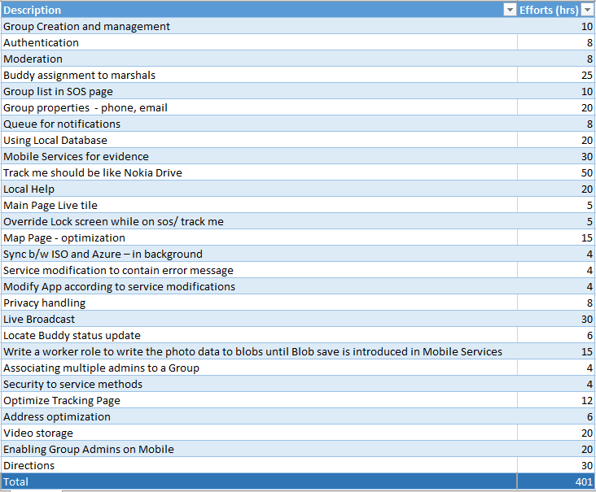
Appendix : Pending features

Slide 7

© 2012 Microsoft Corporation. All rights reserved. Microsoft, Windows, Windows Vista and other product names are or may be registered trademarks and/or trademarks in the U.S. and/or other countries.
The information herein is for informational purposes only and represents the current view of Microsoft Corporation as of the date of this presentation. Because Microsoft must respond to changing market conditions, it should not be interpreted to be a commitment on the part of Microsoft, and Microsoft cannot guarantee the accuracy of any information provided after the date of this presentation. MICROSOFT MAKES NO WARRANTIES, EXPRESS, IMPLIED OR STATUTORY, AS TO THE INFORMATION IN THIS PRESENTATION.

