Slide 1
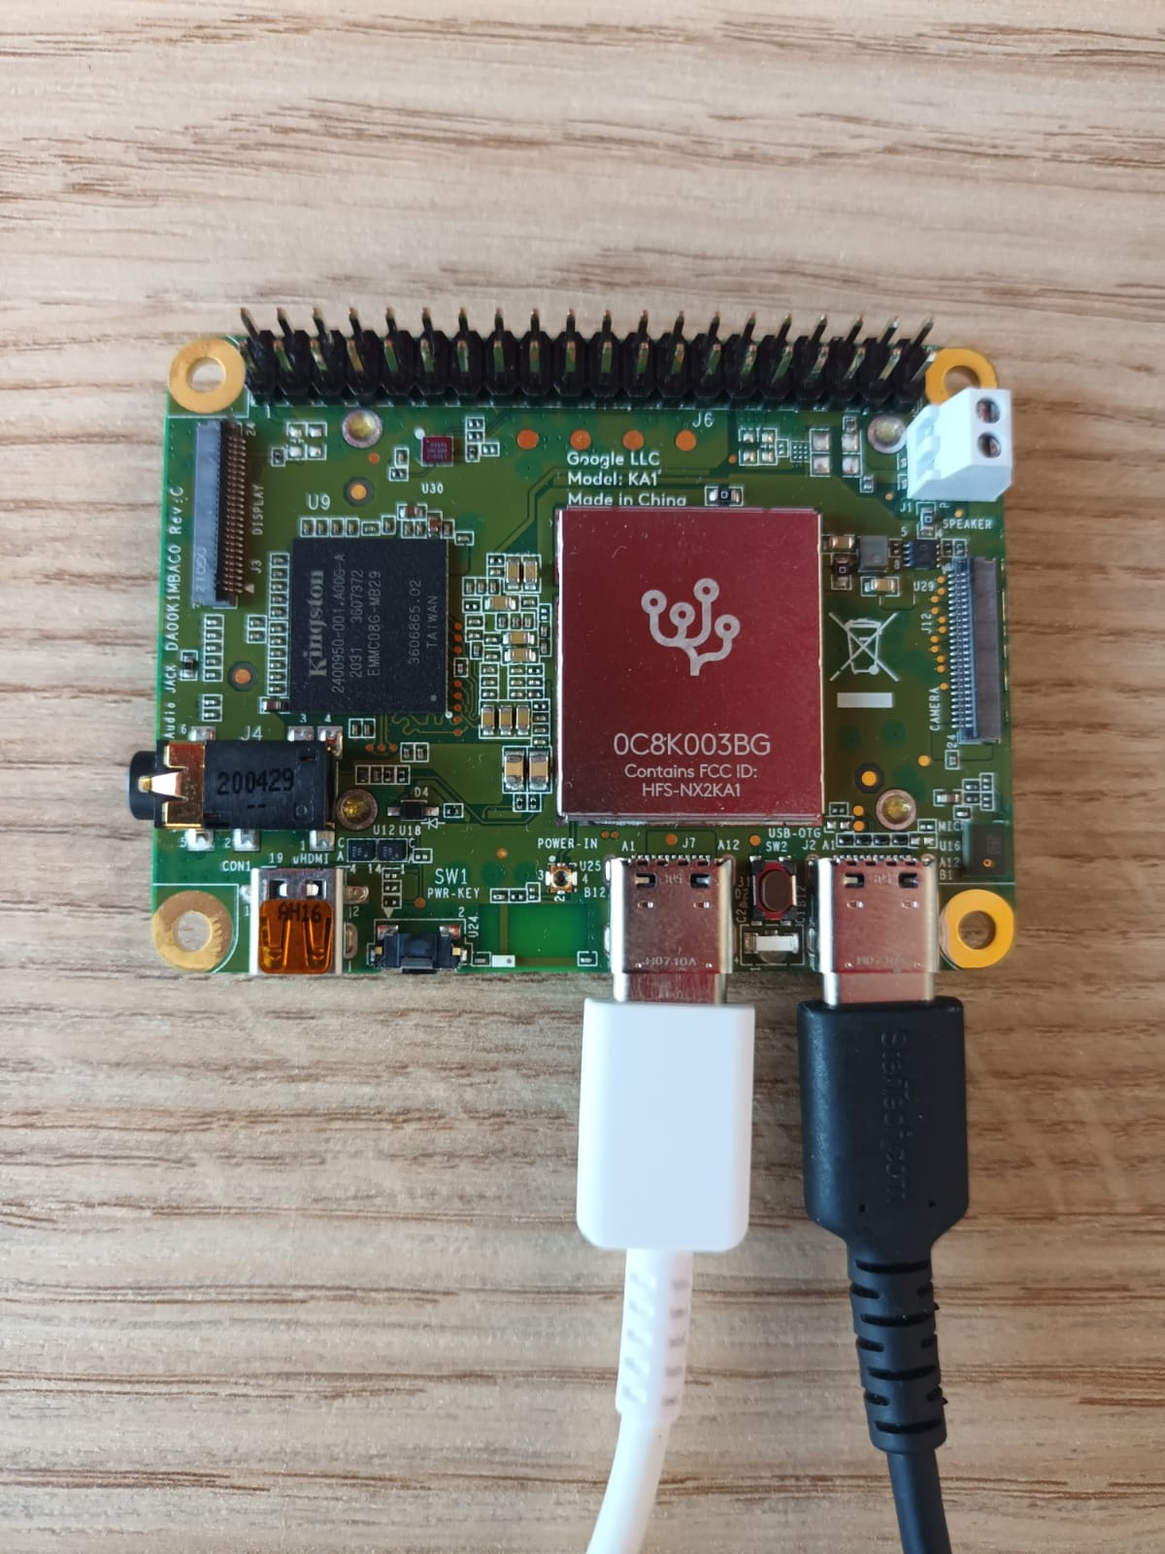
Coral Dev Board Mini
A development board for on-device ML products.
CPU | MediaTek 8167s SoC (Quad-core Arm Cortex-A35)
GPU | IMG PowerVR GE8300 (integrated in SoC)
ML accelerator | Google Edge TPU coprocessor: 4 TOPS (int8); 2 TOPS per watt
RAM | 2 GB LPDDR3
Flash memory | 8 GB eMMC
Wireless | Wi-Fi 5 (802.11a/b/g/n/ac); Bluetooth 5.0
Audio/video | 3.5mm audio jack; digital PDM microphone; 2.54mm 2-pin speaker terminal; micro HDMI (1.4); 24-pin FFC connector for MIPI-CSI2 camera (4-lane); 24-pin FFC connector for MIPI-DSI display (4-lane)
Input/output | 40-pin GPIO header; 2x USB Type-C (USB 2.0)
Power Button
Ref: https://coral.ai/products/dev-board-mini/
Power
Data

