Slide 1

Can solar energy provide Sicily with reliable and affordable supply and decrease dependency on natural gas imports?
SEN1531 Design of Integrated Energy Systems
27.03.2019
Mustika Siti Hajarini 4825608
Elif Gül Demir 4821068
Elena Marabini 4912691
Notes:
Hello, today I’ll be presenting you our project about the potential of solar energy in providing Sicily with reliable and affordable electricity and decreasing dependency on natural gas imports. I am working with Mustika and Elena.

Slide 2

Contents
1. Introduction
2. Scope
3. Problem Definition
4. Research Question
5. Scenarios
6. Modelling Strategy
6.1. PV and Electricity Storage
6.2. Diffusion of Innovations
6.3. Energy Transition Model
7. Results
8. Analysis
9. Discussion
Notes:
I’ll start by introducing the current situation in Italy and scope it down for Sicily. After defining the problem, the solution and KPIs of our design proposal will be mentioned. Then, I’ll talk about our modelling strategy and how we combine these three models for our case.
I’ll finish by providing our plan for the upcoming weeks.

Slide 3

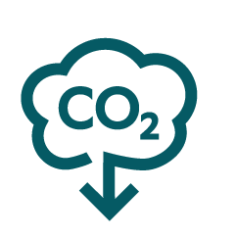
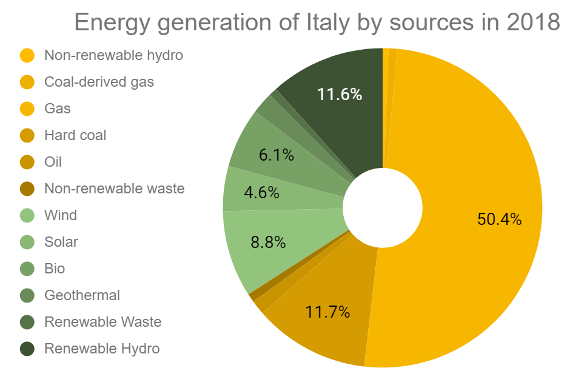
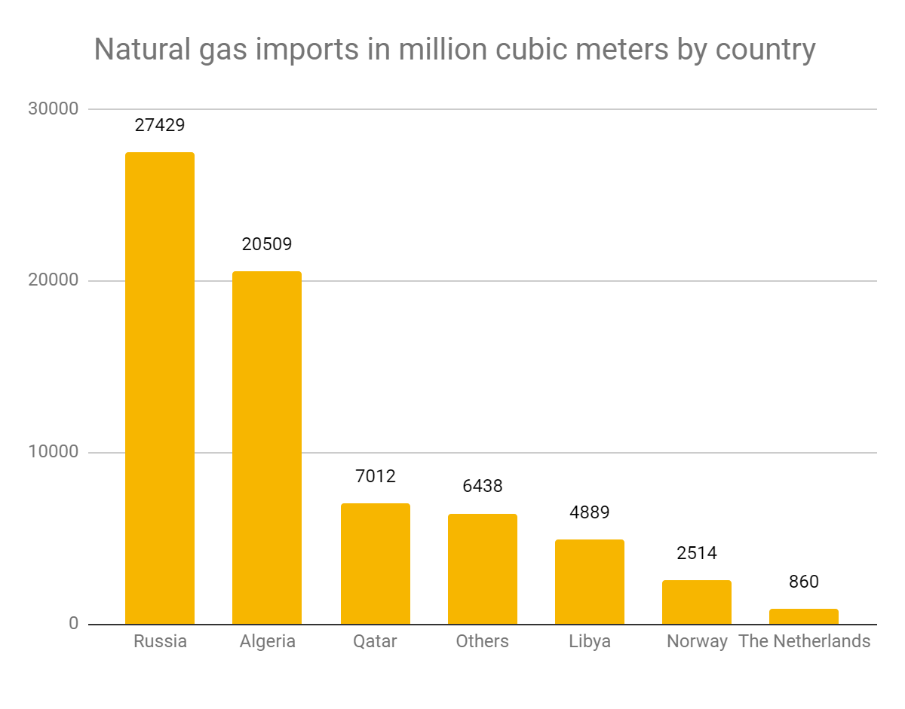
1. Introduction
ITALY
Huge dependency on natural gas since 50% of it is mainly imported from Russia
NATIONAL ENERGY STRATEGY 2017
Competitive, sustainable, and secure
28%
80%
Figure 1. Energy generation of Italy by sources in 2018 [2].
Figure 2. Natural gas imports by country in 2018 [4].
Notes:
As stated in the National Energy Strategy published in 2017, Italy wants to make their energy system more competitive, sustainable, and secure. In line with this, they set their targets for 2030 to increase the renewables to 28% and reduce CO₂ emission by 80% compared to 1990 levels. The figure on the right shows the energy generation by source. The first thing that catches eye is the fact that 50% of the energy is coming from natural gas.

Slide 4
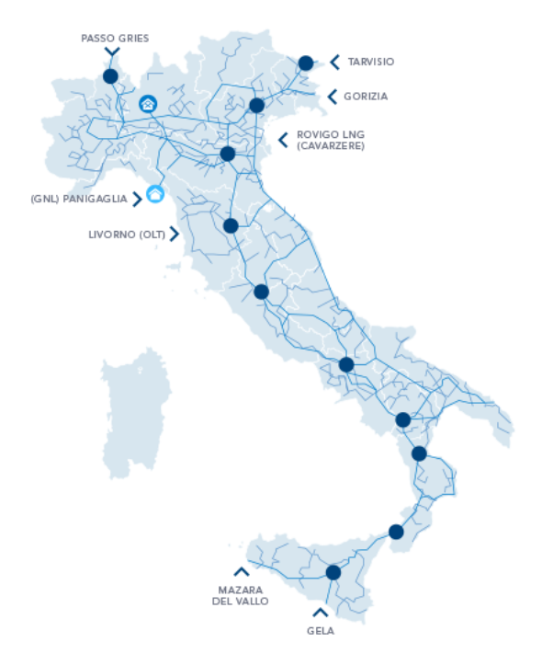
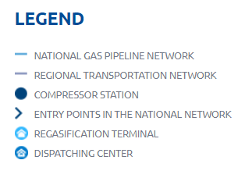
2. Scope
SICILY
Biggest region in Italy
Connections to Algerian gas
RES potential in Sicily:
Wind
Sun
Sea currents
Challenges for the integration of RES
Lack of enthusiasm because of the abundance of conventional electricity
Weak structure of the power grid
Low transport capacity
Limited storage because of landscape issues
Residents’ opposition to the wind turbines for natural land protection
People’s tendency towards solar
Figure 3. The gas transportation network in Italy [8].
Notes:
The map on the right shows the network for natural gas transportation in Italy. With its connections to Algerian gas and a compressor station, Sicily is a big island with high potential for renewable energy sources like wind, sun and sea currents. Since Sicily has more supply coming from thermal power plants than their demand, any excess RES production would benefit to the mainland but not the island. This creates a challenge for the integration of RES, together with weak structure of the power grid, low transport capacity, limited storage space, and the opposition by residents to wind turbines.

Slide 5
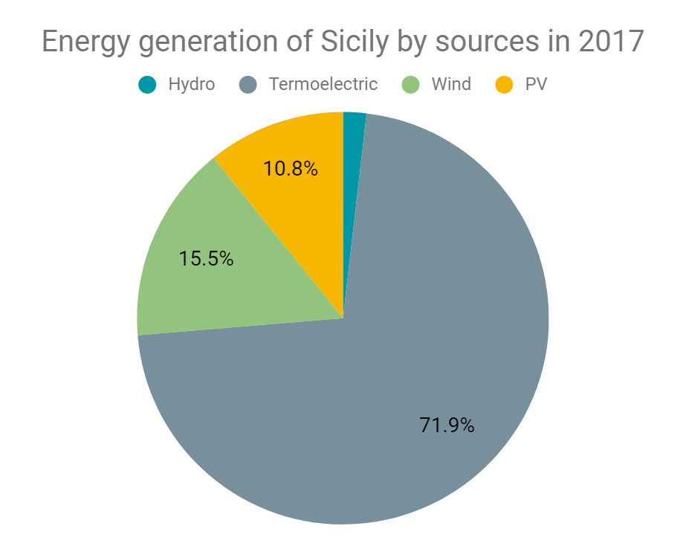
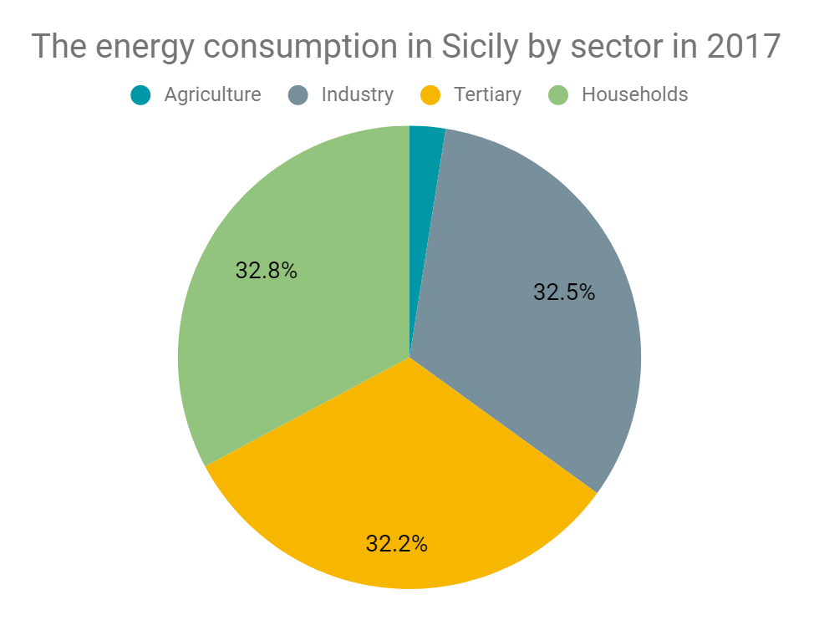
3. Problem Definition
Growth in the generation from renewable energy sources
Dependent on fossil fuel, especially on the imported natural gas
Almost same amount of energy is consumed by three sectors
The solar PV as an option to meet the household demand
Figure 4. Energy generation of Sicily by sources in 2017 [4].
Figure 5. Energy consumption in Sicily by sector in 2017 [4].
Notes:
The graph on the left shows how huge the termoelectric potential is in the island whereas the one on the right shows the energy consumption by sector. As you can see, 32.8% of the energy is consumed by the households which we think can be met by solar PV.

Slide 6


4. Research Question
Can solar energy provide Sicily with reliable and affordable electricity supply and decrease dependency on natural gas imports with the help of subsidies and storage options while taking consumers’ adoption of new technologies into account in 2030?
Using solar energy in households
Subsidizing the renewables
Implementing new storage technologies
Discovering technology adoption by consumers
Figure 6. The solution presented for the problem.

Slide 7
5. Scenarios
Scenario 1
PV or not PV?
Scenario 2
iStore
Scenario 3
Let’s have Fund!
Households decide to adopt solar PV or not
Households can use batteries with solar PV
Households are subsidized for batteries with solar PV

Slide 8
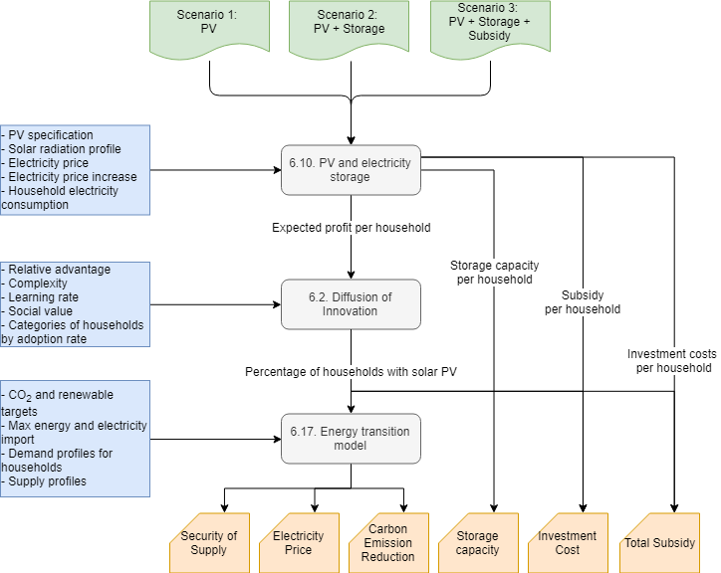
6. Modelling Strategy
Notes:
We have three models that run in series with three scenarios: no subsidy, feed-in tariff, and battery investment subsidy. The first model, PV and electricity storage, used by Mustika gets the specification of PV, solar profile, electricity price increase and electricity consumption of households as input and provides the utilization of storage capacity and subsidy and investment per household which is used by Diffusion of Innovation that Elena is responsible for. This agent-based model takes risks and complexity of different solar PV technologies as inputs and provides the percentage of the households that will use solar PV based on how consumers adopt the technology. Finally, this output is feed into the Energy Transition Model that I use which provides several outputs like security of supply, electricity price, reduction in carbon emission, storage efficiency, investment costs and total subsidy.

Slide 9
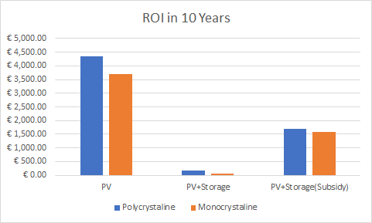
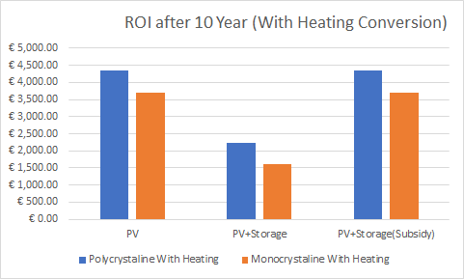
6.1. PV and Electricity Storage
MAIN ASSUMPTIONS
Uniform demand and solar irradiance in every household.
Subsidy is limited into 100 kwh battery. Each household have 20 meter square rooftop surface.
Electricity price is not changed based on the household PV installment.
RESULTS FOR DIFFUSION OF INNOVATION
Mono and Poly similar payback periods
Italy → more uniformity of generation → less battery need
Storage (with or without subsidy): high initial investment → ROI in 10 years lower than PV only
→ the financial benefits emerging from different scenarios are scaled - [1:3] interval - as input for Diffusion of Innovation model through the relative advantage parameter.
EXTENSION WITH HEATING
Higher electricity consumption could increase the financial return in a scenario with storage implementation relative to other scenarios (will not be discussed any further)
Notes:
To incorporate PV and Electricity Storage model to Sicily, we changed several things like solar PV specifications, expected payback period, solar radiation, hourly average consumption, and electricity price. The model has three functions: consumers can use PV and sell it to the grid if not used, consumers can use PV and storage everything in the battery if not used with the option of getting subsidy for battery investment. The built-in assumptions in the models limit the the solar irradiance and household energy demand limit the accuracy of the relative advantage of the technology usage.
Sunerg and chinese battery

Slide 10
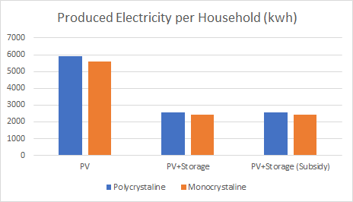
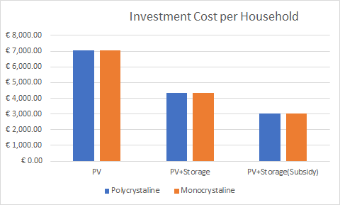
6.1. PV and Electricity Storage
OTHER RESULTS
Optimal number of PV panels:
Scenario 1: 14 panels (max limit)
Scenario 2: 6 panels
Scenario 3: 6 panels
PV generation >> electricity consumption (assuming 20 meter square rooftop area).
Estimated required storage subsidy: €26 400 / household
The investment cost of battery is still relatively expensive compared to the PV investment
Optimal battery capacity:
Scenario 2: 5 kWh
Scenario 3: 100 kWh
Battery usable 30.9% of the time
Decrease on Italy's gas dependency:
Scenario 1: -0.85% gas usage
Scenario 2: -0.29% gas usage
Scenario 3: - 0.31% gas usage
Notes:
Using GRG Non-linear

Slide 11
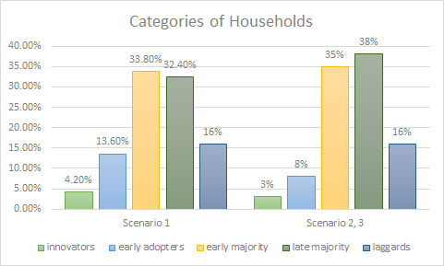
6.2. Diffusion of Innovations
ASSUMPTIONS
500 households represent the trends of adoption rate.
Different categories of households adopt for different reasons, mainly social recognition - more important for innovators - and financial benefits - more relevant for the laggards
LEARNING RATE
The increase in capacity of the technology and the related reduction in costs with time
The first scenario only considers the LR of the PV module, while Scenarios 2 and 3 add the LR of the Balance of System - calculated as weighted average between PV’s LR and BoS’s LR in relation to their contribution to the CAPEX
Households interact more and the word of mouth has a more long-lasting and relevant influence on their decision-making process
1. PV
2. PV + BoS
3. PV + BoS

Slide 12
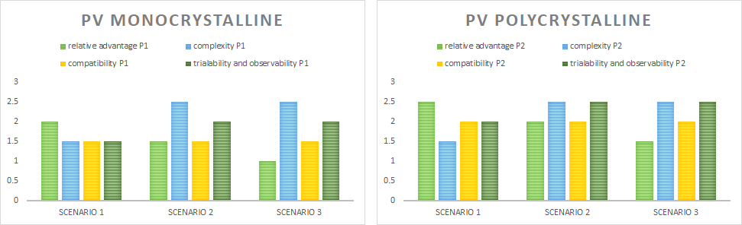
6.2. Diffusion of Innovations
Relative Advantage: Degree to which an innovation is perceived as better, in terms of savings made, or more useful, in terms of social recognition, than others to achieve personal goals
- taken as input from the PV and Electricity Storage → decrease
Complexity: of implementation and usage of the technology, as perceived from households → increase
Compatibility: Degree of compatibility with needs, way of living and values of a potential adopter
Trialability and observability: Degree of trialability, test and visibility of added value before adoption
A rate of 1 is most advantageous for adoption while 3 is the most disadvantageous.

Slide 13
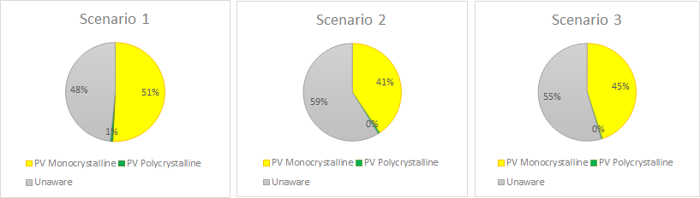
6.2. Diffusion of Innovations
RESULTS
3 variables mainly block or push the adoption of PV panels:
Complexity: if the product requires a high knowledge and a relevant amount of time to be implemented, households will not adopt it
Financial benefits: households will adopt only if the price of the PV panels is lower than the costs related to the traditional appliances. If the electricity bills are lower with the former than with the latter, households will adopt.
Drivers of adoption: different priorities for different categories of households in terms of expected savings and social recognition.

Slide 14
6.3. Energy Transition Model
MODEL FORMULATION
Base scenario: Spain 2030 -> scale for Sicily
Verification with an existing local scenario
ASSUMPTIONS
5.1 million people in Sicily
Flexible area use policies for wind turbines
PARAMETER SETTINGS
Targets
CO₂ emission reduction: 12%
The percentage of renewables: 40%
Max. energy and electricity imports: 50%
Demand
Household demand
Population
Solar panels
Heating and cooling
Supply
Conventional electricity
Coal
Gas
Oil
Nuclear plants
Renewable electricity
Wind turbines
Hydro electric
Geothermal
Hydrogen plants
Solar power
Waste power
Flexibility
% of storage in household batteries
Notes:
The percentage of households adopting the PV technologies is fed into the Energy Transition Model. Since ETM does not have Italy in its predefined scenarios, we are using Spain 2030 scenario because of the similarities in load and RES profiles which we justify with literature review, and then scale it down for Sicily. Since there are more than 400 sliders in the model, we selected variables that we deem important and fixed others like households and buildings. The variables that we change are the targets for CO₂ emission reduction and RES share, allowed change in cost policies, area use policies for wind turbines, demand for households, supply from conventional and renewable electricity sources and lastly, the storage in household batteries.

Slide 15
6.3. Energy Transition Model
Scenario 1
PV or not PV?
Scenario 2
iStore
Scenario 3
Let’s have Fund!
CO₂ emissions | -8.0% | -7.4% | -7.6%
Change in electricity prices | Low | Low | Medium
Security of supply (import/exports) | High | High | Medium

Slide 16
7. Results
 | SCENARIO 1: PV OR NOT PV? 52% | SCENARIO 2: iSTORE 41% | SCENARIO 3: LET’S HAVE FUND! 45%
CO₂ emissions | -8.0% | -7.4% | -7.6%
Electricity prices | Low | Low | Medium
Investment costs | 7.35 B€ | 3.57 B€ | 2.73 B€
Security of supply | Medium | Medium | High
Storage capacity | 0 GWh | 4.11 GWh | 90.12 GWh
Total subsidy | 0 | 0 | 23 792.52 B€
Notes:
The different scenarios will be analyzed and compared based on six KPIs: total subsidy, storage efficiency, security of supply, CO₂ emissions, electricity prices, and investment costs.

Slide 17
8. Analysis
Can solar energy provide Sicily with reliable and affordable electricity supply and decrease dependency on natural gas imports with the help of subsidies and storage options while taking consumers’ adoption of new technologies into account in 2030?
ANSWER TO THE RESEARCH QUESTION
Financially, the most advantageous scenario for households is the one in which they don’t need to install battery in their house (Scenario 1).
Subsidy is needed to increase the adoption of battery in the household.
This approach can help reduce the dependency on natural gas imports.
The security of supply is ensured with the batteries or ample solar PV adoption.
IMPLICATION OF THE ANSWER
In Scenario 1, the government needs consider the effect of the raise of PV usage without the battery technology.
Security of supply is in danger because of the high energy imports.
Subsidizing a new technology may not result in it wide spread of usage by consumers.

Slide 18
9. Discussion
ASSUMPTIONS AND HOW THEY AFFECTED THE RESULTS
In general, models are not completely customizable / adaptable to the location considered.
Local extrapolated trends are assumed to develop also on a global scale.
Complexity of local and diverse factors (behavioural or biophysical) are translated into numerical variables.
Some datasets are missing / no open source / represent different years.
Electricity prices is not changed based on PV installation on the PV and Storage model
The built-in assumptions of the models, together with the ones to modify them for our case limit the accuracy of the outputs. → This allows for a qualitative analysis more than a precise quantitative comparison between different scenarios.
RECOMMENDATION
Solar energy has a huge potential in the transition to low carbon energy market in Sicily.
The government should conduct accurate surveys and interviews to households to collect concrete data about the drivers for adoption behaviour.
The previous point would support an efficient allocation of subsidies and help further potential diffusion of other renewable energy technologies.
Further research on the effect of heating electrification might be valuable to see the effect of electrification with the battery in the households.

Slide 19
9. Discussion
ASSUMPTIONS AND HOW THEY AFFECTED THE RESULTS
In general, models are not completely customizable / adaptable to the location considered.
For what concerns PV and Electricity Storage and Diffusion of Innovations, these models are adapted to the characteristics of Dutch population in terms of averages of electricity consumption and behavioural characteristics of people. At the same time, ETM uses Spain as representation of Sicily’s climate and trends in energy consumption. This implies that data used for the final analysis are subject to personal re-elaboration - based on literature - with the final aim of obtaining general trends useful to evaluate how different initial conditions will influence the diffusion of renewable energy technologies.
Local extrapolated trends are assumed to develop also on a global scale.
Diffusion of Innovations uses a sample of 500 households - it is built to analyse an area of the dimension of a district or small city - to represent the whole population of Sicily; this means that the local fragmentation of the population is assumed to keep constant on a regional scale, when instead it often happens that relevant differences in uses, customs and culture emerge between different cities.
Complexity of local and diverse factors (behavioural or biophysical) are translated into numerical variables.
Characteristics of products - namely, Monocrystalline and Polycrystalline PV panels -, consumers’ behaviours, diffusion of new technologies are represented as values ranging in a finite interval or as percentages, not reflecting the complexity that emerges from the interactions of multiple external factors which influence the decision-making process of an individual. People are assumed to keep an open attitude towards changes in their daily life in order to switch to a more sustainable way of living, when instead literature shows that is extremely difficult to drive people in certain directions.

Slide 20
9. Discussion
ASSUMPTIONS AND HOW THEY AFFECTED THE RESULTS
Some datasets are missing / no open source / represent different years.
Finding data about Sicily was one of the main challenges that we had to face when developing the final project. Some data are missing or are related to different years, and making them match with the inputs’ format required by the models was not an easy task.
The built-in assumptions of the models, together with the ones to modify them for our case limit the accuracy of the outputs. This allows for a qualitative analysis more than a precise quantitative comparison between different scenarios. However, the results obtained can be useful as support in the decision-making process when developing policies - on a city, regional or national level - which aim at pushing people towards the adoption of a renewable energy source like solar power, as further explained in the recommendations.

Slide 21
References
[1] https://www.iea.org/policiesandmeasures/pams/italy/name-171455-en.php
[2] https://www.mise.gov.it/images/stories/documenti/testo_della_StrategiaEnergeticaNazionale_2017.pdf
[3] https://www.entsoe.eu/data/power-stats/monthly-domestic/
[4] https://www.statista.com/statistics/787720/natural-gas-imports-by-country-of-origin-in-italy/
[5] http://www.terna.it/it-it/sistemaelettrico/statisticheeprevisioni/datistatistici.aspx
[6] https://www.forbes.com/sites/annalisagirardi/2018/12/12/growing-dependent-on-russia-the-gas-routes-in-europe/#929df4b62b00
[7] http://www.hazar.org/blogdetail/blog/the_italian_natural_gas_market_an_endless_crisis__857.aspx
[8] http://www.snam.it/en/Natural-gas/snam-infrastructures/
[9] https://www.enfsolar.com/
[10] https://tradingeconomics.com/italy/electric-power-consumption-kwh-per-capita-wb-data.html
[11] https://www.statista.com/statistics/418092/electricity-prices-for-households-in-italy/
[12] http://www.ecn.nl/fileadmin/ecn/units/zon/vansark-carpediem.pdf
[13] http://www.solaranlagen-portal.com/photovoltaik/stromspeicher/voltwerk-vs-5-hybrid
[14] http://www.photovoltaik-shop.com/solarstromspeicherset-bosch-voltwerk-hybrid-m-11-kwh.html
[15] http://www.photovoltaik-shop.com/solarstromspeicherset-bosch-voltwerk-hybrid-l-13-2-kwh.html
[16] https://www.ovoenergy.com/guides/energy-guides/how-much-heating-energy-do-you-use.html
[17] https://www.sciencedirect.com/sdfe/pdf/download/read/noindex/pii/S0959652618316652/1-s2.0-S0959652618316652-main.pdf
[18] https://www.researchgate.net/publication/285596800_Supporting_the_adoption_of_smart_grid_appliances_in_city_districts_-_A_quantitative_evaluation_of_policy_options_using_agent-based_modelling_and_scenario_discovery?enrichId=rgreq-dcdd0c67bb5c6a7ddb6f9d3f76ad0d39-XXX&enrichSource=Y292ZXJQYWdlOzI4NTU5NjgwMDtBUzozMDI5NDk5NzUxNjY5NzZAMTQ0OTI0MDMxMDY4MA%3D%3D&el=1_x_3&_esc=publicationCoverPdf
[19] Rogers, E. M. (2003). Diffusion of innovations. New York: Free Press.
[20] https://unit-converter.gasunie.nl/
[21] https://www.indexmundi.com/italy/natural_gas_consumption.html

Slide 22
Feedback
Gijsbert
Design solution and modelling strategy. Refer back to the design solution which uses the modelling strategy. It should not disappear from the discussion. Make it design oriented, not be very analytical.
Be careful with the use of energy and electricity.
Emile
Find the story and make it count/stick.
Modelling is done. Create a straighter story instead.
Take ownership of the analysis. Stick by your results and recommendations.
Don’t undersell the work.
A lot of point estimates. Beware of the robustness, these are not the final things. Ranges work better.
Overview like a scorecard Group 8 with colors.
Refer to the other projects if possible.

