Slide 1

Can solar energy provide Sicily with reliable and affordable supply and decrease dependency on natural gas imports?
SEN1531 Design of Integrated Energy Systems
01.04.2019
Mustika Siti Hajarini 4825608
Elif Gül Demir 4821068
Elena Marabini 4912691
Notes:
Hello, today I’ll be presenting you our project about the potential of solar energy in providing Sicily with reliable and affordable electricity and decreasing dependency on natural gas imports. I am working with Mustika and Elena.

Slide 2
Abstract
The following slide pack contains the design project developed as part of the course SEN1531 Design in Integrated Energy Systems.
The project aims at evaluating the potential of PV panels rooftops installation in the island of Sicily to decrease the dependency of Italy on natural gas imports - mainly from Russia and Algeria - needed to produce electricity.
Three future scenarios are implemented, namely adoption of PV panels only, PV panels plus storage and PV panels plus storage supported by a subsidy.
Taking the scenarios as starting point, three energy-scenario models in a sequential order have been used to simulate the effects of different assumptions on six main KPIs - the reduction on CO2 emissions, the total investment costs and subsidy required, the fluctuations in the electricity prices and the degree of security of supply, supported by the storage capacity.
After a general introduction of the problem, the modelling strategy will be explained as well as the outputs provided by the simulations. The project ends with a final comparison between the three scenarios, to evaluate strengths and weaknesses of each of them, and develop from here recommendations which can be helpful for governmental bodies in drawing policies supporting the spread of renewable energy technologies.

Slide 3

Contents
1. Introduction
6. Modelling Strategy
2. Scope
6.1. PV and Electricity Storage
3. Problem Definition
6.2. Diffusion of Innovations
4. Research Question
6.3. Energy Transition Model
5. Design Proposal
7. Results
5.1. Solution
8. Analysis
5.2. Key Performance Indicators
9. Discussion
5.3. Scenarios
10. Conclusions & Recommendations
Notes:
I’ll start by introducing the current situation in Italy and scope it down for Sicily. After defining the problem, the solution and KPIs of our design proposal will be mentioned. Then, I’ll talk about our modelling strategy and how we combine these three models for our case.
I’ll finish by providing our plan for the upcoming weeks.

Slide 4
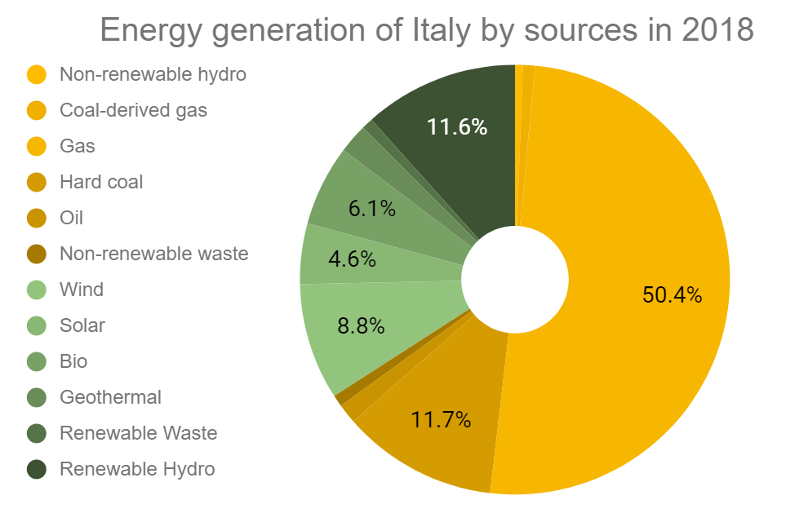


1. Introduction
The objectives of Italy’s National Energy Strategy 2017 [1] consist of making the energy system more:
Competitive: energy prices aligned with the European prices
Sustainable: decarbonization, high energy efficiency
Secure: security of supply, flexibility and independence
To achieve these objectives, Italy decided on the target of a 28% share of RES in total energy consumption by 2030. This RES share will be broken down as follows [1]:
55% of RES in Energy
30% of RES in Heating & Cooling
21% of RES in Transportation
Italy wants to increase RES in energy from 34.1%, shown in Figure 1, to 55% by 2030 [1] and reduce CO₂ emissions by %80 from their 1990 levels [2].
28%
80%
Figure 1. Energy generation of Italy by sources in 2018 [2].
Notes:
As stated in the National Energy Strategy published in 2017, Italy wants to make their energy system more competitive, sustainable, and secure. In line with this, they set their targets for 2030 to increase the renewables to 28% and reduce CO₂ emission by 80% compared to 1990 levels. The figure on the right shows the energy generation by source. The first thing that catches eye is the fact that 50% of the energy is coming from natural gas.

Slide 5
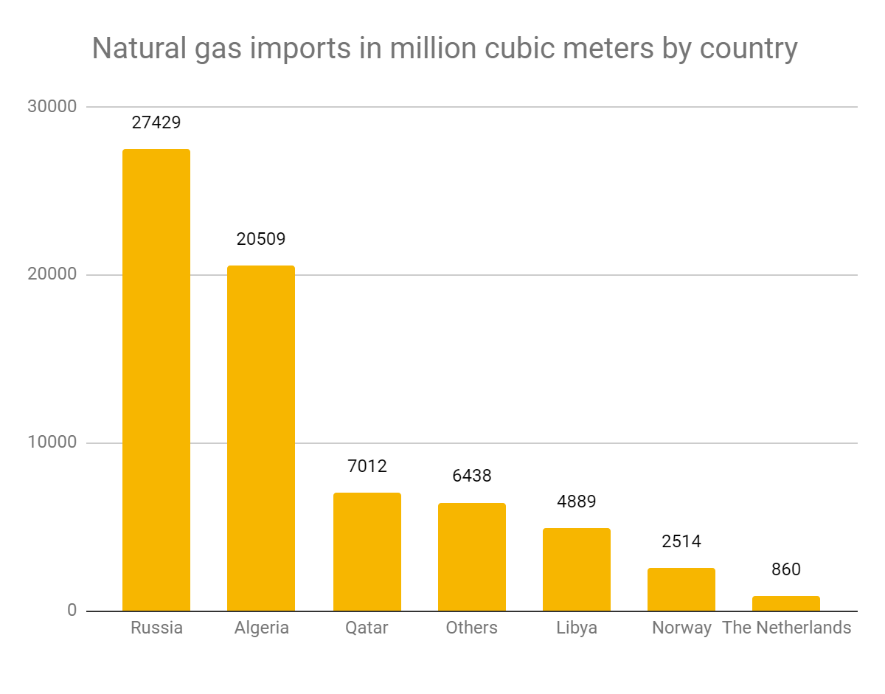
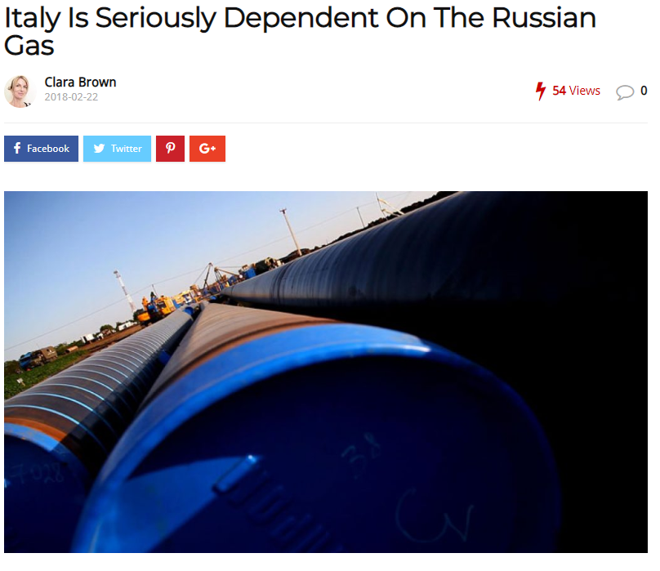
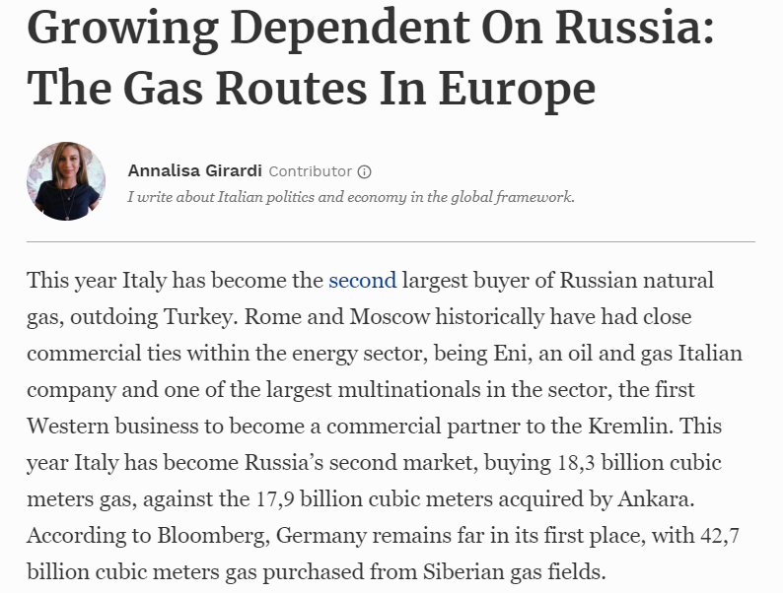
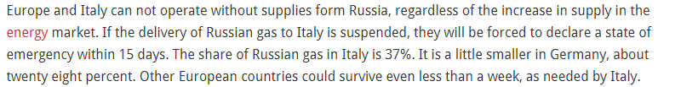
1. Introduction
Approximately 50% of the energy demand of Italy is provided by natural gas [3]. Of this, almost 50% is imported by Russia, followed by Algeria, Qatar, Libya, Norway, and the Netherlands [4] as shown in Figure 2.
Although natural gas has a key role in energy transition as a backup source, its volatility and uncertainty steers Italy towards renewable energy sources in the road to decarbonization.
Improving the security and adequacy of the energy system and increasing the flexibility of gas networks and power grids is necessary, especially considering the dependency on natural gas [5]. That’s why, Italy aims to:
Manage the variability of natural-gas flows and demand peaks
Diversify supply sources
Figure 2. Natural gas imports by country in 2018 [4].
Figure 3. Newspaper clips about Italy’s dependence on Russian gas [6] [7].
Notes:
Of this 50% natural gas, 50% is imported by Russia, followed by Algeria, Qatar and other countries. This dependency on natural gas imports led Italy to manage the variability of gas flows and demand peaks and also diversify supply sources.

Slide 6
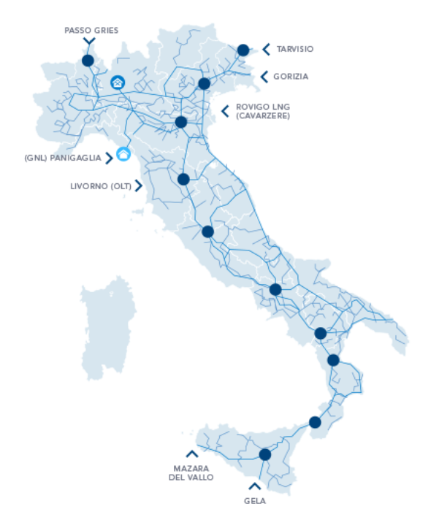
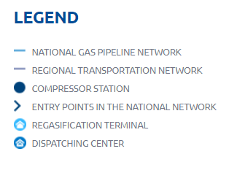
2. Scope
Sicily
Biggest region in Italy
Connections to Algerian gas
RES potential in Sicily:
Wind
Sun
Sea currents
Power production is higher than the consumption because of the refinery districts. The excess supply is transported to the mainland. This creates a lack of enthusiasm for the renewables because any renewable energy produced would be transported to the mainland without any benefits to the island. That’s why RES would be more beneficial in isolated communities or small islands that are running on diesel.
Challenges for the integration of RES
Weak structure of the power grid
Low transport capacity
Limited storage because of landscape issues
The uncontrolled localization of wind power plants in the protected natural areas caused the residents to oppose the wind turbines.
People’s tendency towards solar
Figure 4. The gas transportation network in Italy [8].
Notes:
The map on the right shows the network for natural gas transportation in Italy. With its connections to Algerian gas and a compressor station, Sicily is a big island with high potential for renewable energy sources like wind, sun and sea currents. Since Sicily has more supply coming from thermal power plants than their demand, any excess RES production would benefit to the mainland but not the island. This creates a challenge for the integration of RES, together with weak structure of the power grid, low transport capacity, limited storage space, and the opposition by residents to wind turbines.

Slide 7
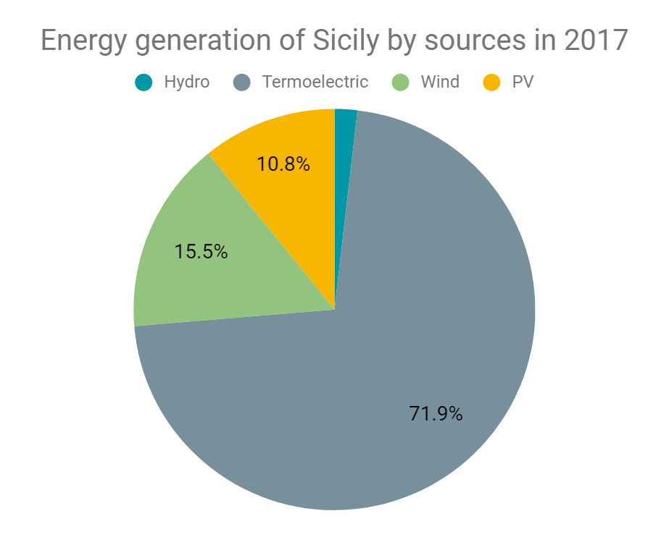
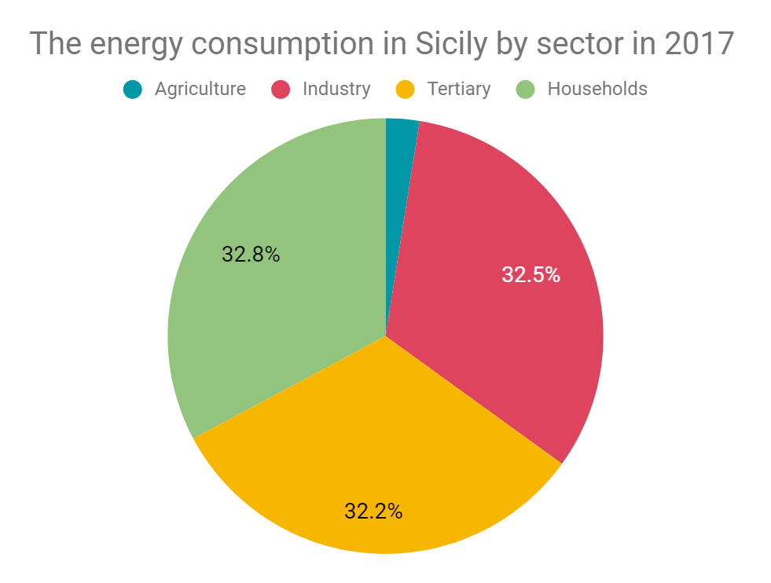
3. Problem Definition
Although there has been an important growth in the generation from renewable energy sources, Sicilian energy system is still dependent on fossil fuel, especially on the imported natural gas [5] as shown in Figure 5. Being in a politically important location with its connections to Algerian gas, Sicily is an important island. In accordance with the targets set for 2030, the share of renewables in Sicily is expected to increase with incentives of the government.
In Sicily, 32.8% of the energy is consumed by the households as shown in Figure 6. The solar PV can be used by the households to meet the demand to reduce the dependency on the termoelectric sources for energy generation..
This research tries to find the effect of subsidies and solar PV technologies on the CO₂ emissions and electricity prices in Sicily.
Figure 5. Energy generation of Sicily by sources in 2017 [4].
Figure 6. Energy consumption in Sicily by sector in 2017 [4].
Notes:
The graph on the left shows how huge the termoelectric potential is in the island whereas the one on the right shows the energy consumption by sector. As you can see, 32.8% of the energy is consumed by the households which we think can be met by solar PV.

Slide 8


4. Research Question
Can solar energy provide Sicily with reliable and affordable electricity supply and decrease dependency on natural gas imports with the help of subsidies and storage options while taking consumers’ adoption of new technologies into account in 2030?
Using solar energy in households
Subsidizing the renewables
Implementing new storage technologies
Discovering technology adoption by consumers
Figure 7. The solution presented for the problem.

Slide 9


5.1. Design Proposal - Solution
Aim
The design solution aims to identify different scenarios for the electricity power system of Sicily in which the share of electricity produced by PV solar panels is increased to reduce CO₂ emissions and the dependency of Italy on Russian gas imports in 2030 by discovering the effect of consumers’ technology adoption, storage, and subsidy options.
Assumptions
Time horizon until: 2030
Solution: solar PV + storage + subsidies considering the rate of technology adoption by consumers
The research focuses on the energy used to produce power for households, leaving out the heating and transport sectors.
The electricity generated from PV will reduce the electricity that comes from the plant with the highest marginal cost, oil and CCGT. Therefore in this research, all the electricity generated by PV will reduce the electricity generated by oil and CCGT power plant.
Discovering technology adoption by consumers
Implementing new storage technologies
Subsidizing the renewables
Moving towards EU targets about CO₂ reduction
Increasing the share of renewables
Figure 8. The solution presented for the problem.
Notes:
That’s why, we try to analyse different future scenarios for the power system of Sicily in which the solar technology adoption by consumers, new storage technologies and subsidies are utilized to reduce the CO₂ emissions and increase the share of renewables.

Slide 10
5.2. Design Proposal - KPIs
Total subsidy
CO₂ emissions
The amount of money given by the government to the households
CO₂ emissions
The amount of carbon emitted to the air
Total subsidy
Electricity prices
Storage efficiency
Electricity prices
The percentage of the storage capacity utilized
The hourly dispatch prices
Storage efficiency
Investment costs
Security of supply
Security of supply
Investment costs
Short-term: The deficit/surplus of production in relation to the demand
Long-term: The amount of energy imported
The amount of money spent for the solar PV systems
Figure 9. The key performance indicators for the design.
Notes:
The different scenarios will be analyzed and compared based on six KPIs: total subsidy, storage efficiency, security of supply, CO₂ emissions, electricity prices, and investment costs.

Slide 11
5.2. Design Proposal - Scenarios
Scenario 1
PV or not PV?
Scenario 2
iStore
Scenario 3
Let’s have Fund!
Households decide to adopt solar PV or not
Households can use batteries with solar PV
Households are subsidized for batteries with solar PV

Slide 12
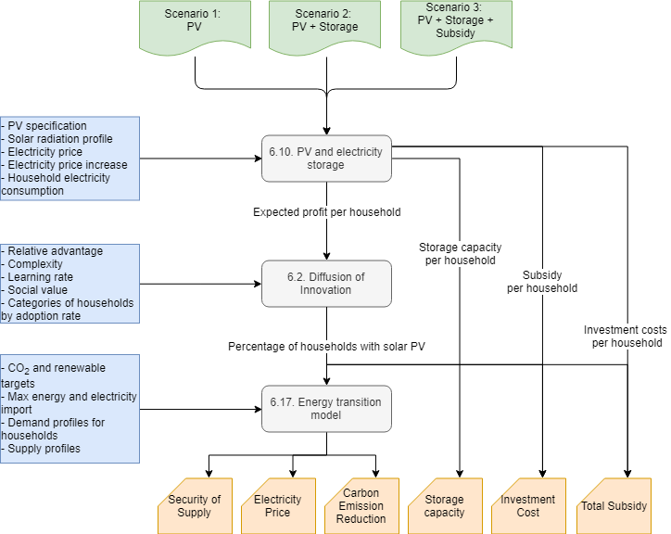
6. Modelling Strategy
Notes:
We have three models that run in series with three scenarios: no subsidy, feed-in tariff, and battery investment subsidy. The first model, PV and electricity storage, used by Mustika gets the specification of PV, solar profile, electricity price increase and electricity consumption of households as input and provides the utilization of storage capacity and subsidy and investment per household which is used by Diffusion of Innovation that Elena is responsible for. This agent-based model takes risks and complexity of different solar PV technologies as inputs and provides the percentage of the households that will use solar PV based on how consumers adopt the technology. Finally, this output is feed into the Energy Transition Model that I use which provides several outputs like security of supply, electricity price, reduction in carbon emission, storage efficiency, investment costs and total subsidy.

Slide 13
6. Modelling Strategy
We will develop our design project starting from three future scenarios, to evaluate the effects on the KPIs selected. The scenarios are:
PV or not PV? Households choose, depending mainly on financial benefits and social recognition, if installing or not PV modules on their rooftops to produce their own electricity.
iStore the option of including a battery, in addition to PV panels, to allow electricity storage is introduced.
Let’s have Funds! is based on the same assumptions of scenario 2 but in addition households receive a subsidy to help them in the initial investment for the installation of the technology.
The modelling strategy that we chose, illustrated in the previous figure, follows a sequential approach. However, iteration was necessary to merge the final results to allow for a concrete comparison between different scenarios.
The first model, PV and Electricity Storage, gets the specification of the PV panels and the average values of the solar profile, the electricity price and the electricity consumption of households of Sicily as input. It provides the expected savings coming from the installation of the technology used by Diffusion of Innovation in the adoption process of households.
This agent-based model evaluates the behaviour of households towards the adoption of renewable technologies and provides the percentage of the households that will install solar PV.
Finally, this output is feed into the Energy Transition Model which provides as outputs the degree of security of supply, the expected electricity price and the forecast reduction in carbon emissions.
The availability of storage capacity, the total initial investment costs and the amount of subsidy required for the batteries are instead provided by the PV and Electricity Storage model.
Notes:
the utilization of storage capacity and subsidy and investment per household which is

Slide 14
6.1. PV and Electricity Storage
ADAPTING THE INPUT FOR SICILY:
Change the PV, battery, and inverter specification into Italian based manufacturer (Sunerg)
Expected turnover will be changed based on the product. Most PV companies in Italy offer 10 years warranty only.
Use payback time variability into input variable of the model: 5 or 10 years
Change the solar radiation average per hour data of different month to Sicily which have longer and more powerful solar radiation than in Netherland (2016 data)
Change the hourly average consumption of different month in Sicily which consume less power for lighting since they have longer day (more equal consumption distribution throughout the day) (2016 data)
Change in total amount of energy used per year (2014 data)
Change in electricity price and expected increase per year (2014 data)
UNCHANGED DATA
Solar panel degradation factor, maintenance cost per year
Insurance cost and cost of capital, increase cost per year
Construction cost
COMPARISON FUNCTION OF THE CURRENT MODEL
Use PV and sell it to the grid if not used
Use PV and store everything in the battery if not used
Battery investment by household
Battery investment not by household
MODEL MODIFICATION
Calculation of total solar energy generation per household
Calculate needed subsidy to give to the consumers in the third scenario.
Notes:
To incorporate PV and Electricity Storage model to Sicily, we changed several things like solar PV specifications, expected payback period, solar radiation, hourly average consumption, and electricity price. The model has three functions: consumers can use PV and sell it to the grid if not used, consumers can use PV and storage everything in the battery if not used with the option of getting subsidy for battery investment.

Slide 15
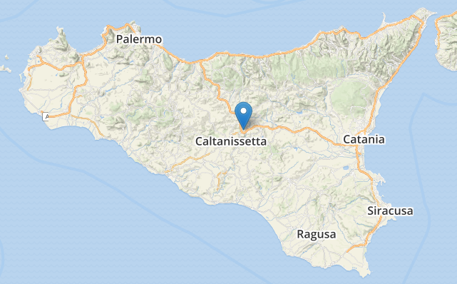
6.1. PV and Electricity Storage
RESULT:
Both Polycrystalline and Monocrystalline products give almost the same payback period.
Since PV generation in Italy is more uniform than Netherland, the need to battery is lower.
Despite the low battery capacity, the household that decided to install both battery and PV will still get less return in their capital than the ones that decided to install only PV.
Even if the household don’t have to pay for the battery, they will still get longer return of investment rather than using only PV
In Italy, total yearly PV generation prediction in the household is bigger than the average energy consumption. (20 meter square)
NEXT MODIFICATIONS:
Add variability if the household also decide to convert their heating and cooking system from gas to electricity
Change in the total consumption per year
Change in energy consumption profile
Addition in the investment cost
Addition on the possibility to sell electricity as well as having a battery at home with normal capacity
Geographical assumptions:
All household are generating and consume uniform electricity. One location in the middle of Sicily is taken as reference, Caltanissetta.
Notes:
The preliminary results for the model shows that both poly- and monocrystalline products have almost the same payback period. The need for battery is lower since the PV generation is more uniform in Italy. We see that even though the battery capacity is low, the households that decided to install them will not get their investment back. Moving on, we consider adding the possibility that the households converting their heating and cooking systems from gas to electricity and for households to be able to sell electricity when they have a battery at home.

Slide 16
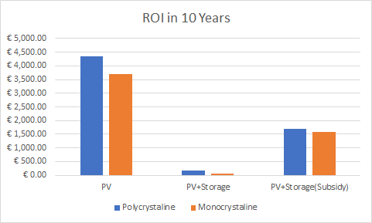
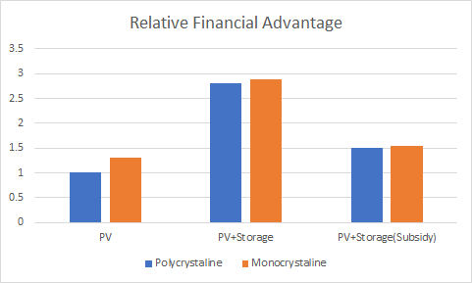
6.1. PV and Electricity Storage
MAIN ASSUMPTIONS
Uniform demand and solar irradiance in every household.
Subsidy is limited into 100 kwh battery. Each household have 20 meter square rooftop surface.
Electricity price is not changed based on the household PV installment.
RESULTS FOR DIFFUSION OF INNOVATION
Mono and Poly similar payback periods
Italy → more uniformity of generation → less battery need
Storage (with or without subsidy): high initial investment → ROI in 10 years lower than PV only
→ the financial benefits emerging from different scenarios are scaled - [1:3] interval - as input for Diffusion of Innovation model through the relative advantage parameter.
3 shows minimum advandantage
1 shows highest advantage
Notes:
To incorporate PV and Electricity Storage model to Sicily, we changed several things like solar PV specifications, expected payback period, solar radiation, hourly average consumption, and electricity price. The model has three functions: consumers can use PV and sell it to the grid if not used, consumers can use PV and storage everything in the battery if not used with the option of getting subsidy for battery investment. The built-in assumptions in the models limit the the solar irradiance and household energy demand limit the accuracy of the relative advantage of the technology usage.
Sunerg and chinese battery

Slide 17
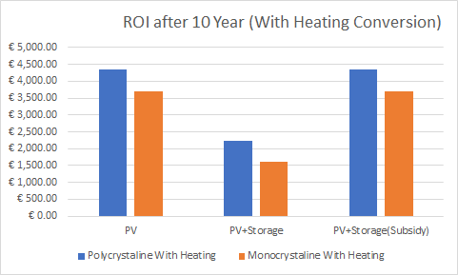
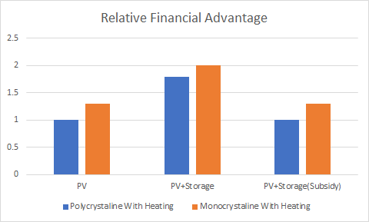
6.1. PV and Electricity Storage
EXTENSION WITH HEATING
Higher electricity consumption could increase the financial return in a scenario with storage implementation relative to other scenarios (will not be discussed any further)
Although this scenario will not be mentioned any further, this result shows that there is a possibility that electrification on heating and might increase the value of battery in the household.
This battery value increase because of the PV area limitation (14 PV per household).
PV limitation gives room for scenario relative value to increase.
Scenario one become relatively paler than other scenario in the case of heating electrification.

Slide 18
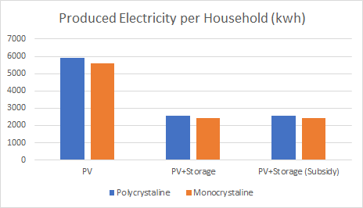
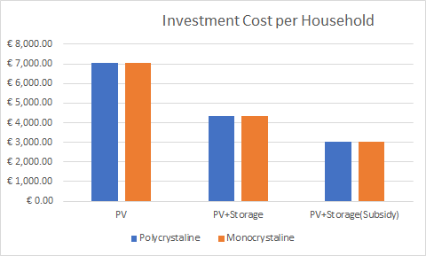
6.1. PV and Electricity Storage
OTHER RESULTS
Optimal number of PV panels:
Scenario 1: 14 panels (max limit)
Scenario 2: 6 panels
Scenario 3: 6 panels
PV generation >> electricity consumption (assuming 20 meter square rooftop area).
Estimated required storage subsidy: €26 400 / household
The investment cost of battery is still relatively expensive compared to the PV investment
Optimal battery capacity:
Scenario 2: 5 kWh
Scenario 3: 100 kWh
Battery usable 30.9% of the time
Decrease on Italy's gas dependency:
Scenario 1: -0.85% gas usage
Scenario 2: -0.29% gas usage
Scenario 3: - 0.31% gas usage
Notes:
Using GRG Non-linear

Slide 19
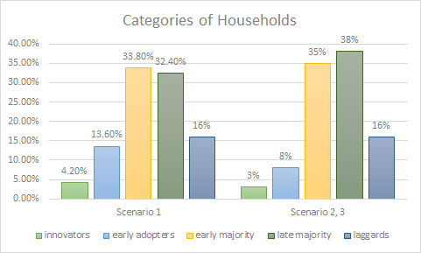
6.2. Diffusion of Innovations
Setup and Assumptions
In the model, 500 households represent the trends of adoption rate. Different categories of households adopt for different reasons, mainly social recognition - more important for innovators - and financial benefits - more relevant for the laggards. The different categories are adapted from Roger’s theory.
An important assumption is that the shares of different categories of households are based on a normal distribution - adapted to the italian region - which does not precisely reflect the real attitude of Sicilian citizens.
The decision making-process of the households takes into account the financial profitability coming from the adoption of a particular technology as well as other factors. The steps are based on 4 main elements:
The amount of information about the products just received from other households
The amount of information in their memory
Individual preferences
Environmental parameters (electricity price, price decrease of PV, current complexity)
The model has been chosen to evaluate:
Policy performance indicators: to measure at each time the number of households that currently own a PV
Adopter specific adoption curves: To understand which type of adopter is not willing to adopt and to develop specific policy directions for these categories
Adoption blockage: to identify the reasons which lead households to refuse to adopt
Following the time horizon set in the design proposal, the model now autonomously stops after 119 ticks, meaning after 10 years - 2020-2030.
Notes:
With the expected profit per household data provided by the previous model, Diffusion of Innovations model the adoption of the solar PV in Sicily. The households are segmented based on their tendency to adopt new technologies, the innovations have characteristics like compatibility and complexity.
MODELLING OBJECTIVES

Slide 20
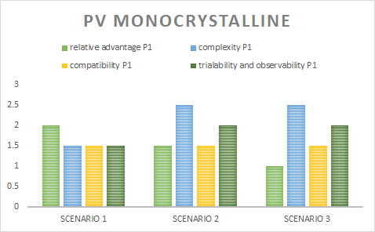
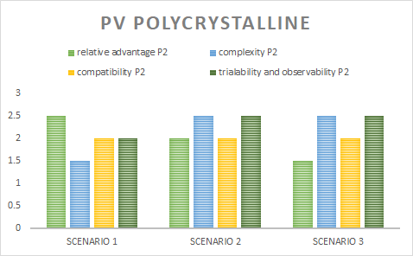
6.2 Diffusion of Innovations
There are four main parameters which, depending on the assigned value, characterise the products:
Relative Advantage: Degree to which an innovation is perceived as better, in terms of savings made, or more useful, in terms of social recognition, than others to achieve personal goals.
The Relative Advantage is taken as input from the PV and Electricity Storage model and reflects the amount of expected savings that can be made in different scenarios. As stated in the definition, what counts in influencing the decision-making process is the perception of the savings made, which needs to reach a specific threshold to be considered satisfactory for adoption; households are assumed to get higher financial benefits when they are able to store the electricity produced, and even higher when they receive a subsidy for installing the technology.
Complexity: of implementation and usage of the technology, as perceived from households; it increases with the introduction of the storage option.
Compatibility: Degree of compatibility with needs, way of living and values of a potential adopter. It is kept constant since needs and values are not expected to change depending on the technology.
Trialability and observability: Degree of trialability, test and visibility of added value before adoption. PV panels are more visible, while the storage option is still not diffused; the parameter decreases from Scenario 1 to Scenario 2 and 3.
An important assumption to be highlighted is that the products are considered belong to the same brand - thus there is no alternative of choice - and the parameters are limited to a [1:3] interval - the efficiency or the degradation factors, for example, are not considered. This limits the comparison and restricts the analysis to simplified scenarios - chosen to be representative of the current PV market situation.

Slide 21
6.2. Diffusion of Innovations
PV TECHNOLOGIES
In the model the same types of technologies investigated in the PV and Electricity Storage model are used combined in different scenarios with the assumption that each technology owns the 50% of the worldwide market share - thus representative samples of the current PV market:
Monocrystalline silicon (with and without subsidy)
Polycrystalline silicon (with and without subsidy)
Our aim is to increase the share of Monocrystalline technology - the most mature technology on the market -, since, even if its price is generally higher than Polycrystalline, its conversion efficiency is higher, and it is more adequate for rooftops installations.
POTENTIAL ADOPTERS & INTERACTIONS
The number of Innovators changes depending on the scenario. In the first is set higher (21), as well as the initial number of households that already own PV monocrystalline: we assume that, since PV technology is each day more common in houses’ rooftops and its advantages - in terms of medium term finances - are well known, the number of people open to switch to this renewable energy source is higher.
Storage, instead, is still a new and expensive technology; people are thus assumed to be less inclined to adopt it. Scenario 2 and 3 consequently see as input a strictly lower number of Innovators which already own the technology - slightly increased in Let’s have Fund because of the financial incentive received by potential adopters.
We assume that also early adopters (category 2) - and not only innovators - will adopt with a perceived complexity value of 3 during the introduction phase to increase the percentage of adopters.
The duration of the validity of the information received from random, friend or neighbours interactions is set to a higher value with respect to the Dutch setup; Households interact more and the word of mouth has a more long-lasting and relevant influence on their decision-making process than in the Netherlands, and thus that it lasts more. Following this line of thought, we set the memory - meaning, the time that needs to pass before one household forgets about the information received from an interactions, and thus becomes unaware - at almost its maximum value (4).
Notes:
We modified the agent-based model with two products and set the number of innovators to 23.

Slide 22
6.2. Diffusion of Innovations
LEARNING RATE
The learning rate reflects the increase in capacity of the technology and the related reduction in costs with time.
The first scenario only considers the LR of the PV module, while Scenarios 2 and 3 add the LR of the Balance of System - calculated as weighted average between PV’s LR and BoS’s LR in relation to their contribution to the CAPEX - to reflect the introduction of the storage component in the system.
After the calculation, we obtained a learning rate of 80% for Monocrystalline Silicon and of 85% for Polycrystalline Silicon in Scenario 1; for Scenario 2 and 3, instead, we assumed a value for the parameter of 85% for the first product and a value of 90% for the second product.
The learning rate appears to be extremely relevant in influencing the rate of adoption, also in real markets. In the model, it is an important factor since the model does not have as input variations in the electricity price and in the electricity consumption from household to household.
1. PV
2. PV + BoS
3. PV + BoS

Slide 23
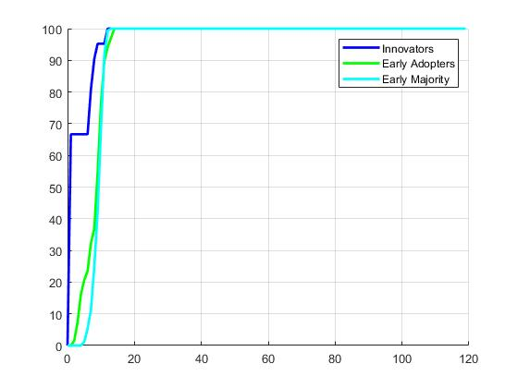
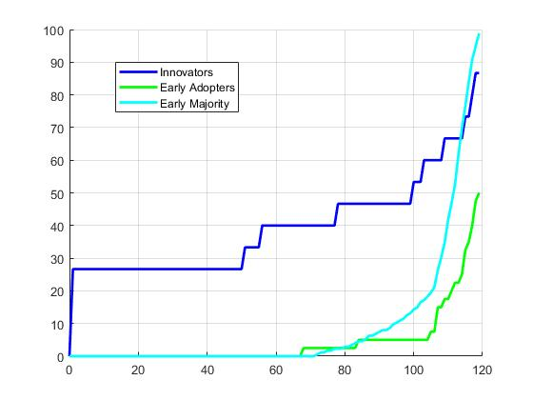
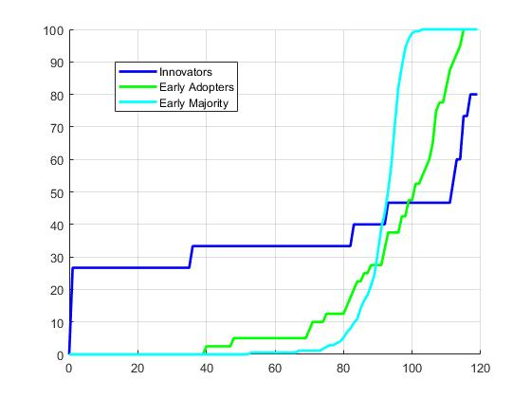
6.2. Diffusion of Innovations
Results
Scenario 1
Scenario 2
Scenario 3
With the assumptions made - and for how the model is built -, after several simulations, in all the three scenarios only Innovators, Early Adopters and Early Majority will implement PV panels on their rooftops.
The initial number of households owning a product influences the diffusion in time of the PV panels within the population. In the first scenario we can notice how a high initial number of Innovators owning PV panels encourages other categories to install the technology in their own house. The payback period happens between the first and the second year, thus information about the savings made can be transferred to neighbours and friends, which will be more inclined to adopt.
Due to a higher complexity of the PV panels and a lower learning rate - the initial investment in case of storage is higher - in Scenario 2 and 3 households tend to adopt the technology at a slower rate, starting to increase considerably only towards the end of the time horizon considered. This can be explained, in addition, by the lacking of passage of information with regard to the financial benefits deriving from the installation of a battery, which will come later in time. From a comparison between the 2 last scenarios, it is evident how the introduction of an economic support in the initial cost could however anticipate the adoption of PV panels for a specific population.

Slide 24
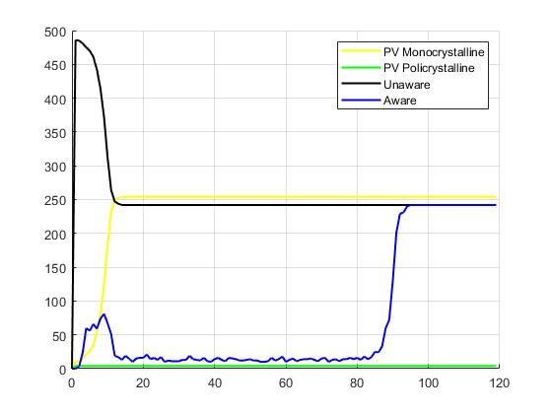
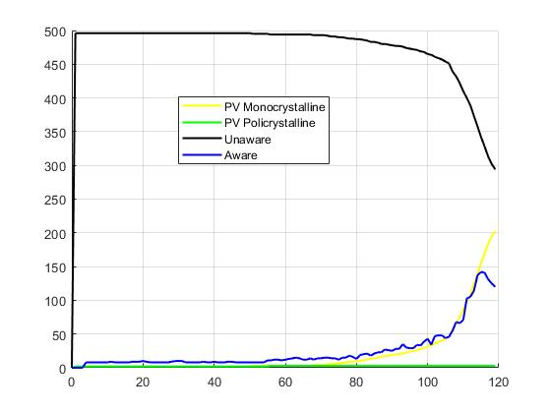
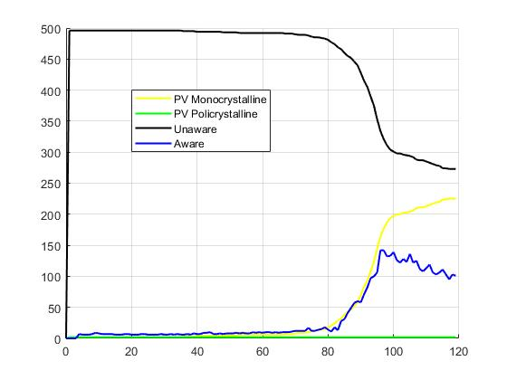
6.2. Diffusion of Innovations
Results
Scenario 1
Scenario 2
Scenario 3
The above graphs show the most representative rates of adoption of PV Monocrystalline during time - related to the previous results - obtained after several simulations. Since PV Polycrystalline is not being adopted, the decrease in the number of unaware households - not informed about the possibility of installing PV panels - is compensated with a proportional increase of households adopting PV Monocrystalline. This shows how the transfer of information - regarding the financial benefits - perceived as reliable between friends and neighbours has a major role in the spread of a specific technology.

Slide 25
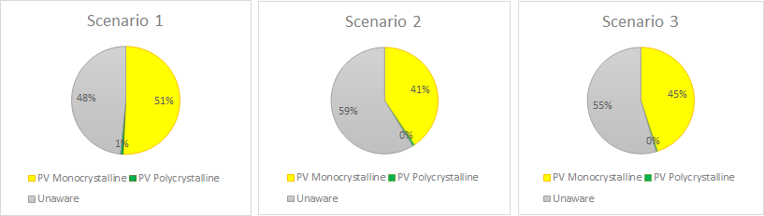
6.2. Diffusion of Innovations
To conclude, with the assumptions made, there are 3 variables that mainly block or push the adoption of PV panels, depending on the assigned value:
The complexity of the product: if the product requires a high knowledge and a relevant amount of time to be implemented, households will simply not adopt it;
The potential financial benefits: households will adopt only if the price of the PV panels is lower than the costs related to the traditional appliances. If they receive information by their neighbours of friends which have previously adopted that the electricity bills are lower with the former than with the latter, households will adopt.
The drivers of adoption: different priorities for different categories of households in terms of expected savings and social recognition influence the final rate of adoption.
The parameters, as set and explained before, lead to an average rate of adoption ranging between 40% and 50% for the three different scenarios taken into account, as shown in the following pie charts:
The different rates of adoption obtained will serve as input for the ETM model.

Slide 26
6.3. Energy Transition Model
ETM
A model based on the principle of energy conversion to evaluate future energy scenarios
MODEL FORMULATION
Base scenario: Spain 2030
The load, solar and wind profiles are similar to Italy because of the similarities in the latitude, weather, and the lifestyles more than any other country available in the ETM.
Data comparison is done with literature review to verify the similarities.
Scaling it down for Sicily according to the population
Since there are over 400 sliders for parameters, the most important ones are selected for the analysis.
This will be verified with the model results.
Fixed parameters (for now - can be expanded in the future):
Households: Cooling, cooking, appliances, lighting, prosperity, behavior, cold snap
Buildings and transport: everything
INPUT
Targets
Renewability: CO₂ emission reduction and the percentage of renewables
Dependence: max. energy and electricity imports
Cost policies: allowed change in the energy and electricity price
Area use policies: inland, coastal, and offshore wind
Demand
Households: population, solar panels, heating and cooling
Supply
Conventional electricity: coal, gas, oil, and nuclear plants
Renewable electricity: wind turbines, hydro electric, geothermal, hydrogen plants, solar power, waste power
Flexibility
Storage in household batteries
Notes:
The percentage of households adopting the PV technologies is fed into the Energy Transition Model. Since ETM does not have Italy in its predefined scenarios, we are using Spain 2030 scenario because of the similarities in load and RES profiles which we justify with literature review, and then scale it down for Sicily. Since there are more than 400 sliders in the model, we selected variables that we deem important and fixed others like households and buildings. The variables that we change are the targets for CO₂ emission reduction and RES share, allowed change in cost policies, area use policies for wind turbines, demand for households, supply from conventional and renewable electricity sources and lastly, the storage in household batteries.

Slide 27
6.3. Energy Transition Model
Scenario 1
PV or not PV?
Scenario 2
iStore
Scenario 3
Let’s have Fund!
CO₂ emissions | -8.0% | -7.4% | -7.6%
Change in electricity prices | Low | Low | Medium
Security of supply (import/exports) | High | High | Medium

Slide 28
7. Results
 | SCENARIO 1: PV OR NOT PV? 52% | SCENARIO 2: iSTORE 41% | SCENARIO 3: LET’S HAVE FUND! 45%
CO₂ emissions | -8.0% | -7.4% | -7.6%
Electricity prices | Low | Low | Medium
Investment costs | 7.35 B€ | 3.57 B€ | 2.73 B€
Security of supply | Medium | Medium | High
Storage capacity | 0 GWh | 4.11 GWh | 90.12 GWh
Total subsidy | 0 | 0 | 23 792.52 B€
Notes:
Add base case scenario
The different scenarios will be analyzed and compared based on six KPIs: total subsidy, storage efficiency, security of supply, CO₂ emissions, electricity prices, and investment costs.

Slide 29
8. Analysis
Can solar energy provide Sicily with reliable and affordable electricity supply and decrease dependency on natural gas imports with the help of subsidies and storage options while taking consumers’ adoption of new technologies into account in 2030?
The final results obtained by merging the outputs of the three models allow for a qualitative comparison between different scenarios. When each scenario is analysed based on the KPIs, it is seen that none of them appears to be optimal solution.
ANSWER TO THE RESEARCH QUESTION
In PV or not PV? the rate of adoption is the highest, as well as the reduction in CO₂ emissions. The dependency on imported gas is reduced of a relatively low factor, but still the highest within the scenarios. Financially, this is the most advantageous scenario for the households, the one in which they don’t need to install battery in their house. The cumulative initial investment required, however, doubles the costs for the other scenarios. The cost is doubled because in this scenario, the household choose to install double PV capacity compared to other scenario.
The problem in this scenario is that the volatility of solar power as energy source is compensated by a raise in electricity imports.
The dependence on gas imports is thus shifted to dependence on electricity imports. This huge burden make this scenario seem as less beneficial for Sicily.
iStore, in which the possibility of storing electricity is introduced, shows the lowest rate of adoption and the lowest amount of CO₂ reduction. On the other side, the cumulative investment required is almost halved with respect to PV or not PV?, the electricity price is maintained low and the security of supply is improved by approximately 4 GWh of extra storing capacity.
Let’s have Funds! results in a percentage of CO₂ reduction and a rate of adoption slightly higher than iStore and slightly lower than PV or not PV?. The electricity prices increase but the total costs reduce du to the allocation of subsidies. The subsidies - even if the amount is not feasible - allow for a high security of supply with a storage capacity that peaks to approximately 90 GWh.

Slide 30
9. Discussion
ASSUMPTIONS AND HOW THEY AFFECTED THE RESULTS (1/3)
In general, models are not completely customizable / adaptable to the location considered.
For what concerns PV and Electricity Storage and Diffusion of Innovations, these models are adapted to the characteristics of Dutch population in terms of averages of electricity consumption and behavioural characteristics of people. At the same time, ETM uses Spain as representation of Sicily’s climate and trends in energy consumption. This implies that data used for the final analysis are subject to re-elaboration - based on literature - with the aim of obtaining general trends which will be useful to evaluate how different initial conditions will influence the diffusion of renewable energy technologies.
Local extrapolated trends are assumed to develop also on a global scale.
Diffusion of Innovations uses a sample of 500 households - it is built to analyse an area of the dimension of a district or small city - to represent the whole population of Sicily; this means that the local fragmentation of the population is assumed to keep constant on a regional scale, when instead it often happens that relevant differences in uses, customs and culture emerge between different cities, especially in the remote islands of Sicily.

Slide 31
9. Discussion
ASSUMPTIONS AND HOW THEY AFFECTED THE RESULTS (2/3)
Complexity of local and diverse factors (behavioural or biophysical) are translated into numerical variables.
Characteristics of products - namely, Monocrystalline and Polycrystalline PV panels -, consumers’ behaviours, diffusion of new technologies are represented as values ranging in a finite interval or as percentages, not reflecting the complexity that emerges from the interactions of multiple external factors which influence the decision-making process of an individual. People are assumed to keep an open mind towards the changes in their daily life in order to switch to a more sustainable way of living, when instead literature shows that it is extremely difficult to change people’s behaviours in certain directions.
Some datasets are missing / no open source / represent different years.
Finding data about Sicily was one of the main challenges that we had to face when developing the final project. Some data are missing or are for different years, and making them match with the input format required by the models was challenging.
The built-in assumptions of the models, together with the ones that needed modification for our case limit the accuracy of the outputs. This allows for a qualitative analysis more than a precise quantitative comparison between different scenarios. However, the results obtained can be useful as support in the decision-making process when developing policies - on a city, regional or national level - which aim at pushing people towards the adoption of a renewable energy source like solar power, as further explained in the conclusions & recommendations.

Slide 32
9. Discussion
ASSUMPTIONS AND HOW THEY AFFECTED THE RESULTS (3/3)
Electricity price is not changed based on the PV availability
The PV and Storage model does not consider the price drop due to the solar availability. In the real market, the electricity price might drop when there is abundance of solar energy. This assumption caused two immediate notable results:
If feed-in-tariff is not applicable, the subsidy needed to pay the price difference of the feed-in-tariff and real market value will increase the total needed amount of subsidy.
If feed-in-tariff is not applicable, the advantage of scenario one might decrease since most of the PV profit gained when radiation is strong.
Even with its limitation, this model can still be used as a strong foundation for household business case point. Their accuracy might be far from ideal when a lot of household decides to adopt the technology, but in case only small amount of household adopts PV, this model can be more useful.
In this case, lowering the payback period may also increase the accuracy of the model since the longer the payback period, the more uncertain electricity price value is.

Slide 33
10. Conclusions & Recommendations
The following conclusions & recommendations complement the analysis in answering the research question by setting guidelines which could prove to be useful when developing policies that aim at increasing the share of renewable energy technologies in a specified location.
Subsidy is in any case still needed - due to high initial costs and as sign of financial security - to increase the rate of adoption of battery within the households.
This general approach can thus help in reducing the dependency of Italy on natural gas imports, keeping a safe level of supply, maintaining the electricity prices and the investment costs on the final consumers at a reasonable level while helping Italy on a national scale in reaching its Climate Goals in terms of CO₂ emissions reduction.
Further research on the effect of heating electrification might be valuable to see the implications of a fourth scenario on electricity demand and on KPIs values.
Solar energy has a huge potential in the transition to low carbon energy market in Sicily.
At the same time, the government needs to consider the drawback concerning the reduction in security of supply when raising the PV usage without battery, because of the higher dependency on energy imports and the volatility of solar power.
The security of supply can instead be ensured with the introduction of batteries.
The government should conduct accurate surveys and interviews to households to collect concrete data about the drivers for adoption behaviour.
The previous point would support an efficient allocation of subsidies and help further potential diffusion of other renewable energy technologies.
Notes:
IMPLICATION OF THE ANSWER
In Scenario 1, the government needs consider the effect of the raise of PV usage without the battery technology.
Security of supply is in danger because of the high energy imports.
Subsidizing a new technology may not result in it wide spread of usage by consumers.
Subsidy is needed to increase the adoption of battery in the household.
This approach can help reduce the dependency on natural gas imports.
The security of supply is ensured with the batteries or ample solar PV adoption.

Slide 34
References
[1] https://www.iea.org/policiesandmeasures/pams/italy/name-171455-en.php
[2] https://www.mise.gov.it/images/stories/documenti/testo_della_StrategiaEnergeticaNazionale_2017.pdf
[3] https://www.entsoe.eu/data/power-stats/monthly-domestic/
[4] https://www.statista.com/statistics/787720/natural-gas-imports-by-country-of-origin-in-italy/
[5] http://www.terna.it/it-it/sistemaelettrico/statisticheeprevisioni/datistatistici.aspx
[6] https://www.forbes.com/sites/annalisagirardi/2018/12/12/growing-dependent-on-russia-the-gas-routes-in-europe/#929df4b62b00
[7] http://www.hazar.org/blogdetail/blog/the_italian_natural_gas_market_an_endless_crisis__857.aspx
[8] http://www.snam.it/en/Natural-gas/snam-infrastructures/
[9] https://www.enfsolar.com/
[10] https://tradingeconomics.com/italy/electric-power-consumption-kwh-per-capita-wb-data.html
[11] https://www.statista.com/statistics/418092/electricity-prices-for-households-in-italy/
[12] http://www.ecn.nl/fileadmin/ecn/units/zon/vansark-carpediem.pdf
[13] http://www.solaranlagen-portal.com/photovoltaik/stromspeicher/voltwerk-vs-5-hybrid
[14] http://www.photovoltaik-shop.com/solarstromspeicherset-bosch-voltwerk-hybrid-m-11-kwh.html
[15] http://www.photovoltaik-shop.com/solarstromspeicherset-bosch-voltwerk-hybrid-l-13-2-kwh.html
[16] https://www.ovoenergy.com/guides/energy-guides/how-much-heating-energy-do-you-use.html
[17] https://www.sciencedirect.com/sdfe/pdf/download/read/noindex/pii/S0959652618316652/1-s2.0-S0959652618316652-main.pdf
[18] https://www.researchgate.net/publication/285596800_Supporting_the_adoption_of_smart_grid_appliances_in_city_districts_-_A_quantitative_evaluation_of_policy_options_using_agent-based_modelling_and_scenario_discovery?enrichId=rgreq-dcdd0c67bb5c6a7ddb6f9d3f76ad0d39-XXX&enrichSource=Y292ZXJQYWdlOzI4NTU5NjgwMDtBUzozMDI5NDk5NzUxNjY5NzZAMTQ0OTI0MDMxMDY4MA%3D%3D&el=1_x_3&_esc=publicationCoverPdf
[19] Rogers, E. M. (2003). Diffusion of innovations. New York: Free Press.
[20] https://unit-converter.gasunie.nl/
[21] https://www.indexmundi.com/italy/natural_gas_consumption.html

