Slide 1
STOCK PRICE FORECASTING AND RISK ANALYSIS USING LSTM ALGORITHM
1. Title
GROUP MEMBERS
Dhanraj S
Dhinesh S
Karunakaran C
Kavidharsan B

Slide 2
2.Abstract
In the financing era of the modern world, understanding and investing on stocks become more familiar with people but because of the dynamic and volatile nature of the asset it is little bit complex to make decision on where to invest the funds. Stock market is very in-deterministic system and numerous of systems influencing the change in direction and pattern. This instance makes the forecast of uptrend and downtrend makes the problem more complicated.
To meet such challenges, the usage of computer-aided stock trading techniques has grown in prominence in recent decades owing to their ability to rapidly and accurately analyze stock market situations. In the recent past, deep reinforcement learning (DRL) methods and trading bots are commonly utilized for algorithmic trading.

Slide 3
Therefore, in this study, a novel time series analysis system for automated stock trading based on deep learning that observes both past and future trends of stock prices whether single and multi-step ahead as an observing state to make the optimal trading decisions of buying, selling, and holding the stocks.
More specifically, at every time step, future trends are monitored concurrently using a forecasting network whose output is concatenated with past trends of stock prices.
This paper suggests the enhancement of ANN by keeping memory of the time series with the help of Recurrent Neural Network Algorithm implemented by LSTM Model

Slide 4
3.Introduction
Since stock market is a mesh so that investment on it without any business knowledge and domain intelligence lead to a great financial loss.
Moreover the external variables as well as trivial and non-trivial Interconnected economic, governmental ,societal and psychological aspect have crucial impact on the price of the stock. For this financial time series analysis , various scientific approaches were practiced to create data mining strategies in order to make investors to make intelligent knowledge-based decisions to make more profit while minimizing the financial risks.
The emergence of Data science and various Machine Learning algorithms can manipulate relatively large and complex datasets , by means of feature engineering it can fetch meaningful features and learn from the patterns in the data to make accurate predictions.

Slide 5
The use of ML techniques in the branch of finance has become increasingly popular in very recent years and also many studies have shown promising results in predicting stock prices. Instead of employing pre-determined strategies, we proposed a self-adjusting automated trading strategy as a decision support system for stock market investors by designing a deep learning framework.
But with the advent of artificial intelligence and machine learning approaches, the difficulty of manually analyzing the reports for trading is eliminated with the help of such automated trading systems.
For the development of the model, Recurrent Neural Network algorithm is employed in this project since we are working with the time series of the financial data , it is necessary to keep the time and value in memory in order to predict the result.

Slide 6
4. Literature review
Zheng, Y., Li, Q., Chen, J., & Chen, Y. (2019). Stock price prediction using RNN and CNN-sliding window model. In International Conference on Intelligent Computing (pp. 473-484). Springer.
This study compares the performance of LSTM,RNN, and CNN-sliding window models for stock price prediction. It investigates different input representations and evaluates the effectiveness of these deep learning architectures in capturing stock price patterns.
Liu, Q., Ding, Y., & Chao, H. C. (2020). Stock price prediction using GRU and attention-based recurrent neural networks. In Proceedings of the 2020 IEEE/ACM International Conference on Advances in Social Networks Analysis and Mining (pp. 516-523). IEEE.
This research explores the use of LSTM, Gated Recurrent Unit (GRU), and attention-based recurrent neural networks for stock price prediction. It analyzes the performance of these models and discusses the impact of attention mechanisms on improving prediction accuracy.

Slide 7
Wang, Z., Zhang, Y., Wang, Y., & Yang, H. (2020). A hybrid model combining gradient boosting for stock price prediction. Journal of Computational Science, 41, 101126.
This paper proposes a hybrid model that combines SVM and gradient boosting for stock price prediction. It utilizes the sequence learning capability of LSTM and the ensemble learning power of gradient boosting to enhance forecasting accuracy.
Liu, W., Zhou, Q., & Zhou, G. (2020). A hybrid LSTM-ELM model for stock price prediction. Journal of Intelligent & Fuzzy Systems, 38(2), 1739-1746.
This study presents a hybrid model that combines LSTM and Extreme Learning Machine (ELM) for stock price prediction. The LSTM network captures long-term dependencies, while ELM serves as a fast and efficient learning algorithm to improve prediction accuracy.

Slide 8
5.Existing System
The approaches used to forecast future directions of share market prices are historically splitted into two main categories: those that rely on technical analysis, and those that rely on fundamental analysis
The machine learning approach to the latter problem has been declined in several forms, especially during recent years, also aiming to find an effective way to predict sudden financial crashes As an example, good results have been obtained using linear classifiers as the logistic regression one, which has been used to predict the Indian Stock market, or with respect to the S&P500 index.
More complicated techniques, as large-margin classifier or Support Vector Machine (SVM), was the best choice for prediction before the rise of neural networks.

Slide 9
The latter uses a kernel trick which allows to consider our input data as embedded into a higher-dimensional space, where it is linearly separable.
Since the majority of Machine Learning algorithms works quite well with the historical data , but working with time series of financial data, it is required to store the series of data through which appropriate result can be Therefore mentioned references are all characterized by an accuracy in stock price movement forecasting that ranges between 70% and 90%.
In what follows, we show that is possible to achieve the same accuracy by mean of neural networks, working with preprocessed open/close/high/low data, also working with high frequent, intra-day, data.

Slide 10
6.Problem Definition
Stock market prediction refers to the process of using various techniques and methods to forecast the future performance of stocks and other financial instruments.
This involves analyzing various factors such as historical market data, economic indicators, company financial statements, news events and other relevant information to make informed predictions about the future direction of stock prices.
Despite the challenges, there is significant interest in stock market prediction, as accurate forecasting can provide investors with valuable insights that can help them make better investment decisions.
Various methods have been developed over the years to predict stock market performance, including technical analysis, fundamental analysis, machine learning algorithms, and other quantitative approaches.

Slide 11
7.Proposed system
A classical approach in time series forecasting is represented by regression, predicting the exact value in the future based on given known historical time window.
Neural networks can face this problem as well.
The main difference from the point of view of the classification architecture, consists in changing the last affine layer which turns to predict real value.
It follows that the activation function should be a linear function within the range -inf, +inf, moreover only one neuron should be present in this layer, instead of number of classes.
There is an important issue affecting the data preparation stage before regression.
In fact, we need first to normalize data to be in some fixed range, them, after the regression procedure ends, we have to restore obtained results to predict actual value.

Slide 12
We can suppose that both the mean and the standard deviation from historical time window are the same as for the next value, so that, for training data, we first normalize every time window and then subtract its mean and divide for its standard deviation, in single prediction value.
The prediction methods can be roughly divided into two categories, statistical methods and artificial intelligence methods. Statistical methods include logistic regression model, ARCH model, etc. Artificial intelligence methods include multi-layer perceptron, convolutional neural network, naive Bayes network, back propagation network, single-layer LSTM, support vector machine, recurrent neural network, etc. we have used Long short-term memory network (LSTM)

Slide 13
8.Methodology (Modules)
Long short-term memory network:
Long short-term memory network (LSTM) is a particular form of recurrent neural network (RNN).
Working of LSTM:
LSTM is a special network structure with three “gate” structures. Three gates are placed in an LSTM unit, called input gate, forgetting gate and output gate. While information enters the LSTM’s network, it can be selected by rules. Only the information conforms to the algorithm will be left, and the information that does not conform will be forgotten through the forgetting gate.

Slide 14
The experimental data in this paper are the actual historical data downloaded from the Internet. Three data sets were used in the experiments. It is needed to find an optimization algorithm that requires less resources and has faster convergence speed
Used Long Short-term Memory (LSTM) with embedded layer and the LSTM neural network with automatic encoder
LSTM is used instead of RNN to avoid exploding and vanishing gradients
The historical stock data table contains the information of opening price, the highest price, lowest price, closing price, transaction date, volume and so on.

Slide 15
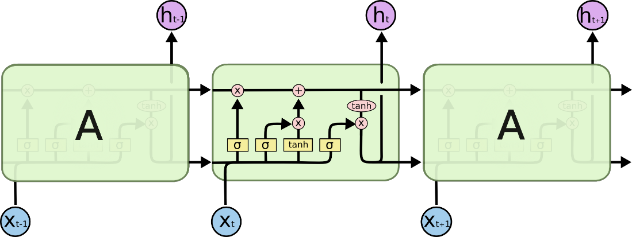
LSTM Architecture

Slide 16
Forget Gate:
Responsible for removing information from the cell state. The information that is no longer required for the LSTM to understand things or the information that is of less importance is removed via multiplication of a filter.
Input Gate:
Regulating what values need to be added to the cell state by involving a sigmoid function. This is basically very similar to the forget gate and acts as a filter for all the information from hi-1 and x_t.
Output Gate:
The functioning of an output gate can again be broken down to three steps:
Creating a vector after applying tanh function to the cell state, thereby scaling the values to the range -1 to +1. Making a filter using the values of h_t-1 and x_t, such that it can regulate the values that need to be output from the vector created above. This filter again employs a sigmoid function.

Slide 17
9. Implementation
Step1: Raw Stock Price Dataset: Day-wise past stock prices of selected companies are collected from the yfinance (Yahoo Finance) python package.
Step2: Pre-processing: This step incorporates the following:
a) Data discretization: Part of data reduction but with particular importance, especially for numerical data
b) Data transformation: Normalization.
c) Data cleaning: Fill in missing values.
d) Data integration: Integration of data files. After the dataset is transformed into a clean dataset, the dataset is divided into training and testing sets so as to evaluate. Creating a data structure with 60 timesteps and 1 output.

Slide 18
Step3: Feature Selection: In this step, data attributes are chosen that are going to be fed to the neural network. In this study Date & Close Price are chosen as selected features.
Step 4: Train the NN model: The NN model is trained by feeding the training dataset. The model is initiated using random weights and biases. Proposed LSTM model consists of a sequential input layer followed by 3 LSTM layers with “tanh” activation and then a dense layer with activation. The output layer again consists of a dense layer with a linear activation function.
Step5: Output Generation: The RNN generated output is compared with the target values and error difference is calculated. The Backpropagation algorithm is used to minimize the error difference by adjusting the biases and weights of the neural network.
Step 6: Test Dataset Update: Step 2 is repeated for the test data set.

Slide 19
Step 7: Error and companies’ net growth calculation: By calculating deviation we check the percentage of error of our prediction with respect to actual price.
Step 8: Visualization: Using Keras and their function APIs the prediction is visualized.
Step 9: Investigate different time interval: We repeated this process to predict the price at different time intervals. For our case, we took 2-month dataset as training to predict 3-month, 6-month, 1 year & 3 years of close price of the share.
In this different time span, we calculate the percentage of error in the future prediction. This would be different for different sectors. So, this will help to find a frame for the particular sector to predict future companies’ net growth.

Slide 20
10. Result
We can be confidently say that the proposed system differs from the existing system in a sense that, unlike other systems, it not only try to predict the accurate stock price of the company but also assigns a risk percentage corresponding to each company based on risk analysis.

Slide 21
A. DATASET COLLECTION
In this research study, we have collected data on four Leading Tech giants like Google,Microsoft, Apple and Amazon, Tesla Alibaba from yfinance’s stock price database
The data for Google, Microsoft, Apple, Amazon, Tesla and Alibaba was gathered from Yahoo Finance from January 1, 2012, to current data inorder to maintain the accuracy on the real time data. However, as with previous studies, we did the experimentation with the stock data employed in existing studies.
However, the trends are fluctuating from 2019 to 2021 because of the influence of COVID. Moreover, the stock prices rose abruptly and subsequently fell. Likewise, U.S Commodity Index and NIFTY 50 have a sudden rise and drop trend in prices.

Slide 22
B. RESULTS OF STOCK FORECASTING NETWORK
The proposed stock forecasting network is based on the LSTM model trained on the different stock datasets namelyGoogle, Microsoft, Apple, Amazon, Tesla and Alibaba.
Initially, the data ofGoogle, Microsoft, Apple, Amazon, Tesla and Alibaba is divided into train and test with a 95/05 ratio.
The Accuracy is closely monitored with different Architectures and also even different algorithms too.
From all those results, LSTM algorithm with 50 + 50 perceptrons and two dropout layers architecture provides best outcome

Slide 23
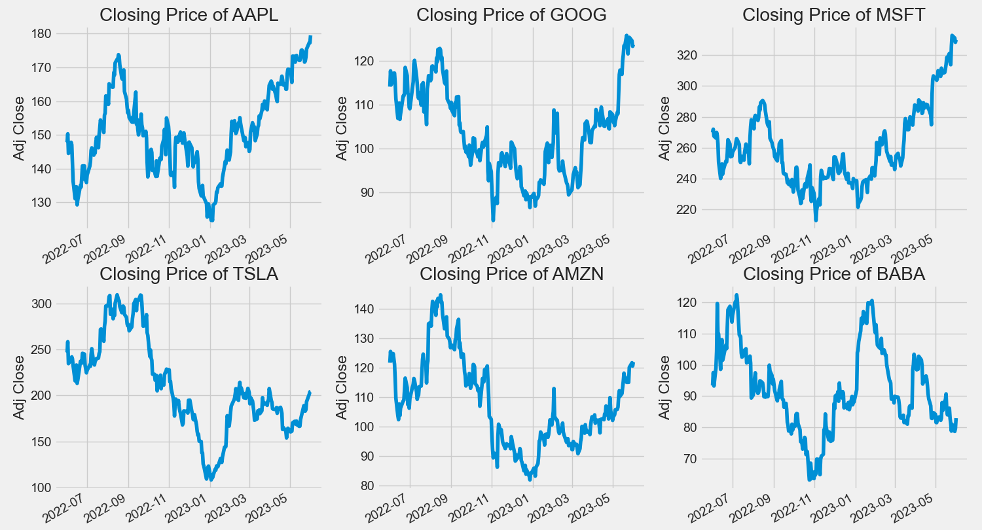

Slide 24
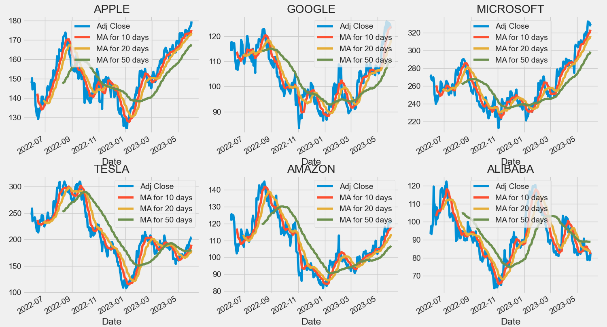

Slide 25
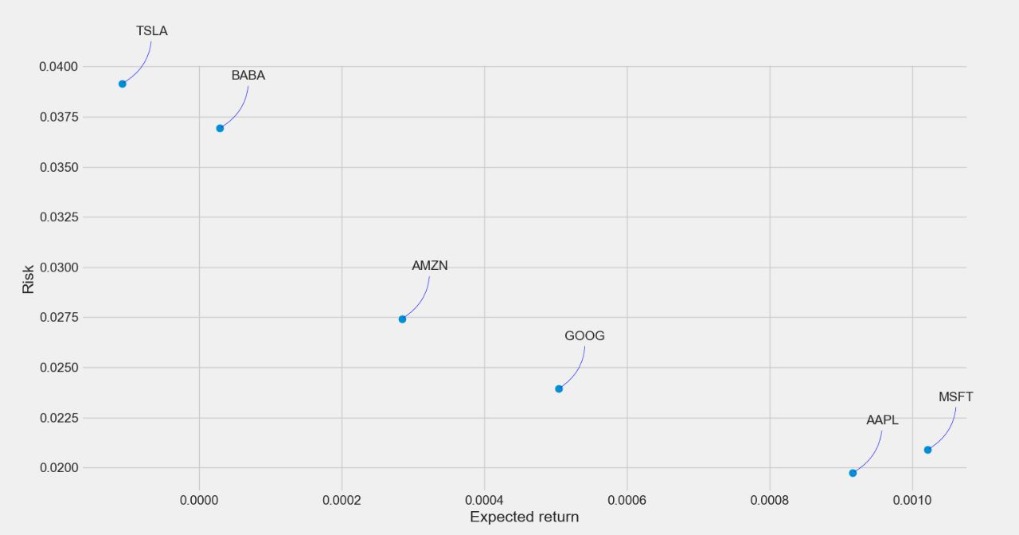

Slide 26
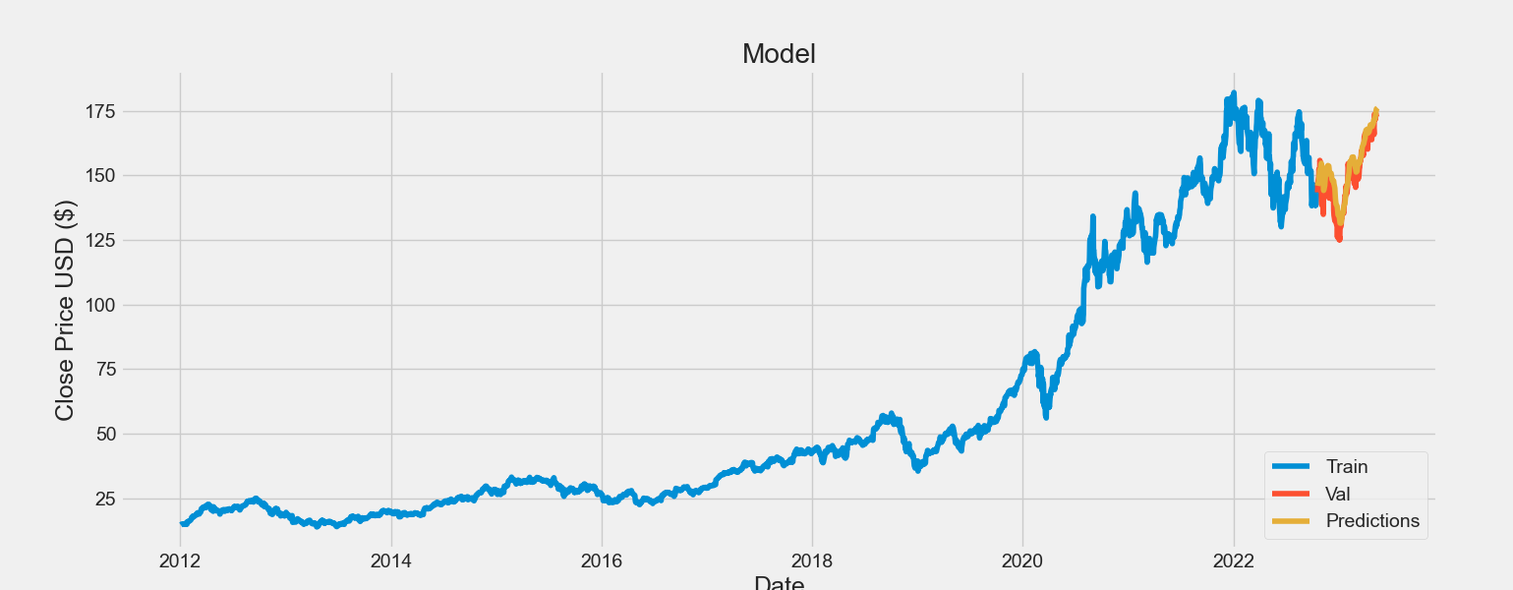
OUTPUT

Slide 27
11. Conclusion
We are predicting the closing stock price of any given organization, we have developed an application for predicting close stock price using LSTM algorithm. We have used datasets belonging to Google, Tesla, Amazon, Apple,Microsoft and Alibaba and achieved above 93% accuracy for these datasets.
The big challenge that stock market prediction face is that most current techniques cannot be identified with the aid of historical data on stocks. Hence stock markets are influenced by other factors such as policy decisions by government and consumer sentiments.
In the future, we can extend this application for predicting cryptocurrency trading and also, we can add sentiment analysis for better predictions.

Slide 28
12. References
Lu, W., Li, J., Wang, J., & Qin, L. (2021). A CNN-BiLSTM-AM method for stock price prediction. Neural Computing and Applications, 33, 4741-4753.
Hu, Z., Zhao, Y., & Khushi, M. (2021). A survey of forex and stock price prediction using deep learning. Applied System Innovation, 4(1), 9.
Yu, P., & Yan, X. (2020). Stock price prediction based on deep neural networks. Neural Computing and Applications, 32, 1609-1628.
Obthong, M., Tantisantiwong, N., Jeamwatthanachai, W., & Wills, G. (2020). A survey on machine learning for stock price prediction: Algorithms and techniques.
Dey, P., Hossain, E., Hossain, M. I., Chowdhury, M. A., Alam, M. S., Hossain, M. S., & Andersson, K. (2021). Comparative analysis of recurrent neural networks in stock price prediction for different frequency domains. Algorithms, 14(8), 251.

Slide 29
Sonkiya, P., Bajpai, V., & Bansal, A. (2021). Stock price prediction using BERT and GAN. arXiv preprint arXiv:2107.09055.
Mokhtari, S., Yen, K. K., & Liu, J. (2021). Effectiveness of artificial intelligence in stock market prediction based on machine learning. arXiv preprint arXiv:2107.01031.
Wu, J. M. T., Li, Z., Herencsar, N., Vo, B., & Lin, J. C. W. (2021). A graph-based CNN-LSTM stock price prediction algorithm with leading indicators. Multimedia Systems, 1-20.
Jiang, W. (2021). Applications of deep learning in stock market prediction: recent progress. Expert Systems with Applications, 184, 115537.
Kumar, G., Jain, S., & Singh, U. P. (2021). Stock market forecasting using computational intelligence: A survey. Archives of computational methods in engineering, 28, 1069-1101.

Slide 30
Thank you

