Slide 1
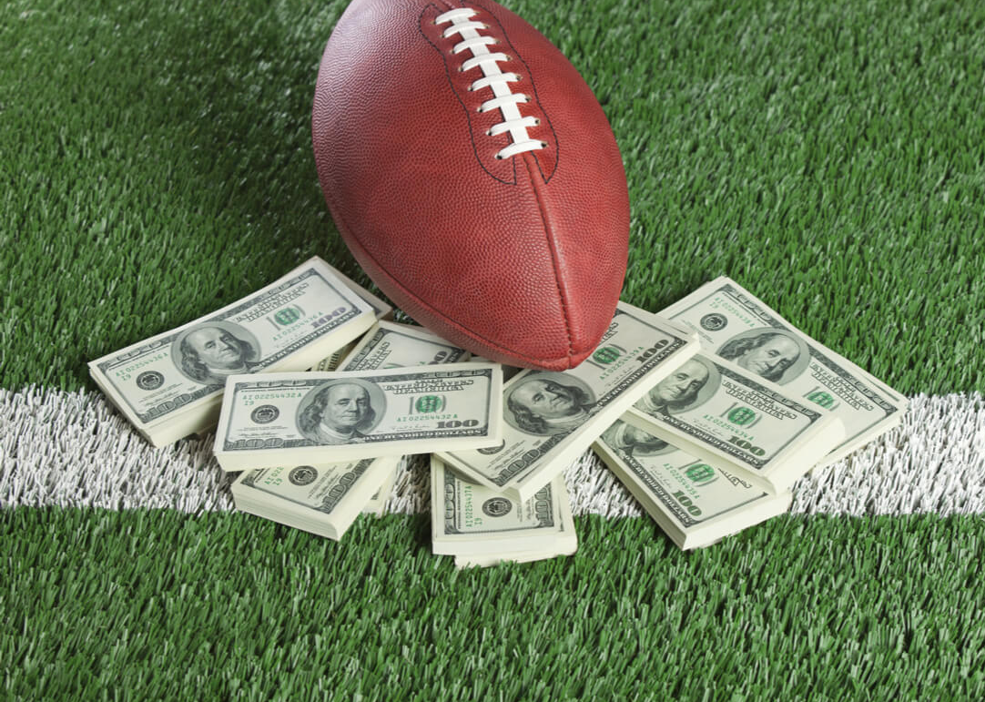
NFL Spread Predictions
“It’s not gambling if you absolutely know you’re going to win” – Barney Stinson

Slide 2

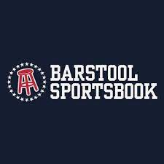


Motivation
NFL is the most popular league in the US
Legalization of gambling is growing in many states
Future of sports may be tied to sports betting
VERY HARD to beat Vegas
Spread vs Money Line

Slide 3
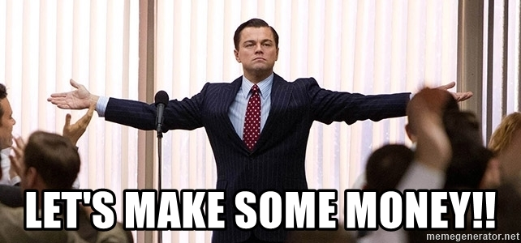
How it Works

Slide 4
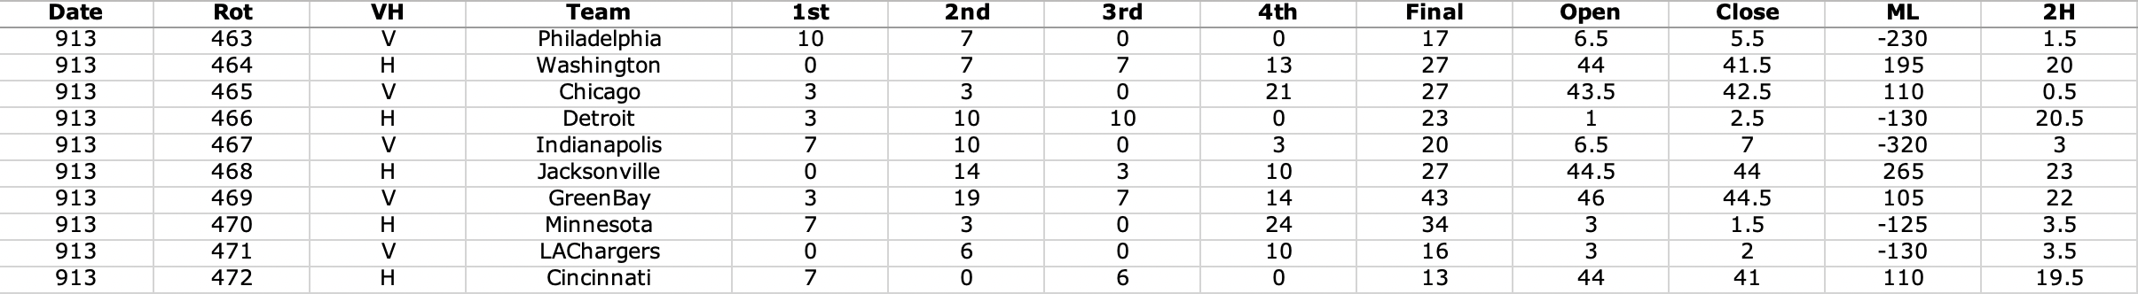
The Data
Provided by Sports Book Review Online
2007-2020
Included Scores by Quarter, Opening and closing lines for the games, and Team names

Slide 5
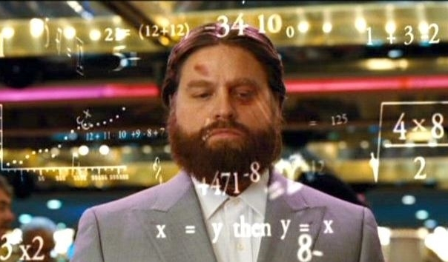
Modeling
Random Forest Model
Home vs Away
Spread
Scoring Averages
Success Criteria
Be able to make money long term
Assuming -105 Lines
Used Opening Lines
Goal: 51.2% accuracy

Slide 6
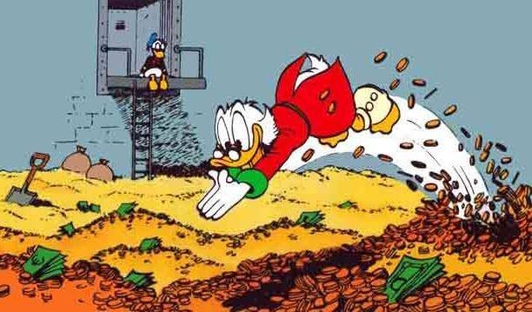
Results and Insights
Cross-Validation accuracy of 51.32%
$56.03 Profit after a season of $100 bets
Weird spread threshold
Covering is much different than winning

Slide 7
Thank You!
I will be making $2 bets on every game this season
If anyone would like the link to the website/model to join let me know
benjaminhakimi2021@u.northwestern.edu
Please Gamble Responsibly

