Slide 1


What to Cook Next?
A Recipe Recommender

Slide 2
Motivation
People enjoy food. Preparing delicious meals can be a rewarding relaxation after a busy day. Nevertheless, even an all-time favorite dish becomes less attractive if one cooks and eats the same thing repeatedly. Yet, exploring new recipes that fit one‘s taste may not be easy, since it’s usually a process of trial and error, taking time and effort.
This application, therefore, helps people to find new recipes that match their taste, adding a twist to their daily meals.
Notes:
it is usually a process of trial and error, taking time and effort.

Slide 3
Link: http://recip-Publi-1R2DWR6Y44L3V-1957760514.us-east-1.elb.amazonaws.com

Slide 4
Data
The dataset used is from Food.com in Kaggle. It includes both recipes and user interactions with the recipes. It has 180K+ recipes and 700K+ recipe reviews, covering 18 years of user interactions.
The MySQL database in RDS stores the recipe information to be used for the web app.

Slide 5
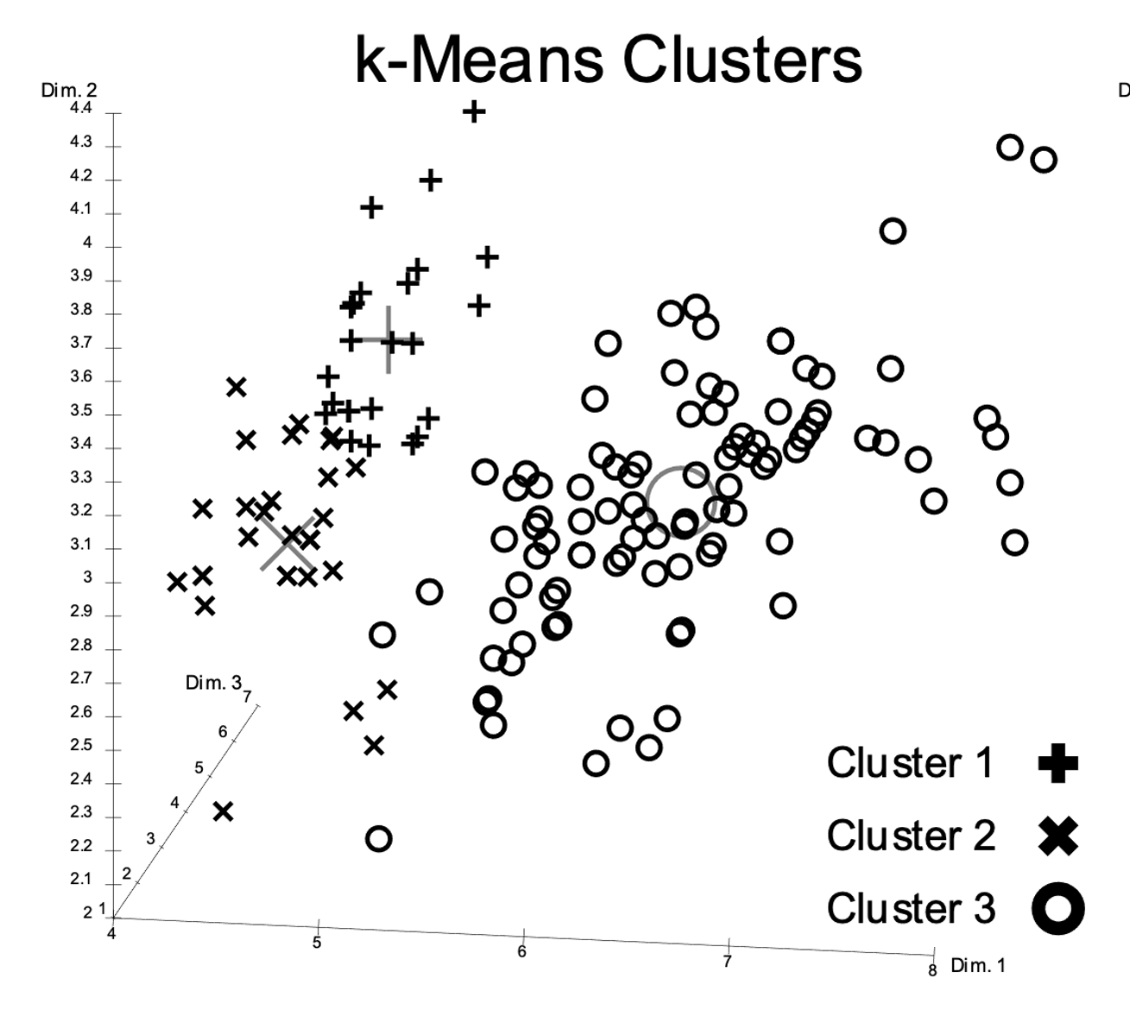
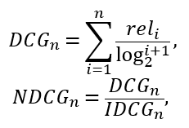



Model
K-Means Cluster
Model Success: nDCG > 0.7
Content-Based Filtering
Likes
Recommend
Result: Average nDCG = 0.734
Similar

Slide 6
Interesting Insight
In Project Mission, I was making an example of linking Carbonara and Mac & Cheese.
But apparently the model does not agree on that.
It turns out that Lasagna is the ultimate substitute for Carbonara (5 out of top 10 are some Lasagna recipes!).

Slide 7
Thank You!
Email: zhiyangchen2021@u.northwestern.edu

