Slide 1
WikiNews
Providing context to daily headlines

Slide 2
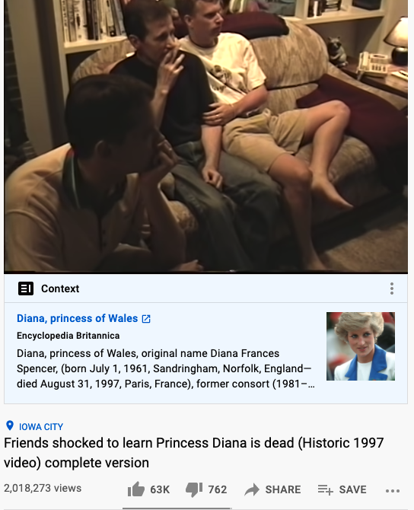
Mission
Provide context to daily headlines
Promote slow news consumption
Reduce bias and misinformation

Slide 3
Data
News API
Is the color of milk and fresh snow, the color produced by the combination of all the colors of the visible spectrum.
Wikipedia API
Is the color of ebony and of outer space. It has been the symbolic color of elegance, solemnity and authority.

Slide 4
Algorithm
1: Match news articles with Wikipedia articles
Spacy Named Entity Recognition
2: Filter out irrelevant matches
Similarity measure between Wikipedia summary and News content
Similarity Score | Sensitivity | Specificity | F1
Sequence Matcher
Levenshtein

Slide 5
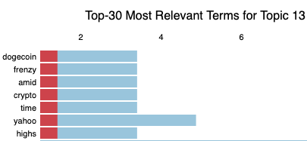
Insights: Topic Modeling
Similarity Scores
- SequenceMatcher
- Levenshtein
Latent Dirichlet Allocation (Unsupervised)
Able to cluster tokens into topics, but not very specific.
BERTopic
(Supervised)

Slide 6
Thank you!
Repo: https://github.com/MSIA/2021-msia423-Ho-Sara-project
GitHub: https://github.com/Sara-ShiHo

