Slide 1
MLDS 400 Team 13
Group Project
Yi (Grace) Xie, Inu Tenneti, Xinyang (Oliver) Zhou, Lishan (Lisa) Gao

Slide 2

Background
Dataset: Dillard’s
Founded in 1938
Upscale American department store chain
with approximately 282 stores in 29 states
5 tables
Notes:
Oliver

Slide 3
Business Question
Difference brands, stores, and states can all affect the profit
Which specific store can have high profit?
We want to build models to solve:
Will the store has high profit or low profit across
different brands, stores, states, and years?
Notes:
Oliver

Slide 4
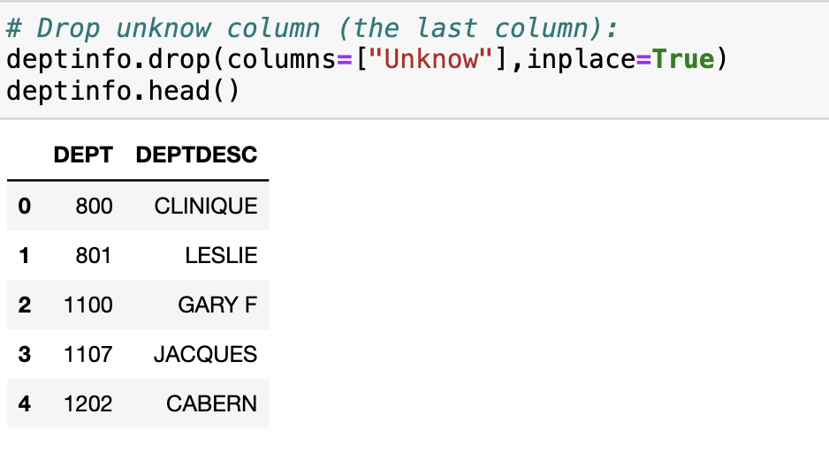
Preparing the Data
Upload tables to PostgreSQL Server
Read into pandas
Clean the data
Remove the last columns from all tables
Notes:
Oliver

Slide 5
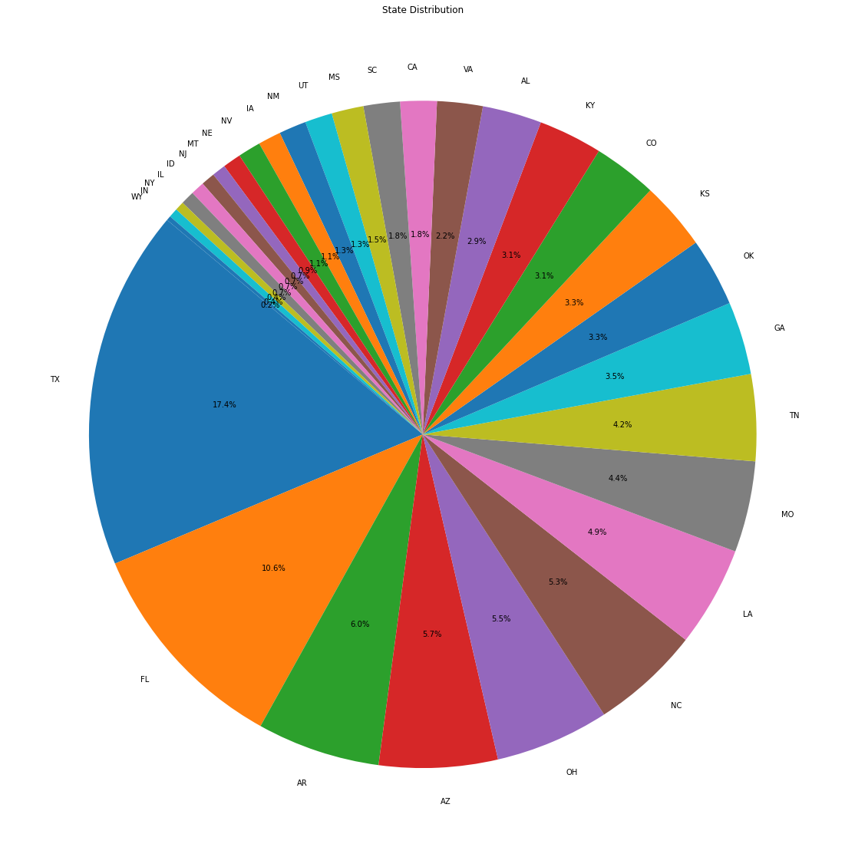
EDA
Check missing value
Plot distributions of columns
This is a visualization of the store location
TX takes 17.4% of the stores
Notes:
Oliver

Slide 6
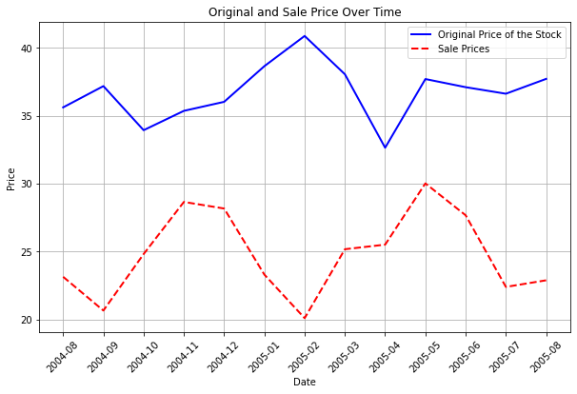
EDA
Big gap between original and sale price
The gap fluctuate by time
Notes:
Oliver

Slide 7
Merge Table
Combined all 5 tables through the identifier between each of them
Notes:
Oliver

Slide 8
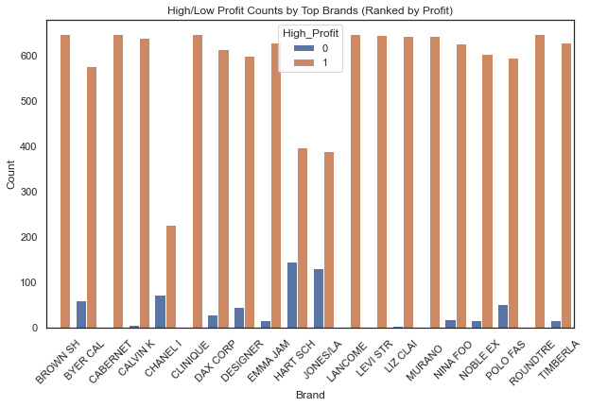
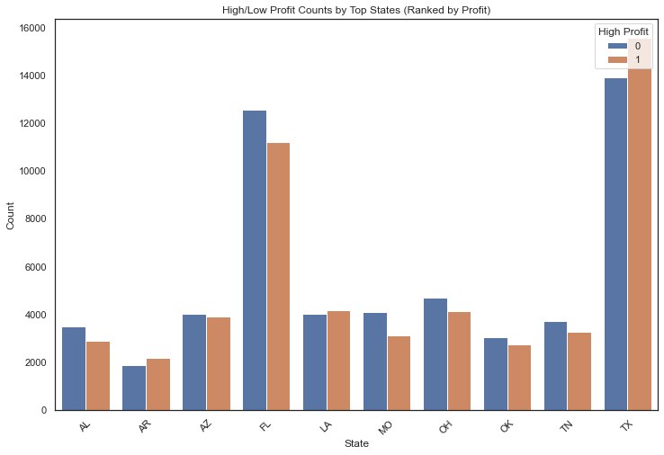
EDA
High profit/low profit count by states and brands (ranked by profit)
Notes:
Oliver

Slide 9
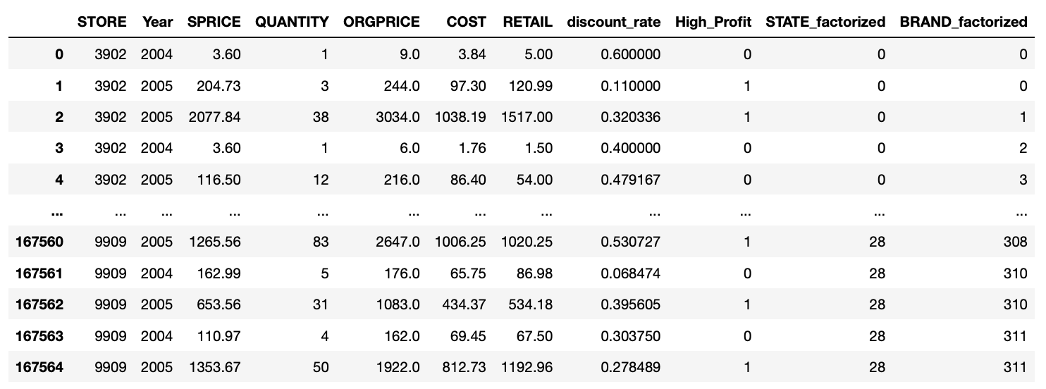
Feature Engineering
Features: STATE, STORE, BRAND, Year, SPRICE, QUANTITY, ORGPRICE, COST, RETAIL, discount_rate, High_Profit
Response Variable: High_Profit (1 if > 100, 0 if <= 100)
Feature Engineering: Factorize STATE and BRAND → STATE_factorized, BRAND_factorized

Slide 10
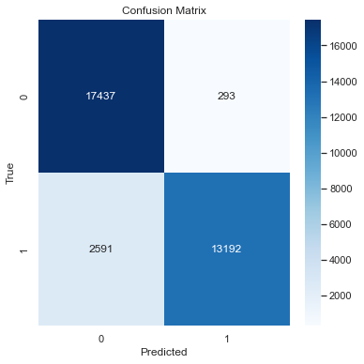
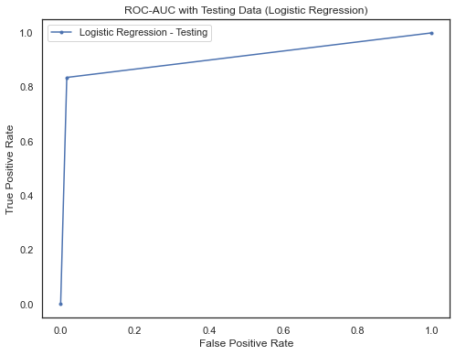
Modeling - Logistic Regression
Parameters:
Regularization: L1 penalty
Solver: liblinear
AUC (testing): 0.9096551816927398
Classification Report:
 | precision | recall | f1-score | support
0 | 0.87 | 0.98 | 0.92 | 17730
1 | 0.98 | 0.84 | 0.90 | 15783
accuracy |  |  | 0.91 | 33513
macro avg | 0.92 | 0.91 | 0.91 | 33513
weighted avg | 0.92 | 0.91 | 0.91 | 33513

Slide 11
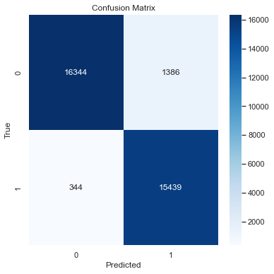
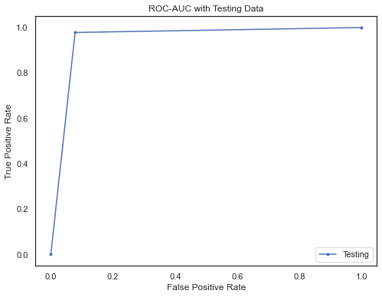
Modeling - Decision Tree
Parameter: max_depth: 3
AUC (testing): 0.9500159041518359
Classification Report:
 | precision | recall | f1-score | support
0 | 0.98 | 0.92 | 0.95 | 17730
1 | 0.92 | 0.98 | 0.95 | 15783
accuracy |  |  | 0.95 | 33513
macro avg | 0.95 | 0.95 | 0.95 | 33513
weighted avg | 0.95 | 0.95 | 0.95 | 33513

Slide 12
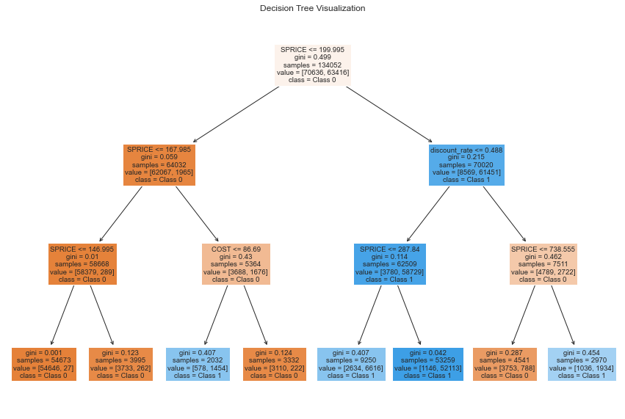
Decision Tree Plot

Slide 13
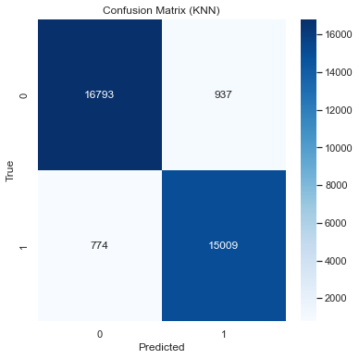
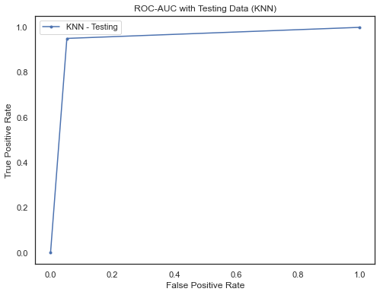
Modeling - KNN
Parameter: n_neighbors = 5
AUC (testing): 0.9490558069022625
Classification Report:
 | precision | recall | f1-score | support
0 | 0.96 | 0.95 | 0.95 | 17730
1 | 0.94 | 0.95 | 0.95 | 15783
accuracy |  |  | 0.95 | 33513
macro avg | 0.95 | 0.95 | 0.95 | 33513
weighted avg | 0.95 | 0.95 | 0.95 | 33513

Slide 14

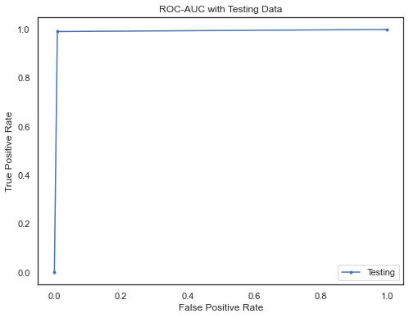
Fine Tune Decision Tree Model
Parameter: max_depth: 10
AUC (testing): 0.9913590818710571
Classification Report:
 | precision | recall | f1-score | support
0 | 0.99 | 0.99 | 0.99 | 17730
1 | 0.99 | 0.99 | 0.99 | 15783
accuracy |  |  | 0.99 | 33513
macro avg | 0.99 | 0.99 | 0.99 | 33513
weighted avg | 0.99 | 0.99 | 0.99 | 33513

Slide 15
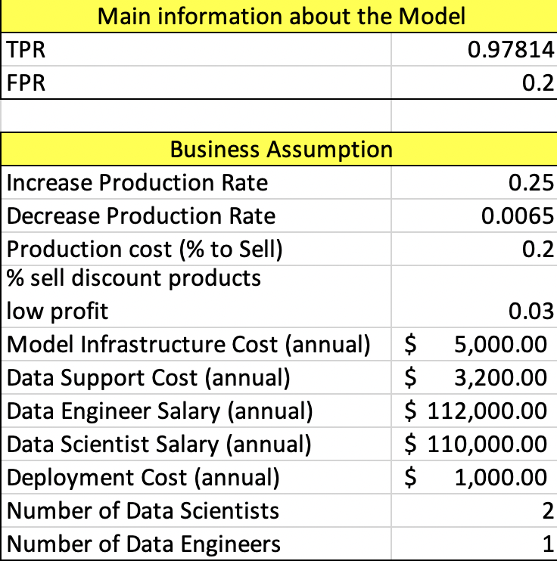
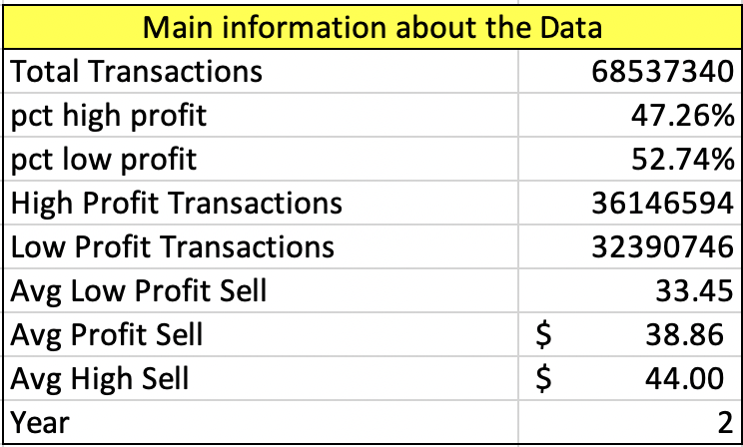
ROI Analysis

Slide 16
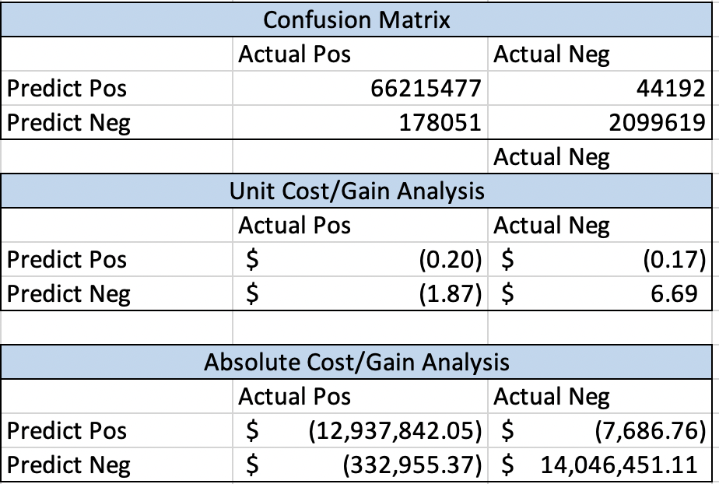
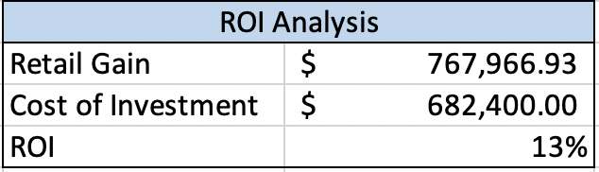
Result

Slide 17
The End
Questions?

