Slide 1


Lecture 4:HTTP Module
Touro College
Fall 2018
Class: MSIN- 636
Instructor: Alfred Rezk
Tue 6:15pm- 9:15 Pm

Slide 2
1.1. Create a basic Server
The HTTP module is a core node.js module that is required to be imported to your application before you can use any of its methods.
In order to create a server we will use createServer() method.
The createServer() method is an even emitter that need to be bounded by any specific port using the listen() method.
The createServer() has only one argument which is request event handler that is invoked each time a new HTTP request is received.
The event handler takes two arguments, request and response.
The request argument is an instance of http.IncomingMessage, and contains information about the client’s request.
The response argument is an instance of http.ServerResponse, and is used to respond to the client.

Slide 3
1.1. Create a basic Server
var http = require("http");
var server = http.createServer(function(request, response) {
response.write("Hello <strong>HTTP</strong>!");
response.end();
});
server.listen(8000);
The handler in this example responds to all connections with a simple string of HTML using the write() and end() methods.

Slide 4
1.2 Request Methods
Any HTTP Request starts with a request method, followed by the requested resource’s URL.
The request method, also called HTTP verb, is used to specify the action to be performed on the specified URL.
For example if a GET request was made for the resource located at “/”. The purpose of the GET request is to view the specified resource.
Another common HTTP verb is POST, which allows the client to submit data to the server.
POST requests are commonly used to submit HTML forms.

Slide 5
1.2 Request Methods
The following table list the most important request methods and their description

Slide 6
1.3 Response Codes
The status line of every HTTP response includes a numeric status code, as well as a reason phrase that describes the code.
The status code is actually used by the client and, in conjunction with the response headers, it dictates how the response is handled.
You can set the status code of a response object using its statusCode property.
If you do not explicitly provide a status code, this value defaults to 200.

Slide 7
1.3 Response Codes
An example server that sets the statusCode property is shown below.
If a request is made for the URL /index, the server will respond with a 200 status code and an HTML response body. However, if any other URL is requested, the server responds with a 404 error.
if (request.url === "/index") {
response.statusCode = 200;
response.end("Hello <strong>HTTP</strong>");
} else {
response.statusCode = 404;
console.log(http.STATUS_CODES[404]);
response.end("File Not Found");
}

Slide 8
1.3 Response Codes
The following table list some of the response codes and their descriptions:
Status code | Description
200 | OK Indicates that the HTTP request was handled successfully.
301 | Moved Permanently The requested resource has permanently moved to a new URL. The Location response header should contain the new URL to redirect to.
400 | Bad Request Indicates that the request was malformed and could not be understood. An example of this is a request that is missing a required parameter.
401 | Unauthorized If a resource requires authentication, and the provided credentials are refused, then the server will respond with this status code.
404 | Not Found The server could not locate the requested URL.
500 | Internal Server Error The server encountered an error while attempting to fulfill the request.

Slide 9
1.4 Response Header
The response headers, combined with the response status code, are used to interpret the data sent back from the server.
Some of the more commonly encountered response headers are shown in following table :
Header | Description
Cache-Control | Specifies whether a resource can be cached. If it can, this header designates the length of time, in seconds, that it can be stored in any cache.
Content-Encoding | Specifies the encoding used on the data. This allows the server to compress responses for faster transmission over the network.
Content-Length | The length of the response body in bytes.
Content-Type | Specifies the MIME type of the response body. Essentially, this header tells the client how to interpret the data.
Location | When the client is redirected, the target URL is stored in this header.
Set-Cookie | Creates a new cookie on the client. This cookie will be included in the Cookie header of future requests.
WWW-Authenticate | If an authentication scheme is implemented for a given resource, this header is used to identify the scheme.

Slide 10
1.4 Response Header
The http module provides several ways to create response headers. The simplest way is with the response argument’s setHeader() method.
This method takes two arguments, the header name and value(s).
The header name is always a string.
The value should either be a string or an array of strings, if you need to create multiple headers with the same name.

Slide 11
1.4 Response Header
In this example the server has been modified to return a Content-Type header.
Since the server is sending back a string of HTML, the Content-Type header should tell the client to interpret the response as HTML.
This is accomplished by setting the header’s value to the text/html MIME type.
var http = require("http");
var server = http.createServer(function(request, response) {
response.setHeader("Content-Type", "text/html");
response.write("Hello <strong>HTTP</strong>!");
response.end();
});
server.listen(3000);

Slide 12
1.4 Response Header
The second way to write response headers is with the writeHead() method.
This method takes two arguments. The first is the status code to return.
The second argument is an optional object containing the response headers.
var http = require("http");
var server = http.createServer(function(request, response) {
response.writeHead(200, {"Content-Type": "text/html"});
response.write("Hello <strong>HTTP</strong>!");
response.end();
});
server.listen(3000);

Slide 13
1.4 Response Header
The following server will use the status code 301 , and response header Location to redirect the client to google.com
var http = require("http");
var server = http.createServer(function(request, response) {
response.writeHead(301, {"Location": "https://www.google.com/"});
response.end();
});
server.listen(3000);
Note : writeHead() must be called only once per request.

Slide 14
2. Form data
Any form can submit its fields using GET or POST method.
The html attribute method can be used to set the method of transferring the form field using the proper method provided.
<form action=“#" method="GET">
<form action=“#" method=“POST">

Slide 15
2.1. Reading POST Forms
In order to read POST form we will use querystring module to read the request body.
Then we will check if the client request is a POST request using req.method property
var http = require('http');
var fs = require('fs');
const { parse } = require('querystring');
var server = http.createServer(function(req, res) {
if(req.method=="POST"){
// parse form data
}
else {
// load form html page
}
});
Server.listen(3000);

Slide 16
2.1 Reading POST Forms
We will create two event handlers to handle data and end events
The request stream’s data handler is used to collect the entire request body in the body variable.
var body = '';
req.on('data', function(chunk){
body += chunk.toString();
});

Slide 17
2.1 Reading POST Forms
When the end event is emitted, the request body is parsed into an object using the querystring.parse() method.
req.on('end', function(){
var first_name=parse(body).first;
var last_name=parse(body).last;
var email=parse(body).email;
res.setHeader("Content-Type", "text/html");
res.write("First Name: " +first_name+"<br>");
res.write("Last Name: " +last_name+"<br>");
res.write("email Name: " +email+"<br>");
res.end();
});

Slide 18
2.1 Reading POST Forms
If the client request was GET request we would like the server to serve the form html page to the client.
else{
fs.readFile('./html/form_post.html, function(err, data) {
if (err) {
res.writeHead(404, {'Content-Type': 'text/html'});
return res.end("404 Not Found");
}
res.writeHead(200, {'Content-Type': 'text/html'});
res.write(data);
return res.end();
});
}

Slide 19
2.2 Reading GET Forms
The GET request send the form data through the URL in a name=value form.
Here is an example of GET request with form data fields.
form_get.html?first=Alfred&last=Rezk&email=alfred.rezk%40yahoo.com&submit=submite
In order to parse the url to a readable parts we will use the core module “url”
With the url module we will be able to parse an address/url with the url.parse() method.
The url.parse() method will return a URL object with each part of the address as properties.

Slide 20
2.2 Reading GET Forms
In the following example we parsing server url, by using the req.url property and url.parse method().
We create an instance to the url.parse() method which takes url.url as the first argument.
One of the properties of this instant is the query object which holds the parsed name=values fields as an object that holds the form fields.
var http = require('http');
var url = require('url');
var server = http.createServer(function(req, res) {
var q = url.parse(req.url, true);
var qdata = q.query;
console.log(qdata.fist);
console.log(qdata.last);
console.log(qdata.email);

Slide 21
2.2 Reading GET Forms
Here is a full server example that will load html form and if the url of the page contain the “first” name value, the server will start to parse form fields using url module and print form fields back to the client
var http = require('http');
var fs = require('fs');
var url = require('url');
var server = http.createServer(function(req, res) {
var q = url.parse(req.url, true);
var qdata = q.query;

Slide 22
2.2 Reading GET Forms
if(qdata.first){
res.setHeader("Content-Type", "text/html");
res.write("First Name: " +qdata.first+"<br>");
res.write("Last Name: " + qdata.last+"<br>");
res.write("email Name: " +qdata.email+"<br>");
res.end();
}

Slide 23
2.2 Reading GET Forms
else{
fs.readFile(./html/form_get.html', function(err, data) {
if (err) {
res.writeHead(404, {'Content-Type': 'text/html'});
return res.end("404 Not Found");
}
res.writeHead(200, {'Content-Type': 'text/html'});
res.write(data);
return res.end();
});
}
});
server.listen(3000);

Slide 24
2.3 File Server
The url parse method() provide many other useful properties that we can use.
for example the pathname property return the url path entered by the user.
Localhost:3000/contact.html
Localhost:300/index.html
Locaclhost:3000/html/signup.html
We can use this property to open the file provided through the url and serve it to the client.

Slide 25
2.3 File Server
var http = require('http');
var url = require('url');
var fs = require('fs’);
http.createServer(function (req, res) {
var q = url.parse(req.url, true);
var filename = "./html" + q.pathname;
fs.readFile(filename, function(err, data) {
if (err) {
res.writeHead(404, {'Content-Type': 'text/html'});
return res.end("404 Not Found");
}
res.writeHead(200, {'Content-Type': 'text/html'});
res.write(data);
return res.end();
});
}).listen(8080);

Slide 26
2.4 Uploading Files
In order to upload files to our server we will use formidable module.
Download formidable module using npm install command
In order to create a file uploading server follow the following steps.
Create an upload form
Parse the uploaded file
Save the file.

Slide 27
2.4.1 Creating an upload form
var http = require('http');
var formidable = require('formidable');
var fs = require('fs');
http.createServer(function (req, res) {
res.writeHead(200, {'Content-Type': 'text/html'});
res.write('<form action="fileupload" method="post" enctype="multipart/form-data">');
res.write('<input type="file" name="filetoupload"><br>');
res.write('<input type="submit">');
res.write('</form>');
res.end();
}
}).listen(3000);

Slide 28
2.4.2 parse the uploaded file
Include the Formidable module to be able to parse the uploaded file once it reaches the server.
When the file is uploaded and parsed, it gets placed on a temporary folder on your computer.
The path to this directory can be found in the "files" object, passed as the third argument in the parse() method's callback function.
if (req.url == '/fileupload') {
var form = new formidable.IncomingForm();
form.parse(req, function (err, fields, files) {
var oldpath = files.filetoupload.path;
console.log(oldpath);
res.write('File uploaded');
res.end();
});
}

Slide 29
2.4.2 Save the file
To move the file to the folder of your choice, use the File System module:
form.parse(req, function (err, fields, files) {
var oldpath = files.filetoupload.path;
var filename = files.filetoupload.name.toString();
var newpath = "./files/" + filename;
fs.readFile(oldpath, function (err, data) {
if (err) throw err;
fs.writeFile(newpath, data, function (err) {
if (err) throw err;
res.write('File uploaded and moved!');
res.end();
});
fs.unlink(oldpath, function (err) {
if (err) throw err;
});
});
});

Slide 30
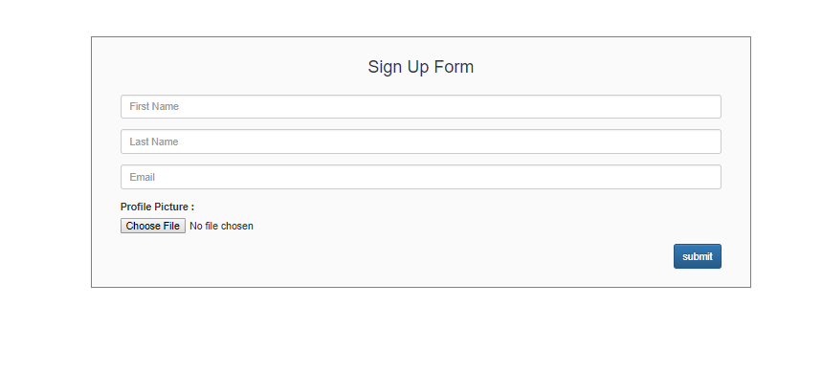
2.5 Signup form application
In the following application we will create a signup form where the user can enter his information and upload his profile picture.
The picture will be saved in directory “files” on the server side.

Slide 31
3. Sending emails with Nodemailer
The Nodemailer module makes it easy to send emails from your computer.
The Nodemailer module can be downloaded and installed using npm:
$ npm install nodemailer
Now you can include the module in any application:
var nodemailer = require('nodemailer');

Slide 32
3. Sending emails with Nodemailer
Node mailer has two important methods
createTransport() : which takes one argument object containing the service and auth fields.
sendMail(): which actually send the email. This method takes two arguments.
The first is an object holds email information in it such as to, from, subject, and text.
The second argument is a callback function

Slide 33
3.1 createTransport
var nodemailer = require('nodemailer');
var transporter = nodemailer.createTransport({
service: 'gmail',
auth: {
user: 'touro.msin.636@gmail.com',
pass: 'tourocollege'
}
});

Slide 34
3.2 sendMail Method
var mailOptions = {
from: '',
to: 'alfred.rezk@yahoo.com',
subject: '',
text: 'That was easy!'
};
transporter.sendMail(mailOptions, function(error, info){
if (error) {
console.log(error);
} else {
console.log('Email sent: ' + info.response);
}
});

Slide 35
3.3 Multiple receivers
To send an email to more than one receiver, add them to the "to" property of the mailOptions object, separated by commas:
var mailOptions = {
from: 'youremail@gmail.com',
to: 'myfriend@yahoo.com, myotherfriend@yahoo.com',
subject: 'Sending Email using Node.js',
text: 'That was easy!'
}

Slide 36
3.3 send HTML Email
To send HTML formatted text in your email, use the "html" property instead of the "text" property:
var mailOptions = {
from: 'youremail@gmail.com',
to: 'myfriend@yahoo.com',
subject: 'Sending Email using Node.js',
html: '<h1>Welcome</h1><p>That was easy!</p>'
}

Slide 37
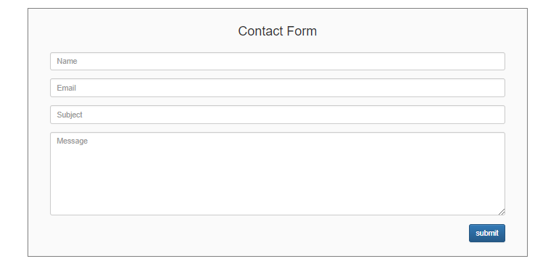
3.4 Contact Form application
In this application will create a form to allow the user to enter his information including the email, subject, text and when he click submit we will sent that email.

Slide 38
3.5 sending SMS
Sending SMS is very simple it is basically sending email by the phone number to the server gateaway for the carrier provider. Here is the format:
0123456789@carrier.com
Here is a list of carrier providers in USA Gateways
var att ='@txt.att.net';
var boost = '@myboostmobile.com';
var tmobil ='@tmomail.net';
var cellular = '@email.uscc.net';
var verizon ='@vtext.com';
var vergin = '@@vmobl.com';
var sprint = '@messaging.sprintpcs.com';
var metro= '@mymetropcs.com';

Slide 39
3.5 sending SMS
Here is an example of sending sms on Sprint carrier
var nodemailer = require('nodemailer’);
var att ='@txt.att.net';
var boost = '@myboostmobile.com';
var tmobil ='@tmomail.net';
var cellular = '@email.uscc.net';
var verizon ='@vtext.com';
var vergin = '@@vmobl.com';
var sprint = '@messaging.sprintpcs.com';
var metro= '@mymetropcs.com';

Slide 40
3.5 sending SMS
var transporter = nodemailer.createTransport({
service: 'gmail',
auth: {
user: 'touro.msin.636@gmail.com',
pass: 'tourocollege'
}
});
var mailOptions = {
from: 'touro.msin.636@gmail.com',
to: '0123456789'+sprint,
subject: 'any',
text: 'That was easy!'
};

Slide 41
3.5 sending SMS
transporter.sendMail(mailOptions, function(error, info){
if (error) {
console.log(error);
} else {
console.log('Email sent: ' + info.response);
}
});

