Slide 1

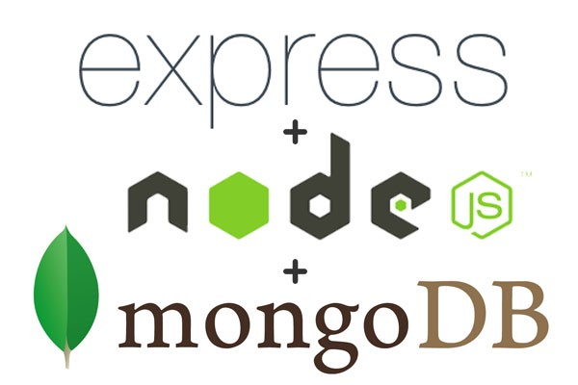
Lecture 5
Touro College
Fall 2018
Class: MSIN- 636
Instructor: Alfred Rezk
Tue 6:30pm- 9:30 Pm

Slide 2
1. Introduction to Express Framework
What Is Express.js?
Express.js is a web framework based on the core Node.js http module and Connect components.
Express.js systems are highly configurable, which allows developers to pick freely whatever libraries they need for a application.
For these reasons, the Express.js framework leads to flexibility and high customization in the development of web applications.
In order to use Express you need to install it locally and globally as well using the npm install command.

Slide 3
1. Introduction to Express Framework
If you write serious apps using only core Node.js modules, you most likely find yourself reinventing the wheel by writing the same code continually for similar tasks, such as the following:
Parsing of HTTP request bodies
Parsing of cookies
Managing sessions
Organizing routes with a chain of if conditions based on URL paths and HTTP methods of the requests
Determining proper response headers based on data types

Slide 4
2. Simple Sever using Express
Here are the steps to create express server:
Create package.json file
Install express
Create the server javascript file (app.js)

Slide 5
2. Simple Sever using Express
Create package.json File:
You can use npm init command to create package.json and then edit the file.
You also can create the file your self as the following configuration
{
"name": "simple-server",
"version": "1.0.0",
"scripts": {
"start": "node app"
},
"dependencies": {
"express": "*",
"jade": "*"
}
}

Slide 6
2. Simple Sever using Express
Install express:
We have the manifest file ready now.
Executing the npm install command in the directory will install all the dependencies in the directory
The --save flag can be replaced by the -S flag.
This flag ensures that Express is added as a dependency to our package.json file.
This has an advantage; the next time we need to install all the dependencies of your project you can just run the command npm install and it will find the dependencies in this file and install them for us.

Slide 7
2. Simple Sever using Express
Create the server javascript file (app.js)
var express = require('express'); // Include the Express module
var app = express(); // Create an instance of Express
app.get('/', function(req, res) { // A route for the home page
res.send('Welcome to <b>Express</b>')
});
app.listen(3000, function(){
console.log('Express app started on port 8080')
});

Slide 8
2. Simple Sever using Express
The app will listen on port 3000.
This page will print "Welcome to Express" when you load its home page, and return a 404 error for all other requests.
HTTP 404 and 500 error handling is built into the router middleware.
The app.get(route, callback) function tells what to do when a get request at the given route is called.
The callback function has 2 parameters, request(req) and response(res).
The request object(req) represents the HTTP request and has properties for the request query string, parameters, body, HTTP headers, etc.
Similarly, the response object represents the HTTP response that the Express app sends when it receives an HTTP request.
The res.send() function takes an object as input and it sends this to the requesting client. Here we are sending the string “welcome to Express".

Slide 9
2. Simple Sever using Express
Now run the server
Start the app and load http://localhost:3000 on your browser to see the output.

Slide 10
2.1 Watching file changes
To make our development process a lot easier, we will install a tool from npm, nodemon.
This tool restarts our server as soon as we make a change in any of our files, otherwise we need to restart the server manually after each file modification.
To install nodemon, use the following command:
$ npm install -g nodemon
now run the server using the following command:

Slide 11
3. Express Routes
The following function is used to define routes in an Express application:
app.method(path, handler)
method: any one of the HTTP verbs (get, set, put, delete).
Path : the route at which the request will run.
Handler is a callback function that executes when a matching request type is found on the relevant route.

Slide 12
3. Express Routes
Here is an example :
var express =require('express');
var app = express();
app.get('/touro', function(req,res){
res.send('<b>Welcome to Toruo </b>');
});
app.listen(8080);
If we run our application and go to localhost:8080/touro, the server receives a get request at route "/touro", our Express app executes the callback function attached to this route and sends " Welcome to Toruo " as the response.

Slide 13
3.1 Multiple Routes
We can also have multiple different methods at the same route. For example:
To test this request, get the Postman extension in chrome browser.
Postman will allow you to make POST requests.

Slide 14
3.2 All methods
A special method, all, is provided by Express to handle all types of http methods at a particular route using the same function.
To use this method, try the following:

Slide 15
3.3 External Routes
Defining routes like above is very tedious to maintain.
To separate the routes from our main app.js file, we will use Express.Router.
Create a new file called users.js and type the following in it.

Slide 16
3.3 External Routes
Now to use this router in our users.js, type in the following code in your app.js
var express =require('express');
var app = express();
var usersRouter = require('./users.js');
app.use('/users',usersRouter);
app.listen(8080);
The app.use function call on route '/users' attaches the users router with this route.
Now whatever requests our app gets at the '/users', will be handled by our users.js router.
The '/' route in users.js is actually a subroute of '/users'.

Slide 17
3.4. Route Identifiers
Route identifiers can be string or regular expression objects.
String-based routes are created by passing a string pattern as the first argument of the routing method.
They support a limited pattern matching capability.
app.get('/touro', function(req, res) {
res.send('/touro Pattern');
});
app.get('/tou?ro', function(req, res) {
res.send('/tou?ro Pattern');
});
app.get('/tou+ro', function(req, res) {
res.send('/tou+ro Pattern' );
});

Slide 18
3.4. Route Identifiers
app.get('/tou*ro', function(req, res) {
res.send('tou*ro');
});
app.get('/to(ur)?o', function(req, res) {
res.send('/to(ur)?o Pattern');
});

Slide 19
4. Dynamic routes
We can now define routes, but those are static or fixed.
Using dynamic routes allows us to pass parameters and process based on them.
You can use the req.params object to access all the parameters you pass in the url.
Here is an example of a dynamic route:
var express =require('express');
var app = express();
app.get('/:name', function(req,res){
res.send('nice to meet you '+req.params.name);
});
app.listen(8080);

Slide 20
4. Dynamic routes
Here is another example
var express =require('express');
var app = express();
app.get('/:product/:id', function(req,res){
res.send('your product is '+req.params.product+' and the id is '+req.params.id);
});
app.listen(8080);

Slide 21
4.1 Pattern Match routes
You can also use regex to restrict URL parameter matching.
Let us assume you need the id to be a 5-digit long number.
You can use the following route definition:

Slide 22
4.1 Pattern Match routes
Note that this will only match the requests that have a 5-digit long id.
You can use more complex regexes to match/validate your routes.
If none of your routes match the request, you'll get a "Cannot GET <your-request-route>" message as response. This message can be replaced by a 404 not found page using this simple route:
Important: This should be placed after all your routes, as Express matches routes from start to end of the app.js file, including the external routers you required.

Slide 23
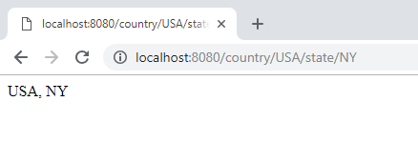
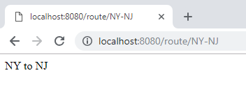
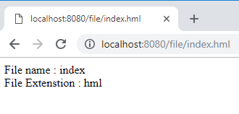
4.1 Pattern Match routes
Exercise:

Slide 24
5. Middleweare
A middleware is a JavaScript function to handle HTTP requests to an Express app.
It can manipulate the request and the response objects or perform an isolated action, or terminate the request flow by sending a response to the client, or pass on the control to the next middleware.
Middlewares are loaded in an Express app using the app.use() method.
Middleware is just a function that accepts three parameters: req, res, and next.
Following is an example of a middleware. All it does is print the IP address of the client that made the request.

Slide 25
5. Middleweare
The following example will call the middleware for every request on the server.
So after every request, we will get the following message in the console.
app.use('/touro', function(req, res, next){ //Middleware function to log request protocol
console.log("A request for things received at " + Date.now());
next();
});
app.get('/touro', function(req, res){ // Route handler that sends the response
res.send('welcome to Touro College');
});
Note that next() function call is very important. It tells that more processing is required for the current request and is in the next middleware function/route handler.

Slide 26
5.1 Custom Middlewears
You can create you own middlewaers.
Here is another middleware, where the middleware defined first and then passed to the app.use() method:

Slide 27
5.1 Custom Middlewears
If we were to rewrite the forbidder middleware as a Node module, we would need to first create the forbidder.js module file with the following content:

Slide 28
5.1 Custom Middlewears

Slide 29
5. Third Party Middlewears
Following are some of the most commonly used middleware; we will also learn how to use/mount these:
5.2.1 body-parser
This is used to parse the body of requests which have payloads attached to them. To mount body parser, we need to install it using :
$ npm install --save body-parser

Slide 30
5. Third Party Middlewears
To mount it, include the following lines in your app.js:

Slide 31
5. Third Party Middlewears
Example

Slide 32
5. Third Party Middlewears
5.2.2 Cookie parser
It parses Cookie header and populate req.cookies with an object keyed by cookie names. To mount cookie parser, we need to install it using:
$ npm install --save cookie-parser
To mount it, include the following lines in your app.js:

Slide 33
6. Views & Templating
An Express application has a set of predefined application variables that are used to configure various options of the app.
These variables are used for setting various dynamic aspects of the app and can be set using the app.set() method.
app.set('views', path.join(__dirname, 'views’));
app.set('view engine', 'jade');
The values of application variables can be retrieved using the corresponding app. get() method.

Slide 34
6. Views & Templating
If we want to use the port number provided in the environmental variables (env vars), this is how to access it: process.evn.PORT.
app.set('port', process.env.PORT || 3000);
Now if you want to run your app on port 8080 just execute the application as the following:
$PORT=8080 node app.js

Slide 35
6. Views & Templating

Slide 36
6. Views & Templating
Pug/ Jade is a templating engine for Express.
Pug is a very powerful templating engine which has a variety of features including filters, includes, inheritance, interpolation, etc.
To use Pug with Express, we need to install it:
$ npm install --save pug
Now that Pug is installed, set it as the templating engine for your app.
You don't need to 'require' it.

Slide 37
6. Views & Templating
Add the following code to your app.js file.
Now create a new directory called views. Inside the directory, create a file called index.pug, and enter the following data in it.

Slide 38
6. Views & Templating
Run the app you should get the output as Hello World Pug converts this very simple looking markup to html.
We don’t need to keep track of closing our tags, no need to use class and id keywords, rather use '.' and '#' to define them.
The above code first gets converted to:

Slide 39
6. Views & Templating
The res.render(viewName, data, callback(error, html)) where parameters mean following:
viewName: a template name with filename extension or if view engine is set without the extension
data: an optional object that is passed as locals; for example, to use msg in Pug, we need to have {msg: "..."}
callback: an optional function that is called with an error and HTML when the compilation is complete.
res.render() is not in the Node.js core and is purely an Express.js addition that, if invoked, calls core res.end(), which ends/completes the response.
In other words, the middleware chain doesn’t proceed after res.render().

Slide 40
7. Serving static files
For a full website we will need CSS, JavaScript, images, and other files for the app.
Express has a middleware called static, using which we can mark a directory in the filesystem for serving static files for the app.
Any file kept in these directories can be directly accessed via the browser.
This is how you use the static middleware to set a directory for static resources:
Now create a static directory named public and use it for our static content as the following:

Slide 41
7. Serving static files
Create a file named style.css in the stylesheets directory with the following content:
Create index.pug

Slide 42
7. Serving static files
Now update you app.js

Slide 43
8. Express Generator
The process of creating the manifest file, the app.js file, the views, and other directories and files can become a tedious.
To automate this process, we can use the express command-line tool.
The express command accepts some options and an optional directory to auto-generate an app.

