Slide 1

1. Introduction To Web Development Frameworks and MEAN STACK

Slide 2
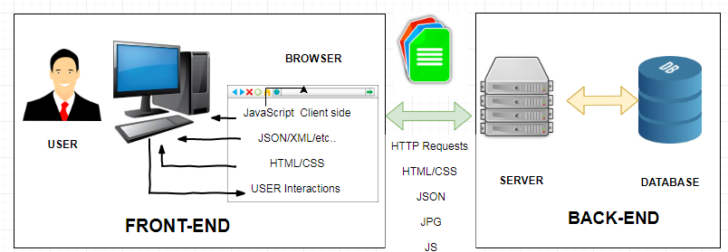
1. Understanding the Basic Web Development Framework
The main components of any given web framework are:
User
Browser
Webserver
Backend services (Data-Base).
The following image provides a basic diagram to make it easier to visualize the components in a website/web application.

Slide 3
1. Understanding the Basic Web Development Framework
1.1 User
User expectations define the requirements for developing a good website.
These expectations have changed a lot over the years. Users used to accept the slow experience of the web, but no longer.
They expect websites to behave closer to applications installed on their computers and mobile devices.
1.2 Browser
The browser plays three roles in the web framework.
Provides communication to and from the webserver.
Interprets the data from the server and renders it into the view that the user sees.
Handles user interaction through the keyboard, mouse, touchscreen, or other input device and takes the appropriate action.

Slide 4
1. Understanding the Basic Web Development Framework
1.3 Browser to Webserver Communication
Browser-to-webserver communication consists of a series of requests using the HTTP protocol.
Hypertext Transfer Protocol (HTTP) defines communication between the browser and the webserver.
HTTP defines what types of requests can be made as well as the format of those requests and the HTTP response.
The browser makes three main types of requests to the server:
GET: Used to retrieve data from the server, such as .html files, images, or JSON data.
POST: Used when sending data to the server, such as adding an item to a shopping cart or submitting a web form.
AJAX: Asynchronous JavaScript and XML (AJAX) is actually just a GET or POST request done directly by JavaScript running in the browser. An AJAX request can receive XML, JSON, or raw data in the response.

Slide 5
1. Understanding the Basic Web Development Framework
1.4 Rendering the Browser View
The screen that the user actually views and interacts with is often made up of several different pieces of data retrieved from the webserver.
The browser reads data from the initial URL and then renders the HTML document to build a Document Object Model (DOM).
The DOM is a tree structure object with the HTML document as the root. The structure of the tree basically matches the structure of the HTML document.
The browser interprets each DOM element and renders it to the user’s screen to build the webpage view.
The browser often ends up getting various types of data from multiple webserver requests to build the webpage.

Slide 6
1. Understanding the Basic Web Development Framework
The following are the most common types of data the browser uses to render the final user view as well as define the webpage behavior.
HTML files: Provide the fundamental structure of the DOM.
CSS files: Define how each of the elements on the page is to be styled; for example, font, color, borders, and spacing.
Client-side scripts: JavaScript files, that provide added functionality to the webpage, manipulate the DOM to change the look of the webpage, and provide any necessary logic required to display the page and provide functionality.
Media files: Image, video, and sound files are rendered as part of the webpage.
Data: Any data, such as XML, JSON, or raw text, can be provided by the webserver as a response to an AJAX request. Rather than sending a request back to the server to rebuild the webpage, new data can be retrieved via AJAX and inserted into the webpage via JavaScript.
HTTP headers: The HTTP protocol defines a set of headers that can be used by the browser and client-side scripts to define the behavior of the webpage. For example, cookies are contained in the HTTP headers. The HTTP headers also define the type of data in the request as well as the type of data expected to be returned to the browser.

Slide 7
1. Understanding the Basic Web Development Framework
1.5 Webserver
The webserver’s main focus is handling requests from browsers.
The browser may request a document, post data, or perform an AJAX request to get a data.
The webserver uses the HTTP headers as well as the URL to determine what action to take.
This is where things get different depending on the webserver, configuration, and technologies used.
Most out-of-the-box webservers, such as Apache and IIS, are made to serve static files such as .html, .css, and media files.
To handle POST requests that modify server data and AJAX requests to interact with backend services, webservers need to be extended with server-side scripts.
A server-side program is really anything that can be executed by the webserver to perform the task the browser is requesting.
These can be written in PHP, Python, C, C++, C#, Java, ….

Slide 8
1. Understanding the Basic Web Development Framework
1.6 Database
When a request comes in from the browser that requires information from the database or other backend service, the server-side script connects to the database, retrieves the information, formats it, and then sends it back to the browser.
Conversely, when data comes in from a web request that needs to be stored in the database, the server-side script connects to the database and updates the data.

Slide 9
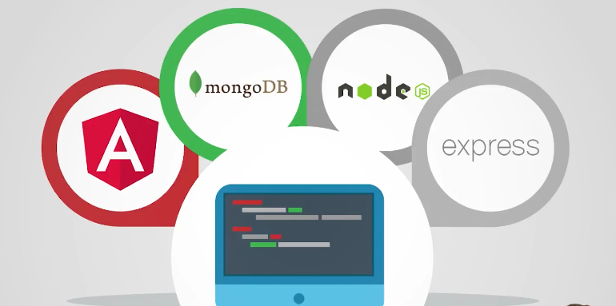
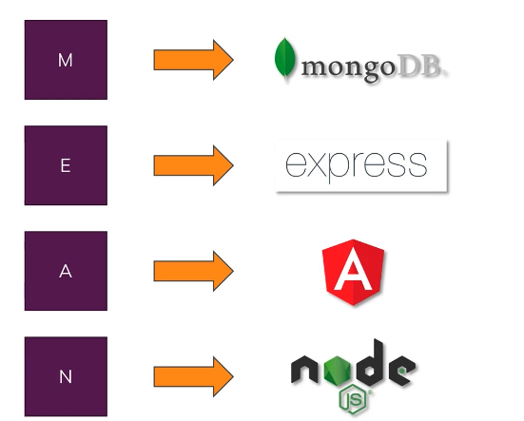
2. What is MEAN Stack?
MEAN Stack is a JavaScript web development stack

Slide 10
2.1 What is Angular?
A client side (browser) Framework developed by Google, which allows you to build single page applications (SPA).
Angular render the user interface with dynamic data, manipulate data on the client side, and control how elements are displayed in the browser view
Angular handle user input
Communicate with backend services
Provide a “Mobile App” like User Experience
It is written using TypeScript. The entire theory behind Angular is to provide a framework that makes it easy to implement web applications using the MVC framework.

Slide 11
2.2 What is Node?
Runtime server side JavaScript.
Node.js is a development framework based on Google’s V8 JavaScript engine.
Node.js code is written in JavaScript and then compiled into machine code by V8 to be executed.
Listen to requests and send responses
Execute server-side logic
Interact with database and files

Slide 12
2.3 What is Express?
A node framework which simplifies writing server-side code and logic
Middleware-based funnel requests through functions
Simplifies and extend the usage of node. Provide several key components for handling web requests. This allows you to implement a running webserver in Node.js with only a few lines of code.
Express framework provides the ability to easily set up destination routes (URLs) for users to connect to.
Express framework provides great functionality on working with the HTTP request and response objects, including cookies and HTTP headers.

Slide 13
2.4 What is MongoDB?
MongoDB is a scalable NoSQL database. It is based on the NoSQL document store model, meaning that data is stored in the database as a form of JSON objects rather than the traditional columns and rows of a relational database.
Enforces no data schema or relations
Easily connected to Node/Express (NOT to Angular)
A powerful database which can easily be integrated into a Node/Express Environment
MongoDB provides great website backend storage for high traffic websites that need to store data such as user comments, blogs, or other items because it is fast, scalable, and easy to implement.
You can use other DBs (eg, SQL) too

Slide 14
2.5 What is a Single Page Application (SPA)?
We will have only one HTML page index.html that will be served from our node server.
Angular will not request a second page form the server
The page will manipulate and be rendered to change the page content
There will be no page reloading
This allows for instant re-rendering, instant user feedback and makes building highly engaging UIs possible

Slide 15
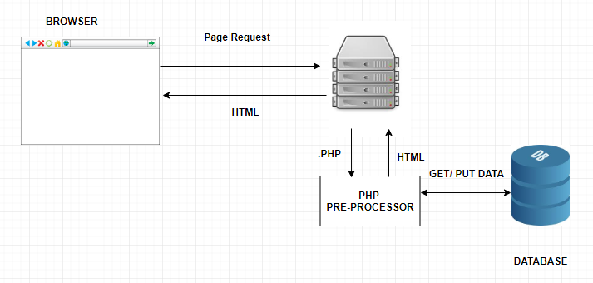
3. How Does MEAN Stack work ?
In the past, all of the front-end code (HTML, JS and CSS) generated from the back-end. User interactions with webpages often require a full-page refresh.

Slide 16
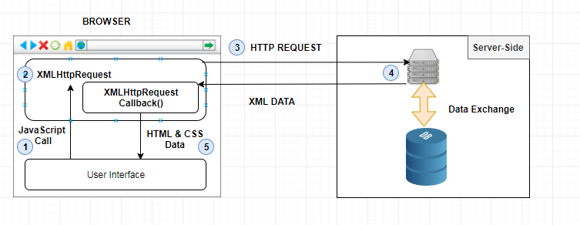
3. How Does MEAN Stack work ?
Then came into play AJAX and JQuery. The main idea was to load content asynchronously in the background to refresh portions of webpage

Slide 17
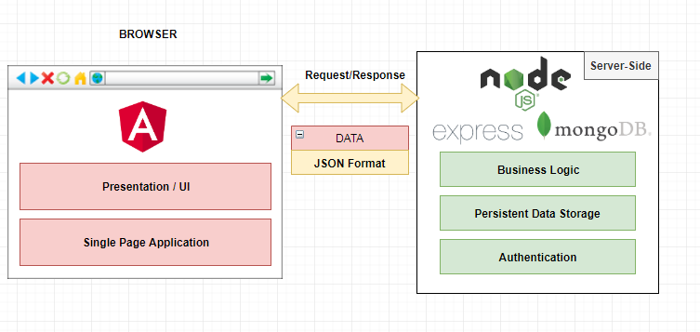
3. How Does MEAN Stack work ?
With Angular, the front-end code is now independent from the back-end. The web server become web-service that outputs JSON data, not dynamic HTML or CSS.

Slide 18

2. Introduction To TypeScript

Slide 19
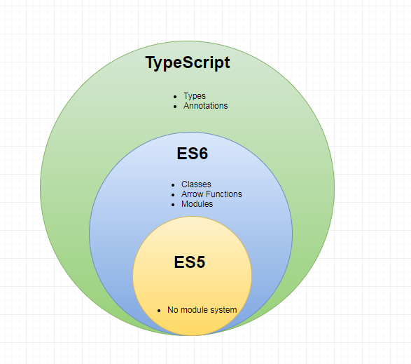
1. Why and What is TypeScript
JavaScript freedom leads to write unorganized codes especially for complex applications.
Typescript is a types superset of ECMAScript 6 - Developed by Microsoft
This is an invaluable way to debug applications at compile time
Typescript is a programming language that compiles to JavaScript. Since Typescript compiles to JavaScript any JavaScript code in Typescript file will still be valid and acceptable.
It is similar to JavaScript but adds a lot of missing features that JavaScript doesn’t have
Makes the language more static and like established backend languages such as java or C++ (Object-oriented design)
Supports annotations, decorators, classes, allow encapsulation, and type checking
Angular is written in Typescript

Slide 20
2. Installing Typescript Compiler
To install typescript in your command line use npm install command.
Also you need to add the –g flag to the command to install the package globally in your machine.

Slide 21
3. TypeScript HelloWorld Example
Create a new file and name it script1.ts inside that file now we can write TS code.
To run this code we need to compile script1.ts file to javaScript file using tsc command. Open you terminal and type the following command:
This command will compile your ts file and generate script1.js file which is a JavaScript version of your code.
Open the script1.js file and check its content, should be as the following:
As you see there no difference between the two files since console.log is a JavaScript code.
To run the JavaScript file, we will use the node command as following:

Slide 22
4. TypeScript ECMAScript5 Example
Create a file and name it Script2.ts with an arrow function that return a name string “Alfred ”.
To compile this file simply enter the following command
This will compile script2.ts to script2.js file. Now script2.ts.js should looks like:

Slide 23
5. Difference between let, var and const
var : informs that variable is scoped in whole document
let: informs that variable is scoped to nearest enclosing block
const: indicates that values are meant to always feature same type
For example if we define variable i using var and assign it to 3. Then we create a for() loop block that define var i initially as 0. Here i will be treated as one variable and its value will be changed to 0

Slide 24
5. Difference between let, var and const
If we change the var keyword to let we will create two different variables with different scopes the variable i will start with 0 till 9 in the for loop context. However variable i will be 3 outside the for loop context.
If we define a variable with const we will not be able to change it later in our code. For example

Slide 25
6. Identifiers
Identifiers are names that given to classes, variables, functions, etc..
Identifiers hold a reference to our data stored in memory.
Identifiers can include letters, and numbers, However they must start with a letter.
They can’t include special characters with the exception of ‘$’ and ‘_’.
Also they cannot be a reserved name, or have a space.
The following example will illustrate valid and invalid identifiers names.

Slide 26
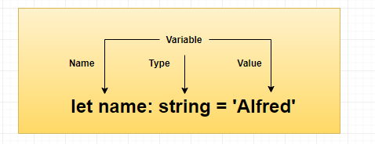
7. Variables
You can create a variable in typescript similarly to creating a variable in javascript. For example:
However what makes typescript different from JavaScript, is that we can assign variable to type to variables.

Slide 27
7. Variables
For example, if we want to assign the a variable to be type string as in the following example we will get error because we assign 1 to a string variable.
To fix that we can now assign a string to the a variable as the following:

Slide 28
8. Basic Types
Here is a list of basic type script types:
The following example will illustrate the use of these types

Slide 29
8. Basic Types
8.1 Strings
With ECMAScript 6 we can create string variables using back ticks key which is support multi-line string assignment.
Here is an example which will user the color property variable in the msg property using ${ } dollar-sign and curly parentheses to wrap the variable property.
8.2 Any
The any type can accept any value and properties can be edited later with any type of values

Slide 30
8. Basic Types
8.3 Custom type
We can define a new types using type keyword and choose what values it can take.
8.4 Types Notes
Typing is optional
When no type inference is possible, typescript assign any type to loosely typed data

Slide 31
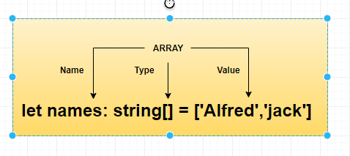
9. Complex Types
9.1 Arrays
Arrays is one of the complex types, you can create an array by two different methods:
Both methods are identical they will be compiled to JavaScript the same way.

Slide 32
9. Complex Types
9.2 Tuples
Tuples is multiple types array with known length for example:
9.3 Enum
Enum is a set of unique numeric values. Represented by assigning friendly names. Used as a way to list, in convenient and recognizable way.

Slide 33
9. Complex Types
In the following example , WeekDay is an enum and MONDAY , TUESDAY etc are the constants in the set, also called the enumerators.
We can make the enum list start with a specific counting number instead of 0.

Slide 34
10. Type Assertions
Type assertion is a way to guide the compiler to know the type of the compiler.
For example if we define a message variable then we assign it with string in different line the compiler will think about the message variable as any type variable.
We can explicitly assign the type using parentheses and either arrow type <type> before the variable name or the keyword as.

Slide 35
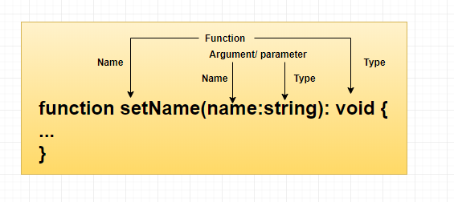
11. Functions
11.1 Annotate types in functions
Here is an example of using types for a function arguments and return value.

Slide 36
11. Functions
Functions in typescript can be anonymous when we assign the function to a variable
11.2 Functions optional arguments
Typescript offers optional functionality by adding “?” to parameter name make it optional.

Slide 37
11. Functions
11.3 Functions unlimited number of arguments
11.4 Arrow Functions
Arrow Functions offers better function syntax and scope handing
ES6 introduced fat arrow function (lambda function)
Simplifies general function syntax
Provides a bulletproof way to handle scope of functions
Value of this can point to a different context
Referring to this inside a callback loses track of the upper context, an forces

Slide 38
11. Functions
Here is an examples of Arrow Functions

Slide 39
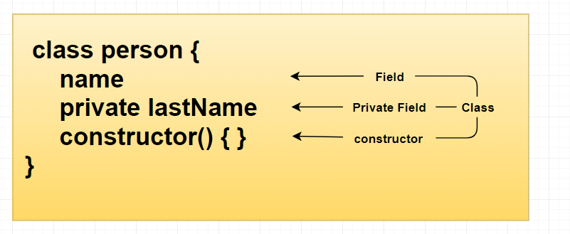
12. Classes
Classes are building blocks of typescript and angular applications
Private keyword makes properties accessible only from the class api and not from outside the class.
Constructor function is used when the instant of the class is created and can be used to initiate properties

Slide 40
12. Classes
12.2 Constructor
We can instantiate properties in classes using the constructor function, to set the property’s value when we create a class.
The constructor will be called when we instantiate the class.
We can use constructor to create the properties for us using accessors in the constructor

Slide 41
12. Classes
12.3 Methods
Methods are functions inside a class, without using the function keyword. Here is an example:

Slide 42
12. Classes
11.4 Access Modifiers
Allow us to change the level of access to any element within a class.
The default modifier is public.
The private access modifier will make the element not accessible outside the class.

Slide 43
12. Classes
11.5 Inheritance
We can create a class that extends and inherit another class properties and methods.

Slide 44
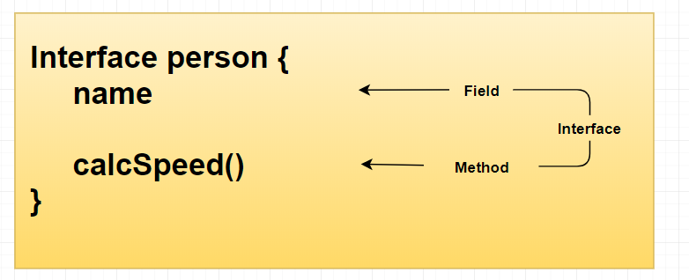
13. Interfaces
13.1 Interfaces
Essential to ensure consistency and rules compliance
It is code blueprint
Define certain field’s schema and types
Used for enforcing the existence of certain fields and methods

Slide 45
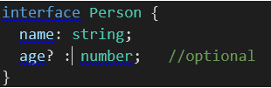
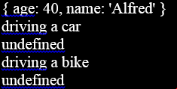
13. Interfaces
Interfaces can define optional
members using ? symbol next to
the field name.

Slide 46
14. Modules
Modules makes your application sustainable and more reusable. Modules can be either internal or external.
14.1 Internal Modules
Singleton wrappers containing a range of classes, functions, objects, or variables
One can publicly expose to contents of a module by prefixing the keyword export

Slide 47
14. Modules
14.2 External module
Solution to building applications designed to grow
Each external module works at file level
Module name matched filename without .ts extension
Module keyword not used anymore
Each member marked with export prefix to become part of external module API

Slide 48
14. Modules

Slide 49

14. Spread Parameter

Slide 50
3. Introduction To Angular Framework

Slide 51
1. What is Angular
Angular is a Frontend framework for building user interface for web applications - Created and maintained by Google
Using HTML, CSS, and Typescript
Gives our application a clean structure
Includes a lot of re-usable code
Makes Our applications more testable
Separate DOM manipulation from application logic
Angular is used to build a powerful Frontend Application (SPA)
Rapid development and code generation
In short, Angular makes our life easier.

Slide 52
2. Why is Angular a revolution
New languages: TypeScript, ES6 and Dart
New tools: module managers, RxJS and transpiler
New Template syntax
New concepts: component, pipes, and so on
New tooling: Angular CLI – command line interface

Slide 53
3. What about AngularJS or 1.x
Angular 2 is not AngularJS they are completely different
AngularJS or 1.x is still maintained.
AngulaeJS is now 6 years old, which is very old in today’s web dev world.
Angular Features
Component Services Routing Lazy Loading
Testing Data binding HTTP module Forms module
Pipes Directives Observables

Slide 54
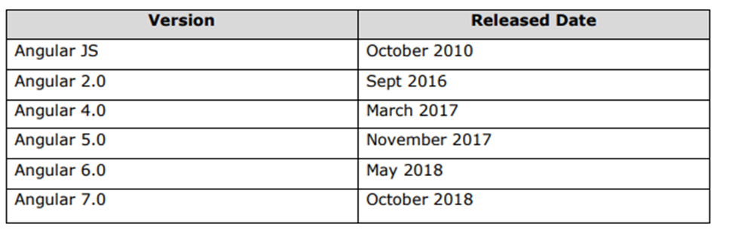
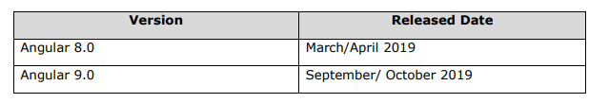
4. Angular Versions
Angular is owned by Google below is the list of Angular versions released so far:
The release dates for the next two major upcoming versions of Angular are given below:
Google plans to release the major Angular version every 6 months.
The version released so far are backward compatible and can be updated to the newer one very easily.

Slide 55
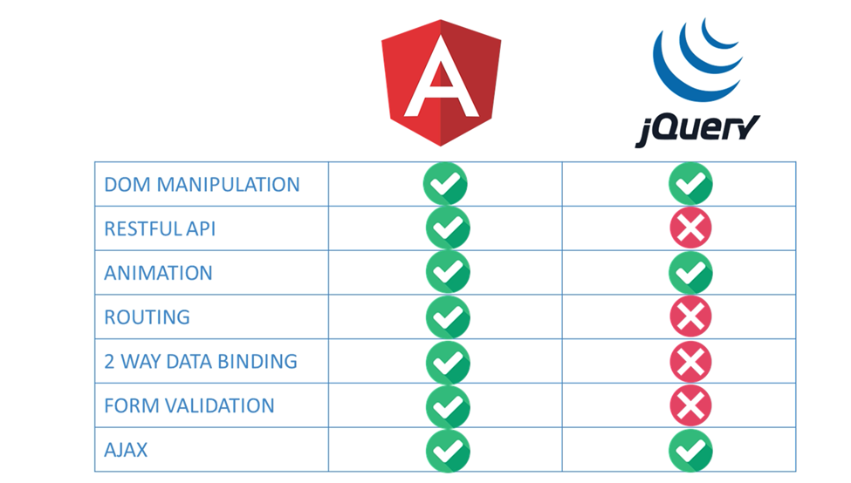
5. How its different from other Frameworks
React : JavaScript library to build web components ~ 130KB
AngularJS: Web development framework JavaScript only ~ 150KB
Angular: Web development framework JavaScript, Typescript, or Dart Many more APIs and Patterns ~500KB

Slide 56

4. Environment Setup and Your First Angular Application

Slide 57
1. Angular CLI
Allows to scaffold an application
Add new construct can be added, Angular applications, Components, Modules, etc...
Enables running tests
Create a Production grade bundle
Configuring typescript
Installing all dependencies
To install Angular CLI you need Node.js and NPM to be installed on your machine

Slide 58
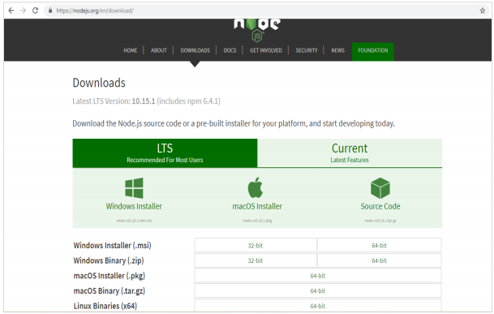
2. Installing Node.js
Node.js is a JavaScript runtime which allow us to run JavaScript application on desktop instead of just on the browser.
Installation of Node.js will include Node Packet Manger NPM, which is a tool that allow us to install dependencies.
Also Angular will utilize Node.js to run its developer server which access our Angular files. To install Node.js go to : https://nodejs.org/en/

Slide 59
2. Installing Node.js
To check if nodejs is installed on your system, type node -v in the terminal.
The first command will check node.js installed version, and the second command will check the npm installed version.

Slide 60
3. Installing Angular CLI
Angular 7 installations are very simple with the help of angular CLI.
Visit the homepage https://cli.angular.io/ of angular to get the reference of the command.
To install Angular CLI we will use the following command:
The npm install command will install angular cli, and the -g flag will install it globally which will make it accessible from any directory at your local machine.

Slide 61
3. Installing Angular CLI
To verify the installation, enter the following command:
This command will give you a full version breakdown of all angular dependencies packages like Typescript, rxjs, etc..

Slide 62
4. Visual Studio Code IDE
I will use Visual Studio Code IDE throughout this course, Feel free to use any text editor or IDE
I will also use the following extensions

Slide 63
5. Generating Angular Application
Open a new terminal
To create an new angular app use “ ng new ”command.
Our first application will be called “HelloWorld”.
To create that application using the Angular CLI, enter the following command:
Angular will create the directory HelloWorld, so we need to change directory to our project and the last command will open it in Visual Studio Code.
When we use “ng new” command to generate an Angular App it will generate a default start up that we can run it.

Slide 64
5. Generating Angular Application
when we generated our application, we can specify optional flags that shown in the table below:

Slide 65
6. Serve the application
When we use “ng new” command to generate an Angular App it will generate a default start up that we can run it.
To run our app we will use the command “ng serve -o” which will built , run and serve our application in the development server
The “-o” flag open it automatically in your default browser.
The web server starts on port 4200. Type the url, http://localhost:4200/ in the browser and see the output.

Slide 66
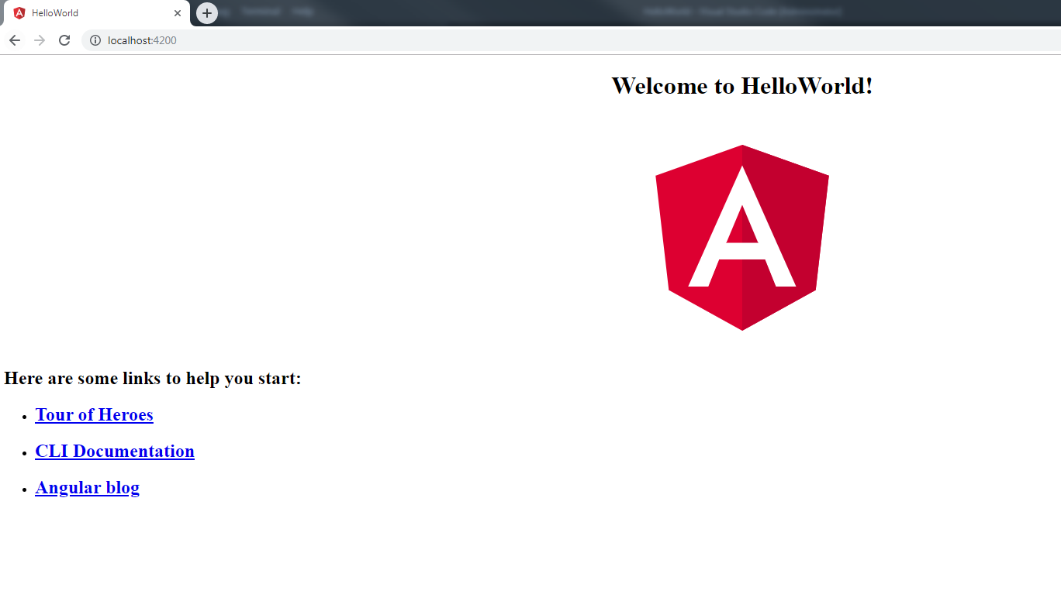
6. Serve the application
You can change the port if you wish using the following command
ng serve --host 0.0.0.0 –port 4205

Slide 67
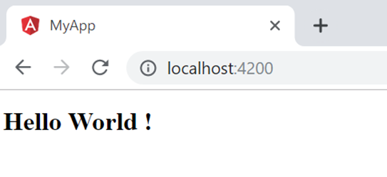
7. HelloWorld Template
Now to edit this application to display the message “Hello World” we need to edit src/app/app.component.html file HTML content.
Will create an h1 tag with Hello world text.
Notice that the development server is still running once I save the changes it will be reflected in the browser.

Slide 68
5. Angular Project Structure & How Angular Application Loads

Slide 69
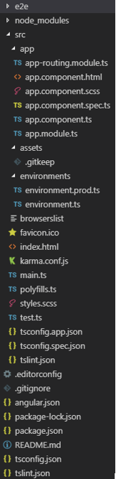
1. Angular File Structure

Slide 70
1. main.ts
In this file we imported the AppModule from “app.module.ts” file and we bootstrap it as the main or the first module our application loads in our project.
The “main.ts” file is the entry point of our application, let’s take a look at it :

Slide 71
2. app.module.ts
In the first four lines NgModule, BrowserModule, AppRoutingModule and AppComponent are imported to the “app.module.ts”.
Then we have the NgModule decorator which is used to define a module.

Slide 72
2. app.module.ts
The NgModule decorator include the following properties

Slide 73
3. app.component.ts
The AppComponent is the root component of our application.
It will be the first component loads in the project.
Here is TypeScript (logic) file of AppComponent looks like:
In the first line, the Component library is imported we use it using @Component decorator

Slide 74
3. app.component.ts
The @Component decorator can include the following properties:
The component is simply a class were we can have properties and methods within it.
In the default generated app.component.ts file we have only one property in the AppComponent class which is title and its assigned to be ‘HelloWorld’ our project name.

Slide 75
4. index.html
This file contain only the basic html skeleton of our application
It will load the root component (the only component we have now) AppComponent using the selector app-root.
The app-root html tag will be replaced by the component template file (app.component.html).

Slide 76
4. app.component.html
Now let’s take a look at what will be actually shown in our browser when the application run.
Since we have only one component the component template app.component.html will be render when the application is loaded:

Slide 77
6. Angular Components

Slide 78
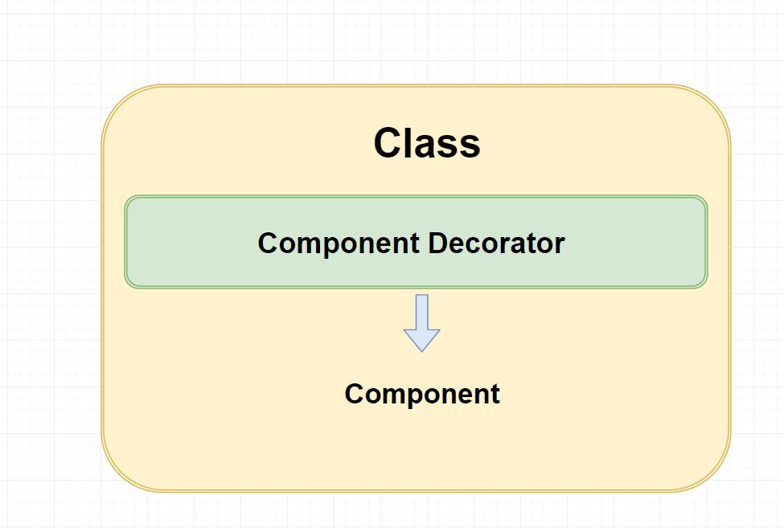
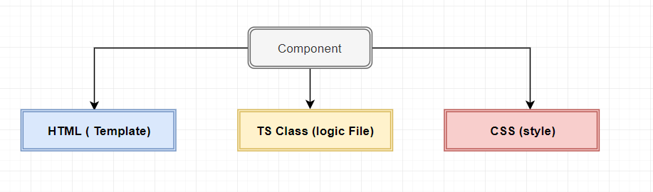
1. Introduction to Angular Components
Components are the basic bricks in Angular Application
Component is just a class with component decorator
Each Component consist consists of
Template (HTML)
Style sheet (CSS)
Logic code (Typescript Class)
Web component Standard:
Isolated components
Reusable in different apps

Slide 79
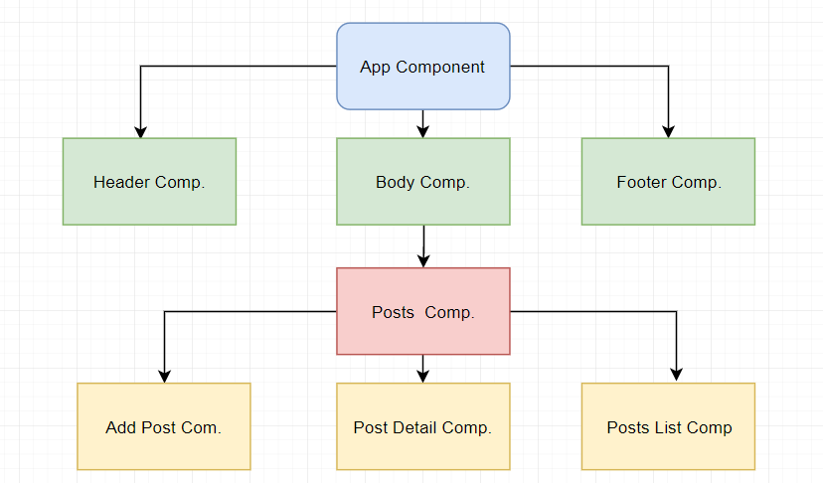
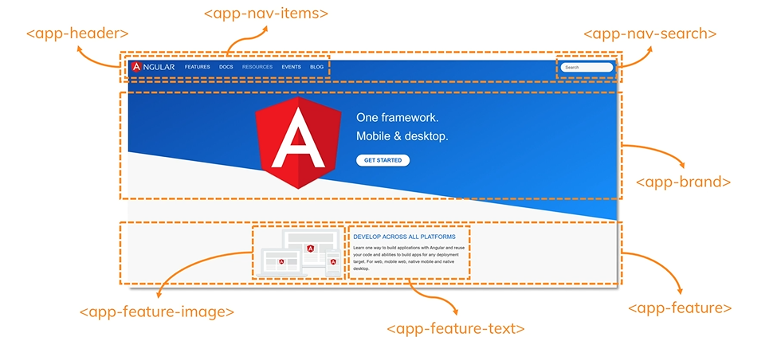
1. Introduction to Angular Components
Components are Hierarchical
The advantage you will have small and easily to maintain building blocks for your UI.
They also can be even reuse because some components appear more than once in a page.

Slide 80
2. Generating a component
We can use Angular CLI command to generate angular component.
Type ng generate component command or ng g c for shorthand, followed by the component name.
I will name the component hello-world.
Angular CLI created a directory with the component name for us inside the app directory.
The component directory contain four files.
These files are component template, component testing file, component logic file and component styling file.
Angular CLI also updated the app module file to register the new generated component to the model.

Slide 81
3. Component class and decorator
The @Component decorator function which imported from @angular/core, takes an argument of JavaScript object that contain meta-data about the component.
Angular component is just a typescript class and @Component allow angular to identify it as component.
The selector property will define how we will reference our component in other HTML page.
This will reference our component as HTML element for example <app-hello-world>.
Selector is a CSS selector which means we can select the component as a class by adding dot in front of the value “.app-hello-world” and our component will be referenced as a class of an element for example <div class=”app-hello-world”>

Slide 82
3. Component class and decorator
templateUrl property define a relative path to our template file.
If our component template is small we can use template property instead of templateUrl.
The template property allow us to define inline HTML markups inside the logic file as in the following example
styleUrls property define the relative path to component styling sheets.
Notice it’s a plural and it’s an array since our component might have more than one styling sheet.
We can use styles instead of styleUrls to add the component styling inline inside the component class as in the following example

Slide 83
3. Component class and decorator

Slide 84
4. Component Registeration in App Module
In order to use a component you need to register it in a module. By now we have only one module app module app.module.ts.
The app module is also a typical typescript class and what define it as a module is @NgModule decorator function that takes an object as an argument.
The @NgModule decorator was imported from @angular/core library.
Notice that our component class HelloWorldComponent is imported to the app module.
This is done automatically when we used angular cli to generate the component.
The declaration property takes an array of all component classes used by the module.
Right now there is two component registered in the declaration array Hello-world component and app component.

Slide 85
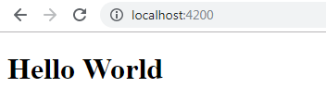
5. Component Template
Now we can edit the default template angular generated for our hello-world component as the following
In order to render hello-world template we need to use its selector <app-hello-world> inside the app component template ad the following
Now if your run the application you should get the following results

Slide 86
6. String Interpolation
In hello-world component we can define a field in its class as the following
We can use the msg property inside our template using string interpolation by placing the property name inside a double curly brackets in the template as the following

Slide 87
6. Angular Modules

Slide 88
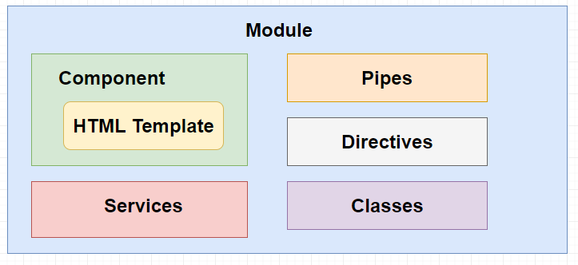
1.Module Introductions
Module in Angular refers to a place where you can group the components, directives, pipes and services, which are related to the application.
Every Angular Application has at least one module
The main module describes the structure of the application
We can define modules for specific features that can be shared between different applications

Slide 89
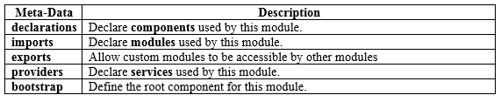
1.Module Introductions
To define module, we can use the NgModule.
When you create a new project using the Angular –cli command, the ngmodule is created in the app.module.ts file by default and it looks as follows:

Slide 90
2. Generating Modules using Angular CLI
To create your module, open the terminal and use the ng generate module command or for short ng g m as the following command that will generate a module called reset
This command will create a folder inside your src directory with a name similar to the module name.
Inside the reset folder we will have our generated module reset.module.ts and here how it looks like:

Slide 91


7. Adding Bootstap and Angular Material to your Projects

Slide 92
1. What is Angular Material
Angular Material is the official UI design framework for angular in which we can create user interfaces that follow Material design guidelines.
Go to https://material.angular.io/ and click on Get started button that will take you to installation page which include the steps you need to follow to install angular material.
However I will make a use of angular schematic that will automate this process.

Slide 93
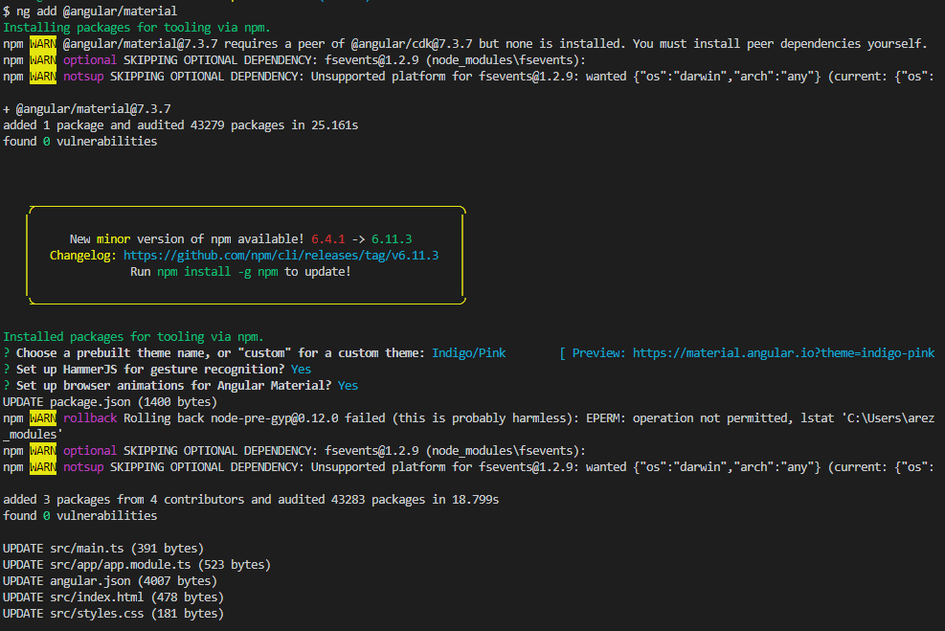
2. Install Angular material
To install angular material using angular schematics open your terminal and type the following command:

Slide 94
2. Install Angular material
While the installation process it will ask you to choose your angular material theme.
In this example I selected “Indigo/Pink” Theme.
Also you will be asked if you want to install HammerJs and animations libraries for angular material.
Notice at the end of the installation process it will list all the files that get affected by the installation.
For example angular.json file will have the theme css file added to the styles array as the following:

Slide 95
2. Install Angular material
Also in the index.html it added material fonts and material icons

Slide 96
2. Install Angular material
In the app.module.ts the BrowserAnimationModule is added to the imports array from installed animation library

Slide 97
3. Using Angular Material
To use Angular material I will generate a Module using the ng generate module command or ng g m for short as the following:
The flat flag will skip generating a directory for the module and just create the file in the app folder.
The new generated file material.module.ts will look as the following:

Slide 98
3. Using Angular Material
In the material.module.ts we will add all modules and components used in our UI Design.
We need to declare and import the material.module in the app.module.ts since it is our main module.

Slide 99
4. Material Button
To create a button using Angular Material we need to first to import MatButtonModule in material.module.ts file as the following:
Note that we added the exports array in the @NgModule decorator to make the dependency modules available everywhere in our application.

Slide 100
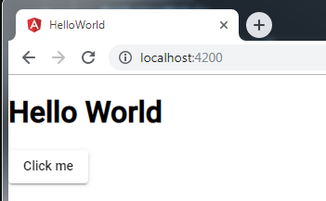
4. Material Button
Now we can use the material button in the Hello World template file “hello-world.component.html”.
Use the button tag with mat-raised-button attribute as the following:
Run the application now and verify the following results:

Slide 101
5. Installing Bootstrap
We will use bootstrap CSS framework to make our application responsive.
Go to https://getbootstrap.com/ to learn more about bootstrap grid system.
To install bootstrap we will use NPM npm install command as the following:
Now we need to update the styles array in angular.json file and add the bootstrap.css file to it as the following:

Slide 102
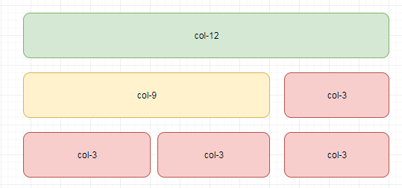
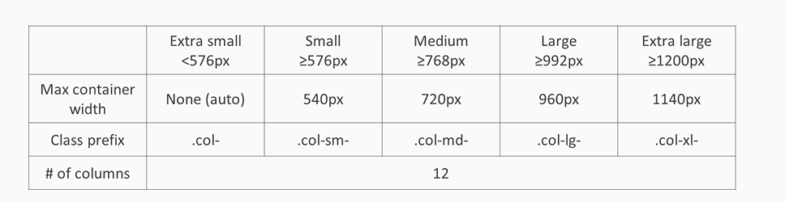
6. Bootstrap Grid-system
12 columns. 5 responsive tires (xs, sm, md, lg, xl)
Container class is required for bootstrap grid layout and it has a responsive width
Inside the container you will have the row element it’s the wrapper of the columns
The column element set in percentage they use margin and padding for spacing
Spacing between columns can be removed using “no-gutters” on the parent row
Bootstrap provide another container container-fluid which takes 100% of the width

Slide 103
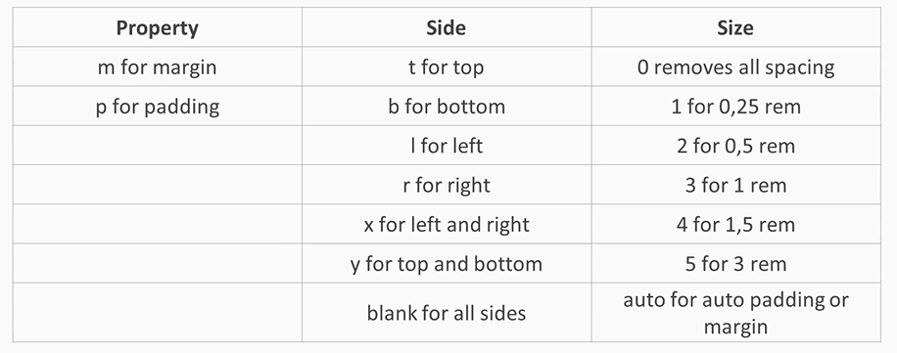
7. Bootstrap Utility Classes
1. Display Utility
Display utility Show/hide depending on breakpoint.
For example The following element will be only visible from sm and md breakpoints
<div class= ”d-none d-sm-block d-lg-none”></div>
2. Margin and Padding Utilities
Gives responsive spacing by defining margins and paddings
Classed are named using format {property}{sides}-{size}
Or {property}-{sides}-{breakpoint}-{size} for breakpoint responsive spacing

Slide 104
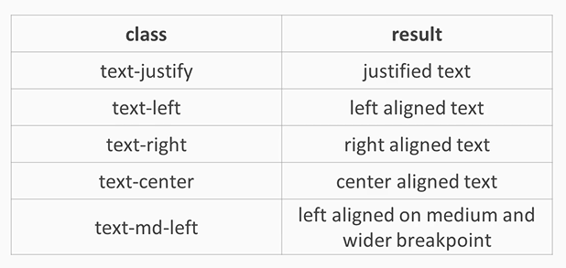
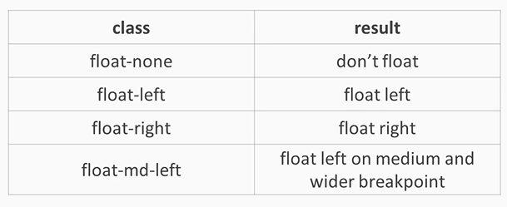
7. Bootstrap Utility Classes
3. Test Utility
Used for re-align the text and start with text prefix
4. Float Utility
Used to floats any element and start with float prefix

Slide 105
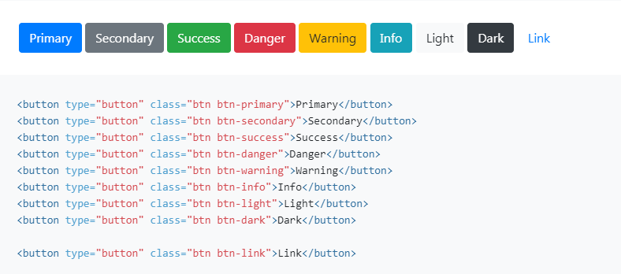
7. Bootstrap Buttons

