Slide 1

SunPy Mini-Workshop
Michael Kirk, Monica Bobra, Will Barnes

Slide 2
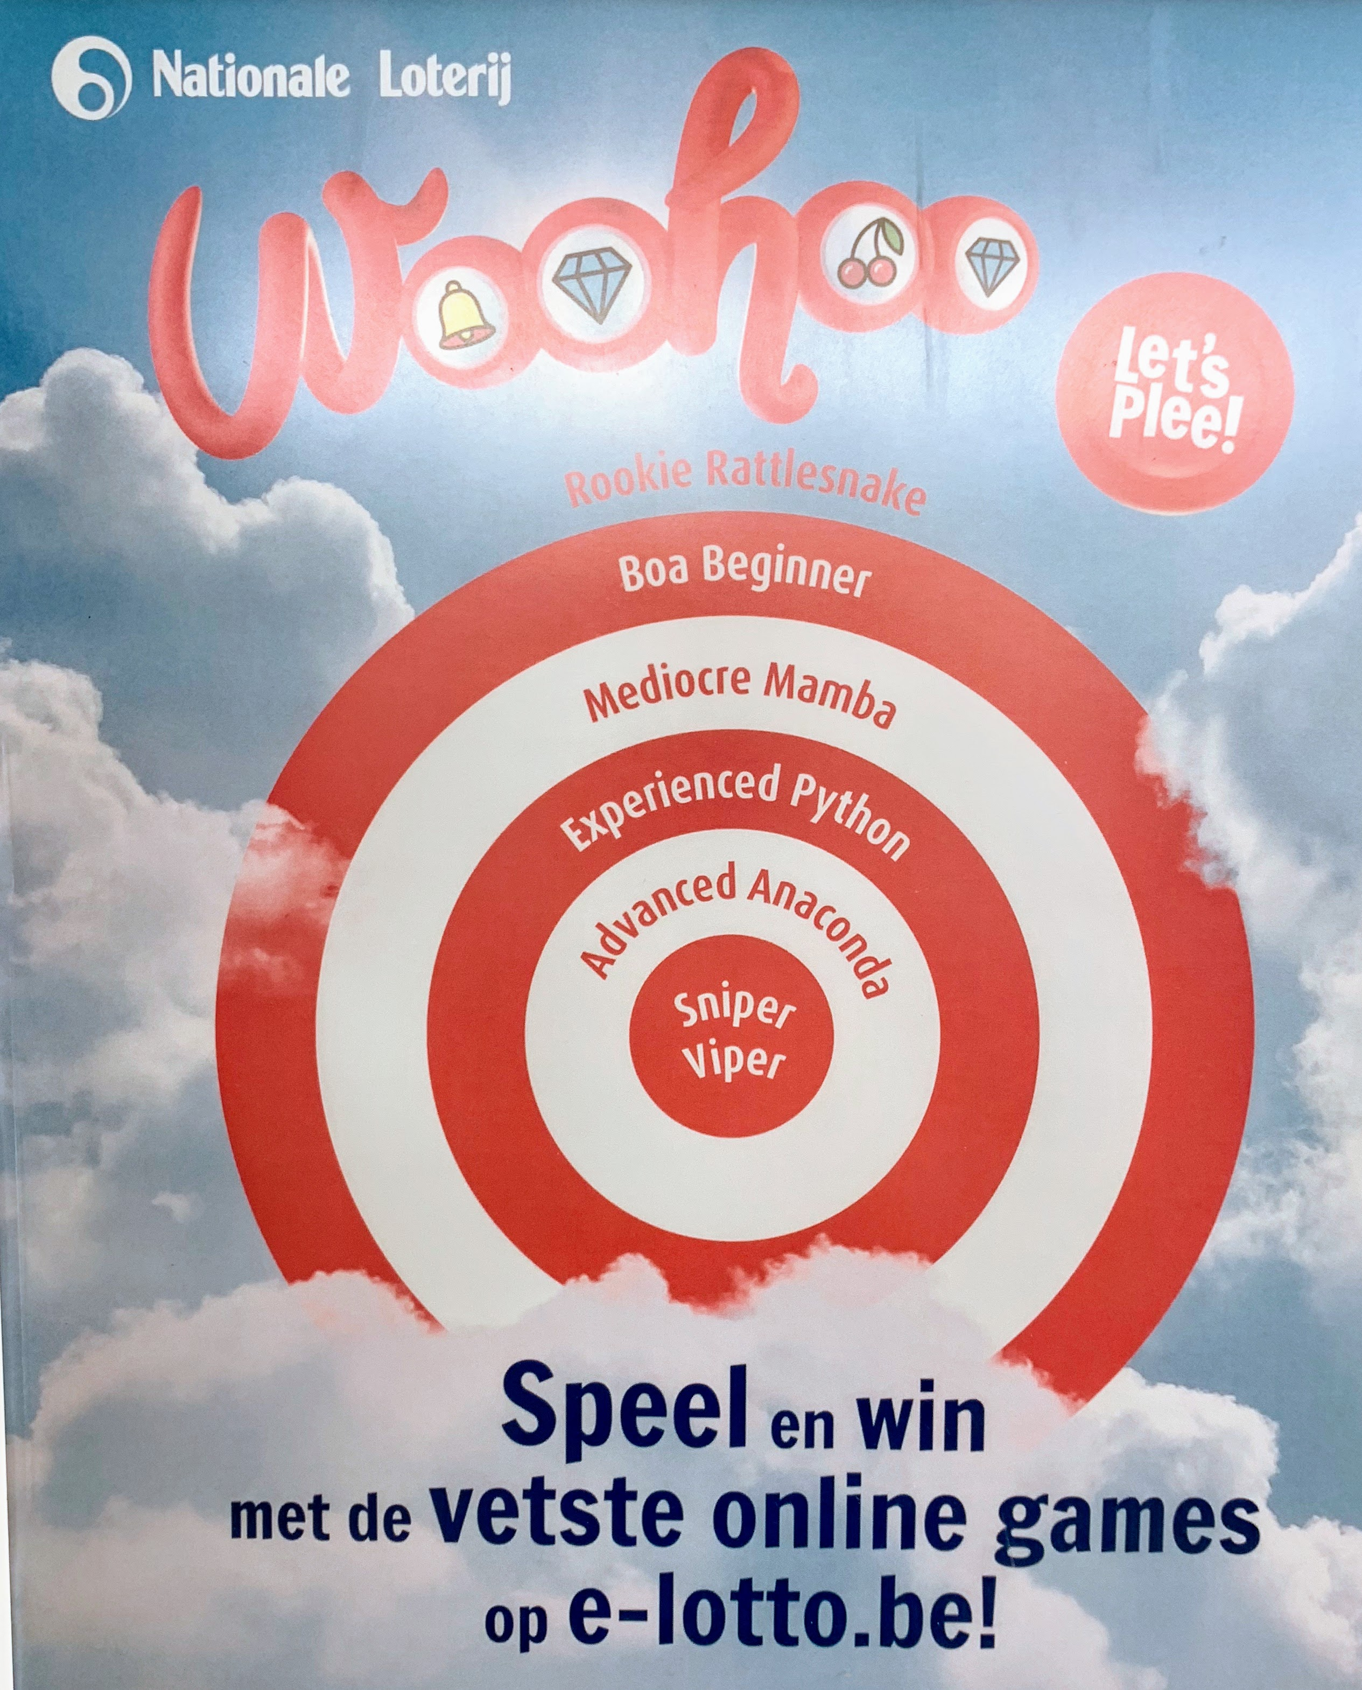
How comfortable are you with Python?
A) I use it regularly in my science workflow.
B) I have played around with it a little.
C) I just installed it for this workshop.

Slide 3
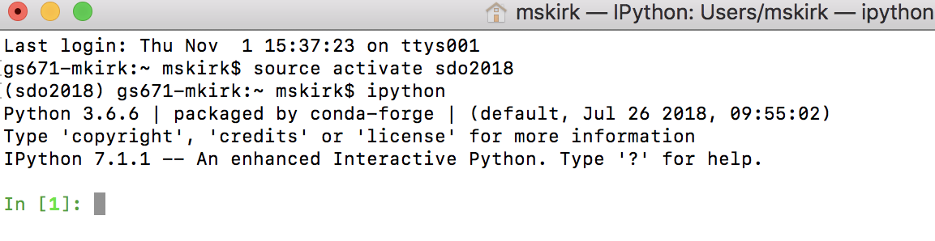
Lets get started:
1) Open a terminal
2) Windows: activate sdo2018
– MacOS or Linux: source activate sdo2018
3) Launch ipython (interactive python)

Slide 4
Additional resources
This Tutorial: https://github.com/sunpy/tutorial-notebooks
Self-led Scientific Python Tutorial (highly recommend): https://openastronomy.org/rcsc18/chapters/00-lessons
SunPy Example Gallery: https://docs.sunpy.org/en/stable/generated/gallery/index.html
SSWIDL to Python Cheat Sheet: https://docs.sunpy.org/en/stable/guide/ssw.html

