Slide 2
Collaborative and Reproducible data analysis
GutMicro R workshop

Slide 3

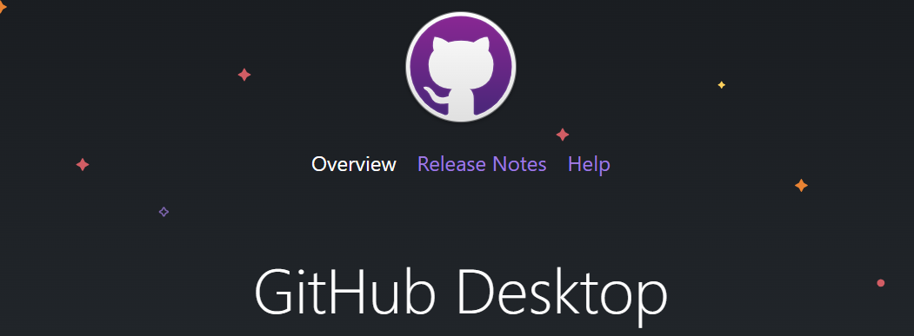

Write
Share
Store
”Remember, kids, the only difference between screwing around and science is WRITING IT DOWN” - Adam Savage
Notes:
This will be the framework for the group data analyses.

Slide 4
DATA.DTU.DK
Each repository is given a DOI when made public
Github repositories can be directly imported
Fantastic for publication related data
Public data is permanent
Cannot be deleted or updated
If you need help just ask, but no group teaching

Slide 5
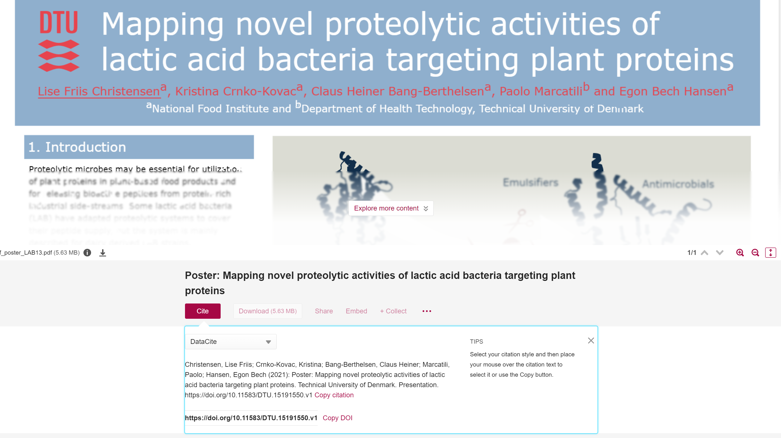
DATA.DTU.DK
Each repository gest a DOI
Fantastic for publication related data

Slide 6
Github
Notes:
How to

Slide 7
Github
Github is a free repository of private and shared files
Keeps a record of changes to each file
Github repositories can be synchronized to github.com using command line or a GUI
On windows I recommend Github desktop
Software functions
Download (pull/clone) repository to folder
Keep track of changes to files in local folder and remote repository
Syncronise changes with history and comments
REMEMBER
Use DTU email as primary email, but no DTU identifier in username
Email can be changed, but not username

Slide 8
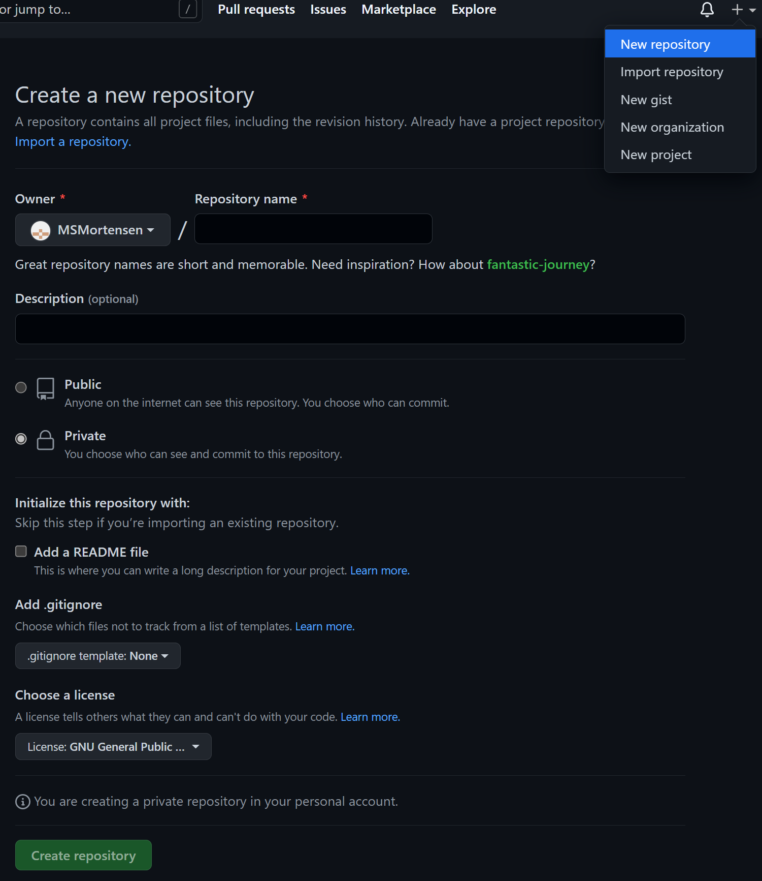
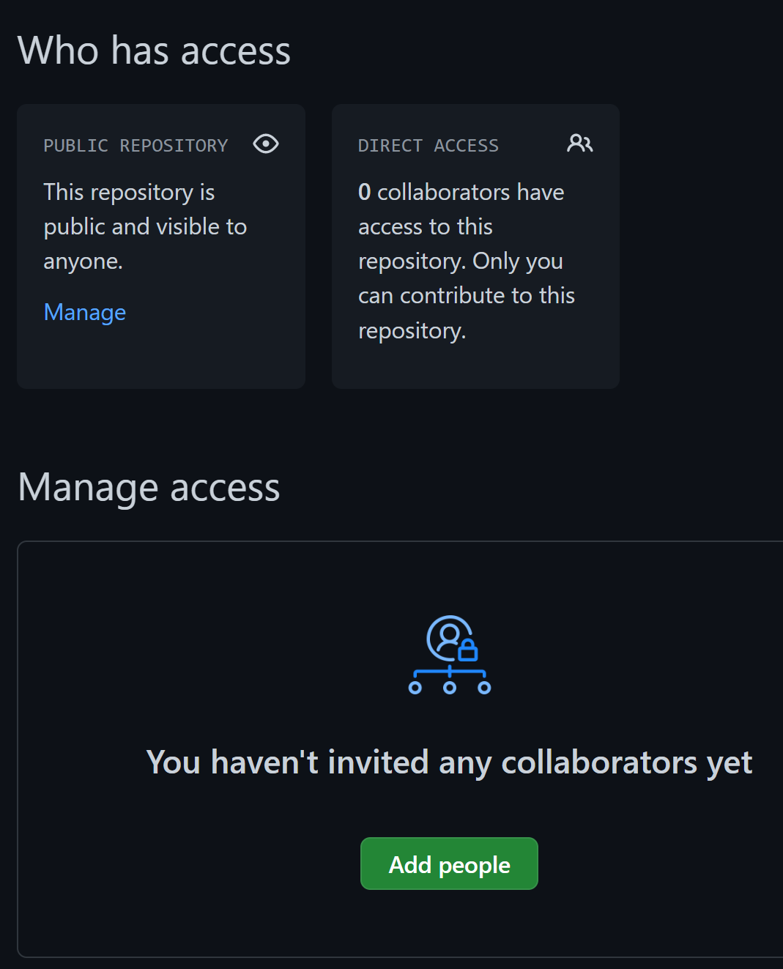
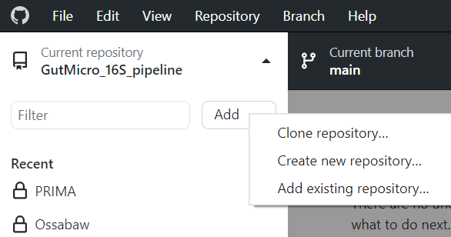
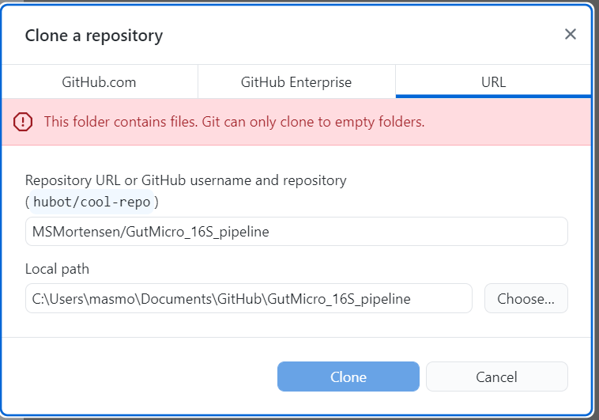
Create
Share
Clone
Notes:
CREATE: Go to github.com, log in, the create a new repository
SHARE: Go to settings, select Collaborators, press Add people, share with me (MSMortensen)
CLONE: Open Github desktop, press ”Current repository”, press ”Add” and select ”Clone repository”, choose the URL option and download ”MSMortensen/GutMicro_16S_pipeline” to a local folder

Slide 9
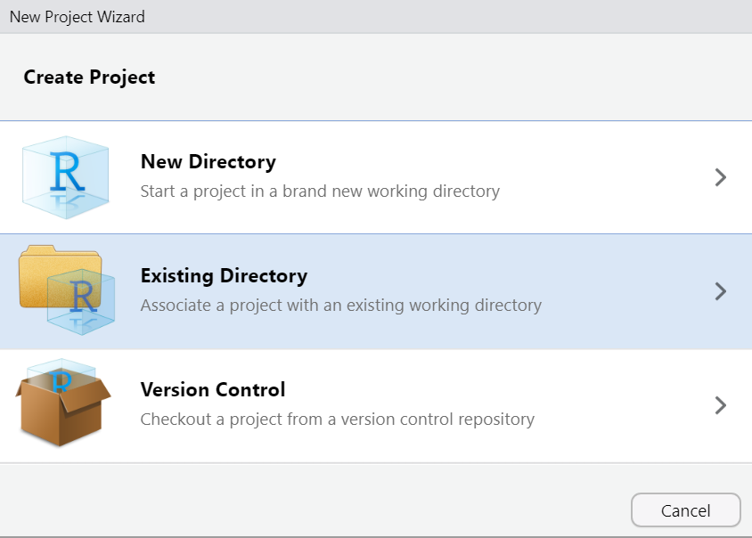
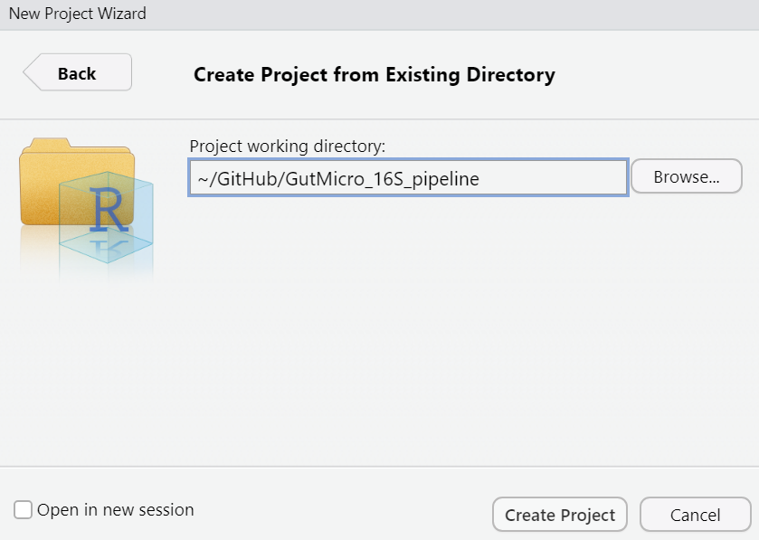
R projects
Projects are linked to folders
Easy to switch between projects
Use the Github repository folder

Slide 10
Notes:
How to

Slide 11
Rmarkdown
Digital ”lab book”
Reuse scripts and code between projects
Increasing number of journals require code with publication
The basics are simple
Especially using visual editor
Rmarkdown contains three types of chunks
YAML header: Defines output and and themes
Markdown text: Written text, formatted using markdown syntax or visual editor
Code chunks: Sections of R code that will be executed
Knitting it together to create a single file
Notes:
Rmarkdown is made and edited using Rstudio.

Slide 12
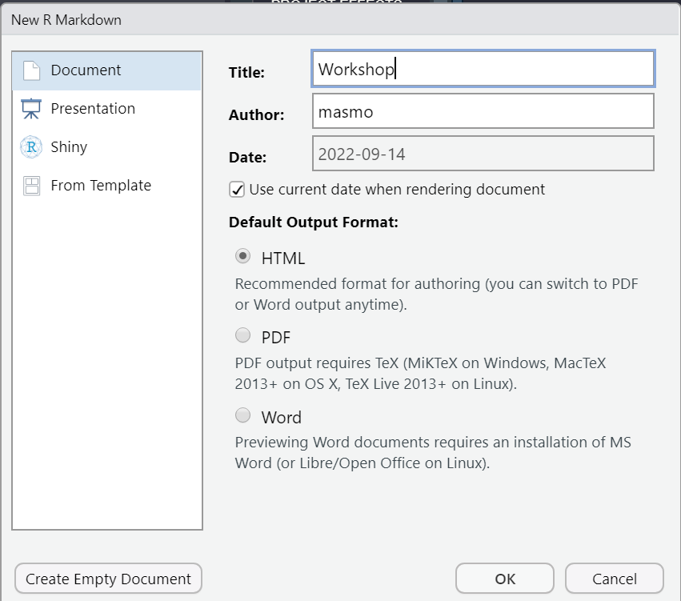
Create a new Rmarkdown file
HTML is the simplest output
Easy to waste time testing formats and templates
If rmdformats is installed, i recommend:
HTML readthedown template
Help
R Markdown Cheat Sheet
R Markdown Reference Guide
All Cheat Sheets

Slide 13
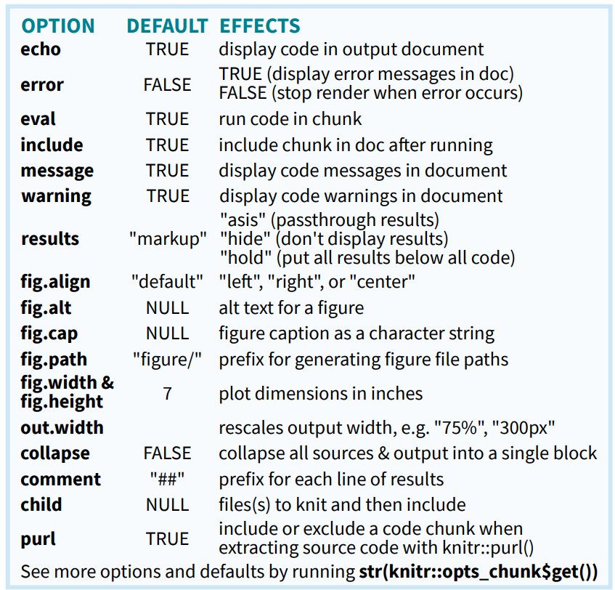
Code options
Code chunks
```{r <NAME>, <OPTIONS>}
summary(mtcars)
```
Chunk settings overwrite default options
Naming chunks makes things easier
Names must be unique
Inline code
Best fuel efficiency in mtcars is `r max(mtcars$mpg)` mpg
Allows mixing code and text

Slide 14
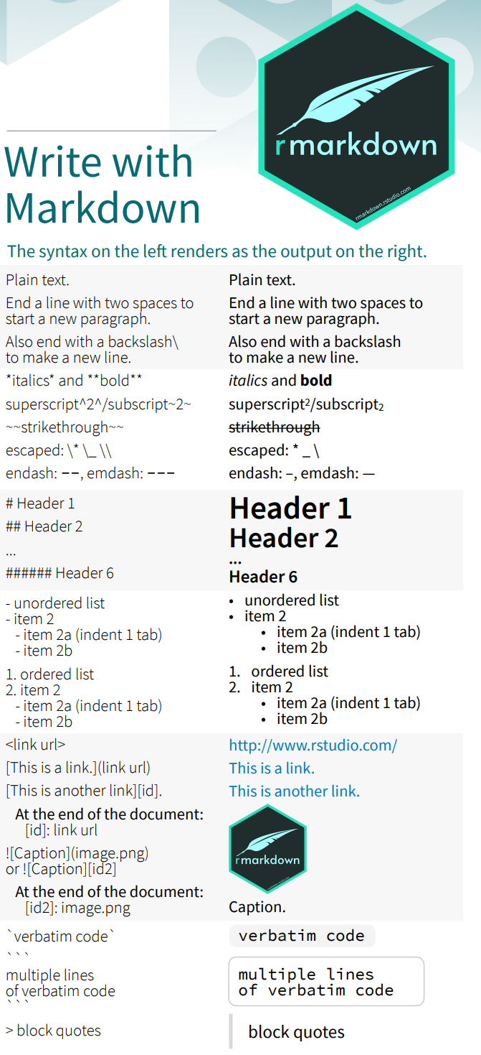
Markdown
Written shortcuts to formatting
Headers are REALLY important
Makes “Outline” panel useful
Editor
Source (coding)
High degree of control
Additional complexity
Visual (almost WYSIWYG)
Easier to begin
Can be less precise

Slide 15
Exercise
TASK
Create Rmarkdown file with:
two headers
Bold and italic text
a data summary/statistics
a plot
Knit to HTML
Commit to Github
Datasets
Use the data() function
mtcars
diamonds
Help
Cheat sheets

Slide 16
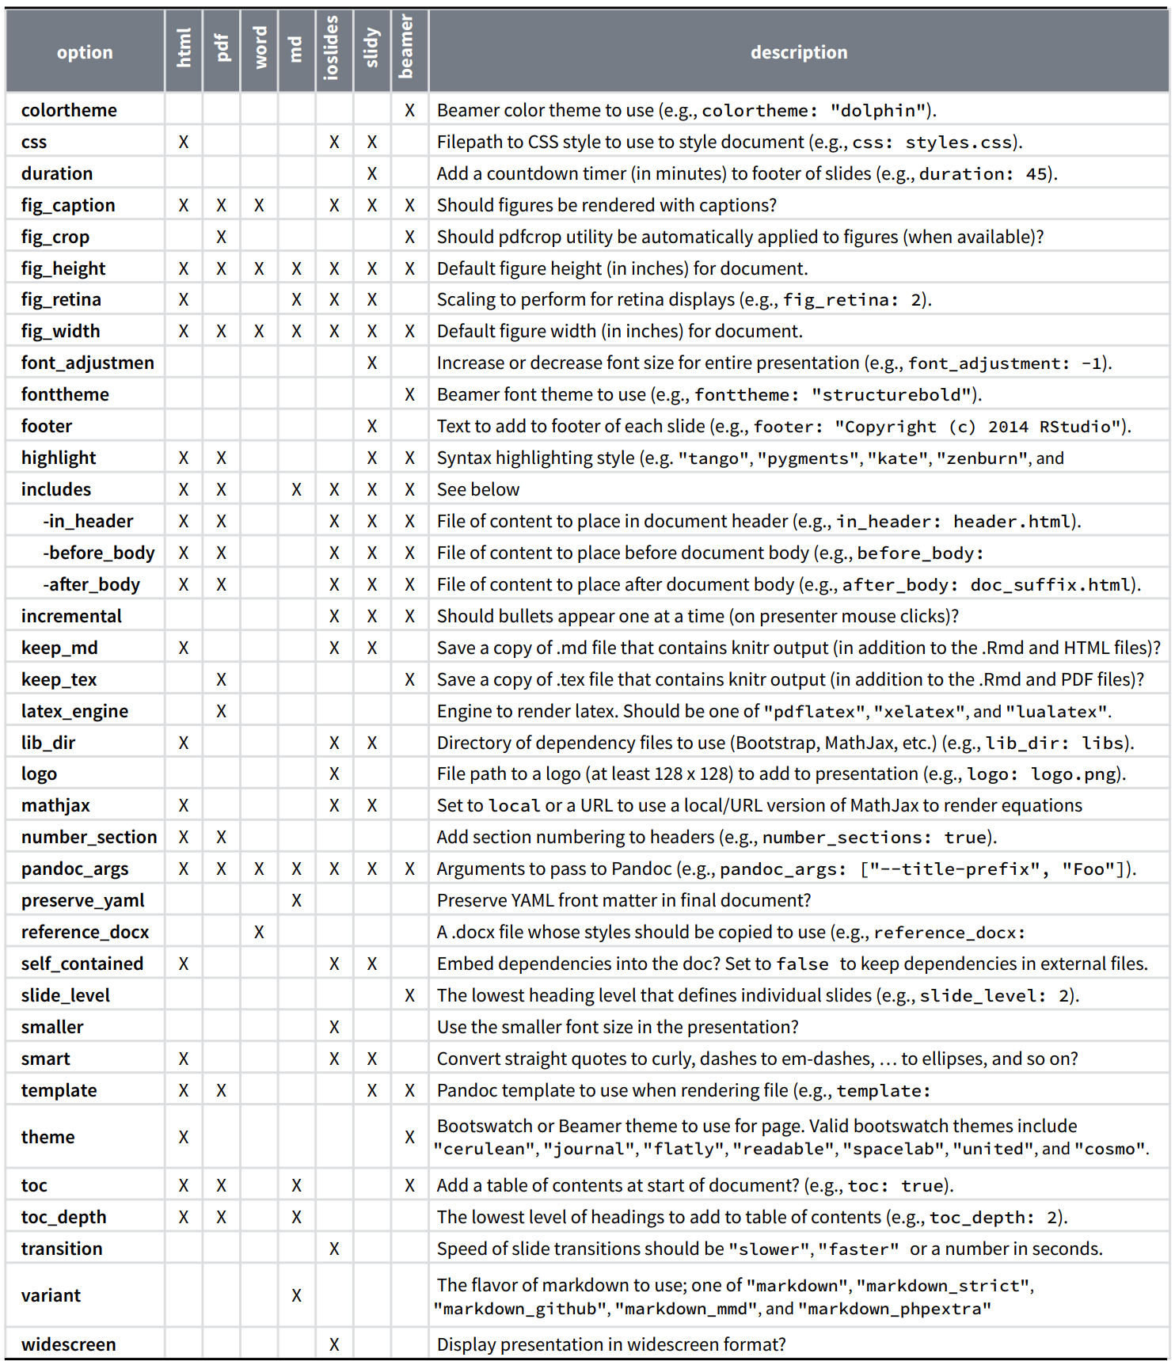
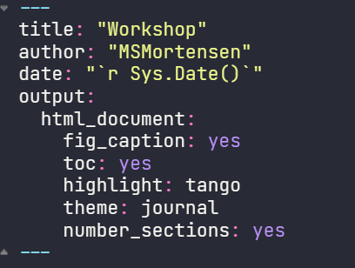
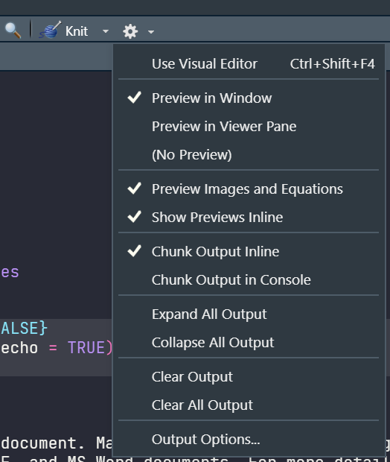
Pandoc options (Header)
Settings for the entire document
Some options can be set in chunks
Template contains necessary settings
Some options can be added automatically

Slide 17
Exercise
TASK
Create Rmarkdown file with:
Multiple levels of headers
Numbered sections
Floating table of content
Collapsed table of content
Knit to HTML
Commit to Github
Datasets
Use the data() function
mtcars
diamonds
Help
Cheat sheets
https://bookdown.org/yihui/rmarkdown/
Section 3.1

Slide 18
Good habits
Load libraries in the setup chunk
After restart this chunk is loaded before any other command
Text
Use text chunks for long explanation
Add code comments within code chunks
Interpret output after code chunk
Headers
Makes everything easier
Can be automatically numbered
Copy code and functions
Write down where it is copied from
Checkpoint code
Save and load Rdat
save(wuf.dist, wuf.nmds, wuf.pcoa, file = "R_objects/WUF.RData")
load("R_objects/WUF.RData")
Save and load RDS
saveRDS(mtcars, file = "mtcars.RDS")
dat <- readRDS("mtcars.RDS")
Clear environment regularly
rm(list = ls(all.names = TRUE))
Exclude something:
rm(list = ls(all.names = TRUE)[ls(all.names = TRUE) != "params"])
invisible(gc())

