Slide 1
WOXSEN UNIVERSITY • DBMS PBL
FINAL REVIEW EVIDENCE
Flask web application
MySQL database
19 relational tables
5 SQL views + 3 triggers
Reports Playground
20 / 20 test cases passed
ROBO-LAB
Final System Demonstration
Working application • Database outputs • Validation • Results
ROBO-LAB • FINAL REVIEW • DBMS PBL
1

Slide 2
01 — WORKING PROTOTYPE
Application workflow
The final system connects the user interface to the relational database and exposes the main laboratory workflows.
AUTHENTICATION
Login / registration
Role-aware session
Admin, Lab Technician, Faculty, Student
Database: USERS + ROLES
OPERATIONS
Equipment
Components
Projects
Bookings
Allocations / Returns
Maintenance / Calibration
Procurement
DATABASE OUTPUT
Live inventory
Status changes
Stock changes
Reports
Notifications
Audit / timeline data
ROBO-LAB • FINAL REVIEW • DBMS PBL
2

Slide 3
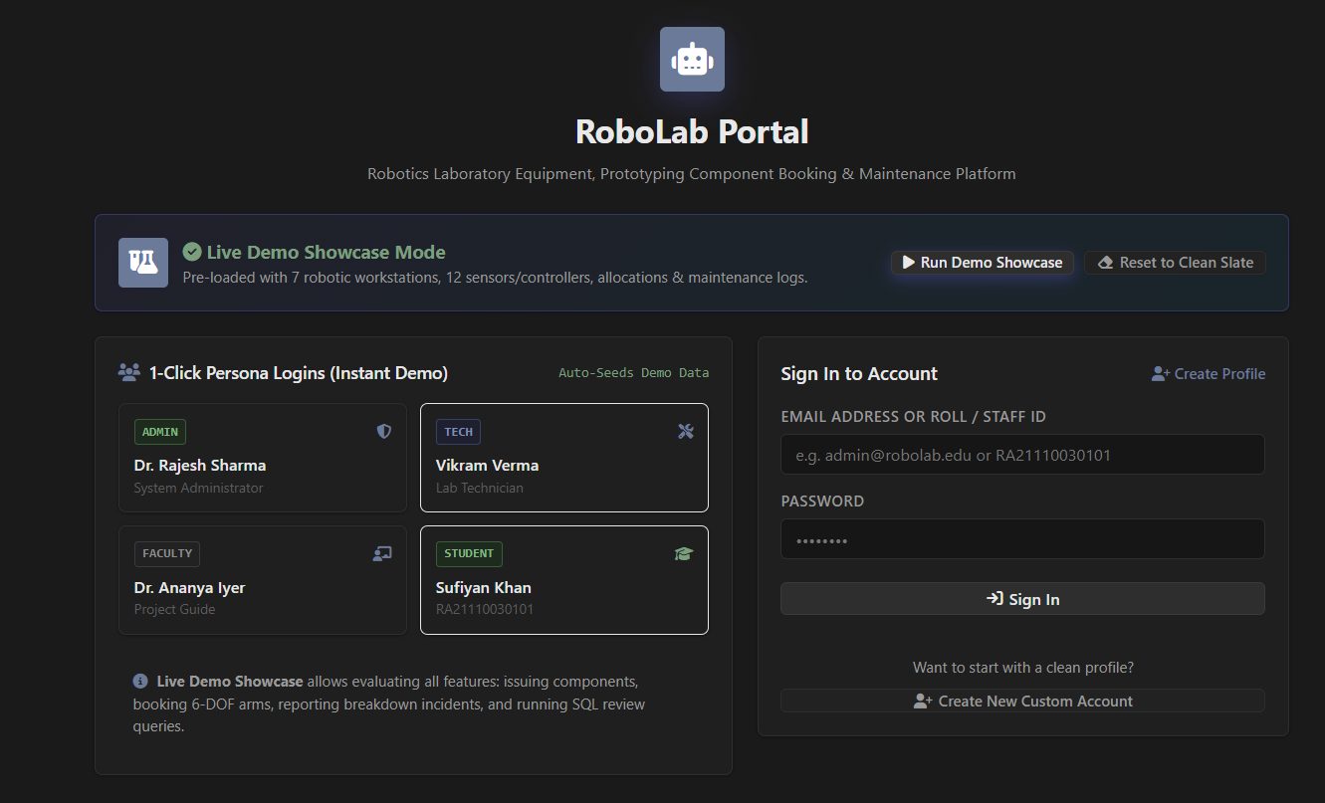
02 — APPLICATION EVIDENCE
Login and role-based access
Running Flask application — login, demo personas and role-aware access.
Figure 2 — Login / role-selection screen
ROBO-LAB • FINAL REVIEW • DBMS PBL
3

Slide 4
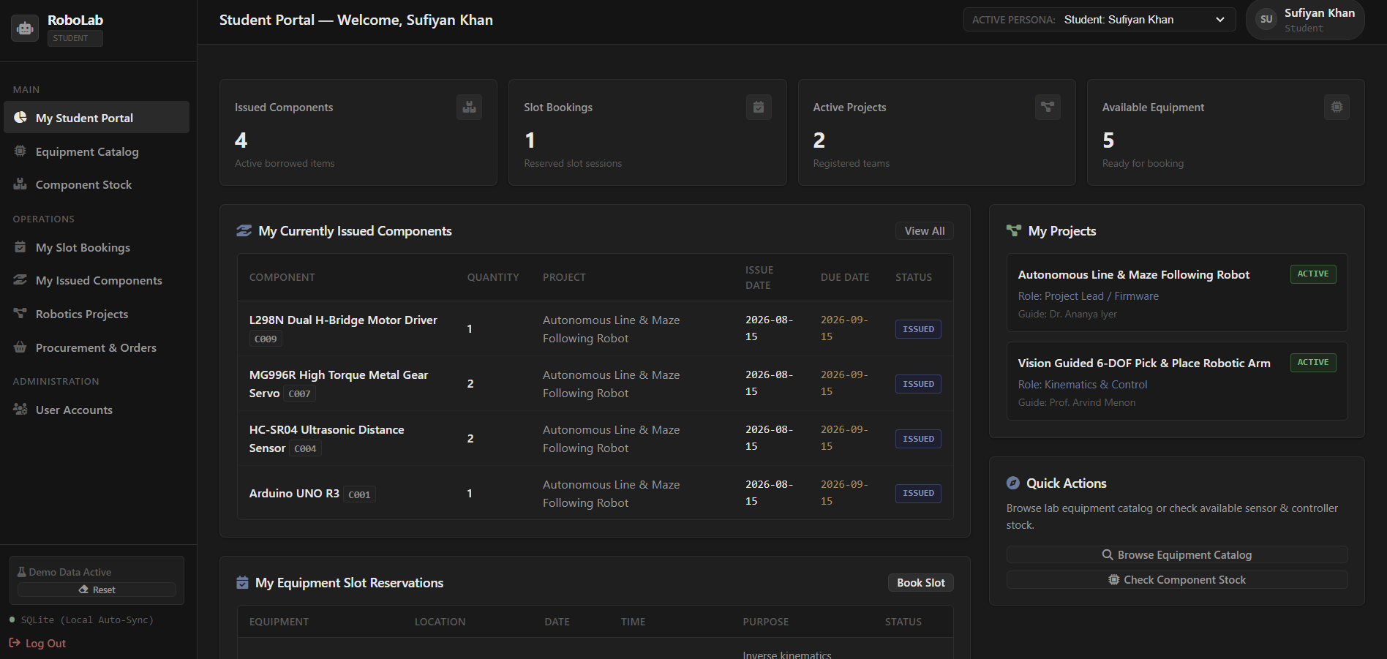
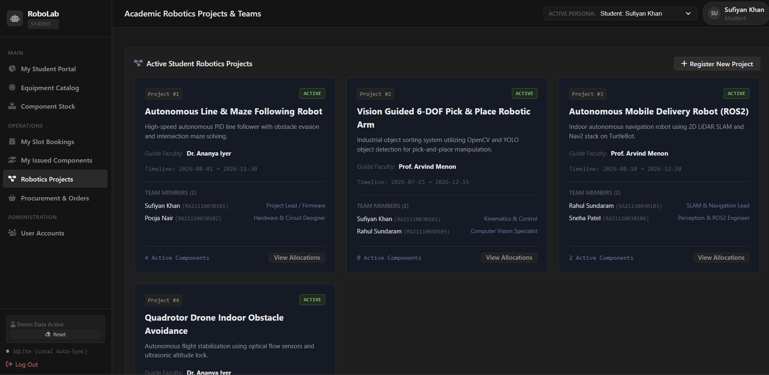
03 — APPLICATION EVIDENCE
Role-tailored dashboard
Dashboard and project-management evidence from the running prototype.
Figure 3 — Student portal dashboard and academic robotics projects module
ROBO-LAB • FINAL REVIEW • DBMS PBL
4

Slide 5
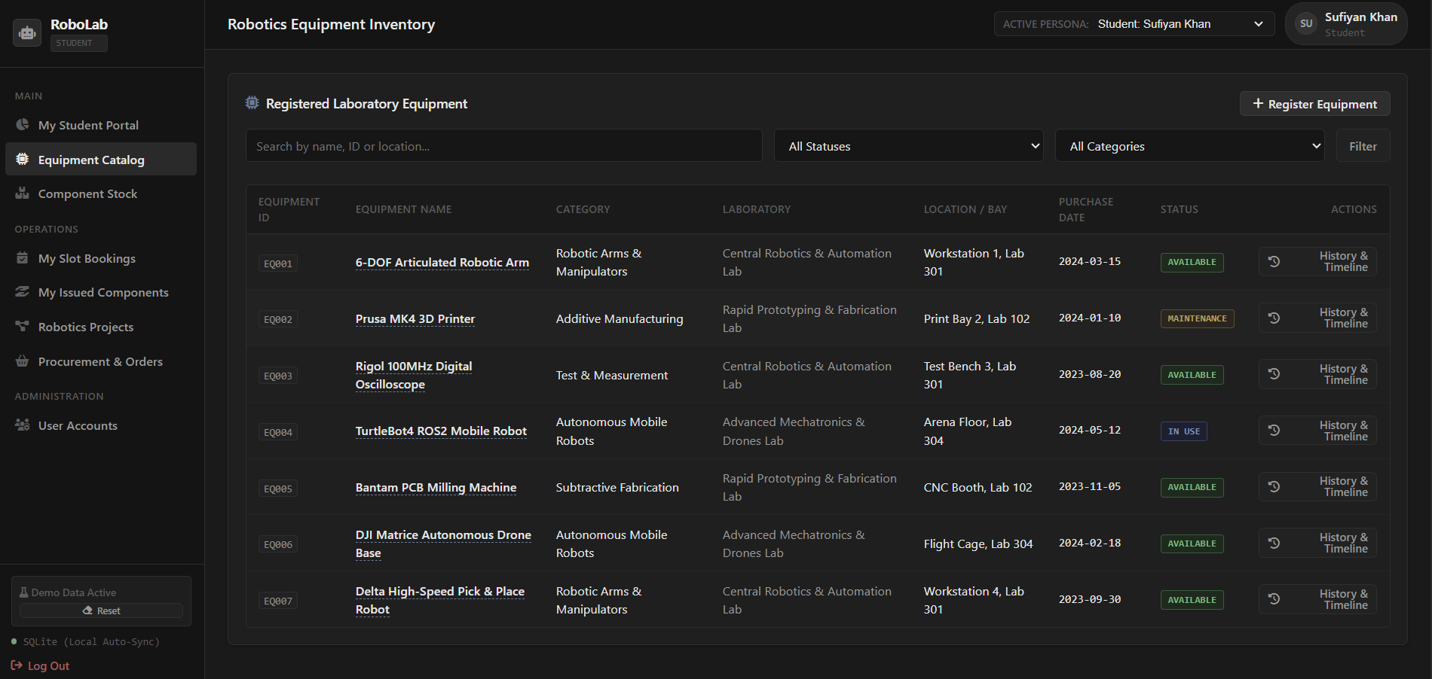
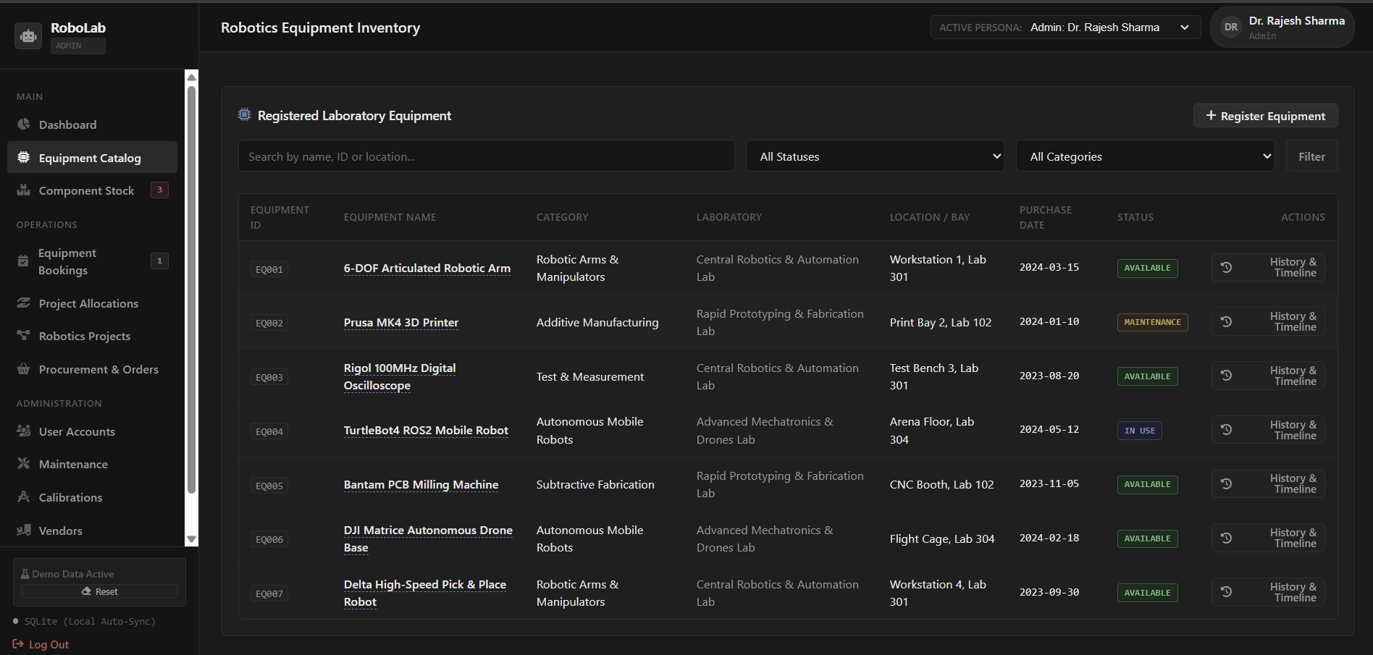
04 — APPLICATION EVIDENCE
Equipment catalogue and filtering
The equipment catalogue is exposed with role-specific navigation and controls.
Figure 4 — Student and Admin equipment catalogue views
ROBO-LAB • FINAL REVIEW • DBMS PBL
5

Slide 6
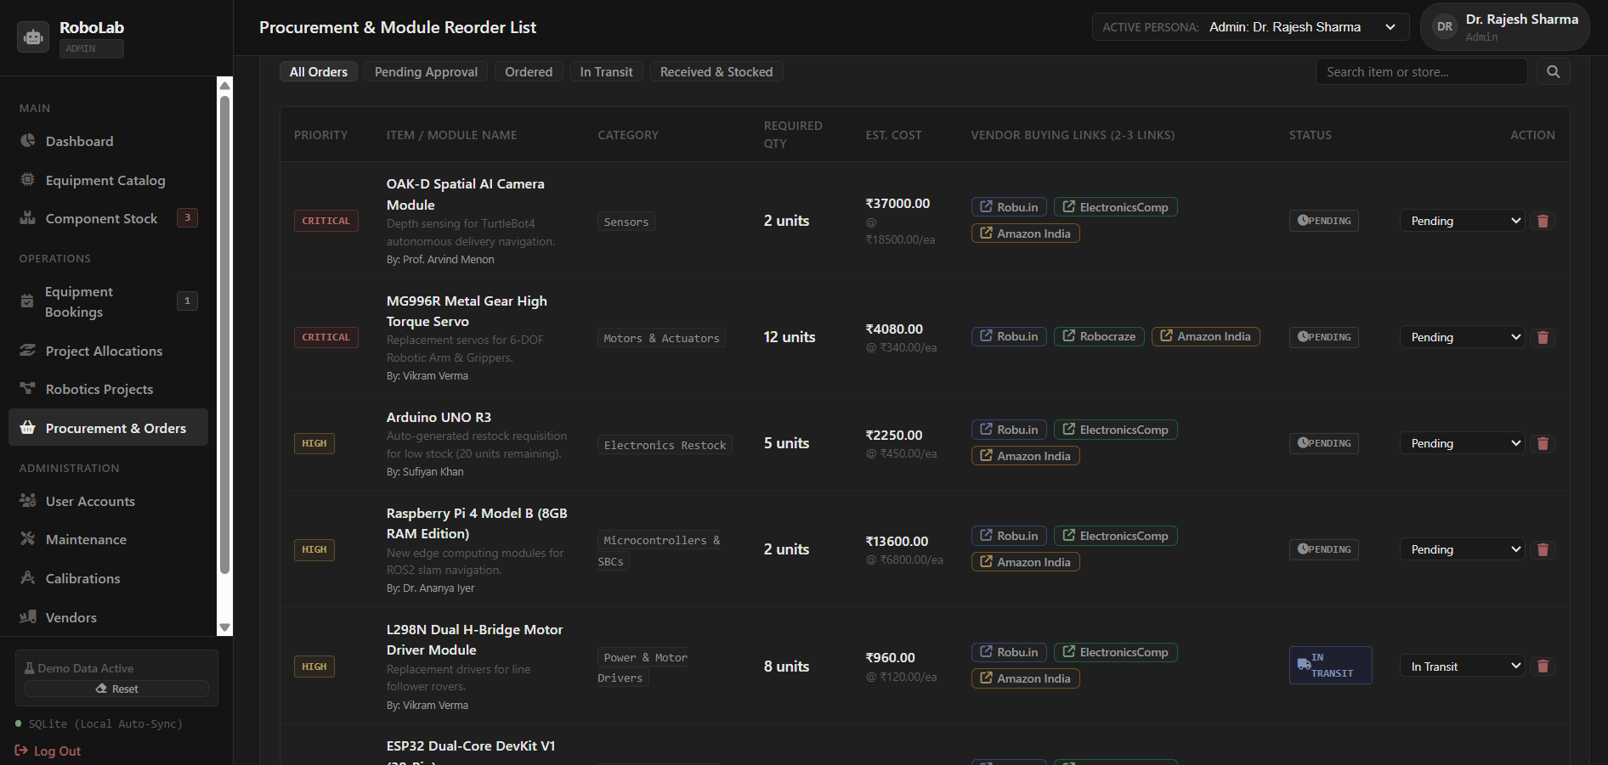
05 — APPLICATION EVIDENCE
Procurement and module reorder workflow
The available screenshot shows procurement, replenishment priority, quantities, cost estimates, vendors and order status.
Application evidence — Procurement & Module Reorder List
ROBO-LAB • FINAL REVIEW • DBMS PBL
6

Slide 7
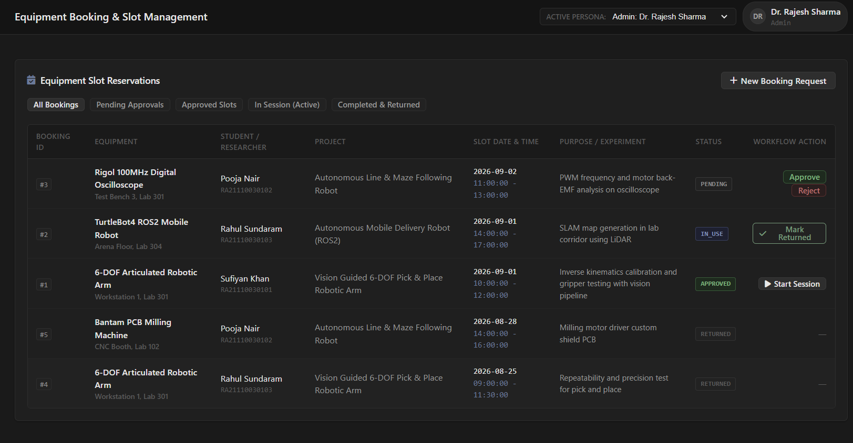
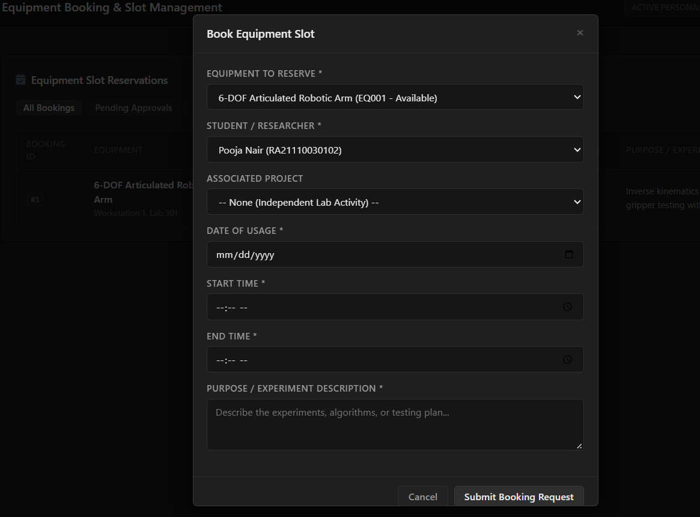
06 — APPLICATION EVIDENCE
Booking and approval workflow
Booking requests, approval states and the booking form are demonstrated in the live application.
Figure 6 — Booking list and booking-request form
ROBO-LAB • FINAL REVIEW • DBMS PBL
7

Slide 8
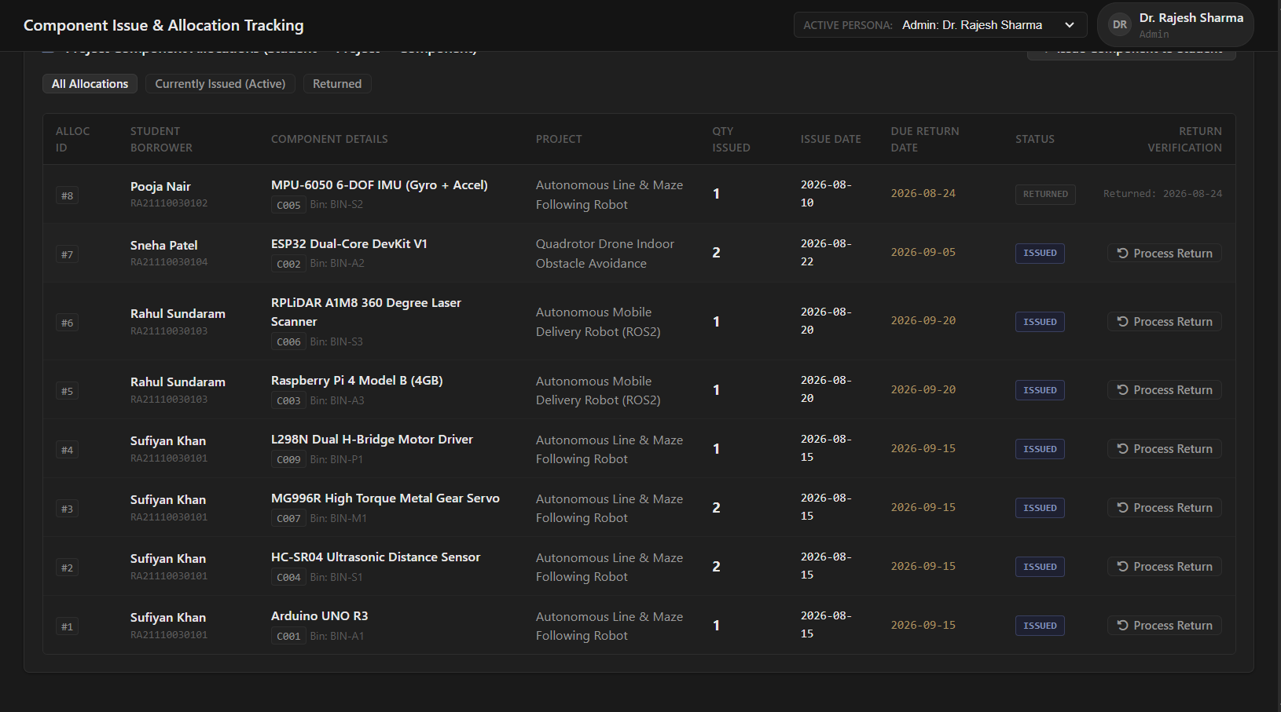
07 — APPLICATION EVIDENCE
Component issue and return
Issued quantities, borrowers, projects, due dates and return verification are visible in the allocation module.
Figure 7 — Component issue and return tracking
ROBO-LAB • FINAL REVIEW • DBMS PBL
8

Slide 9
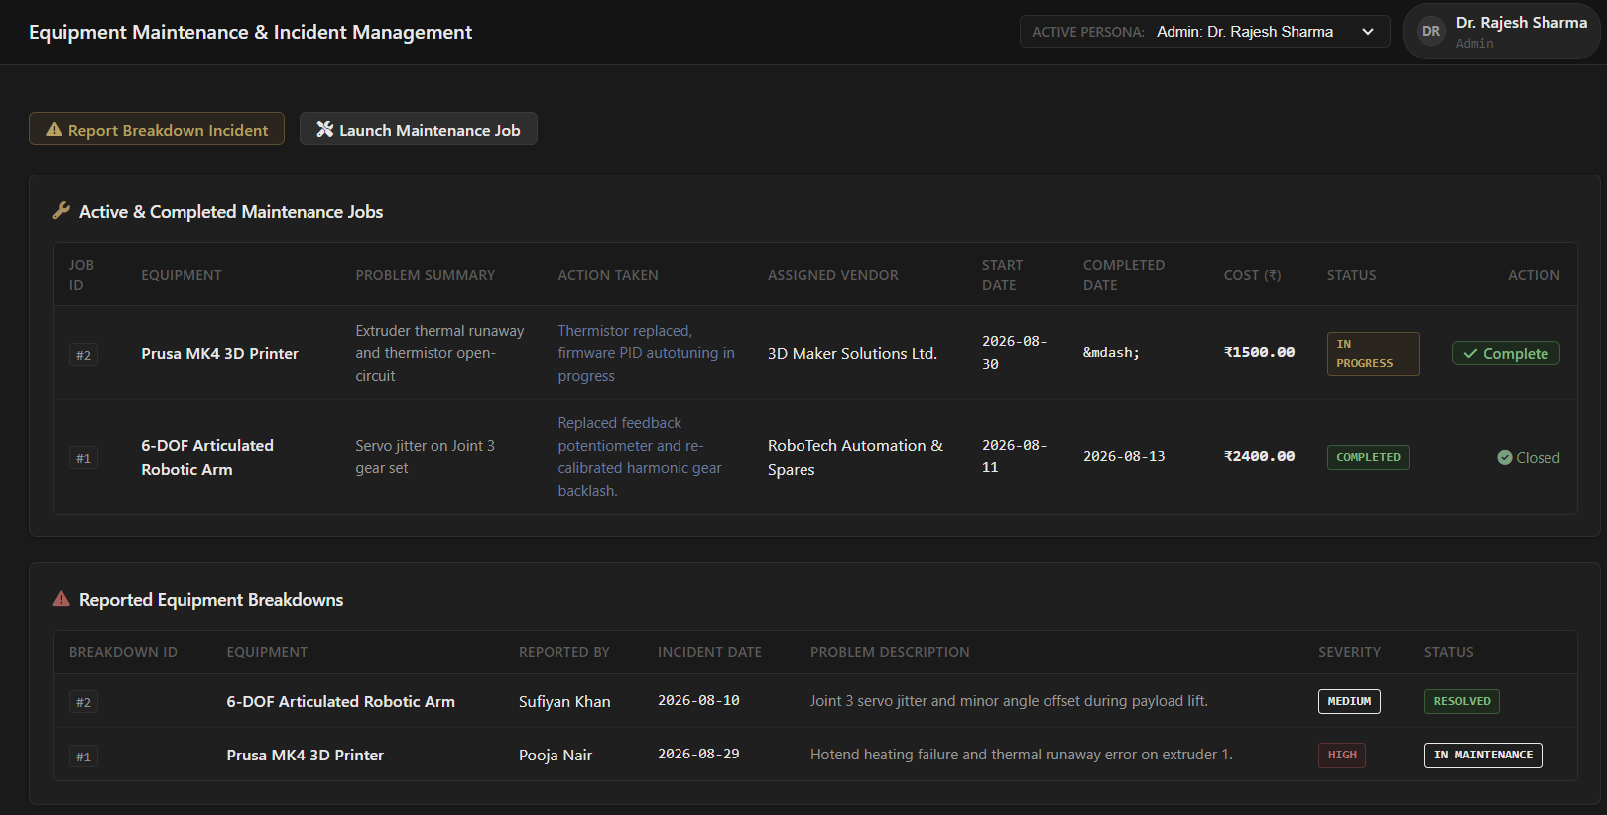
08 — APPLICATION EVIDENCE
Maintenance and breakdown workflow
Maintenance status, vendor, cost, incident severity and resolution state are demonstrated.
Figure 8 — Maintenance jobs and reported breakdowns
ROBO-LAB • FINAL REVIEW • DBMS PBL
9

Slide 10
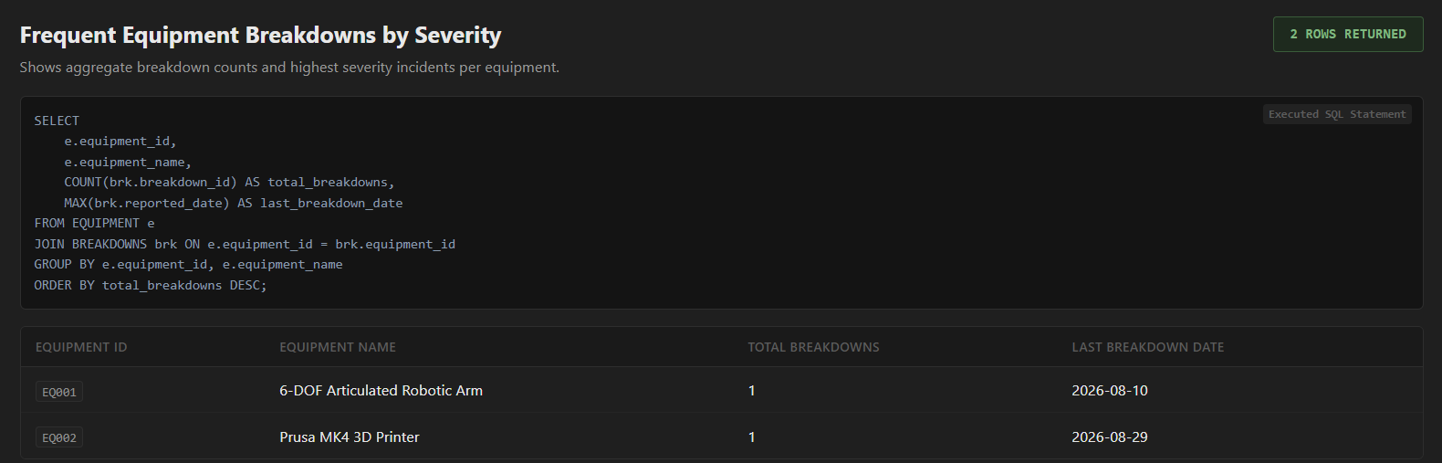
09 — REPORTS PLAYGROUND
SQL output and analytical reporting
The Reports Playground executes predefined SQL reports using JOINs, GROUP BY, HAVING, subqueries and aggregation.
AVAILABLE REPORTS
R-01 Available Equipment
R-02 Current Component Allocations
R-03 Low Stock & Inventory Shortage
R-04 Maintenance & Repair History
MORE ANALYTICS
R-05 Equipment Utilization
R-06 Component Value per Project
R-07 Breakdown Frequency
R-08 Calibration Audit
Figure 9 — Reports Playground
ROBO-LAB • FINAL REVIEW • DBMS PBL
10

Slide 11
10 — DATABASE OUTPUT
Representative SQL report outputs
These outputs are based on the report's seed-data examples; actual values can vary with database state.
ID | EQUIPMENT | CATEGORY | STATUS
EQ005 | Bantam PCB Milling Machine | Subtractive Fabrication | Available
EQ006 | DJI Matrice Autonomous Drone Base | Autonomous Mobile Robots | Available
EQ001 | 6-DOF Articulated Robotic Arm | Robotic Arms & Manipulators | Available
EQ003 | Rigol 100MHz Digital Oscilloscope | Test & Measurement | Available
EQ007 | Delta High-Speed Pick & Place Robot | Robotic Arms & Manipulators | Available
LOW-STOCK OUTPUT
C010: OAK-D Spatial AI Camera Module — available 1 / minimum 2 / shortage 1. C005 and C006 are at their minimum threshold.
ROBO-LAB • FINAL REVIEW • DBMS PBL
11

Slide 12
11 — LIVE DATABASE RULE
Trigger verification: component allocation
The report defines trg_after_allocation_insert to decrement available_quantity after an allocation is inserted.
BEFORE ALLOCATION
C001
available_quantity = 20
TRANSACTION
Allocate 3 units
EQUIPMENT_ALLOCATION
component_id = C001
AFTER TRIGGER
C001
available_quantity = 17
− 3
→
VERIFICATION RESULT
The allocation trigger automatically decreases available stock by the issued quantity.
ROBO-LAB • FINAL REVIEW • DBMS PBL
12

Slide 13
12 — BUSINESS RULE VALIDATION
The system accepts valid transactions and rejects invalid ones
Selected tests demonstrate database constraints, application validation and role-based restrictions.
TEST | ACTION | OBSERVED RESULT | STATUS
TC-01 | Valid equipment registration | Record created | PASS
TC-02 | Duplicate serial | Duplicate rejected | PASS
TC-04 | Allocate 25 when 20 available | Insufficient stock rejected | PASS
TC-06 | Faculty approves booking | Status → APPROVED | PASS
TC-10 | High/Critical breakdown | Equipment → Maintenance | PASS
TC-12 | Maintenance completed | Equipment → Available | PASS
TC-15 | Admin deletes own account | Operation prevented | PASS
TC-16 | Student adds equipment | Unauthorized operation prevented | PASS
TC-20 | Requisition received | C001 stock +10 | PASS
ROBO-LAB • FINAL REVIEW • DBMS PBL
13

Slide 14
13 — TEST SUMMARY
20 / 20 test cases passed
The completed validation demonstrates that the application correctly uses the designed database and enforces the documented business rules.
DATABASE OPERATIONS
Equipment registration
Component allocation / return
Bookings and approvals
Maintenance transitions
Procurement stock updates
Reports
RULE ENFORCEMENT
Duplicate prevention
Stock validation
Role restrictions
Equipment status transitions
Low-stock detection
Requisition quantity updates
RESULT
20 / 20 PASS
Valid operations completed successfully.
Invalid operations were rejected according to the defined rules.
ROBO-LAB • FINAL REVIEW • DBMS PBL
14

Slide 15
14 — FINAL CONCLUSION
ROBO-LAB: database-backed laboratory resource management
The final prototype connects the conceptual design, relational implementation and application workflows into one demonstrable system.
DESIGN
19 entities
19 relational tables
3NF normalization
PK / FK relationships
Defined business rules
IMPLEMENTATION
MySQL
5 views
3 triggers
10 analytical SQL queries
Python Flask application
EVIDENCE
Application workflow
SQL report outputs
Trigger verification
Business-rule validation
20 / 20 test cases passed
NEXT: LIVE DEMO → LOGIN → CRUD → RULE REJECTION → REPORTS
ROBO-LAB • FINAL REVIEW • DBMS PBL
15

