Slide 1
An Introduction to A/B Testing
Benjamin W. Sturm
bwsturm@gmail.com
June 8, 2018

Slide 2
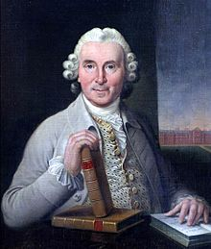
Introduction
One of the first controlled experiments was done in the 1700s
Dr. James Lind, a Scottish physician, believed that scurvy among sailors could be treated with citrus fruits
He suggested to Captain James Cook to give half his sailors lemons and limes and the other half their regular diet
James Lind

Slide 3
Some 300 years later…
Greg Linden at Amazon created a prototype to show personalized recommendations based on items in the shopping cart
However, a marketing senior VP didn’t like the idea claiming it will distract people from checking out and Greg was ”forbidden to work on this any further”
Despite this, Greg ran a controlled experiment and he demonstrated that the feature improved sales by such a wide margin that not having it live was hurting business
With new urgency, shopping cart recommendations launched at Amazon, and many other online shopping sites followed suit

Slide 4
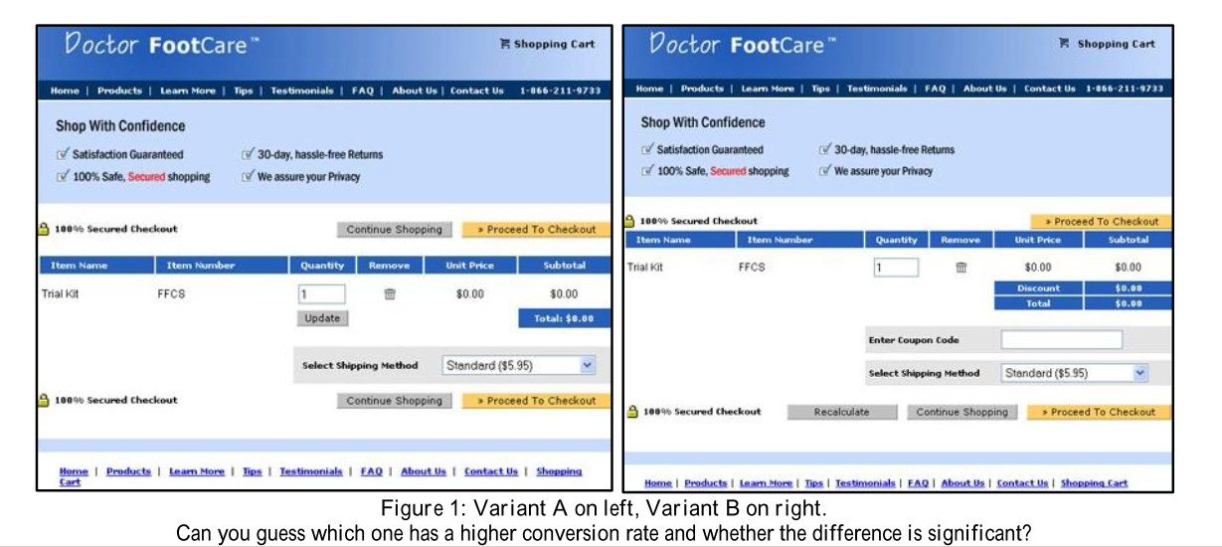
A motivating example
Notes:
For the Doctor FootCare checkout page, variant A in Figure 1 outperformed variant B by an order of magnitude. In reality, the site ―upgraded‖ from the A to B and lost 90% of their revenue. Most of the changes in the upgrade were positive, but the coupon code was the critical one: people started to think twice about whether they were paying too much because there are discount coupons out there that they do not have. By removing the discount code from the new version (B), conversion-rate increased 6.5% relative to the old version (A)

Slide 5
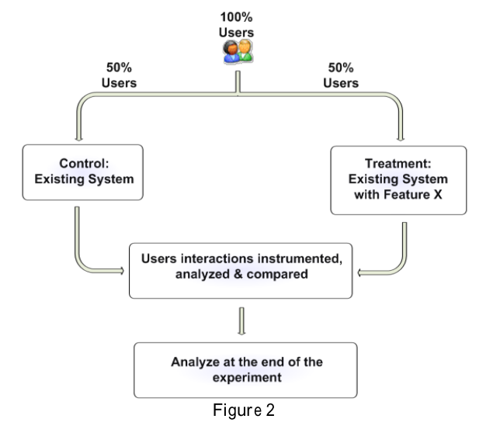
How do you implement an A/B test?
For the simplest case, users are randomly exposed to one of two variants
The Control, which is usually the existing version
The Treatment, which is usually a new version being evaluated
Based on observations collected, an Overall Evaluation Criterion (OEC) is derived for each variant
OEC can be the conversion rate, units purchased, revenue, profit, expected lifetime value, or some weighted combination of these

Slide 6
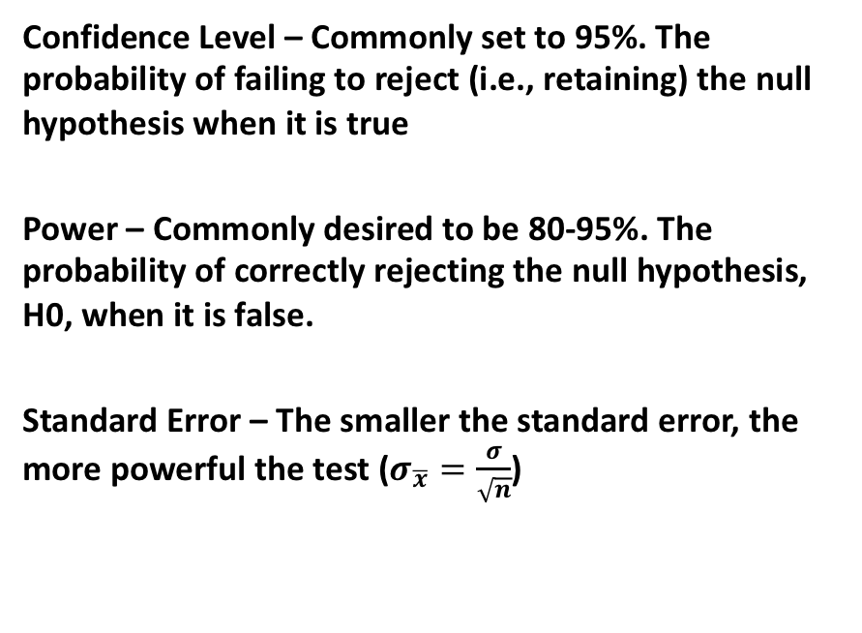
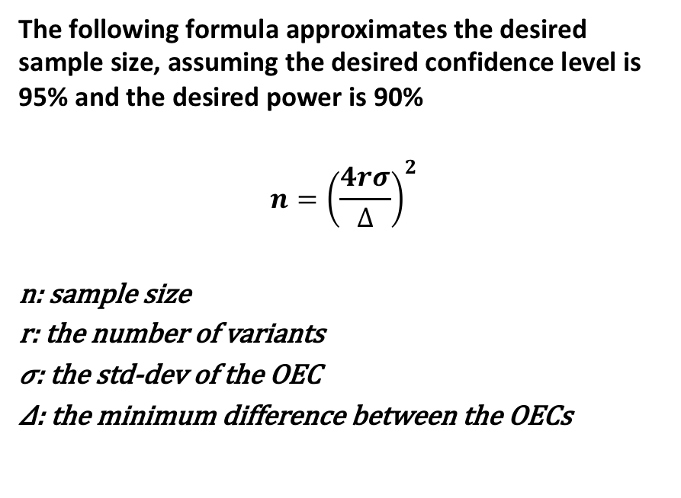
Why sample size is important
Hypothesis Testing Terminology
A Useful Equation
Confidence Level – Commonly set to 95%. ﻿The probability of failing to reject (i.e., retaining) the null hypothesis when it is true
Power – Commonly desired to be 80-95%. ﻿The probability of correctly rejecting the null hypothesis, H0, when it is false.
Standard Error – The smaller the standard error, the more powerful the test ($σ_{\overline{x}}=\frac{σ}{\sqrt{n}}$)
The following formula approximates the desired sample size, assuming the desired confidence level is 95% and the desired power is 90%
$${n=\left(\frac{4rσ}{∆}\right)}^{2}$$
n: sample size
r: the number of variants
𝜎: the std-dev of the OEC
𝛥: the minimum difference between the OECs
Notes:
Power measures our ability to detect a difference when it indeed exists.

Slide 7
An example
﻿Suppose you have an e-commerce site and 5% of users who visit during the experiment period end up purchasing. Those purchasing spend about $75. The average user therefore spends $3.75 (95% spend $0). Assume the standard deviation is $30. If you are running an A/B test and want to detect a 5% change to revenue, you will need over 1.6 million users to achieve the desired 90% power, based on the previous formula: 4 ∙ 2 ⋅ 30 / (3.75 ⋅ 0.05) ²

Slide 8
Other considerations
Treatment Ramp-Up
You might start with a 99.9%/0.1% split, then ramp up the Treatment from 0.1% to 0.5% to 2.5% to 10% to 50%
Run Continuous A/A Tests
﻿An A/A test can be used to test the experimentation system (the Null hypothesis should be rejected about 5% of the time when a 95% confidence level is used)
Randomization Algorithm
A good randomization algorithm is critical because the statistics of controlled experiments assume that each variant of the experiment has a random sample of users
Users must be equally likely to see each variant of an experiment (assuming a 50-50 split)
Repeat assignments of a single user must be consistent
When multiple experiments are run concurrently, there must be no correlation between experiments

Slide 9
An Awesome Reference
R. Kohavi, R. M. R. Henne, and D. Sommerfield, “Practical guide to controlled experiments on the web,” Proc. 13th ACM SIGKDD Int. Conf. Knowl. Discov. data Min. - KDD ’07, vol. 2007, pp. 959–967, 2007.

