Slide 1

Super Bike in NYC
Abed, Owen, Ben, Filippo

Slide 2
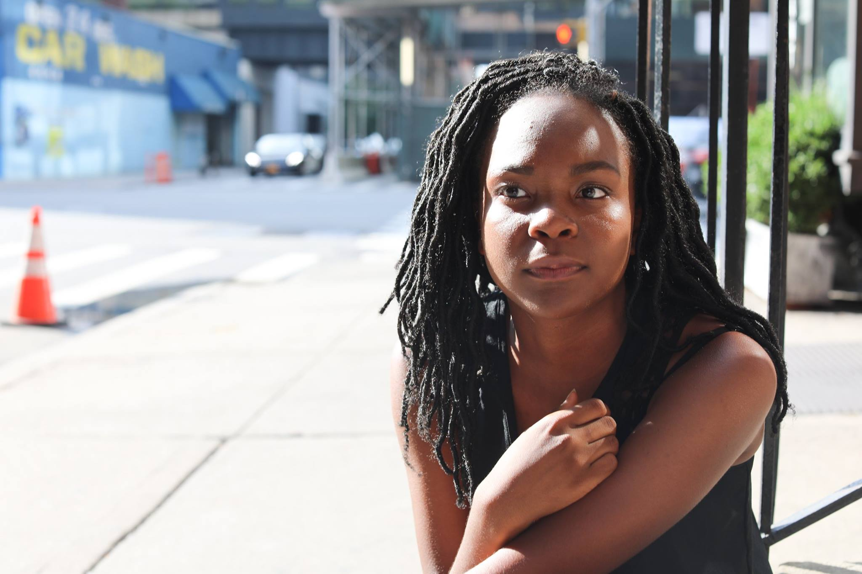

Slide 3
Agenda
Motivation
Proposal
Findings
Next Steps

Slide 4
Motivation
24 % of adult New Yorkers (1.6M) ride a bike at least once a year
460k cycling trips/day
MTA opportunities!
**http://www.nyc.gov/html/dot/downloads/pdf/cycling-in-the-city.pdf

Slide 5
Proposal
Efficiently allocate bikes throughout the city
Increase customer satisfaction
Support Super Bike’s mission encouraging public transit use

Slide 6
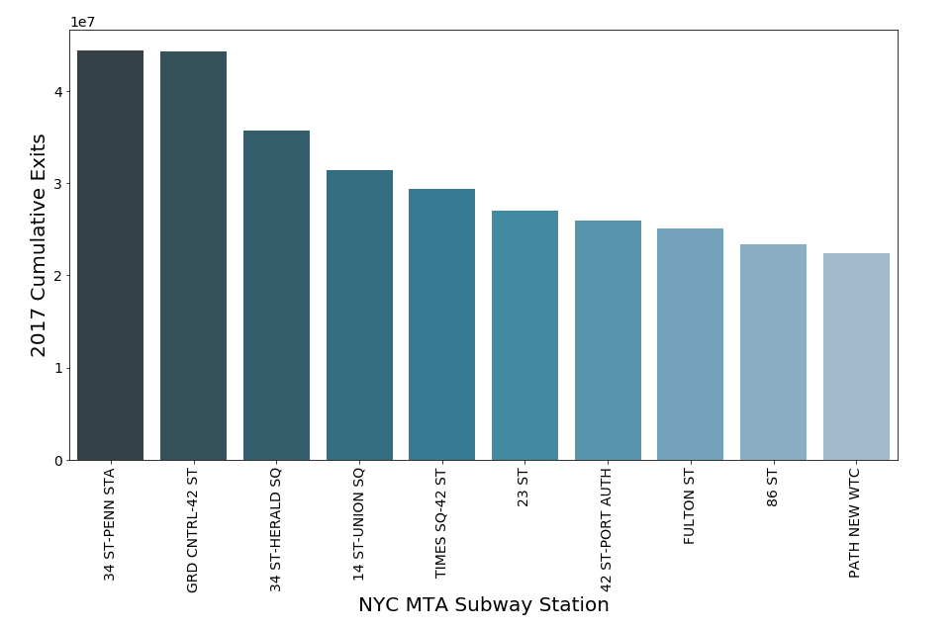
Findings I – Penn Station/34 St Highest Exits

Slide 7
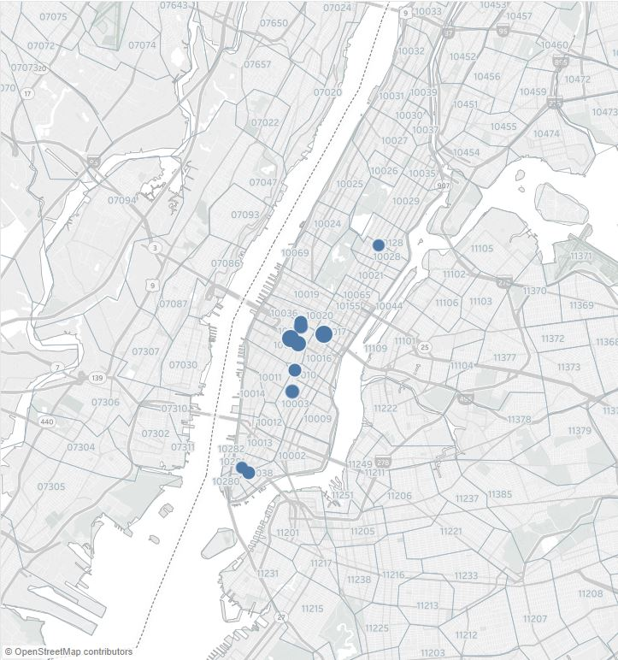
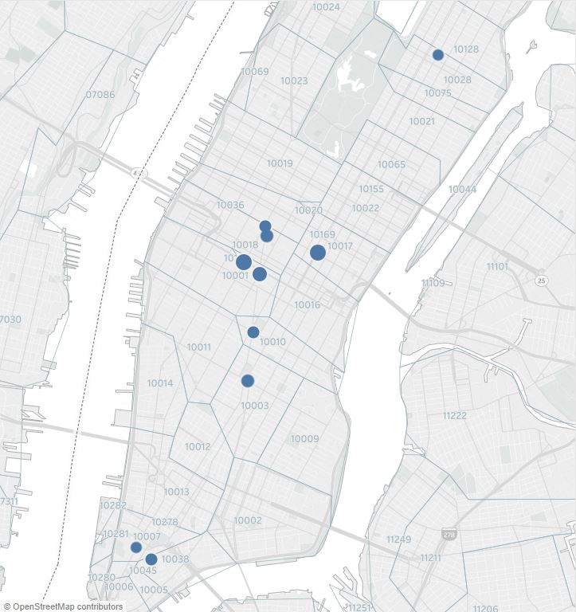
Findings II – Highest Density through Manhattan

Slide 8
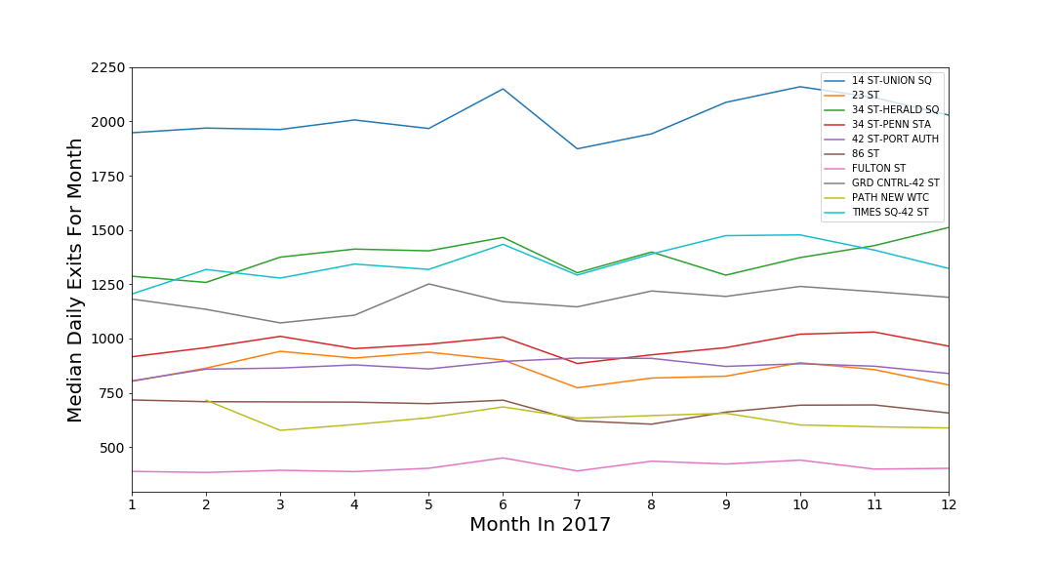
Findings III – Consistent Ridership

Slide 9
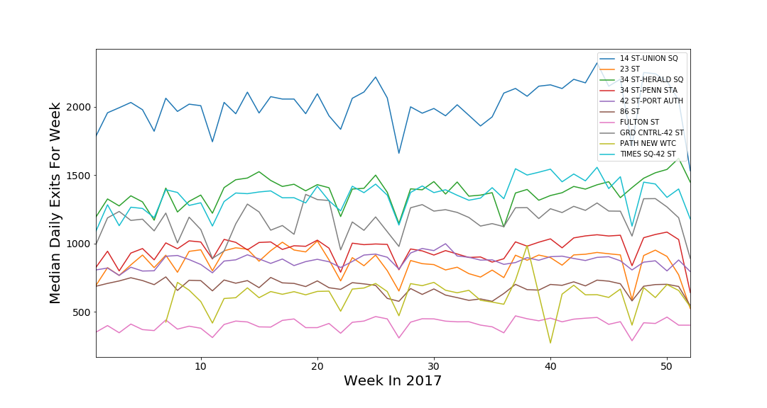
Findings III – Consistent Ridership

Slide 10
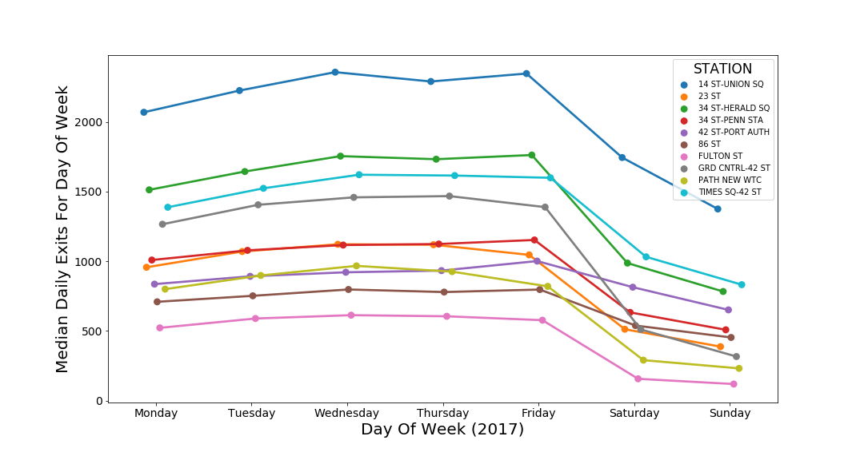
Findings IV – Target Commuters

Slide 11
Next Steps
Incorporate Citi & Super Bike ridership data
Evaluate station cluster density
Add public park usage data

