Slide 1
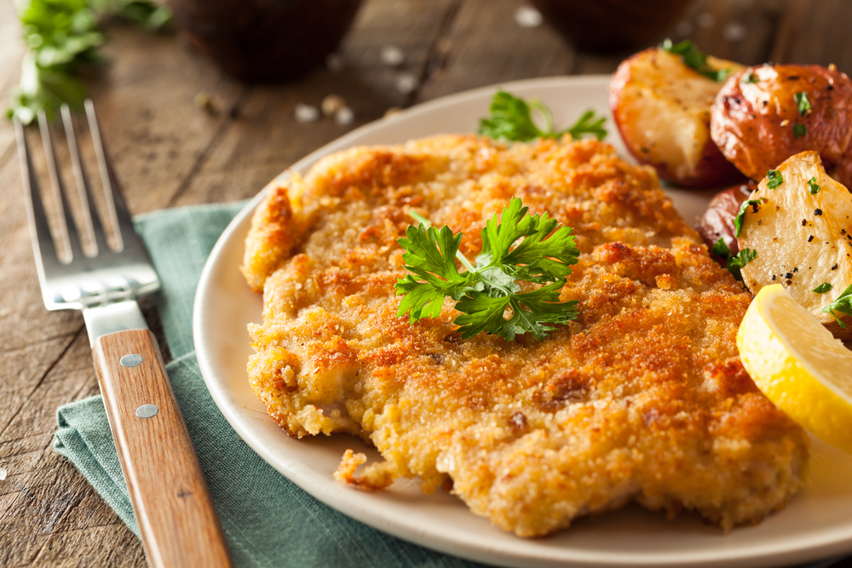
An Examination of Recipes from Around the World
Benjamin W. Sturm
bwsturm@gmail.com
June 1, 2018

Slide 2
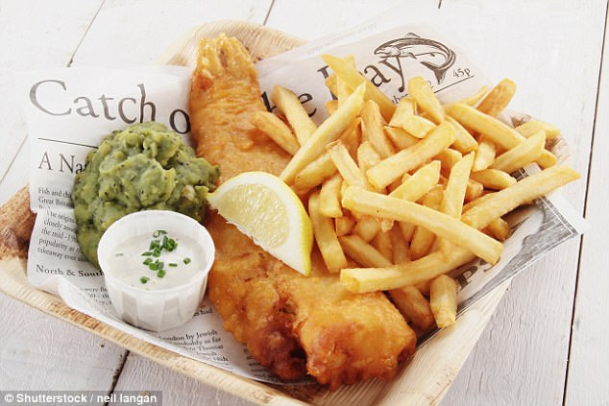
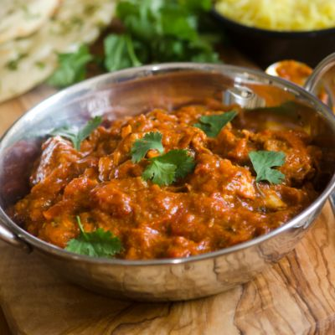
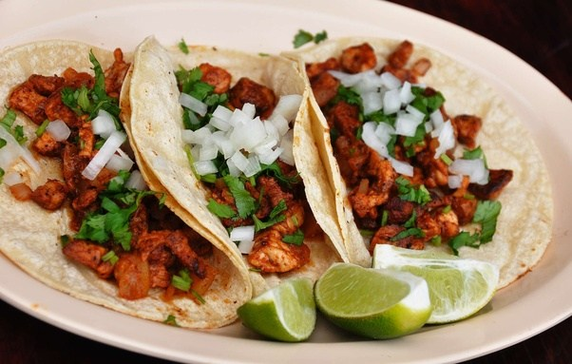
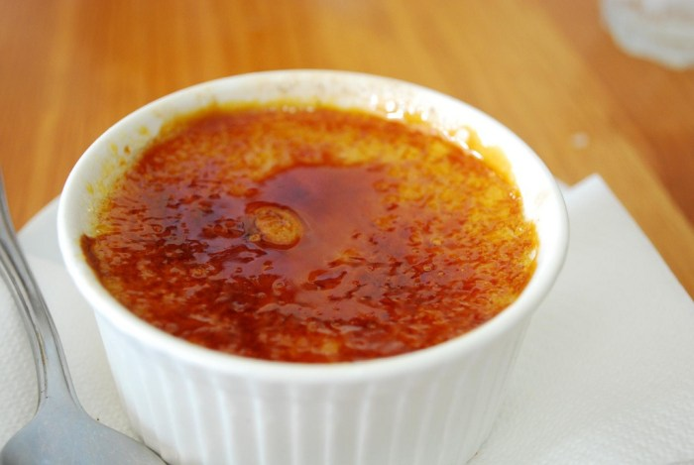
The goal of my project was to use data science to gain insights of cuisines from around the world.
Questions I wanted to explore:
Spicy chicken curry
Which cuisines are most similar and which are most different?
Are there any unexpected relationships?
Can we use topic modeling to separate out different cuisines?
Fish and chips
savory
Tacos
Crème brulle
spicy

Slide 3
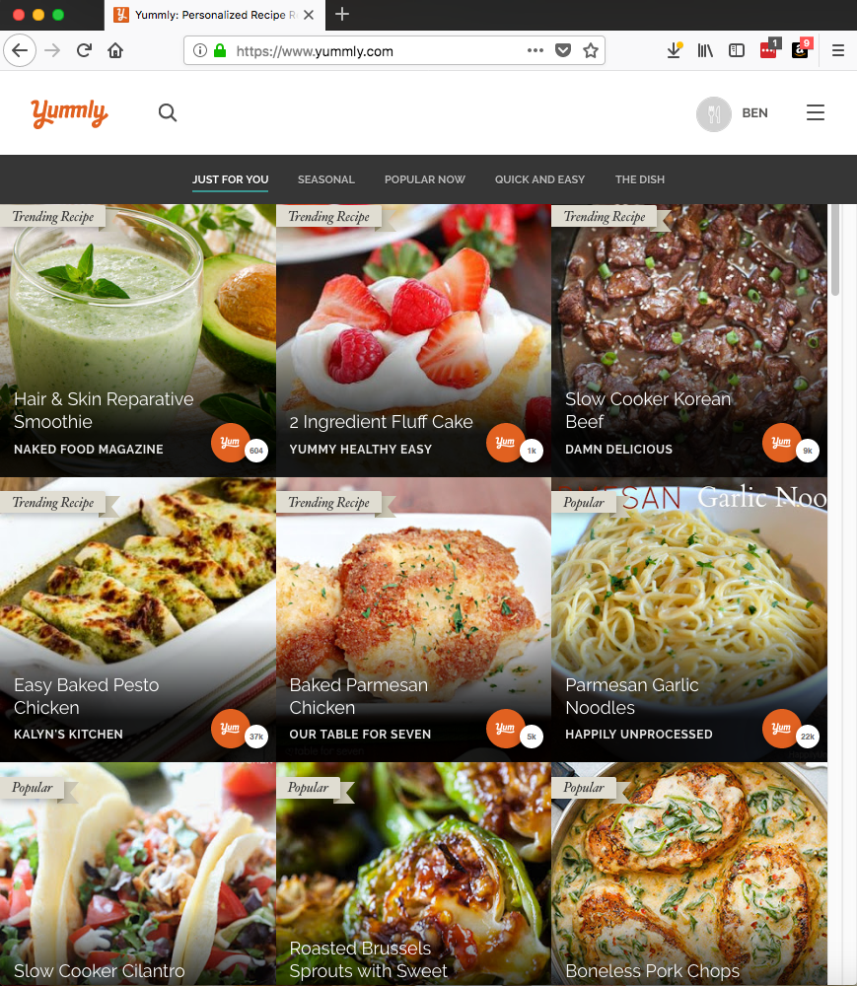
In order to explore this topic, I decided to use recipe data
Yummly.com API
Data Description
Name | Type | Description
Cuisine | String | e.g. italian, indian, mexican
Course | String | e.g. Lunch, Main Dish
Flavors | Dict | e.g. {sour: float, salty: float, sweet: float}
Ingredients | List of Strings | e.g. [bow-tie pasta, bacon slices]
Rating | Int | Rating from 1-5
RecipeName | String | e.g. ‘Lemon Chicken Pasta’
Size of data:
Total number of recipes downloaded: 12,492
Total number of cuisines: 25
Number of recipes / cuisine: ~500

Slide 4
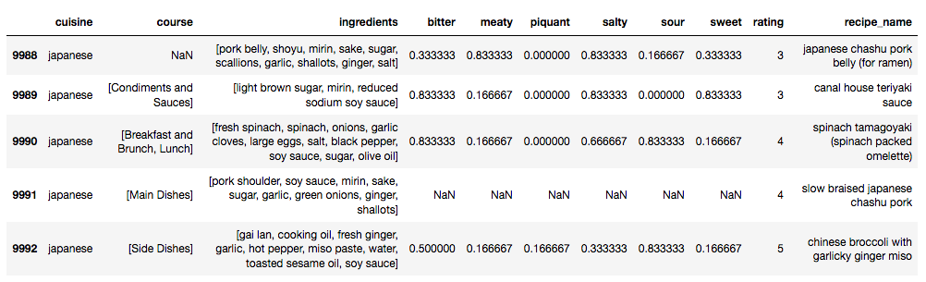
Before I began to do machine learning, there were a number of preprocessing steps
Description of cleaning steps:

Slide 5
Results slide 1

Slide 6
Results slide 2

Slide 7
Conclusions

