Slide 1
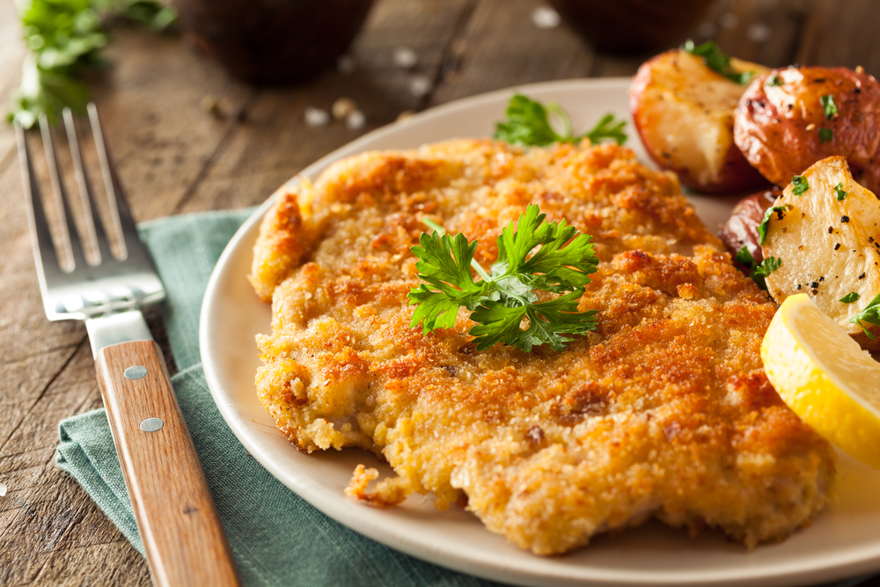
An Examination of Recipes from Around the World
Benjamin W. Sturm
bwsturm@gmail.com
May 16, 2018

Slide 2
The goal of my project was to use data science to gain insights of cuisines from around the world.
Questions I wanted to explore:
Which cuisines are most similar and which are most different?
Are there any unexpected relationships?
Which ingredients are most predictive of a particular cuisine?
Image to go here
Notes:
Need to think of a good image:
Perhaps have pictures of different foods and put them in a 2D plot

Slide 3
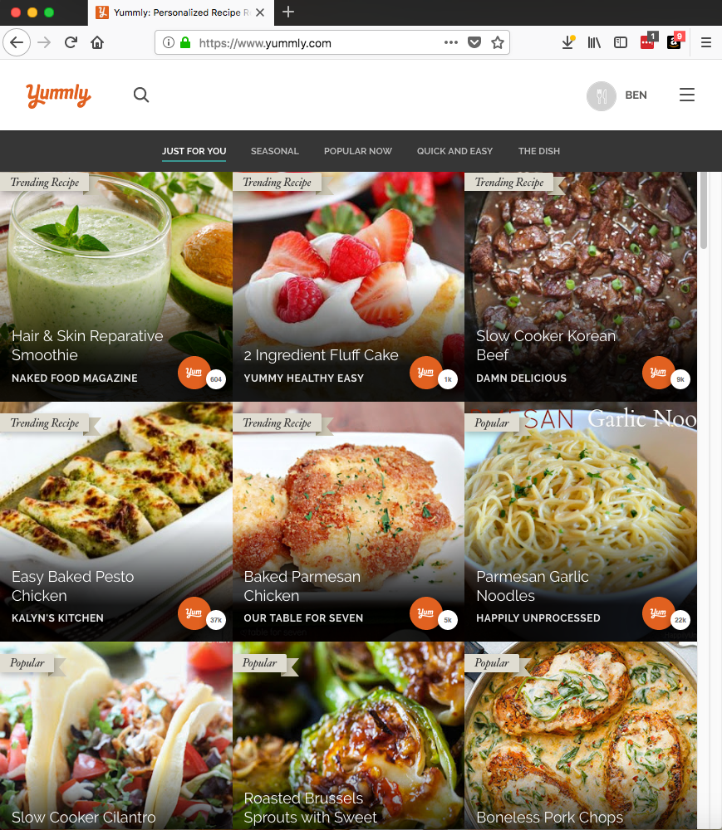
In order to explore this topic, I decided to use recipe data
Yummly.com API
Data Description
Name | Type | Description
Cuisine | String | e.g. italian, indian, mexican
Course | String | e.g. Lunch, Main Dish
Flavors | Dict | e.g. {sour: float, salty: float, sweet: float}
Ingredients | List of Strings | e.g. [bow-tie pasta, bacon slices]
Rating | Int | Rating from 1-5
RecipeName | String | e.g. ‘Lemon Chicken Pasta’
Size of data:
Total number of recipes downloaded: 12,492
Total number of cuisines: 25
Number of recipes / cuisine: ~500

Slide 4
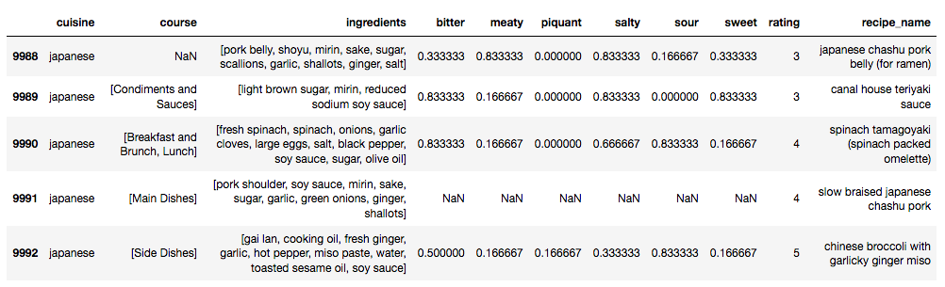
Before I began to do machine learning, there were a number of preprocessing steps
Description of cleaning steps:

Slide 5
Results slide 1

Slide 6
Results slide 2

Slide 7
Conclusions

