Slide 1
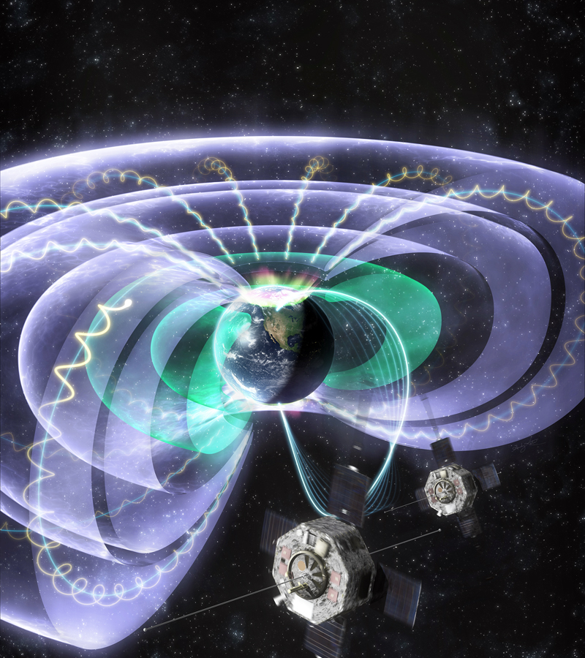
Matina Gkioulidou: Observing the Global Geospace in Mesoscale Resolution Anthony Sciola: Build-up of the Storm-Time Ring Current via Mesoscale Plasma Sheet Flows
Spacecraft Exploration and Physics Modeling of the Earth’s Ring Current

