Slide 1
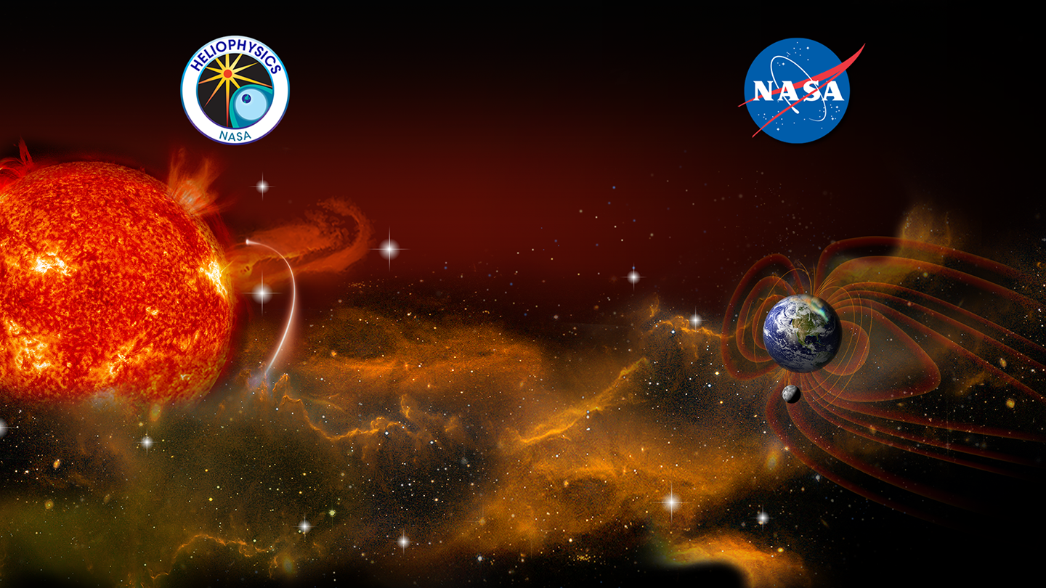
Intro to Python Notebooks and Code Sharing Barbara Thompson and the Helioanalytics Group

