Slide 1
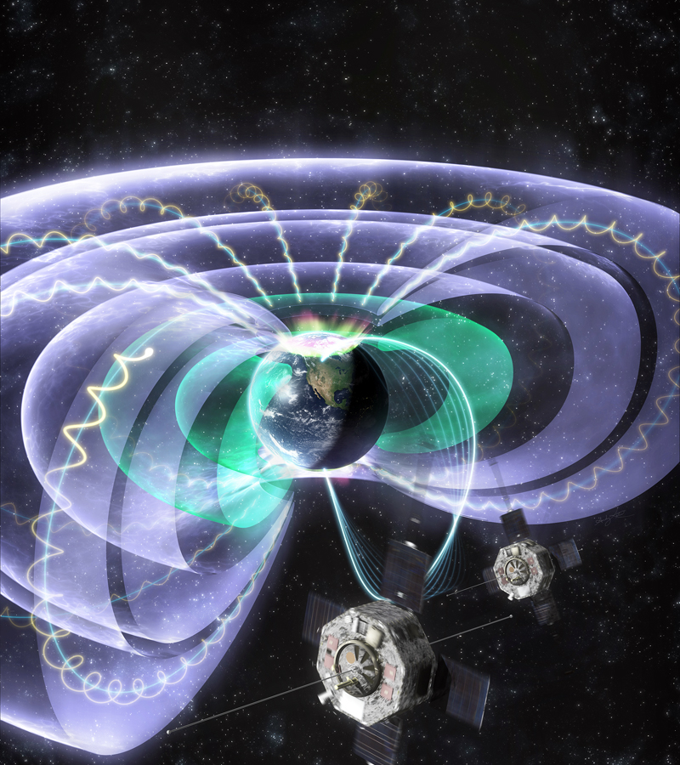
Center for Geospace Storms (CGS): Transforming the Understanding and Predictability of Space Weather
Slava Merkin, Kareem Sorathia, Dong Lin, Shanshan Bao, Adam Michael

