Slide 1
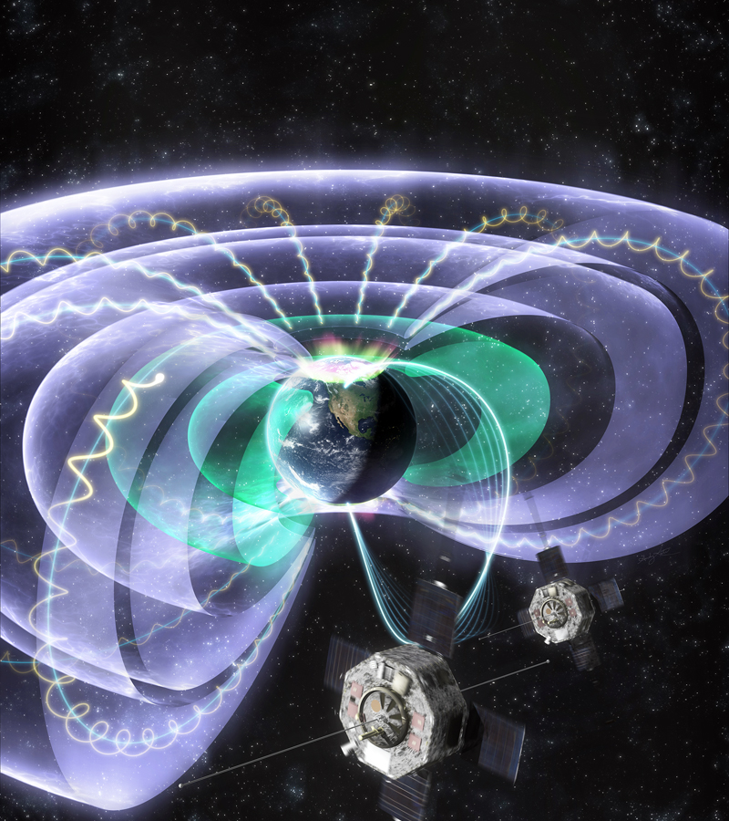
Justin Likar: Natural Space Environment (NSE) Effects on Space Flight System Design and Operations Yannis Daglis: Predicting Outer Van Allen Belt Dynamics with the Prototype SafeSpace Service
Space Weather Impacts of Near-Earth Particle Radiation

