Slide 1
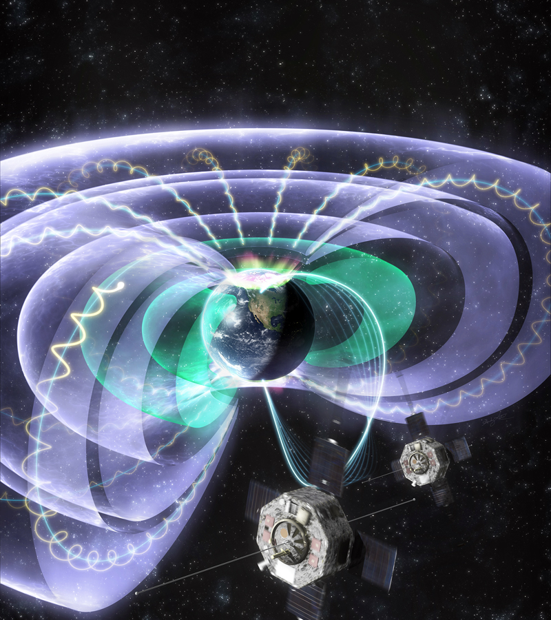
Jacob Bortnik : Inner Magnetospheric Environment Reconstruction and Explainability Enrico Camporeale : Data-Driven Discovery of the Fokker-Planck Equation for the Earth's Radiation Belts Using Machine Learning
Machine Learning in Space Physics

