Slide 1
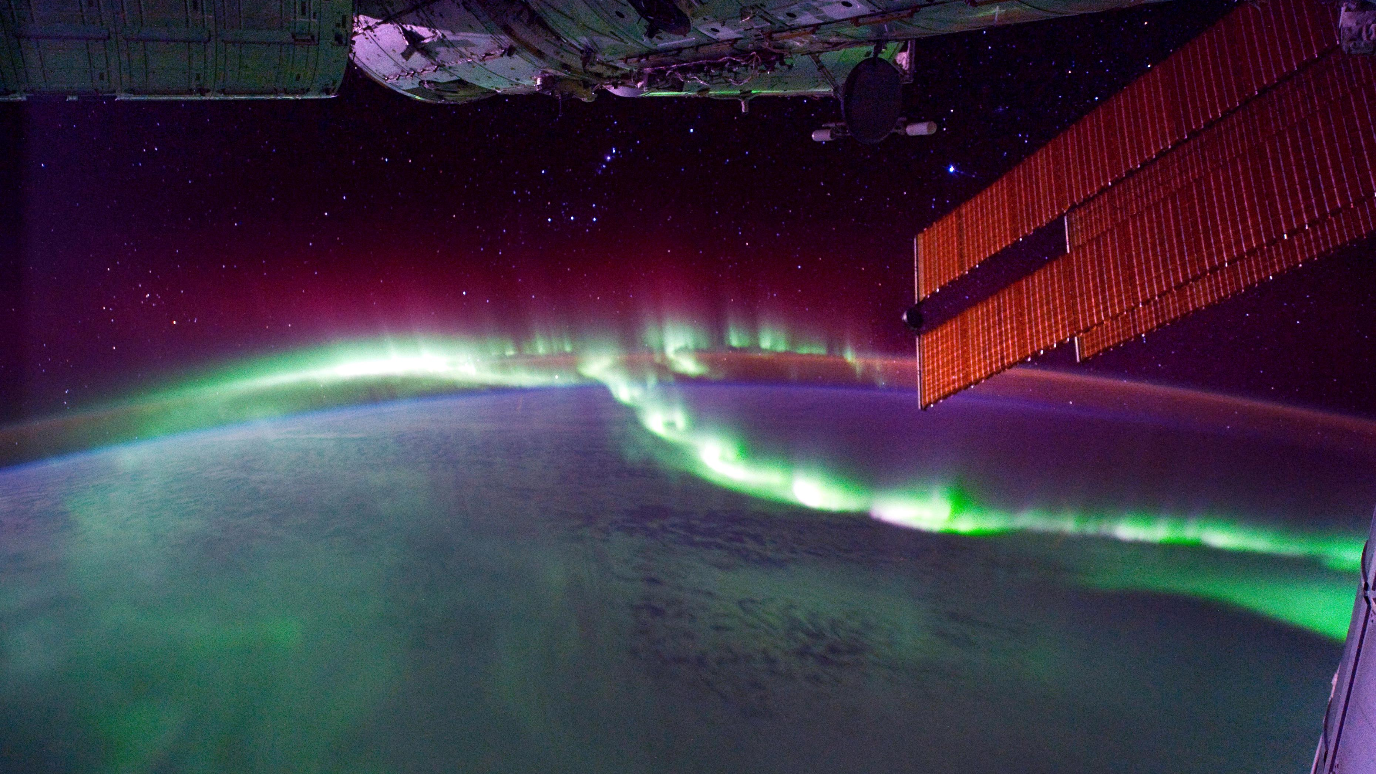
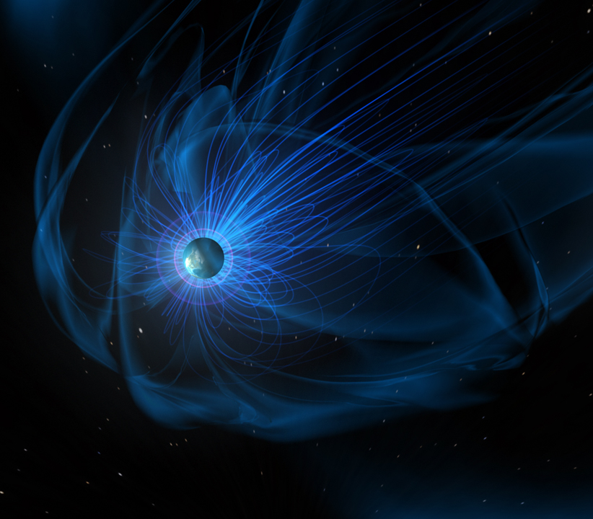
Riley Troyer Substorm Activity as a Driver of Energetic Pulsating Aurora
Leon Olifer Space Radiation:
How Bad Can It Get?
Early Career
Seminars

