Slide 1
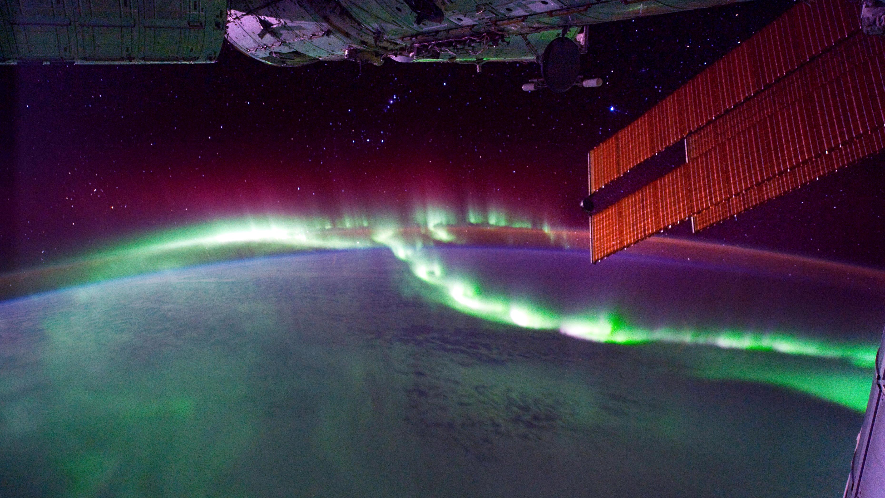
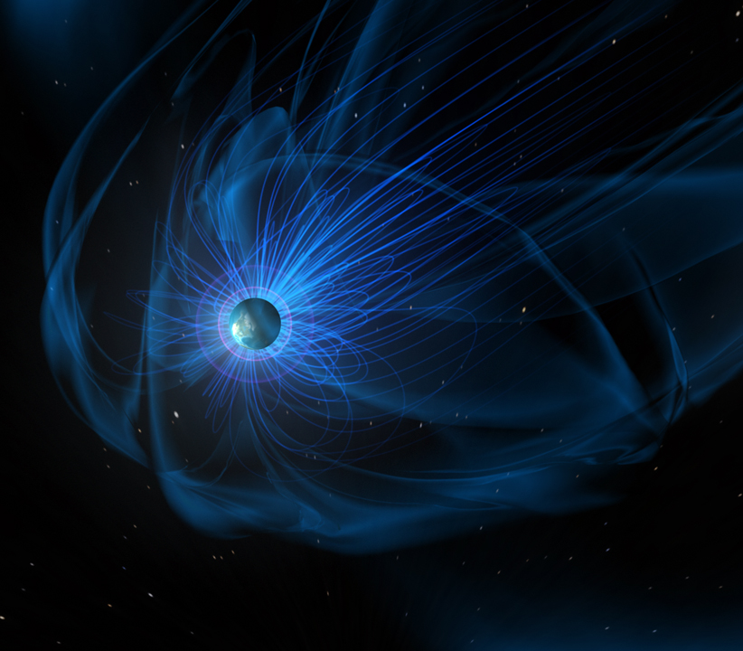
Xi Lu Statistical Study of Foreshock Density Holes
Connor O'Brien Neural Network Models
of the Near-Earth Solar Wind
and Magnetosheath
Early Career
Seminars

