Slide 1

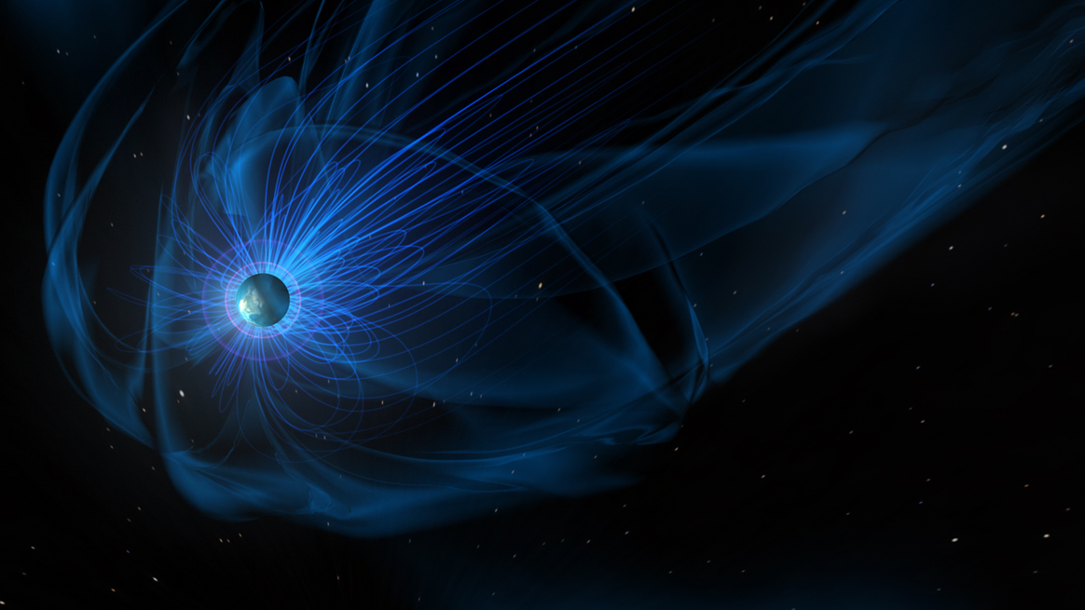
Jean-Francois Ripoll Earth’s Radiation Belt Dynamics: Observations and Simulations
Magnetosphere Online Seminar Series
September 20, 2021

Slide 2
Magnetosphere Online Seminar Series Difficulties? Email: magnetosphere.seminars@gmail.com
This presentation and the question and answer period will be recorded and posted online.
Questions should be asked to Kyle. Use the chat button at the bottom of your screen (try and keep questions concise). He will do his best to get to your question at the end of the seminar.
Be sure to have the latest version of Zoom
Join the YouTube Stream on our homepage
Suggestions for topics/speakers?
Contact us at:
https://msolss.github.io/MagSeminars/contact.html
magnetosphere.seminars@gmail.com
Join the mailing list:
https://msolss.github.io/MagSeminars/mail-list.html
Rules:
Please disable your video.
Please remain on mute until the question period.
Do not flood the chat, use private chat for private discussions.
Remain courteous.
Failure to obey the rules may result in you being ejected from the seminar and any future seminars.
This magnetosphere seminar is hosted by Kyle Murphy, David Sibeck, Jason Shuster, Marcos Silveira, Remya Bhanu, Homayon Aryan, and Nithin Sivadas.

