Slide 1
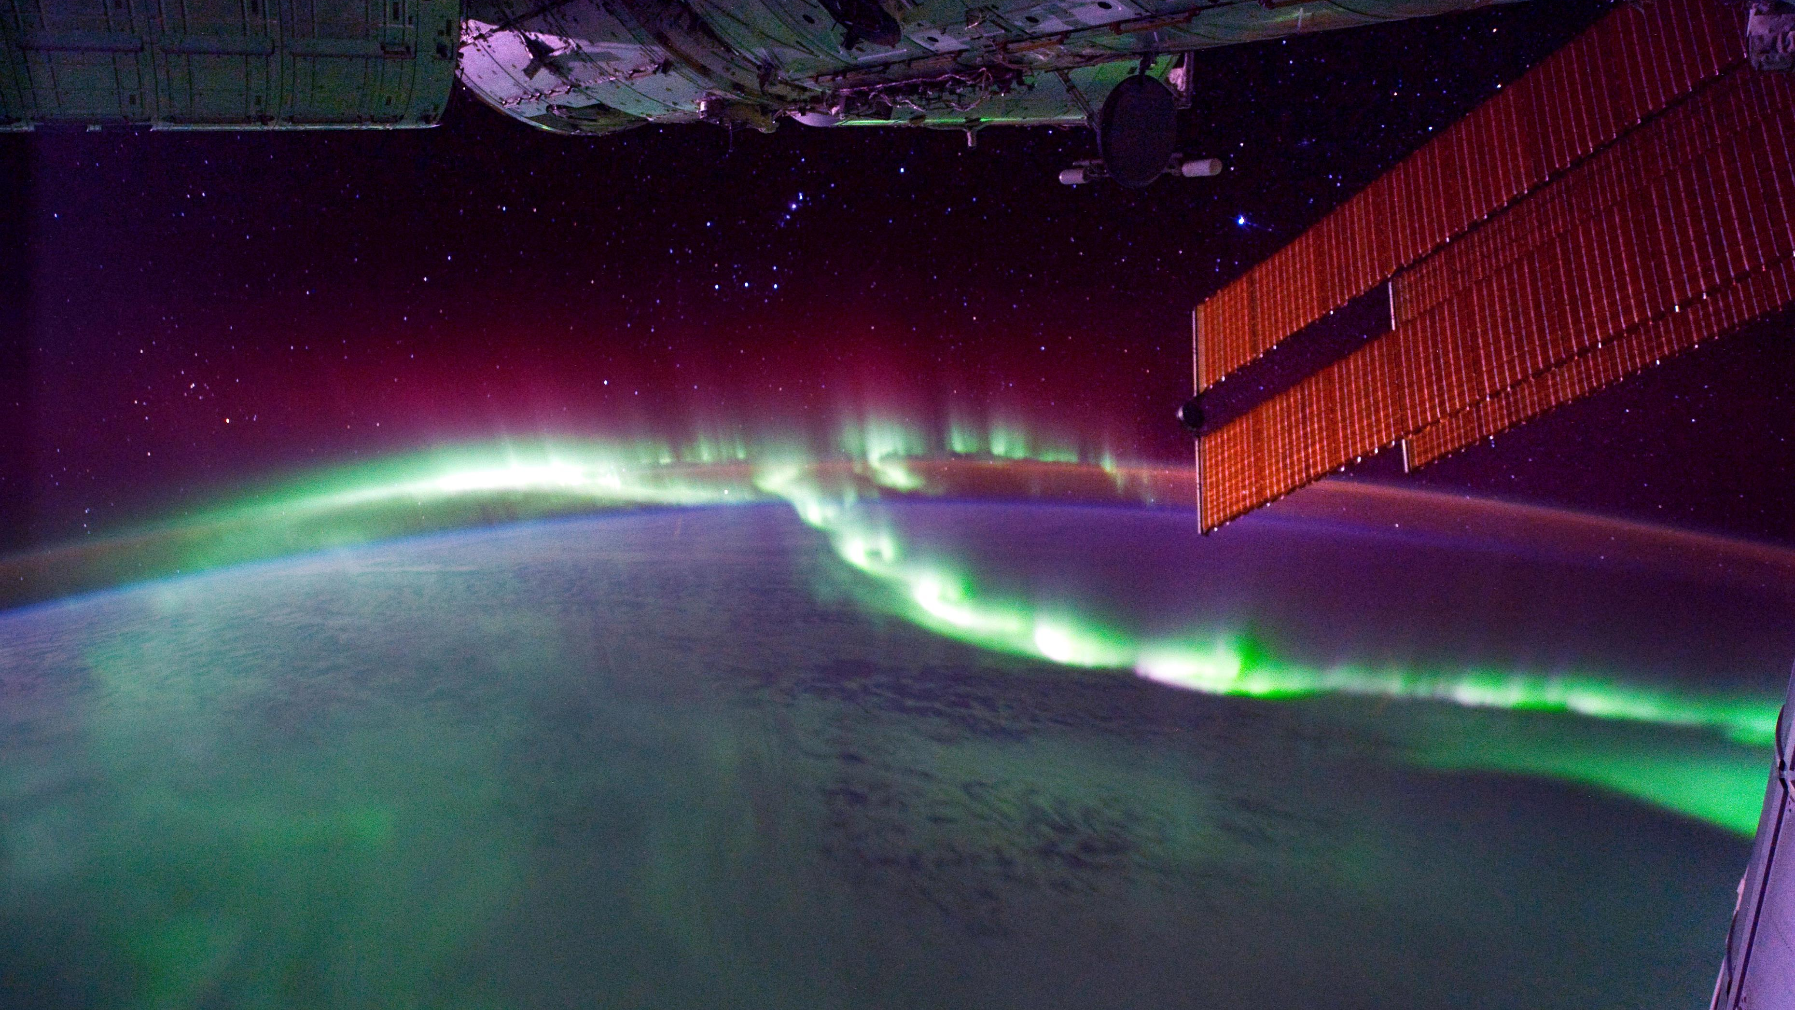
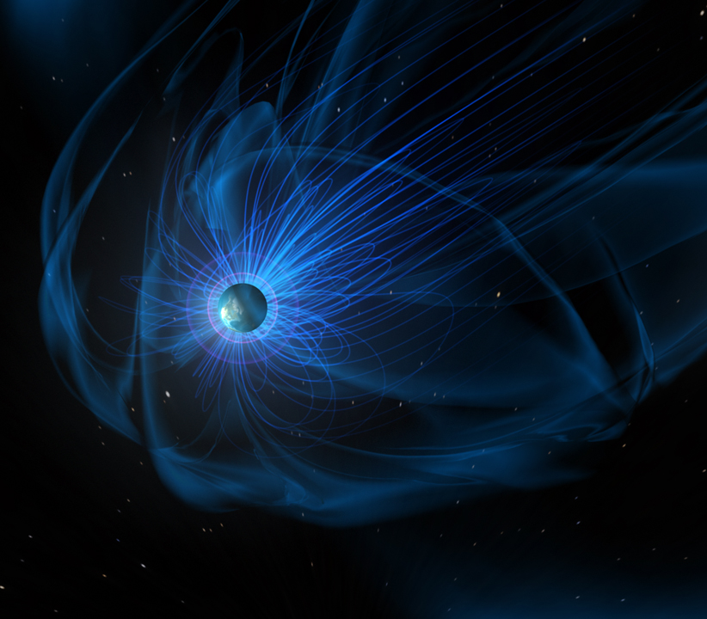
Anthony Sciola Build-up of the Storm-Time Ring Current via Mesoscale Plasma Sheet Flows
Dong Lin Characterizing Auroral
Precipitation and Ionospheric Conductance with the
Multiscale Atmosphere-Geospace Environment Model
Early Career
Seminars

