Slide 1
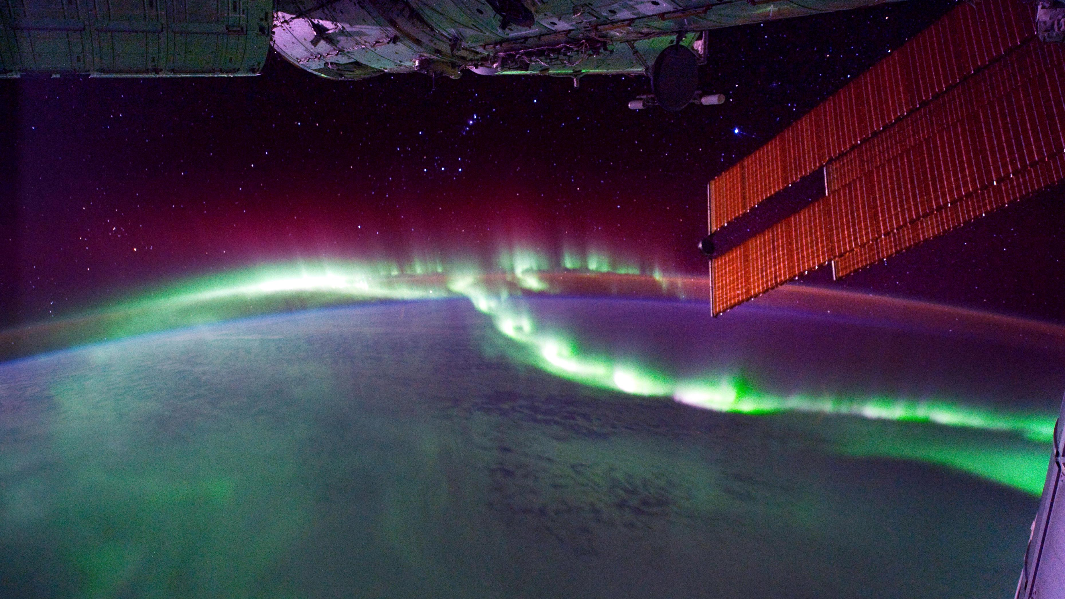
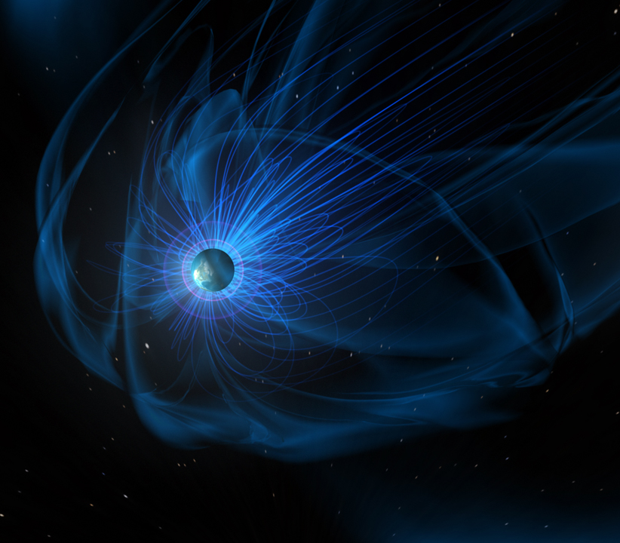
Man Hua Radiation Belt Electron Acceleration Driven by Very-Low-Frequency Transmitter Waves in Near-Earth Space
Ramiz Qudsi Refining predictions of
reconnection X-lines
at Earth’s Magnetopause
Early Career
Seminars

