Slide 1
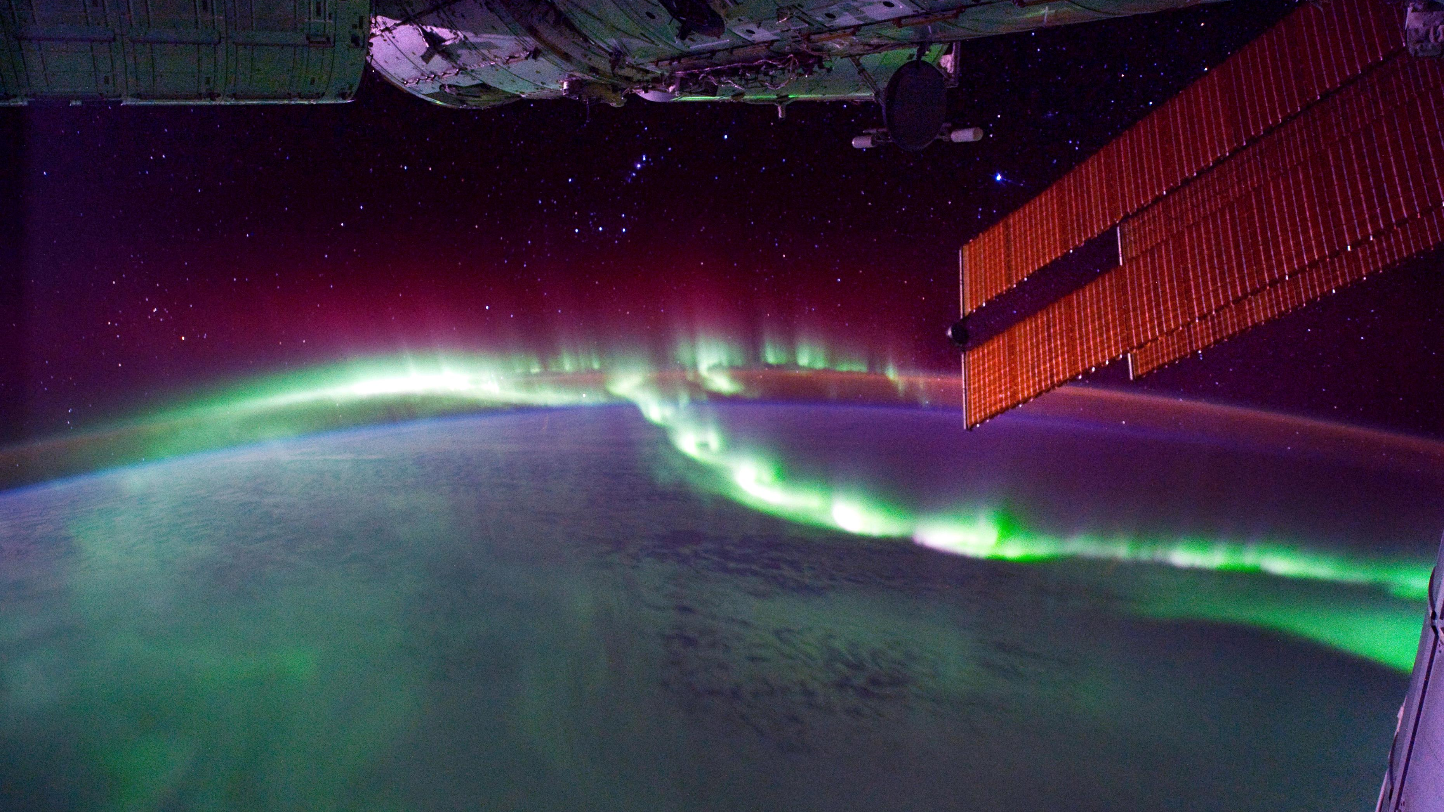
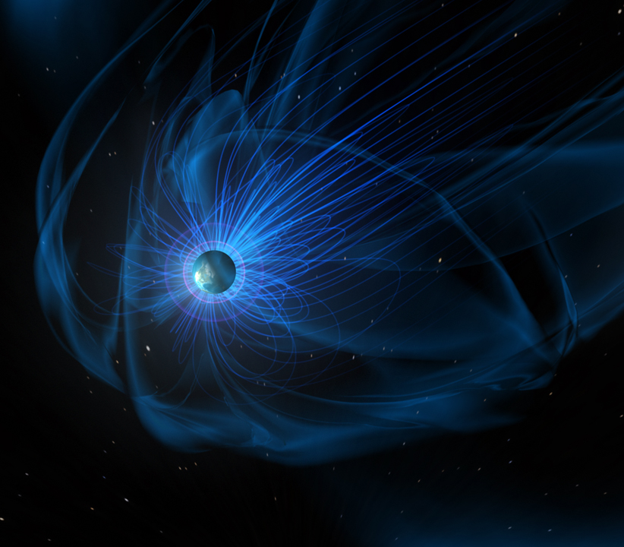
Nithin Sividas Uncertainty in the solar wind propagation may explain polar cap potential saturation
Leng Ying Khoo On the challenges of
measuring energetic
particles in the inner belt
Early Career
Seminars

