Slide 1
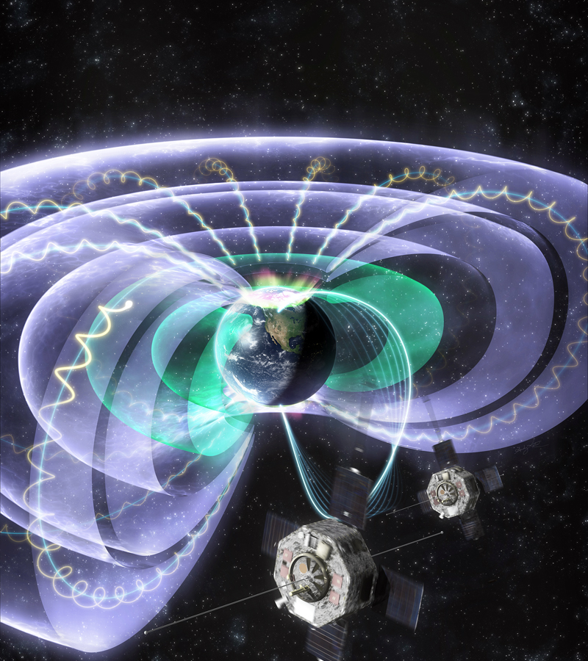
Ian Richardson: A Heliospheric View of Solar Energetic Particle Events Rachael Filwett: Solar Energetic Particle Access to the Magnetosphere, a Comparison of 4 SEP Events Measured with RBSP
Solar Energetic Particles in Heliosphere and Geospace

