Slide 1
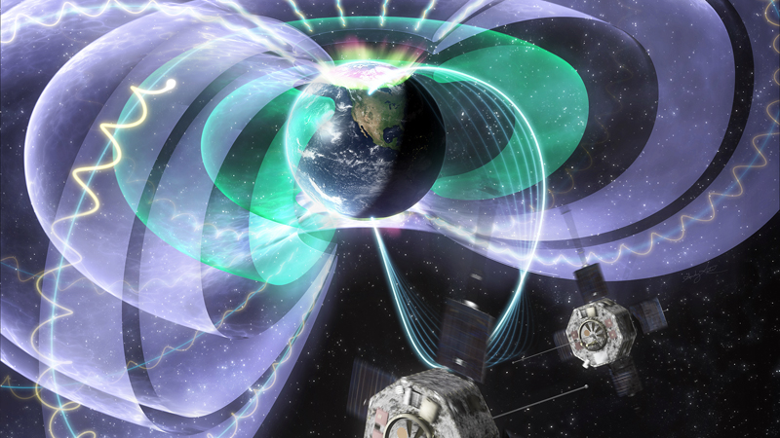
George Clark and Bin Zhang
Particle Radiation in the Jovian Magnetosphere

