Slide 1
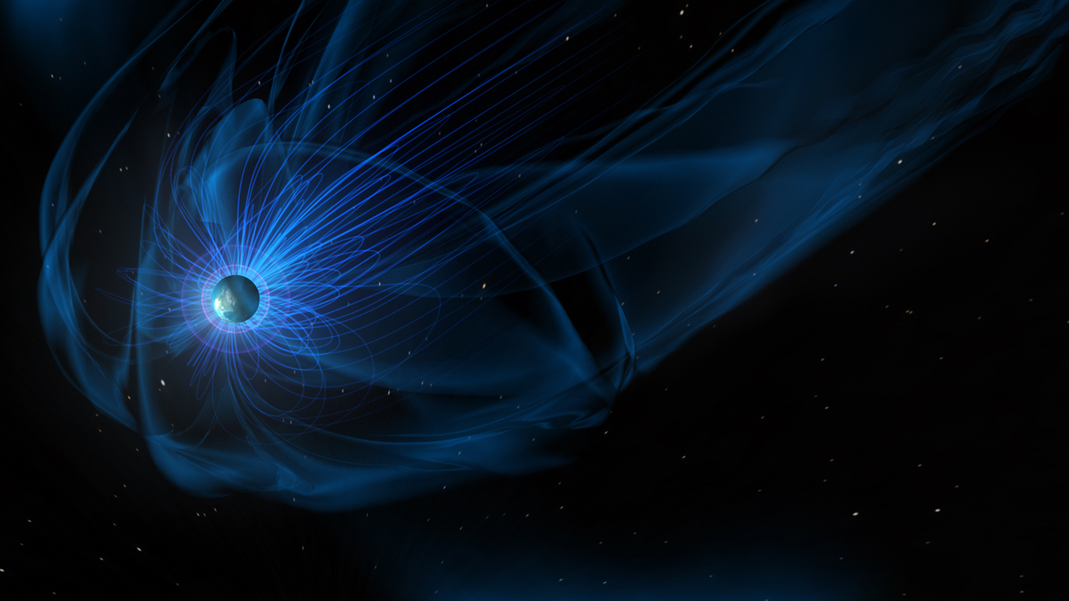


Magnetosphere Online Seminar Series
Please note that this presentation and the question/answer period will be recorded and posted online.
All participants, except for the speaker, will be muted.
Questions can be asked in the chat or at the end of the talk.
Enjoy!
website: https://msolss.github.io/MagSeminars/
contact: magnetosphere.seminars@gmail.com

