Slide 1
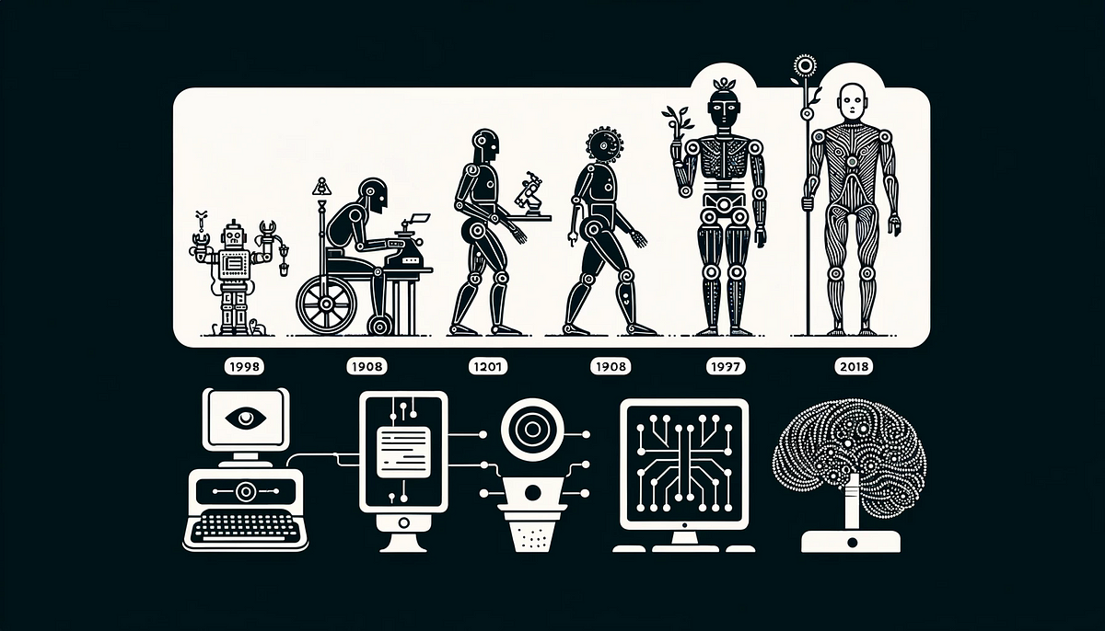
HISTORY AND EVOLUTION OF ARTIFICIAL INTELLIGENCE(AI)
PRESENTER:MSONGERA R JUMA

Slide 2
Introduction to AI
Definition of Artificial Intelligence
A branch of computer science that uses computational models to perform tasks that previously required human intelligence
AI is the basis for mimicking human intelligence processes through the creation and application of algorithms built into a dynamic computing environment,hence AI is trying to make computers think and act like humans

Slide 3
Early History of AI
The concept of AI in ancient myths and early literature
Historians usually trace the idea of automata to the middle ages when the first self moving devices were invented but the concept of artificial or life like creatures dates to myths from 2700 years ago said by Adrienne Mayor a scholor in school of Hummanities and science.these ancient myths are subject of Mayor’s latest book,Gods and Robot:Myths, Machines,and Ancient Dreams of Technology.

Slide 4
The Birth of AI (1950s-1960s)
Dartmouth Conference (1956)
Date of note:1950-1956: the pioneer of AI Alan Turing published”computer machinery and intelligence” which proposed a test of machine intelligence called The Imitation Game.1952: A computer scientist named Arthur Samuel developed a program to play checkers which is the first to ever learn the game independently
Early AI programs:the first program Logic Theorist by Allen Newell though Samuele’s checkers also has strong reason

Slide 5
The First AI Winter (1970s)
Decline in funding and interest
The first AI occurs as the capabilities of AI programs remain limited,mostly due to lack of computing power at the time
Causes: Limitations of early AI technology, overhyped expectations

Slide 6
Expert Systems and Renewed Interest (1980s)
Development of expert systems
These were first truly successful forms of AI software forexample disease diagnosis expert system,MYCIN to diagnose bacterial infections,DENDRAL for chemical anlsis,XCON used to nfigure computer VAX system,PROSPECTOR for geographical exploration
Most of these systems were based on Commercial applications in medicine, finance

Slide 7
The Second AI Winter (Late 1980s-1990s)
Again, decline due to high costs and limited capabilities
Emergence of machine learning and neural networks

Slide 8
Modern AI (2000s-Present)
Advancements in computational power and data availability which can adapts to new inputs and even perform human like tasks
Breakthroughs: Deep Learning, AlphaGo, GPT-3

Slide 9
Key Technologies in Modern AI
Machine Learning
Neural Networks
Natural Language Processing
Robotics

Slide 10
AI in Ghana
Case Study: mPharma
Application: Healthcare
Description: mPharma uses AI to manage pharmaceutical inventory and ensure the availability of essential medicines in pharmacies and hospitals

Slide 11
AI in South Africa
Case Study: Clevva
Application: Customer Service
Description: Clevva uses AI-driven virtual assistants to enhance customer service across various industries, providing automated and efficient support.

Slide 12
AI in Nigeria
Case Study: Hello Tractor
Application: Agriculture
Description: An AI-powered platform connects tractor owners with smallholder farmers, improving access to mechanized farming and boosting productivity.

Slide 13
AI in Egypt
Case Study: Affectiva
Application: Automotive
Description: Affectiva, co-founded by an Egyptian, uses AI to analyze drivers' emotions and behaviors, improving road safety and driver experience

Slide 14
AI in Rwanda
Case Study: Zipline
Application: Healthcare
Description: Zipline employs AI to manage drone delivery of medical supplies to remote areas, ensuring timely access to blood and essential medicines.

Slide 15
Future of AI and Ethical Considerations
Potential future advancements
Ethical concerns: Job displacement, privacy, bias in AI systems
Importance of responsible AI development

Slide 16
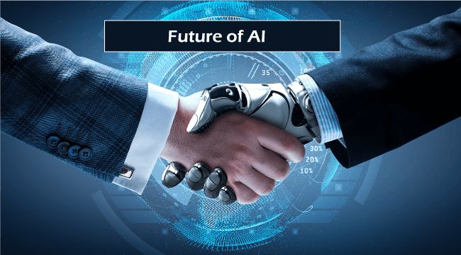
Conclusion
The future is on AI. the machine can do better than human being. AI can play a role in every sector.it has improving understanding of human reasoning and the nature of intelligence in general. It providing new areas and rich challenges for future

