Slide 1



<p>
EMPOWERMENT TECHNOLOGY
</p>
HTML & CSS
MSP Club

Slide 2
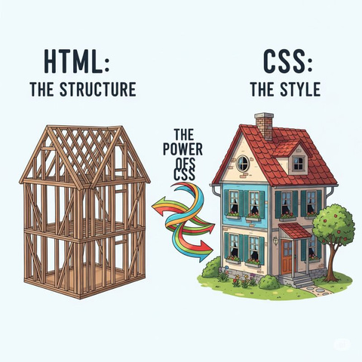
What is HTML?
HTML stands for HyperText Markup Language.
It's the backbone of all web pages. It provides the fundamental structure, not the style.
Every website you visit is built with HTML.
Structure vs. Style
Think of it as a building's framework. HTML is the beams, walls, and floors
CSS, which we'll cover later, is the paint, furniture, and decorations.

Slide 3
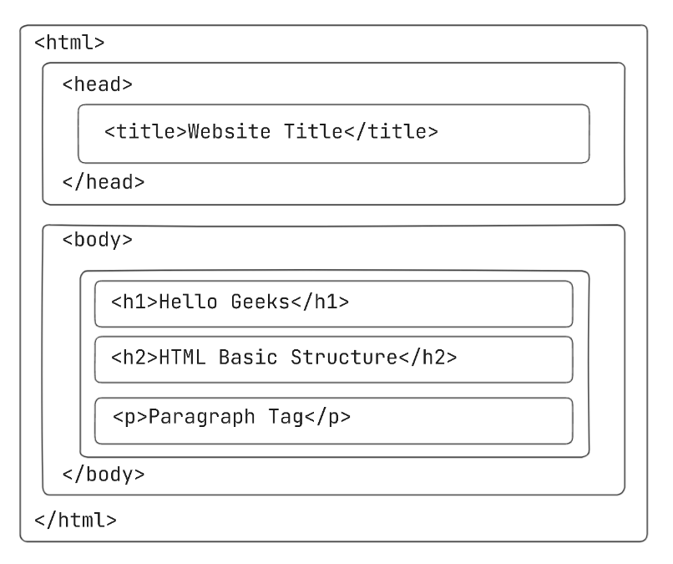
HTML Page Structure
Part | Purpose
<!DOCTYPE html> | Declares HTML5
<html> | Wraps the entire document
<body> | Visible content
<head> | Metadata, imports, SEO

Slide 4









File
Edit
Selection
View
Go
Run
Terminal
Help
Headings
HTML HEADINGS
HTML headings are defined with the <h1> to <h6> tags.
<h1> defines the most important heading. <h6> defines the least important heading:
Example code:
This is Heading 1
<h1>This is heading 1</h1>
<h2>This is heading 2</h2>
<h3>This is heading 3</h3>
<h4>This is heading 4</h4>
<h5>This is heading 5</h5>
<h6>This is heading 6</h6>
This is Heading 2
This is Heading 3
This is Heading 4
This is Heading 5
This is Heading 6

Slide 5
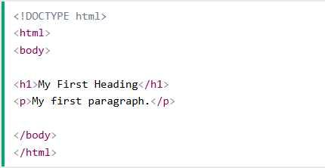
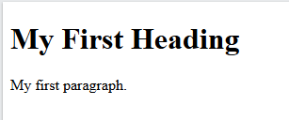
File
Edit
Selection
View
Go
Run
Terminal
Help
Headings
Paragraph
HTML PARAGRAPH
HTML paragraphs are defined with the <p> tag:
Example code:
<p>This is a paragraph.</p>
<p>This is another paragraph.</p>

Slide 6
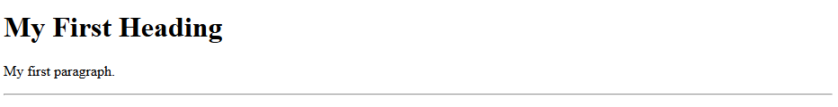
File
Edit
Selection
View
Go
Run
Terminal
Help
Headings
Paragraph
H_Rules
HTML HORIZONTAL RULES
The <hr> tag defines a thematic break in an HTML page, and is most often displayed as a horizontal rule.
The <hr> element is used to separate content (or define a change) in an HTML page:
Example code:
<h1>This is heading 1</h1>
<p>This is some text.</p>
<hr>
The <hr> tag is an empty tag, which means that it has no end tag.

Slide 7
File
Edit
Selection
View
Go
Run
Terminal
Help
Headings
Paragraph
H_Rules
L_Breaks
HTML LINE BREAKS
The HTML <br> element defines a line break.
Use <br> if you want a line break (a new line) without starting
a new paragraph:
Example code:
<p>This is<br>a paragraph<br>with line breaks.</p>
The <br> tag is an empty tag, which means that it has no end tag.

Slide 8

File
Edit
Selection
View
Go
Run
Terminal
Help
Headings
Paragraph
H_Rules
L_Breaks
Links
HTML LINKS
HTML links are defined with the <a> tag:
Example code:
<a href="https://www.reallygreatsite.com">This is a link</a>
The link's destination is specified in the href attribute.
Attributes are used to provide additional information about HTML elements.

Slide 9
File
Edit
Selection
View
Go
Run
Terminal
Help
Headings
Paragraph
H_Rules
L_Breaks
Links
Images
HTML IMAGES
HTML images are defined with the <img> tag.
The source file (src), alternative text (alt), width, and height are provided as attributes:
Example code:
<img src=“picture.jpg" alt="reallygreatsite.com" width="104" height="142">

Slide 10



File
Edit
Selection
View
Go
Run
Terminal
Help
Headings
Paragraph
H_Rules
L_Breaks
Links
Images
Favicon
HTML FAVICON
A favicon is a small image, so it should be a simple image with high contrast.
A favicon image is displayed to the left of the page title in the browser tab, like this:
Really Great Site

Slide 11
File
Edit
Selection
View
Go
Run
Terminal
Help
Headings
Paragraph
H_Rules
L_Breaks
Links
Images
Favicon
HTML FAVICON
Example code:
<!DOCTYPE html>
<html>
<head>
<title>My Page Title</title>
<link rel="icon" type="image/x-icon" href="favicon.ico">
</head>
<body>
<h1>This is a Heading</h1>
<p>This is a paragraph.</p>
</body>
</html>

Slide 12
The "Big 6" Semantic Tags
<header>
Represents the top section of a page or a section.
Usually contains logo, navigation, and titles.
<nav>
Contains navigation links.
Used for menus, sidebars, or any major group of links.
<main>
Holds the main unique content of the page.
Only one <main> per page.

Slide 13
The "Big 6" Semantic Tags
<article>
A standalone, self-contained piece of content.
Examples: blog post, news post, comment, card.
<section>
Groups related content together.
Often has a heading inside it.
<footer>
Bottom area of a section or the whole page.
Contains: copyright, links, contact info, author info.

Slide 14
File
Edit
Selection
View
Go
Run
Terminal
Help
Headings
Paragraph
H_Rules
L_Breaks
Links
Images
Favicon
Lists
HTML LIST
HTML lists allow web developers to group a set of related items in lists.
An unordered HTML list:
Item
Item
Item
Item
An ordered HTML list:
1. First item
2. Second item
3. Third item
4. Fourth item

Slide 15
File
Edit
Selection
View
Go
Run
Terminal
Help
Headings
Paragraph
H_Rules
L_Breaks
Links
Images
Favicon
Lists
UNORDERED LIST
An unordered list starts with the <ul> tag. Each list item starts with the <li> tag.
The list items will be marked with bullets (small black circles) by default:
Example code:
<ul>
<li>Coffee</li>
<li>Tea</li>
<li>Milk</li>
</ul>
Coffee
Tea
Milk

Slide 16
File
Edit
Selection
View
Go
Run
Terminal
Help
Headings
Paragraph
H_Rules
L_Breaks
Links
Images
Favicon
Lists
ORDERED LIST
An ordered list starts with the <ol> tag. Each list item starts with the <li> tag.
The list items will be marked with numbers by default:
Example code:
<ol>
<li>Coffee</li>
<li>Tea</li>
<li>Milk</li>
</ol>
Coffee
Tea
Milk

Slide 17
File
Edit
Selection
View
Go
Run
Terminal
Help
Headings
Paragraph
H_Rules
L_Breaks
Links
Images
Favicon
Lists
Table
HTML TABLE
A table in HTML consists of table cells inside rows and columns.
Example code:
<table>
<tr>
<th>Company</th>
<th>Contact</th>
<th>Country</th>
</tr>
<tr>
<td>Alfreds Futter</td>
<td>Maria Anders</td>
<td>Germany</td>
</tr>
</table>
Company | Contact | Country
Alfreds Futter | Maria Anders | Germany

Slide 18
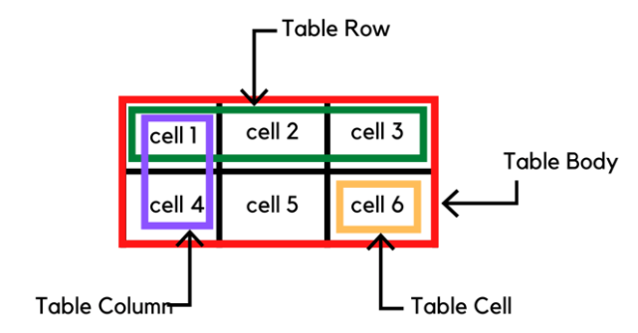
File
Edit
Selection
View
Go
Run
Terminal
Help
Headings
Paragraph
H_Rules
L_Breaks
Links
Images
Favicon
Lists
Table
HTML CELLS
Each table cell is defined by a <td> and a </td> tag.
td stands for table data.
Everything between <td> and </td> are the content of the table cell.

Slide 19
File
Edit
Selection
View
Go
Run
Terminal
Help
Headings
Paragraph
H_Rules
L_Breaks
Links
Images
Favicon
Lists
Table
HTML ROWS
Each table row starts with a <tr> and ends with a </tr> tag.
tr stands for table row.

Slide 20
File
Edit
Selection
View
Go
Run
Terminal
Help
Headings
Paragraph
H_Rules
L_Breaks
Links
Images
Favicon
Lists
Table
HTML HEADERS
Sometimes you want your cells to be table header cells. In those cases use the <th> tag instead of the <td> tag:
th stands for table header.

Slide 21
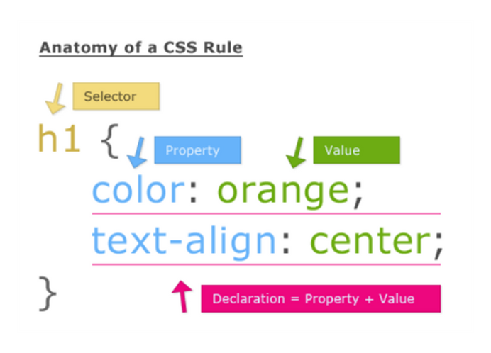
File
Edit
Selection
View
Go
Run
Terminal
Help
Intro
Style css
Cascading Style Sheets
CSS describes how HTML elements should be displayed.
It controls the layout, colors, fonts, and overall visual appearance of a web page.
A CSS rule is made of three parts:
Selector: The HTML element to target.
Property: The visual aspect to change.
Value: The new setting for that property.

Slide 22
File
Edit
Selection
View
Go
Run
Terminal
Help
Intro
Selectors
Properties
Model
Adding ways
How to add CSS
Inline CSS
Uses the style attribute, bad for large projects.
<p style="color:red;">Hello</p>
Internal CSS
Inside <style>, good for small pages.
<style>
p { color: red; }
</style>
External CSS
In a .css file, best practice.
<link rel="stylesheet" href="style.css">

Slide 23
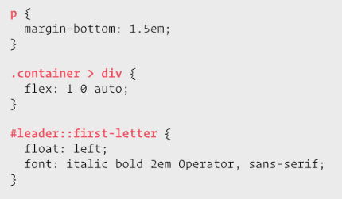
File
Edit
Selection
View
Go
Run
Terminal
Help
Intro
Selectors
Tag Selector
Selects all elements of a certain type.
EX: p { color: white; }
Class Selector
Selects all elements with a specific class attribute. Use this the most!
EX: .highlight { background: yellow; }
ID Selector
Selects the one element with a specific id attribute. Use it sparingly.
EX: #main-header { font-size: 32px; }

Slide 24




File
Edit
Selection
View
Go
Run
Terminal
Help
Intro
Selectors
Properties
Common CSS Properties
color
background-color
font-size / font-family
width / height

Slide 25
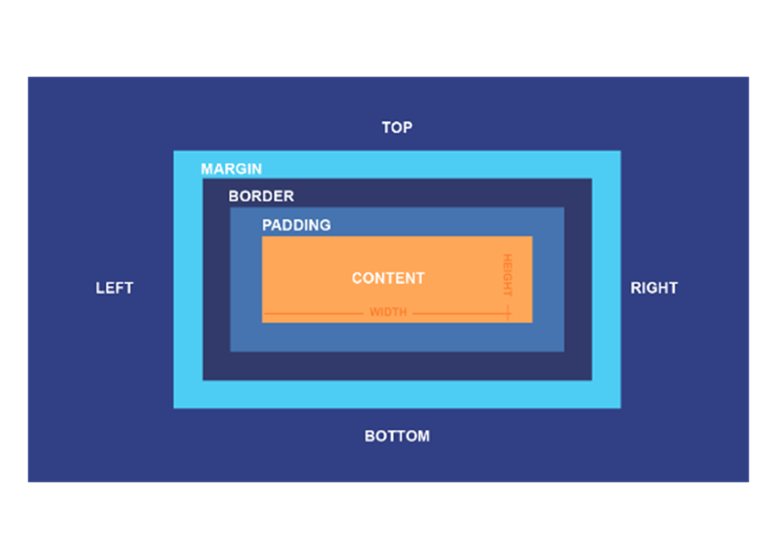
File
Edit
Selection
View
Go
Run
Terminal
Help
Intro
Selectors
Properties
Model
The CSS Box Model
Every HTML element is a rectangular box. The CSS Box
Model describes the parts of that box:
Content: The text, image, or other content.
Padding: The space *inside* the border, between
the content and the border.
Border: The line that goes *around* the padding.
Margin: The space *outside* the border, separating
it from other elements.

Slide 26

THANK YOU FOR LISTENING
<p>
</p>
Created By:
Mohammed Esam - Head
Abdulkader Adnan - Co-Head
Youssef Hussein - Co-Head
Shahd waleed – Co-Head

