Slide 1

Team Mockingjays
RAMAIAH INSTITUTE OF TECHNOLOGY, BANGALORE

Slide 2

ICPAPP
MINISTRY OF STATISTICS AND PROGRAMME IMPLEMENTATION

Slide 3
The Problem at Hand
Redundant Data entry
Proxy reporting
Repudiation
Manipulation
Entire system runs on trust basis
No Validation of data

Slide 4
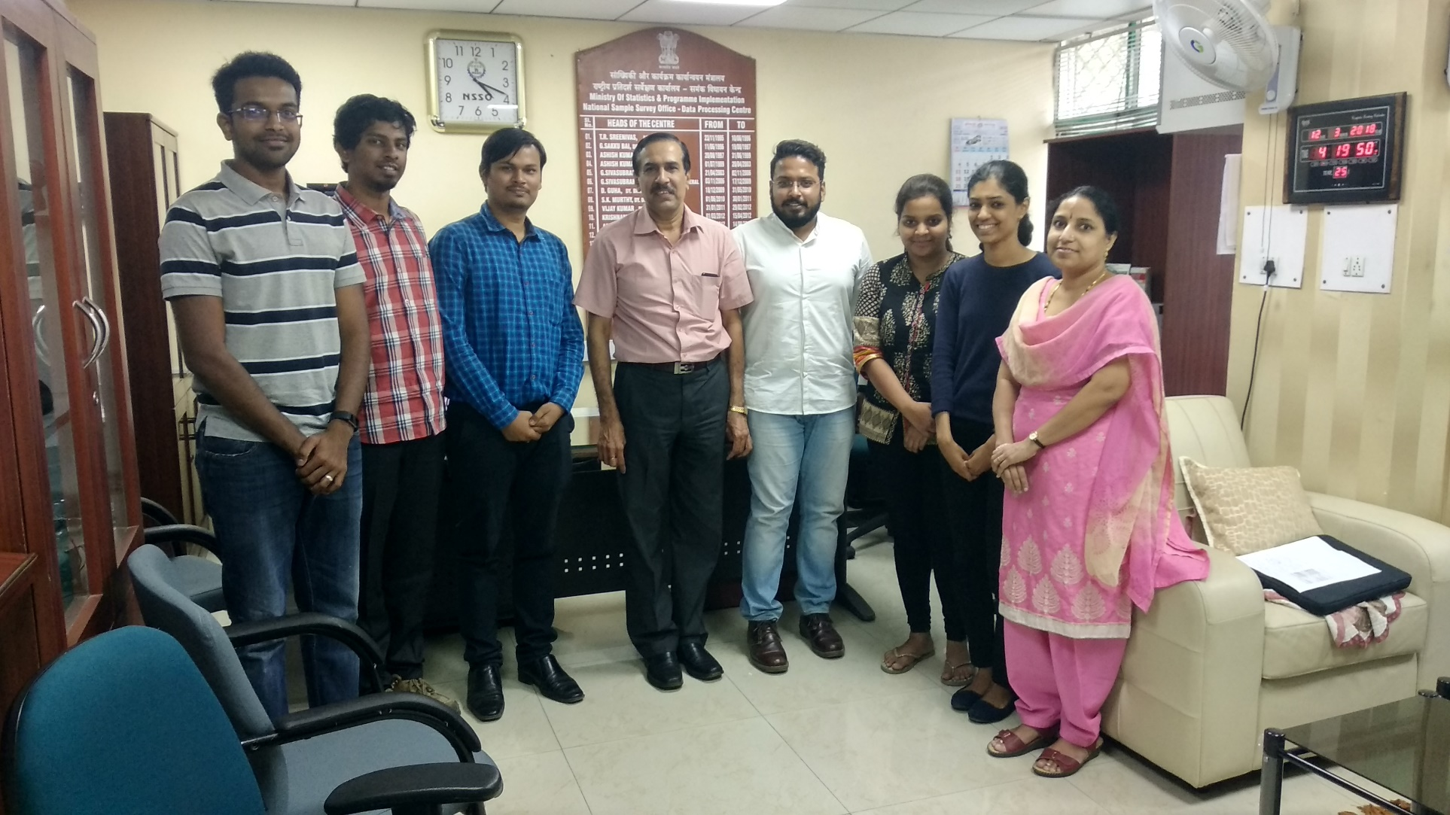
Field Study

Slide 5
Our Solution
Intuitive and Relevant Interface for data collectors and Supervisor
Two step authentication using user credentials and biometrics
Real time Tracking of location using GPS (Google maps api)
Validating the presence of the authorised data collector continuously
Multiple lingual diversity
Scrutiny of data
Notes:
change the contents

Slide 6
Implementation

Slide 7










Representation
FIREBASE AUTH
ASSIGN TASK
FIREBASE STORAGE
SUPERVISOR
UPLOAD
FIREBASE
(CENTRAL)
MATCHING
FIREBASE DATABASE
(CENTRAL)
VIEW TASK
COLLECTOR
FIREBASE AUTH

Slide 8
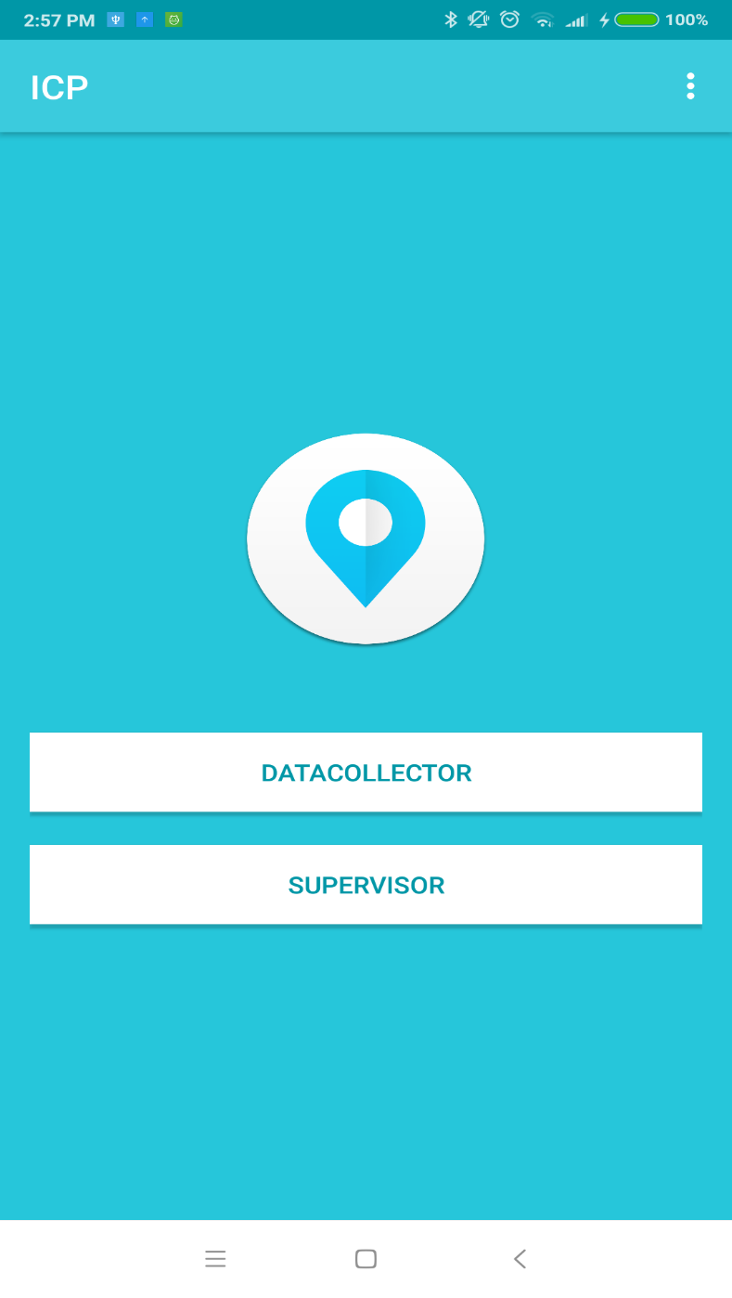
Home Screen
Notes:
change the contents

Slide 9
Two Factor Authentication
Finger-print
GPS
The unique identity for a human being .
It cannot be easily forged without person consent.
Unique identity Solved !
The Global positioning system can track places with accuracy upto 5m
And with special accurate system may hit 3ft.
It’s the tool to track anything in the world.

Slide 10
Combining two powerful technology
The Authentication of the person who is authorized to do particular task is done with help of fingerprint matching
The authorized is tracked and validated to specific co-ordinates of the world using
GPS
To ensure the authenticated person is only allowed to take document of the subject at specified place only
Notes:
change the contents

Slide 11
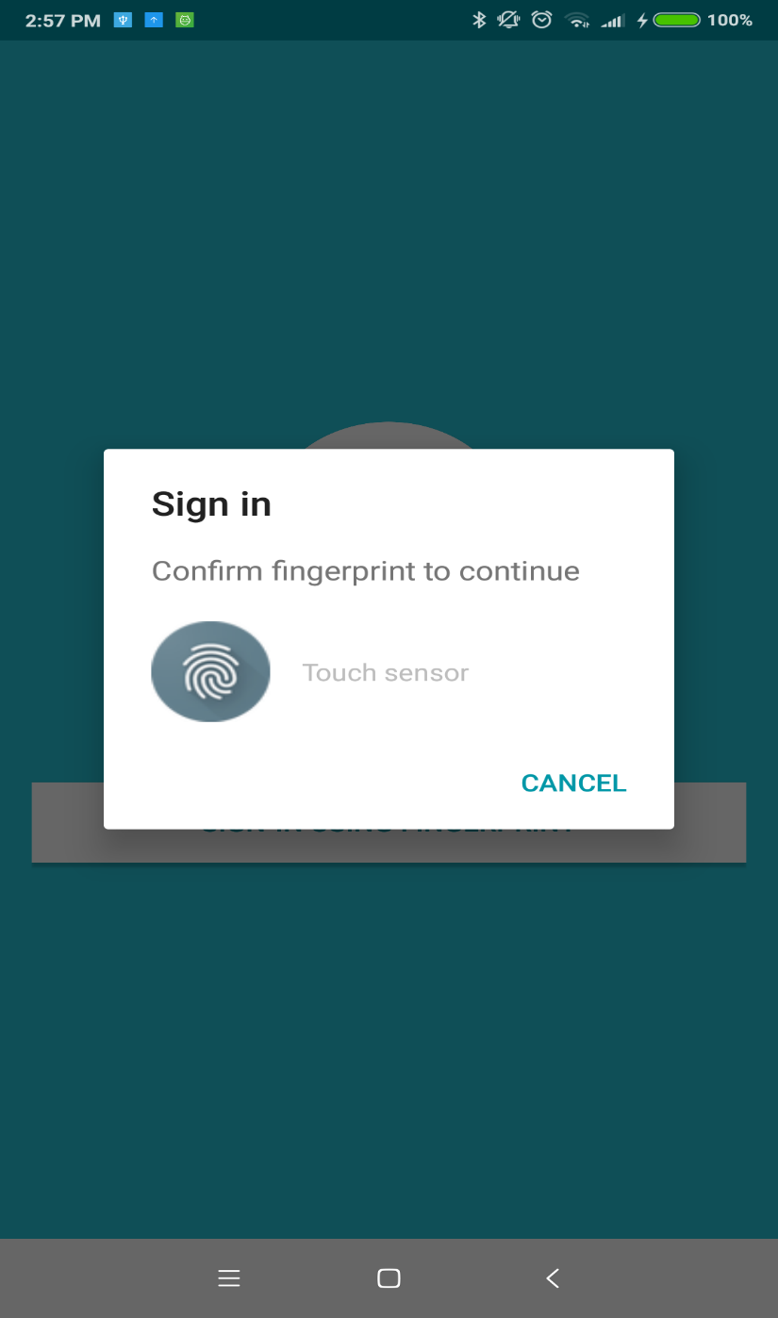
Authentication
Notes:
change the contents

Slide 12
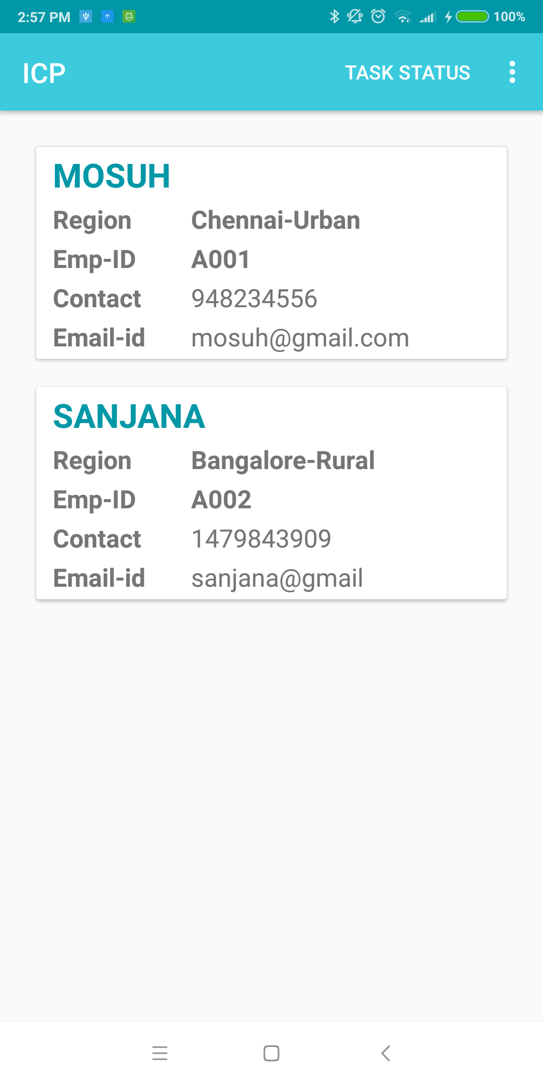
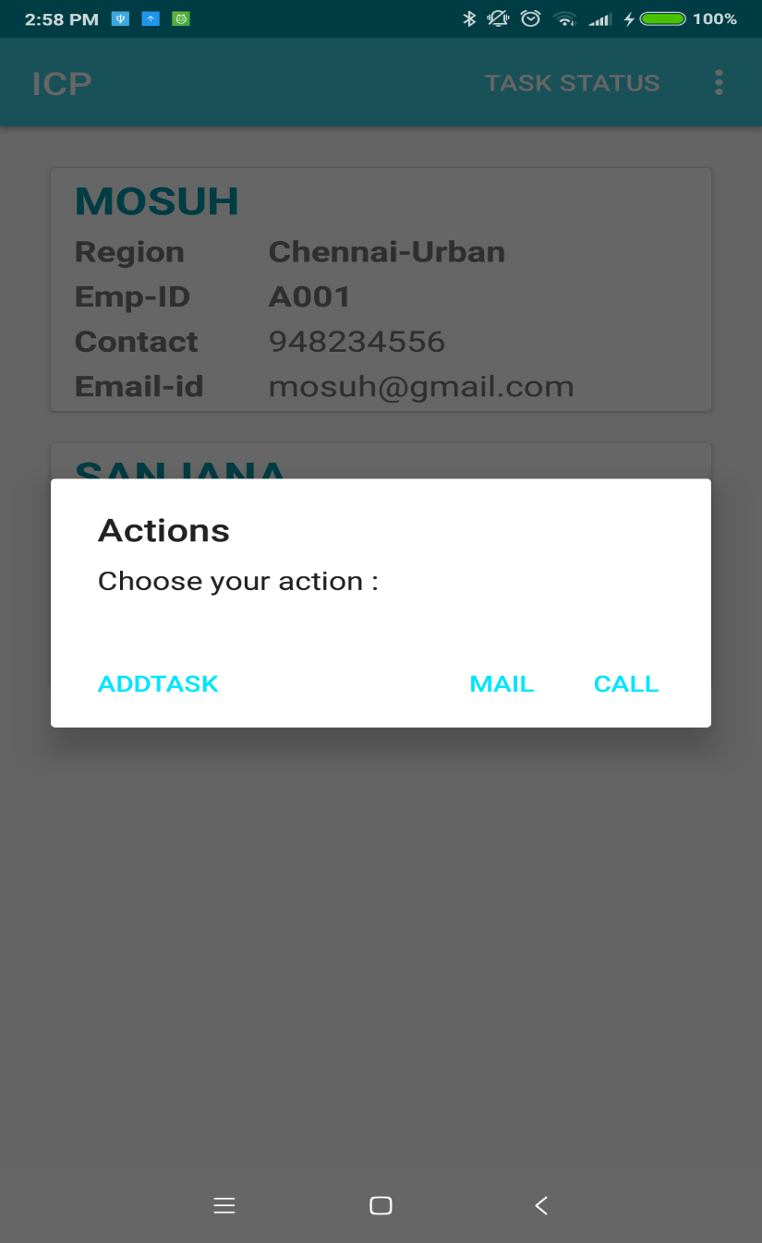
SUPERVISOR VIEW
Notes:
change the contents

Slide 13
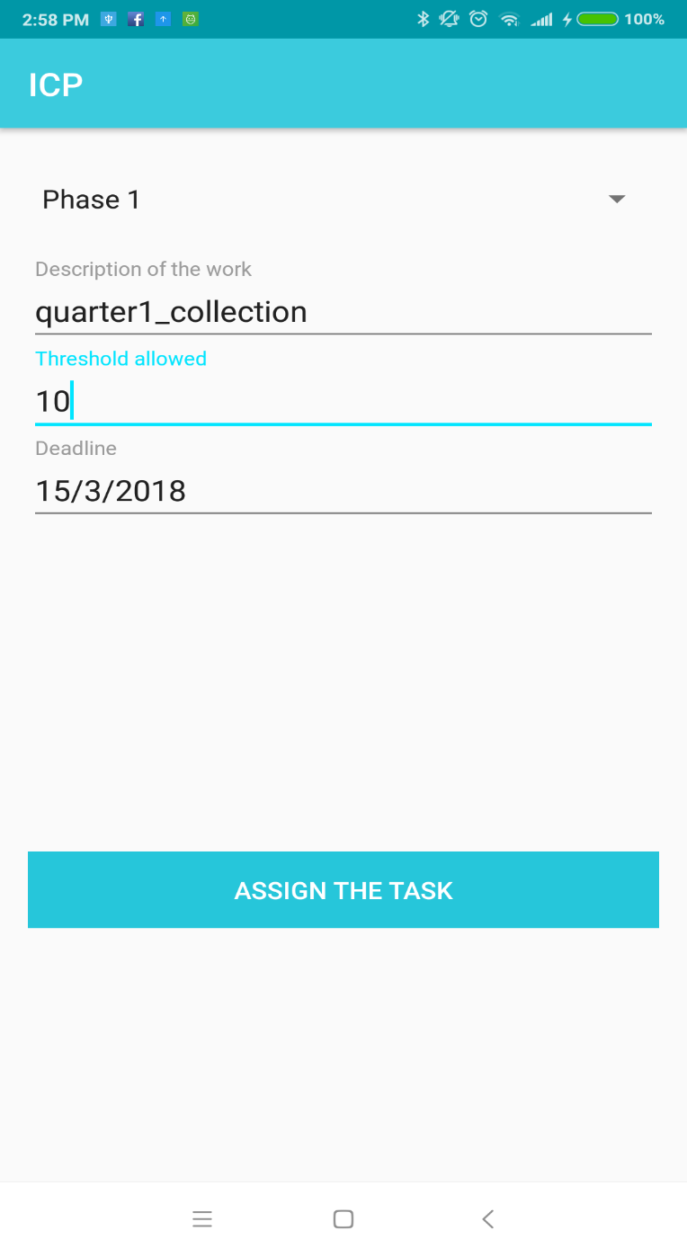
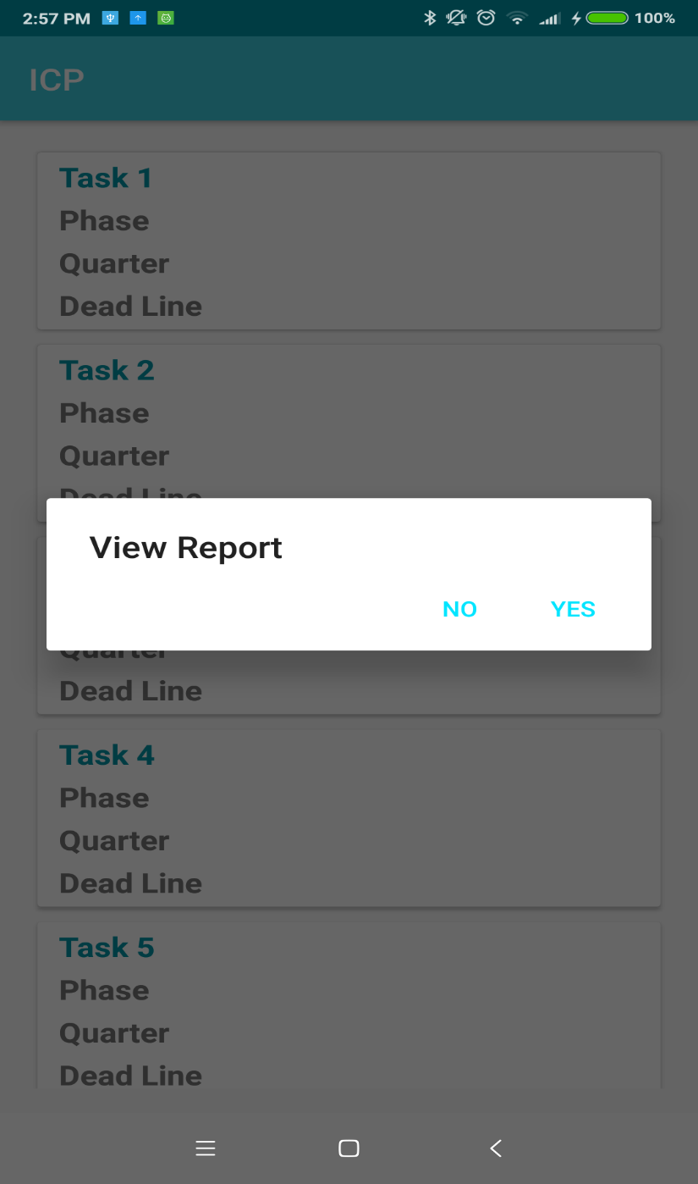
SUPERVISOR VIEW
Notes:
change the contents

Slide 14
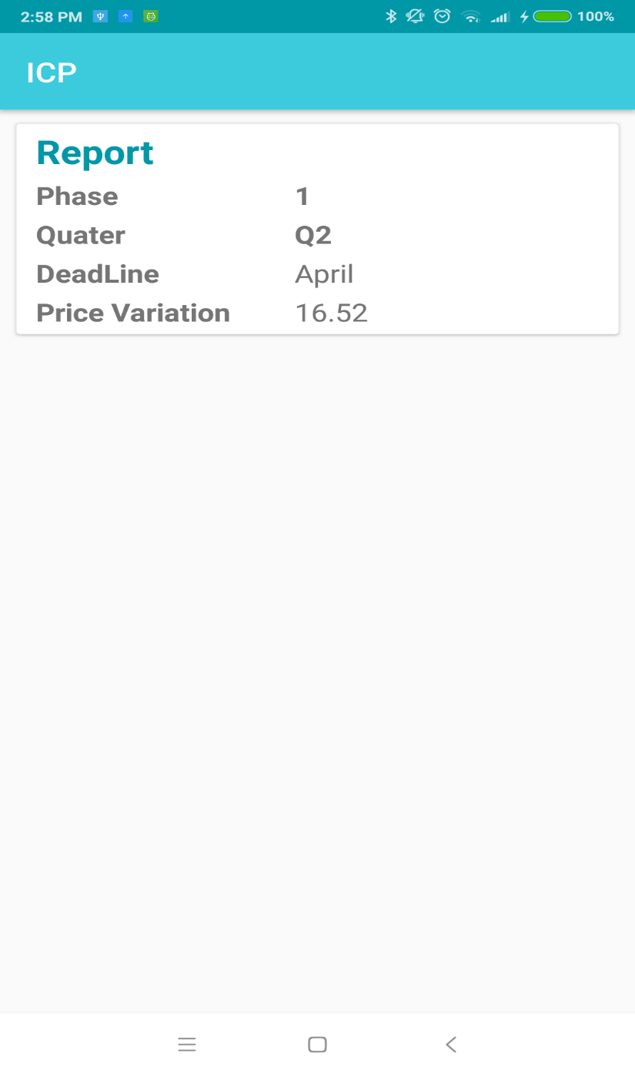
SUPERVISOR VIEW
Notes:
change the contents

Slide 15
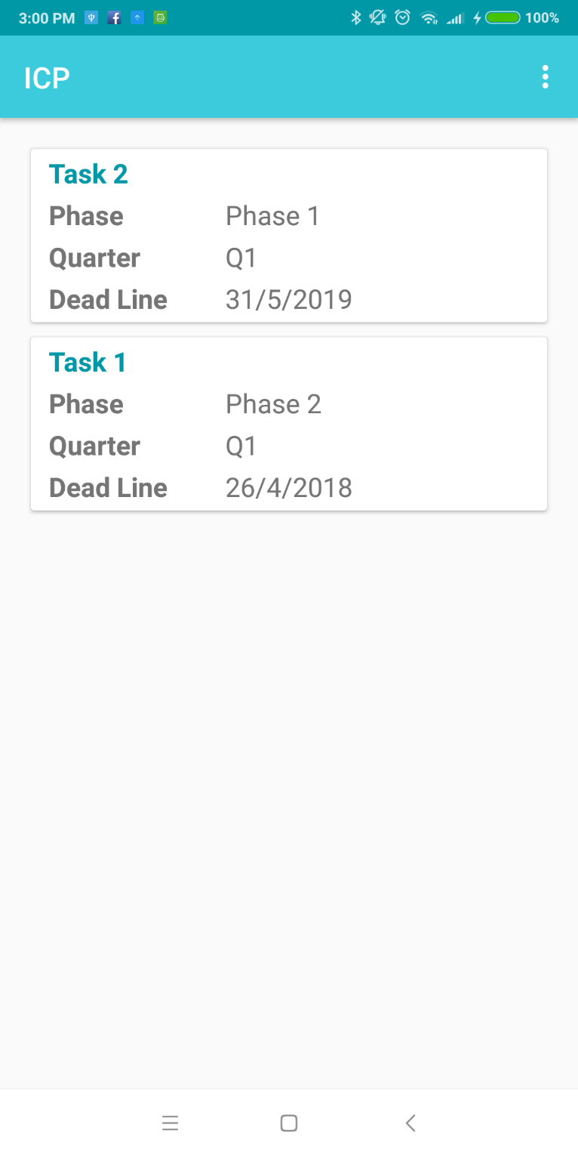
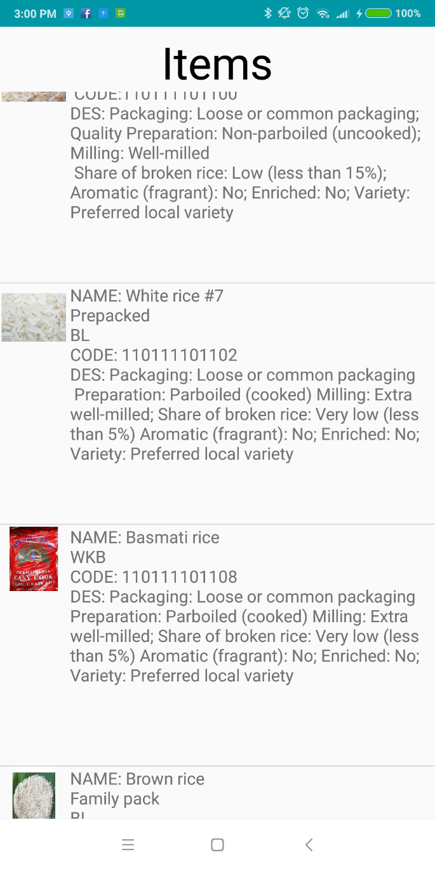
DATA COLLECTOR VIEW
Notes:
change the contents

Slide 16
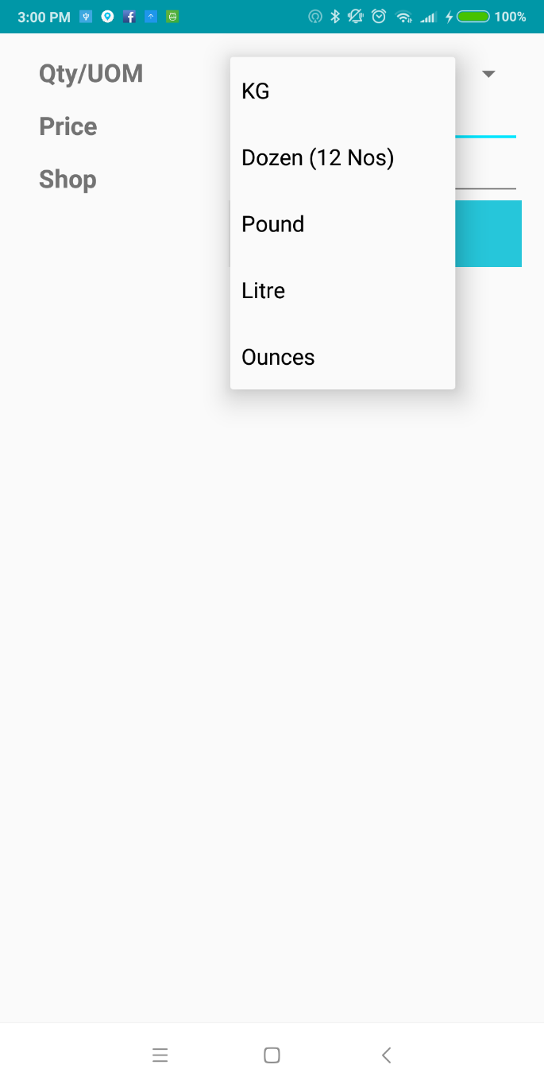
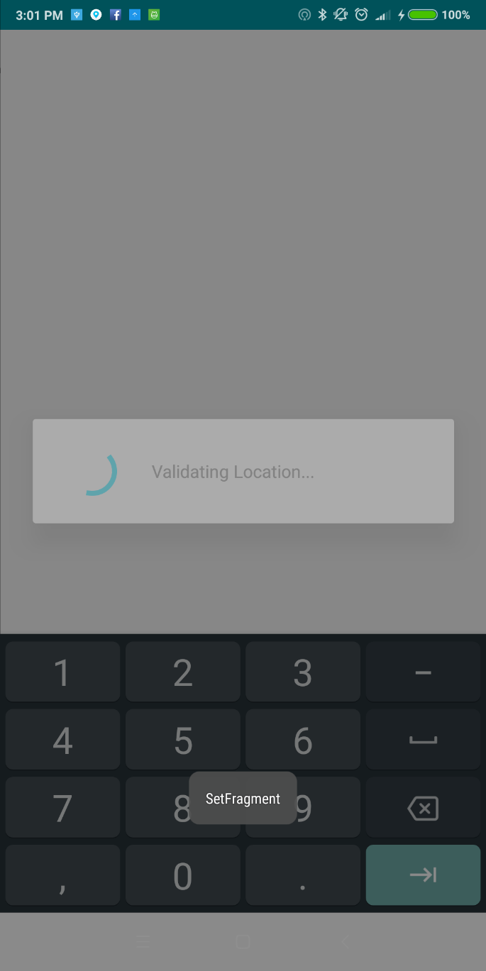
DATA COLLECTOR VIEW
Notes:
change the contents

Slide 17
Other Features
Multiple lingual diversity
The app is designed to handle multiple languages and has already been implemented for English and Hindi.
Scrutiny of data
Threshold set by the supervisor is validated on the data collector’s end. Any inconsistencies are reported to the supervisor.
Notes:
change the contents

Slide 18
Our USP
Availability for inclusion of Aadhar authentication
Hassle free UI
Multilingual capability
Land Survey and Revenue Department

