Slide 1
Deep Sparse-to-Dense Automotive Radar Perception for Super-Resolved Object Detection and Classification
Bangladesh University of Engineering and Technology
Department of Electrical and Electronic Engineering
EEE 400 (July 2025) - Final Examination
Presentation Date: 10th June 2026
Presented by:
Md. Symria Raihan
Student ID: 2006133
Md Moshahed Parvez
Student ID: 2006148
Examination Committee:
Dr. Md. Asiful Islam (Supervisor)
Dr. Lutfa Akter (Member)
Dr. Md. Mohsinur Rahman Adnan (Member)

Slide 2
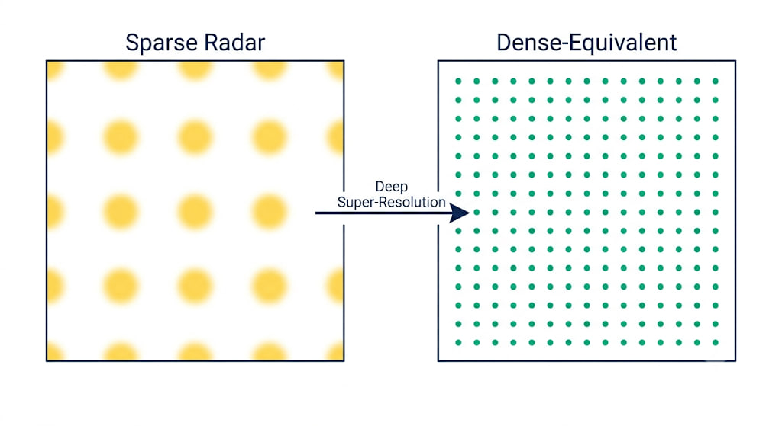
Outline of Presentation
Summary
Acknowledgement and References
Literature Review
Simulation
Results
Design
Conclusion

Slide 3
Outline of Presentation
Summary
Acknowledgement and References
Literature Review
Simulation
Results
Design
Conclusion

Slide 4
Summary
Low-cost sparse automotive radar has limited angular resolution, making nearby road users harder to separate.
This thesis proposes a two-stage radar perception pipeline:
Stage 1: angular super-resolution
Stage 2: detection, classification, and object counting
Dataset3000 was developed using CARLA and a MATLAB FMCW signal model to train the sparse-to-dense radar super-resolution model.
The SR-enhanced RA input improved RAMP-CNN+ performance compared with raw RA:
Weighted F1: 0.468 → 0.717
mAP: 0.480 → 0.722
mAR: 0.424 → 0.682

Slide 5
Outline of Presentation
Summary
Acknowledgement and References
Literature Review
Simulation
Results
Design
Conclusion

Slide 6
Literature Review
Patole et al. (2017) reviewed FMCW automotive radar signal processing for range, velocity, angle estimation, detection, and tracking.
Schuessler et al. (2023) showed deep-learning-based sparse-array radar super-resolution using enhanced virtual data.
Gao et al. (2021) proposed RAMP-CNN, using multi-perspective radar views for automotive object recognition.
Existing works provide strong foundations for radar SR and radar perception, but these are mostly studied separately.

Slide 7
Literature Review
Limited work combines sparse-array radar super-resolution with downstream multi-view radar detection and classification for low-cost automotive radar.
• Use sparse 2Tx × 4Rx radar as the low-cost input
• Reconstruct dense-array-equivalent 5Tx × 10Rx RA representation
• Generate paired training data through Dataset3000
• Use RA, RV, and VA views for road-user perception
• Compare raw RA and SR-enhanced RA for RAMP-CNN+ and Prototype

Slide 8
Outline of Presentation
Summary
Acknowledgement and References
Literature Review
Simulation
Results
Design
Conclusion

Slide 9
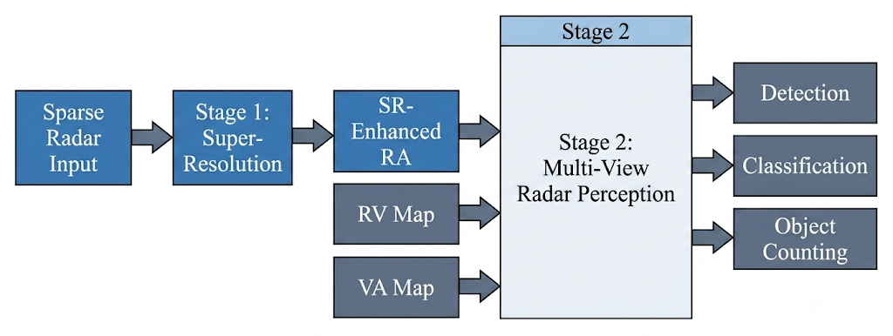
Design
Fig: Overall system architecture of the proposed two-stage radar perception pipeline

Slide 10
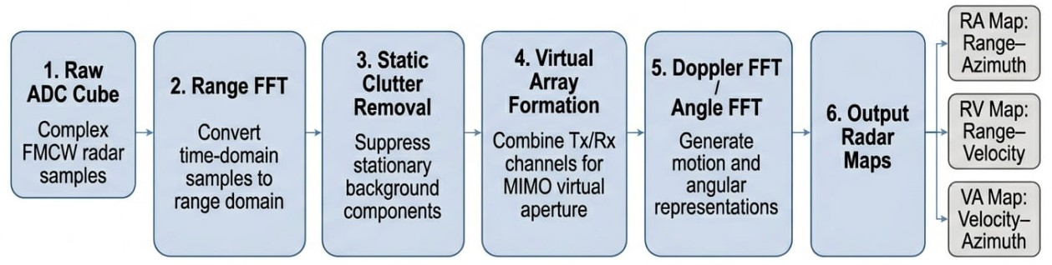
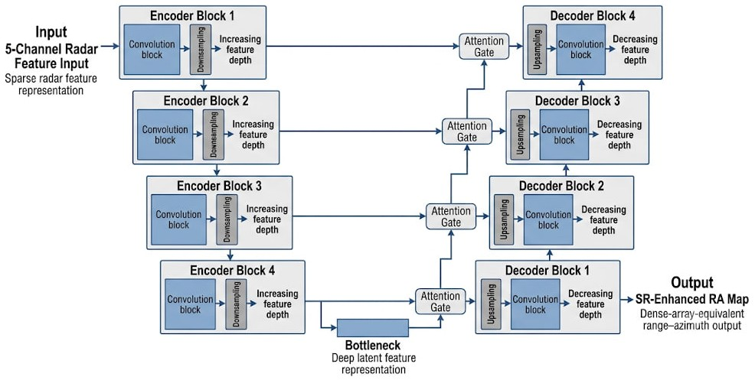
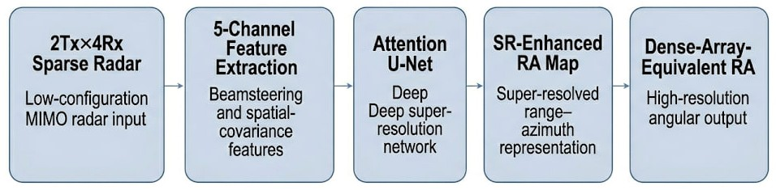
Design
Fig: Radar Super-Resolution Model
Fig: Attention U-Net

Slide 11
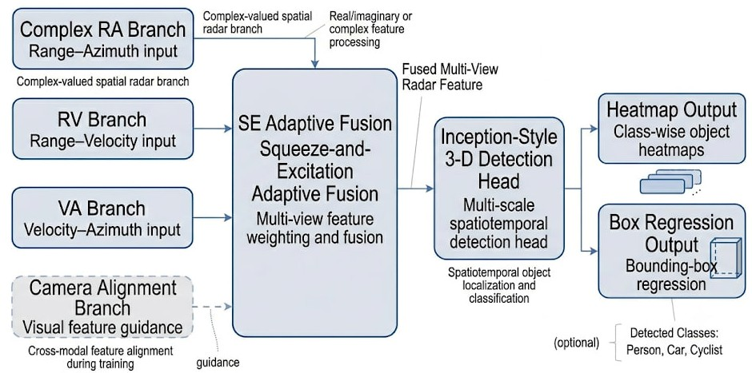
Design
Fig: RAMP-CNN+ architecture used for multi-view radar object detection and classification

Slide 12
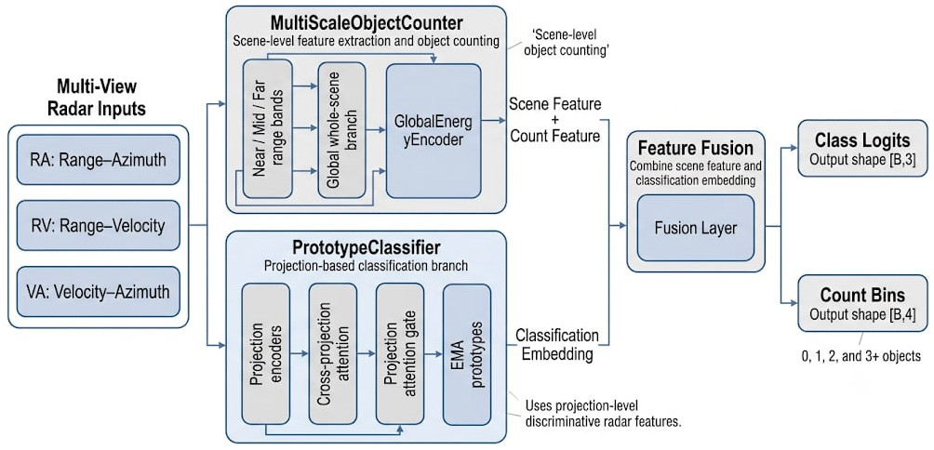
Design
Fig: Architecture of the prototype-based Stage 2 classification and object-counting model. The model contains a multi-scale object-counting branch and a projection-based prototype-classification branch

Slide 13
Outline of Presentation
Summary
Acknowledgement and References
Literature Review
Simulation
Results
Design
Conclusion

Slide 14
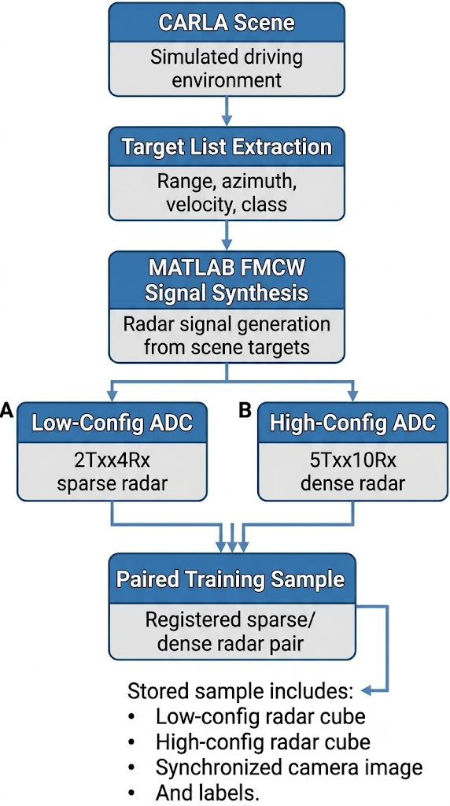
Simulation: Dataset3000 Generation
Dataset3000 was developed to train the Stage 1 radar super-resolution model.
CARLA was used to generate driving scenes and road-user target lists.
A MATLAB FMCW signal model synthesized radar ADC cubes from the same target list.
Two radar configurations were simulated:
Sparse input: 2Tx × 4Rx
Dense target: 5Tx × 10Rx
Each frame produced paired sparse and dense radar data for supervised training.

Slide 15
Outline of Presentation
Summary
Acknowledgement and References
Literature Review
Simulation
Results
Design
Conclusion

Slide 16
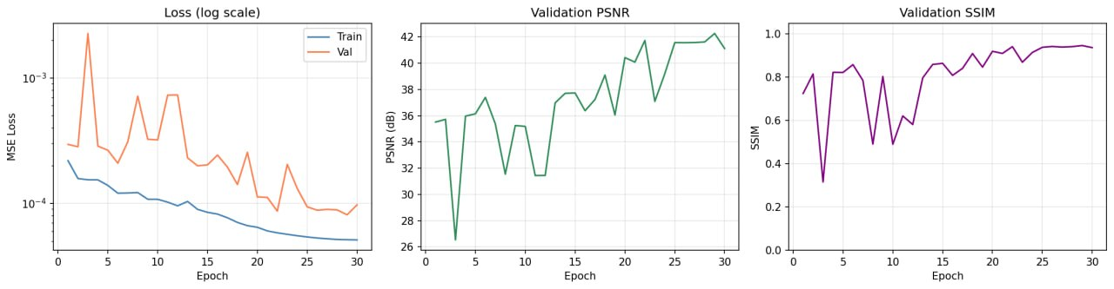
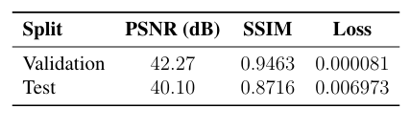
Results
Fig: Training behaviour of the Stage 1 Attention U-Net super-resolution model.
Fig: Quantitative results of the Stage 1 radar super-resolution model.

Slide 17
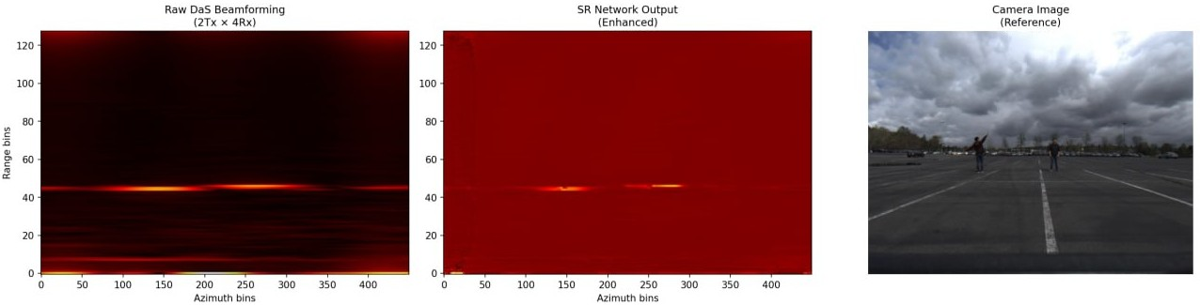
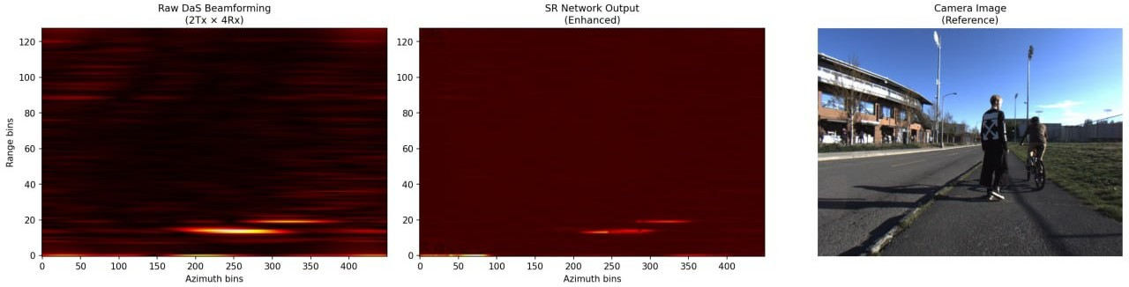
Results
Fig: Qualitative sim-to-real validation of the Stage 1 super-resolution model. The SR output should be compared with the raw sparse-array RA map and the synchronized camera frame

Slide 18
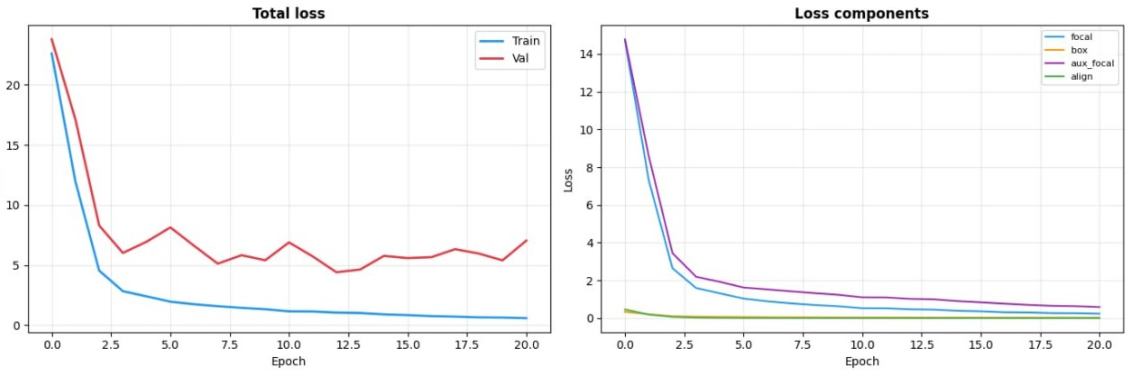
Results
Fig: Training curves of the RAMP-CNN+ detection and classification model(Without SR)
Best validation loss: 5.1517 at epoch 13
Training stopped at epoch 21 by early stopping

Slide 19
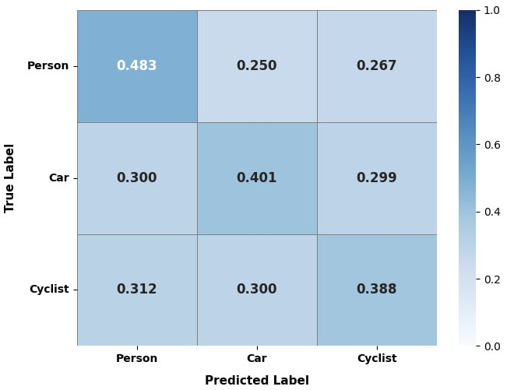
Results
Class | Precision | Recall | F1
Person | 0.512 | 0.483 | 0.497
Car | 0.455 | 0.401 | 0.426
Cyclist | 0.473 | 0.388 | 0.426
Table: Per-class RAMP-CNN+ detection results on the test set without Stage 1 super resolution
Fig: Row-normalized confusion matrix of
RAMP-CNN+ without Stage 1 super-resolution

Slide 20
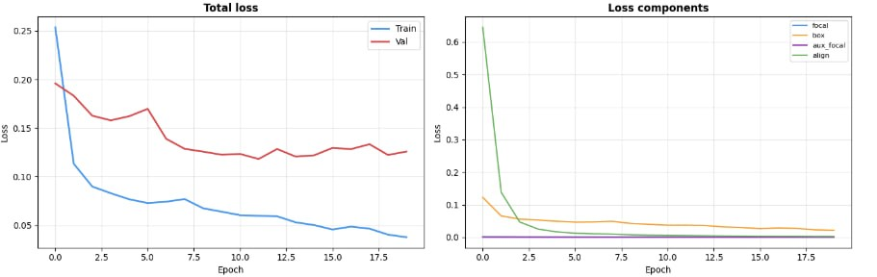
Results
Fig: Training curves of the RAMP-CNN+ detection and classification model(With SR)
Best validation loss: 0.125 at epoch 1
Training stopped at epoch 18 by early stopping

Slide 21
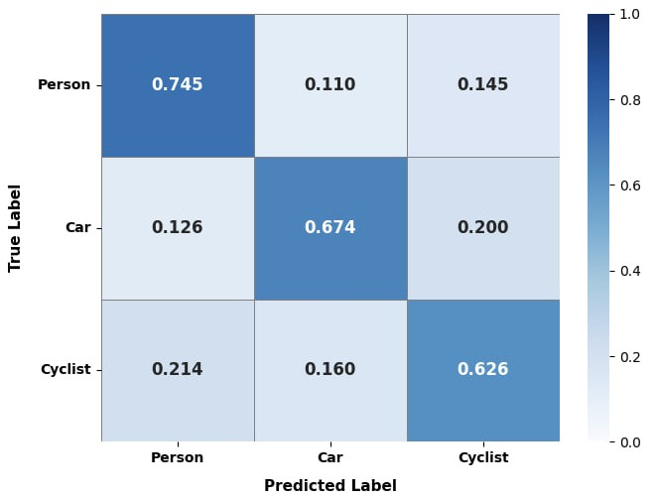
Results
Class | Precision | Recall | F1
Person | 0.753 | 0.745 | 0.749
Car | 0.699 | 0.674 | 0.686
Cyclist | 0.714 | 0.626 | 0.667
Table: Per-class RAMP-CNN+ detection results on the test set with Stage 1 super resolution
Metric | Without SR | With SR
Weighted F1 | 0.468 | 0.717
mAP | 0.480 | 0.722
mAR | 0.424 | 0.682
Fig: Row-normalized confusion matrix of
RAMP-CNN+ with Stage 1 super-resolution
Table: RAMP-CNN+ FullModel classification comparison with and without Stage 1 super-resolution.

Slide 22
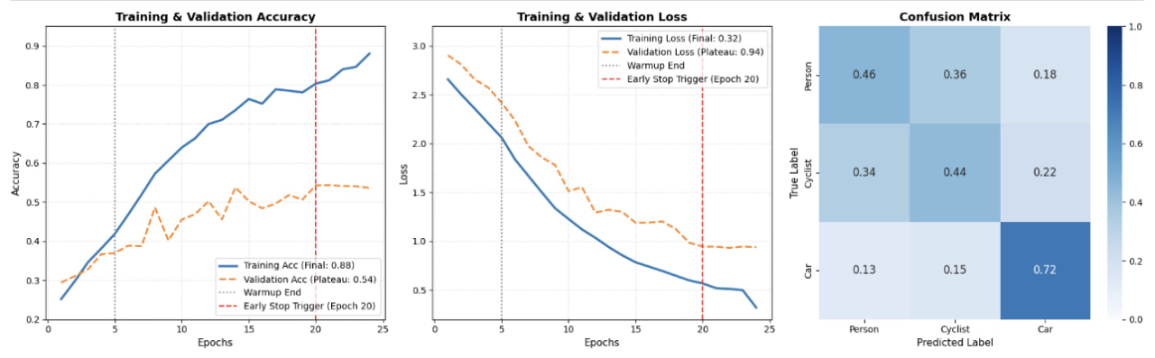
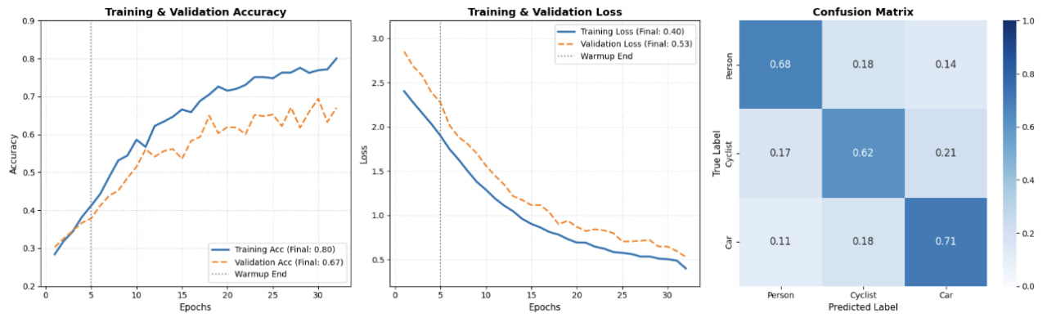
Results
Without SR
With SR
Fig: Training behaviour comparison of the prototype-based FullModel

Slide 23
Results
Fig: Confusion matrices of the prototype-based FullModel without Stage 1 super resolution
Fig: Confusion matrices of the prototype-based FullModel with Stage 1 super resolution

Slide 24
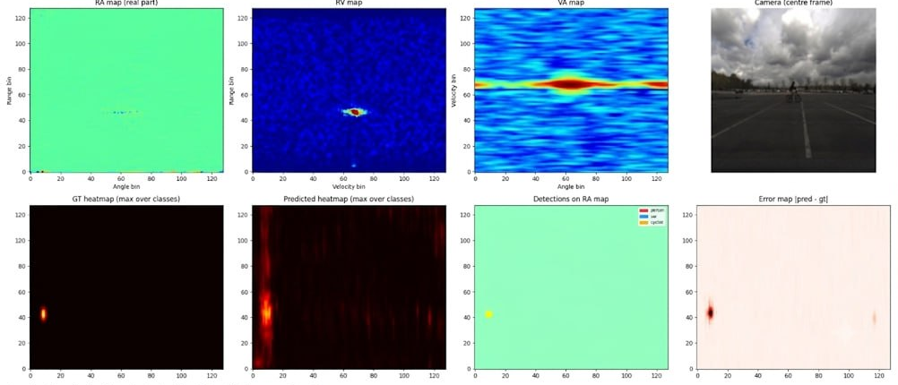
Results
Fig: Prediction overlay for a held-out test frame

Slide 25
Outline of Presentation
Summary
Acknowledgement and References
Literature Review
Simulation
Results
Design
Conclusion

Slide 26
Conclusion
• A two-stage radar perception pipeline was developed for low-cost autonomous-driving radar.
• Stage 1 improved sparse radar angular representation using Attention U-Net based super-resolution.
Test PSNR = 40.10 dB, SSIM = 0.8716
• Stage 2 used multi-view radar inputs for road-user detection and classification.
With SR-enhanced RA, RAMP-CNN+ achieved Weighted F1 = 0.717, mAP = 0.722, mAR = 0.682
• Compared with raw RA, SR-enhanced RA improved RAMP-CNN+ weighted F1 from 0.468 to 0.717.
• The proposed pipeline demonstrates the feasibility of combining learned angular enhancement with multi-view radar perception.

Slide 27
Outline of Presentation
Summary
Acknowledgement and References
Literature Review
Simulation
Results
Design
Conclusion

Slide 28
Acknowledgement and References
We are indebted to our supervisor, Dr. Md. Asiful Islam, Professor, Department of Electrical and Electronic Engineering, BUET, for his valuable guidance, encouragement, and constructive feedback throughout this thesis work.
We also express our sincere gratitude to the Department of Electrical and Electronic Engineering, BUET, and to our teachers for their support and inspiration. Finally, we thank our families, friends, and classmates for their constant encouragement and moral support.

Slide 29
Acknowledgement and References
Patole et al., “Automotive radars: A review of signal processing techniques,” IEEE Signal Processing Magazine, 2017.
Schuessler et al., “Super-resolution radar imaging with sparse arrays using a deep neural network,” IEEE Journal of Microwaves, 2023.
Gao et al., “RAMP-CNN: A novel neural network for enhanced automotive radar object recognition,” IEEE Sensors Journal, 2021.
Wang et al., “RODNet: A real-time radar object detection network,” IEEE JSTSP, 2021.

Slide 30


