Slide 1
MSR6 TE Requirements USA Operators Domestic Use Cases
Gyan Mishra
Verizon Inc.
July 26th 2022

Slide 2



Video Transport Use Cases – Bandwidth/Format
Contribution
(External)
Primary Distribution
Secondary Distribution
Studio to Studio
Owner to Provider
- Compressed (Very High quality)
Provider to Subscriber
- Compressed (MP4 etc.)
RSVP-TE
(CN)
Dynamic Receivers
SD: 2 – 6 Mbps
HD: 6 – 16 Mbps
P-to-P for VoD
P-to-MP for IPTV
Uncompressed/Lossless Compression
SD: 270 Mbps
HD: 1.5 – 3 Gbps
SD: 10-50 Mbps
- HD: 50-100 Mbps
P-to-P and P-to-MP
P-to-MP for DTT/DVB-T
Static Receivers
RSVP-TE
(AN)
FBB
mLDP
UHD: 12 Gbps
P-to-P, MP-to-P, P-to-MP
Stricter Requirements, Higher per-flow bandwidth
In all cases, point-to-point + multipoint services over Network Transport are required

Slide 3






Video Content Delivery Service Providers
Video Stream Bandwidth
Studio to Studio; Broadcaster to Broadcaster (External)
Uncompressed, Lossless
Very High bit-rate stream: SD (270Mbps), HD (1.5-3Gbps)
P-to-P and P2MP (unicast and multicast)
P2MP RSVP-TE
Broadcasters, Studios
Content owner to provider Compressed
Low/moderate bit-rate stream
~ same as secondary dist
P2MP (multicast)
P2MP RSVP-TE
Provider to subscriber i.e.
Cable TV & IPTV
Compressed
Low bit-rate stream: SD (3- 4Mbps mpeg2, 2-3Mbps mpeg4), HD (16-20Mbps mpeg2, 8-10Mpbs mpeg4)
Contribution providers Cable backbones providers
P-to-P for VOD (unicast) & P2MP for IPTV (multicast)
MPLS mLDP
Contribution
Service Providers
Primary Distribution
Secondary Distribution
# of end points

Slide 4

















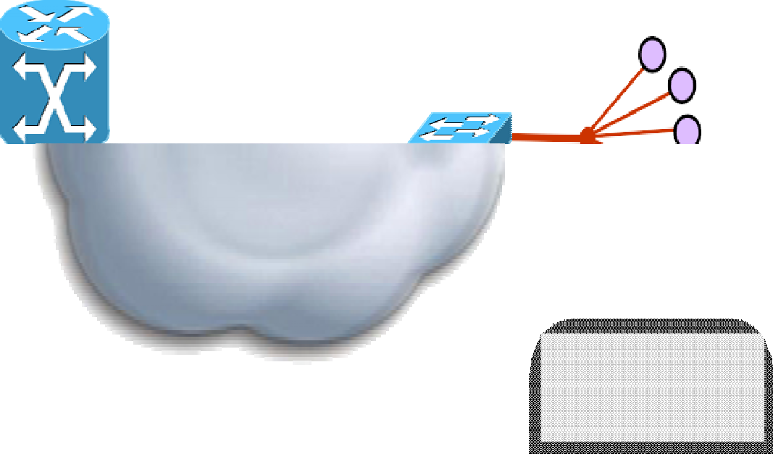



















Video Service Providers
Mapping to Broadcast Industry
Increasing demand for localised content
Service Control & Broadcast Quality gaining prominence
Increasing scale to end- customer
Contribution
Primary Distribution
Studio
Studio
Final Studio
Common core network requirements & designs
RSVP-TE
Secondary Distribution
RSVP-TE
Mobile Studio
Fixed
Studio
mLDP
Home Network
Access
DCM
VOD
content distributing to scale
Network
Super Head End (x2)
DCM
VOD
VOD
DCM / VQE
Head End (x10s)
VOD
International & National Content
National Content Insertion
Super Head End (x2)
Local Content Insertion
VSO (x100s)
Home x millions
Insertion

Slide 5
Public Internet MPLS Network Routing Architecture - USA Domestic Operators - IPv4 Multicast

Slide 6
Private MPLS Network Routing Architecture – USA Domestic Operators - IPv4 Multicast

Slide 7
MSR6 Requirements for IPTV Video Delivery transports
Model | QoE | BW Usage per stream (Y) Where X = MPEG stream bw, Z = FEC o/h, and W = FEC + TR overhead, (W < Z) |  | Network Complexity | Video End System Complexity | Delay impact
Fast Convergence | Lossy; target < 1 GOP | Working case: Failure case: | Y = X Y = X | Low | Low | Zero
MPLS TE FRR | Lossy; < 1 GOP | Working case: Failure case: | Y = X Y =>2X | Medium | Low | Zero
MoFRR | Lossy; < 1 GOP | Working case: Failure case: | Y = X Y = X | Low | Low | Zero
FC + FEC or MPLS TE FRR + FEC | Lossless | Working case: Failure case: Fast convergence: FRR: | Y = X * Z Y = X * Z Y =>2X * Z | Fast convergence: Low Fast reroute: Medium | Medium | High
FC + TR or MPLS TE FRR + TR | Lossless | Working case: Failure case: Fast convergence: FRR: | Y =2X Y = X Y =>2X | Fast convergence: Low Fast reroute: Medium | Medium | High
MoFRR + SR | Lossless | Working case: Failure case: | Y = X Y = X | Low | Medium | Low
MPLS TE + SR | Lossless | Working case: Failure case: | Y = X Y = X | High | Medium | Low
MTR + SR MTR⬄ISIS MT | Lossless | Working case: Failure case: | Y = X Y = X | High | Medium | Low

Slide 8
MSR6 Requirements & legacy technologies characteristics to meet?
Characteristic | IP Multicast | MPLS Multicast: RSVP TE | MPLS Multicast: mLDP
Convergence | < ~500ms (< 50ms with MoFRR path separation) | ~50ms (FRR) | < ~500ms (~50ms with p2p MPLS LP)
Offload routing | ✓ (IGP metric based traffic engineering) | ✓ | ✓ (IGP metric based traffic engineering)
Path separation | (MoFRR) | ✓ | (MoFRR)
Admission control and bw reservation | (RSVP) | ✓ | ✗
Scalable mp2mp | ✓ | ✗ | ✓
Initiator | Receiver | Source | Receiver
Application | Ideal for single-source multicasts with many leafs | Ideal for single-source multicasts with few leafs | Ideal for dynamic, receiver-driven multicasts with many leafs
Insertion | Secondary Distribution | Contribution | Enterprise VPN

Slide 9
MSR6 Requirements for Network infrastructure Protection & Resiliency
Preferred choice of transport:
IP (native multicast/PIM) or MPLS (mLDP and RSVP-TE P2MP)
Path selection
(dual path) – MoFRR or exposed to service Tree cost optimization
Load-splitting:
ECMP: PIM and mLDP
Arbitrary: RSVP-TE (CSPF) ⬄ Required for Triple Play Services
Preferred choice of virtualization
L2VPN, L3VPN context – or why not…
…not complete list

Slide 10
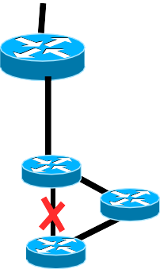

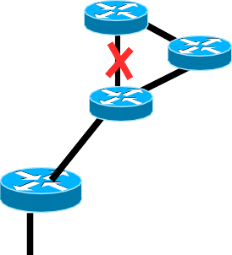
MSR6 requirements compare to PIM/mLDP benefits over RSVP-TE P2MP
Cost of trees (in node/network)
N = # tailend LSR (#PE)
PIM/mLDP P2MP: ~1, RSVP-TE P2MP: ~N
Full mesh of RSVP-TE P2MP LSP: ~(N * N) Bidir-PIM/mLDP MP2MP: ~1
Summary: No scaling impact of N for PIM/mLDP
Locality:
Affects convergence/reoptimization speed:
PIM/mLDP: Failure in network affects only router in region (eg: in pink region).
RSVP: impact headend and all affected midpoint and tailends for RSVP-TE reoptimization.
Src
Headend LSR
Join/leave of members affect only routers up to first router on the tree in mLDP/PIM. Will affect headend and all midpoints in RSVP-TE P2MP.
Rcv
Rcv
Rcv

Slide 11
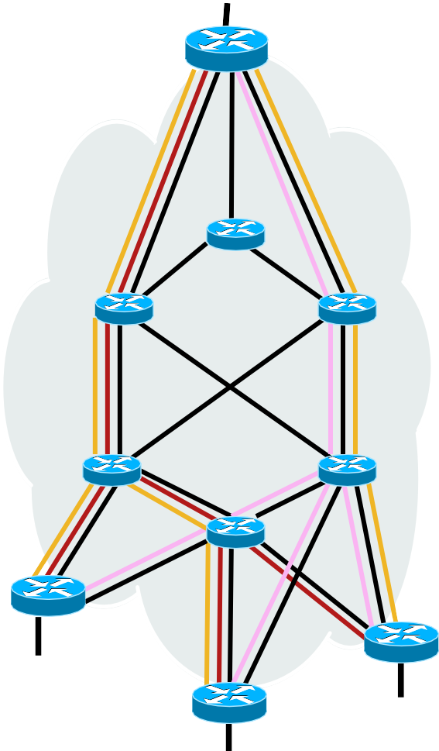
MSR6 Requirements compare to RSVP-TE P2MP benefits over PIM/mLDP
Sub 50 msec protection
Load-split traffic across alternative paths (ECMP or not)
PIM/mLDP tree follows shortest path, “dense” receiver population == dense use of links
RSVP-TE P2MP ERO trees (RED/PINK) under control of headend LSR.
CSPF load split based on available bandwidth. “Steiner tree” CSPF modifications possible
Block (stop) trees on redundancy loss
Assume high-prio and low-prio trees.
Src
Headend LSR
With full redundancy, enough bandwidth to carry all trees (with load-splitting)
On link-loss, reconverge high-prio, block low-prio
Rcv
Rcv
Rcv
52

Slide 12
MSR6 Requirements for Live-Live Protection
Live-Live—Spatial Separation
Two separate paths through network; can engineer manually (or with RSVP-TE P2MP )
Use of two topologies (MTR)- 2 ISIS MT ??
“Naturally” diverse/split networks work well (SP cores, likely access networks too), especially with ECMP
Target to provide “zero loss” by merging copies based on sequence number → Similar to DETNET Concept
Live-Live—Temporal Separation
In application device—delay one copy—need to know maximum network outage

Slide 13
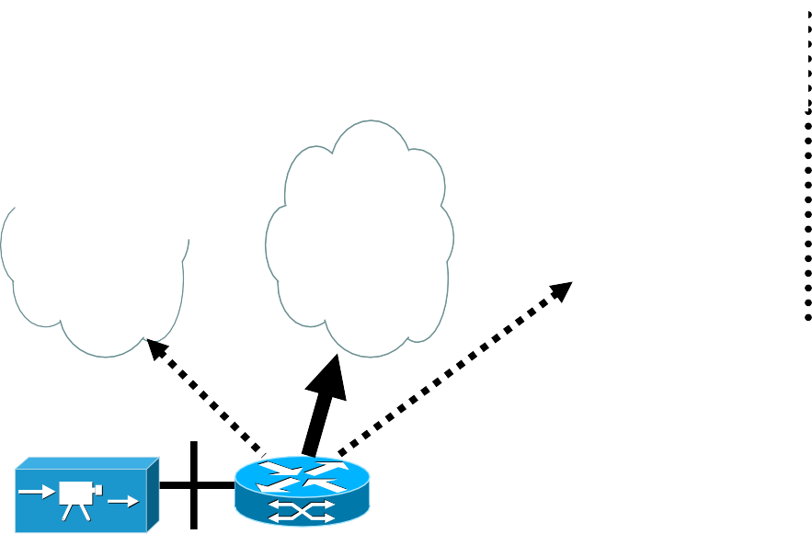
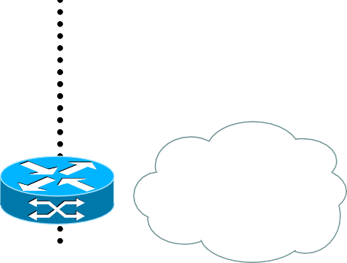









Legacy Infrastructure Content Delivery End-to-end protocol view
Current Content Access technologies
Fixed Broadband all flavors
Contribution
Primary Distribution
External Network Eg: Content provider
Core (CN)
Distribution
/ regional
Dis.
Edge Rtr
Aggregation
PE-AGG
Access
FBB Home Net
CPE/
(RG)
FIOS / Cable / Satellite
RSVP-TE
P2MP
Agg/Distro
AN EAN
Video encoder/ multiplexer
mLDP/TE
Agg Node
/ BNG
Access Node
First hop router
Triple Play
Services
Content injection:
External, national, regional, local
IGMPv3 (S,G)
Headend
PIM-SSM (S,G) joins
membership
Voice, Video,
Internet
L3 Transport options in clouds:
Native: PIM-SSM or MVPN/SSM MPLS: LSM / mLDP RSVP-TE
IGMP:
{Limits}
{Static-fwd} PIM-SSM
FIBER / DOSCIS
IGMPv3 SSM
PIM-SSM PIM-SSM

Slide 14
MSR6 Requirements Summary
Fast Reroute (FRR) Protection ~50ms.
Engineer separate diverse protected paths
Scalability of multicast distribution trees
Live-Live Protection = Lossless, Zero Delay
Triple Play services

Slide 15
USA Domestic Operators & SRv6 deployment
Operators understand the benefits of Segment Routing over IPv6 data plane (SRv6), however thus far the deployments have been limited.
Major benefits of SRv6 over SR-MPLS and reasons why USA operators are planning for SRv6 deployments in the future.
Native SRv6 steering capabilities with SRv6 SRH.
IPv6 flow label support RFC 6437 for native ECMP load balancing.
Data Center underlays for NVO overlay is typically “Non MPLS” and most Data Centers are moving quickly towards SRv6 underlay for steering to fabric attached host endpoints for NFV and SFC service chaining.
IPv6 data plane opens up QOS to use DSCP over MPLS EXP classes.
MPLS elimination allows for ubiquitous use cases for SRv6.

Slide 16
SRv6 Solutions for Multicast
There is no exact solution for Multicast for Segment Routing SRv6
Depending on the requirements, we can choose the best fit from the following options:
Deploy traditional Multicast Solutions
PIM
mLDP
RSVP-TE
Ingress Replication (IR)
TreeSID – a controller based solution – uses Replication SID
BGP Multicast & BGP Multicast Controller
Bit Index Explicit replication (BIER)
MSR6 (New)

